Slide 1
DATAWorks 2025: A Framework for VV&A of Preproduction Software Environments
Luis A Aguirre
Gillen B Brown
Allison L Goodman
April 25, 2025

Slide 2

BLUF: Production-representative environments are key to operational testing success.
As software acquisition programs embrace Agile and DevSecOps, operational testing paradigms are shifting.
Stakeholders aim to shift testing to the left, requiring appropriate testing resources, such as production-representative environments.
Operational test data should be gathered in an operationally representative environment
Verification, validation, and accreditation (VV&A) is one method to determine whether the testing environments are operationally representative.
Source: AI generated photo via StockCake.com.
Our goal is to present a generalized framework for the verification and validation of software test environments.
Acronyms: BLUF – Bottom line Upfront; DevSecOps – Development, Security, and Operations

Slide 3



The pace of Agile development is driving changes to the way we operationally test.
Waterfall Model (Legacy):
Software is delivered complete or in large components.
Operational testing in Waterfall Model typically consists of two or more operational tests:
  Initial operational test after first fielding
  Follow-on operational tests after fixes
Iterative Release Model (Agile):
Software is delivered via small and frequent updates.
Operational testing for Iterative Model is less concrete:
  Initial operational test after fielding of MVCR or other major development milestones
Operational testing is also needed for smaller feature releases.
New Features
Added
Plan
Vers. 1.0
Vers. 1.1
Vers. 1.2
Build
Test software as it is developed and delivered, iteratively.
Test/Deliver
Acronym: MVCR – Minimum Viable Capability Release

Slide 4
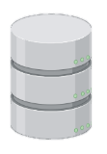

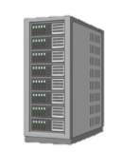





Testers can use preproduction environments for operationally testing software.
A software environment refers to the hardware and software infrastructure in which the software operates.
  Hardware
  Operating systems
  Network architecture
  Database design
  Etc.
A preproduction environment is a representation of the production environment, a “test range” for software.
Production Environment
Preproduction Environment
?
=
End-user devices
Load balancers
Servers, VMs, or containers
Databases
IDA illustration created using BioRender.com.
Acronym: VM – Virtual Machine

Slide 5
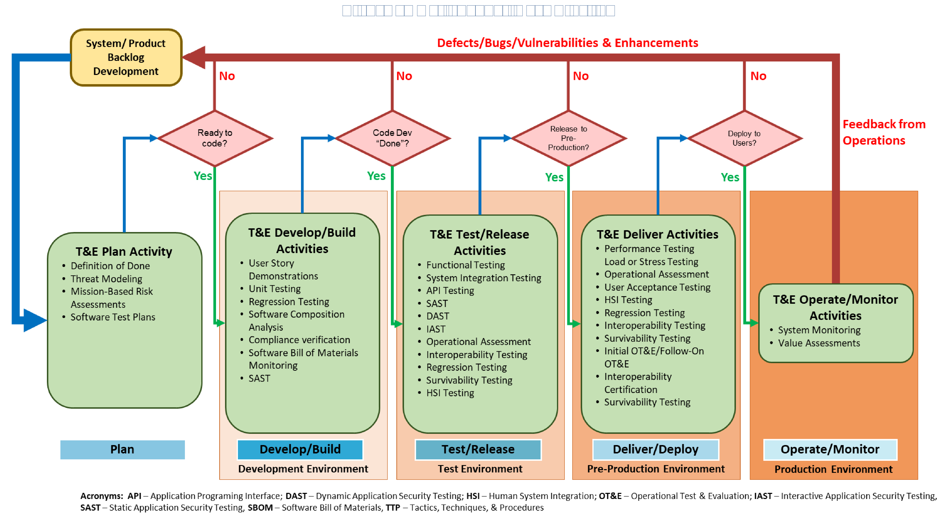
Representative preproduction environments can enable operational test data collection.
Possible benefits of testing in preproduction environments:
Small software updates can be released and operationally tested in between major operational test events.
Software defects can be identified before release, when they are cheaper and easier to fix.
Software tests have more flexibility as events within the testing environment have no effects on real-world operations.
Source: Illustration modified from DoDM 5000.96.
Benefits of testing software in preproduction environments are contingent on a close resemblance to the production environment.
Acronyms: DoDM – Department of Defense Manual; HSI – Human-System Interactions; OT&E – Operational Test and Evaluation; T&E – Test and Evaluation

Slide 6
VV&A is one method to determine whether testing environments are operationally representative.
Operational testers should accredit the preproduction environment to determine whether it is an adequate representation of the production environment.
This talk will present a general VV&A framework for software-centric programs, such as business systems and C2 systems.
Production Environment
Preproduction Environment
?
=
End-user devices
Load balancers
Servers, VMs, or containers
Databases
IDA illustration created using BioRender.com.
Acronyms: C2 – Command and Control; VM – Virtual Machine; VV&A – Verification, Validation, and Accreditation

Slide 7
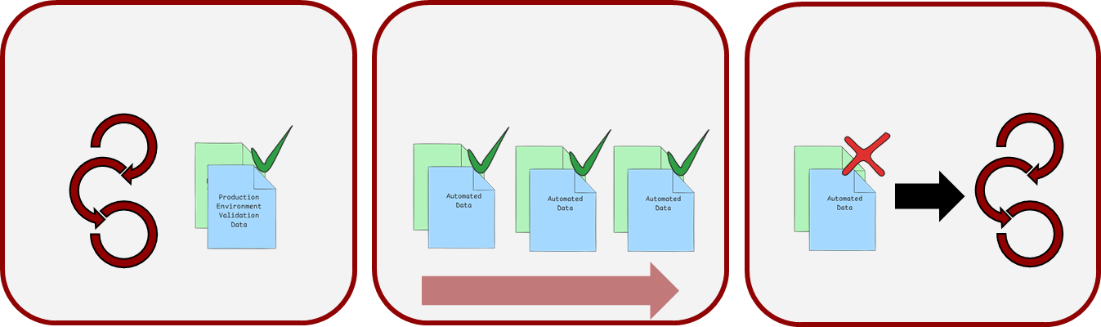
We recommended a three-stage VV&A strategy.
1. Initial VV&A
2. Continuous V&V Checks
3. Risk-Informed VV&A
V
V
A
Program Development
VV&A preproduction environment at MVCR
Automated, V&V checks before tests
Update VV&A when environments differ
Acronyms: MVCR – Minimum Viable Capability Release; V&V – Verification and Validation; VV&A – Verification, Validation, and Accreditation

Slide 8
Initial Verification, Validation and Accreditation (VV&A)
1. Initial VV&A
2. Continuous V&V Checks
3. Risk-Informed VV&A
Program Development
VV&A preproduction environment at MVCR
Automated, V&V checks before tests
Update VV&A when environments differ
Acronyms: MVCR – Minimum Viable Capability Release; V&V – Verification and Validation; VV&A – Verification, Validation, and Accreditation

Slide 9



VV&A Strategy Tailored for Agile Development
Demonstrate that the preproduction environment is set up in a manner similar to the production environment.
Verification
Demonstrate that the SUT software performs similarly in the production and preproduction environments.
Validation
Certify that the preproduction environment is acceptable for use as an operational testing tool.
Accreditation
Acronyms: SUT – System Under Test; VV&A – Verification, Validation, and Accreditation

Slide 10
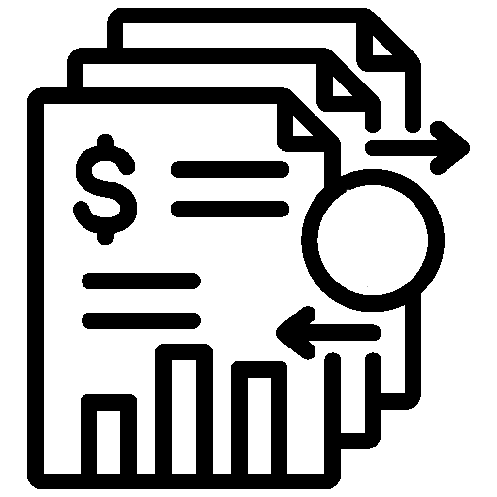





VV&A efforts should be targeted to accredit for specific operational evaluation objectives.
Can SUT maintain accurate and complete data?
Can SUT obtain external data and propagate transaction-based changes across databases and interfaces?
Functionality
Performance
Can SUT receive, process, and send large amounts of data at a fast pace?
Evaluation
Objectives
Is SUT reliable, available, and maintainable?
Can SUT continue to operate when individual capabilities are disabled?
Resilience
UX
Can SUT provide a better user experience than legacy business systems?
Acronyms: SUT – System Under Test; UX – User Experience; VV&A – Verification, Validation, and Accreditation

Slide 11

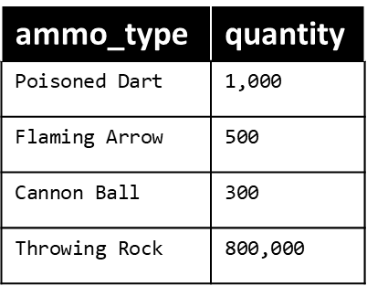


Verification criteria focus on parity between software environment components.
Verification
Hardware
Technical specifications for all load balancers, servers, databases, and client-side access hardware, including virtualizations (i.e., VMs and containers)
Interfaces
Live API communication with external software systems
Security Measures
Security settings (such as user permissions)
Software
Database Design
Database schema and partitioning/sharding methods
Architecture
Software and hardware system architecture
OS and software versions and system configurations
Data standardization
Firewall hardware model/software version and configuration
Isolation between preproduction and production environment
Acronyms: API – Application Programming Interface; OS – Operating System; VM – Virtual Machine

Slide 12
Verification criteria will depend on the intended testing within the preproduction environment.
Verification
 |  | Functionality | Performance | Resilience | UX
Verification | Software
Verification | Security Measures
 | System Architecture
 | Hardware
 | Database Design
 | Interfaces
Acronym: UX – User Experience

Slide 13
Preproduction environments should meet minimum software and security parity thresholds.
Verification
 |  | Functionality | Performance | Resilience | UX
Verification | Software
Verification | Security Measures
 | System Architecture
 | Hardware
 | Database Design
 | Interfaces
Security Measures
Security settings (such as user permissions)
OS and software versions and system configurations
Software
Firewall hardware model/software version and configuration
Isolation between preproduction and production environment
Acronyms: OS – Operating System; UX – User Experience

Slide 14
Operational evaluation objectives will differ in their verification needs.
Verification
 |  | Functionality | Performance | Resilience | UX
Verification | Software
Verification | Security Measures
 | System Architecture
 | Hardware
 | Database Design
 | Interfaces
Hardware
Modularity, topology, connectors (APIs, message queues, LBs, etc.)
System Architecture
Database Design
Interfaces
API connections
Resources available (i.e., CPU, RAM, and storage), manufacturer
Caching, indexing, schema design, and partition/sharding methods
Acronyms: API – Application Programming Interface; CPU – Central Processing Unit; LB – Load Balancer; RAM – Random Access Memory; UX – User Experience

Slide 15
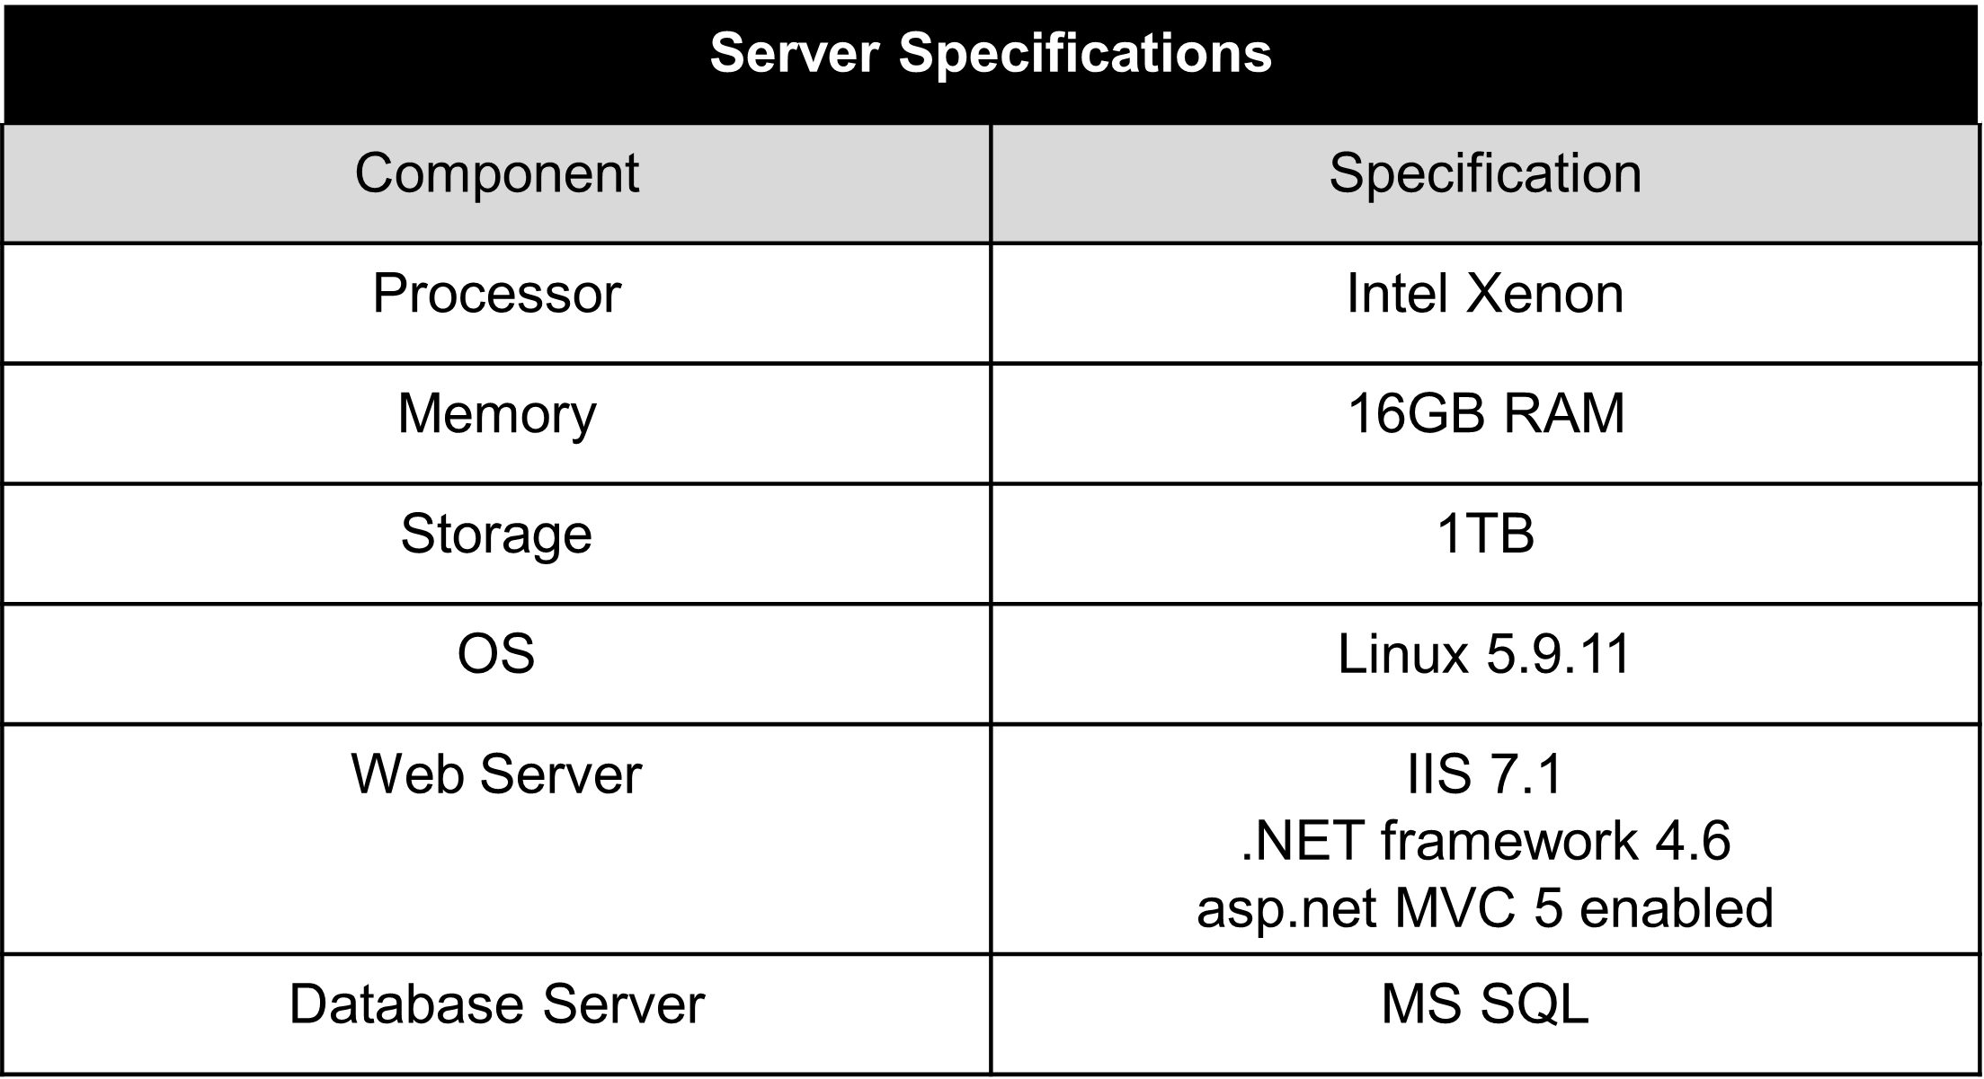
Technical planning documents and meetings can provide data for verification criteria.
Verification
Utilize planning or technical review documentation that includes architecture diagrams, interface control documents, and ATO packages.
Conduct a side-by-side comparison of system architectures, system resource specs, and interfaces.
System
Architecture
System
Specifications
Source: IDA illustration Created with BioRender.com
Acronym: ATO – Authority to Operate

Slide 16
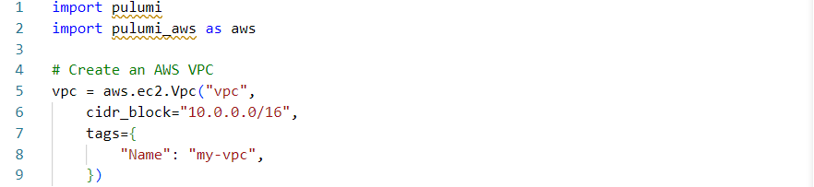
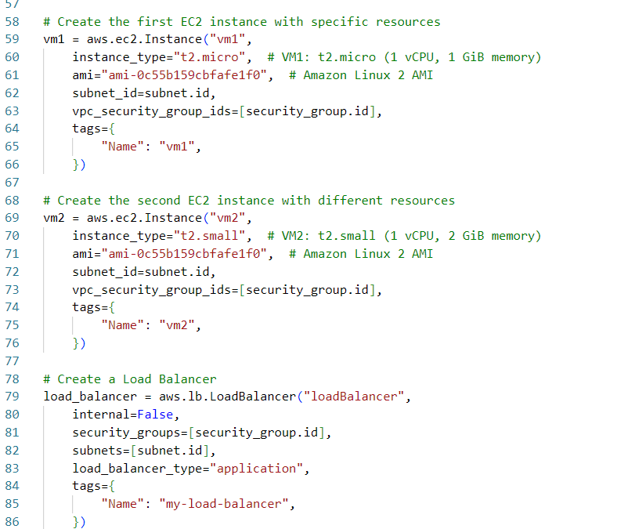

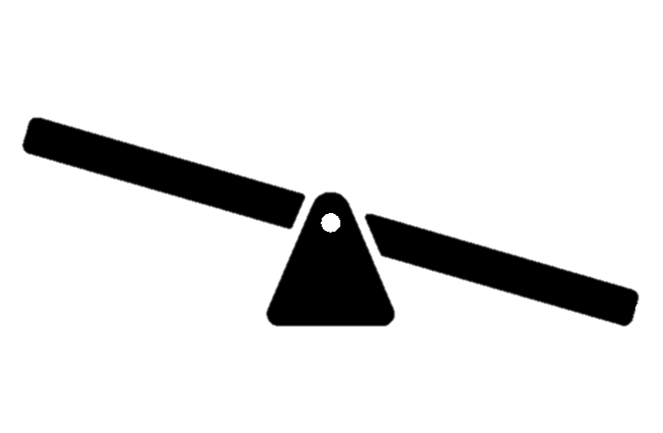
Infrastructure-as-Code tools can provide data for verification criteria.
Verification
VPC
Alternatively, when the preproduction and production environments are implemented with Infrastructure-as-Code (IaC) tools, the code acts as the system’s description documentation.
Side-by-side comparisons of the code can be used to compare system architectures.
VM #1
VM #2
LB
Source: IDA Illustration created using ChatGPT and Biorender.com.
Acronyms: IaC – Infrastructure-as-Code; LB – Load Balancer; VM – Virtual Machine; VPC – Virtual Private Cloud

Slide 17
Validation evaluation criteria focus on system performance similarity.
Validation
Resource Use
Compute, memory, and storage (disk storage)
Error Rates
Proportion of requests that result in errors
Throughput
Amount of requests processed per time unit
Response Times
Query Speed
Time it takes to execute database requests
Latency
Minimal time a simple request takes, such as ping response
Data Quality
Total time between a client sending a request and receiving a response; includes latency, processing delays, and queueing delays
Capability to interface with other information systems (including active legacy systems)
Interface Connectivity
Input data accuracy and completeness
Output data accuracy and completeness, including transaction propagation

Slide 18
Preproduction environment validation requirements will also depend on the intended use.
Validation
 |  | Functionality | Performance | Resilience | UX
Validation Criteria | Resource Use
 | Response Times
 | Latency
 | Query Speed
 | Throughput
 | Server Error Rates
 | Data Quality
 | Interface Connectivity
Acronym: UX – User Experience

Slide 19




Validate preproduction environment with data from read-only requests.
Validation
Validation metrics can be sourced from performance testing-like events.
Validation metrics can be obtained prior to MVCR by performing read requests in the preproduction AND production environments.
Read requests can be safely performed in production without modifying data.
Preprod. Env.
SELECT
ammo_type,
quantity
FROM ammo_inventory;
Production Env.
SELECT
ammo_type,
quantity
FROM ammo_inventory;
Acronym: MVCR – Minimum Viable Capability Release

Slide 20

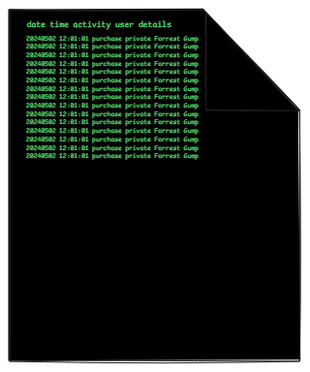
Validate environment by replicating production activity in the preproduction environment.
Validation
In production environment:
Capture snapshot of data
Collect activity logs
Measure performance
In preproduction environment:
Ingest prod. data snapshot
Execute activities from logs
Measure performance
Production Env.
Preprod. Env.
Data Snapshot
Data Snapshot
Activity Logs
Activity Logs
Compare validation measures.

Slide 21
Continuous and Automated Verification & Validation (V&V) Checks
Accreditation
1. Initial VV&A
2. Continuous V&V Checks
3. Risk-Informed VV&A
Program Development
VV&A preproduction environment at MVCR
Automated, V&V checks before tests
Update VV&A when environments differ
Acronyms: MVCR – Minimum Viable Capability Release; VV&A – Verification, Validation, and Accreditation

Slide 22
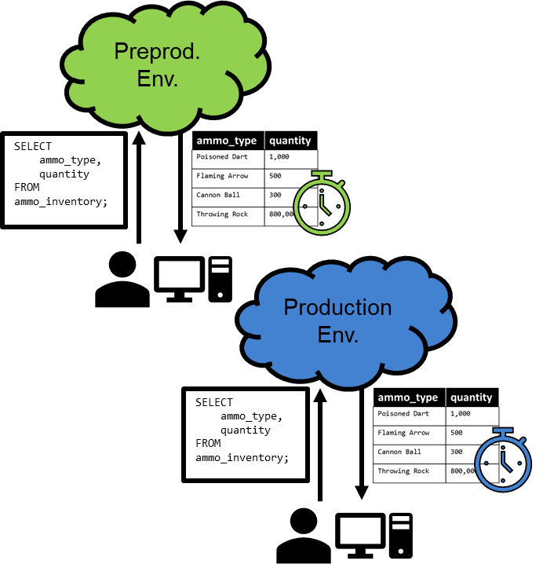
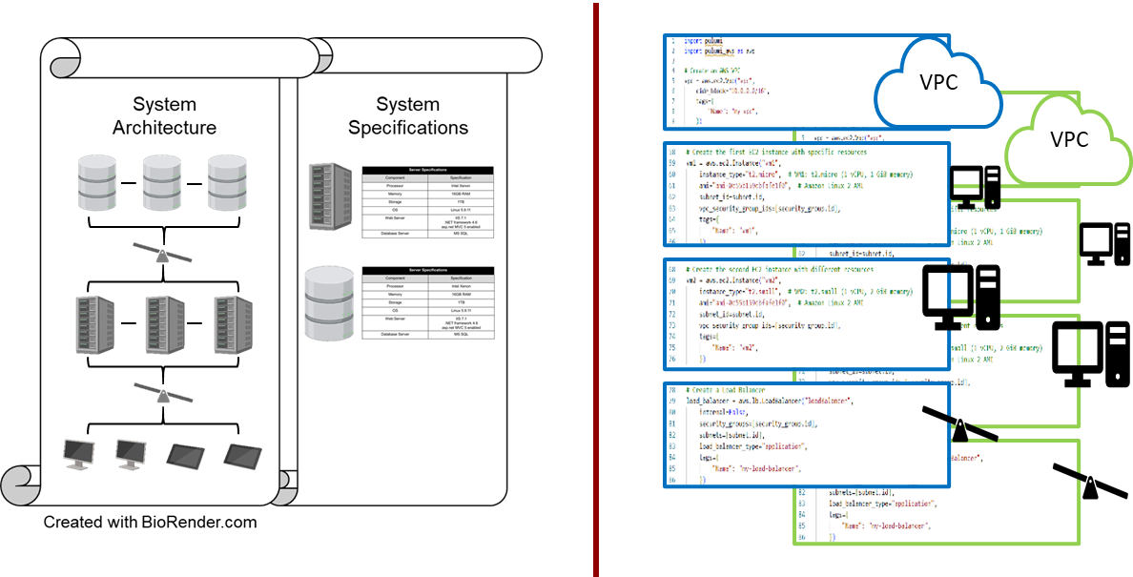
Types of data needed for continuous and automated V&V checks.
Verification
Validation
Verification
Same as initial verification
  Use test scripts comparing IaC provisioning instructions
  Identify tools, such as LLMs, to compare the most up-to-date technical review documentation
Validation
Pared-down validation
  Subset of performance testing comparisons using read-only requests during downtimes, such as maintenance windows
Acronyms: IaC – Infrastructure-as-Code; LLM – Large Language Model; VPC – Virtual Private Cloud; V&V – Verification and Validation

Slide 23
Risk-Informed Verification, Validation, and Accreditation (VV&A)
Accreditation
1. Initial VV&A
2. Continuous V&V Checks
3. Risk-Informed VV&A
Program Development
VV&A preproduction environment at MVCR
Automated, V&V checks before tests
Update VV&A when environments differ
Acronyms: MVCR – Minimum Viable Capability Release; V&V – Verification and Validation

Slide 24
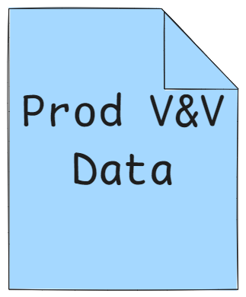
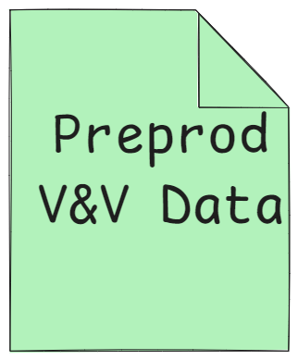

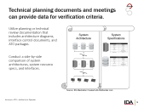

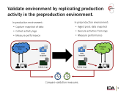
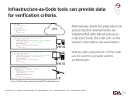



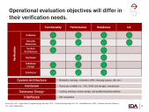
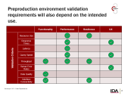

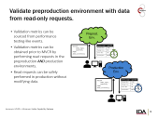
Risk-Informed VV&A is triggered by environment deviations detected in V&V checks.
Verification
Validation
VV&A Update
V&V Checks Trigger Update
Verification
Validation
VV&A update should repeat the process undertaken during the initial VV&A using metrics tailored to the planned evaluation.
Acronyms: V&V – Verification and Validation; VV&A – Verification, Validation, and Accreditation

Slide 25
Challenges Ahead
Remaining VV&A Challenges:
VV&A framework needs clear accreditation requirements
  Collect data on V&V case studies to formulate recommendations on accreditation standards
Undefined or dynamic production environments
  Hybrid environments – programs with mix of cloud and on-prem resources
  Autoscaling cloud resources
  Function-as-a-Service (FaaS)
Cyber security and cyber mission effects
Hardware systems with embedded software
Acronyms: V&V – Verification and Validation; VV&A – Verification, Validation, and Accreditation

Slide 26
Questions?

