Slide 1
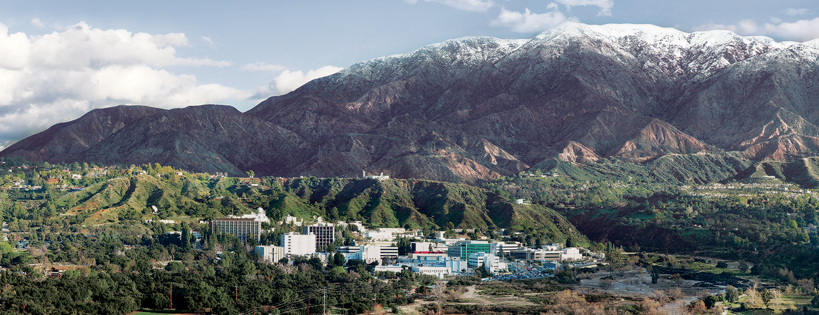
UQ for spacecraft thermal modeling during design and ground operations
Zaki Hasnain (312C), Rez Rahman (353G), Erik Bailey (343T) - Jet Propulsion Laboratory, California Institute of Technology
DATAWorks25 Conference Presentation
© Copyright 2025, California Institute of Technology, All Rights Reserved. Portions of this research were carried out by the Jet Propulsion Laboratory, California Institute of Technology

Slide 2
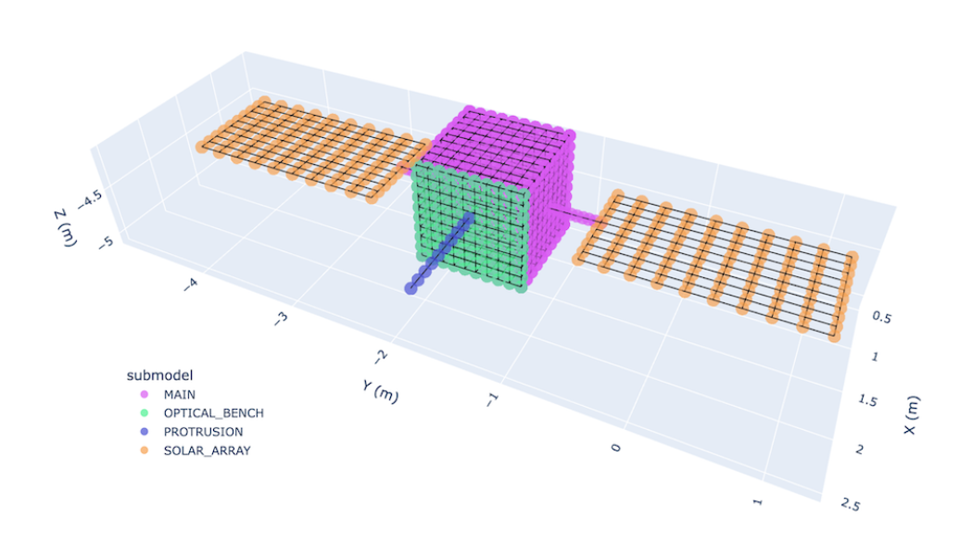
DATAWorks25: Talk Outline
Problem motivation
  Why do we need UQ?
  What are the pain points right now?
  What is the state of practice?
Proposed solution stack
  Ansys Thermal Desktop
  Ansys OpenTD
  SANDIA Dakota
  Standard Python visualization (Plotly)
Sample Model
  DummySat – Earth orbiter
Simulations
  Sampling
  Optimization
Next steps
  Surrogate modeling

Slide 3
Why we need meta-analysis tools for UQ at NASA
Consistency across studies to resolve algorithmic implementation differences
  Speeds up building trust in results across multiple tools (same algorithms used)
  Unifies thinking at the meta-level (where it can be very messy)
  Provides one tool suite to capture new techniques (rather than per analyst)
Standardized way to interface to tools with capability to support and automate multiple tools per study (e.g. Structural/Thermal/Optics analyses for telescope missions)
  One interface to write and test per tool
    Analysts can focus on interface, not implementation or development (saves resources)
  Multiple studies enabled via one interface (“Hook up once, use repeatedly”)
Inherent scalability from individual workstations to high performance computing with support for multi-threaded models per interface (no license-bound bottlenecks, etc.)
US Department of Energy (DoE) already has the open-source Dakota tool
  Been available since 1999, and is completely open-source
  Standard analysis driver tool for the Sierra toolchain components (FEM multi-physics structural/dynamics/thermal/fluids/combustion modeling tools

Slide 4
State of practice for UQ/Optimization in Thermal Desktop
Dynamic SINDA in TD is used to do DOE, optimization, runtime updates on geometry/parameters etc.
User can write SINDA/FORTRAN based logic in the dynamic SINDA to perform runtime updates. e.g. Rover movement, logic-based power control/optimization etc.
User can use existing Fortran library to customize SINDA based optimization
Dynamic SINDA is not a simple module to use. User needs to be careful and check the results to ensure correctness

Slide 5

Dakota overview
Dakota provides methods for multiple analyses:
  Uncertainty Quantification Methods
  Parametric Study Methods
  Optimization Methods (gradient and non-gradient methods)
  Surrogate Modeling Methods (e.g. Polynomial Chaos Expansion, Kriging, etc.)
  Reliability Methods
  Model calibration
Dakota manages parallel sample execution
  Supports MPI and process management tools like SLURM and PBSPro
  Easy settings to preserve individual sample runs in full detail
  Supports execution requiring feedback from sample results (e.g. optimization)
Dakota has multiple tool interface capabilities:
  System/File-based (a.k.a. “loosely coupled”)
  Specific Languages: (C/C++, Python, Matlab, Scilab, etc.)

Slide 6
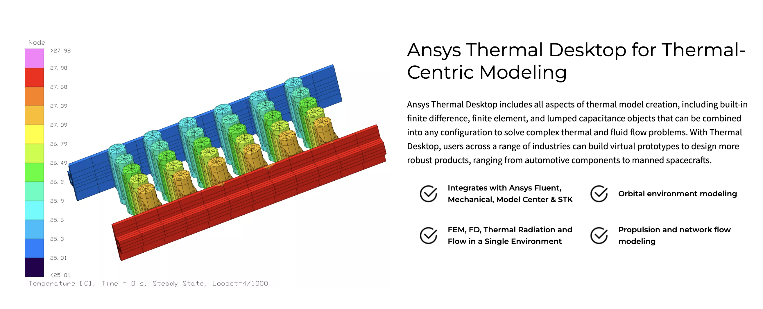
Ansys Thermal Desktop
Standard thermal analysis model for NASA
Used for heat transfer and fluid flow modeling
Formerly owned by CRTech
Recently acquired by Ansys
OpenTD
  Application Programming Interface (API)
  Accessible with any language that can talk to .NET
    C#, MATLAB, Python, Powershell, VB.NET, F#, etc.
    C# has most documentation and support
  No Python API documentation (yet)
Source: Ansys

Slide 7
Proposed solution Stack
Dakota input file: defines analysis method(s)
Analysis driver
Python script
Read Dakota sim parameters using Dakota Python module
Python script
Launch Thermal Desktop simulation using OpenTD python API
Python script
Read SINDA simulation results using Dakota Python module and save outputs
Python script
Generate report by reading all outputs and visualizing results

Slide 8
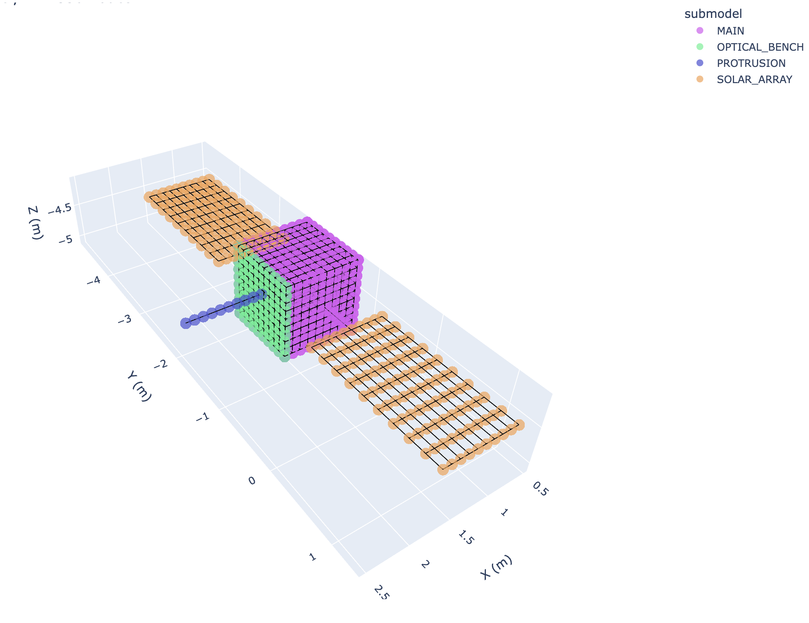
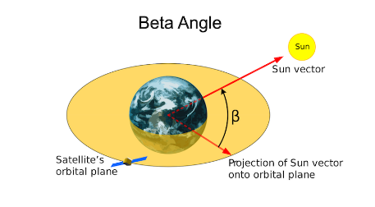
DummySat: Earth observing orbiter
DummySat Thermal Model has 4 sub-models
  Main: 28 nodes
  Optical Bench: 4 nodes
  Protrusion: 4 nodes
  Solar Arrays: 8 nodes

Slide 9
Examples of common UQ/Optimization simulations
Example 1: Latin hypercube sampling (LHS) for sensitivity analysis
Example 2: Random sampling for sensitivity analysis
Example 3: Optimizing without gradients

Slide 10
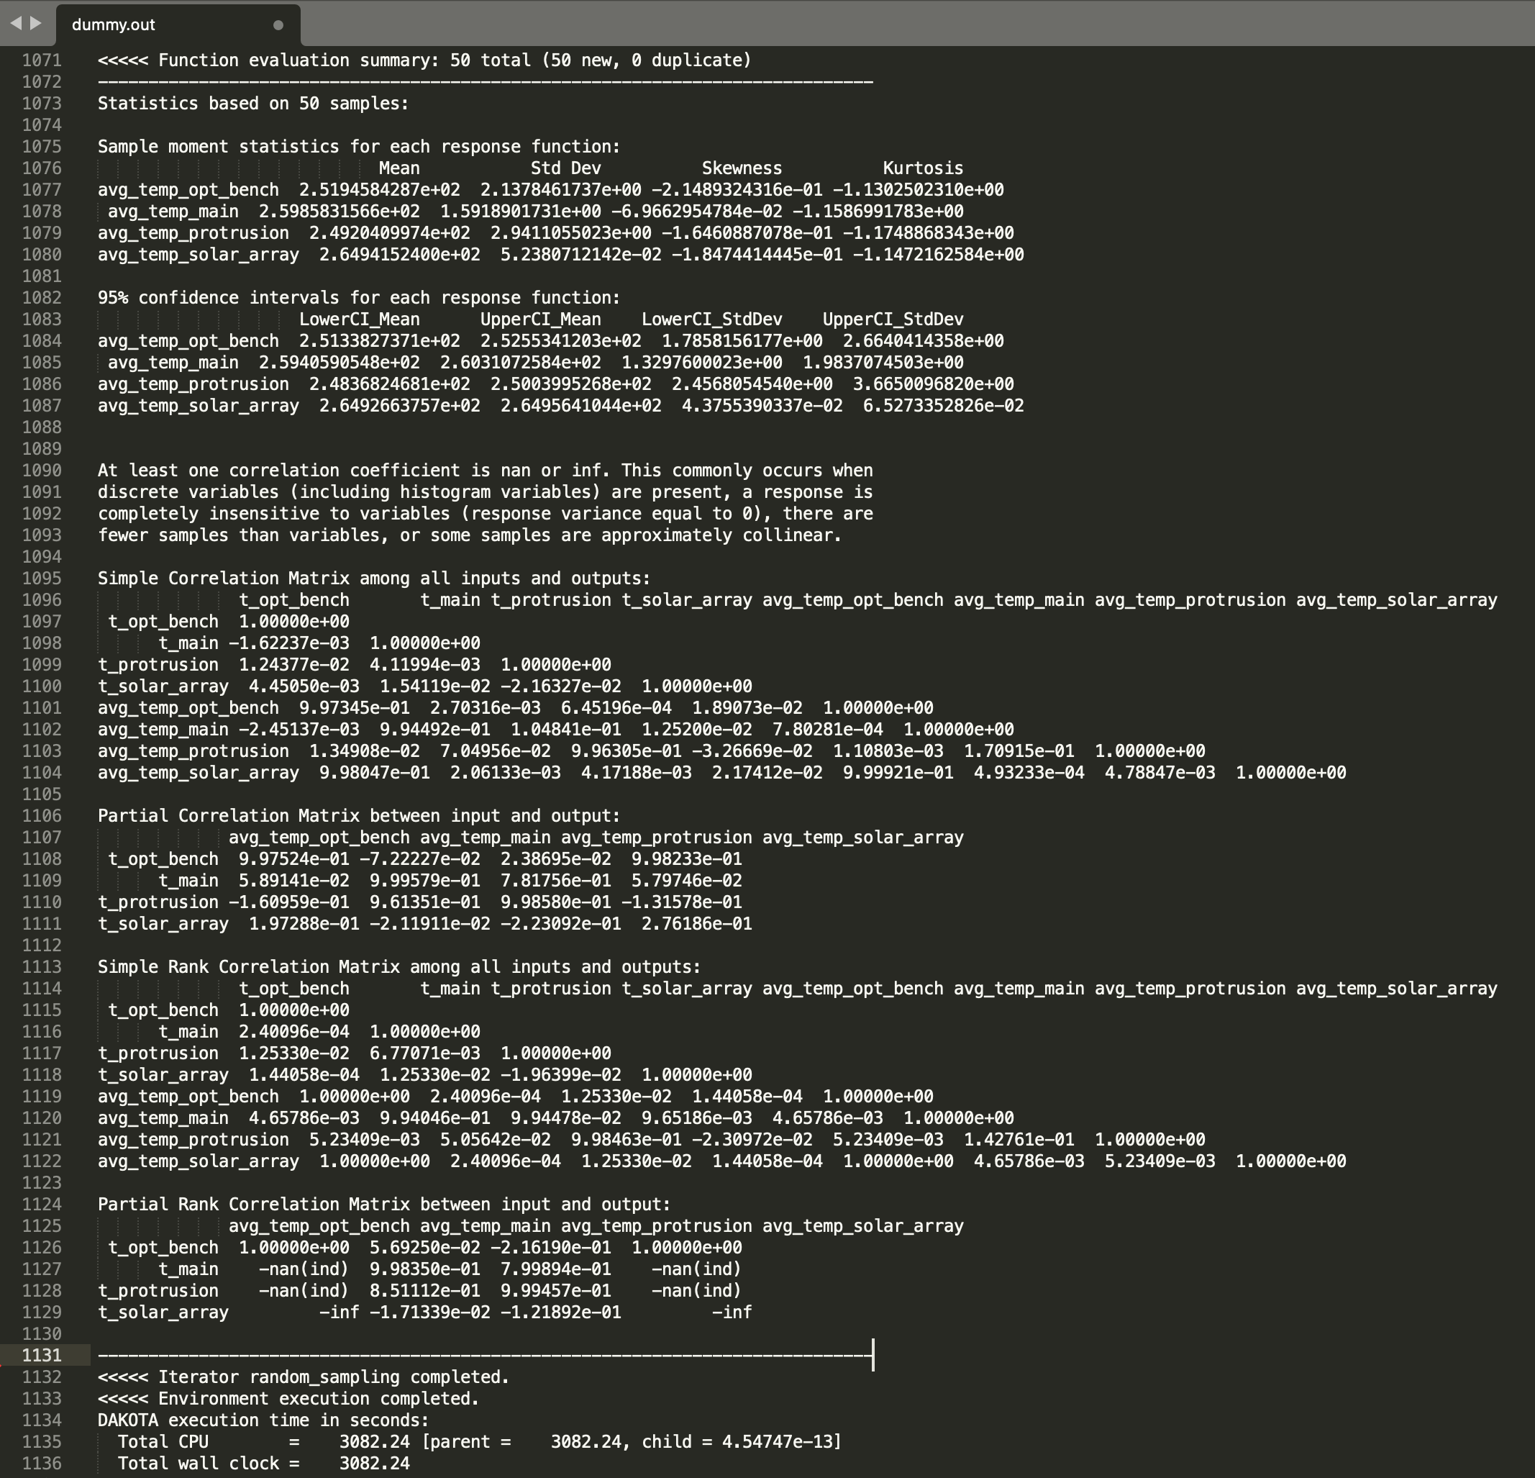
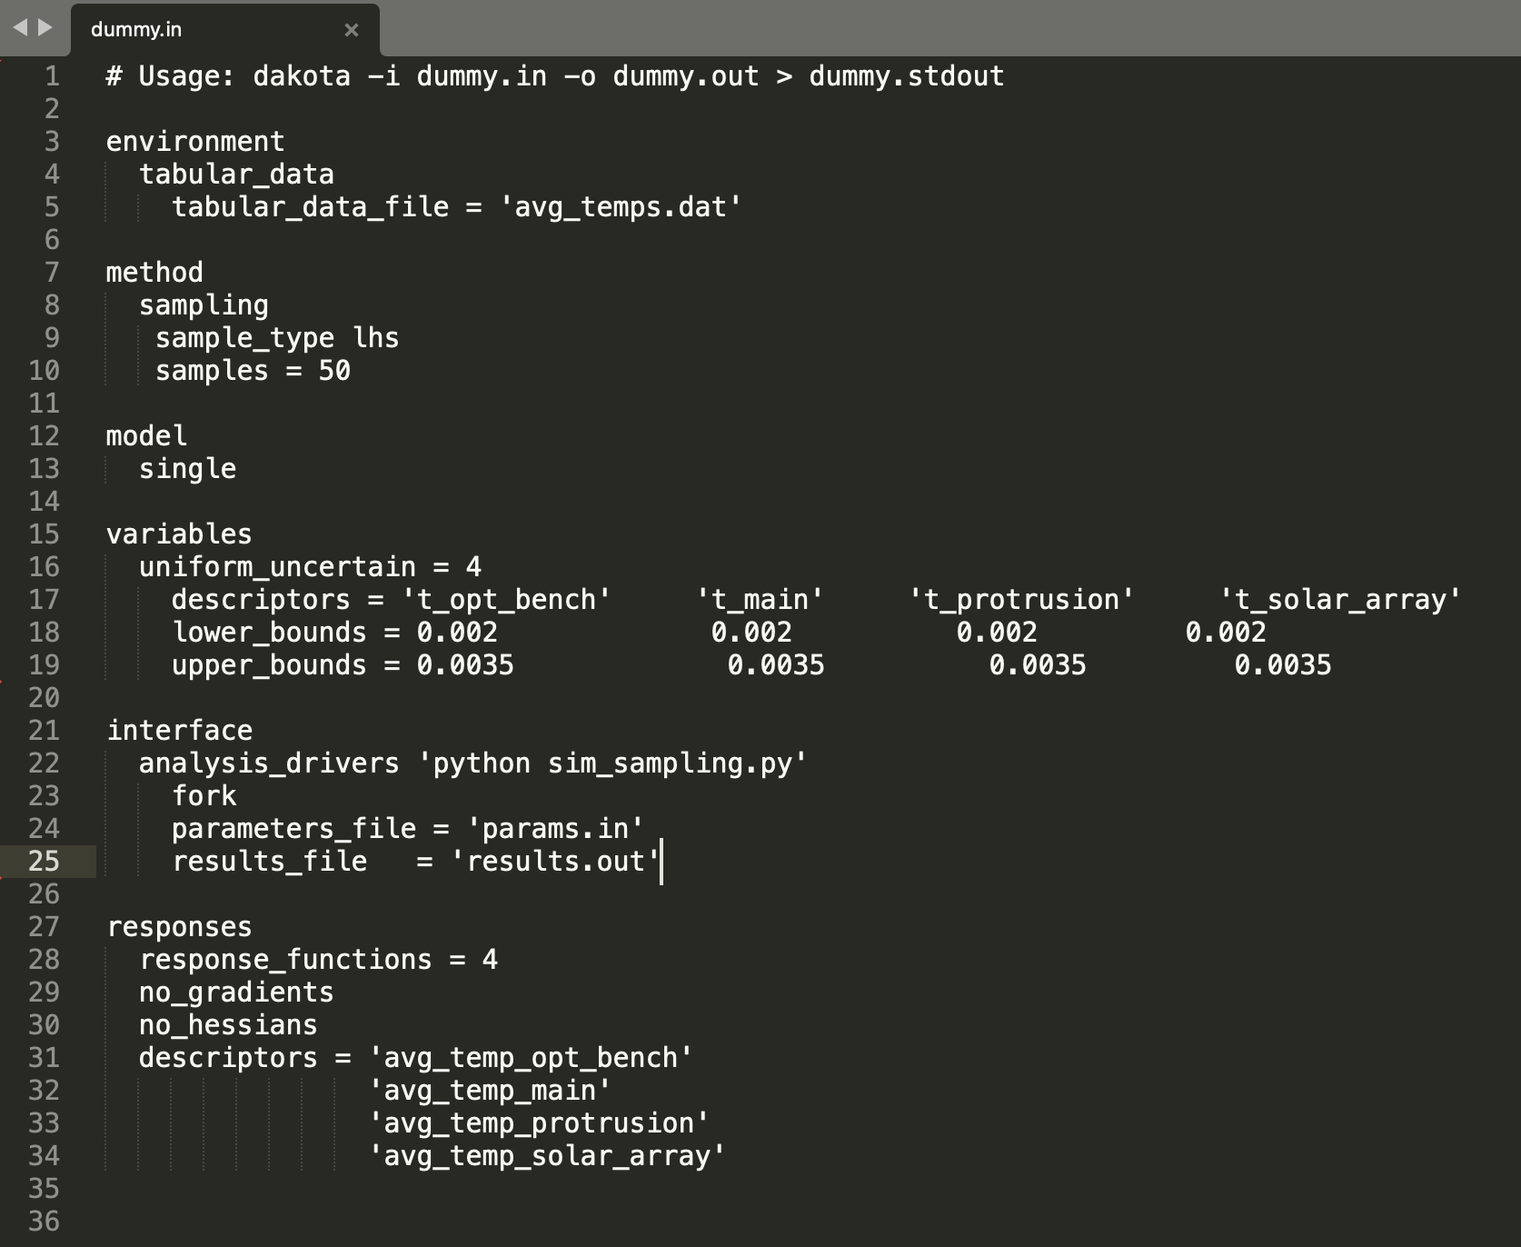
Example 1: LHS sensitivity analysis w/ Dummy Sat
Latin Hypercube sampling
Dakota input script
Dakota simulation output

Slide 11
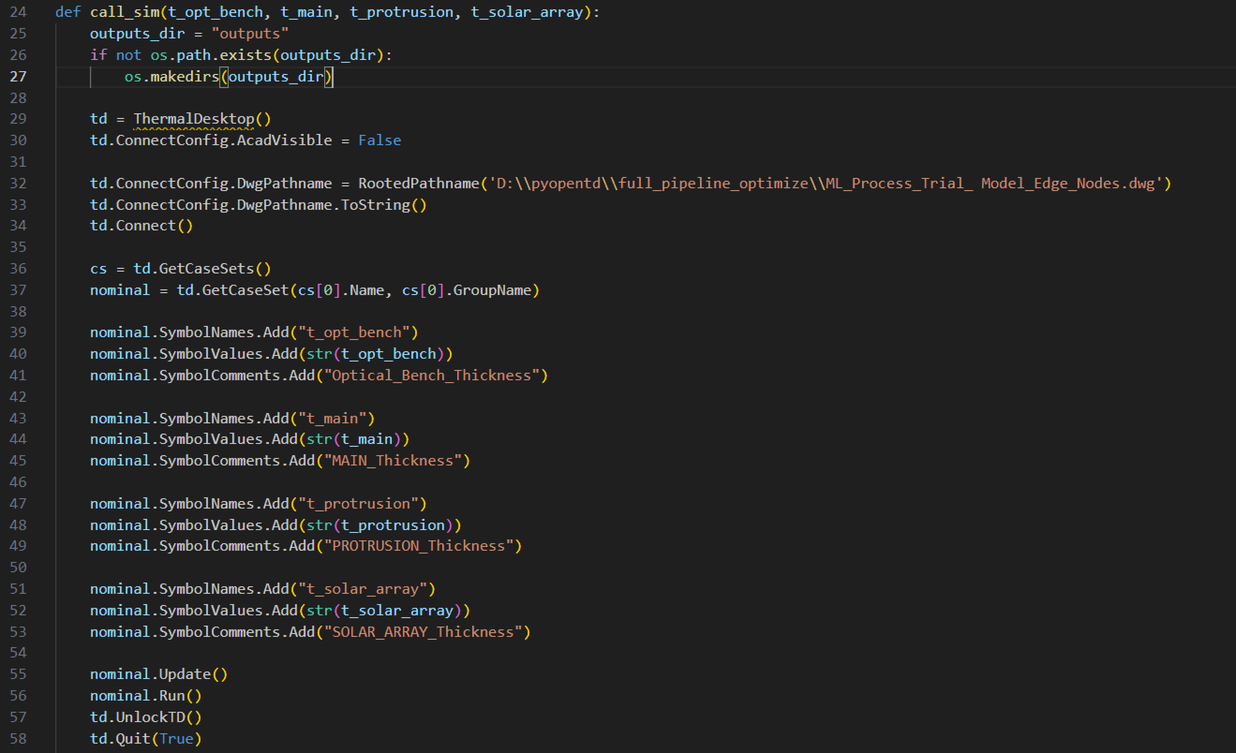
Example 1: Python OpenTD script to call Thermal Desktop
Requires setting up symbols in Thermal Desktop
Symbol values are specified by Dakota for each simulation

Slide 12
Example 1: LHS sensitivity analysis w/ Dummy Sat
Usage:
  What is the probability of a variable exceeding a threshold value?
  What are the defining quantiles of a variable?
  How does the uncertainty in model parameters affect the uncertainty on metrics of interest?
  How do system choices affect the uncertainty in a metric of interest?
  Which are the driving parameters of the performance metrics?
  How much can a parameter increase before a threshold value is exceeded?
  How sensitive is a system to modeling errors?
  What is the accuracy of the system performance metrics?
Outputs:
  Sample moment statistics for each response function
  95% confidence intervals for each response function
  Simple Correlation Matrix among all inputs and outputs
  Partial Correlation Matrix between input and output
  Simple Rank Correlation Matrix among all inputs and outputs
  Partial Rank Correlation Matrix between input and output

Slide 13
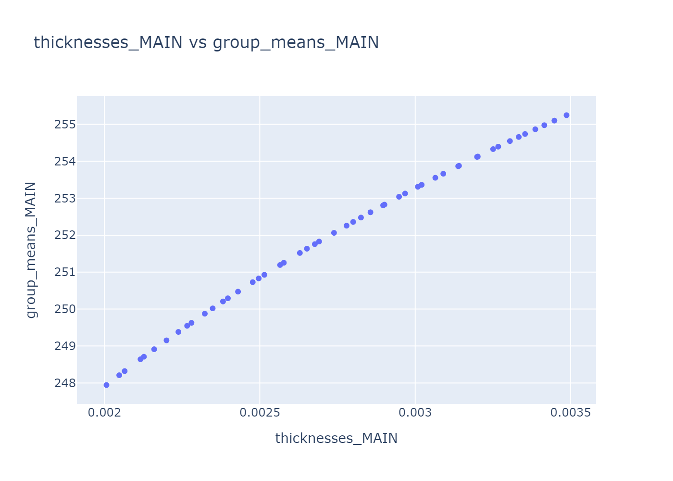
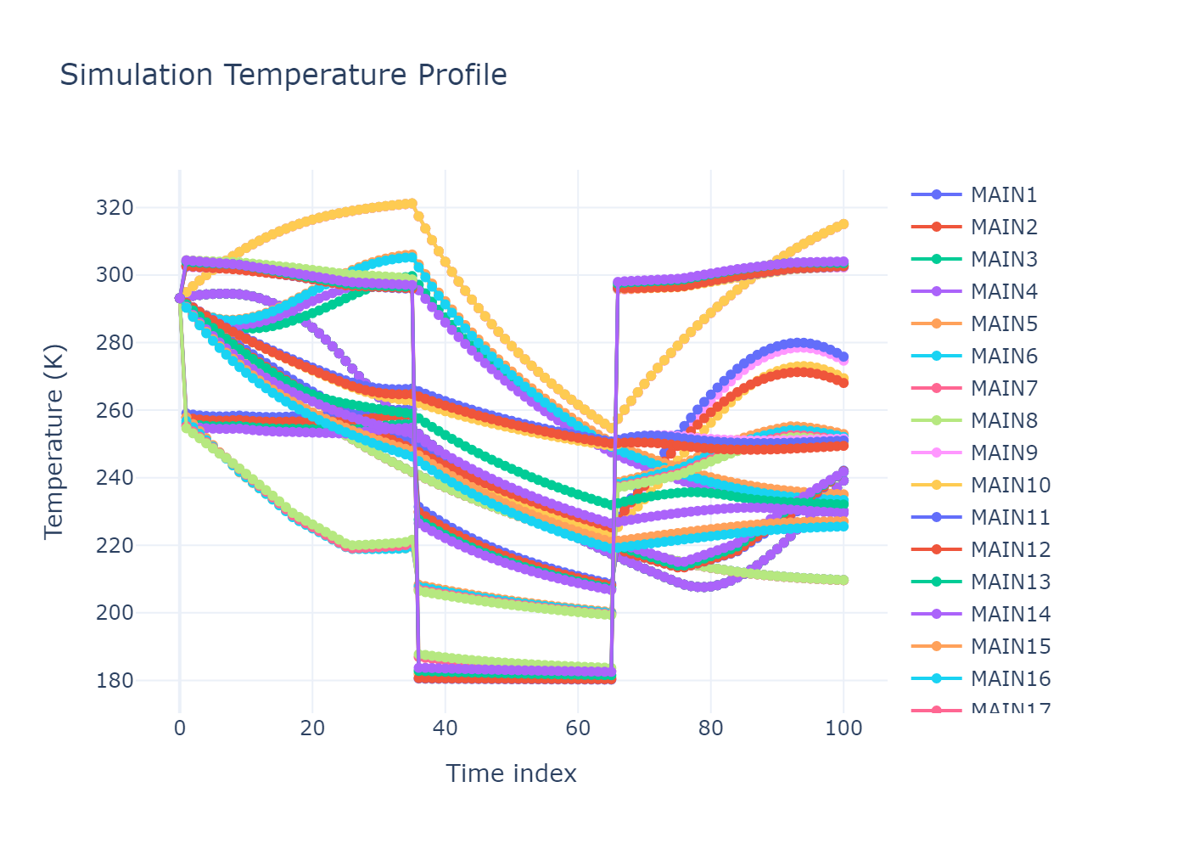
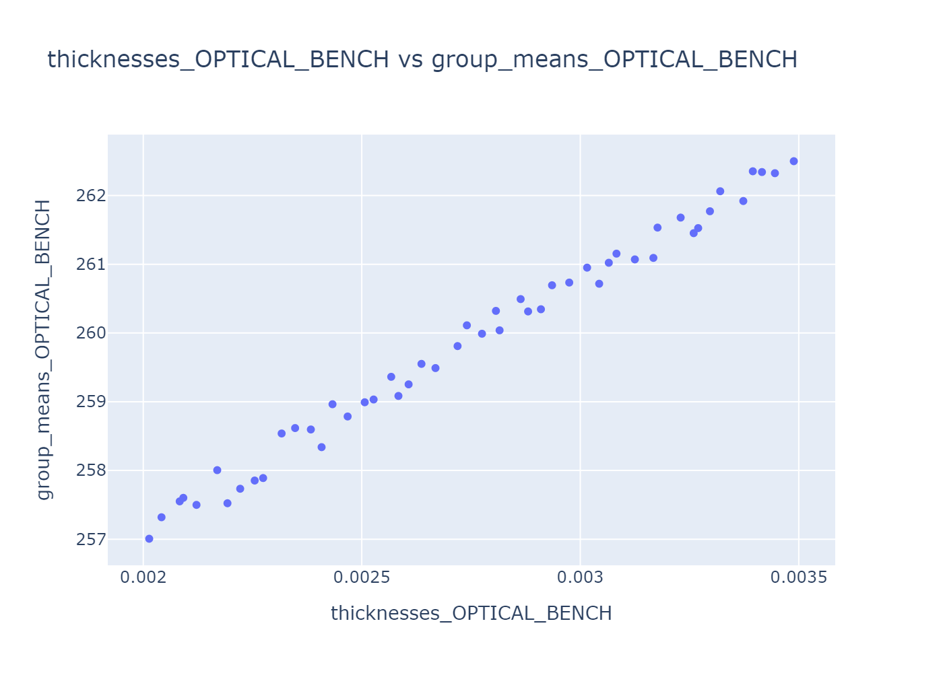
Example 1: LHS sensitivity analysis w/ Dummy Sat

Slide 14
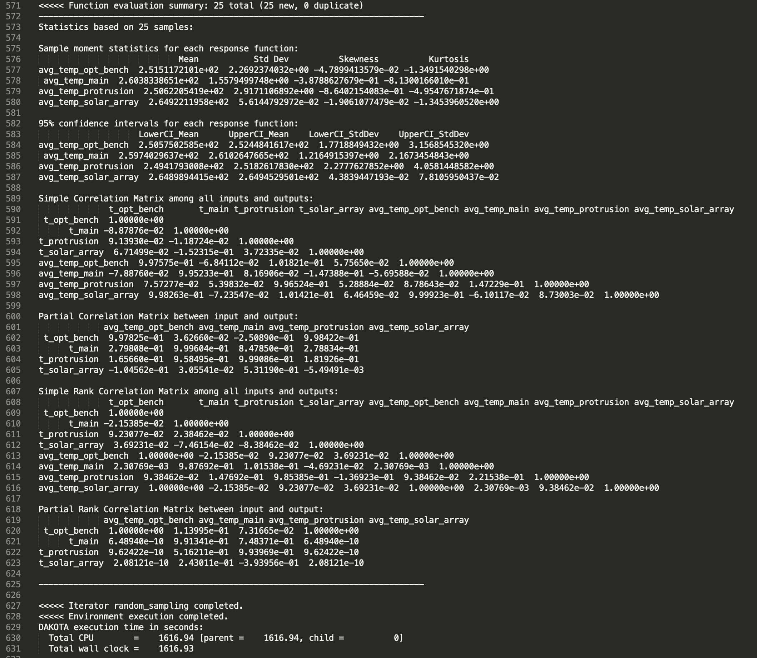
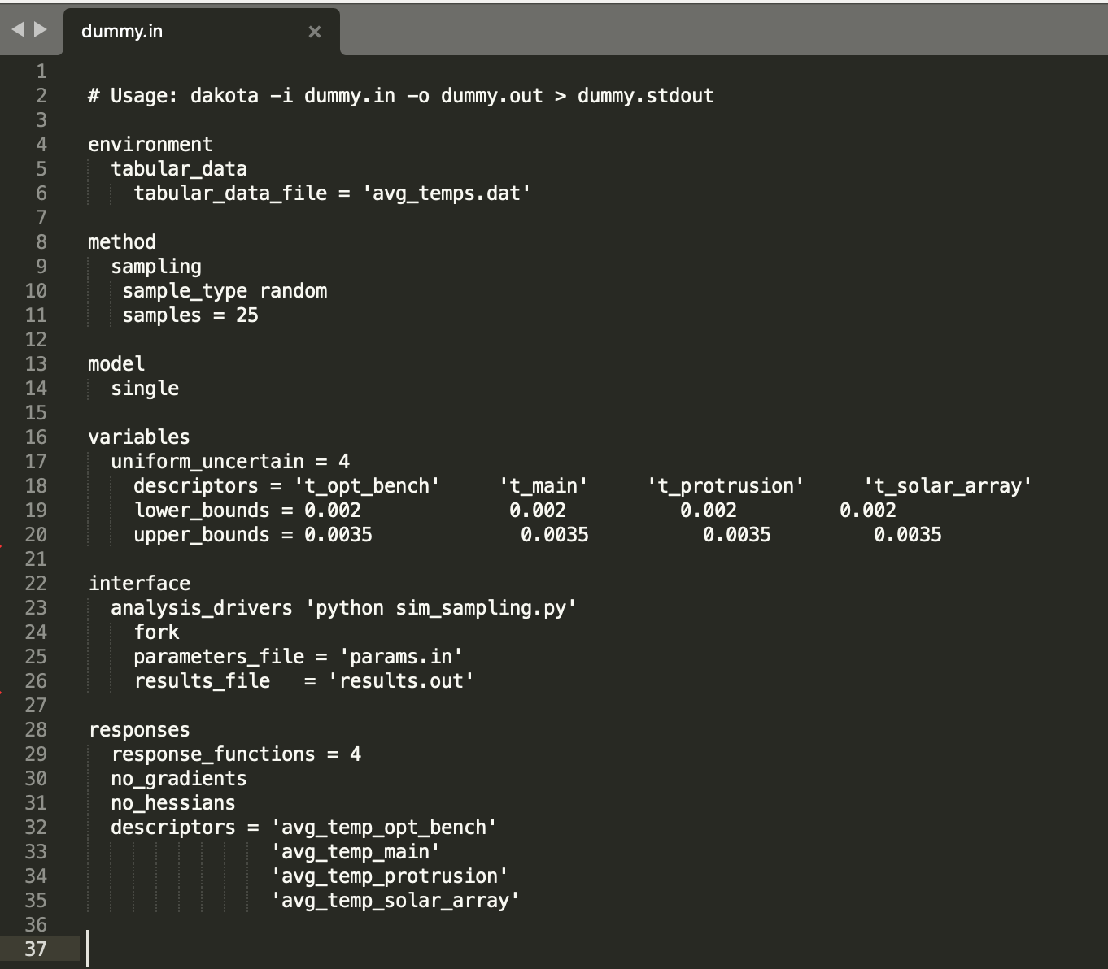
Example 2: Random - sensitivity analysis w/ Dummy Sat
Random sampling
Dakota input script
Dakota simulation output

Slide 15
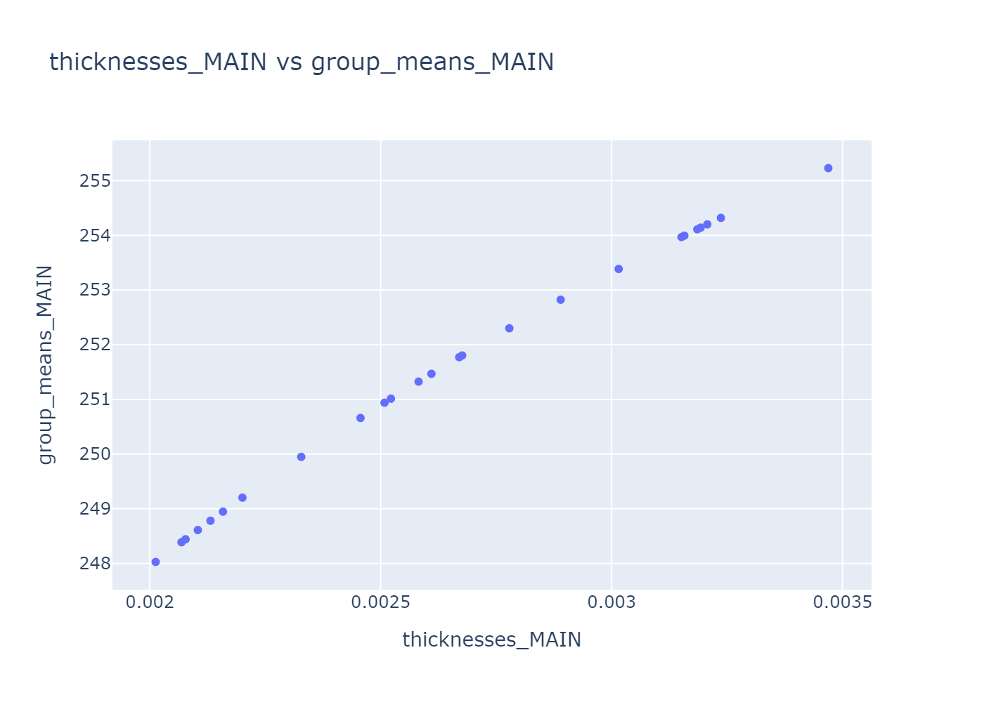
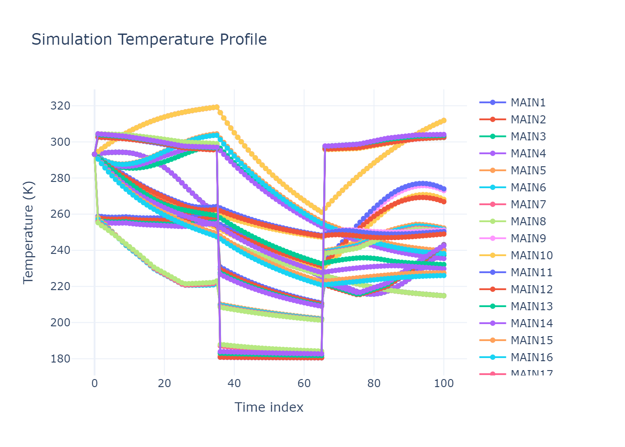
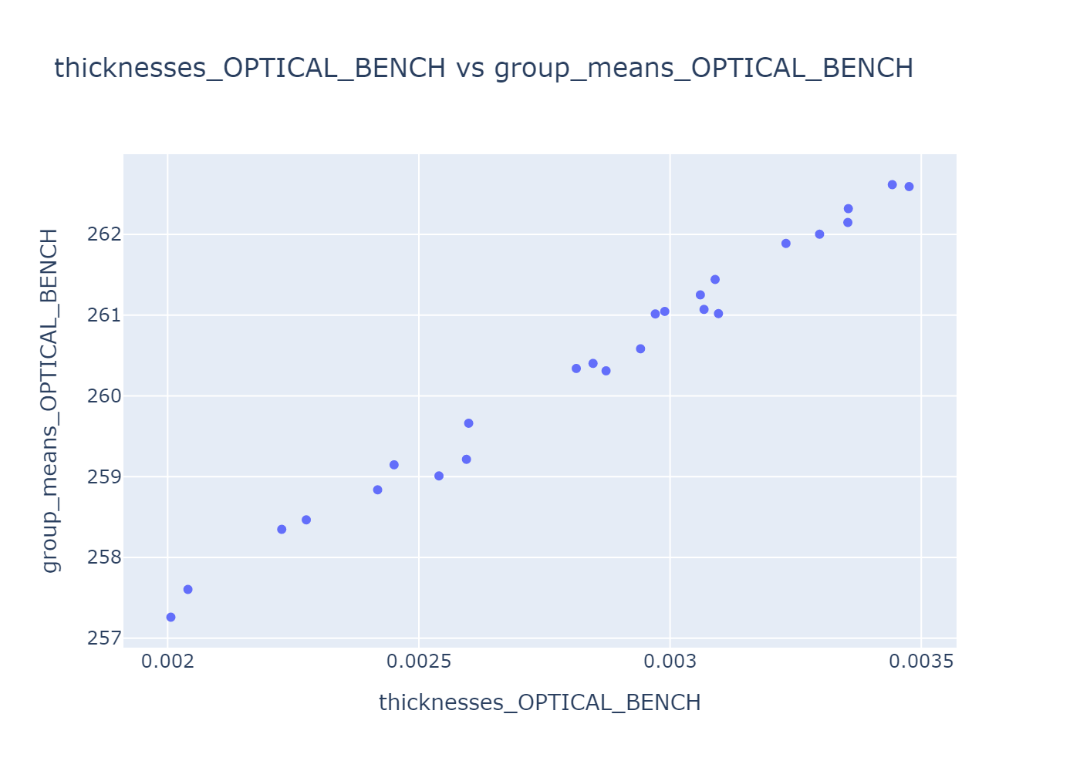
Example 2: Random - sensitivity analysis w/ Dummy Sat

Slide 16
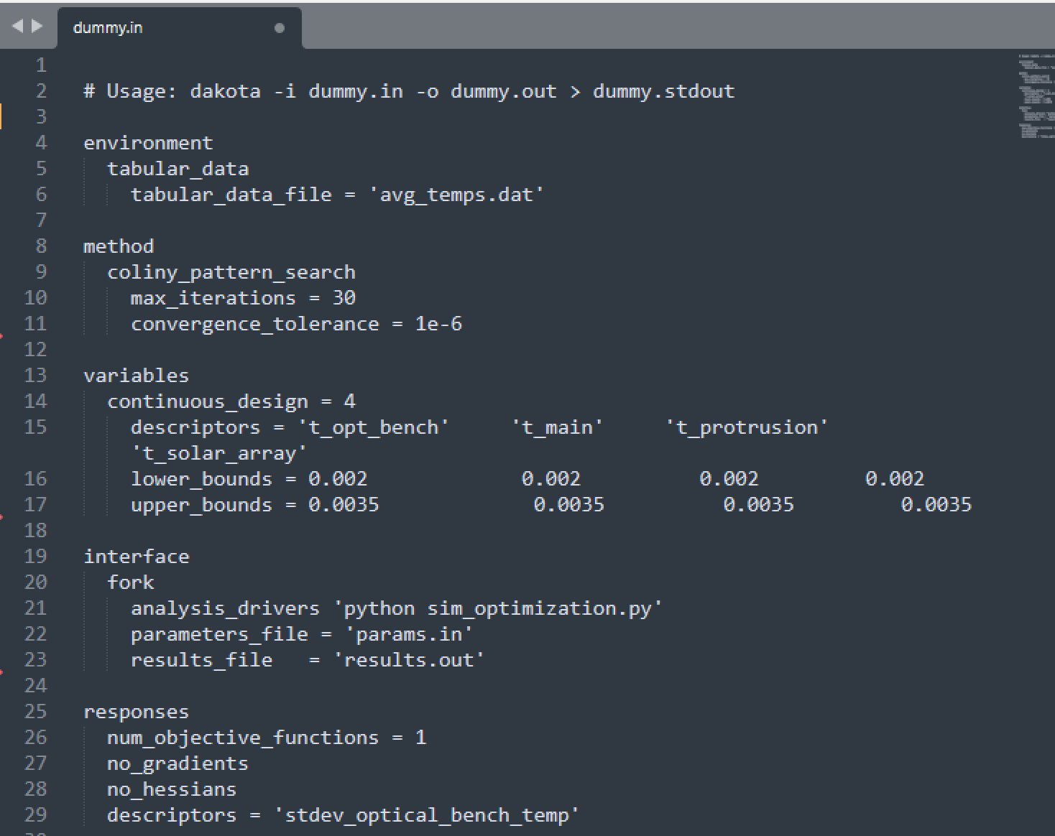
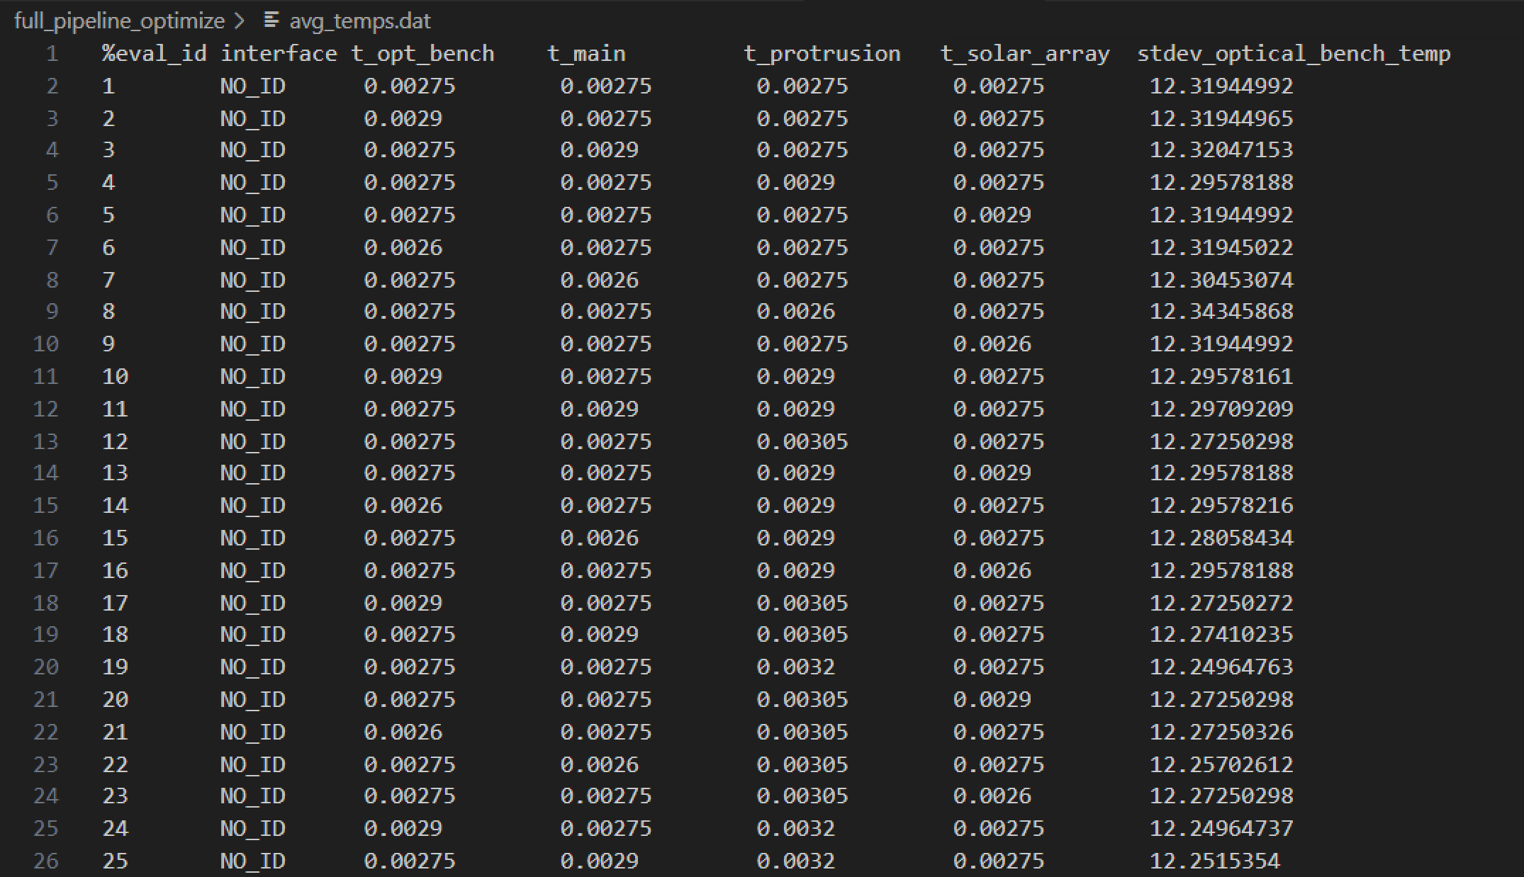
Example 3: optimization w/ Dummy Sat
Pattern search: gradient free optimization method
Minimize the standard deviation of the temperature in the optical bench
Dakota optimization output
Dakota input script

Slide 17
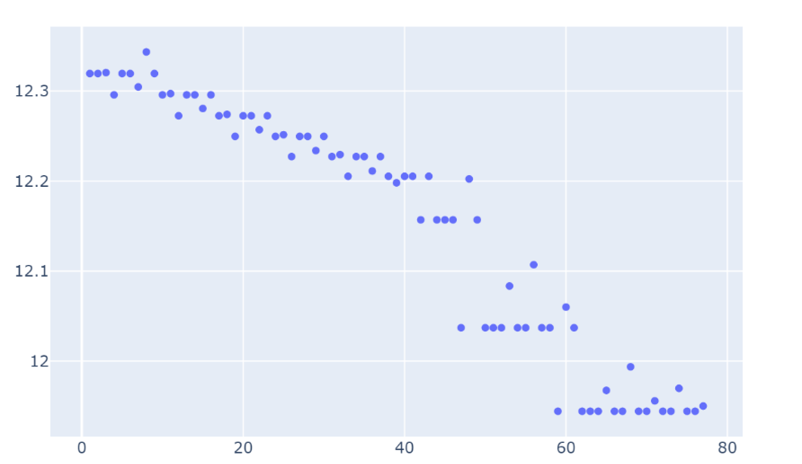
Example 3: optimization w/ Dummy Sat
Pattern search: gradient free optimization method
Minimize the standard deviation of the temperature in the optical bench
Standard deviation in optical bench
temperature
Search iteration index

Slide 18
Future steps
Document process for thermal engineering community
  OpenTD Python API does not have documentation yet
  Need to define and train best practices during thermal model development
Expand to other simulation steps of an integrated model
  E.g. structural, dynamics, optics, etc.
Explore surrogate modeling with Dakota
  Seed with high-fidelity Thermal Desktop model runs
  Benefits
    Speeds up analysis during time-critical phases of a mission
    During operations you don’t have to run the full scale (slow) model
    During design, we can build a surrogate model off the variables that matter the most
      Find the subset of important variables using initial sensitivity analysis run
    If there are license, or platform limitations for the full-scale/high-fidelity model, the surrogate model can be used to do studies during design with less platform and license constraints
  Caution
    Extrapolating out-of-domain should not be done unless it is validated

