Slide 1
Improving Readiness Outcomes with Collaboration: Quantifying the Cost of Siloed Resourcing Decisions
Connor McNamara
Jasmine Bertram
April 24, 2025
Notes:
Consider setting up the problem here
Ready systems, spares in the best location
Efficiency of centralization vs spares to every operational unit: urgent care MRI vs hospital located ones
Every $ spent on that MRI means it’s not spent on something potentially more critical
“tie resource decisions to readiness outcomes”

Slide 2









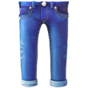







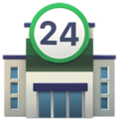
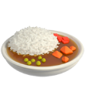




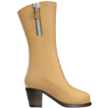














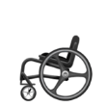




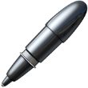




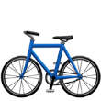
How is the supply system supposed to work?
A single household has “demands” with limited funds
Optimal purchases must foresee fluctuating demands over time
Other households will have different demands
All retail stores are stocked through wholesale
Local retail stores must have corresponding stock
Notes:
Considering moving this to slide one. Reduce the amount of pictures on this slide to add a box to translate this grocery store example to our actual study
Highlight that retail/wholesale have limited knowledge of the other and that there are separate entities making decisions for wholesale and retail, which makes coordination difficult
Change title to communicate the problem
“What does retail buy? What does wholesale buy?”

Slide 3

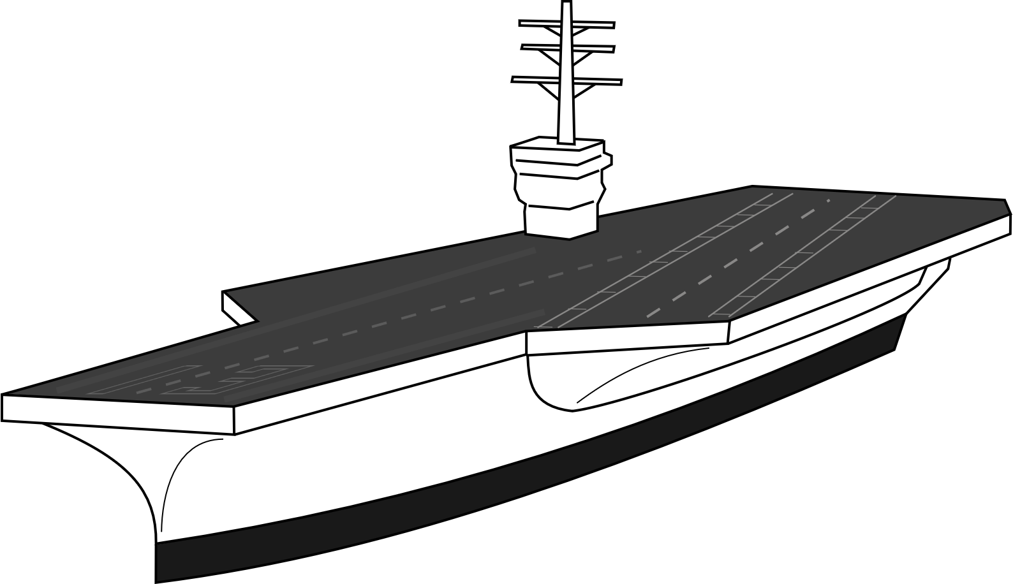
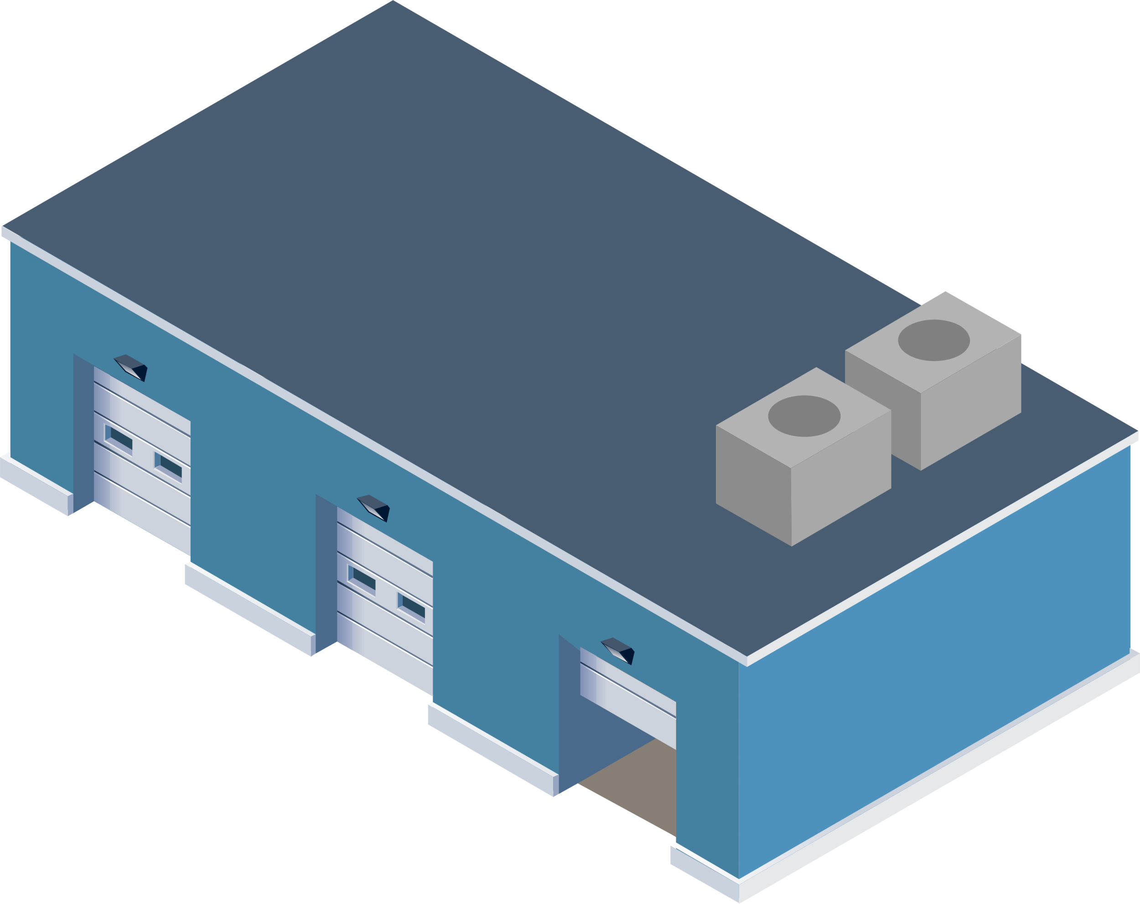
When buying spares, we need to decide how many to buy, and where to put them
All Wholesale
All Retail
Both these solutions achieve or exceed the target readiness. The optimal answer depends on factors such as the price of the item and the frequency of demands.
There is a spectrum of sparing positions and there is no one correct answer that works for every spare.
Total Cost: $2 Million
Total Cost: $11 Million
In practice, the sparing decisions at wholesale and retail are often made in isolation
Notes:
Replace with a simple example. Maybe show the two extremes – putting everything at wholesale or putting everything at retail. Use that to explain the pros and cons of both and then motivate coordination between stocking some things at wholesale and some things at retail. Fundamental efficiencies of centralized vs. localized stocking
Highlight why this is a hard problem to solve (stovepipes in the DoD)

Slide 4
Stovepiped sparing decisions can lead to suboptimal outcomes
Notes:
Better transition between the context/setup and the actual study
Rephrase to the question being answered on the next two slides

Slide 5
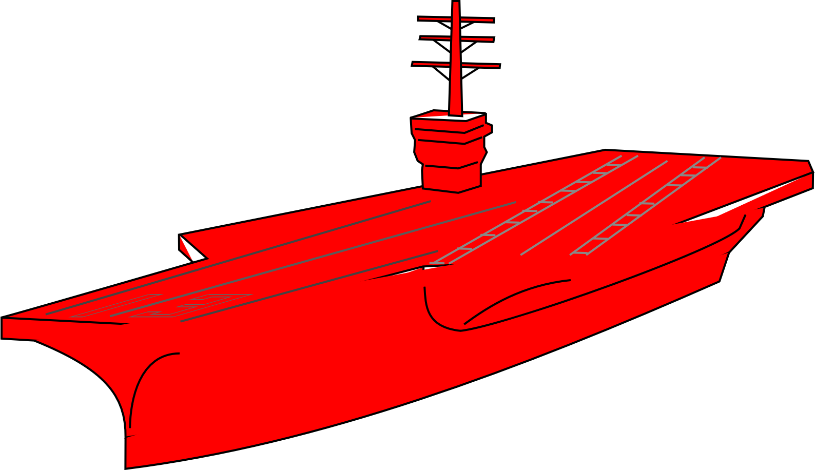
Centralized wholesale stocking is often efficient, and cuts can pass on non-linear costs to retail
Optimal stocking at wholesale and retail
Wholesale’s budget is cut, and readiness suffers due to lack of available spares
Retail must spend more on spares to maintain the prior level of available aircraft
Accept lower readiness
or
Notes:
False economy

Slide 6
For a given readiness target, underfunding wholesale passes a non-linear cost on to retail to maintain the same readiness
 | For Every $1 Wholesale Doesn’t Spend, Retail Must Spend:
Change in Wholesale Spending* | Platform 1
$ 70 M to $ 60 M | $1.05
$ 80 M to $ 70 M | $1.10
$ 90 M to $ 80 M | $1.15
$ 100 M to $ 90 M | $0.85
Increased overall spending to regain availability
Wholesale currently overfunded for target availability
The numbers are notional, but representative of actual system spending. In each case, retail expenditure is adjusted to maintain the number of available aircraft.
Using our end-to-end simulation tools, we were able to quantify the “exchange rate” between retail and wholesale spending for a range of different weapon systems.
*These results assume optimal purchasing.
Cost is notional
Notes:
90M is optimal
Red – inefficiency tax - making up for wholesale problems at retail
Novel results and was unseen before in terms of the outcomes.
Surprising and significant

Slide 7
Optimizing resource decisions across weapon systems
Notes:
Key elements: every aircraft costs different amounts, $ is fixed for all of it

Slide 8




How should the DoD allocate its budget to buy spares for multiple weapon systems?
Why is this a hard problem?
Platform A
Platform B
Different platforms cost different amounts to achieve a given readiness target.
A fixed and limited budget to support all weapon systems requires tradeoffs to be made between platforms.
40 Planes
250 Planes
Platform C
Platform D
Quantifying the cost of readiness for each platform can serve as a basis for optimizing and evaluating resource allocation strategies.
200 Planes
60 Planes

Slide 9
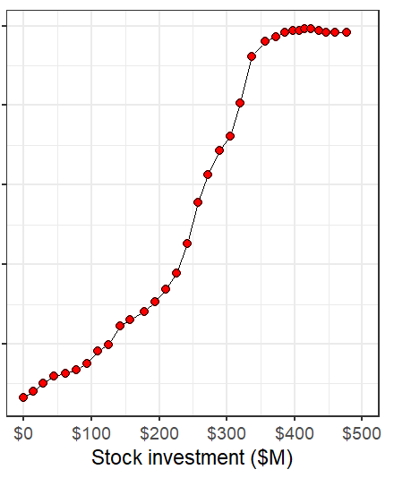
We can use models to estimate the cost of readiness for a given platform
Return-on-investment plateaus as spares are no longer the limiting factor of readiness.
80%
Readiness-based sparing (RBS) gives the optimal set of spares for a given budget that minimizes the expected number of backorders.
70%
For $300M:
3 radar
8 landing gear
100 screws
6 generators
60%
Avg. % of Available Aircraft
A simulation of the platform’s operations, maintenance strategy, and supply system structure can estimate the average percent of available aircrafts with a given set of spares.
50%
For $200M:
1 radar
5 landing gear
100 screws
40%

Slide 10
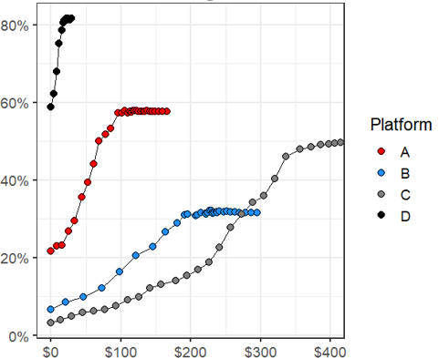
How should the DoD allocate its budget to buy spares for multiple weapon systems?
Cost of Readiness by Platform
Platform A
Platform B
40 Planes
250 Planes
Avg. % of Available Aircraft
Platform C
Platform D
200 Planes
60 Planes
Stock Investment ($M)

Slide 11
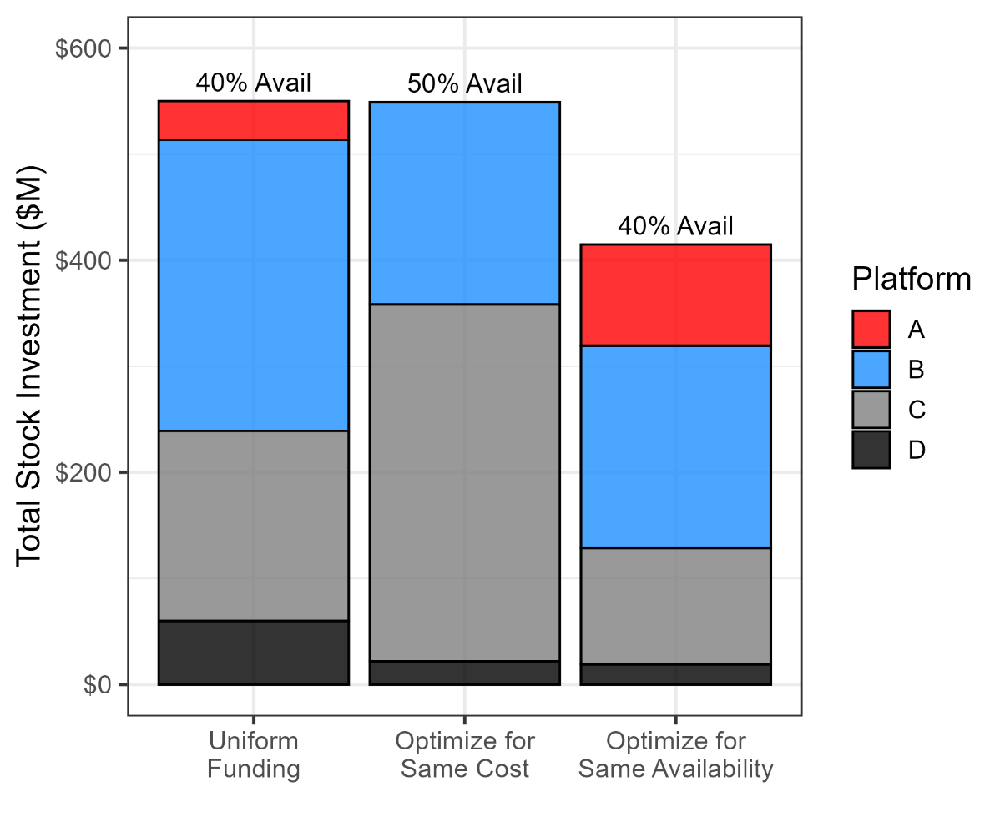
The DoD can use the cost of readiness for each platform to determine where funds will have the largest impact
Cost of Readiness by Platform
Overfunded!
These platforms are funded past their readiness return-on-investment plateau
Total Stock Investment ($M)
Avg. % of Available Aircraft
Uniform Funding:
Allocate $1M per Aircraft
Stock Investment ($M)
Notes:
There is no existing model for such an outcome

Slide 12
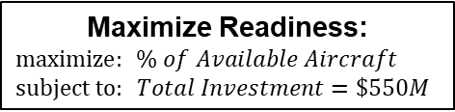
The DoD can use the cost of readiness for each platform to determine where funds will have the largest impact
Cost of Availability by Platform
Underfunded!
This algorithm would allocate $0 to Platform A. Model adjustments are probably required.
Total Stock Investment ($M)
Avg. % of Available Aircraft
Maximize Readiness:
$$maximize:{\% of Available Aircraft}$$
$$subject to: Total Investment=\$550M$$
Stock Investment ($M)
Notes:
There is no existing model for such an outcome

Slide 13
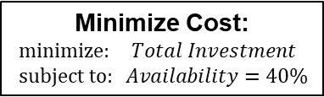
The DoD can use the cost of readiness for each platform to determine where funds will have the largest impact
Cost of Availability by Platform
Total Stock Investment ($M)
Avg. % of Available Aircraft
Minimize Cost:
$$minimize:{Total Investment}$$
$$subject to: Availability=40\%$$
Stock Investment ($M)
There is no single correct optimization function! However, tying funding to readiness outcomes enables operational requirements to drive budget decisions.
Notes:
There is no existing model for such an outcome

Slide 14
We can tie resource decisions to readiness outcomes using our modeling and simulation tools that look at the end-to-end sustainment system.
Notes:
Key elements: every aircraft costs different amounts, $ is fixed for all of it

