Slide 1

The North America Competitive Laundry Initiative
Sunny Escobar, Cindy Rodenberg, Alex Varbanov
The Procter & Gamble Company

Slide 2
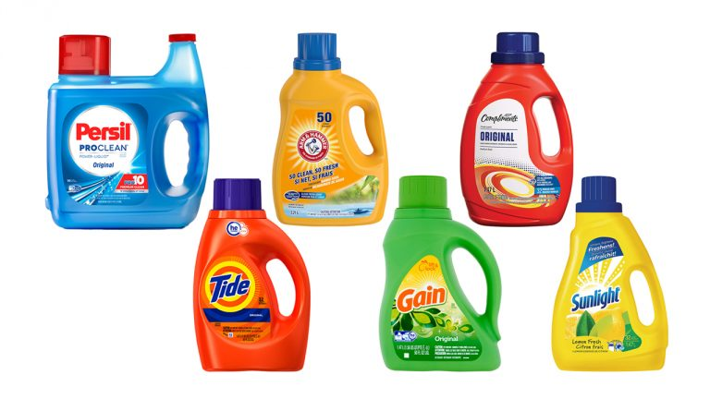
Talk Outline
Project Background and Business Impact
Link to Statistical Engineering
6 Statistical Engineering Stages
Summary

Slide 3

P&G Mission
The Procter & Gamble Company (P&G) is one of the top 10 largest consumer packaged goods companies leading growth and innovation in an evolving market (https://www.bizvibe.com/blog/largest-cpg-companies/)
P&G’s mission is to “provide branded products and services of superior quality and value that improve the lives of the world’s consumers, now and for generations to come.” (https://www.pg.com).
In order to stay competitive, it is essential for P&G to be at the leading edge of product superiority by providing consumers with high-performing products

Slide 4
NA Competitive Product Laundry Initiative
Fabric and Home Care is one of P&G’s six industry-based Sector Business Units
Laundry business is a highly competitive environment with multiple other players such as Henkel, Unilever, and numerous Private Label (store-brand) products
Interested in landscaping the performance of key NA laundry products relative to the main competition since 2016
Focused on 5 key Laundry benefit spaces: Stain Removal, Odor Removal, Whitening, Color Care, and Freshness

Slide 5
Integrating…
800+ P&G and Competitive Laundry Detergents
20000+ Stain Removal Outputs
700+ Malodor & Freshness Screenings
300+ Whiteness Readings
1400+ Analytical Toplines
2300+ Technical Specifications
AND CONTINUING TO GROW!!!
Notes:
Life’s gotten a little more complicated! Now we have a huge number of products, many vectors that are of interest to the consumer, and many different ways that we can leverage the information.
No one’s going to disagree that this is a complex problem… but is it a Statistical Engineering problem and if so how treating it as such helps us to solve it.

Slide 6
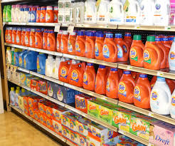

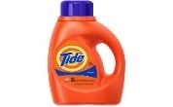
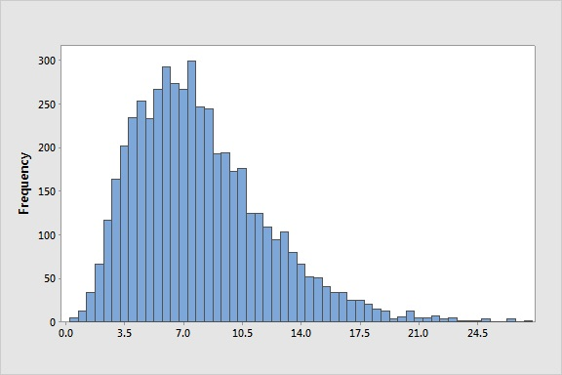

Big Business Impact
NA Competitive Product Results
Develop Models for
New Prototype Screening
Competitive Benchmarking
(e.g., Tide #1 Stain and Odor Claim)
Precious Resource
for Sales Teams
Notes:
Top line growth:
Being front and center because we’re good. By being able to articulate ourselves very clearly to our customers our sales force was able to convince our customers to give us premium shelf space.
We had solid, robust proof to be able to make consumer relevant claims.
Bottom line growth:
Using historic data AND creating new data smartly to enable modeling.

Slide 7
Bringing a Competitive Advantage
Multi-disciplinary Team
BU Partnership
Right Data
Foundation
Statistical Engineering

Slide 8
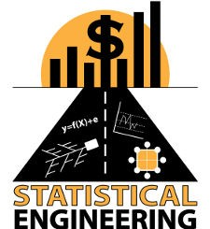
Link to Statistical Engineering
Large:
Lots of data
Multi-disciplinary
Multi-benefit
Multiple customers
Need for strategy:
Where to start
Structure
Output
Data Challenges:
Disparate data sources
Complex:
Statistical complexity
Analytical complexity
Notes:
Is this a statistical engineering problem?
Let’s think about it relative to other complex but well-defined problems with clear objectives

Slide 9
Leveraged All Statistical Engineering Stages
Identify the High Impact Problems
Providing Structure
Understanding Context
Develop Strategy
Develop and Execute Tactics
Identify and Deploy a Final Solution
Hoerl, R.W. and Snee, R.D. (2017), “Statistical Engineering: An Idea Whose Time Has Come?” The American Statistician, 71(3), 209-219.

Slide 10
1) Identify the High Impact Problems
Essential to understand the questions to be addressed by this Initiative:
  Status Quo
    Where does my current product stand relative to competition and benefit spaces?
    As the environment changes, is my product maintaining superiority or is the gap closing?
  Investment
    How have other products changed and can they extract consumer and monetary value from it?
    When is the optimal time to re-invest in my product formulation or innovate on new formulation?
  Consumer
    How can I leverage my superiority gap to communicate the benefit I provide to consumers?
    How can I confidently state my performance value in business-building claims for TV and Media advertisement?
  Expansion
    Where can I launch a new product (performance whitespace) and what currently exists there?
    What product performance trends exist and what is my product’s potential in them?

Slide 11
2) Providing Structure (Team)
Small Multi-disciplinary Team
Organization Unit | Role | Responsibility | Link to Critical Stakeholders
Fabric Care: Franchise | Product Researcher | Identifying: competitive product landscape, test methods for comparing product benefits | Senior Leadership to ensure that critical questions addressed and raise awareness of opportunity
Fabric Care: Franchise | Lab Researcher | Expert in test method execution and management of testing labs | Report to Product Research Leader for lab testing execution
Corporate Functions: Data & Modeling Sciences (D&MS) | Statistician | Experimental Study Design, Method Validation, Data Processing, Database Creation and Maintenance, Statistical Analysis, Results Interpretation | Senior D&MS Leadership for work accountability, work priority decisions, and availability of statistical resources
Corporate Functions: D&MS | Informaticist | Develop tools to access database of results | Project Statistician to ensure tools meet user requirements
Fabric Care/D&MS | Director Management | Communicate work/effort; Provide additional resources and funding as needed | Senior Leadership to ensure priority of initiative

Slide 12
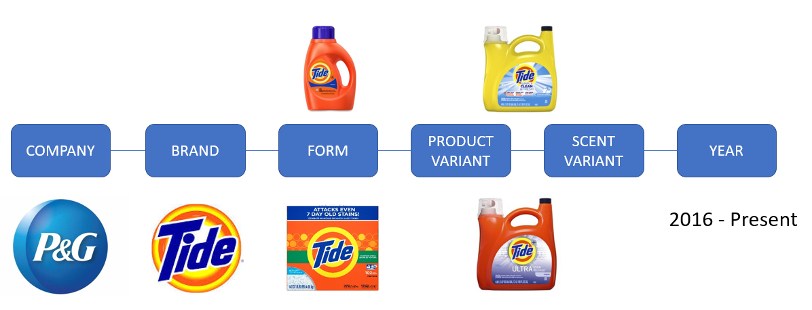
2) Providing Structure (Product Annotation)

Slide 13
3) Understand Context
Identify and Plan against the critical challenges
  Working in highly focused organizations
    Convince Business Unit management how the proposed initiative will deliver on a win-win scenario for the Business
  Uncertainty in committing to future value initiatives that involve high initial cost investment
    Create new testing methods that deliver higher overall efficiency from the start
    Identify innovative ways to reduce the amount of testing via powerful statistical methods
  Pressure for delivering large and growing business needs while utilizing even less resources and time
    Embrace the reality in industry

Slide 14
4) Develop Strategy
Data Standardization
Data Quality using Validated Technical Methods
Use Statistical Thinking During Study Planning
Apply Network Meta-Analysis (NMA) for Data Integration

Slide 15

Strong Foundation Requires Statistical Thinking During Study Planning
Optimal
Controls
Method Validation
Randomization
Replication
Blocking

Slide 16
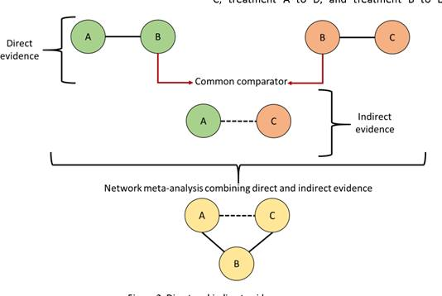
Network Meta-Analysis
Jones, B., Roger, J., Lane, P.W., Lawton, A., Fletcher, C., Cappelleri, J.C., Tate, H. and Moneuse, P. (2011). “Statistical Approaches for Conducting Network Meta-Analysis in Drug Development”, Pharmaceutical Statistics, 10, 523-531.

Slide 17
5) Develop and Execute Tactics
Many tactical decisions enabled the project success
Key Ones
  Use pilot studies to validate new technical methods
  Use controls (repeated products) across tests
  Use SAS software for all data processing, analysis, and activation
  Provide access to product results using an Online Access Tool

Slide 18
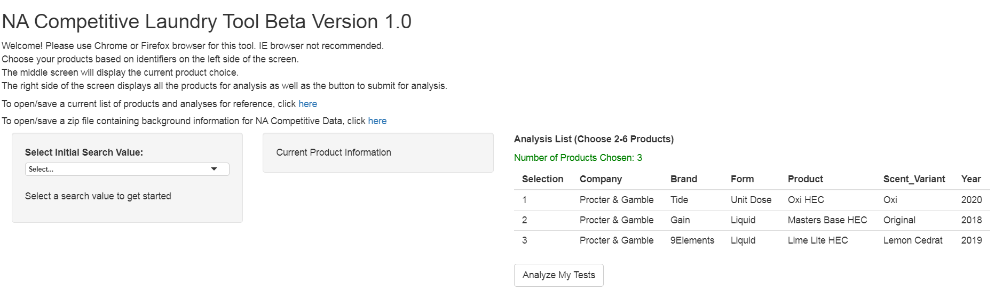
6) Identify and Deploy a Final Solution
Identified the need for an online tool for easy access of the NMA results across benefits
User specifies products in question, and gets all corresponding performance data available across all benefits tested
Results used by the online tool are updated regularly in the background by the statistician
Deployed solution is routinely assessed for upgrades

Slide 19
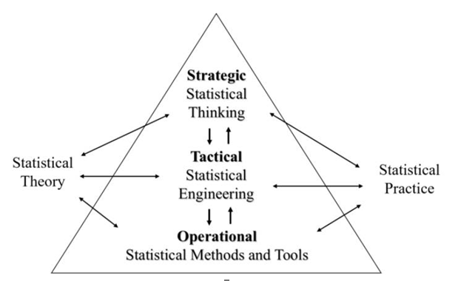
Summary
P&G Competitive Product Laundry Initiative
is complex covering multiple benefits, studies,
and products
Final solution is the ability to make informed data-driven business decisions about how to make superior products and/or allow for cost savings without sacrificing product performance
Presentation illustrated the importance of utilizing all Statistical Engineering elements when faced with a large, unstructured, complex problem
Initiative creates significant business value (e.g., helps P&G make right innovation investment choices) for the company which makes it a successful Statistical Engineering case study
Hoerl, R.W. and Snee, R.D. (2017)

