Slide 1
DOE and Test Automation for System of Systems T&E
Larry Harris, Navy SPAWAR PMW-120 APM–T&E
Luis Cortes, MITRE Corporation
Jim Wisnowski, Adsurgo
Darryl Ahner, OSD STAT COE
Jim Simpson, JK Analytics

Slide 2
Bottom Line Up-Front (BLUF)
Many Programs of Record (PoRs) are improving their individual performance through innovative applications of emerging thrust areas and methodologies – AGILE Testing, Test Automation, Design of Experiments (DOE), and Cyber Security Testing
Even though the performance of the majority of these PoRs depends on other PoRs, they are not evaluated as a System of Systems (SoS) earlier in the acquisition cycle

Slide 3
Motivation
Refocus Developmental Test on mission end-to-end performance to improve the likelihood of success in Operational Test
Optimize test designs and increase software test coverage to obtain the right information at the right price
Deliver an integrated and interoperable capability to the Fleet
Leverage the application of emerging thrust areas for Systems Engineering and Test & Evaluation
Demonstrate System-of-Systems (SoS) T&E concept that integrates thrust areas under a single, comprehensive application

Slide 4
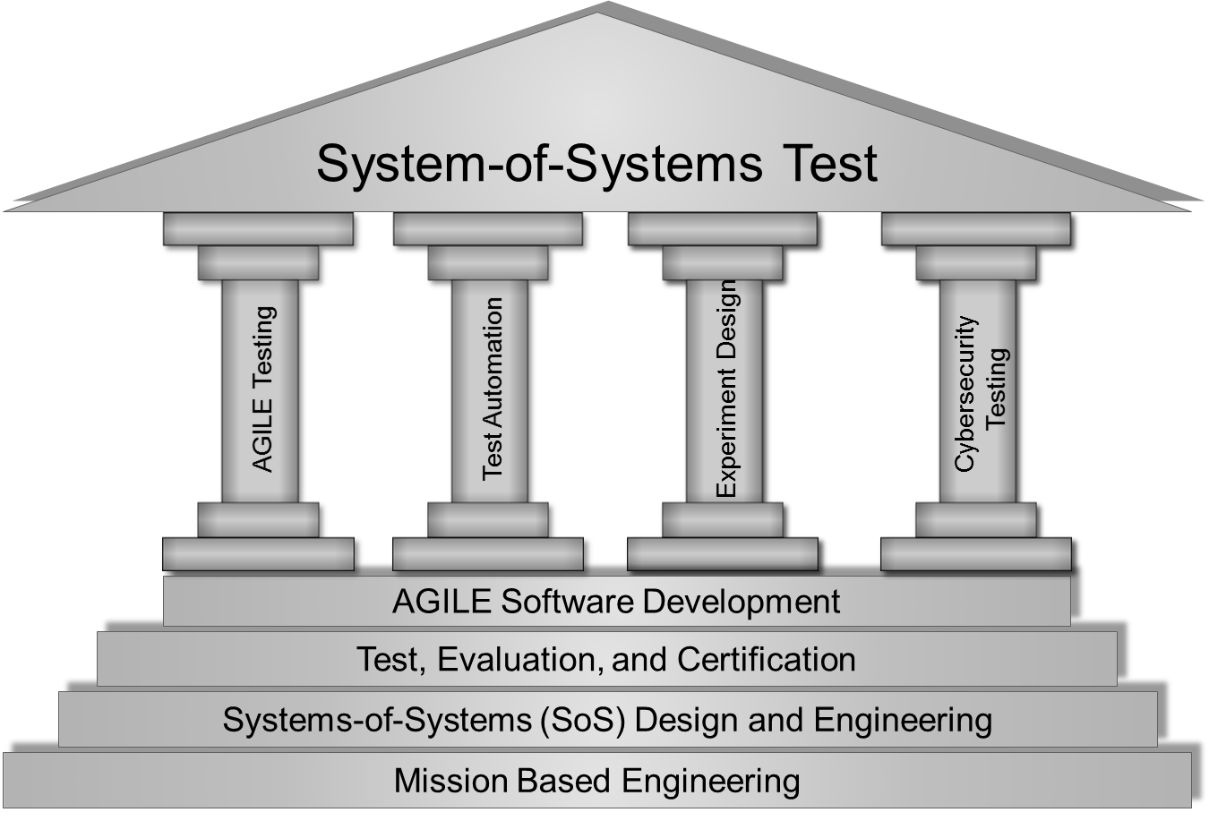
Introduction - Vision
An efficient, disciplined, and informative process that takes advantage of advanced techniques and methods to provide quantifiable results for the verification and validation of technical requirements and operational capabilities

Slide 5
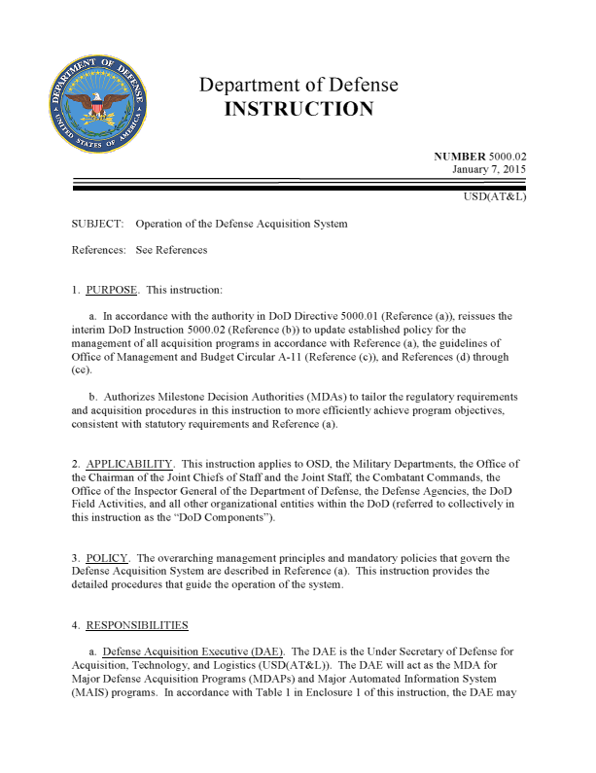
Introduction
Thrust Areas Policy & Guidance
In addition to the TEMP Guidebook, recent directives require Program Managers to take advantage of innovative, disciplined, effective, and efficient test methodologies to characterize system behavior across an appropriately selected set of factors and conditions
Design of Experiments – DoDI 5000.02 (2015)
Cyber Security Testing – CyberSecurity Guidebook (2015)
Modeling and Simulation in T&E – DOT&E Memo
DoD Instruction 5000.02 – Operation of the Defense Acquisition System; Under Secretary of Defense (Acquisition, Technology, & Logistics); 7 January 2015

Slide 6
SoS Test Concept
Value and Benefits
Provides potential reduction in unit and systems level testing (could be as much as 2/3 test times!)
Provides a scenario based test tool that verifies and validates KPPs, KSAs, other PoR requirements
Provides more effective and efficient method for certification of systems prior to field deployment
Reduces variance, cost , and maintenance of systems in the field
Provides a Lab test environment for future DTs, OA, and OTs
Lays foundation for future Cyber Security testing, with automation and SoS-level focus
Serves as baselining event for providing metrics on value of Cyber Built-in ‘vs’ Bolted-on.
Provides metrics or comparing AGILE ‘vs’ Non-AGILE development and the factors that affect the comparison

Slide 7
SoS Overall Notional Architecture
Primary
System
Connected
Sys 1
Hosted Sys 1
Hosted Sys 2
Hosted Sys 3
Connected
Sys 2
Connected
Sys 3
Infrastructure

Slide 8
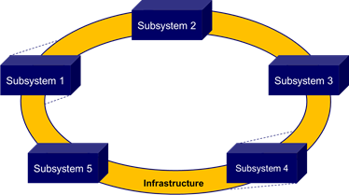

SoS Notional Architecture
Example 1 - Units With Identical Systems
Unit 1
Unit 2
Information
Exchange
Information
Exchange
Information
Exchange
Unit 3

Slide 9
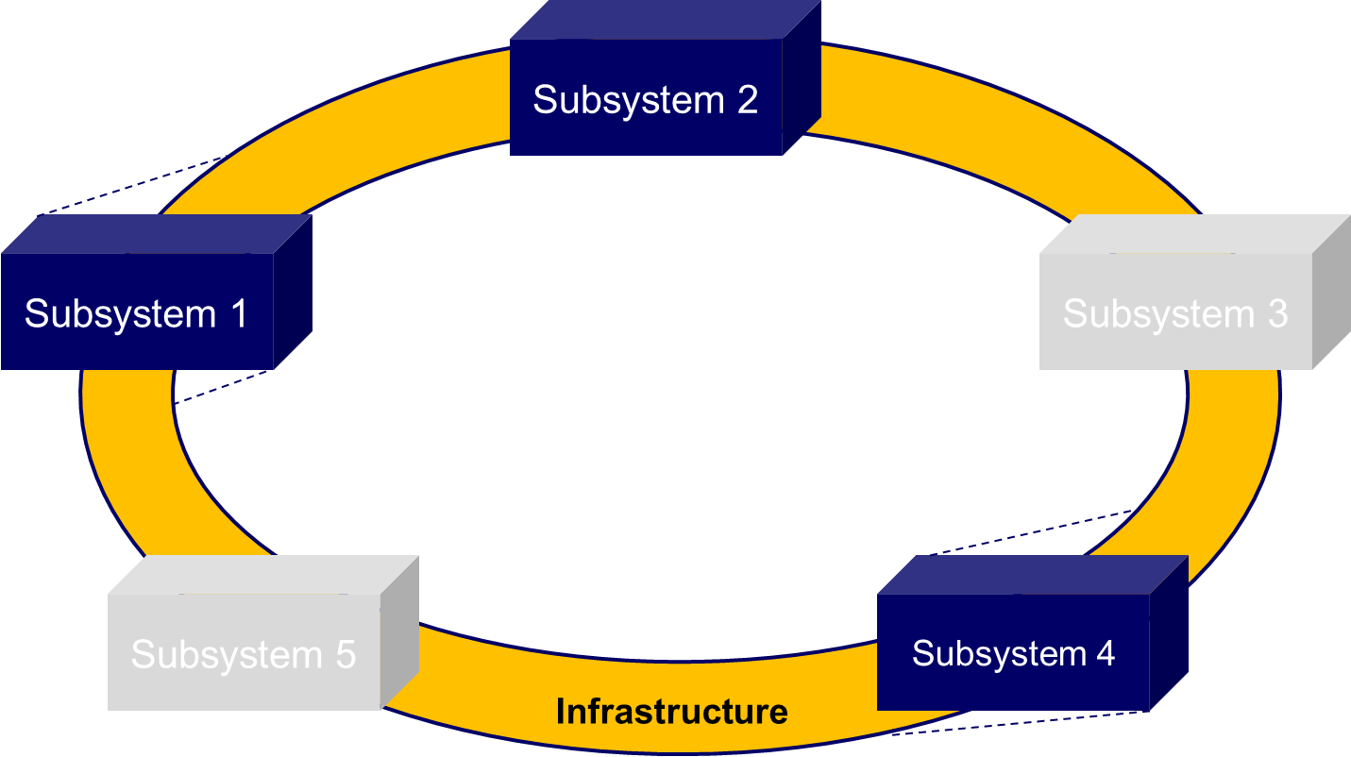
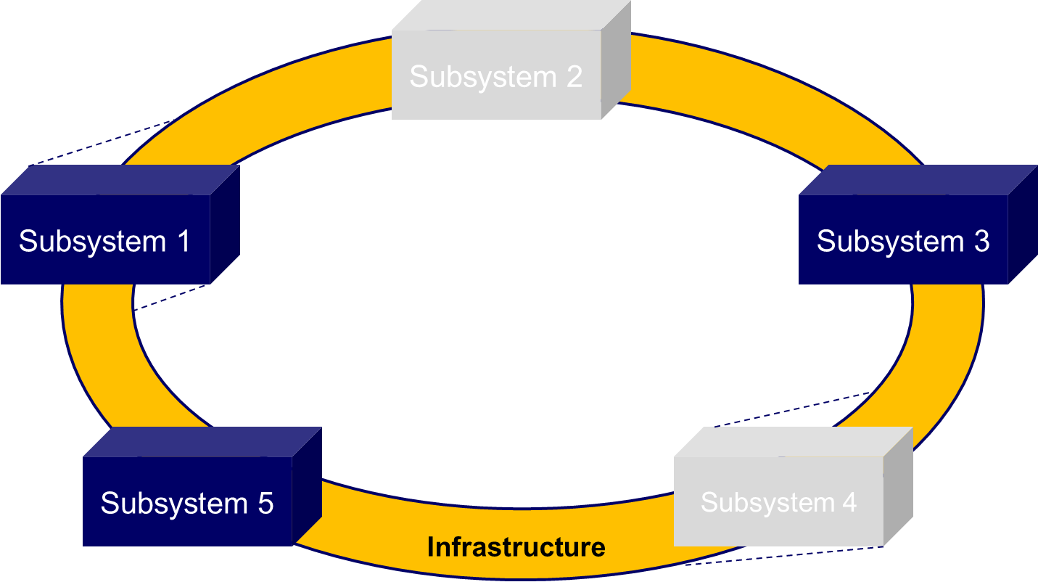
SoS Notional Architecture
Example 2 - Units With Different Systems
Unit 1
Unit 2
Information
Exchange
Information
Exchange
Information
Exchange
Unit 3

Slide 10
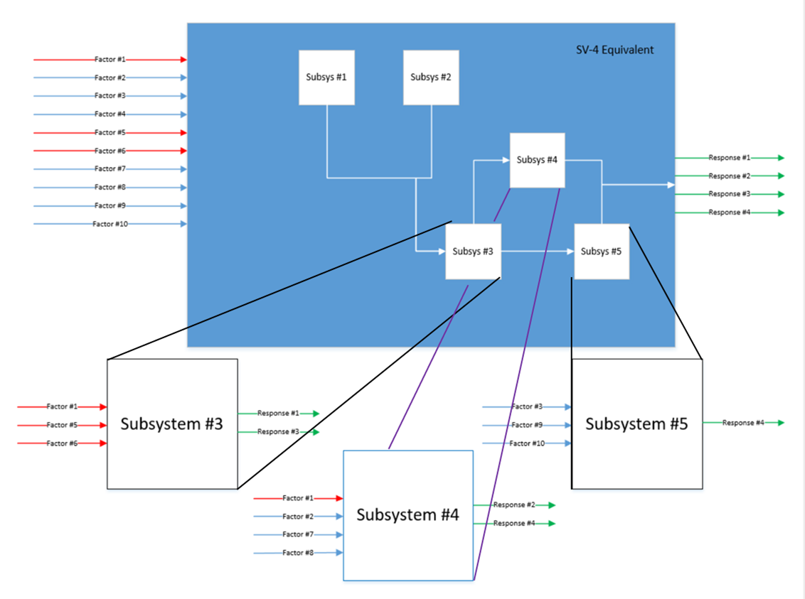
SoS Experiment Design
Notional Input-Process-Output Diagram

Slide 11
DOE Table
COMMs PoR Example
Response Variable |  | Test Phase
 |  | OT-B1/IT-C1 | IT-C2/ IT-D1/ IT-D2 | OT-C1/ OT-D1/ OT-D2
 |  | - Chat Latency - Data LAN Transfer Timeliness - Common Operating Picture (COP) Timeliness - Imagery Display Timeliness | - Chat Latency - Data LAN Transfer Timeliness - COP Timeliness - Imagery Display Timeliness | - Chat Latency - Data LAN Transfer Timeliness - COP Timeliness - Imagery Display Timeliness
Factors | Levels
Network Loading | - high >74 percent user CCE devices in use - low <51 percent user CCE devices in use | Systematically Vary | Systematically Vary | Systematically Vary
Enclave | UNCLAS, SECRET, SR, and SCI | Systematically Vary | Systematically Vary | Systematically Vary
Transmission Type | Super Hi Frequency (SHF) satellite communications - Hi Frequency | Systematically Vary | Systematically Vary | Systematically Vary
File Size | Large ≥5 MB medium 1 to 5 MB small <1 MB | Systematically Vary | Systematically Vary | Systematically Vary
Transport Method | upload download | Systematically Vary | Systematically Vary | Systematically Vary
Platform Type | Unit Level Force Level Subsurface MOC Aviation | Record | Record | Record
Air Temperature | As occurs | Record | Record | Record
Relative Humidity | As occurs | Record | Record | Record

Slide 12

What is Automated Software Test (AST)?
“The application of automation technology throughout the software testing lifecycle wit the goal of delivering capability faster and more affordably.” Innovative Defense Technologies
Important aspects of AST
  Applies to software-only or software-intensive systems and offers
  alternative to manual testing
  Requires specialized software to control the input feeds, execution,
  and data collection of the test
  There are various levels of automation complexity
  Automation can be applied in all phases of software development and testing, from unit tests to software integration tests, to functional tests to performance tests
  The software tools consist of open source and commercial products, that work can operate on the front-end (GUI) and the back-end (objects) of the system
  Automation capability has both costs (licensing, expertise, automation scripts) and benefits (faster execution, more testing)
Without automation, testing is limited to what we can do with limited manual testers
“automaton”

Slide 13
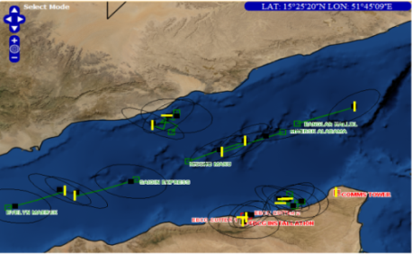
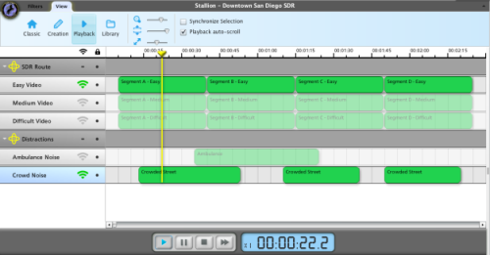



Test Automation
Simulation and Stimulation
SUT
Tool Adapters
Workstation
(Automation Suite)
Tester
Automation Tools
Stallion
jBehave
Sikuli
Selenium
TestNG
JMeter
Perform VV&A assessment of simulator to ensure realistic and scalable generation of input data that would be experienced in operational environment
Determine key factors (e.g. volume of message traffic) that would span the space of operational conditions and implement combinations

Slide 14
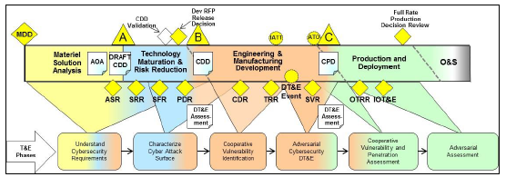
Cybersecurity T&E in SoS Environment
Cybersecurity testing is required in most software-intensive systems at both the DT and OT milestones
Cybersecurity vulnerability assessments and penetration testing can only be effectively performed in a SoS environment
Cybersecurity testing benefits from a rigorous planning, design, and analysis process

Slide 15

Software SoS Cybersecurity Test
Factors and Metrics
INPUTS
(Factors)
OUTPUTS
(Responses)
PROCESS:
Adversary Activity Type
Adversary Level of Effort
Time to Detect Intrusion/Exploitation
Defensive Activity
Time to Mitigate Intrusion/Exploitation
Adversary Skill Level
Vulnerability Severity Category Code
Adversary Access
Sysop Login Steps
Time to Restore Mission Capabilities
Number of Users
Reduction in Mission Effectiveness

Slide 16
Summary and Conclusion
Focus is on leveraging T&E state-of-the art practices and inject them software-intensive programs by integrating some key thrust areas in a single SoS application
DoD services and organizations are making progress in integration testing of linked systems in SoS testing under realistic conditions

