Slide 1
Bayesian Performance Evaluation of Covariate
Software Reliability Growth Models
Maskura Nafreen, PhD, University of Massachusetts Dartmouth
Priscila Silva, MS, University of Massachusetts Dartmouth
Lasitha Dharmasena, PhD, Deakin University
Vidhyashree Nagaraju, PhD, The University of Tulsa
Lance Fiondella, PhD, University of Massachusetts Dartmouth

Slide 2
Introduction
Covariate Software Reliability Growth Models (Covariate SRGM)
  Consider multiple test activities performed to discover defects
Relevant past studies
  Maximum likelihood estimation
  Expectation maximization
  Expectation conditional maximization
Contributions
  Bayesian estimation of covariate SRGM parameters
  Markov Chain Monte Carlo method
  Confidence intervals on the mean value function and failure intensity
Results
  Informative priors converge quickly and achieve the highest maximum likelihood
  Bayesian methods can accurately and efficiently estimate covariate SRGM parameters

Slide 3
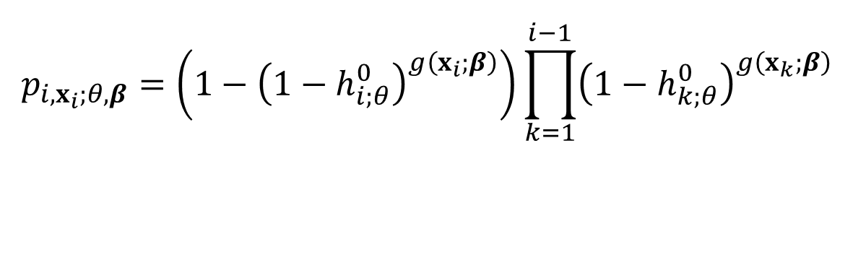
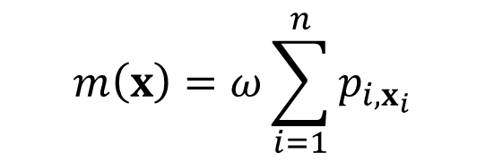
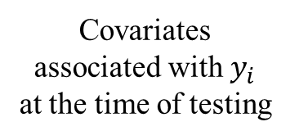
Model Estimation
Covariate Software Reliability Growth Models
Covariates associated with $y_{i}$ at the time of testing
Discrete Cox Proportional Hazard model
$$p_{i,x_{i};θ,β}=\left(1−{\left(1−h_{i;θ}^{0}\right)}^{g\left(x_{i};β\right)}\right)\prod_{k=1}^{i−1}{{\left(1−h_{k;θ}^{0}\right)}^{g\left(x_{k};β\right)}}$$
$$m\left(x\right)=ω\sum_{i=1}^{n}{p_{i,x_{i}}}$$
Vector of Cox model
parameters
Baseline hazard function
Vector of model parameters
Maximum Likelihood Estimation: Maximizes the log-likelihood function
Bayesian Estimation: Combines prior beliefs and log-likelihood distribution to determine posterior distribution

Slide 4
Bayesian Methodology
Informative Priors: beta, gamma, normal distributions
Non-informative Priors: Jeffrey’s rule
Monte Carlo Markov Chain (MCMC) Algorithm: Approximate posterior distribution of a parameter by random sampling in a probabilistic space
Metropolis–Hastings Algorithm: A proposed new state has certain probability of being accepted
Gibbs Sampling: A proposed new state is always accepted
Model Assessment
Bayesian Information Criterion (BIC): penalizes a model proportionally to number of parameters multiplied by logarithm of sample size
Sum of Square Erros (SSE): sum of squares difference between observations and model predictions
Akaike Information Criterion (AIC): quantifies tradeoff between model precision and complexity

Slide 5
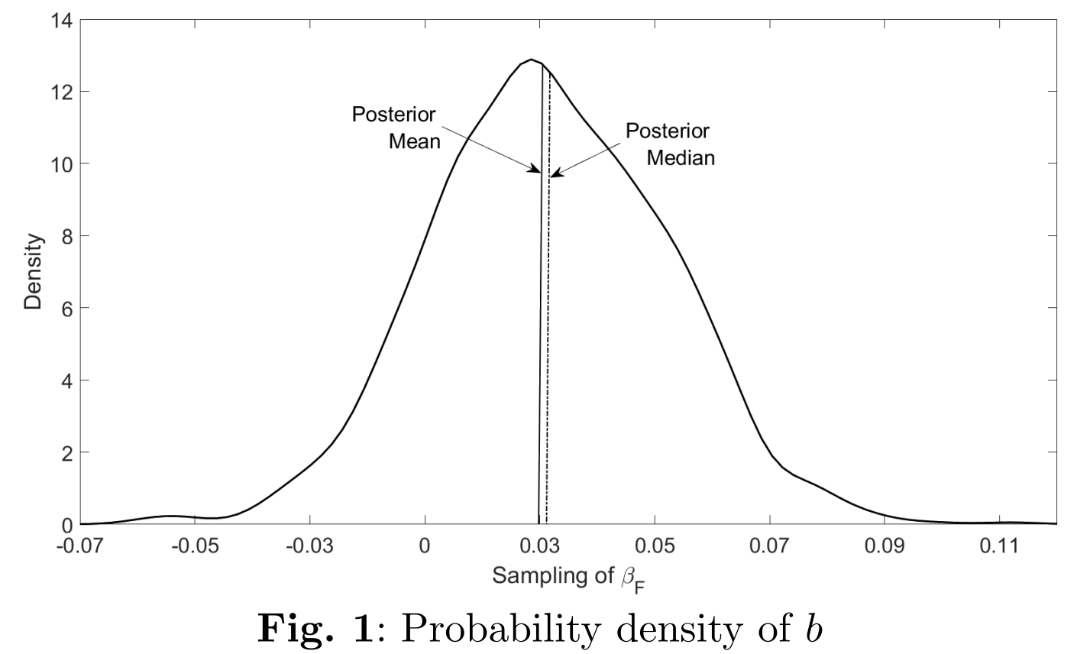
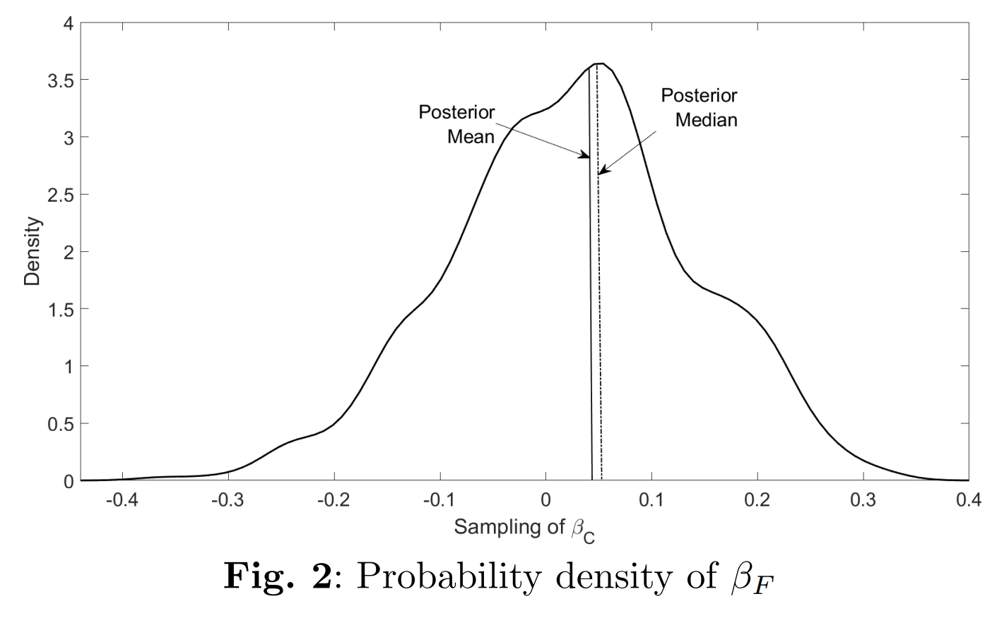
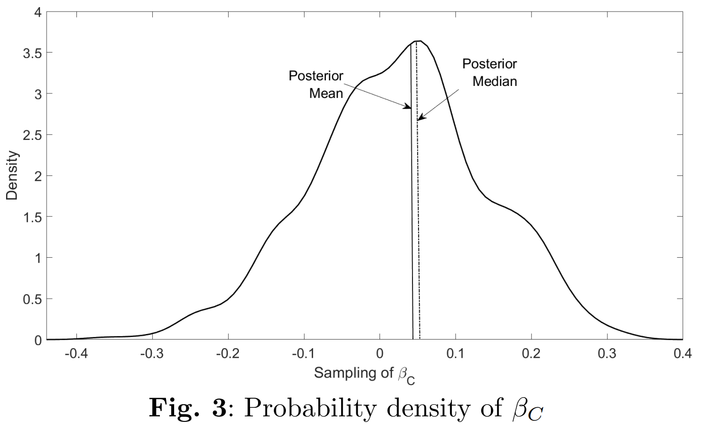
Illustrations: Posterior density of parameters
Prior distributions of parameters can be generated to estimate posterior distribution, mean and median, even if analytical computation of the posterior distribution is not possible.

Slide 6
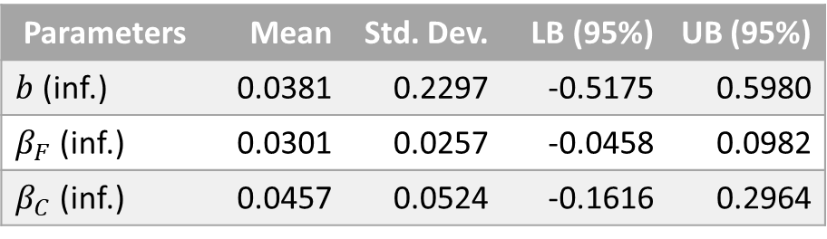
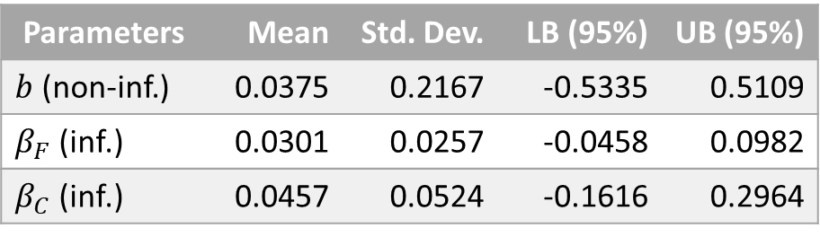
Illustrations: Mixture of informative and non-informative priors, and informative priors
Table 1: Posterior inference of model parameters for defect detection characterized by GM hazard function applied to F and C covariates using mixture of informative and non-informative priors
Table 2: Posterior inference of model parameters for defect detection characterized by GM hazard function applied to F and C covariates using informative priors
Parameters | Mean | Std. Dev. | LB (95%) | UB (95%)
$b$ (non-inf.) | 0.0375 | 0.2167 | -0.5335 | 0.5109
$β_{F}$ (inf.) | 0.0301 | 0.0257 | -0.0458 | 0.0982
$β_{C}$ (inf.) | 0.0457 | 0.0524 | -0.1616 | 0.2964
Parameters | Mean | Std. Dev. | LB (95%) | UB (95%)
$b$ (inf.) | 0.0381 | 0.2297 | -0.5175 | 0.5980
$β_{F}$ (inf.) | 0.0301 | 0.0257 | -0.0458 | 0.0982
$β_{C}$ (inf.) | 0.0457 | 0.0524 | -0.1616 | 0.2964
The mixture of informative and non-informative priors required more time than informative priors for convergence to improve log-likelihood values, mean and median posterior estimates.

Slide 7
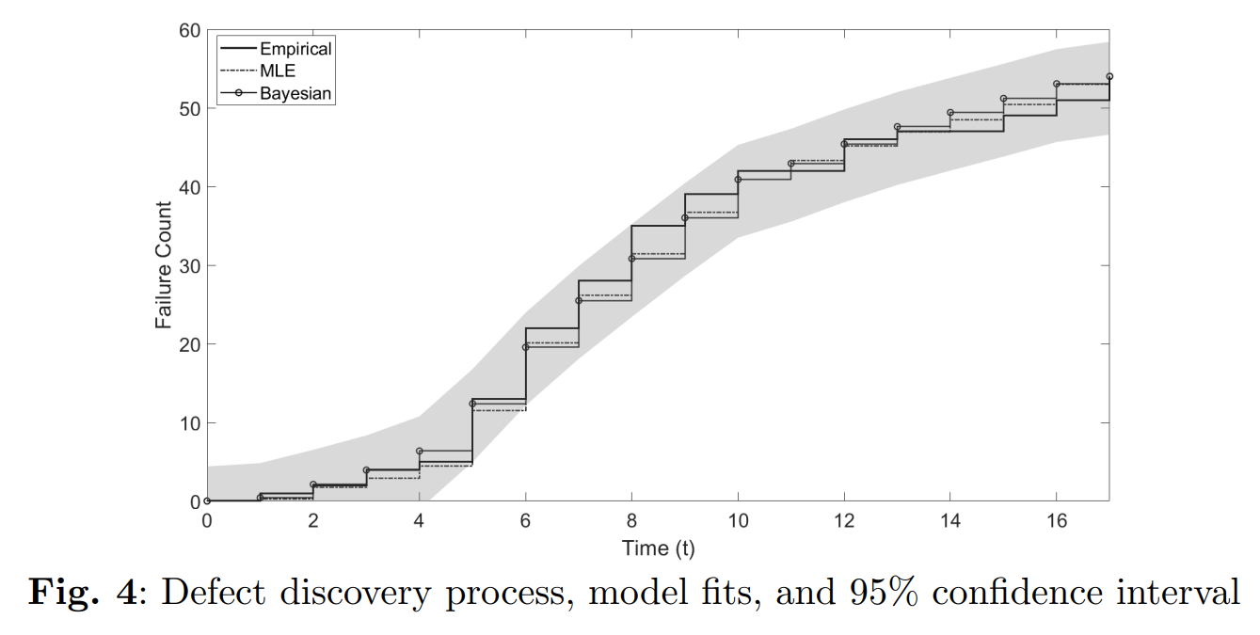
Illustrations: Model fit and confidence intervals
All observed data points are within the 95% confidence interval of the Bayesian model fit, suggesting a conservative empirical coverage

Slide 8
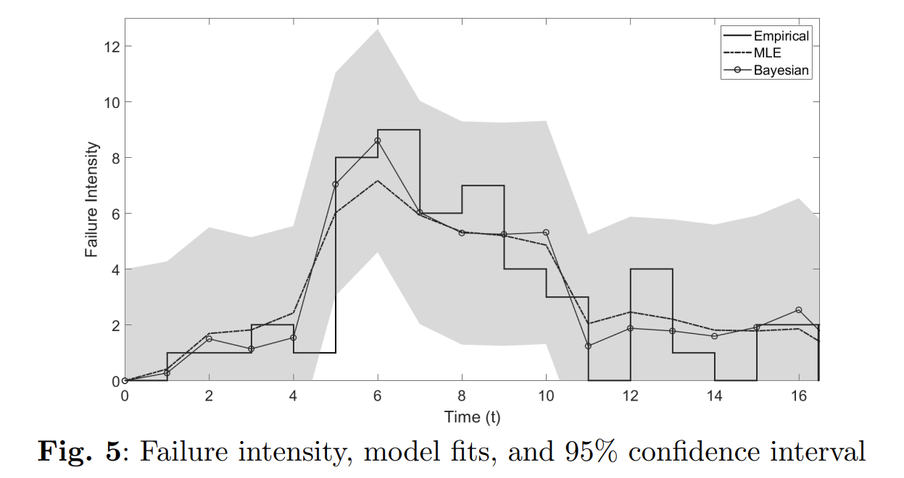
Illustrations: Failure intensity
All but one of the 17 observed data points are within the 95% confidence interval of the Bayesian model fit, suggesting an optimistic empirical coverage

Slide 9
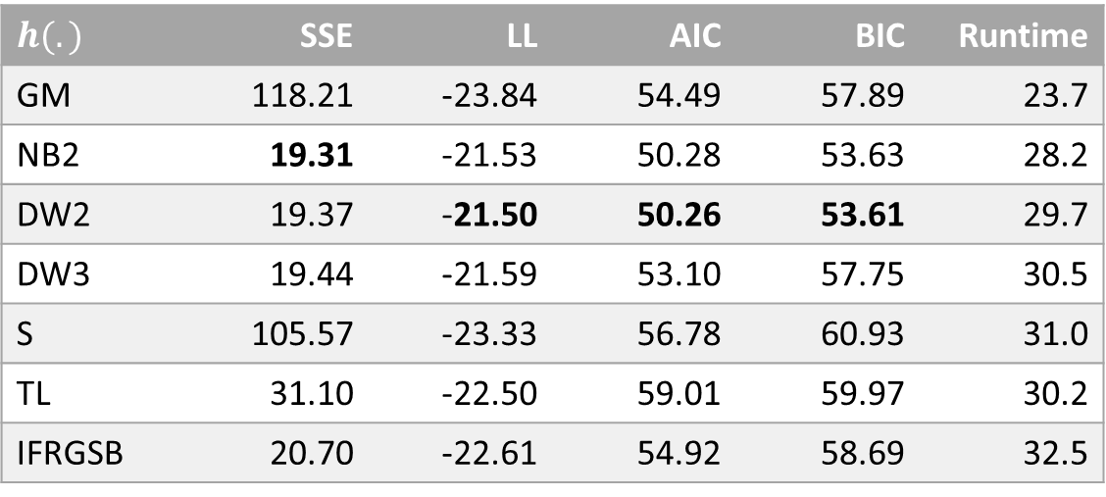
Illustrations: Goodness of fit to alternative hazard functions
Table 3: Goodness of fit of covariate model with different hazard functions applied to F and C covariates using Bayesian approach with informative priors
$$h(.)$$ | SSE | LL | AIC | BIC | Runtime
GM | 118.21 | -23.84 | 54.49 | 57.89 | 23.7
NB2 | 19.31 | -21.53 | 50.28 | 53.63 | 28.2
DW2 | 19.37 | -21.50 | 50.26 | 53.61 | 29.7
DW3 | 19.44 | -21.59 | 53.10 | 57.75 | 30.5
S | 105.57 | -23.33 | 56.78 | 60.93 | 31.0
TL | 31.10 | -22.50 | 59.01 | 59.97 | 30.2
IFRGSB | 20.70 | -22.61 | 54.92 | 58.69 | 32.5
GM hazard function was fastest, but DW2 achieved better goodness of fit measures

Slide 10
Conclusion
Summary
  This paper presented a Bayesian approach to estimate the parameters of Covariate SRGM
  Markov Chain Monte Carlo methods compared with the method of maximum likelihood
  Different scenarios: mixture of information, non-informative priors, and informative priors
Results
  Bayesian methods can accurately and efficiently estimate the parameters of Covariate SRGM
    Informative priors converged most quickly and achieved the highest maximum likelihood
Future Research
  Analytical proof of convergence of Markov chain in MCMC to obtain convergence for complex cases
  Optimize methods to higher dimensional covariate data
    For incorporation into the Covariate Software Failure and Reliability Assessment Tool (C-SFRAT)

Slide 11

Acknowledgement
This material is based upon work supported by the National Science Foundation under Grant Number (#1749635). Any opinions, findings, and conclusions or recommendations expressed in this material are those of the authors and do not necessarily reflect the views of the National Science Foundation

