Slide 1
Next Gen Breaching Technology: A Study in Deterministic Binary Response Emulation
Eli S. Golden, GStat
UNCLASSIFIED
DISTRIBUTION STATEMENT A. Approved for public release: distribution unlimited.
Statistician
Systems Analysis Division
27 APR 2022

Slide 2
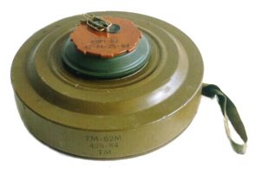
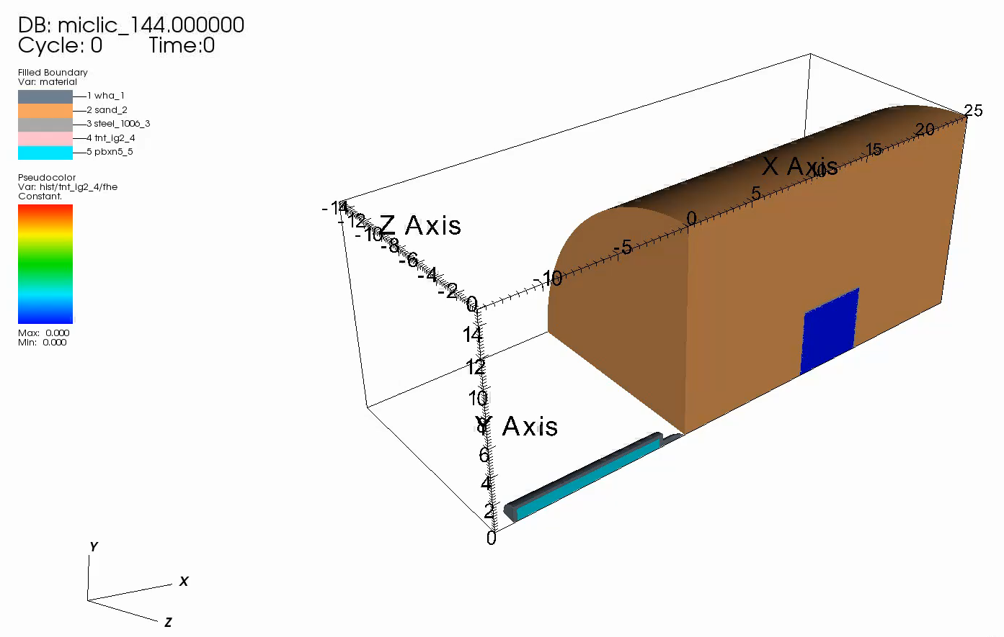

Intro
Armament Center’s Next Gen Breaching Technology program developing a new system to more effectively cover minefields and neutralize subsurface threats
Fuzed, dart-shaped penetrators, which fire into the ground and deliver an energetic payload
Engagements simulated using deterministic Finite Element Analysis
Uncertainty Quantification methodology used to construct a surrogate model (aka metamodel aka emulator), a closed-form approximation of the FEA, maximizing effectiveness while reducing overall computational burden
This approach facilitated exploration of penetrator design space and enabled team to identify the most promising candidates for maturation
Crux of the study was deriving a binomial probability function trained with data generated by deterministic computer simulation
UNCLASSIFIED
DISTRIBUTION STATEMENT A. Approved for public release: distribution unlimited.

Slide 3
Objective and Scope
Objective: Select designs that…
  Maximize probability of defeat
  Are insensitive to engagement distance (driven predominantly by penetrator velocity/time of fuze initiation)
  Also of interest: easy to manufacture, minimize profile, minimize weight, maximize performance at slower speeds
Scope:
  Feature Set: six dimensions, initial velocity, fuze initiation time
  Response: Binary Go/No Go performance
  Additional constraints imposed to further control aspects of profile and internal volume
  Sample size: 150 observations in initial design, 261 fully augmented
UNCLASSIFIED
DISTRIBUTION STATEMENT A. Approved for public release: distribution unlimited.
Notes:
Other qualities of interest…

Slide 4
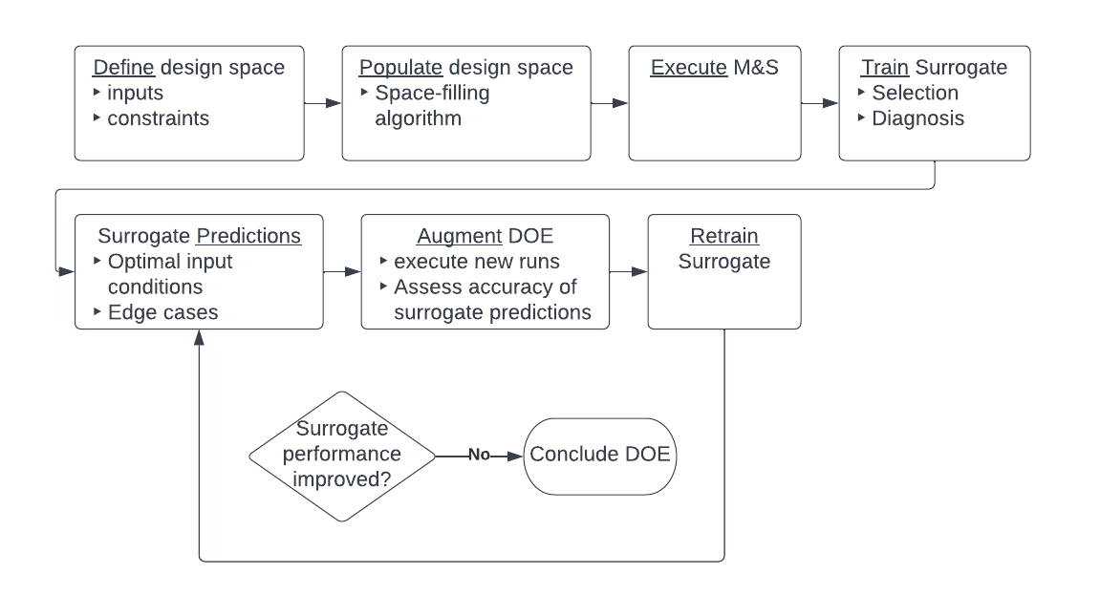
Approach
UNCLASSIFIED
DISTRIBUTION STATEMENT A. Approved for public release: distribution unlimited.

Slide 5
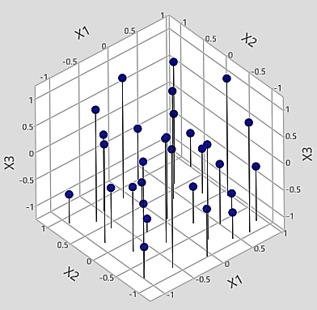
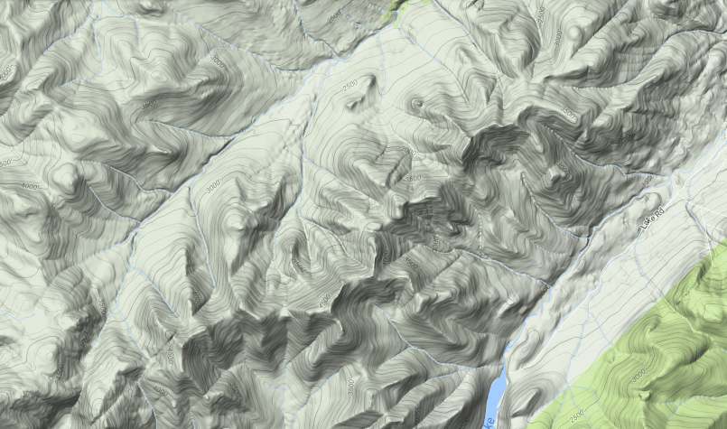
Test design
Relationships between inputs and outputs of computer simulation typically complex (“black box”)
Functions used to approximate provide perfect or near-perfect fit to the data
  highly flexible, highly nonlinear
  continuously differentiable (can be optimized)
Space-filling design paradigm favors coverage over leverage and replication, ideal for probing black box environments
UNCLASSIFIED
DISTRIBUTION STATEMENT A. Approved for public release: distribution unlimited.

Slide 6
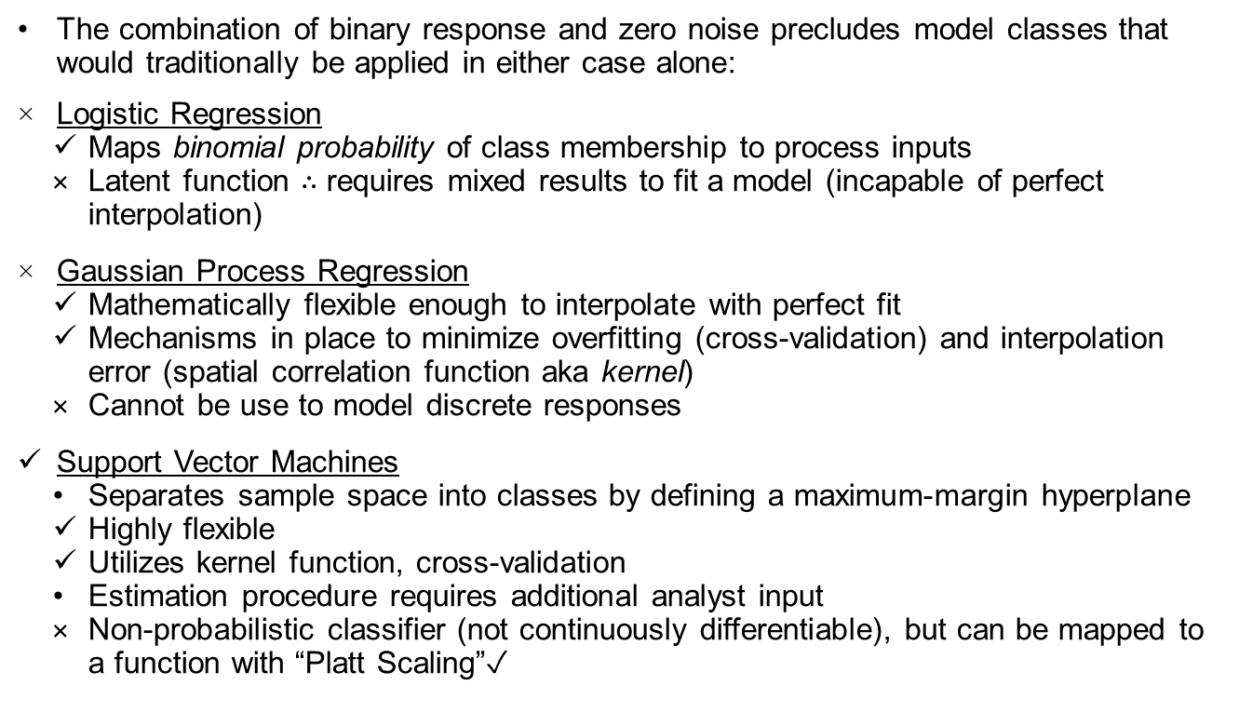
Modeling tool selection
The combination of binary response and zero noise precludes model classes that would traditionally be applied in either case alone:
Logistic Regression
  Maps binomial probability of class membership to process inputs
  Latent function $∴$ requires mixed results to fit a model (incapable of perfect interpolation)
Gaussian Process Regression
  Mathematically flexible enough to interpolate with perfect fit
  Mechanisms in place to minimize overfitting (cross-validation) and interpolation error (spatial correlation function aka kernel)
  Cannot be use to model discrete responses
Support Vector Machines
  Separates sample space into classes by defining a maximum-margin hyperplane
  Highly flexible
  Utilizes kernel function, cross-validation
  Estimation procedure requires additional analyst input
  Non-probabilistic classifier (not continuously differentiable), but can be mapped to a function with “Platt Scaling”✓
UNCLASSIFIED
DISTRIBUTION STATEMENT A. Approved for public release: distribution unlimited.

Slide 7
Support Vector Machines details
A support vector is an observation that lies on the margin
Cost and Gamma are hyperparameters (dictate the behavior of the learning)
  specified by analyst prior to executing fit routine
  have a direct impact on Misclassification Rate, Number of Support Vectors (implies curvature/complexity of the hyperplane), and Probability Threshold (values other than 0.50 imply model bias)
UNCLASSIFIED
DISTRIBUTION STATEMENT A. Approved for public release: distribution unlimited.
Notes:
“Implied by”

Slide 8
Hyperparameter Optimization
Objective: Find hyperparameter values that result in the simplest unbiased model that achieves a perfect fit
Approach: Meta-experiment featuring a hybrid application of grid search and Bayesian methodologies:
Generate initial list of model i/o via grid search
UNCLASSIFIED
DISTRIBUTION STATEMENT A. Approved for public release: distribution unlimited.

Slide 9
Hyperparameter Optimization (cont.)
Conduct coarse optimization by fitting second-order models and computing desirability functions
Test optimized values by fitting new model
UNCLASSIFIED
DISTRIBUTION STATEMENT A. Approved for public release: distribution unlimited.

Slide 10
Feature Optimization
A viable emulator facilitated exploration of different design goals which could be expressed mathematically as simple functions of penetrator geometry.
Optimizations were carried out for each vignette, aiming simultaneously for maximum probability of defeat (objective #1) and target values for each defining feature (objective #3).
UNCLASSIFIED
DISTRIBUTION STATEMENT A. Approved for public release: distribution unlimited.

Slide 11
Assessing Robustness To INITIATION DEPTH
Surface plots of predicted P(Go) vs velocity and ignition time generated for each candidate penetrator helped the team identify plateaus of optimal performance
UNCLASSIFIED
DISTRIBUTION STATEMENT A. Approved for public release: distribution unlimited.

Slide 12
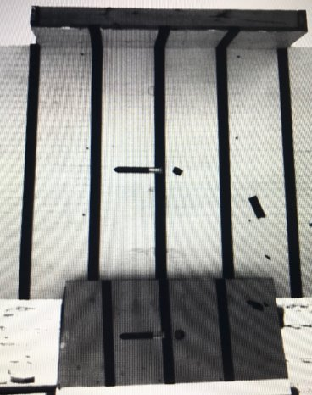
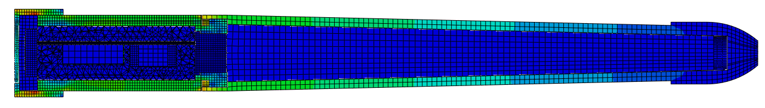
Project Impact
Multiple viable designs were selected for follow-on development and experimentation, including the following activities: High-fidelity model confirmation, off-axis performance, protoyping, static live-fire, and flight dynamics.
This study has led directly to the continued success of the NGBT program.
UNCLASSIFIED
DISTRIBUTION STATEMENT A. Approved for public release: distribution unlimited.

Slide 13
Acknowledgements & References
Acknowledgements:
  Peter Strong
  David Pfau
  Daniel Suarez
  Andrew Nguyen
  David Kafrouni
  the rest of the CCDC AC NGBT team
References:
  Pfau, D, Golden, E., Suarez, D., Nguyen, A., Kafrouni, D. (2021) “Developing Mine-Neutralizing Penetrators for Next-Generation Breaching”, Defense Technical Information Center, Accession Number: AD1145294
  Joseph, V.R., Gul, E., and Ba, S. (2015), “Maximum Projection Designs for Computer Experiments,” Biometrika, 102:2, 371-380.
  Platt, John (1999). "Probabilistic outputs for support vector machines and comparisons to regularized likelihood methods". Advances in Large Margin Classifiers. 10 (3): 61–74.
UNCLASSIFIED
DISTRIBUTION STATEMENT A. Approved for public release: distribution unlimited.

