Slide 1
Convolutional Neural Networks with Semantic Segmentation for Cloud Detection
CDT Prarabdha Yonzon
Advisors:
Dr. Greg Furlich, LTC Blake Schwartz, LTC James Starling

Slide 2
Agenda
Problem Statement
Background on Neural Networks
Previous Findings
Data Processing
New Results
Way Forward

Slide 3
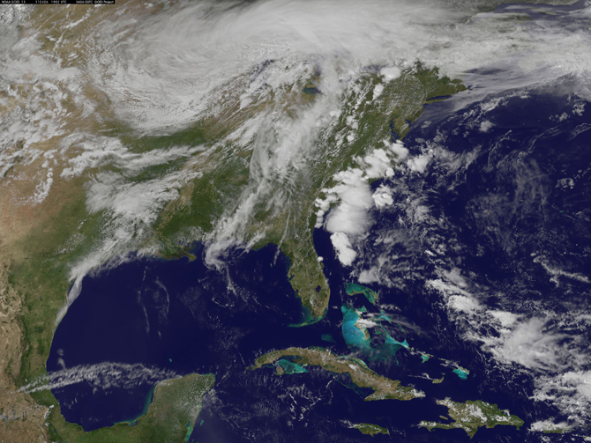
Problem Statement
Create a Convolutional Neural Network proficient at detecting clouds in an image.
Notes:
Explain why segmenting low SN data is good

Slide 4
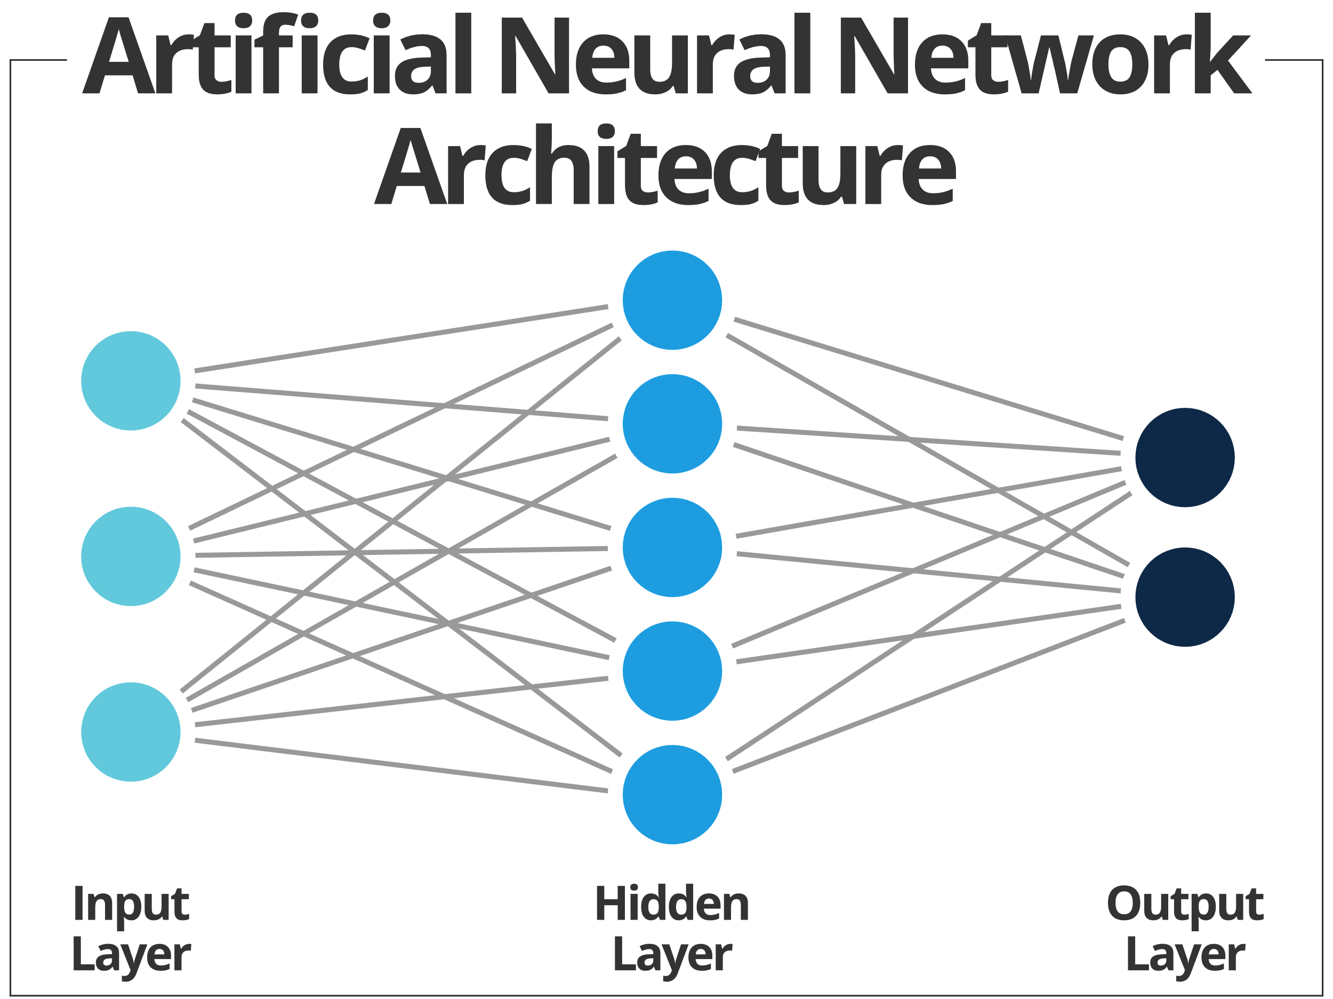
Artificial Neural Networks
Notes:
Explain that segmentation is an intermediate step

Slide 5
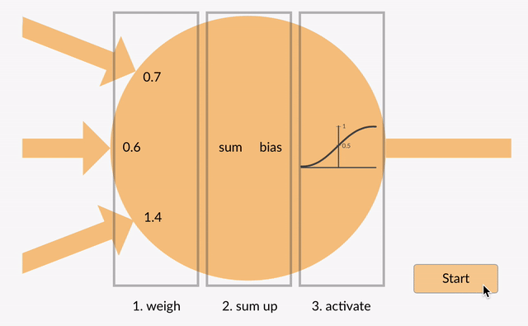
Artificial Neural Networks
Notes:
Explain that segmentation is an intermediate step

Slide 6
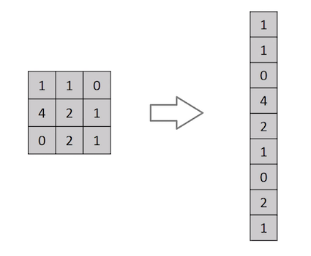
Artificial Neural Networks

Slide 7
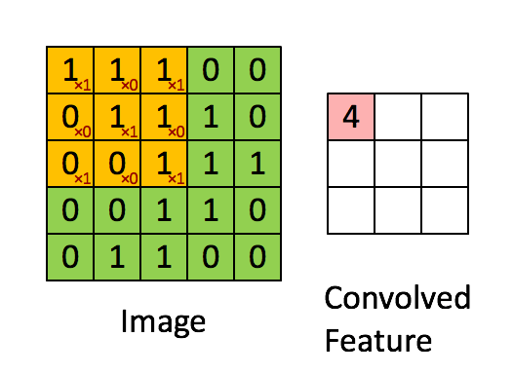
Convolutional Neural Networks (CNNs)
Notes:
0.9315 IoU

Slide 8
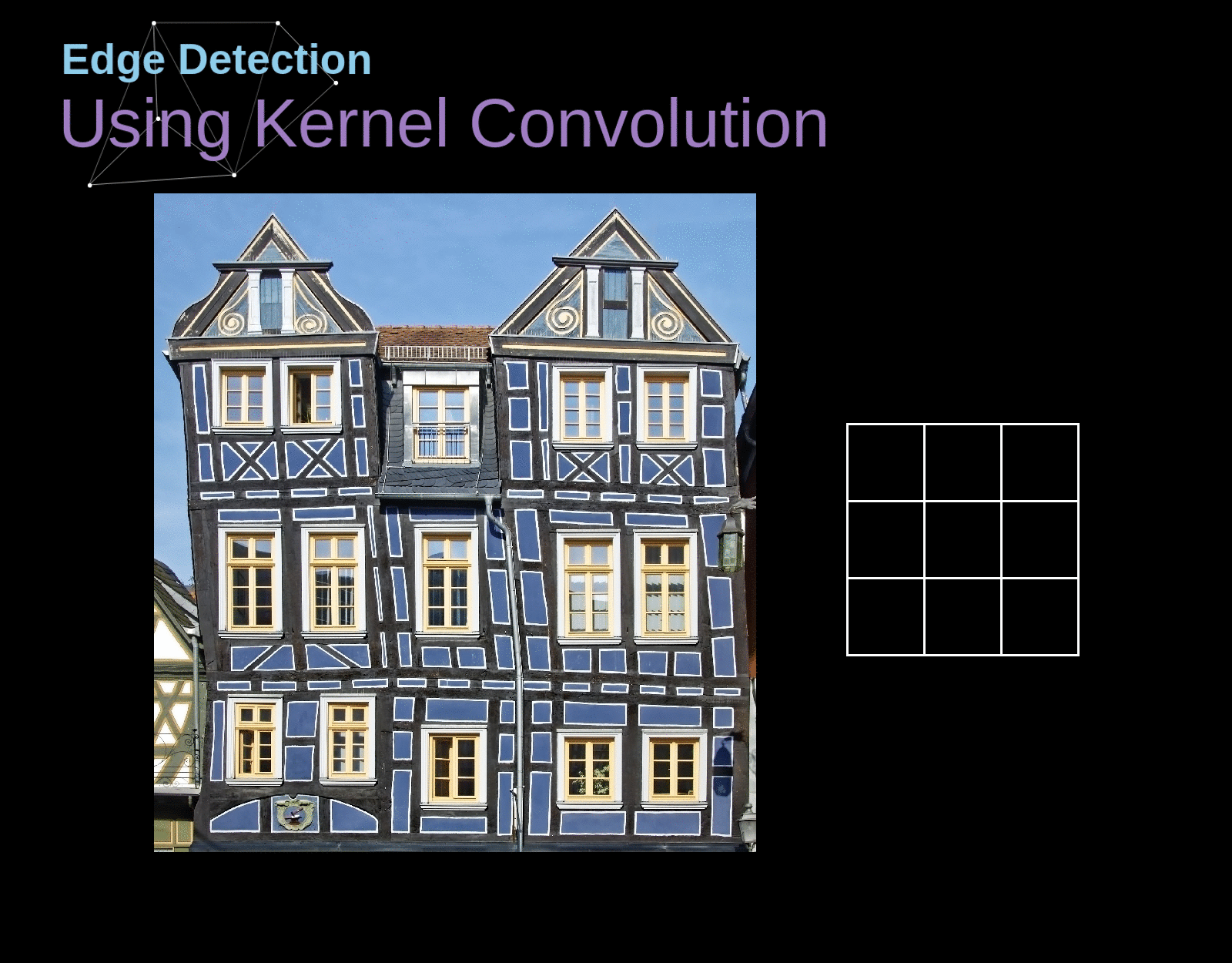
Feature Extraction
Notes:
0.9315 IoU

Slide 9
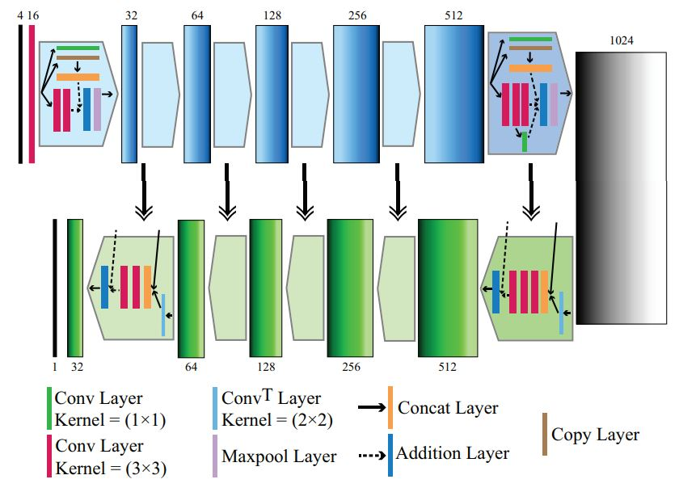
Cloud-Net

Slide 10


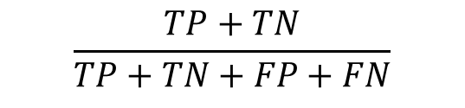


Metrics
Jaccard Coefficient*
$$\frac{TP}{TP+FN+FP}$$
Precision
$$\frac{TP}{TP+FP}$$
Recall
$$\frac{TP}{TP+FN}$$
Specificity
$$\frac{TN}{TN+FP}$$
Accuracy
$$\frac{TP+TN}{TP+TN+FP+FN}$$

Slide 11
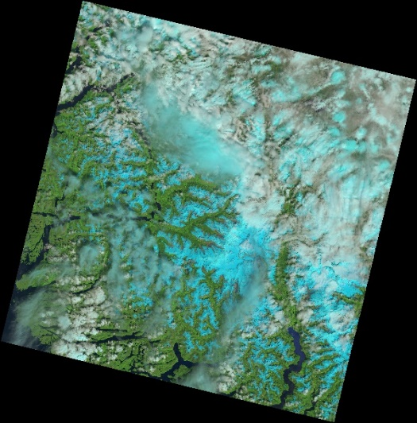
Landsat 8 Results
Natural
Ground Truth
Prediction
Jaccard Coefficient | Precision | Recall | Specificity | Accuracy
91.892 | 98.179 | 93.485 | 91.892 | 96.605

Slide 12
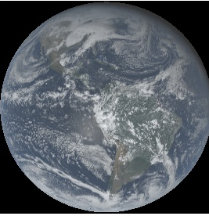
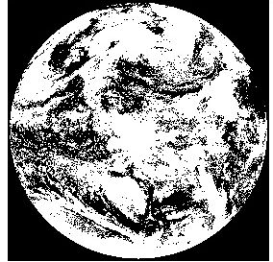
GOES-16 Information
Full disk images are 10848 by 10848 pixels.
568 384 by 384 non-overlapping patches.
Training data is from 01/01/2021 at 18 hours UTC.
Testing data is from 01/11/2021 at 18 hours UTC.
Examining Red, Blue, and Near-infrared Bands.
GOES-16 False Color Full Disk Image
GOES-16 Binary Cloud Mask (BCM)

Slide 13
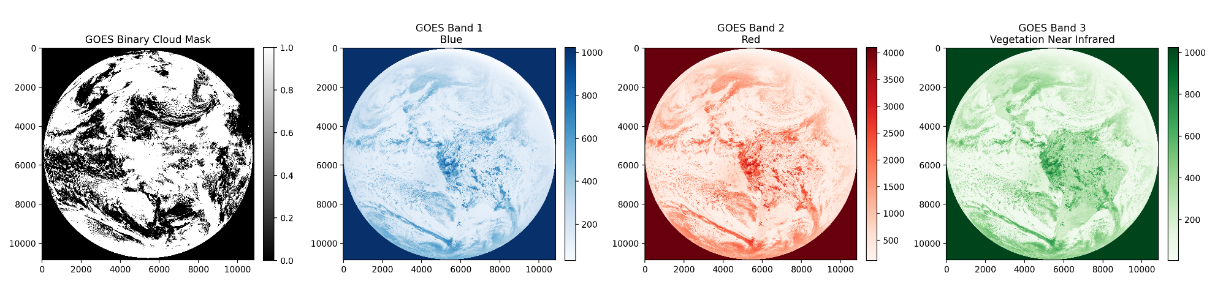
GOES-16 Preparing Data
GOES-16 Full Disk in Three Bands and BCM

Slide 14
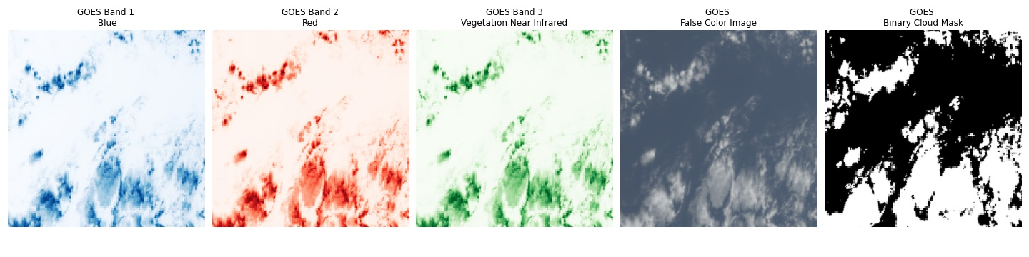
GOES-16 Data Preparation
GOES-16 Random 384 by 384 pixel Batch

Slide 15
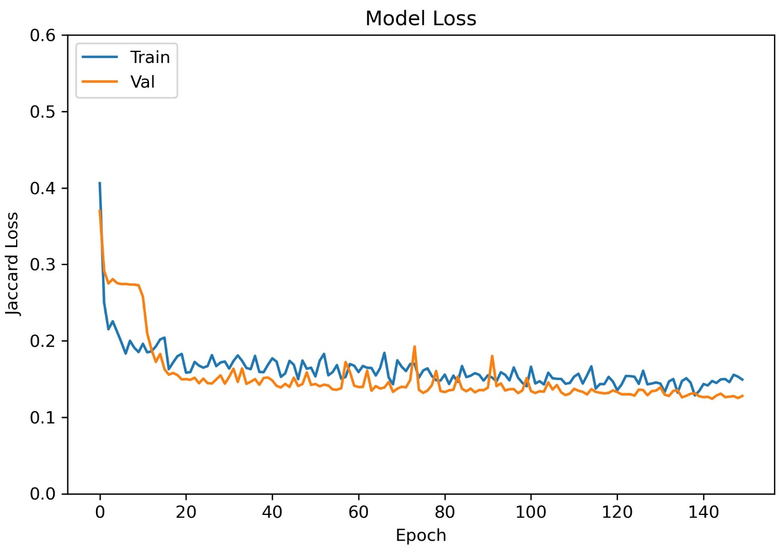
GOES-16 Results
Training Jaccard Loss After 150 Epochs

Slide 16
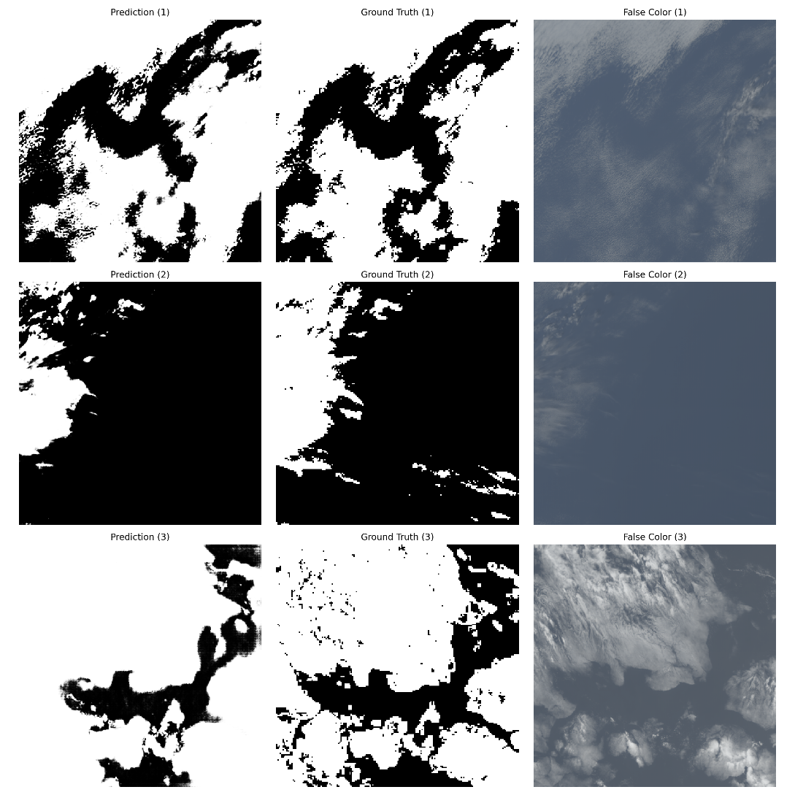
GOES-16 Results
Cloud-Net Predictions on GOES-16 Test Set

Slide 17

GOES-16 Results
Image ID | Jaccard Coefficient | Precision | Recall | Specificity | Accuracy
1 | 86.742 | 93.089 | 92.713 | 87.313 | 90.814
2 | 53.846 | 1 | 53.846 | 1 | 90.576
3 | 85.209 | 93.089 | 92.713 | 87.131 | 90.814
Cloud-Net Predictions and Metrics on GOES-16 Test Set

Slide 18
GOES-16 Results
Jaccard Coefficient | Precision | Recall | Specificity | Accuracy
83.291 | 91.871 | 89.785 | 66.856 | 89.740
Cloud-Net Predictions and Average Metrics (n = 568) on GOES-16 Test Set

Slide 19
Moving Forward
Continue to train epochs.
Train on separate channels to understand the effect of each channel on predicting the cloud mask.
Highlight false positives and false negatives on different images to visualize the short comings of the model.
Train on more GOES-16 full disk imagery, encompassing different seasons.
Identify areas in satellite imagery that may contain ice and incorporate ice classification in the model.

Slide 20
Questions?

Slide 21
Citations

