Slide 1
Estimating the time of sudden shift in the location or scale of ergodic-stationary processes in SPM applications
Presented by: Zhi Wang
Co-Author: Marcus Perry
Defense and Aerospace Test and Analysis Workshop
April 26-28, 2022

Slide 2
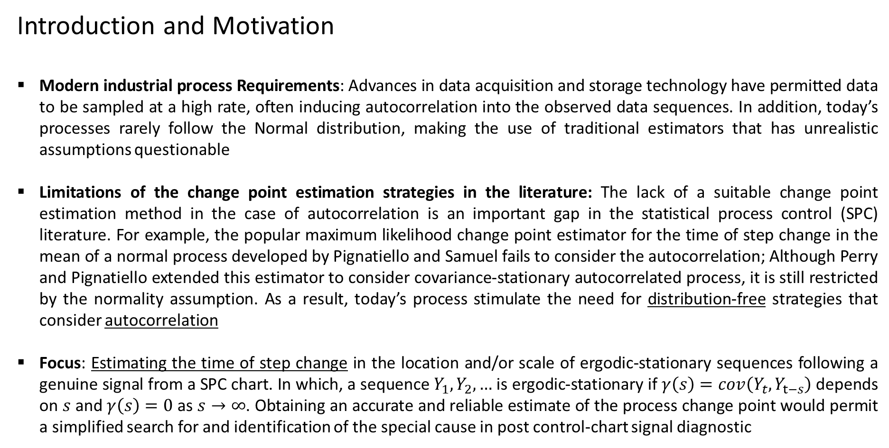
Introduction and Motivation
Introduction and Motivation
Modern industrial process Requirements: Advances in data acquisition and storage technology have permitted data to be sampled at a high rate, often inducing autocorrelation into the observed data sequences. In addition, today’s processes rarely follow the Normal distribution, making the use of traditional estimators that has unrealistic assumptions questionable
Limitations of the change point estimation strategies in the literature: The lack of a suitable change point estimation method in the case of autocorrelation is an important gap in the statistical process control (SPC) literature. For example, the popular maximum likelihood change point estimator for the time of step change in the mean of a normal process developed by Pignatiello and Samuel fails to consider the autocorrelation; Although Perry and Pignatiello extended this estimator to consider covariance-stationary autocorrelated process, it is still restricted by the normality assumption. As a result, today’s process stimulate the need for distribution-free strategies that consider autocorrelation
Focus: Estimating the time of step change in the location and/or scale of ergodic-stationary sequences following a genuine signal from a SPC chart. In which, a sequence $Y_{1},Y_{2},…$ is ergodic-stationary if $γ\left(s\right)=cov\left(Y_{t}, Y_{t−s}\right)$ depends on $s$and $γ\left(s\right)=0$ as $s→∞$. Obtaining an accurate and reliable estimate of the process change point would permit a simplified search for and identification of the special cause in post control-chart signal diagnostic
Defense and Aerospace Test and Analysis Workshop
Zhi Wang
April 27, 2022
2/10

Slide 3
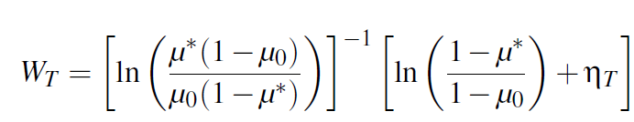
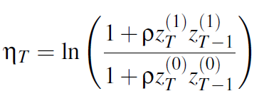
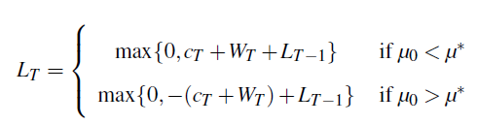
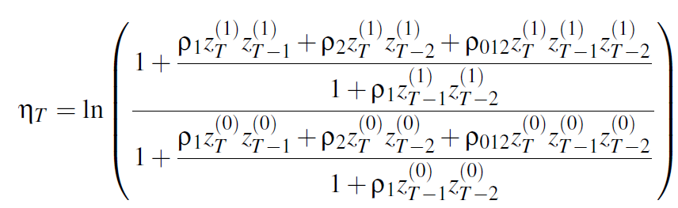
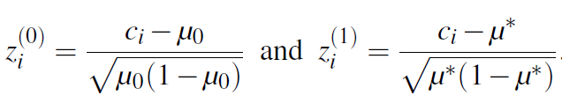



Introduction and Motivation
A distribution-free joint monitoring scheme for location and scale using individual observations:
Define a median clipped binary sequence $\left\{C^{\left(M\right)}\right\}$and an interquartile clipped binary sequence $\left\{C^{\left(IQR\right)}\right\}$ of the continuous data sequence $\left\{Y_{t}\right\}$ is generated for each $t=1, 2, …$, where $C_{t}^{(M)}=\left\{\begin{aligned}1, if Y_{t}>Q2 \\ 0, otherwise\end{aligned}\right.$ and $C_{t}^{(IQR)}=\left\{\begin{aligned}1, if Y_{t}∉[Q1, Q3] \\ 0, otherwise \end{aligned}\right.$ . We then model the joint mass function for the clipped binary sequences using the Bahadur approximation proposed by Bahadur (1961). As a result, we proposed a CUSUM strategy for monitoring the mean of ergodic-stationary binary sequences. Our CUSUM charting statistic was derived from the sequential probability ratio test (SPRT) for testing the simple hypotheses $H_{0}:μ_{i}=μ_{0}$ versus $H_{1}:μ_{o}=μ^{∗} (i=1, …, T)$, where $μ_{0}≠μ^{∗}.$
For $T=1, 2, …$ and $L_{0}=0$, the charting statistics:
first- order dependence structure
second-order dependence structures:
$ρ$’s denoting the autocorrelation coefficients and
$c_{T}$ is the observed value of the binary sequence at time $T$
Next, we consider estimating the time of sudden shift in the mean μ of an ergodic-stationary binary sequence following a genuine signal from this CUSUM control chart
Defense and Aerospace Test and Analysis Workshop
Zhi Wang
April 27, 2022
3/10

Slide 4
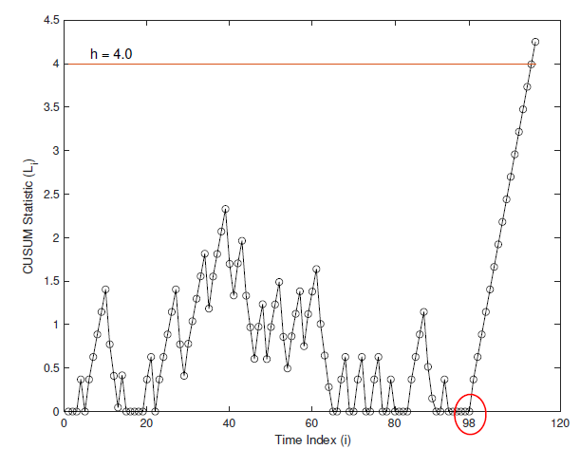
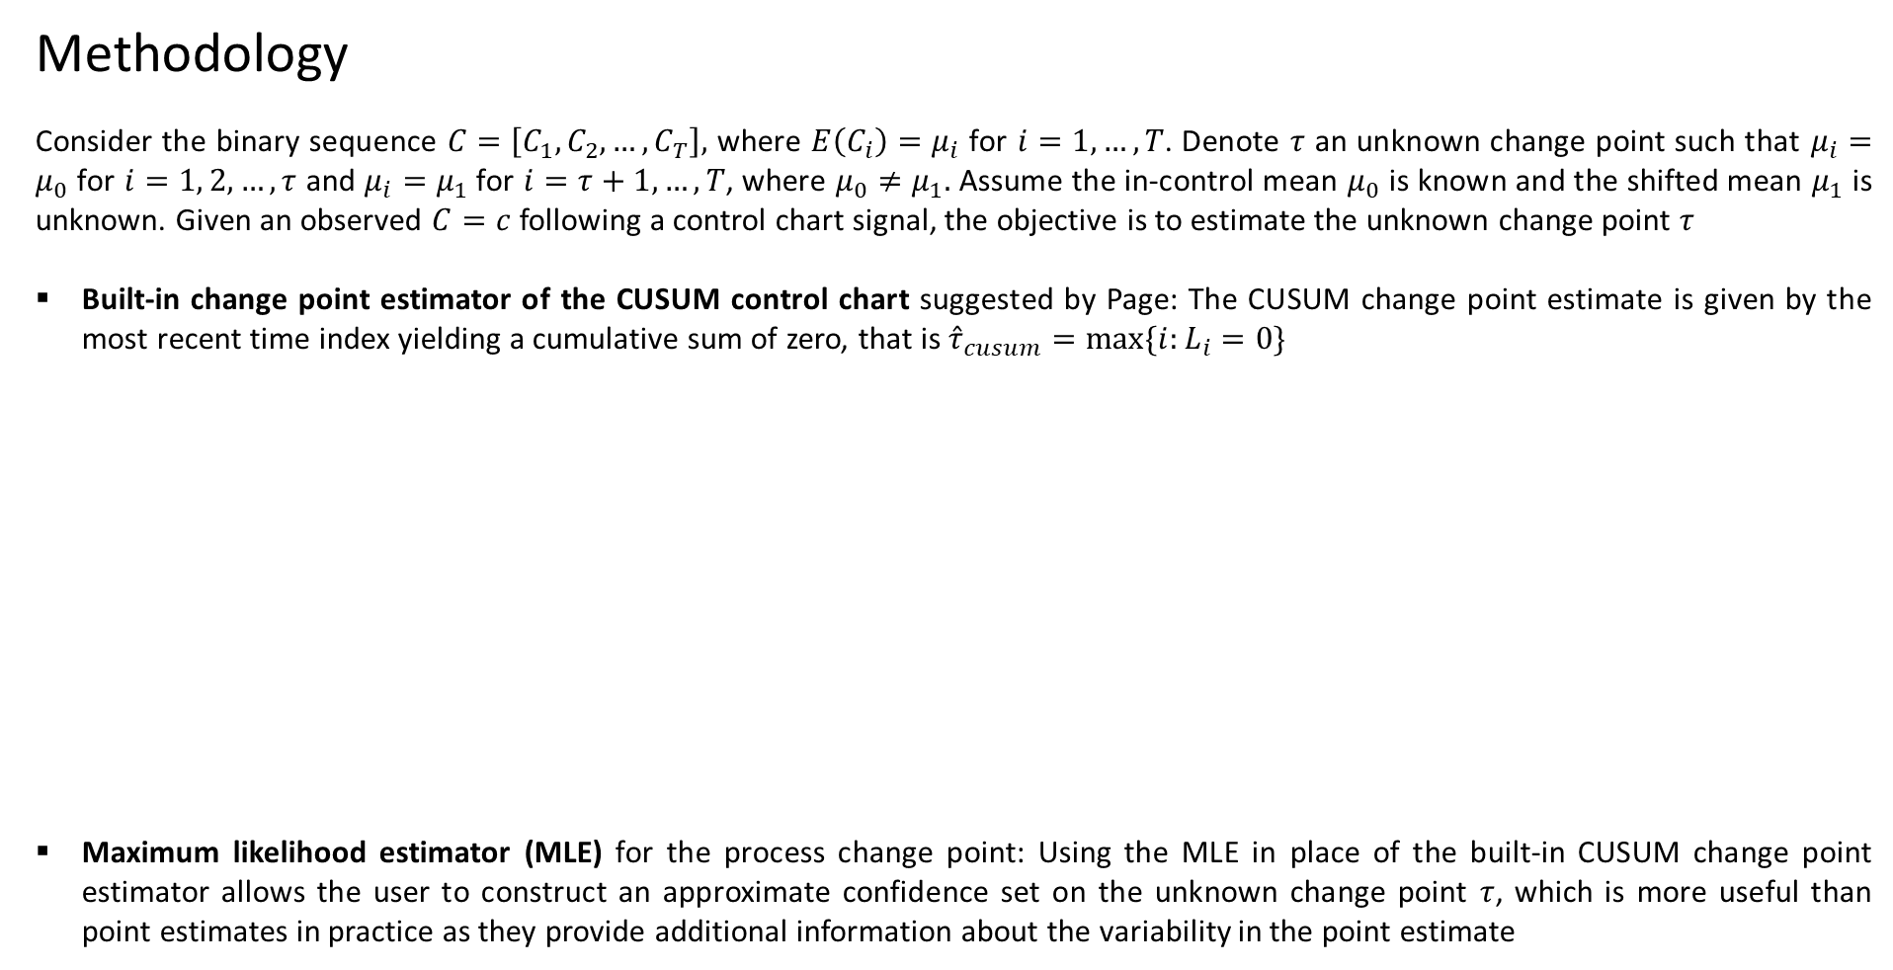
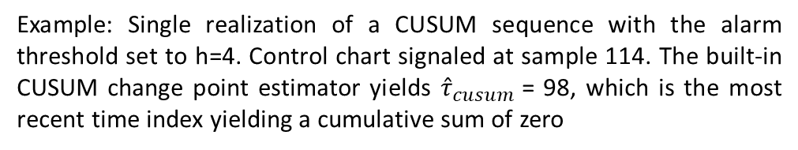
Methodology
Methodology
Consider the binary sequence $C=\left[C_{1},C_{2},…,C_{T}\right],$ where $E\left(C_{i}\right)=μ_{i}$ for $i=1, …, T$. Denote $τ$ an unknown change point such that $μ_{i}=μ_{0}$ for $i=1, 2, …, τ$ and $μ_{i}=μ_{1}$ for $i=τ+1, …, T$, where $μ_{0}≠μ_{1}.$ Assume the in-control mean $μ_{0}$ is known and the shifted mean $μ_{1}$ is unknown. Given an observed $C=c$ following a control chart signal, the objective is to estimate the unknown change point $τ$
Built-in change point estimator of the CUSUM control chart suggested by Page: The CUSUM change point estimate is given by the most recent time index yielding a cumulative sum of zero, that is ${\hat{τ}}_{cusum}=max⁡\{i:L_{i}=0\}$
Maximum likelihood estimator (MLE) for the process change point: Using the MLE in place of the built-in CUSUM change point estimator allows the user to construct an approximate confidence set on the unknown change point $τ$, which is more useful than point estimates in practice as they provide additional information about the variability in the point estimate
Example: Single realization of a CUSUM sequence with the alarm threshold set to h=4. Control chart signaled at sample 114. The built-in CUSUM change point estimator yields ${\hat{τ}}_{cusum}$= 98, which is the most recent time index yielding a cumulative sum of zero
Defense and Aerospace Test and Analysis Workshop
Zhi Wang
April 27, 2022
4/10

Slide 5
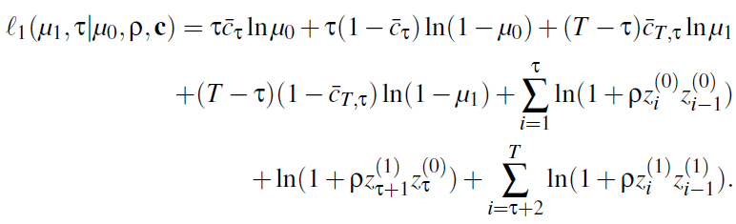

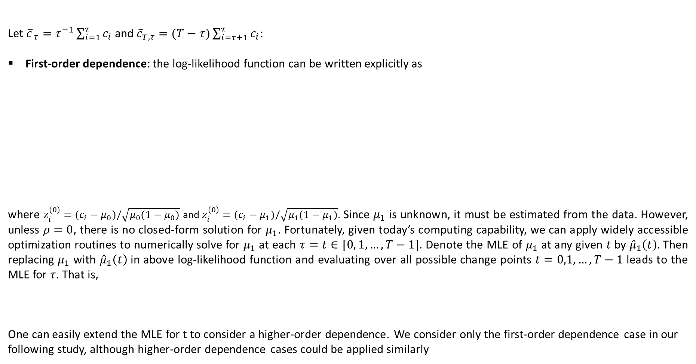
Methodology
Let ${\overline{c}}_{ τ}=τ^{−1}\sum_{i=1}^{τ}{c_{i}}$ and ${\overline{c}}_{T, τ}=(T−τ)\sum_{i=τ+1}^{τ}{c_{i}}$:
First-order dependence: the log-likelihood function can be written explicitly as
where $z_{i}^{(0)}=(c_{i}−μ_{0})/\sqrt{μ_{0}(1−μ_{0})}$ and $z_{i}^{(0)}=(c_{i}−μ_{1})/\sqrt{μ_{1}(1−μ_{1})}$. Since $μ_{1}$ is unknown, it must be estimated from the data. However, unless $ρ=0$, there is no closed-form solution for $μ_{1}$. Fortunately, given today’s computing capability, we can apply widely accessible optimization routines to numerically solve for $μ_{1}$ at each $τ=t∈[0, 1, …, T−1]$. Denote the MLE of $μ_{1}$ at any given $t$by ${\hat{μ}}_{1}\left(t\right).$ Then replacing $μ_{1}$ with ${\hat{μ}}_{1}\left(t\right)$in above log-likelihood function and evaluating over all possible change points $t=0,1,…,T−1$ leads to the MLE for $τ$. That is,
One can easily extend the MLE for t to consider a higher-order dependence. We consider only the first-order dependence case in our following study, although higher-order dependence cases could be applied similarly
Defense and Aerospace Test and Analysis Workshop
Zhi Wang
April 27, 2022
5/10

Slide 6

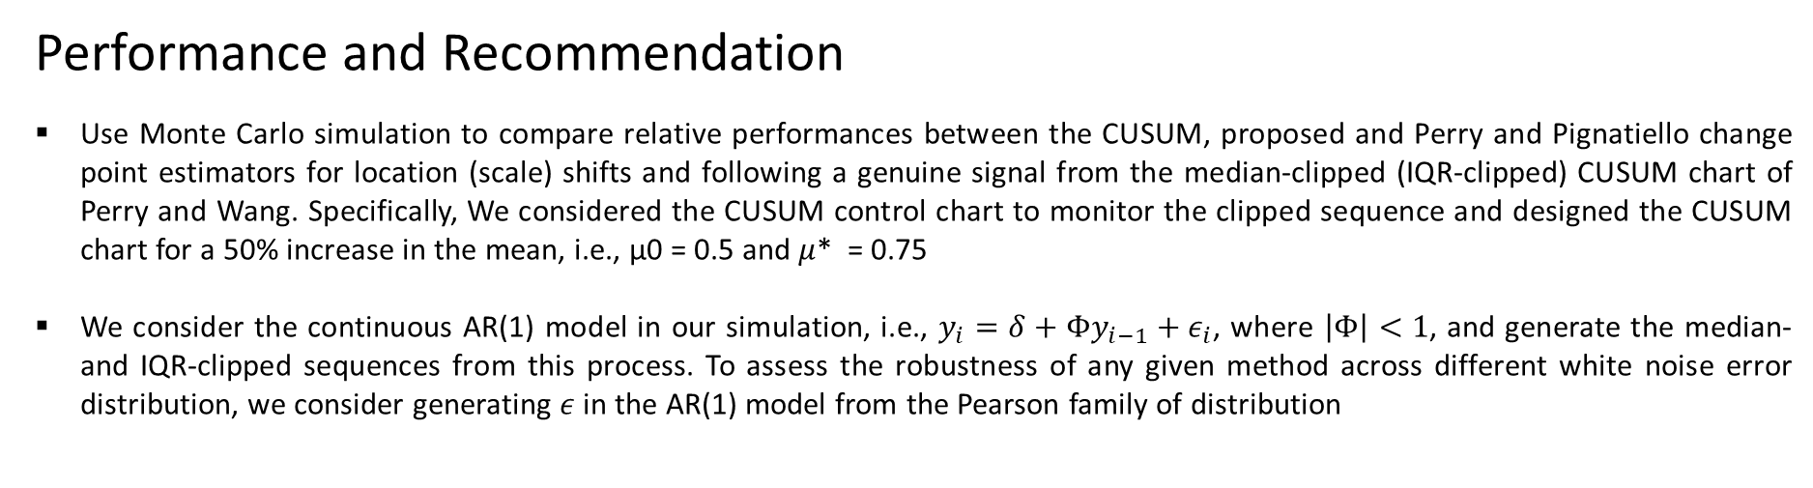


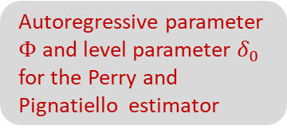
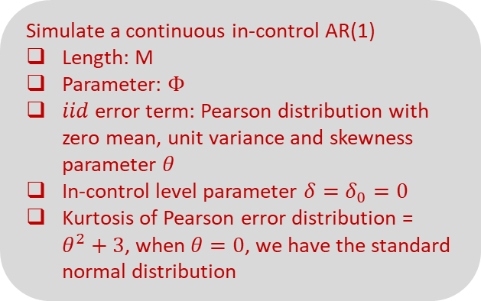

Performance and Recommendation
Performance and Recommendation
Use Monte Carlo simulation to compare relative performances between the CUSUM, proposed and Perry and Pignatiello change point estimators for location (scale) shifts and following a genuine signal from the median-clipped (IQR-clipped) CUSUM chart of Perry and Wang. Specifically, We considered the CUSUM control chart to monitor the clipped sequence and designed the CUSUM chart for a 50% increase in the mean, i.e., μ0 = 0.5 and $μ$* = 0.75
We consider the continuous AR(1) model in our simulation, i.e., $y_{i}=δ+Φy_{i−1}+ε_{i}$, where $\left|Φ\right|<1$, and generate the median- and IQR-clipped sequences from this process. To assess the robustness of any given method across different white noise error distribution, we consider generating $ε$ in the AR(1) model from the Pearson family of distribution
Simulate a continuous in-control AR(1)
Length: M
Parameter: $Φ$
$iid$ error term: Pearson distribution with zero mean, unit variance and skewness parameter $θ$
In-control level parameter $δ=δ_{0}=0$
Kurtosis of Pearson error distribution = $θ^{2}+3$, when $θ=0$, we have the standard normal distribution
Estimate quartiles
Median-clipped sequences
IQR-clipped sequences
Estimate the process change point using the proposed and alternative methods
Estimate correlation parameters in Bahadur model
MLE
Autoregressive parameter $Φ$ and level parameter $δ_{0}$ for the Perry and Pignatiello estimator
Genuine signal obtained
Monitoring began…
Change simulated…
$$M$$
$$M+1$$
$$M+τ+1$$
$$M+T$$
In-control process
Out-of-control-process
Defense and Aerospace Test and Analysis Workshop
Zhi Wang
April 27, 2022
6/10

Slide 7
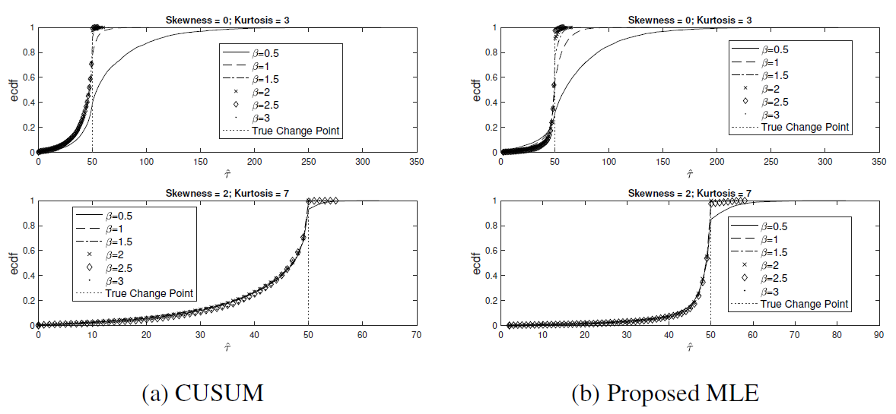
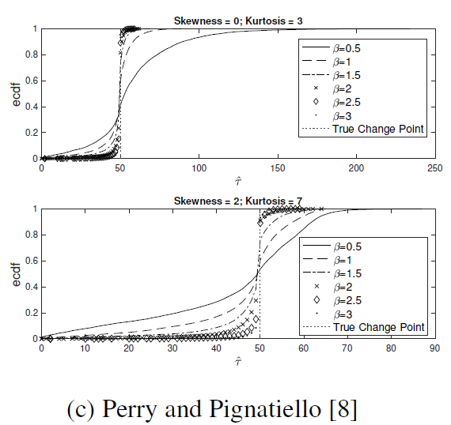
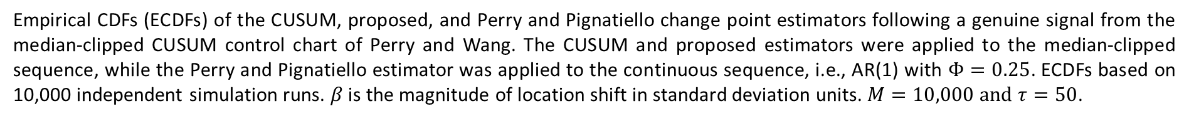
Performance and Recommendation
Empirical CDFs (ECDFs) of the CUSUM, proposed, and Perry and Pignatiello change point estimators following a genuine signal from the median-clipped CUSUM control chart of Perry and Wang. The CUSUM and proposed estimators were applied to the median-clipped sequence, while the Perry and Pignatiello estimator was applied to the continuous sequence, i.e., AR(1) with $Φ=0.25$. ECDFs based on 10,000 independent simulation runs. $β$ is the magnitude of location shift in standard deviation units. $M=10,000 and τ=50$.
Defense and Aerospace Test and Analysis Workshop
Zhi Wang
April 27, 2022
7/10

Slide 8
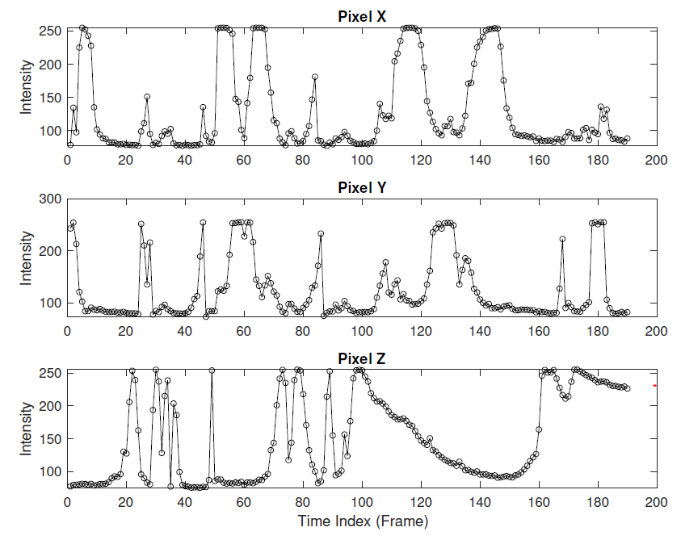
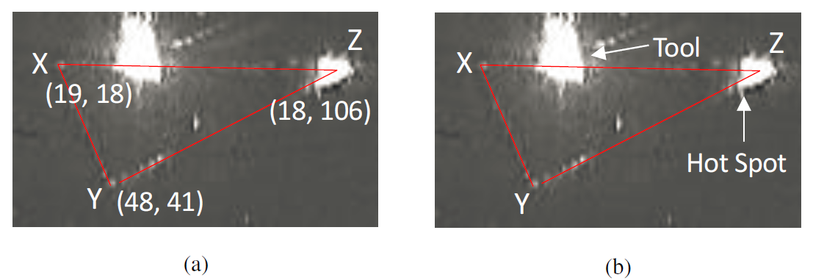
Illustrative Example
Illustrative Example
Demonstrate our new change point estimator on the selective laser melting (SLM) process discussed in Colosimo
and Grasso.
  Problem: hotspot occurrences in a laser powder bed fusion (LPBF) process
  Data: Monitoring data are collected by video capture of the process, where any given video can be broken down into a time series of frames.
    Rate of capture: 32 frames per second
    Each frame consists of a 71121 matrix of
Figure shows the triangle shape being manufactured for this example, with the three corners identified by X, Y, and Z. Note that Figure 7a reports the pixels considered within each frame (or matrix), while Figure 7b identifies the laser melting tool along with the hotspot that occurred at pixel Z.
Figure plots the time series extracted from each of the three pixels
Defense and Aerospace Test and Analysis Workshop
Zhi Wang
April 27, 2022
8/10

Slide 9
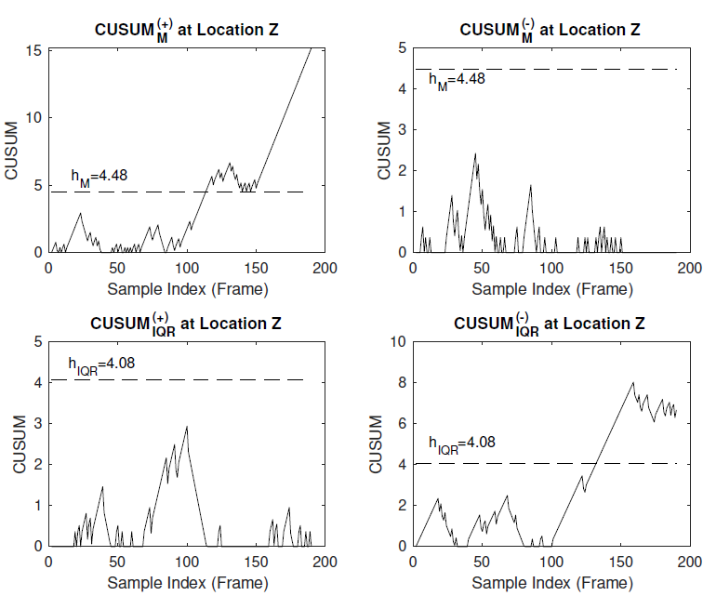
Illustrative Example
The CUSUMs were designed for a 50% increase/decrease in the mean of the clipped process
The alarm threshold for each chart was set so that the joint monitoring scheme yielded an in-control ARL of approximately 1000
Both CUSUM charts were designed under a first-order Bahadur approximation to the clipped sequences
Notice that the median-clipped CUSUM for increases produced a signal at frame 114, while the IQR-clipped CUSUM produced a signal at frame 133
Figure shows the median- and IQR-clipped CUSUM charts applied to pixel Z, for both the increasing and decreasing cases.
Defense and Aerospace Test and Analysis Workshop
Zhi Wang
April 27, 2022
9/10

Slide 10
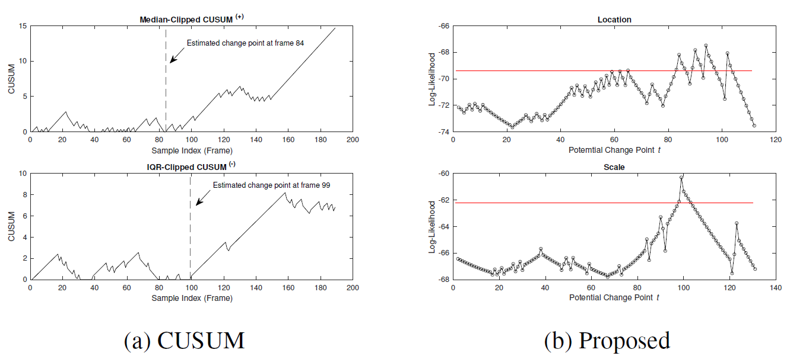

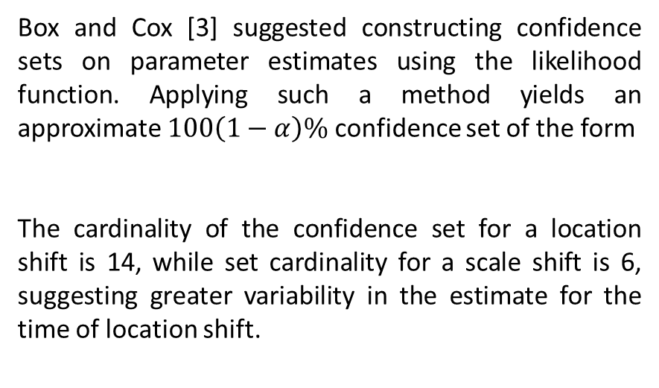
Illustrative Example
Figure shows Change point estimates using (a) CUSUM estimator and (b) proposed estimator. Horizontal lines in log-likelihood vs potential change point plots in (b) represent the 95% critical value for the confidence set, i.e., all t that yield log-likelihood values above the horizontal line are included in the 95% confidence set.
Box and Cox [3] suggested constructing confidence sets on parameter estimates using the likelihood function. Applying such a method yields an approximate $100\left(1−α\right)\%$ confidence set of the form
The cardinality of the confidence set for a location shift is 14, while set cardinality for a scale shift is 6, suggesting greater variability in the estimate for the time of location shift.
Given that the true process change occurred around frame 100:
The CUSUM approach estimated an increase in process location following frame 84 and a decrease in process scale following frame 99
The proposed approach estimated a location increase following frame 94, and a scale decrease following frame 99
Defense and Aerospace Test and Analysis Workshop
Zhi Wang
April 27, 2022
10/10

Slide 11
Thank You !

