Slide 1
Test & Evaluation of ML Models
April 27, 2022
Anna Rubinstein
Director of Test and Evaluation // Technical Program Manager
Anna.H.Rubinstein.ctr@mail.mil // ARubinstein@morsecorp.com

Slide 2
MORSE Overview
Intro to T&E and AI
Computer vision metrics
T&E CAPABILITIES
Lessons learned

Slide 3
MORSE Overview

Slide 4
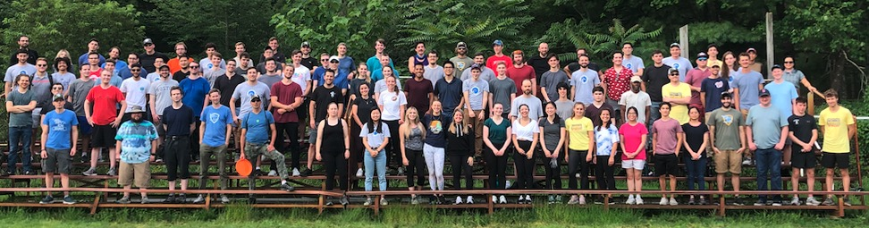
Mission statement
MORSE is a specially selected team of scientists, engineers, and software developers who use asymmetric and unconventional approaches to deploy practical solutions that solve difficult multi-disciplinary problems faced by the US National Security Ecosystem.

Slide 5

Company overview
Our values
Headquartered in Cambridge Tech Square/MIT
Founded in Oct 2014
  Management team together over 15 years
MORSE Staff - 160+ Employees
  90% Engineers, Scientists, Developers
  10% Operations, IT, HR, Security, TA
  32 interns and co-ops
All our data is belong to you
Sustained customer relationships
The smart team that’s easy to work with
Efficient and lean
Happy cows make happy cheese
Agility without sacrificing rigor
Passion for the mission
100% employee owned
Notes:
No proprietary restrictions
Unlimited government rights
No product-based business model
Government/MORSE partnership
with shared objectives

Slide 6
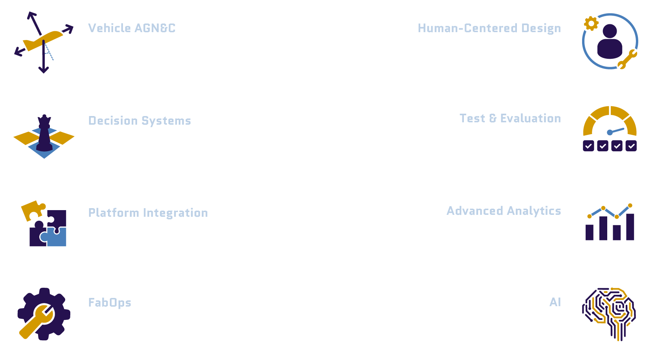
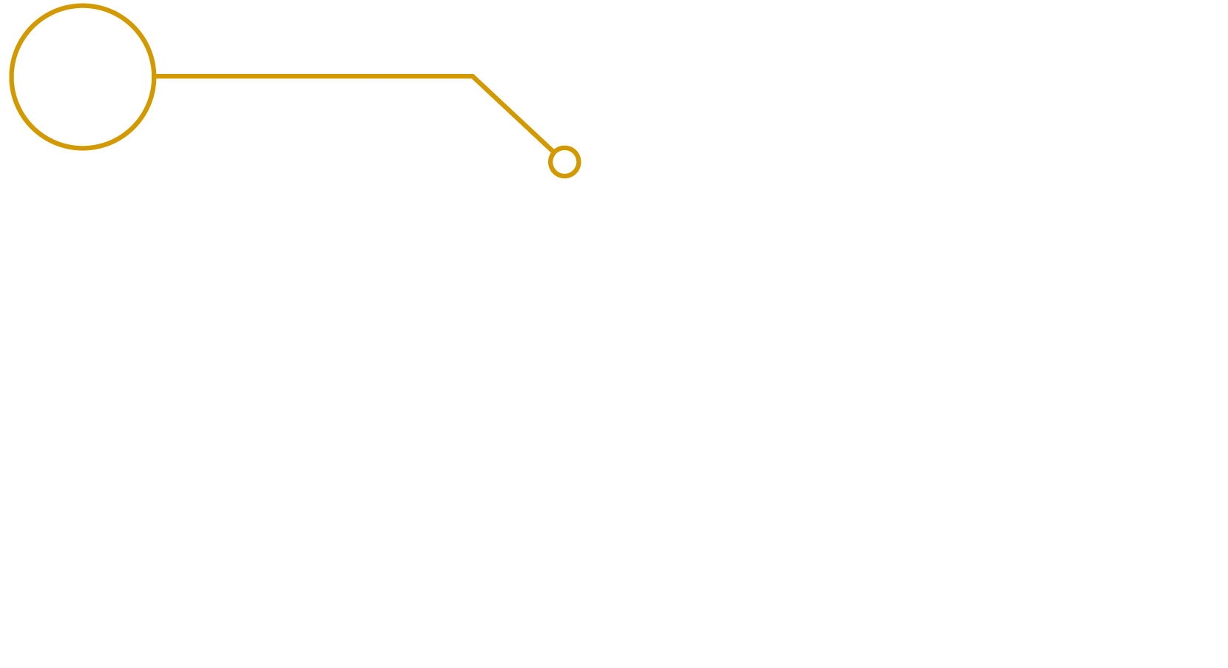
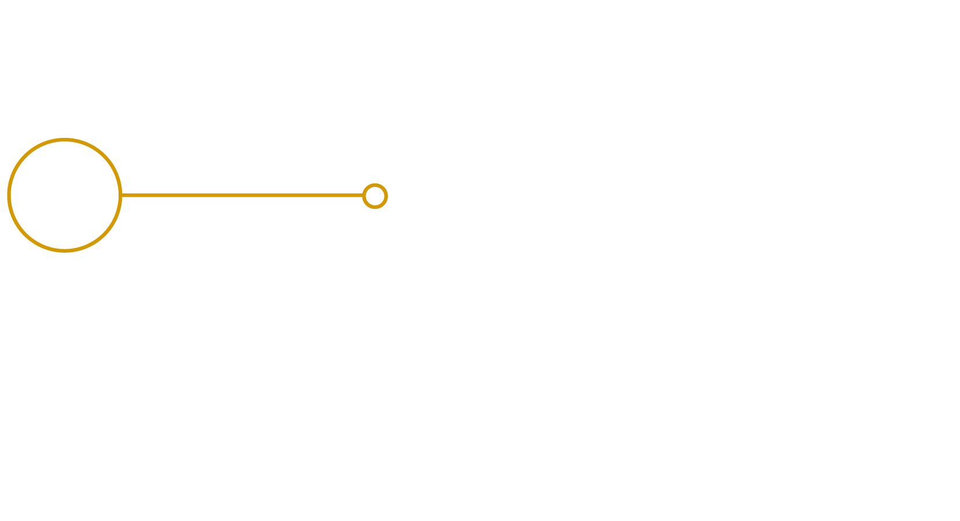
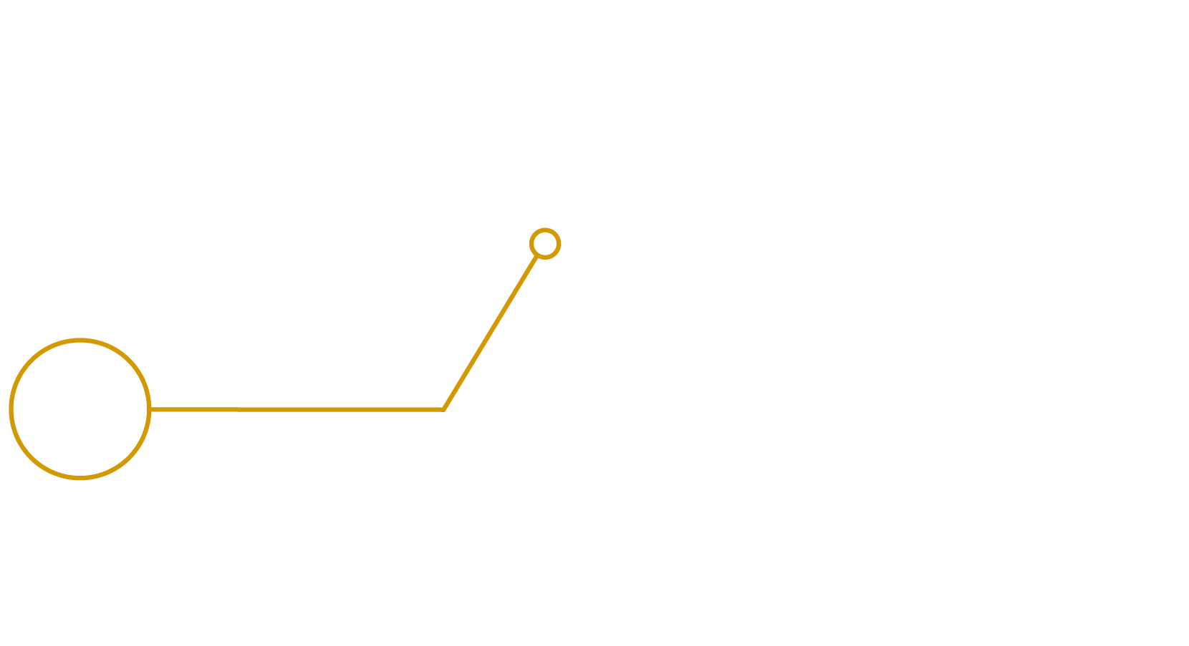
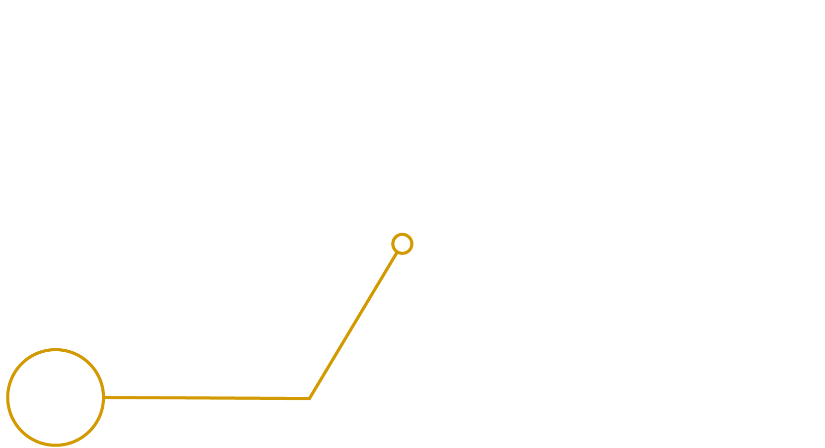
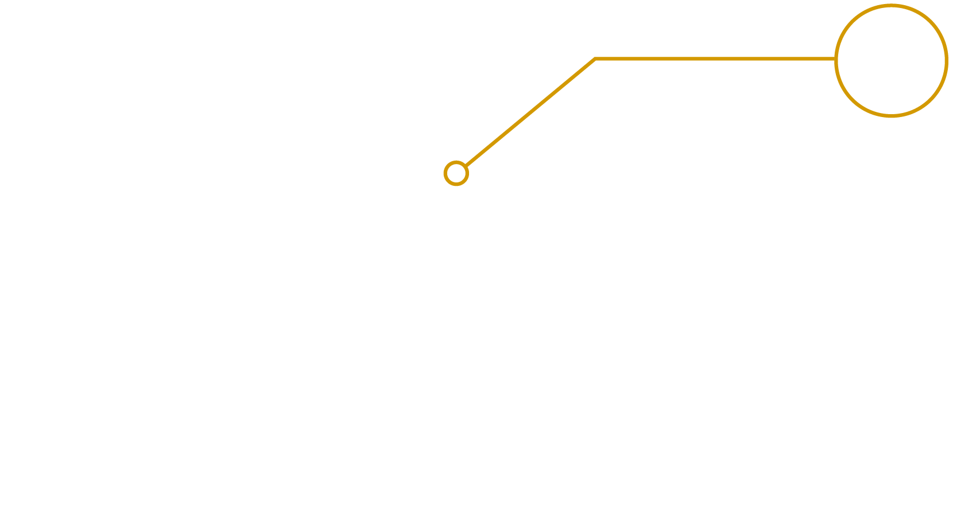
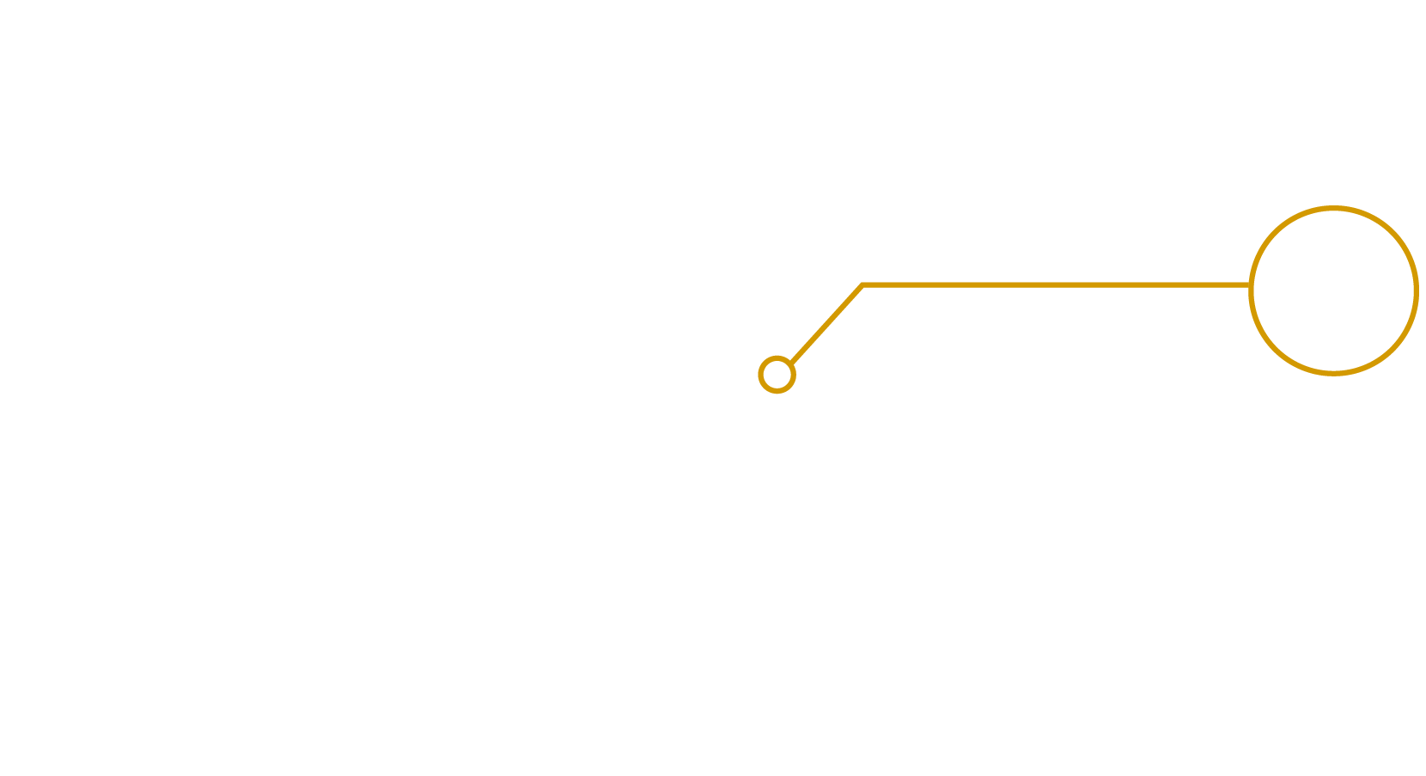

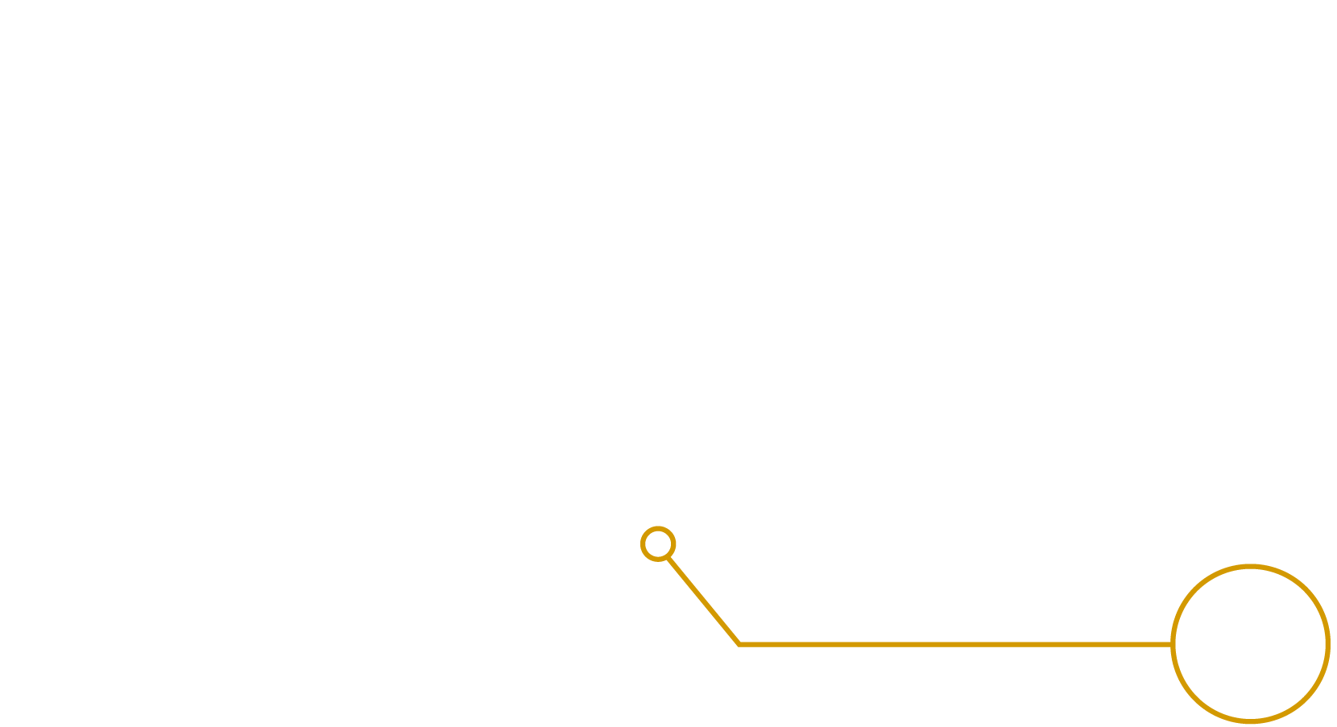
© 2021 MORSECORP, Inc.

Slide 7
Intro to T&E and AI

Slide 8
Test & Evaluation (T&E) and AI
Based on our work with several major DoD AI efforts, we’re pursuing opportunities for improvement while keeping pace with the operational cadence:
Transparency with unambiguous metrics
Open, standard interfaces that enable
self-serve integration
Fast turnaround time
8

Slide 9
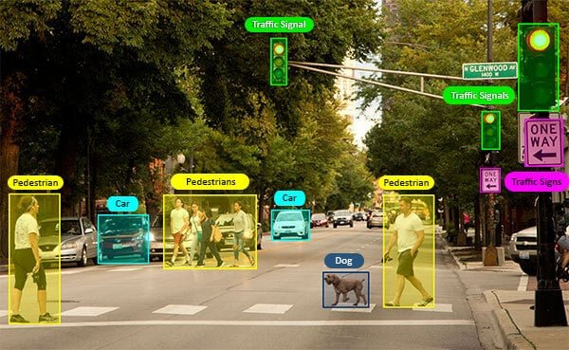
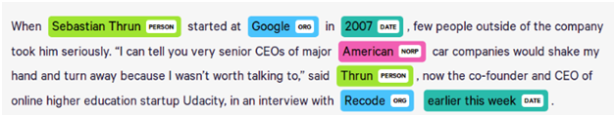
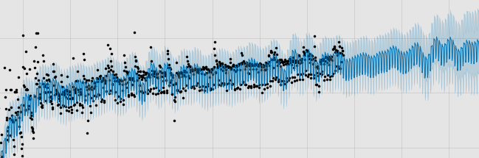
Broad Definitions – AI Models
Computer Vision
  Analyze imagery or video data
  Recognize, detect, track, and segment things in visual data sources
Natural Language Processing
  Analyze text data
  Translate, summarize, tag parts of speech, and find named entities in text
Time-Series Forecasting
  Analyze data collected over time
  Detect trends, identify anomalies, and predict the future of time series data

Slide 10
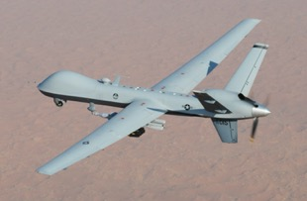
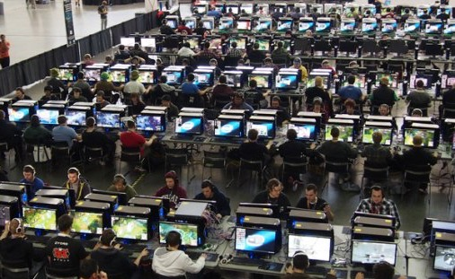

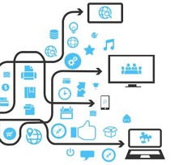

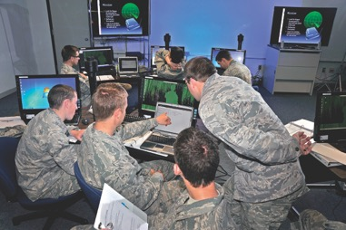

AI Project Life Cycle
Data Preparation
Deployment
Training
Poor Good Excellent
Test & Evaluation
https://en.wikipedia.org/wiki/General_Atomics_MQ-9_Reaper; https://www.pcmag.com/news/pax-east-2013-in-pictures; https://www.af.mil/News/Article-Display/Article/112733/cadets-study-art-of-cyber-warfare/

Slide 11
Testing Pyramid
More
Integration,
Slower
More
Isolation,
Faster
Operational T&E
Measure whether the system is useful, usable, and desirable for end users
Measure how effective the system is in assisting the user at their task
System T&E
Run on the actual hardware
Ensure the full system behaves as expected in Algorithm T&E
Algorithm T&E
Isolate model performance using validation/test set
Heavily automated and scaled
Close the feedback loop and repeat

Slide 12
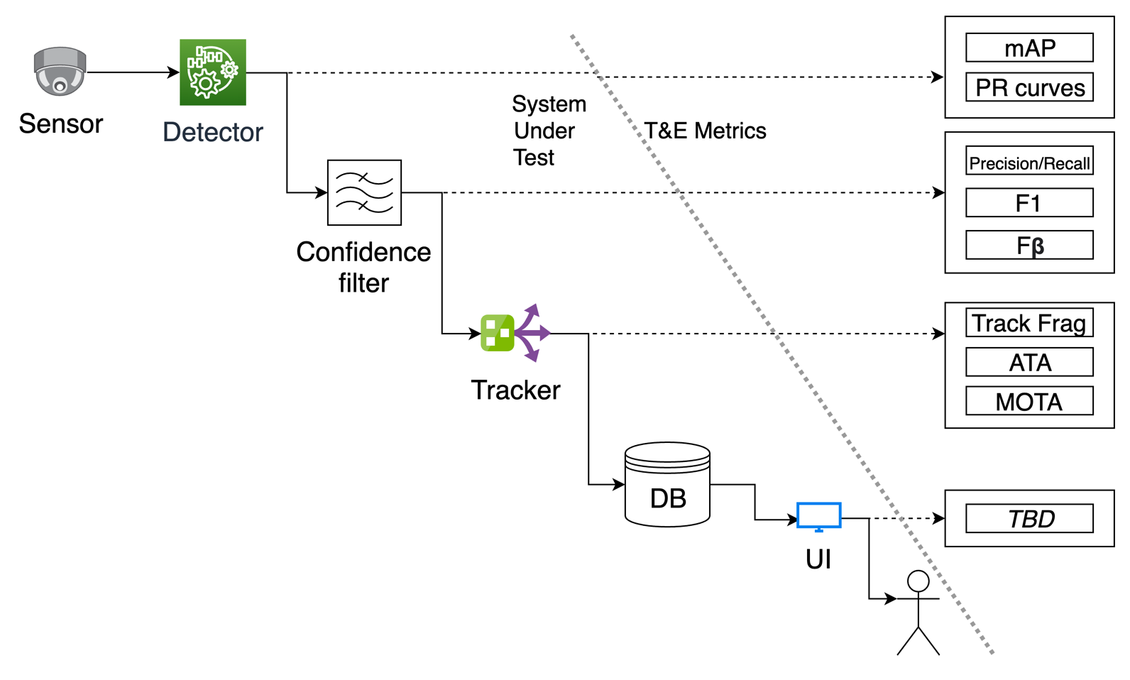
Testing Pyramid in practice
Development metrics
Deployment metrics

Slide 13
Computer Vision Metrics

Slide 14
Metrics
Metrics need to capture CV model performance in ways that are reflective of the sentiments of the human users who work with the models on a daily basis.
  Good on paper =/= Good in practice
  Precision and recall are often enough to begin to understand why users enjoy some models and not others
  Complex metrics often depend on the “goodness” of other metrics before being meaningful
    Tracking metrics are only useful to look at when detection metrics are good
  How do we effectively roll up different aspects of performance on different object classes into meaningful decision metrics?
    Tradeoff between simplicity and transparency

Slide 15
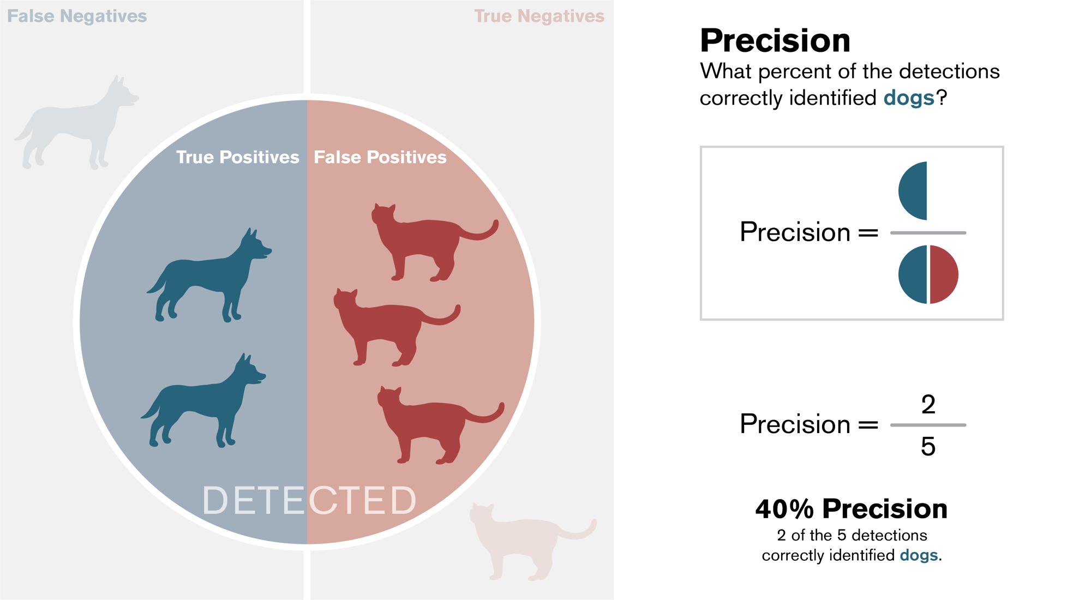
© 2021 MORSECORP, Inc.

Slide 16
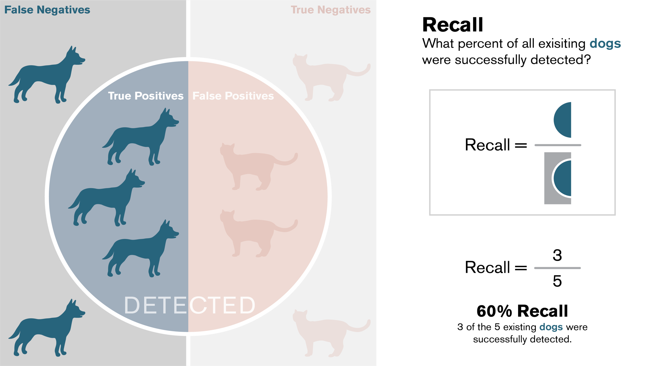
© 2021 MORSECORP, Inc.

Slide 17
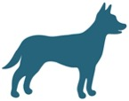

Visual Intuition: Perfect Precision, Low Recall
Model Detection

Slide 18

Visual Intuition: Perfect Recall, Low Precision
Model Detection

Slide 19

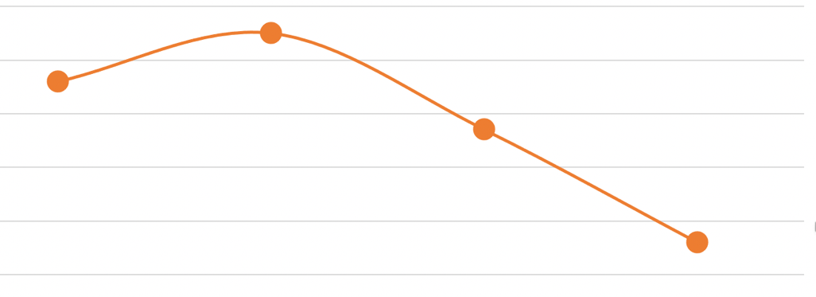
Precision-Recall Curves
Confidence: 0.8
Confidence: 0.6
Confidence: 0.4
Confidence: 0.2
Model Detection
P = 0.66, R = 0.4
P = 0.75, R = 0.6
P = 0.57, R = 0.8
P = 0.36, R = 1.0
0.8
0.7
Precision
0.6
0.5
0.4
0.3
0.4
0.6
0.8
1
Recall

Slide 20

Average Precision / Mean Average Precision
Average Precision = AP
  Average precision for a given object class
  Computed as the area under the PR curve
  Blue shaded region
Mean Average Precision = mAP
  Average of AP over all object classes (c)
$${AP}_{tank} =0.8$$
$${AP}_{fighter} =0.9$$
$${AP}_{radar} =0.4$$
$mAP$ $=\frac{\left(0.8 + 0.9 + 0.4\right)}{3} =0.7$
Vehicles
0.8
0.7
Precision
0.6
0.5
AP
0.4
0.3
0.4
0.6
0.8
1
Recall

Slide 21
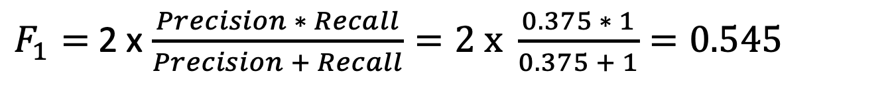
F1: Harmonic Mean of Precision and Recall
Model Detection
$F_{1}=$2 x $\frac{Precision ∗ Recall}{Precision + Recall}=\text{2 }\text{x} \frac{0.375 ∗ 1}{0.375 + 1}=0.545$

Slide 22
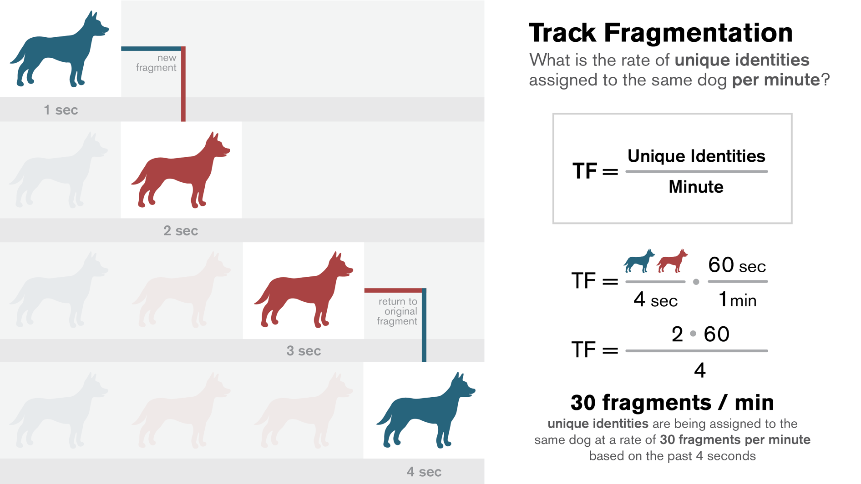
© 2021 MORSECORP, Inc.

Slide 23

Decision Metrics
When combining metrics, how do we determine which model is best?
Answer:
  Normalization can help with weighting
  User interviews can help with prioritization
  Analysis of metrics can help prevent gaming
Lower is better
Higher is better

Slide 24
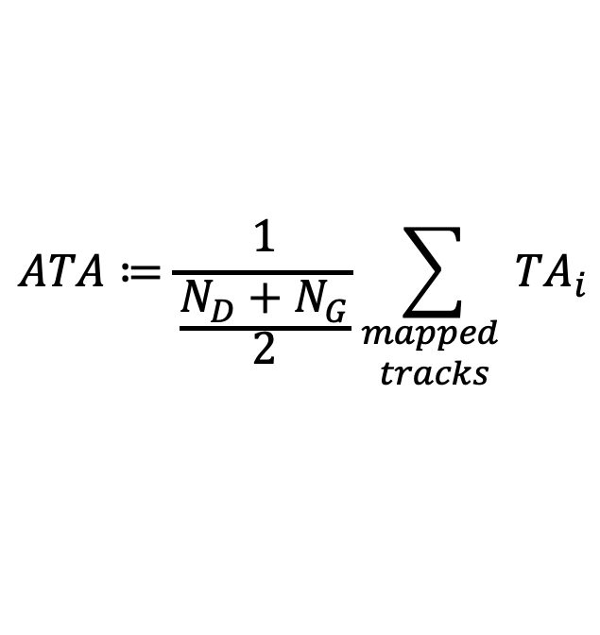
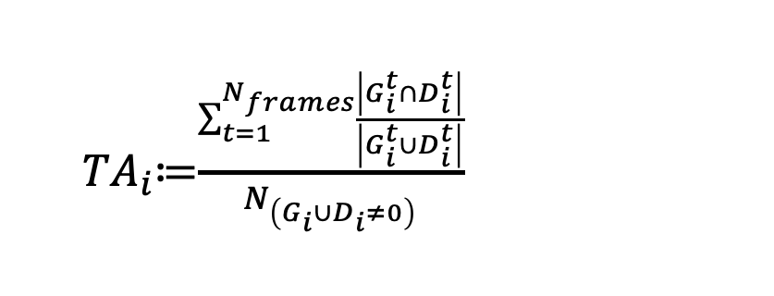
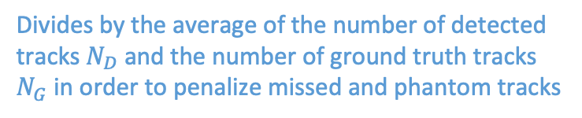
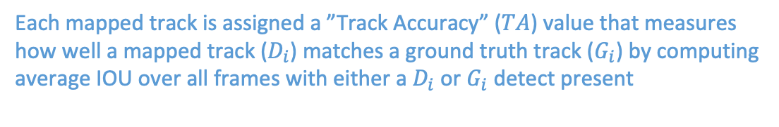
Average Track Accuracy (ATA)
$$ATA≔\frac{1}{\frac{N_{D}+N_{G}}{2}}\sum_{\begin{aligned}mapped \\ tracks\end{aligned}}{{TA}_{i}}$$
Each mapped track is assigned a ”Track Accuracy” ($TA$) value that measures how well a mapped track ($D_{i}$) matches a ground truth track ($G_{i}$) by computing average IOU over all frames with either a $D_{i}$ or $G_{i}$ detect present
  ${TA}_{i}$≔$\frac{\sum_{t=1}^{N_{frames}}{\frac{\left|G_{i}^{t}∩D_{i}^{t}\right|}{\left|G_{i}^{t}∪D_{i}^{t}\right|}}}{N_{\left(G_{i}∪D_{i}≠0\right)}}$
Divides by the average of the number of detected tracks $N_{D}$ and the number of ground truth tracks $N_{G}$ in order to penalize missed and phantom tracks
Failure Mode | ATA | F1 + Track Frag
Missing Detects | yes | yes
Object Id Switching | yes | yes
Short phantom tracks | yes | under penalizes
Lagging Tracks | yes | no
Jittery Tracks | yes | no

Slide 25
Multiple Classes
General rule of thumb is to keep things simple for stakeholders and for quick analysis
  One method is to simply average their scores. But that can have shortcomings during development

Slide 26
Multiple Classes (7 total)
Is this average still meaningful?

Slide 27
Multiple Classes (10 total w/ sparse classes)
How do we weight performance toward priority and populated classes?

Slide 28
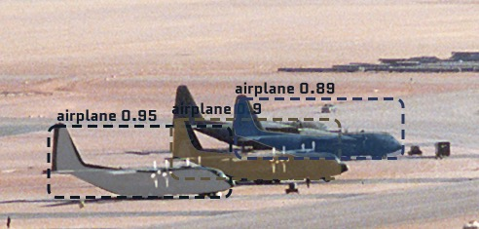
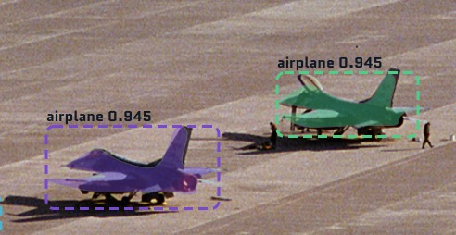
Example of Confidence Reliability
Ideally, the confidence output will align exactly with the measured precision

Slide 29
Example of Confidence Reliability
Ideally, the confidence output will align exactly with the measured precision
But the actual model’s output will be offset and incomplete

Slide 30
Example of Confidence Reliability
Ideally, the confidence output will align exactly with the measured precision
But the actual model’s output will be offset and incomplete
The error between the ideal curve and the model is the difference between them
  error = |model – ideal|
But how do we handle when there are only a few cases in a bucket?

Slide 31
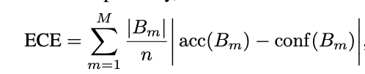
Example of Confidence Reliability
High error in 90% bucket, but there’s only a few detects there. So weigh it less
For this example, ECE = 16%
Expected Confidence Error
B_{m} = bucket
n = total detects
https://arxiv.org/pdf/1706.04599.pdf

Slide 32
T&E Capabilities

Slide 33
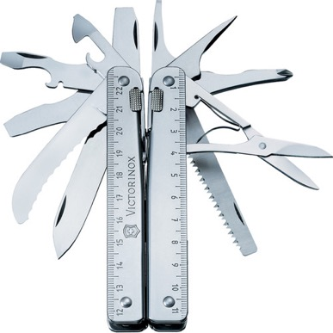
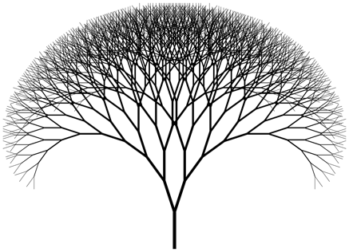



Core T&E capabilities
We’ve built a suite of tools and capabilities that allow us to process AI models on large sets of test data. Our tools are designed to operate at scale, executing on distributed platforms to optimize the evaluation process
+
+
+
Charybdis
Measurement multi-tool
METAL
Charybdis scale &
parallelization using Spark
Proctor
Build scheduling &
resource management
Gradient
Report generator
Notes:
METAL is orchestrator
Parses CV engine output
Invokes Charybdis to produce core metrics
Performs additional metric calculations used Charybdis output

Slide 34
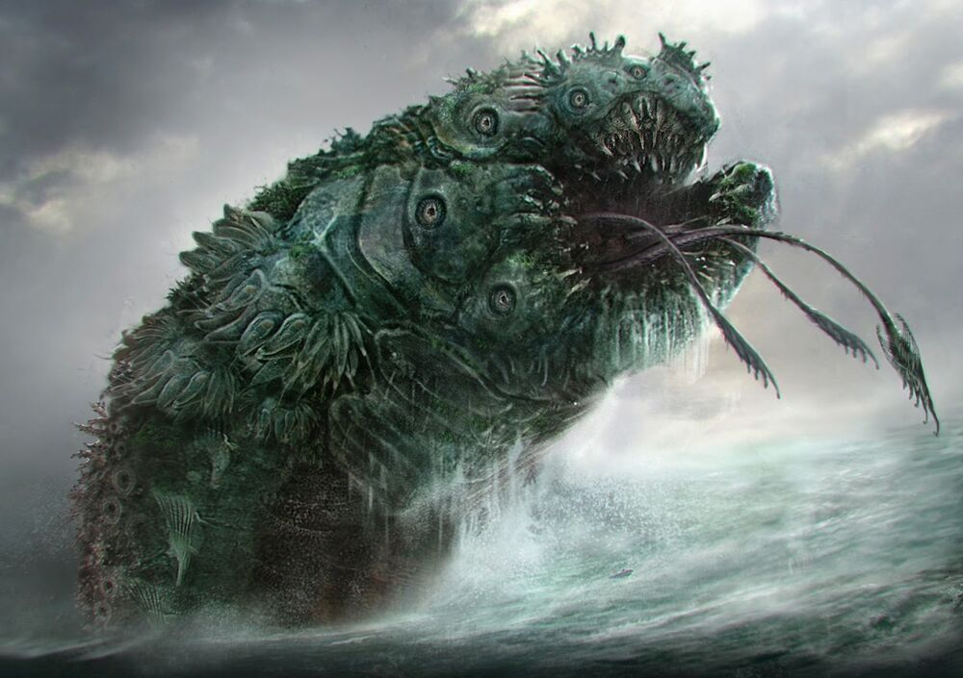
What is Charybdis?
Charybdis was developed out of necessity when off-the-shelf metric packages failed to sufficiently describe the complex plane of behaviors CV applications were seen to experience when deployed.
Charybdis is a dynamic and flexible measurement framework designed to assess the performance of CV applications when compared against labeled ground truth data.
Charybdis’ utility is sourced from its architecture rather than the metrics and measurements it produces – everything is modular.
Charybdis allows for detailed, easy, and rich exploration of CV model performance.
Charybdis (Kar-ib-dis) was a sea monster in Greek mythology, which dwelt in the Strait of Messina.
Charybdis is sometimes referred to as a whirlpool with a cauldron-like stomach. Other times, it is referred to as a gigantic mouth capable of swallowing millions of gallons of water, creating a huge whirlpool miles wide, then spitting it back out. Charybdis is also described as being eternally hungry.
Notes:
Nearly all aspects of Charybdis are built of a plug-and-play architecture.
How data is read (data types)
CV inference domains/type (style of inference data)
Ground truth to inference mapping strategies
Detection only support
Tracking support
Metrics
Similarity measurements

Slide 35
Everything is a plugin
CV object type
Native support
  Bounding boxes
  Polygons
  Pixel masks
Customization
  Charybdis defines shapes abstractly, allowing users to define their own shapes as needed
  Users can implement their own serialization strategies for their custom shapes
Mapping strategies
Pre-loaded
  Best intersection over union (detection)
  Best confidence (detection)
  Best intersection over union + longest track (tracking)
Customization
  Users can define mapping strategies/tell Charybdis how they define a true positive.
  For example
    Centroid distance
    Polygon edge alignment
    Spatial/temporal for tracks
Metrics
Pre-loaded
  Dozens of metrics MORSE has curated while collaborating with partner CV organizations
  For example
    Detection performance for every inference object or every frame
    Tracking performance at the video level
Customization
  Charybdis provides users the ability to define their own metrics
Notes:
Nearly all aspects of Charybdis are built of a plug-and-play architecture.
How data is read (data types)
CV inference domains/type (style of inference data)
Ground truth to inference mapping strategies
Detection only support
Tracking support
Metrics
Similarity measurements

Slide 36
Lessons Learned

Slide 37
Best Practices
Operational testing is the most important, but also the slowest
  Push OT lessons learned earlier in the process, when possible
Automation is key to moving quickly and cheaply
  In one instance, MORSE used automation to drop T&E time from 30 days per model to 1.5 hours per model
Integrate “computer science” (CS) drops before proper model drops
  Isolate software and interface bugs from model performance
Decide on decision metrics *before* model development
  But always be open to improving your metrics for the next round of models
  Calculate all metrics, but focus on decision metrics
Data splitting
  Training / Validation / Testing set splits
  Make sure the sets are balanced and representative
  Beware test set contamination
    When the test set is exposed to vendors or is otherwise similar to the training set
    Recommend a strategic reserve that is held out so the test set can quickly refreshed if data is contaminated

Slide 38
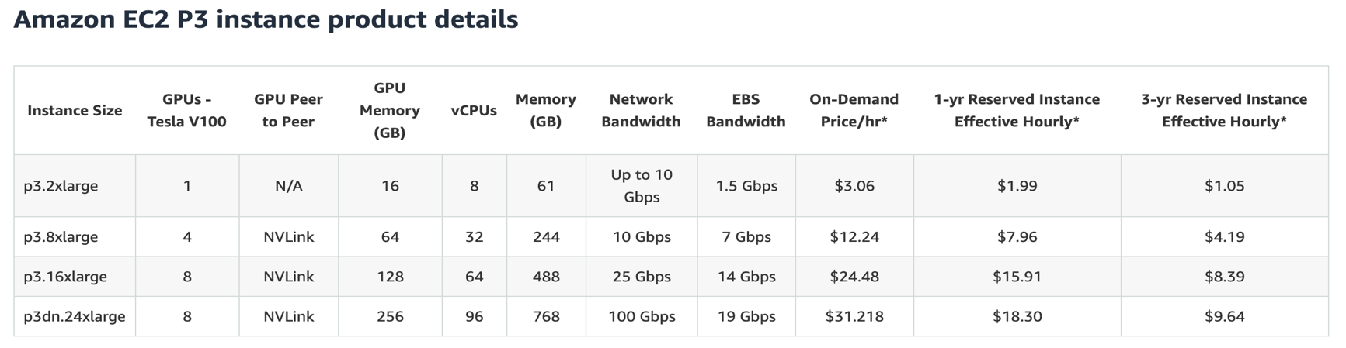
Be wary of cloud costs
Cloud
  To train on 1 GPU for 4 weeks is $0.7k to $2k
  To train on 8 GPUs for 12 weeks is $16k to $48k
On-prem
  One Tesla V100 is $4k MSRP, plus machine (~$20k) & maintenance
General rule-of-thumb is that cloud is cheap for low duty cycles and quick scaling
  GPU training is a long-running persistent process
https://aws.amazon.com/ec2/instance-types/p3/

Slide 39
Available libraries
MORSE’s Charybdis – Available to government
MSCOCO
  See github: https://github.com/cocodataset/cocoapi
MOT Metrics
  See github: https://github.com/cheind/py-motmetrics
VOT
  See github: https://github.com/votchallenge/toolkit

Slide 40


