Slide 1
Optimal Designs for
Multi-Response Experiments
Brittany M. Fischer¹
Sarah E. Burke²
Douglas C. Montgomery¹
Bradley Jones³
1. Arizona State University; 2. LinQuest; 3. JMP Division, SAS Institute

Slide 2
Problem Statement
Provide a general solution to finding a test design for multiple responses that follow different distributions
  Consider a three-response problem
    Normal: continuous data (e.g., time or distance)
    Binomial: probability of success (e.g., detection or survival of target)
    Poisson: count data (e.g., number of false alarms or number of defects)

Slide 3
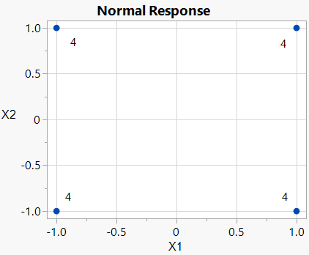
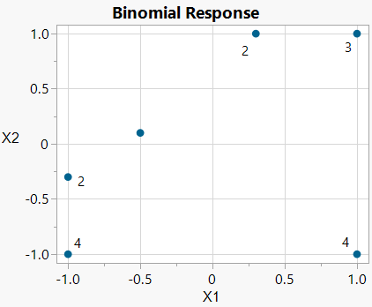
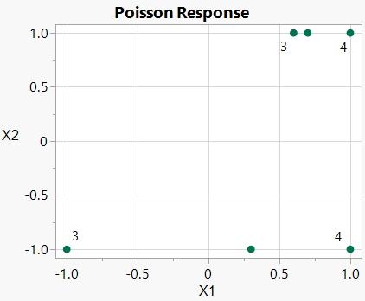
Optimal designs for individual responses will be different for different response types
*16 run designs with 2 continuous factors, main effects + 2 factor interaction model,
and given set of priors for the binomial and Poisson responses

Slide 4
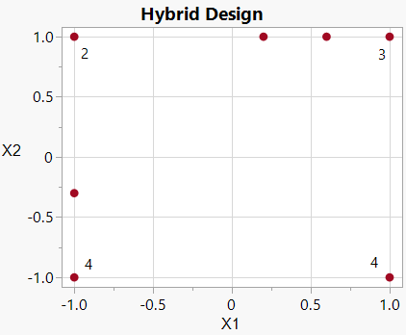
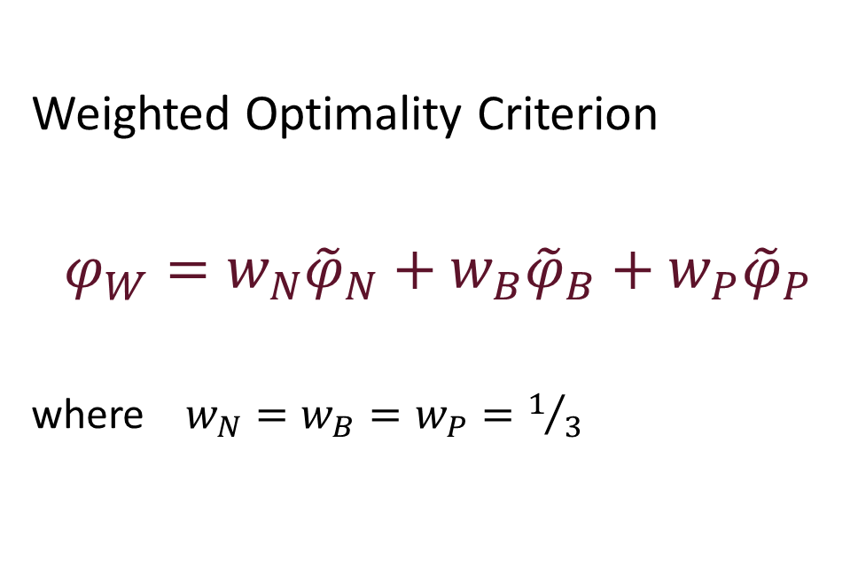
Demonstrated Capability of 3 Response Model
Weighted Optimality Criterion
$$φ_{W}=w_{N}{\tilde{φ}}_{N}+w_{B}{\tilde{φ}}_{B}+w_{P}{\tilde{φ}}_{P}$$
where $w_{N}=w_{B}=w_{P}=1/3$
Weighted optimal design is a hybrid of the individual optimal designs

Slide 5
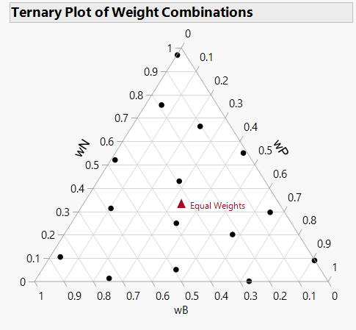
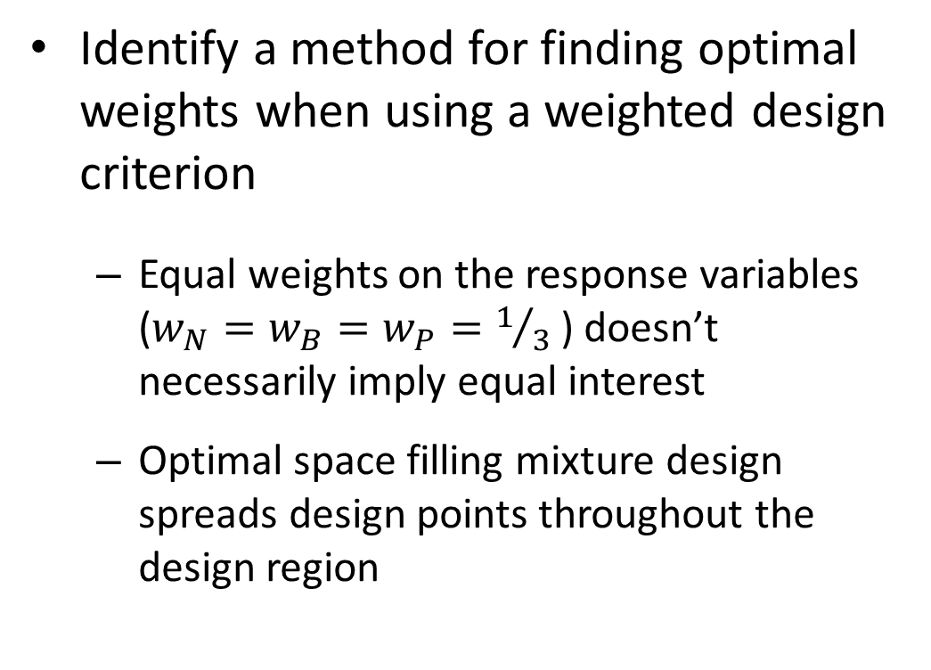
Secondary Problem Statement
Identify a method for finding optimal weights when using a weighted design criterion
  Equal weights on the response variables ($w_{N}=w_{B}=w_{P}=1/3$) doesn’t necessarily imply equal interest
  Optimal space filling mixture design spreads design points throughout the design region

Slide 6
Thank you!

