Slide 1
Quantifying the Impact of Staged Rollout Policies on Software Process and Product Metrics
Kenan Chen, University of Massachusetts Dartmouth, USA
Zakaria Faddi, University of Massachusetts Dartmouth, USA
Vidhyashree Nagaraju, PhD, University of Tulsa, USA
Lance Fiondella, PhD, University of Massachusetts Dartmouth, USA

Slide 2
Outline
Introduction
Problem
Contributions
Modeling
Illustrations
Conclusions and Future Research

Slide 3
Introduction
DevOps
Emerging set of practices
Includes Agile methods
Combines software development and operations
Methodology (Not a technology)
Goal: To reduce system development life cycle while preserving quality

Slide 4
Problem
Most research
Focuses on process related issues and case studies
Offers empirical evidence of DevOps’ efficacy
Few formal models of modern software development practices

Slide 5
Contributions
Develop quantitative model based on popular definition of Bass et al.
DevOps: “a set of practices intended to reduce the time between committing a change to a system and the change being placed into normal production, while ensuring high quality.”

Slide 6
Contributions (2)
Quantifies tradeoffs between process metrics (delivery time) and product metrics (safety, availability, and security)
Utilizes software failure data collected during testing
Gives rise to multi-objective problem that must balance customer preferences

Slide 7
Modeling
Staged rollout
Characterizes tradeoff between
(i) time to deliver new functionality
(ii) downtime incurred
Strategy to field new functionality on an ongoing basis without incurring failures that
Induce system outages
Widespread unavailability of services
Economic losses
User dissatisfaction

Slide 8
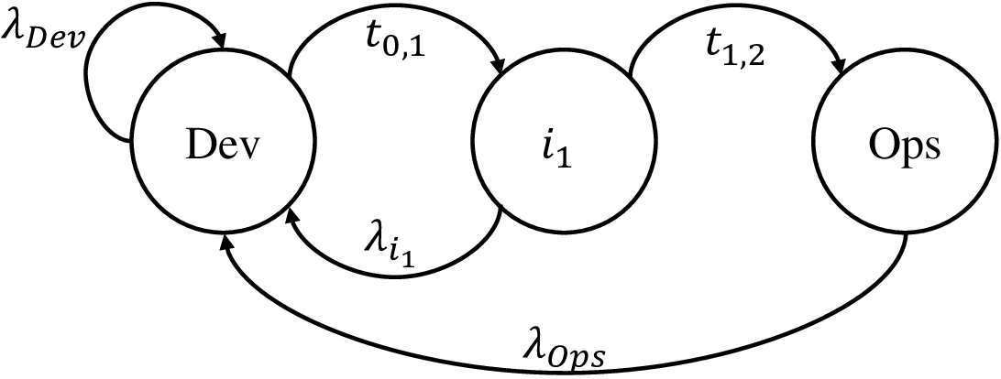
Staged Rollout
States
Represent stages of deployment
Possesses unique fault detection rates
Transition policy drives tradeoffs

Slide 9
Software Failure Data
Time at which unique defects were discovered during testing
SYS1 dataset ($n=136$) failures discovered during 24.63 hours of testing

Slide 10
Delivery Time
Parameters
User population
$n_{Ops}=10,000$
${p_{i}}_{1}=0.1$
${n_{i}}_{1}=1,000$
$n_{Dev}=50$
Acceleration factors
$a_{i_{1}}=\frac{{n_{i}}_{1}}{n_{Dev}}=20$
$a_{Ops}=\frac{n_{Ops}}{n_{Dev}}=200$
$t_{del}=t_{n}+t_{Dev,i_{1}}+t_{i_{1},Ops}$
Time to last ($n^{th}$) failure, plus time to transition from Dev to Ops

Slide 11
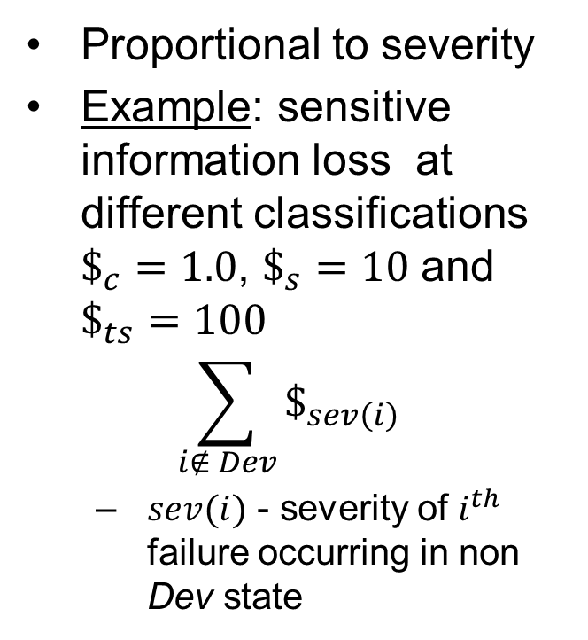
Additional Metrics
Downtime
Safety and Security
Proportional to fraction of user base multiplied by MTTR
Weighted sum
$$MTTR×\sum_{i=1}^{n}{ p_{s\left(i\right)}}$$
$s(i)$ - state in which $i^{th}$ failure occurs
Proportional to severity
Example: sensitive information loss at different classifications $\$_{c}=1.0$, $\$_{s}=10$ and $\$_{ts}=100$
$$\sum_{i∉ Dev}{\$_{sev\left(i\right)}}$$
$sev(i)$ - severity of $i^{th}$ failure occurring in non Dev state

Slide 12
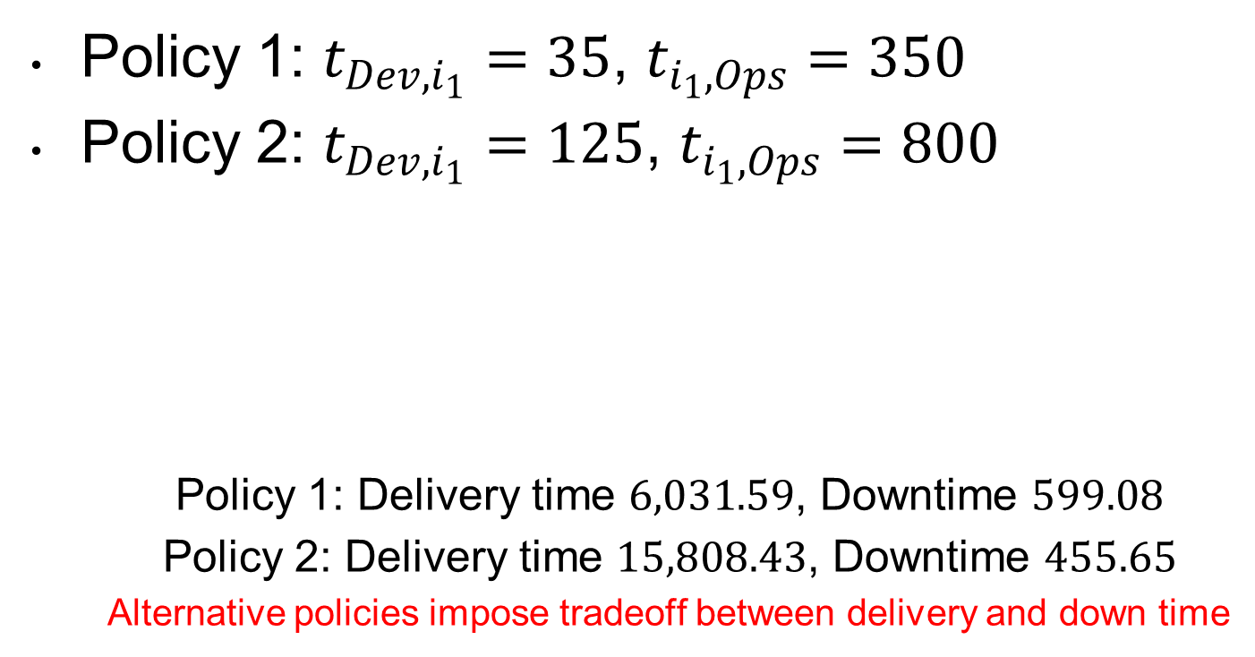
Illustrations: Policy Evaluation
Policy 1: $t_{Dev,i_{1}}=35$, $t_{i_{1},Ops}=350$
Policy 2: $t_{Dev,i_{1}}=125$, $t_{i_{1},Ops}=800$
Policy 1: Delivery time $6,031.59$, Downtime $599.08$
Policy 2: Delivery time $15,808.43$, Downtime $455.65$
Alternative policies impose tradeoff between delivery and down time

Slide 13
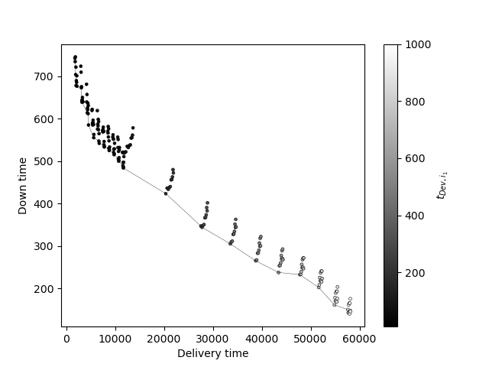
Tradeoff Analysis
Range of policies produces Pareto curve

Slide 14
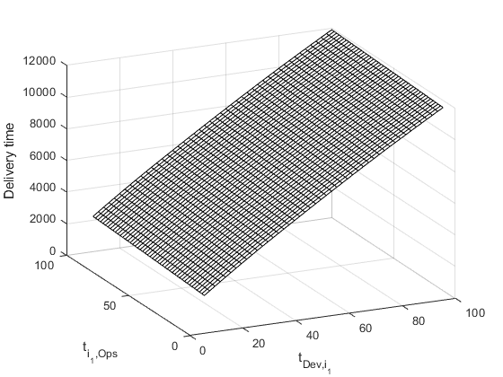
Tradeoff Analysis (2)
Staged rollout policy impacts delivery time

Slide 15
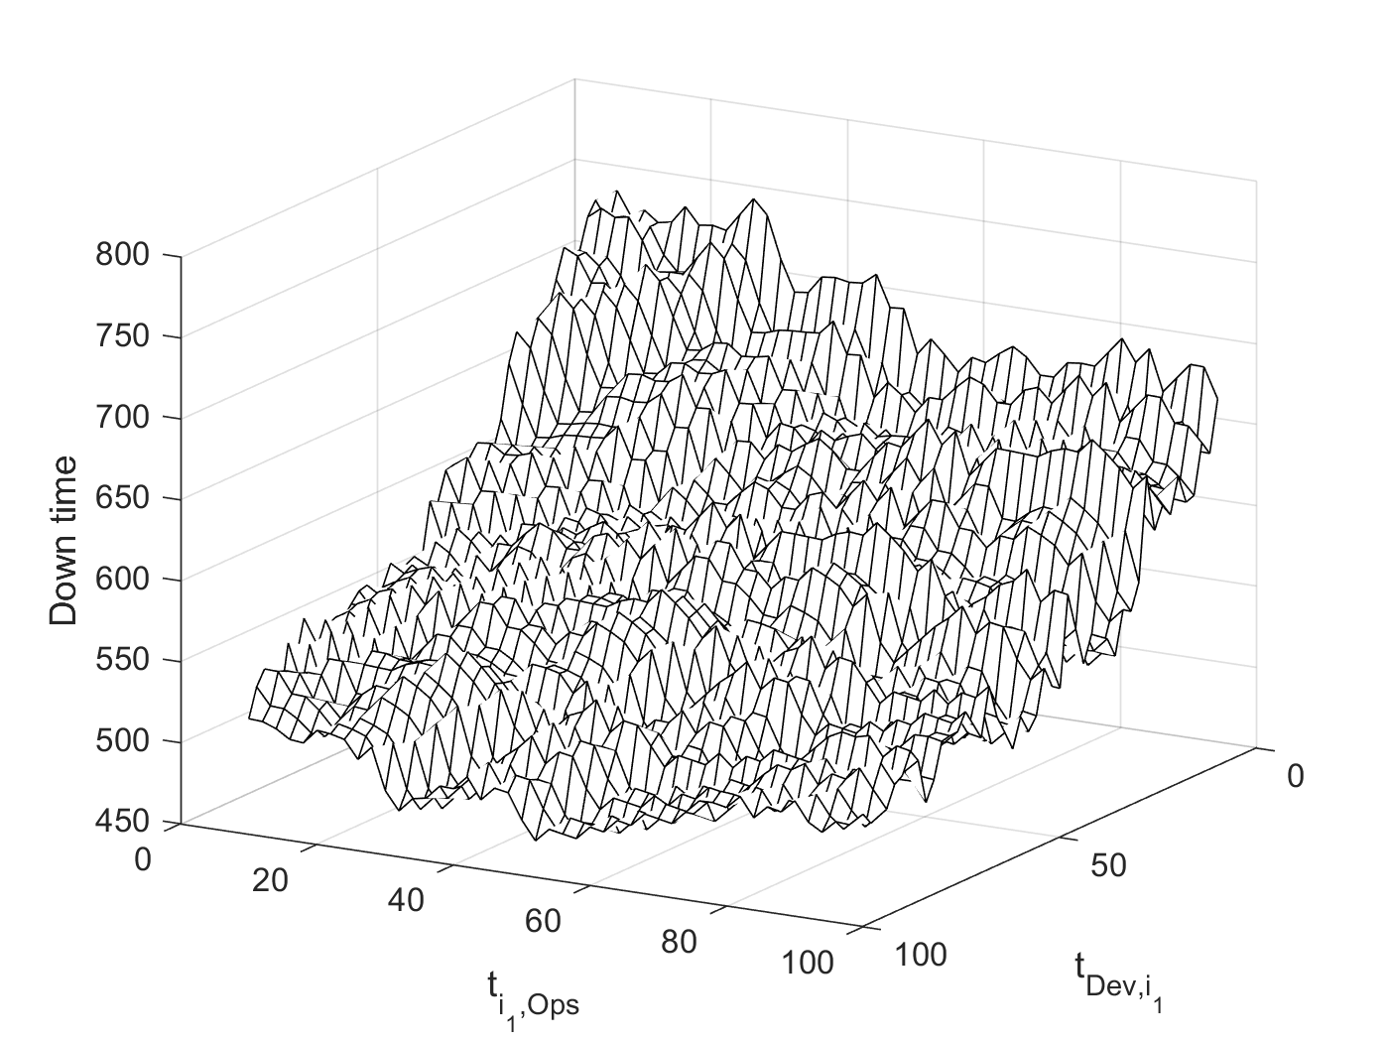
Tradeoff Analysis (3)
Staged rollout policy impacts downtime

Slide 16
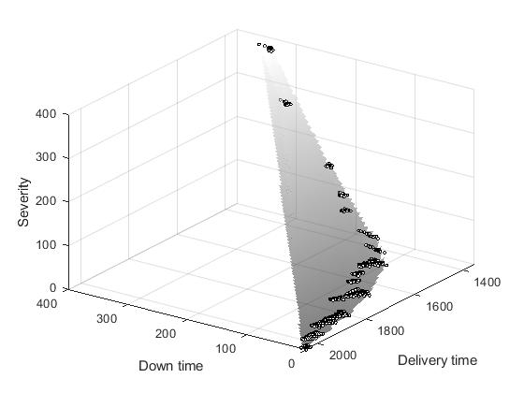
Tradeoff Analysis (4)
Multidimensional trades also possible

Slide 17
Future Research
Extend models to
Further formalize security dimension of tradespace
Determine if more than one intermediate staged rollout state improves tradeoffs
Automate staged rollout decisions with reinforcement learning to solve constrained optimization problems

Slide 18
Conclusions
Presented framework to assess staged rollout approach performed in modern software practices
Enables objective assessment of process and product metrics
Can (i) establish baselines, (ii) assess maturity of an organization, and (iii) inform process improvement efforts

Slide 19
Acknowledgement
This material is based upon work supported by the National Science Foundation under Grant Number (#1749635). Any opinions, findings, and conclusions or recommendations expressed in this material are those of the authors and do not necessarily reflect the views of the National Science Foundation.

