Slide 1
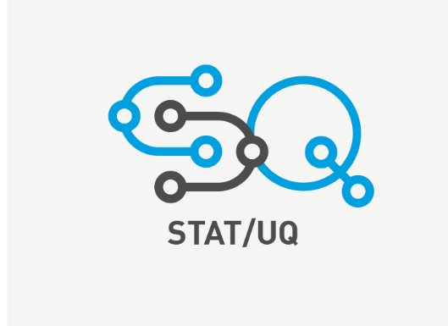
STAT and UQ Implementation Lessons Learned
Growing Statistical Engineering
Kelsey J. Cannon, David R. Harrison
Lockheed Martin Space
©2022 Lockheed Martin, all rights reserved

Slide 2
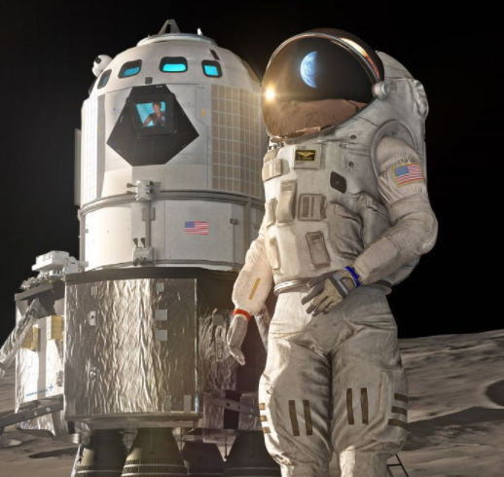
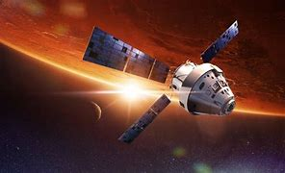

Agenda/Summary
Challenge
Faced with training thousands of engineers in statistics, a plan was formed to make STAT and UQ processes the standard at Lockheed Martin.
Agenda
Beginning state at LM
Implementation lessons learned
  Initial communications plan
  Obtaining leader adoption
  Training engineers
Lessons learned as a vehicle
Notes:
Kelsey

Slide 3
Beginning State at Lockheed Martin Space
Setting
20,000 employees in 2 major locations and multiple smaller locations
Challenge
There is no job code for ‘statistical engineer’
How do we find our audience?
Beginning to Overcome the Problem
Established a monthly Community of Practice
Space Fence and Mk21A both have formal STAT oversight
There are industrial engineers spread out across programs
Approximately half of which are engineers
Notes:
David

Slide 4
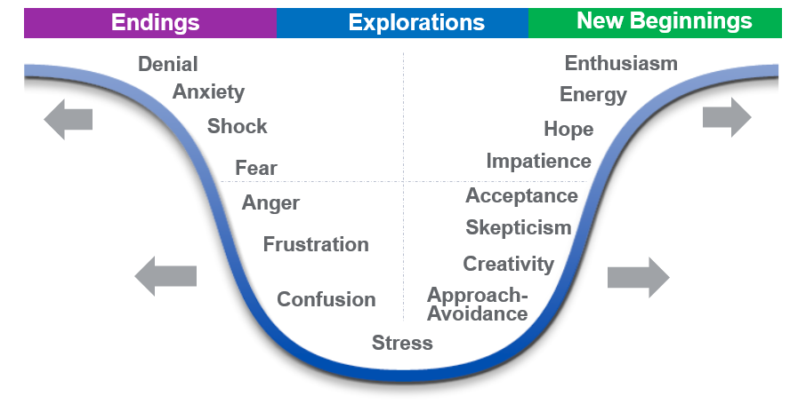
What We Learned About Change Management
Hurdles:
Sheer number of engineers at LM Space
Not many industrial engineers
Gaining credibility and getting buy-in
Approach that did not work:
Very few read mass emails, and fewer act on them
Approach that worked:
Solve from both sides: leadership and word of mouth
Understand the typical engineering landscape and provide hope
Communications plan
  Side campaigns to communicate to leaders
  Get list of leader-nominated trainees
Conduct instructor-led trainings
Successive connections
  200-400 engineers of the ideal audience
Notes:
Kelsey

Slide 5
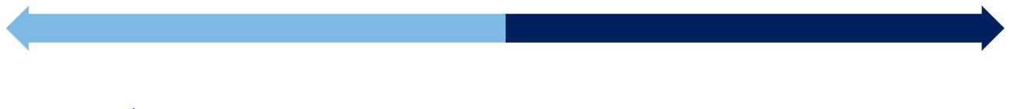

What We Learned About Engineers
Holding Implementation Back
Moving forward
Most engineers have taken 1 statistics course, if any. It is possible that that course could be 10-30 years ago as well.
Encourage excitement and curriculums around applied statistics, verification, and validation.
Some view a statistical background or education as unnecessary .
Real-world examples of time and cost savings have proven effective.
In each training group, there are 1-2 “superusers.”
Acceptance that not everyone can be converted, and the superusers are a socialization tool.
Fragmented use; “if I would have known this yesterday, that would have been great.”
Engage when the challenges arise.
Notes:
David

Slide 6

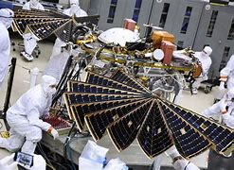
Real-World Example-- Proposals
What do program managers want?
Credibility
Proven Ability
Savings
Efficiency
We have found that engineers pick up on STAT/UQ quickly and intuitively
So what?
When STAT/UQ is required, it inherently overcomes the obstacle of getting buy-in
When STAT/UQ is not required, program managers need to feel like STAT/UQ is a good choice
Notes:
Kelsey

Slide 7
Real-World Example-- nTopology
CEO of nTopology became interested and scheduled training
Half Day Training
Waiting
Waiting
STAT/UQ principles sunk in.
Major software issues solved.
STAT/UQ became a practice
Start
6 months later
Notes:
David

Slide 8
Real-World Mini Examples
Optical Contamination
Ran 80 OFAT experiments and still didn’t have an answer (science project).
Software and Telemetry
This example was from an older IRAD that “had never been solved.” The STAT/UQ process generated a rigorous and defensible test design in less than 1 hour.
Model Based Engineering
A Kriging study was performed on the model and multiple physical tests had been run, but they were not architected to overlap or connect. A Physical DOE was generated to close the gap.
16 runs would have covered 1 contaminant in the year-long effort.
Notes:
Kelsey

Slide 9

Lessons Learned as a Vehicle
Faced with large challenge
Some plans did not work
Some plans did work
Gain ground
Produce savings and proven ability
Notes:
David

