Slide 1
Deep learning prediction of stress fields in additively manufactured metals with intricate defect networks
Brendan Croom (brendan.croom@jhuapl.edu)
Michael Berkson
Robert Mueller
Michael Presley
Steven Storck
JHU/APL, Research and Exploratory Development Department
Acknowledgement:
This work was sponsored by internal research and development funds at JHU/APL.

Slide 2
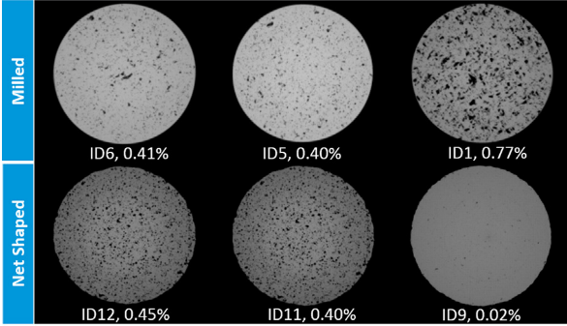
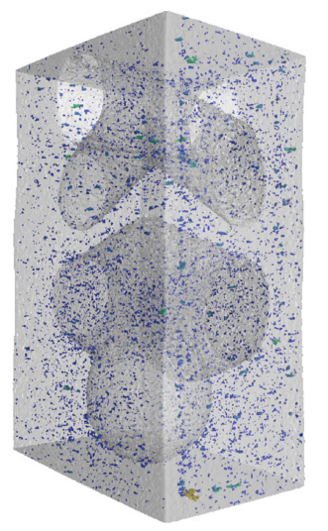
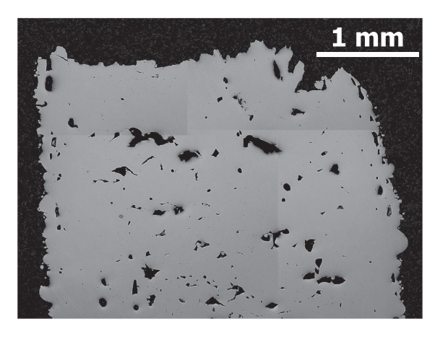
Defects are ubiquitous in L-PBF processes
AlSi₁₀Mg, 0 to 1% porosity
(Beevers Intl J Fatigue 2019)
17-4PH, 0.1% porosity
(Kramer Intl J Fracture 2019)
How do we guarantee mechanical properties despite a large number of pores?
In718, ~5% porosity
(Solberg EFM 2019)

Slide 3
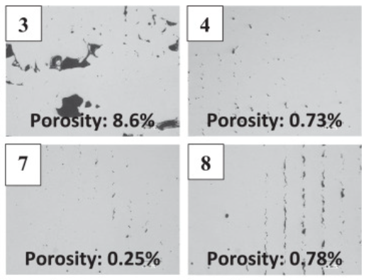
Defect morphology matters
Which sample has the highest strength?
Illustrated with the same volume fraction of porosity
Defects exhibit a variety of shapes:
Low alloy steel, micrographs from parameter optimization study (Seede, Acta Materialia 2020)

Slide 4
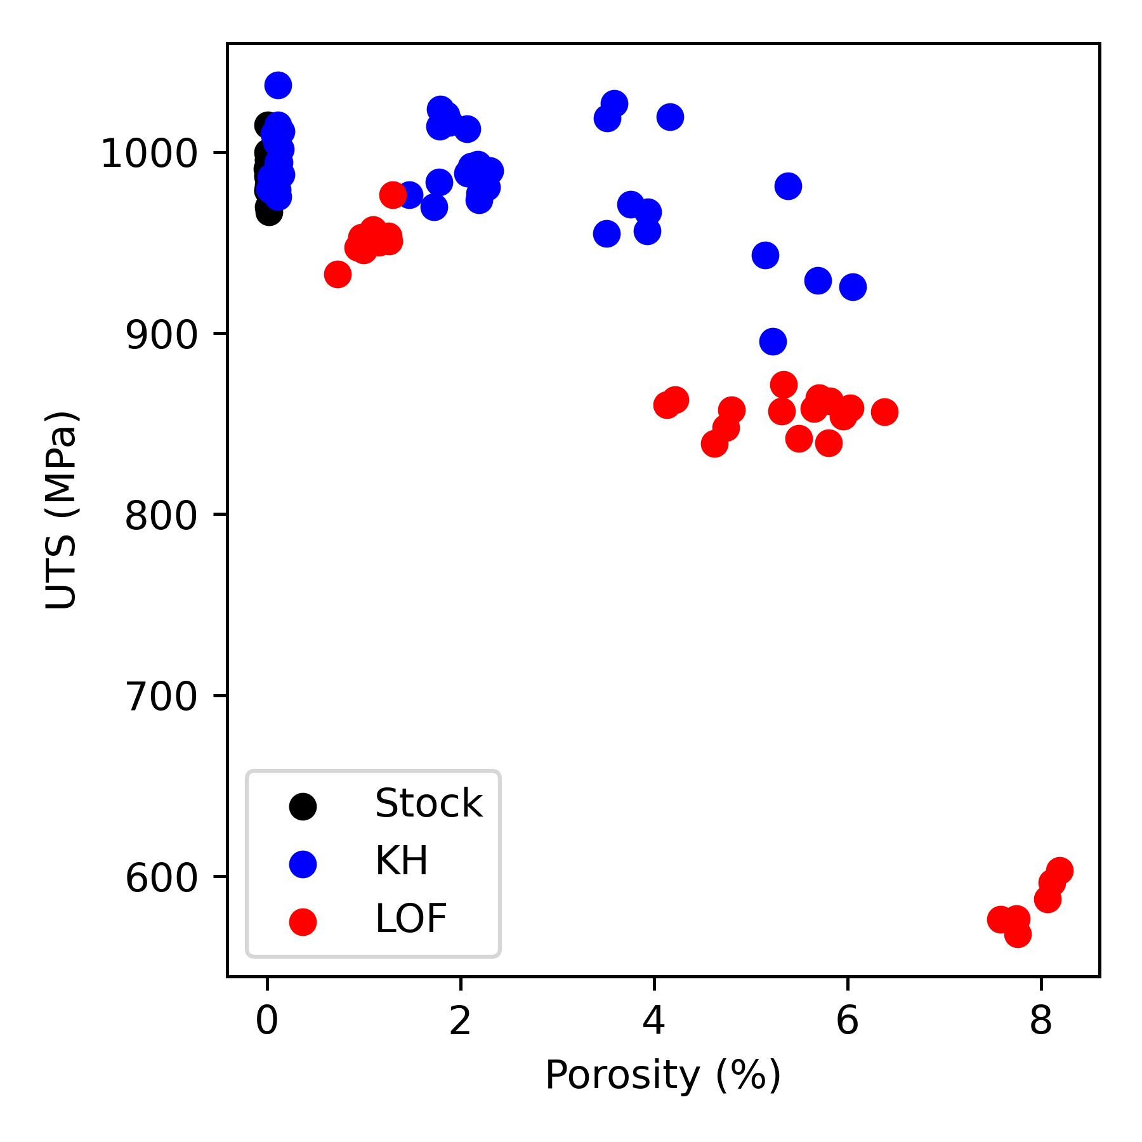
Defect morphology matters
Properties are sensitive to defect morphology:
Ti-6Al-4V, printed with Keyhole and Lack of Fusion defects
(Montalbano 2021)
A need for high-fidelity, efficient evaluation of defects
Acceptable
minimum
properties
Volume fraction is inadequate predictor
Differences in mechanical properties observed based on defect type
Conventional FE methods are time intensive

Slide 5
CNNs to predict the stress localization around defects
Convolutional Neural Networks are appealing strategy to predict mechanical response:
  Image-based solution can capture details of pore morphology, clustering and size
  CNNs as function approximator: can learn to emulate finite element method results
  High solution speed:
    ~100x faster than FFT-based solver
    >1000x faster than conventional finite element method solver
CNNs address many of the primary limitations of current techniques:
Faster than FE, more accurate than heuristic/empirical methods

Slide 6
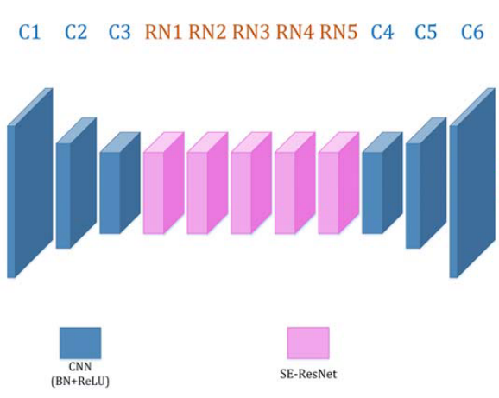
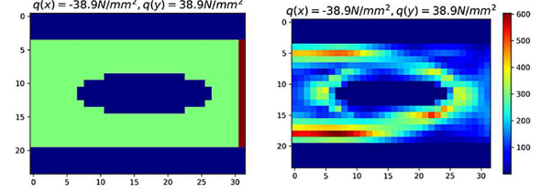


Prior work: StressNet (Nie 2019)
Problem Statement:
Predict stress distribution in cantilever beam with complex geometry using CNN
$$q_{y}$$
$$q_{x}$$
Input:
Beam geometry
Output:
Stress field
Training data:
100,000 images (32x24 px)
Manually constructed cantilever geometry
2D Finite Element solution

Slide 7
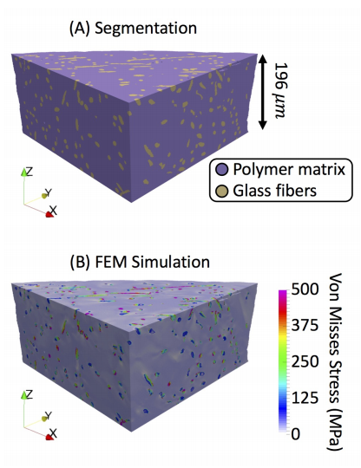
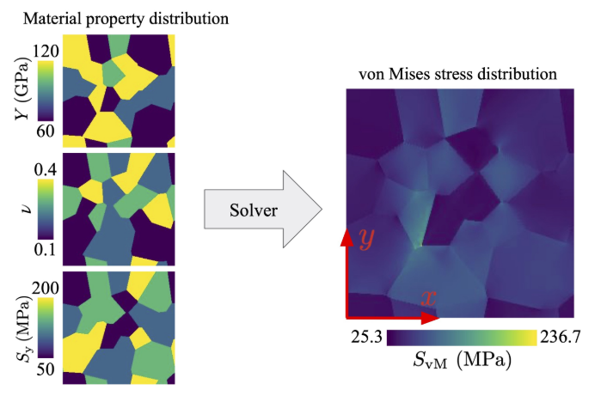
Prior work:
Predicting stress in fiber composites
Encoder-Decoder CNN
(Sun 2020)
Predicting stress in polycrystal metals
U-Net
(Mianroodi 2021)

Slide 8
Research questions:
How do we efficiently generate large training datasets?
Can CNNs predict complex stress fields?
  Defects in AM materials are more complex than prescribed cantilever beams (Nie 2019)
  Defects interact across length scales (i.e., small and large defects)
  Higher “mechanical contrast” than fiber reinforced composites (Sun 2020), crystal plasticity (Mianroodi 2021)
Can CNNs generalize to real AM microstructures?
Aim: Address many of the key obstacles to
CNN adoption

Slide 9
Development of CNN model

Slide 10
Problem definition
Generate random porous microstructure
Calculate stress using FFT-based solver
Train CNN to predict stress from microstructural image
Data generation schema
Downsampled to reduce numerical errors

Slide 11
Challenge 1: Generating large training database
Random generation of porous microstructures
  Overlap between circles = complex geometry
  100,000 training images generated!

Slide 12
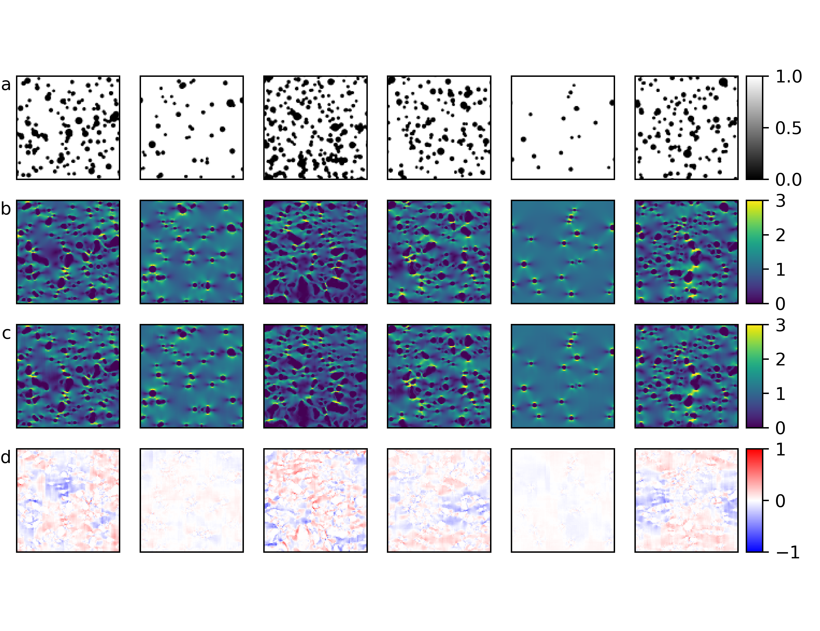
Challenge 1: Generating large training database
Note complex geometry and stress fields
Random generation of porous microstructures
  Overlap between circles = complex geometry
  100,000 training images generated!
Analysis performed on high-resolution images using FFT solver:
  384x384 pixels, then downsampled to 96x96 to enhance numerical convergence
  FFT solver is >10x faster than ANSYS APDL
Microstructure
FE Ground Truth

Slide 13
Challenge 2: Learning multiscale interactions between defects
U-Net architecture
Squeeze-Excitation ResNet module
U-Net is well-suited to the problem
Shortcuts preserve information across multiple length scales
Depth can account for complex stress localization defects

Slide 14
U-Net predicts stress localization around defects
Results after training 500 epochs:
Microstructure
Ground Truth
MAE = 0.066
MSE = 0.0098
CNN Prediction
Difference

Slide 15
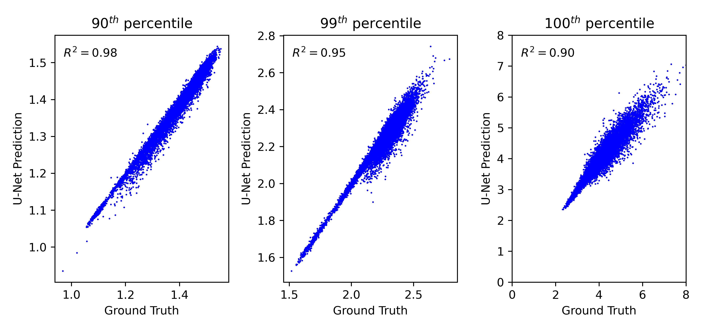
U-Net predicts stress localization around defects
U-Net accurately predicts “extreme” stress concentrations
Works well for 90th, 99th and 100th percentile stress values
Recall, MAE and MSE reflect the average stress

Slide 16
Application to real AM microstructures

Slide 17
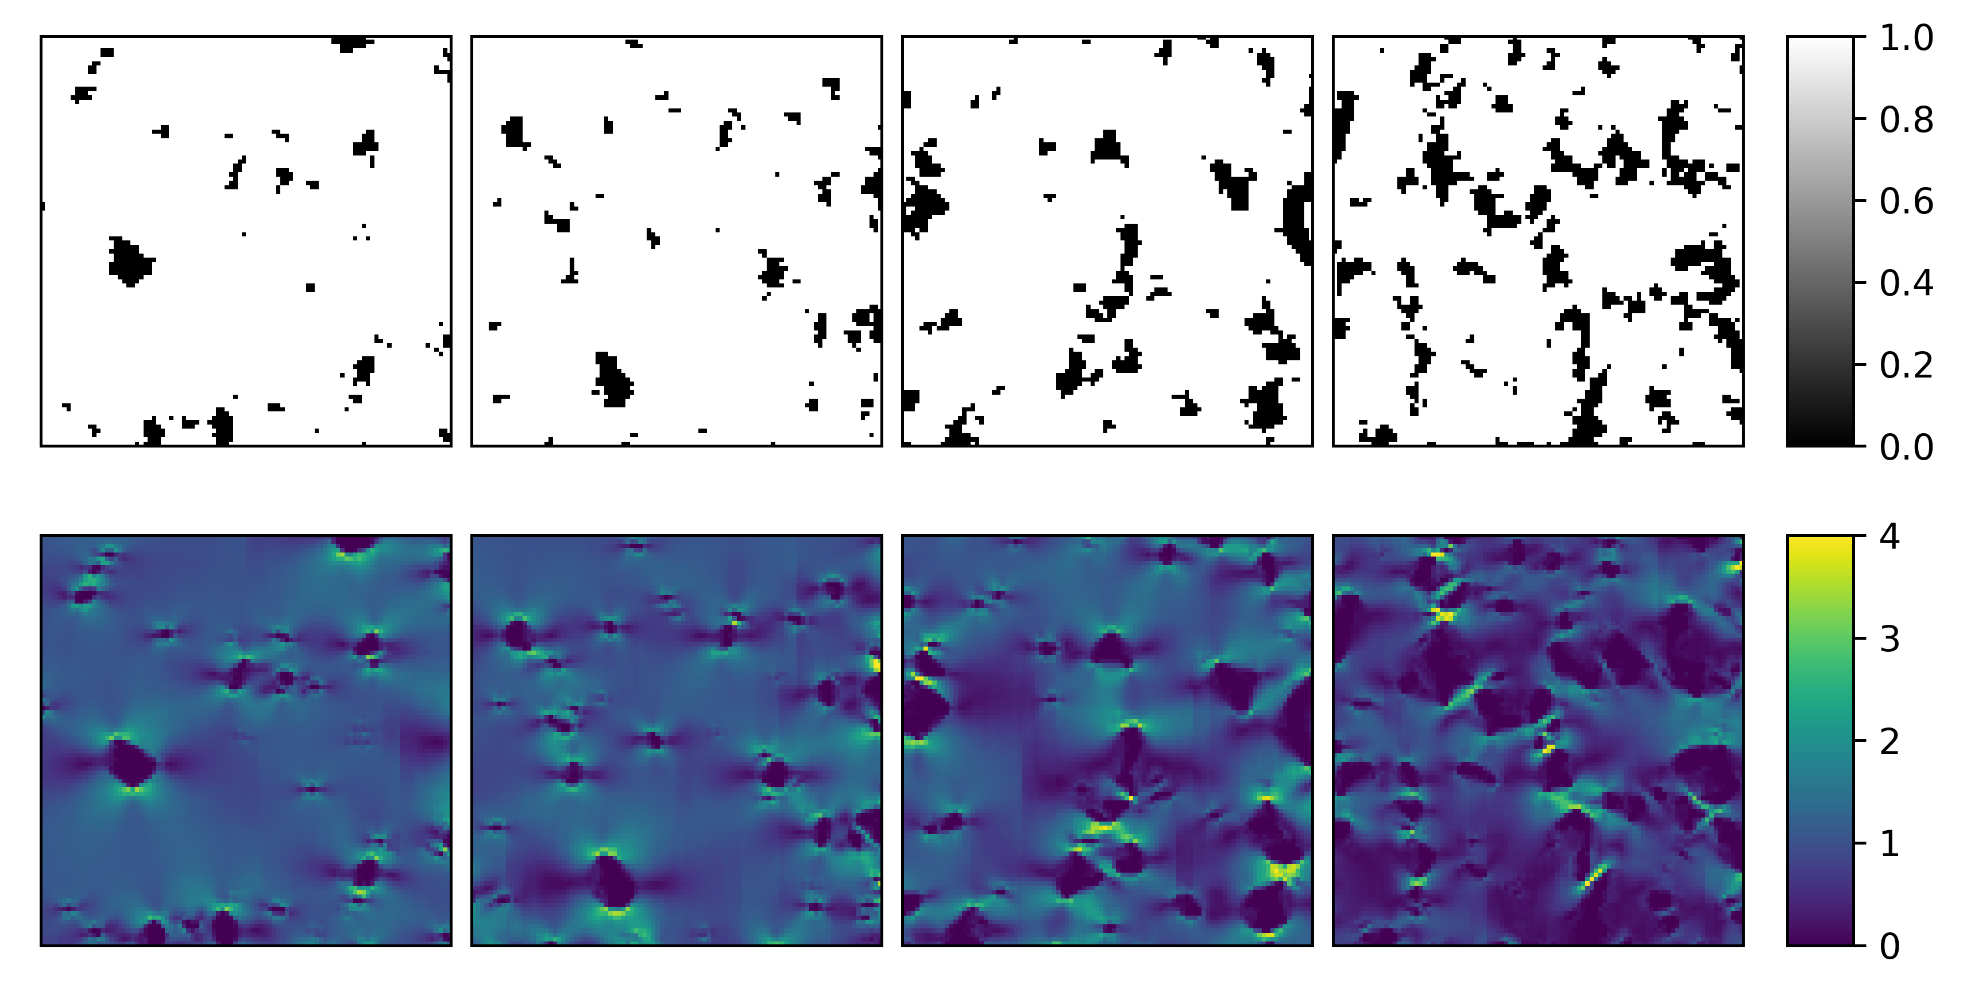
Evaluation of real AM microstructures
Microstructures extracted from XCT images of Lack of Fusion In718 samples
Porosity ranging from 1% to 17%
Defect morphology very different than training data set:
  Angular / crack-like features
  Complex geometry

Slide 18
Evaluation of real AM microstructures
Microstructures extracted from XCT images of Lack of Fusion In718 samples
Porosity ranging from 1% to 17%
Defect morphology very different than training data set:
  Angular / crack-like features
  Complex geometry
CNN stress predictions reveal complex stress state
  Validated against conventional FFT-FE calculations

Slide 19
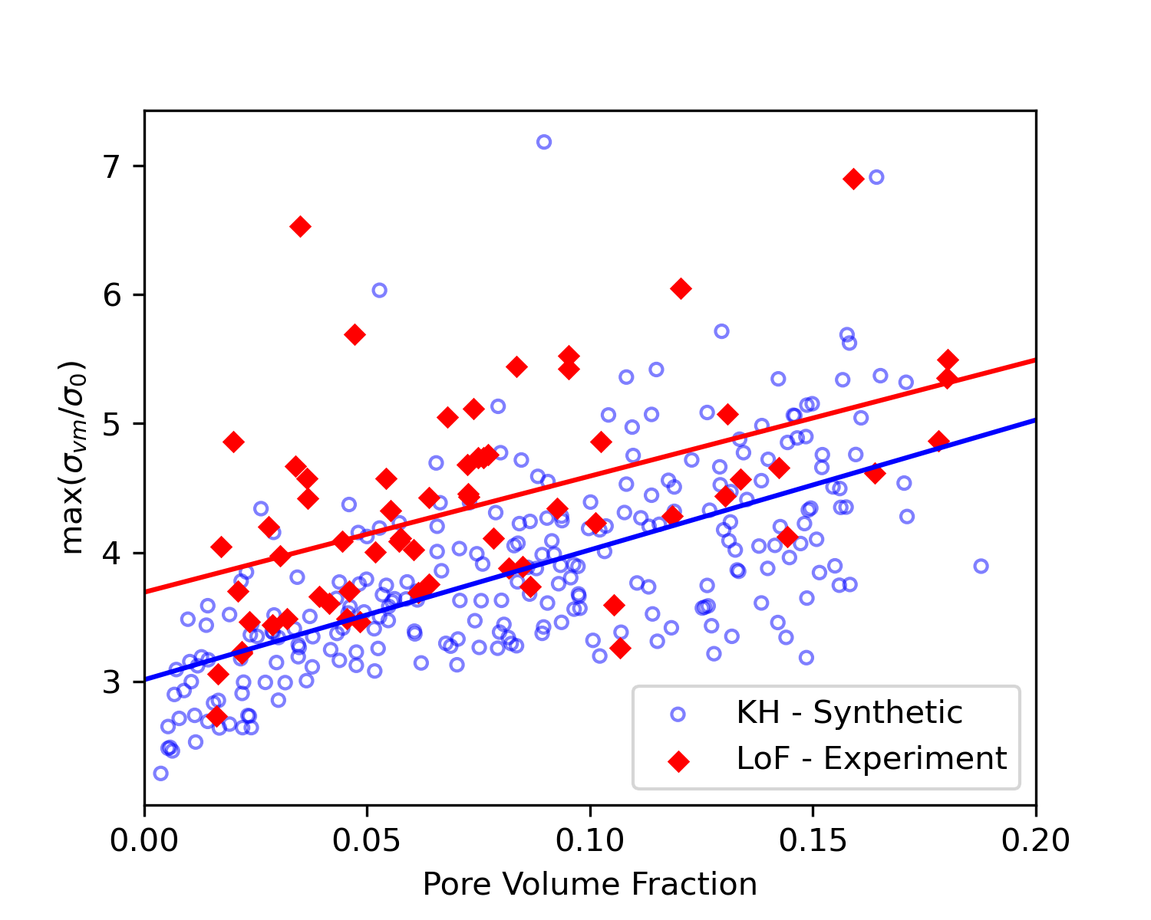
Evaluation of real AM microstructures
Microstructures extracted from XCT images of Lack of Fusion In718 samples
Porosity ranging from 1% to 17%
Defect morphology very different than training data set:
  Angular / crack-like features
  Complex geometry
CNN stress predictions reveal complex stress state
  Validated against conventional FFT-FE calculations
Stress in LoF samples is variable, but systematically higher than for KH samples

Slide 20
Conclusions

Slide 21
Conclusions
FFT-based solver can generate large training database
  10x faster than FE-based solvers
  Well-suited to building large training dataset
U-Net can predict stress localization around defects in AM materials, and fast!
  Indicates untapped CNN potential to solve complex mechanics problems
  CNN is 40x-100x faster than FFT based solver
Trained U-Net can efficiently screen real AM microstructures for stress concentrations around defects
  Highlights effect of pore clustering, morphology on stress localization
  Indicates systematically higher stress around irregular LoF vs. spherical KH defects
CNNs are robust substitute for conventional numerical methods:
  Captures local, long-range effects on stress fields
  Perhaps suitable for uncertainty quantification methods, process optimization

