Slide 1
Everyday Reproducibility
Greg Hunt, W&M Mathematics [ghunt@wm.edu]
Johann Gagnon-Bartsch, UM Statistics [johanngb@umich.edu]
paper: https://arxiv.org/abs/2103.16004
A multi-pronged approach to ensure analyses are fully reproducible, easy to access, and easy to use

Slide 2
A definition by the National Academies [here]
1) Reproducibility – obtaining consistent results using the same data and code (sometimes called computational reproducibility)
2) Replicability – obtaining consistent results when trying to answer the same scientific question using different data and/or code
Today’s talk will focus on 1) computational reproducibility.
Computational reproducibility seems like a low bar, but in practice its often difficult.
Definitions of Reproducibility and Replicability

Slide 3
Challenges:
  Actually running third-party code
    Issues with versions, languages, dependencies, data availability, directory structure,
    troubleshooting is a black hole of time, energy, and frustration
Challenges for Computational Reproducibility

Slide 4
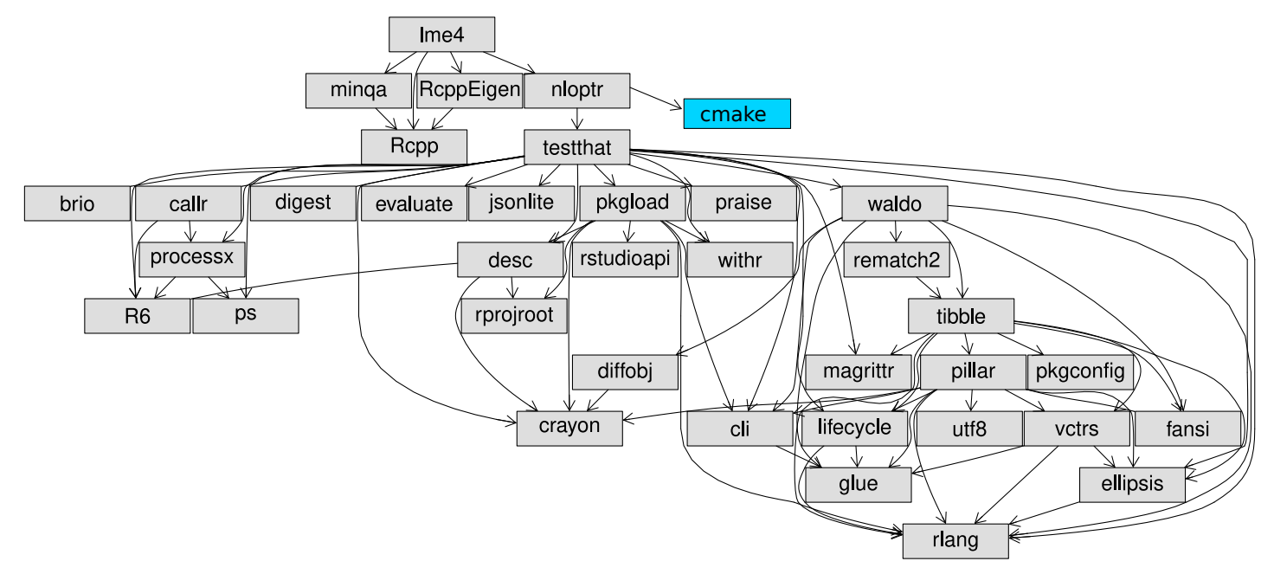
Dependency graph for R package lme4
Dependency Problems are Complex

Slide 5
Challenges:
  Actually running third-party code
    Issues with versions, languages, dependencies, data availability, directory structure,
    troubleshooting is a black hole of time, energy, and frustration
  Understanding and interacting with this code
    Modifying code, parameters, function arguments and observing changes to output
    Finding entry points into analysis
Challenges for Computational Reproducibility

Slide 6
Our goals for computational reproducibility:
The analysis is exactly reproducible from soup to nuts
The code is accessible, understandable, and can be experimented with by various types of users
The code is shareable.
Above all: practicality. We can use this everyday.
Our Goals

Slide 7
Our strategy for computational reproducibility:
Problem 1: actually Running the code
Code containerization: e.g. docker [docker.com]
Problem 2: interacting with the code
2. Code notebooks: e.g. jupyter + jupytext [jupyter.org]
Our Strategy

Slide 8
Problem 1: actually running the code
Our solution: containerization

Slide 9
Containerization
Encapsulates entire system (data, code, dependencies, and programs) into a reproducible, shareable, and self-contained format.
When third-party runs container it will be as if they are instead working on the computer where the analysis was originally done. Programs, files, code, data, and configurations will be exactly reproduced.
Virtualization isn’t new, containerization is a light-weight version:
  Re-use low-level computer resources/structure
  Small on disk, fast to start, runs at native speeds
Three perspectives: 1) high level, 2) using a container, 3) building a container
Challenges for Computational Reproducibility

Slide 10
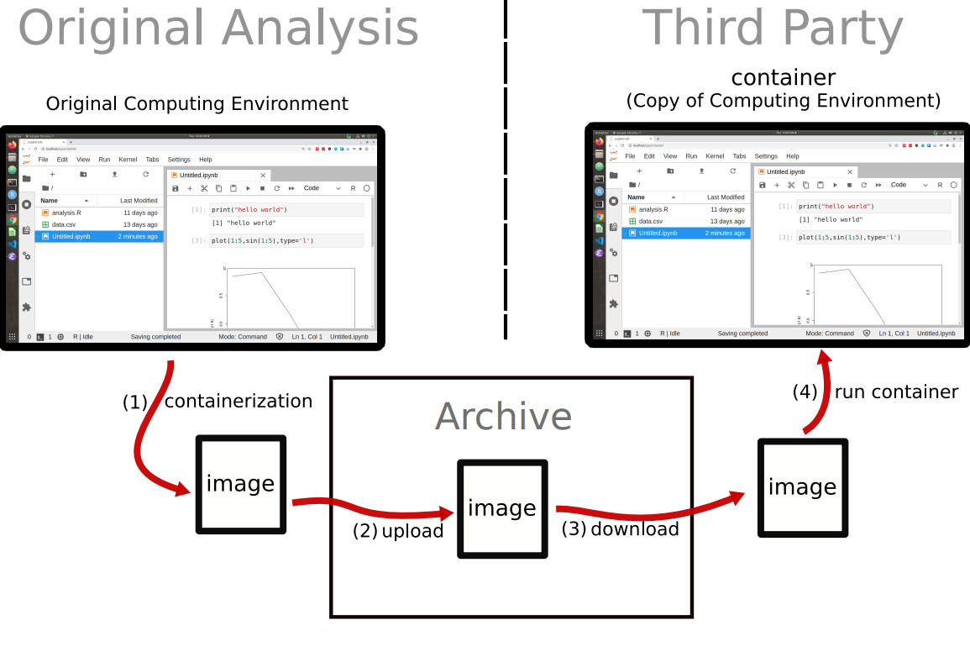
Code Containerization
Perspective 1: High Level

Slide 11
Example Running Container
There are many options for containerization: docker, singularity, podman
Going to use an example using Docker.
Perspective 2: Running a Container

Slide 12
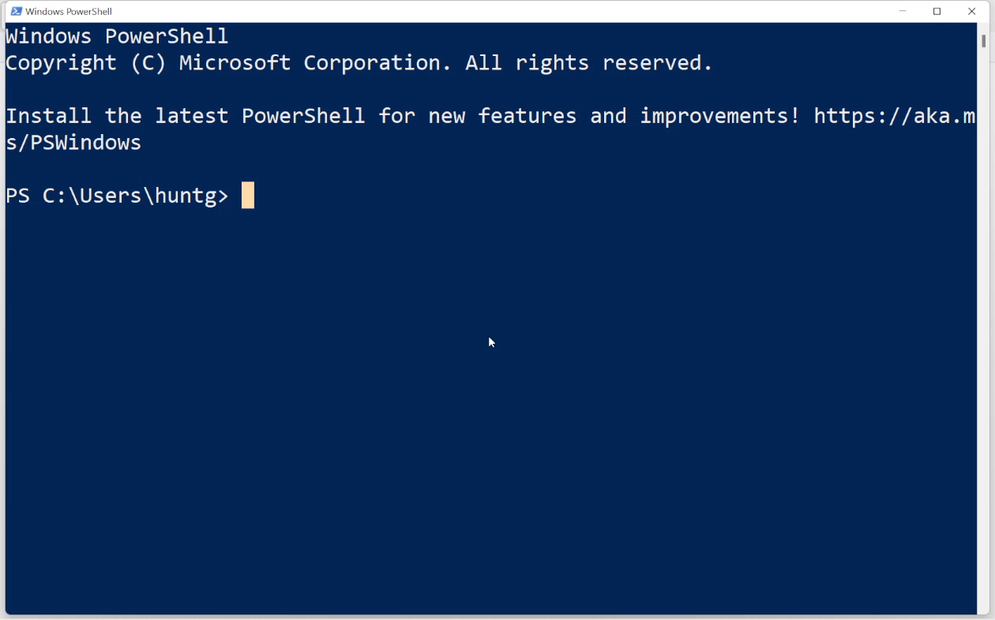
https://youtu.be/Hn3GUi9yvPU
Perspective 2: Running a Container

Slide 13
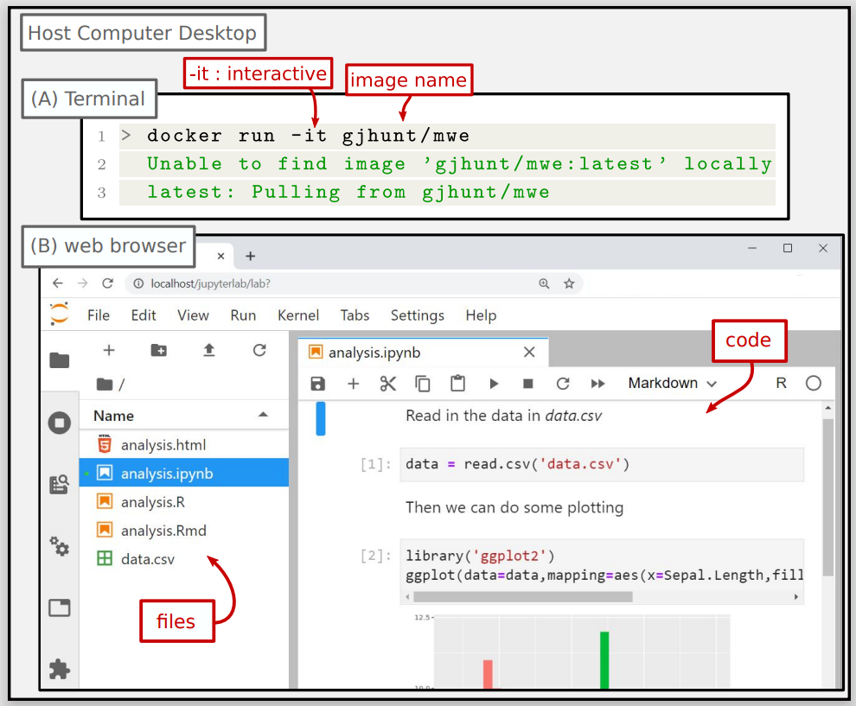
Perspective 2: Running a Container

Slide 14
How to we containerize our analysis?
Need to write a configuration file (for docker called a Dockerfile)
Config file tells image what files to copy over and what programs to install and how to set everything up
You don’t need to start from scratch. Dockerhub has thousands of pre-configured images with (almost) everything already installed.
  Reality: copy over your data and code files, maybe install a couple obscure packages you need
Ex: https://hub.docker.com/r/rocker/r-ver for R
Perspective 3: Containerizing an analysis

Slide 15
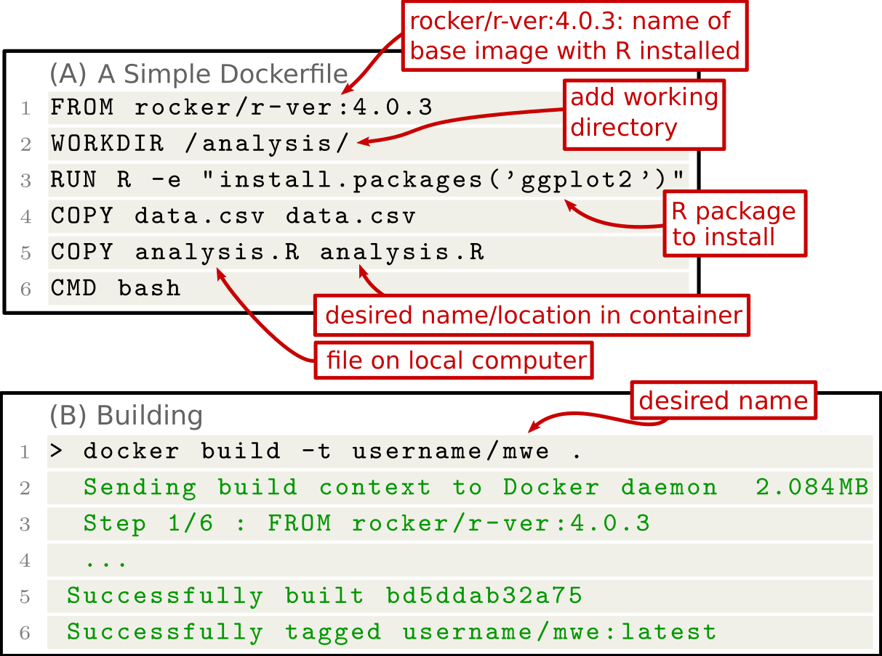
Perspective 3: Containerizing an analysis

Slide 16
Problem 2: interacting with analysis
Our solution: code notebooks

Slide 17
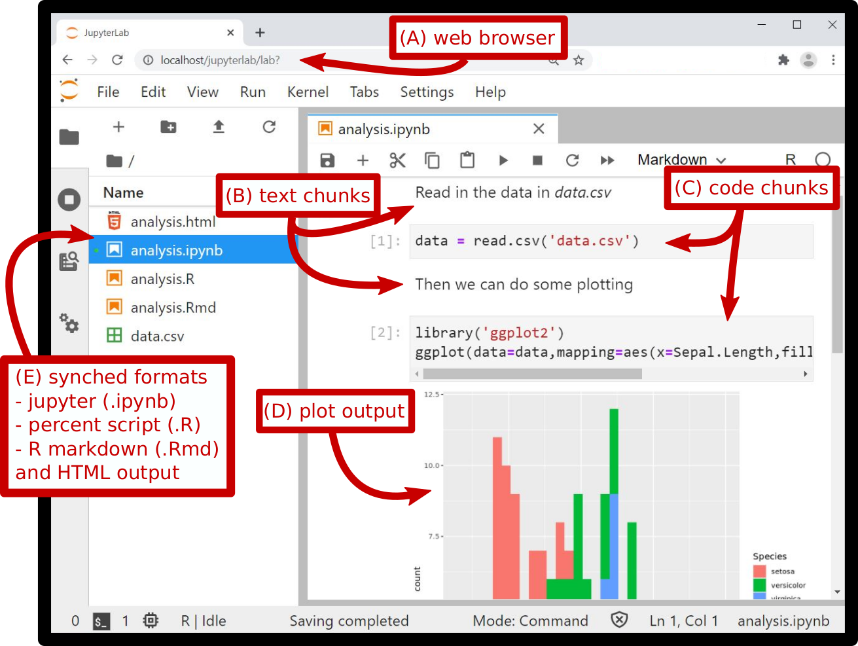
Example: Code Notebook

Slide 18
Command line interfaces aren’t everyone’s cup of tea.
We advocate using code notebooks.
Code notebooks have many benefits:
  Allows natural interweaving of (rich-text) commentary and code which encourages good programming practices
  Allow commentary on output as well as code
  Enables documentation of analysis microdecisions
  Puts output directly beside code/output – a check that figures are actually generated by corresp. code
  Creates logical entry points into code
Problem 2: Interacting with analyses

Slide 19
Caching intermediate results can help with accessibility of code.
Ideally a reproducible analysis will take analysis all the way from
  raw sources,
  to cleaned and processed data sets
  to final results and plots
and cache intermediate results along the way
Raw Data
Processed Data
Results and Output
entry point
cached
raw
cached
processed
cached
ouput
entry point
entry point
Caching

Slide 20
  There are many popular notebook formats e.g. jupyter, rmarkdown, zeppelin
  Most can export results for showcasing e.g. as pdf, html, …
We particularly advocate: project jupyter
jupytext plugin allows us to synchronize all formats
Problem 2: Interacting with analyses

Slide 21
Final Thoughts:
  Goal of the approach: easy to use, interact with, share, and perfectly reproducible
  Other benefits of containerizing notebooks:
  Security for running code
  Tool for teaching and talking about reproducibility
  Forces a code review
  Can be interwoven with popular languages and development platforms
  Potential Issues:
  Data and code rights (proprietary software issues)
  Archiving and storage (https://zenodo.org/)
Final Thoughts

Slide 22
Thanks!
More info:
gjhunt.github.io/containerize
Thanks

Slide 23
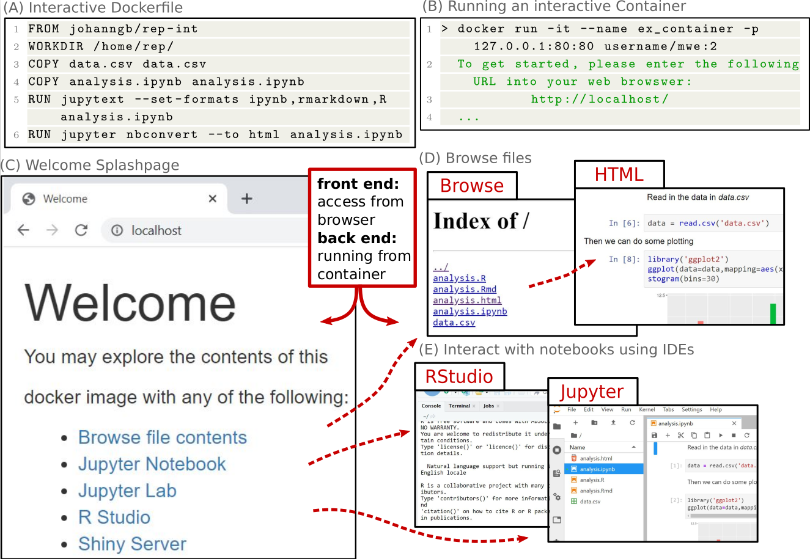
You can containerize code notebooks

