Slide 1



Survey Dos and Don’ts
Gina Sigler & Alex McBride
Scientific Test and Analysis Techniques
Center of Excellence
www.AFIT.edu/STAT

Slide 2

Pros & Cons for Using a Survey
Pros
  Reach large group of people easily
  Exploratory purposes
  Efficient & inexpensive
  Consistent
  Easy to analyze
Cons
  Data quality is dependent on the survey quality
  Non-response bias
  Accuracy
Notes:
Surveys can be distributed to a large group of people rather efficiently and at a relatively low cost. They can also be used for exploratory purposes to gain more knowledge about the population of interest. They have the potential to help investigators make informed decisions for further phases of research. Surveys also contain a level of consistency because each respondent is asked the same-worded questions, eliminating some forms of bias such as interviewer bias. Furthermore, when a survey is designed correctly, the data is fairly easy to analyze.
The quality of your data is completely depended on the quality of your survey. So a poorly designed survey will result in poor quality data. Another con is the risk of non-response bias. Respondents could incompletely answer the survey questions, or fail to complete it entirely. There are also accuracy issues that should be considered. The accuracy of the data could be questionable due to misinterpretation of the question, respondents’ literacy, and respondents’ honesty. One or more of the cons mentioned previously could result in the sample data being unrepresentative of the true population of interest. This is a critical issue because the purpose of collecting the sample data is to make inference on a population of interest or answer a research question. This can only be done if the sample data is representative of the true population.

Slide 3

Common Mistakes
The STAT COE has compiled a list of their top 5 survey mistakes
Think of any surveys you might have seen in the past, did any of them fall prey to these common mistakes?
The quality of the data from a survey is entirely dependent on the design of the survey and the amount of upfront planning that was involved

Slide 4
The STAT Process
Determine the problem statement
  Develop research question(s) based on the problem statement
  The research question(s) drives the scope and nature of the survey
Surveys can guide the development of testing goals, factors, and responses
Be sure to refine research question to ensure a survey will accomplish the testing goal
Surveys need clearly defined test variables related to the STAT goal
What do you think makes a good problem statement?
Notes:
The STAT process begins with a well-defined problem statement. Break down the problem statement into goals and decide where a survey might provide the most value. Research questions are then derived from the problem statement. Developing clear, concise research questions is imperative because it drives the scope and the nature of the survey. Surveys can be implemented in the STAT process to guide the development of testing goals, factors, and responses. However, many research questions don’t require a survey. So always consider all possible options for answering the research questions before resorting to a survey. The research questions should be refined and revisited throughout the process to ensure the survey will accomplish the testing goal. For effective data analysis, surveys need clearly defined test variables related to the overall STAT goal.

Slide 5

STAT Process
Requirements
PLAN
Understand
Requirements
ID/Clarify/Quantify
STAT Candidates
Program Level
Basic Test Process
Decompose Mission/System
Screening
Characterization
Verification
Optimization
STAT Infusion
Determine Objective(s)
System decomposition and developing practical objectives is critical
Define Design Space
Design Factors
Recorded Conditions
Noise
Define Response(s)
Randomization
Blocking
Disallowed Combinations
Select Factor(s) / Level(s)
Identify Constraint(s)
DESIGN
Confidence & Power
Signal & Noise
Coverage
Replication
Create
Test Matrix
Orthogonality
Model Specification
Optimality Criteria
Does the analysis address the requirement?
Perform sequential tests that build on previous results
EXECUTE
Run Card Generation
Experimental Protocol/Training
Record Deviations
Execute Test
ANALYZE
Analysis of (Co)Variance
Response Surface Methodology
Regression Modeling
Multivariate Analysis
Distribution Fitting
Hypothesis Testing
Monte Carlo Simulation
Optimization
Report Decision Quality Info
Decision-quality information gives insight into system performance and quantifies risk
Program Decision(s)
Employ a STAT Working Group for Best Results
Notes:
Updated to match animated slides as of 8/17/2020
The typical current test process

Slide 6
Motivating Example
Imagine you are tasked with evaluating the comfort and fit of a new prototype flight helmet
Problem Statement: In a particular unnamed aircraft, pilots are in need of a helmet that will provide suitable protection and an acceptable level of function without sacrificing an appropriate level of comfort. This will optimize protection, mission effectiveness, and performance. Comfort refers to having a proper fit that will decrease the long term medical risks to the pilot relative to the current system.
Research Question: How do pilots feel the new prototype helmet compares to the legacy in terms of comfort and fit?

Slide 7

Survey Implementation
Spend adequate time in the planning phase to determine where the survey will provide the most value
  Preliminary vendor selection
  User feedback
  Operational testing
  Pre/Post test
Work backwards
Ensure the survey maps back to the test objectives
Don’t create unnecessary work
Allocate time and resources to survey design and sampling plan development
Notes:
The planning phase is where the test team must decide whether a survey will provide value, and where it should be implemented for maximum return on investment. Surveys are often used for tech demos or vendor selection. If multiple vendors are being considered, surveys can be used to collect user feedback to down select to a single vendor for follow on testing. They are also common in operational testing.
Perhaps there is a new financial system being implemented across the DoD. It has made it to the operational testing phase. A survey can be used to collect feedback on the new system in its typical, operational environment. Consider whether a pre/post test is necessary to track attitudes/satisfaction before and after significant changes. Sometimes it’s easier to work backwards. Focus on the data you hope to collect and/or the analysis you wish to conduct and determine how a survey can help you get there.
Always make sure the survey is going to provide value in some capacity. There is no point in creating unnecessary work for the test team. The test objectives drive the entire STAT process, and the survey should map back to the test objectives through some avenue. In addition, adequate survey design and development is necessary to ensure high quality data is collected. This includes question/response development, formatting, well-developed sampling plan, distribution, data entry, data cleaning, analysis, conclusions. If there is not enough time or resources to allocate to this upfront effort, then don’t include a survey in the test plan.

Slide 8
Test Variables
Generated from research question(s)
Well-designed test variables help ensure the correct questions will be answered
Should be measurable, of practical consequence, and provide a clear route to data analysis
Having a clear understanding of the target population makes it easier to form test variables
Without well-defined research questions and test variables, surveys have a tendency to answer the wrong question!
Notes:
The research question comes from the problem statement and goals outlined in the “understanding requirements” phase of the STAT process and will help generate the variables of interest for the research study. Without well-defined research questions and test variables, surveys have a tendency to answer the wrong question. Surveys with strong research questions, clear survey objectives, and measurable responses avoid situations where the collected data cannot be analyzed.

Slide 9

Identify Target Population
Need a representative sample in order to make inference that is on the population of interest
Consider population characteristics such as:
  Gender
  Experience as operator
  Professional background
  What others can you think of?
Attempt to motivate the audience to respond
Develop a sampling plan to collect data
Notes:
A representative sample is necessary to make inference on the population of interest. It’s important to not only identify the target population, but also any defining characteristics of the population that should be considered when designing the survey. Proper interpretation of the questions is critical to gathering accurate data, so being aware of population characteristics that could affect interpretation is important. It’s also usually a good idea to attempt to motivate the audience to respond. Try to explain the purpose of the survey, emphasize why their participation is valuable, and discuss what positive outcomes or decisions could be made based on the resulting data.

Slide 10
Survey Distribution
There are many methods of survey distribution
  Face-to-face discussions either individually or with a group
  Telephone calls/texts to individuals (used to be very common to cold call)
  Mail-in surveys
  E-mail or web based (which are currently the most popular)
Each method has its own pros and cons and might result in a different selection of participants
This can tie back to sampling methods if you are trying to get a particular sample
Notes:
Note that the ideal sampling method may not be possible depending on how you intend to distribute the survey. There are many methods of survey distribution can each one can have a different audience or response rate. Method of survey distribution should be part of the planning process.

Slide 11
On-line Survey Tools
On-line Tool | # of surveys | # questions | Cost? | # respondents | Custom design?
Google Forms | ∞ | ∞ | Free | ∞ | Yes
Survey Monkey | ∞ | 10 (∞) | Free ($26 per month) | 100 (∞) | No
Type Form | ∞ | ∞ | Free ($29 per month) | 100 per month (∞) | Yes
Survey Legend | 3 (∞) | ∞ | Free ($15 per month) | ∞ | Yes
Polldaddy | ∞ | ∞ | Free ($200 per year) | ∞ | No (yes)
Survey Planet | ∞ | ∞ | Free ($180 per year) | ∞ | No (yes)
Surveynuts | ∞ | 10 | Free | ∞ | No
Zoho Survey | ∞ | 15 | Free | 150 | No
Qualtrics | ∞ | ∞ | $1,500 a year + | ∞ | Yes
SoGoSurvey | ∞ | ∞ | Free ($25 per month) | 200 per year (∞) | Yes
Don’t forget that surveys might require PA approval!
Notes:
There are many on-line survey tools available. All of them have some pros and cons. The table in the slide shows a small subsample of tools that are available. Most of some free version that can be used with some minor drawbacks. Please keep in mind that not all question types might be available with each survey tool. Also, most free versions of the tools will have either ads, logos, or other methods of advertisement.
Don’t forget to discuss with leadership if an on-line survey tool is allowed! Many policies do not allow on-line survey tools. Also, there can be issues either setting up or sending out on-line surveys due to firewalls or blocked sites.

Slide 12
Question Choice

Slide 13

Types of Questions
Open-ended
  Difficult to analyze
  Take respondent more time to answer
  Help researcher gain new insights
Close-ended
  Force respondent to select one or more answers
  Save time
  Simpler to analyze
Open-ended questions lead to arduous analysis
Notes:
There are two main types of questions found on surveys. The first are open-ended questions that allow for respondents to give a free response. While this gives the respondent the most flexibility to provide information, it can also be very difficult to analyze. These types of questions can be very useful to gain new insights or to get opinions from respondents. On the other hand, close-ended questions only allow respondents to choose from a selection of possible answers. These are usually much more easily analyzed, but do not offer any room for explanation. A good survey will have a mix of both questions that relate back to the overall research question.

Slide 14
Types of Closed-Ended Questions
Dichotomy: standard yes/no question
  Limited amount of information
  Often prone to wording bias
  Simple and fast to answer
  Easy to analyze
Example
  Have you worn the new prototype helmet during flight?
    Yes No
Notes:
Dichotomous questions are the most simple of the closed ended questions. Respondents are asked to choose from one of two options. The dichotomy can take on other forms from yes/no such as agree/disagree, fair/unfair, or true/false.

Slide 15
Types of Closed-Ended Questions
Multiple choice: select one answer or select all that apply
  Could force the respondent to pick a single choice
  Simple to analyze
  Still gives only limited and categorical information
Example
  Select the size of helmet you wear.
    Small Medium Large
  Select all the helmets you have worn during flight testing.
    Prototype 1 Prototype 2 Prototype 3 Legacy
Notes:
Multiple choice questions build upon the dichotomy to add other possible selections. For these types of questions, the respondent could be asked to choose a single answer or select as many answers as apply. Answers should be mutually exclusive and should cover all possible responses.

Slide 16
Types of Closed-Ended Questions
Likert scale: obtain positions on certain issues
  Difficult to word without creating bias
  Allows for a quantitative assessment
  Simple to analyze
Example
  Please rate your comfort level for your current helmet.
  Very uncomfortable Uncomfortable Neutral Comfortable Very Comfortable
  1 2 3 4 5
Odd numbers of response choices allow for a neutral response!
Notes:
Likert scale questions typically give five or seven options on a numbered scale. This allows for the respondent to give a response of neutral. The wording of Likert scale questions can be tricky and should be carefully chosen so that the respondent is not biased towards any particular answer. Consult a STAT expert for help designing question scales that yield measurable responses.

Slide 17
Common Likert Scales
Frequency
Agreement
Satisfaction
Never | Rarely | Sometimes | Often | Always
Strongly disagree | Disagree | Neutral | Agree | Strongly Agree
Very dissatisfied | Somewhat dissatisfied | Neutral | Somewhat satisfied | Very satisfied
Notes:
Questions for discussion:
How might you change these from 5 point to 7 point scales?
For each common scale, is it unipolar or bipolar?

Slide 18
Survey Development

Slide 19
Wording Matters
Survey conducted in the 1940s on opinions of free speech
Half of respondents were asked if:
  they felt ‘public speeches against democracy’ should be ‘forbidden’
Other half were asked if:
  they felt ‘public speeches against democracy’ should be ‘allowed’
54% endorsed ‘forbidding’ the speeches
75% say no to ‘allowing’ the speeches
Rugg D. Experiments in wording questions: II. Public Opinion Quarterly. 1941; 5: 91–92. 10.1086/265467
https://www.ncbi.nlm.nih.gov/pmc/articles/PMC5056712/
Notes:
Why does wording matter so much? Because humans have specific reactions to certain words and phrases. As this is often not an area of study for us, we have to be very careful in how questions are worded as it may trigger an unexpected response.

Slide 20
Positive and Negative Framing
Think about the framing of the two statements:
  Due to safety issues, use of the system should be prohibited
  So not to limit options, use of the system should be permitted
The first statement has a negative framing and the second has a positive framing
A good way to determine the respondents’ true attitudes is to have respondents answer both the positive and negative framed questions
Notes:
Participants may be biased to agreeing or disagreeing with all questions depending on how many questions are asked. Or, respondents may have different responses to the same question when worded in different ways as seen with the 1940s opinions of free speech example.
By having the same question included from the two different viewpoints, you can check to see if respondents are appropriately reading the questions and/or if there are any extreme differences in the two different framings.

Slide 21

Survey Bias
Types of Bias
Nonresponse Bias: respondents unwilling or unable to participate
Voluntary response bias: sample consists of volunteers who offered to provide data or complete the survey “self-selection”
Response Bias
  Leading questions: Poorly worded questions that lead respondents to answer a certain way
  Social desirability: Resistant to admit to unsavory attitudes, beliefs, behaviors, etc.
  Measurement Error: Using the wrong response scale for respondents to answer with
Notes:
Everyone is familiar with bias. We often hear about biased news outlets. Certain news channels or newspapers have a tendency to sway viewers/readers in a certain direction, or they may only report information that is in favor of their stances on issues. The same can be true for surveys. Whether intentional or not, bias can creep into surveys if they are not properly planned and designed well. It is imperative that a survey is designed in such a way that bias is minimized or eliminated to ensure the resulting data is unbiased. Biased data will lead to biased conclusions, which is never the goal!
There are several types of bias. Nonresponse bias occurs when respondents are unwilling or unable to participate. Ethically, no one can be forced to complete a survey; if subjects refuse to complete a survey, then nonresponse bias is introduced. Nonresponse bias can also occur if subjects are unable to participate. Perhaps you distribute your survey via email, and some people don’t have at-home internet or their firewall blocks the message. Those people will fail to complete the survey and are thus unrepresented in your sample.
Another form of bias is voluntary response bias. This occurs when your sample consists of people who willingly agreed to complete the survey for one reason or another. A great example are product reviews. As consumers, we are not forced to complete a product review survey but we may do so if we choose. Perhaps you buy a product on Amazon and you hate it. You are so disappointed with your purchase that you give it a bad review online while filling out a satisfaction survey. However, if you were content with your purchase, you’d probably be a lot less likely to fill out a satisfaction survey in the first place. So a product’s reviews might be biased toward a negative rating because people who were unsatisfied with the purchase are much more likely to fill out the survey.
Response bias is a side effect of design flaws in the survey. Characteristics such as poorly written questions and inappropriate measurement scales can cause response bias.

Slide 22
Leading Question
Poorly worded question that leads respondents to answer a certain way
Including additional information within the question about one side of the issue that would influence how the respondent answers
We know the new financial system has drastically increased efficiency across the DHS, how would you rate the usability of the updated system?
1 Neutral | 2 Satisfied | 3 Very Satisfied
Notes:
Leading questions are exactly what they sound like. The wording of the question is biased and therefore “leads” a person to answer a certain way. The response choices can also be leading if they only include positive options, (e.g. ok, good, very good, excellent). The verbiage of each question should be neutral so that respondents answer honestly without any other influences, and the response scale should be balanced and comprehensive.

Slide 23

Social Desirability
Resistant to admit to unsavory attitudes, beliefs, behaviors, etc.
Please rate your supervisor’s ability to communicate his/her expectations.
1 Very Poor | 2 Poor | 3 Neutral | 4 Good | 5 Very Good
Notes:
Sometimes responses are affected by social desirability. This is common with very polarizing questions where people don’t want to be judged for answering honestly. For example, let’s say you visit your doctor and they ask you the standard set of questions, including whether you drink alcohol, smoke, amount of exercise, etc. If you happen to be a smoker, you might be inclined to lie and say you don’t smoke because you don’t want to be judged negatively by your healthcare professional.

Slide 24
Measurement Error
Providing the wrong scale or answer choices for responses
Balance between being comprehensive but not too overwhelming
Issues with consistency
Example: Please circle your marital status?
Single | Divorced | Married
Response options are just as important as question wording
Notes:
Measurement error can occur when an incorrect or inconsistent scale is used to collect data. It is critical that the scale or answer choices associated with each question are comprehensive but not too overwhelming. You don’t want to leave out an option that a respondent might need. For example, people often forget to include a “Not Applicable”, or N/A, option when necessary. If a statement or question doesn’t apply to a respondent, they might leave the question blank, select a different answer that isn’t entirely accurate, or quit filling out the survey entirely. Any of those outcomes will introduce bias. If you plan on doing a before/after or pre/post questionnaire you especially need to ensure the exact same survey is being used for both. If the questions and/or response options change, then comparisons can no longer be made.

Slide 25
Question and Answer Wording
Avoid double negatives
  Facilitators were not unhelpful.
Only ask about one topic at a time
  How would you rate the comfort and safety?
Mutually exclusive question choices
  Does this happen?: Yes, Sometimes, Rarely, No, Never
Notes:
Notes for writing your own Likert Scale questions:
Avoid using double negatives in your questions. This includes using the words “no” or “not” in conjunction with negative prefixes (un-, in-, mis-, etc.), negative adverbs (seldom, hardly, little, etc.), or exceptions (unless, except, etc.).
Avoid double-barreled questions or questions that ask more than one question. Stick to only one topic at a time in case respondents have differing opinions. Even if you think the two topics are tied together, the respondents may see things differently. Split questions on multiple topics into multiple questions.
Create choices that are mutually exclusive when creating your own scales. In the example above, what is the difference between “no” and “never”? How do you think someone filling out this survey question would respond using this scale if they were deciding between no and never?

Slide 26
Writing Likert Scale Questions
Unipolar versus bipolar items
  Not satisfactory, somewhat satisfactory, satisfactory, very satisfactory
  Very dissatisfied, not satisfied, neutral, satisfied, very satisfied
Statements and questions
  Rate agreement with statement: The device was comfortable.
  What level of discomfort did the product cause?
Notes:
Purposely choose to create a unipolar or bipolar question. Unipolar questions focus on the presence or absence of an attribute, where one end of the scale could be thought of as 0 and the other end a high value. Bipolar questions instead give two opposite choices at the two poles and a neutral middle response. In the case of bipolar questions, you could consider 0 to be the middle choice and the two ends to be positive and negative values. The appropriate type of scale is dependent on the topic and planned analysis.
Also, Likert Scale questions can have two distinct setups: statement or question. When writing a question, make sure that the responses make sense as answers to the question. It is often quite easy to switch back and forth between a question and a statement in the phrasing of the individual survey item. Again, some choices may be more suitable given a particular survey topic or analysis plan.

Slide 27
Writing Free Response Questions
There can also be some pitfalls to writing free response (open-ended questions)
  Try to word the question to provoke more than a yes or no response
Example:
  Do you notice any differences in the fit or comfort of the new helmet versus the legacy helmet?
Reword:
  What differences do you notice in the fit or comfort of the new helmet versus the legacy helmet?

Slide 28

Consideration Summary
Keep narrow focus on key issues
Keep each item brief
Write with clarity
Use familiar vocabulary
Keep sentences simple
Avoid bias or error
Use structured questions
Characterize answers carefully
Select suitable categories
Use scales effectively

Slide 29
Analysis

Slide 30

Analysis
The analysis method should be considered throughout the entire design process
  The survey design is dependent on the type of analysis the team wants to conduct
  Question development must take the analysis method into consideration to ensure the appropriate data will be collected
Types of analysis
  Descriptive statistics
  Principal components analysis
  Factor analysis
  Cluster analysis
  Hypothesis testing
  Regression analysis
Notes:
The analysis options available are dependent on the type of data (quantitative or qualitative) that is collected. Therefore, the questions should be designed with a particular analysis method in mind to ensure the appropriate data will be collected to conduct that analysis. When the analysis phase is not considered throughout the survey planning and design process, the analysis methods to choose from becomes very limited.

Slide 31
Descriptive Statistics
Simple way to present results through graphical and/or numerical summaries
If the data is quantitative, mean, median, and standard deviation can be calculated
Graphical methods to analyze data:
  Histograms
  Boxplots
  Scatter plots
  Bar charts
Descriptive statistics can always be performed on survey data
Notes:
Most of the time, descriptive statistics are used for exploratory data analysis before further, more informative analysis is conducted.

Slide 32
Limitations of Data
Not truly continuous data
  Discrete numeric values
  Distance between values is often arbitrary
How would you rate the distances between the values?
Descriptive statistics such as means and standard deviations have difficult interpretations
Often | Sometimes | Seldom | Never
1 | 2 | 3 | 4
Notes:
While Likert scales do create numerical values, it is often difficult to interpret them purely as numbers. Consider the example question from earlier:
Please rate your comfort level for your current helmet.
Very uncomfortable (1) Uncomfortable (2) Neutral (3) Comfortable (4) Very Comfortable (5)
Can we assume that the distance between neutral and comfortable is the same distance as between very uncomfortable and uncomfortable? Also, if you have an average score of 1.8, how do you interpret that on the given scale? This may be easier on some scales than for others.

Slide 33
Likert Scale Analysis
Median is often used as measure of central tendency
Bar chart can be used to look at distribution of individual questions
Can use non-parametric tests without normality assumption
Calculating overall question “score”
  Can add answers to 4 or more questions
Having acceptable or unacceptable responses to questions
Calculate proportions above thresholds
Notes:
Methods of analysis for Likert Scale data are often debated among statisticians. Because of the difficult interpretations of the mean and the standard deviation, the median is often used as the measure of central tendency. More often than not, the median will also be a whole number that can easily be interpreted on the original scale.
To look at the results of a single Likert Scale question, a bar chart can be created. Or, non-parametric tests might be used to look at the results of a single question without any assumptions of normality. While non-parametric tests have less power than their parametric counterparts, they are more appropriate when the assumptions of normality and thus symmetry are violated.
One alternative is to create a score metric (as will be seen in the System Usability Scale section) based on the answers to multiple questions. It is suggested that at least four question scores be added together to create an overall score metric. After scores are calculated, the distribution can plotted and analyzed to see if parametric tests may be used. Caution should be taken to make sure adding the scales from the questions makes sense. Varying the framing of questions (positive/negative) means that the scales might be reversed from one question to another.
Another alternative is to create a dichotomy among question responses. On a five point scale, perhaps there are two responses that are deemed acceptable and three that are deemed unacceptable. The responses can now be analyzed using binomial methods. While this does lead to a loss of information, it also allows the analysis of individual questions.

Slide 34
Principal Components Analysis (PCA)
PCA replaces correlated variables with fewer, uncorrelated variables called principal components
Principal components retain most of the information from the original variables
Each principal component accounts for a portion of the total variation
  First few components typically account for a large portion, so the other components can be discarded
PCA is an exploratory process and does not produce a model
Notes:
PCA is a dimension reduction method used when variables are highly correlated. PCA is difficult to interpret, and you will not end up with a model as a result. Instead, PCA creates a list of components that can be used for further analysis. There are also different approaches for how to determine which components will be kept. You can keep the first k components that explain a large portion of the variability, you can analyze the correlation matrix and keep components with an eigenvalue greater than 1, you can investigate a scree plot, or you could consider if the component has a practical/useful interpretation. For these reasons, PCA is controversial among statisticians.

Slide 35
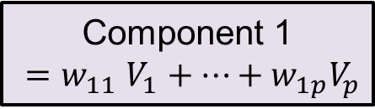
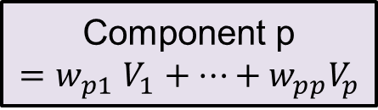
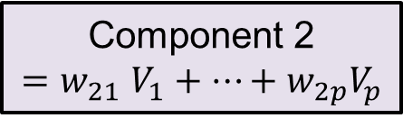
PCA – The Idea
Variable 1
Component 1
${=w}_{11}V_{1}+…+w_{1p}V_{p}$
Variable 2
Component 2
$${=w}_{21}V_{1}+…+w_{2p}V_{p}$$
Select first q components
Variable p
Component p
$${=w}_{p1}V_{1}+…+w_{pp}V_{p}$$
Notes:
When you run a principal component analysis, it will produce the same number of components as you have original variables. However, the components are produced in order of how much variance they account for, so you will only select a subset of components and ignore the components generated after some point. It is up to you to decide where that point is. Each component is orthogonal to the others and is a linear combination or your original variables.

Slide 36
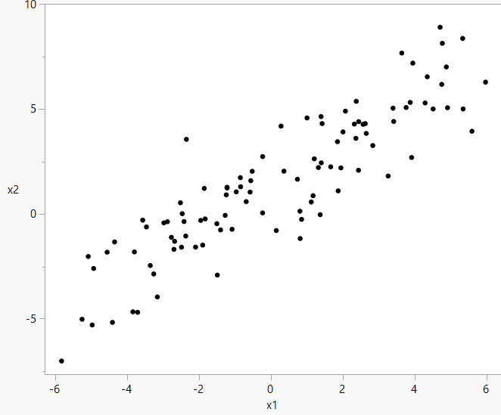

PCA – The Idea
Notes:
In this example, there are two original variables, x1 and x2. PCA will identify two components such that the first component is in the direction of the most variance and the second component is at a right angle to the first (just like the original axes) and accounts for as much variance it can under that condition. In this case, where would you draw the axis for the first component?

Slide 37
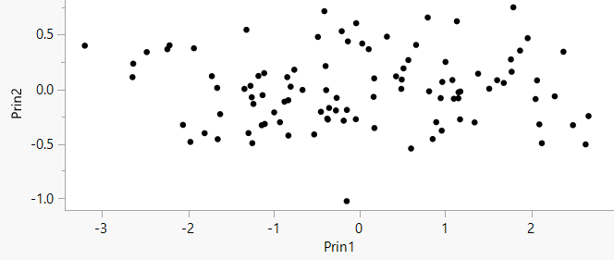
PCA – The Idea

Slide 38
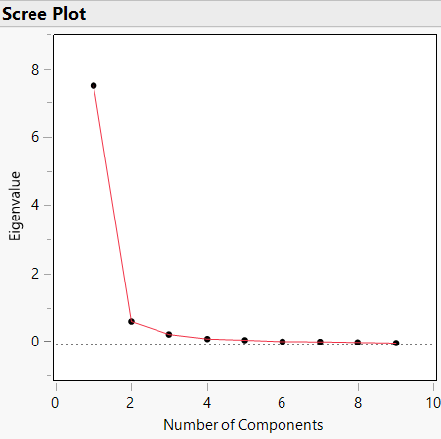
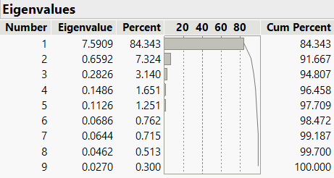
PCA – How Many Components Should I Choose?
Eigenvalues
  Component should be included if eigenvalue is
    Greater than 1
    Greater than .7
Cumulative Variance
  A cumulative variance of at least .7 to .8 is ideal
Scree Plot
  Diminishing returns
Interpretability*
Notes:
There is rarely a correct number of components to choose from PCA. You may use the eigenvalues of the components (visualized with the Scree plot), the cumulative variance, and (to a lesser extent) interpretability of the components to decide where your cut-off point is. When looking at the Scree Plot, it helps to look for where the graph bends (sometimes called the ‘knee’ or ‘elbow’ of the plot).
*There is debate among statisticians as to whether it is ever appropriate to interpret PCA components. So use this to inform your judgement with caution.

Slide 39
Factor Analysis
Attempts to account for correlations between variables
Tries to identify underlying, common factors responsible for groups of variables with large within-group correlations but small between-group correlations
Factor Analysis can be used to construct a model, but it is difficult to interpret
Notes:
Factor analysis is also a dimension reduction method, but unlike PCA, you can use it to construct a model. However; like PCA, factor analysis is difficult to interpret so it’s controversial among statisticians.

Slide 40
Factor Analysis – The Idea
Factor 1
unobservable
Factor 2
Observed variable 1
Observed variable 2
Observed variable 3
Observed variable 4
observable
Notes:
We use Factor Analysis when want to know something about the underlying factors. These factors are of interest, but we are unable to directly observe them. So instead, we observe variables that we believe to be observable manifestations of the underlying factors we wish to measure. Because multiple observable variables result from one factor, those variables are correlated with each other. The goal of factor analysis is to use the correlation between observed variables to recover the information about the underlying factors. This is different than PCA which finds factors that account for the greatest amount of variability and factor analysis does assist with model building.

Slide 41
Factor Analysis – Model Assumptions
$$V_{i}=w_{i0}+w_{i1}f_{1}+ …+w_{iq}f_{q}+e_{i}$$
Factors are uncorrelated
All factors have a mean of zero and variance of one
Errors are independent and centered around zero

Slide 42


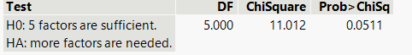

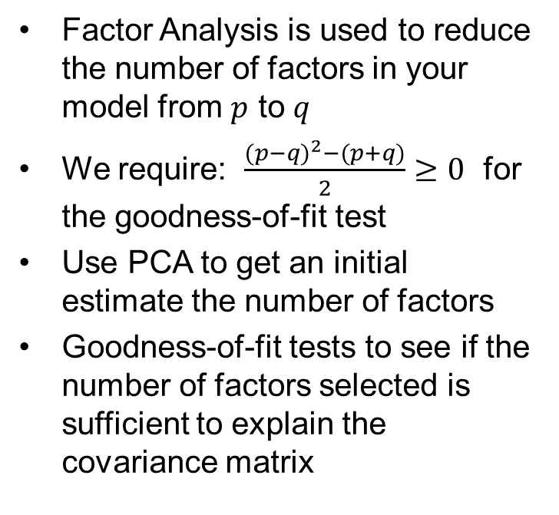
Factor Analysis – How Many Factors Should I Choose?
Factor Analysis is used to reduce the number of factors in your model from $p$ to $q$
We require: $\frac{{(p−q)}^{2}−(p+q)}{2}≥0$ for the goodness-of-fit test
Use PCA to get an initial estimate the number of factors
Goodness-of-fit tests to see if the number of factors selected is sufficient to explain the covariance matrix
Test for Common Factors
Goodness-of-Fit Test
Notes:
Like with PCA, it is up to you to decide how many factors you think are needed. It is helpful to do PCA first and use that to inform your choice of the number of factors you select. There are two additional considerations regarding how many factors to choose. First, there is a test to determine if the number of factors you selected are ‘sufficient’ to account for the correlation in the observable variables. Additionally, it is important to select few enough factors relative to the number of observed variables to make the above inequality true. If this inequality is not satisfied, then you will be unable to test to see if the number of factors you selected was sufficient (this appears differently depending on what version of JMP you have).

Slide 43
Factor Analysis – Evaluating the Fit
Interpretability
Rotated Factor Loadings
Goodness-of-Fit
Significance Tests
Explained Variance
Final Communality Estimates
When evaluating the fit of the model proposed by factor analysis, you are looking to find the best balance between interpretability, goodness-of-fit, and explained variance
Notes:
It is rare that we can build a model using Factor Analysis that demonstrates good interpretability, sufficient goodness-of-fit, and explains the variance in the observed variables well. Most of the time we will want to compare several different models produced by factor analysis to determine which model strikes the best balance between these three goals. Consider the end goals of your analysis when evaluating how to balance these goals, some projects might have a heavier requirement on goodness-of-fit, other projects might be looking to explain the most variance.

Slide 44
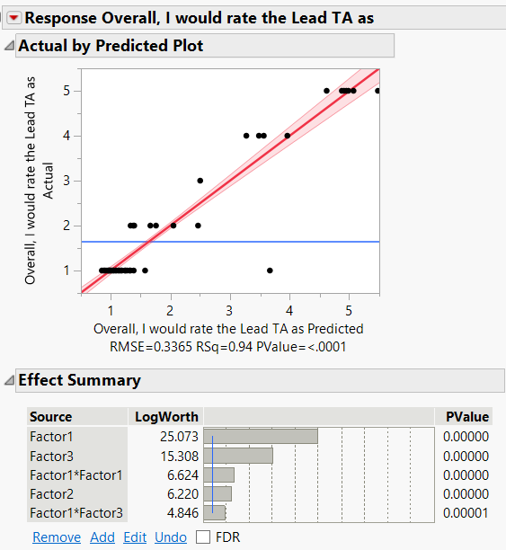
Factor Analysis - Regression
After deciding on the number of factors to put in your model, you can build a regression model based on those factors
Caution: If you have oblique factors, you might consider examining the correlation between your factors before proceeding with regression
Notes:
If you try to perform regression on your original variables, there are two problems you might run into. First, you may have too many variables to estimate the effect of; and second, you may have highly correlated variables which violates an assumption of regression. Factor analysis (particularly orthogonal factor analysis) should help to resolve these problems by reducing the number of observed variables to the smaller number of underlying factors and by forming factors that are less correlated than your original variables. Recall that using an oblique rotation during factor analysis can produce correlated factors, so before using those factors in a regression model, you should check to see how extreme the correlation between your factors is.

Slide 45
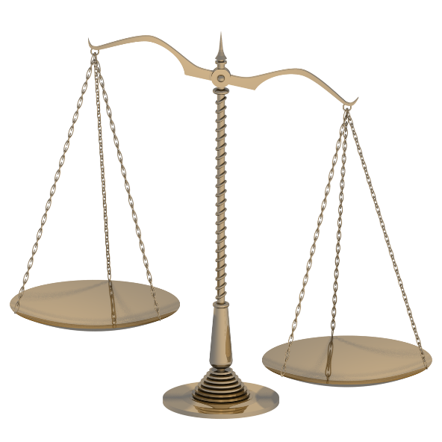
PCA vs Factor Analysis
PCA is ideal if your only goal is to reduce dimensions and you are not worried about interpretability
Accounts for variance
Factor Analysis is ideal when you wish to interpret underlying factors
Accounts for covariance among original variables
This Photo by Unknown Author is licensed under CC BY-SA

Slide 46

Cluster Analysis
Clustering is often done as a first step when analyzing a large dataset to identify patterns or relationships among observations
The patterns are found by grouping similar observations into clusters
Like PCA or Factor Analysis, clustering may also provide insight into potential data reduction
Notes:
Cluster analysis attempts to group the observations into like clusters. This can be done graphically by plotting observations and seeing where natural groups form. Often this method is used with factor analysis to minimize the number of survey questions that measured the same thing.

Slide 47
Types of Clustering
The clusters as a whole are dissimilar from each other
  Distance is typically used as a dissimilarity metric
  It can also be used to identify points that do not match other common patterns
After deciding the appropriate number of clusters, assess the validity and interpretability
We will review two types of clustering that might be useful for survey analysis
  Hierarchical Clustering
  K-Means Clustering
Notes:
While there are many different distance metrics that can be used for clustering, they are all about measuring some form of “closeness”. Of course using different distance metrics can lead to different clusters being made within the data. There are also different methods of combing those points into explainable clusters. In this course, we will only cover the first two simplest methods: hierarchical clusters and k-means clustering. In both of these methods, we seek to find patterns in our survey responses.

Slide 48
Hierarchical Clustering
Each point begins as a single cluster
Close points are then merged together to form one single cluster
This process is repeated until all data points are combined into one cluster
Our goal is to look at the lower order groups of clusters to see if certain types of people might have their like responses explained by clusters
Once assigned, points do not leave a cluster
Notes:
This method of clustering will produce the same clusters for any given data set as long as the same metric for distance is used. However, a different result may be obtained if a difference metric is used. The method also does not make any recommendations as to how many clusters should be considered. There are as many different combinations of possible clusters as you have data points, which can make the interpretation more tricky.

Slide 49
Hierarchical Example
Consider a student evaluation data set where Likert scale scores on 28 questions have been collected from 5820 students²
Can see what relationships there are to student responses on the questions
What can you glean from the clustering graph on the next slide?
²Gunduz, G. & Fokoue, E. (2013). UCI Machine Learning Repository [[Web Link]]. Irvine, CA: University of California, School of Information and Computer Science.

Slide 50
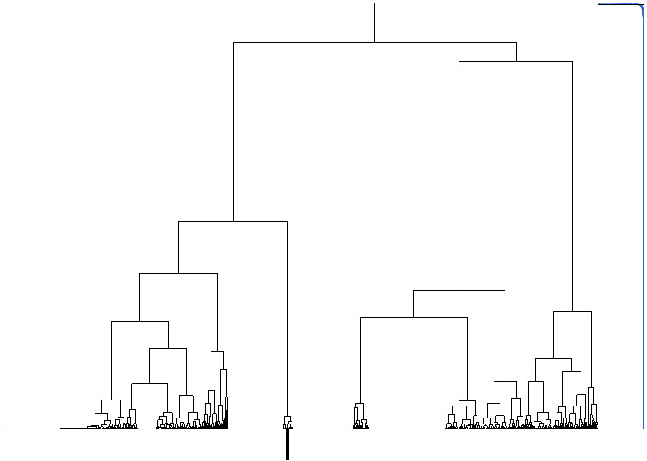
Dendrogram
A dendrogram is a tree diagram showing how points are assigned to clusters
Notes:
There are so many data points to this example that we can’t even really see the clusters at the very bottom of the figure. One interesting thing about how JMP displays this dendrogram is that the distances between points are included in the figure. The black bar at the bottom highlights a group of data points that are very different from others. They are not included in another cluster until only three clusters remain. This might help determining exactly how many clusters exist in the data set. Based on the groupings at the bottom, it might not be unreasonable to conclude that there are 4 unique clusters.

Slide 51
Hierarchical Clustering:
Heat Maps
Create two dendrograms
  Columns of the matrix
  Rows of the matrix
Reorder rows and/or columns of matrix using the dendrograms
Display matrix elements using color scale
Scaling across rows or columns is often needed
Notes:
The figure on the slide shows hierarchical clustering of the rows (students) and columns (survey questions results). The dendrogram on the right hand side represents clustering of the rows of the data table (the students). The dendrogram on the bottom represents clustering of the columns of the data table (the survey questions). The heat map shows some clear patterns in the data and where students clustered. The block of solid red in the figure represents the cluster of students that loved every aspect of the class and gave scores of 5 on all of the questions. The solid block of blue represents the cluster of students that hated the class and gave scores of 1 on all the questions. Finally, the very top of the figure represents a cluster of students that were ambivalent about the course and tended to give scores of 3 on most of the questions.

Slide 52
Hierarchical Clustering Challenges
Can be difficult to see where to cut off the dendrograms
Having a larger number of data points can make the dendrograms difficult to read
Using different distance metrics will lead to different dendrogram results
Clusters may not have simple interpretations

Slide 53

K-Means Clustering
Assign points to a specific number of clusters based on the mean of the point distances
Iterative algorithm will place specified number of means on a plot and then move them according to the data points that are assigned to the clusters
Points are re-assigned as the means of the clusters move
Process repeats until the means converge
This Photo by Unknown Author is licensed under CC BY-NC-ND
Notes:
Unlike hierarchical cluster, k-means clustering can change based on the initial positions of the means. Thus, it is possible to end up with different results even without changing the distance metric.

Slide 54
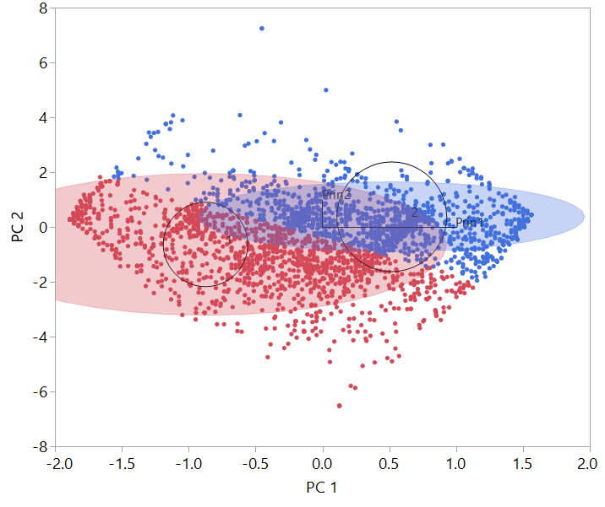
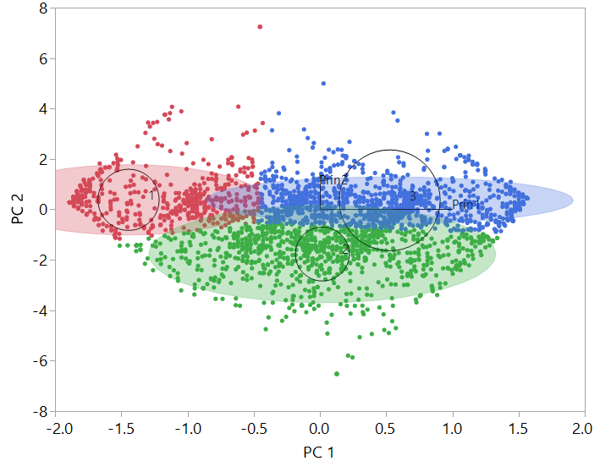
K-Means Example:
2 & 3 Clusters
Using the same data set as before, we can see what clusters might look like for 2, 3, 4, 5, or 6 clusters (for ease the data set was reduced to two principal components)

Slide 55
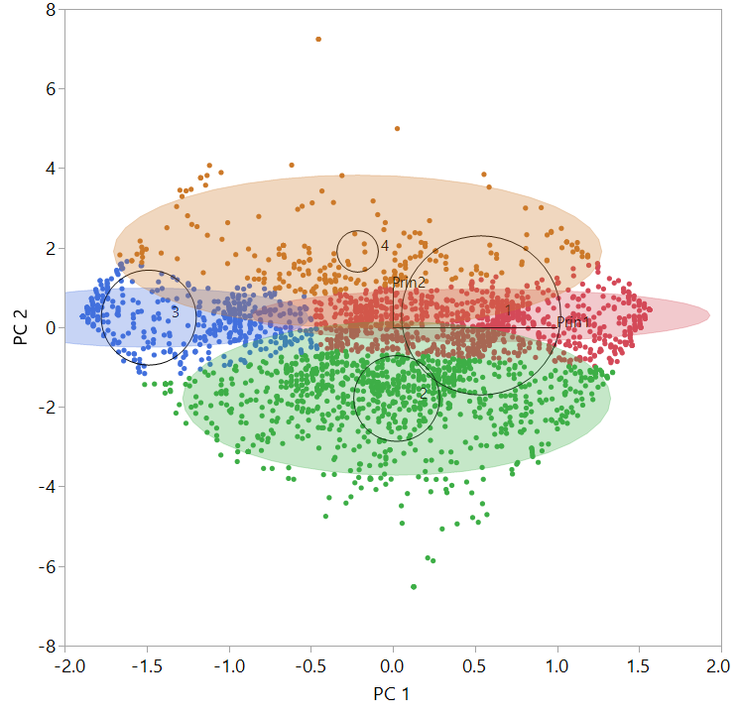
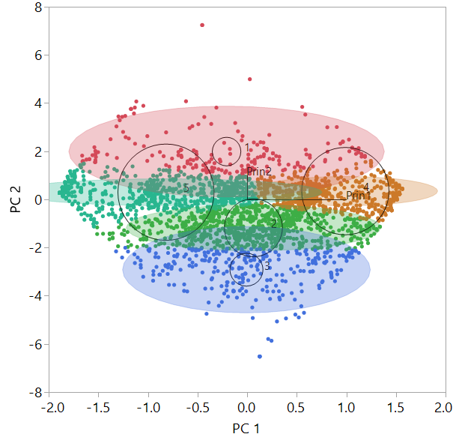
4 & 5 Clusters

Slide 56
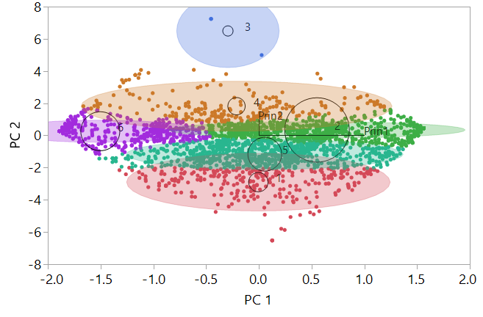
6 Clusters
By the time we add 6 clusters, we can see the algorithm attempting to explain some outlier points with their own cluster

Slide 57
Hypothesis Testing
Many different types of hypothesis tests can be used depending on the specific research question associated with the survey
The type of hypothesis test will be determined by the underlying assumptions associated with the survey data and therefore should be set during the planning phase of survey design
Most often the t-test or the nonparametric alternative, the Mann-Whitney U test are the more appropriate

Slide 58
Before & After Surveys
May have data from two surveys representing before/after or observations are somehow paired
  Same respondent fills out the survey twice (e.g., before/after some event)
  Repeated data from same respondent are not independent and we must account for this in analysis
Use 1-sample methods on differences (e.g., after score – before score)
  Null hypothesis is that the difference is equal to 0 (the response did not change after the event)
  Alternative hypothesis is that the difference is different than 0 (the response is different after the event)
Notes:
The key piece for paired data is that two sets of observations are paired in someway; in survey applications, this is typically because the respondent fills out the survey twice to identify if their opinion has changed over time or due to an event of some kind. The alternative hypothesis could be one-sided in that the difference is greater than 0 or less than 0. For example, if new training has been implemented, we could compare responses to determine if their opinion or score improved with the new training compared to the old training. Whether the alternative is two-sided or one-sided should be determined from the test objectives.

Slide 59
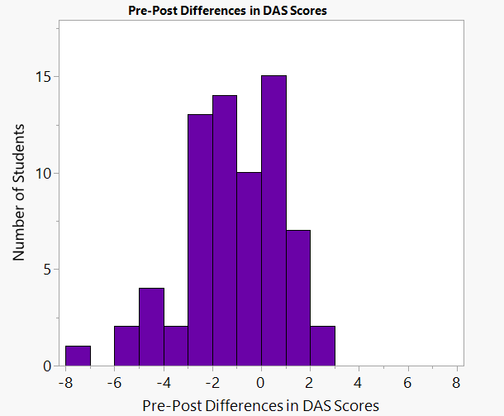
Before & After Surveys
Consider a survey that is given before and after some event or exercise
Each survey participant has two responses that are paired and subtracted to get the “effect” that the event/ exercise had
The example histogram shows a distribution of score differences¹
¹Campbell D, Lugger S, Sigler GS, Turkelson C. Increasing awareness, sensitivity, and empathy for Alzheimer's dementia patients using simulation. Nurse Educ Today. 2021 Mar;98:104764.. Epub 2021 Jan 14.
Notes:
The histogram illustrates how scores changed pre and post activity. The distribution is skewed to the left with more negative than positive scores. A hypothesis test can also be done on the differences to see if the median is different from 0 (using a Wilcoxon Signed-Rank Test).

Slide 60
Regression Analysis
Allows you to investigate the relationship between independent and dependent variables
Can result in a useful model to be used for prediction
  But, with survey data, model assumptions are usually violated
  Might be necessary to use PCA or factor analysis prior to creating the model
If used properly, the model will be able to describe which factors are impacting the chosen response and to what degrees

Slide 61
Analysis of Free Response
Natural Language Processing technology
Combination of statistics, linguistics, and machine learning
Basic methods include word frequency, collocation, and concordance
Software tools are the only way to analyze free response questions
Notes:
Text mining is part of a larger artificial intelligence process called Natural Language Processing (NLP) in which software is used to manipulate or summarize text or speech. These methods combine statistics with linguistics, and machine learning to process information.
Some of the most basic methods of text mining include word frequency, collocation, and concordance. Word frequency is simply counting the amount of times that a particular word or words occur in a set of text. Collocation looks for sequences of words that commonly appear next to one another. This is helpful if multiple words are used together to create a common phrase. Concordance is checking to see in what context a word was used.

Slide 62
Word Clouds
Data visualization of text
Prominence in the cloud is determined by frequency
Needs to have methods to filter out stop words “the”, “and”, “if”, etc.
Looking at the following example, can you guess what the topic of document it was generated from?
Notes:
Word clouds are a data visualization that can be used to view free response answers and are created by using some type of software tool. Currently there are many free tools that can be used to create many different qualities of word clouds.
Most of the tools are very basic and will simply size the words in the text according to frequency. So, words that appear frequently in the text will be large as compared to words that are rare. Most of the tools also have filters that will remove the words that are common but meaningless such as “the”, “a”, “an”, “I”, “and”, “if”, and more.

Slide 63
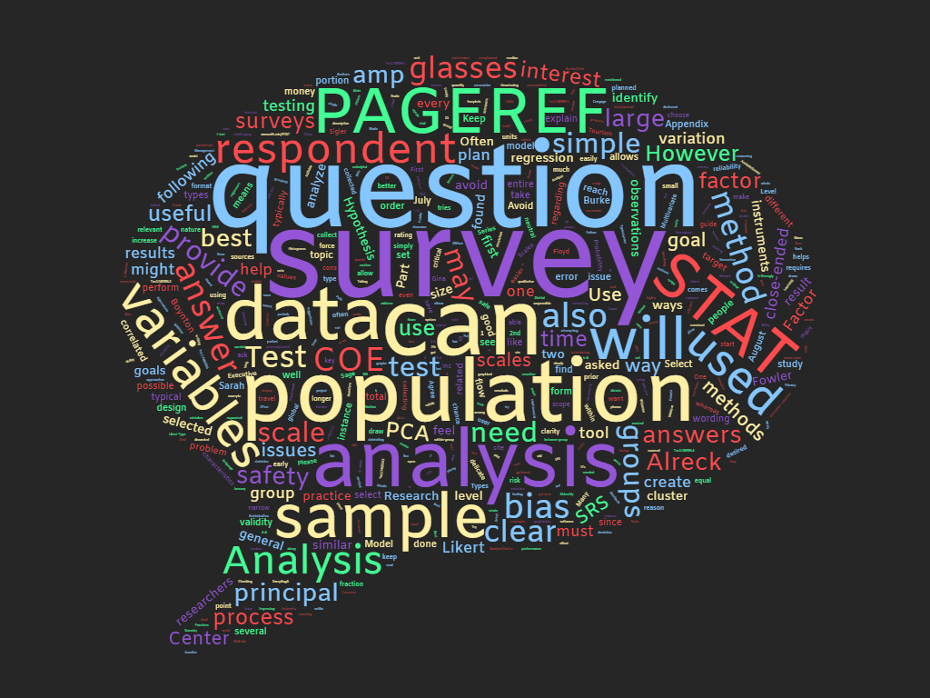
www.wordclouds.com

Slide 64

Word Cloud Pros and Cons
Pros
  Easy to read
  Easy to create
  Visually appealing
Cons
  Does not distinguish between like words
  Style matters
  Missing context
  Sorted bar chart gives more numerical information
Notes:
Word clouds are popular because of their visual appeal. They usually need no explanation as they are becoming more and more common in documents. Also, the amount of free tools that are able to create them make them relatively easy to create. For most of the tools, it is as simple as uploading a document and choosing style preferences for the output.
However, there are also a few negative aspects of a word cloud. It does not distinguish like words. In the previous word cloud we notice that it made a differentiation between the capital and lower case word “analysis.” The degree to which words are grouped together is very dependent on the tool used. Another issue with the word cloud is the degree to which style matters. Colors, fonts, and shapes all play an important role in how easy or hard to read a word cloud becomes. One of the previous slides mentioned concordance (a determination of the context of a word). Concordance is missing from the typical word clouds and so interpretation of results is sometimes difficult. Depending on the type of response that needs to be investigated, it may be easier to look at a sorted bar chart of certain words than the full word cloud to see quantitative information.

Slide 65
Survey Analysis
Tips & Tricks

Slide 66
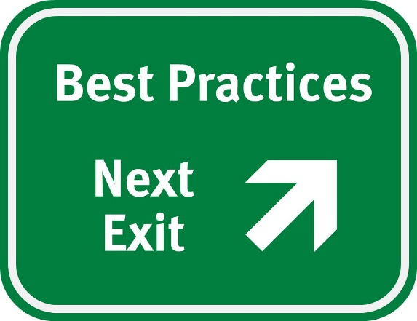
Survey Best Practices
Survey analysis can be very difficult
Humans are messy and the results might not be as expected
There are some analysis tricks or good practices that can be used on survey data
This Photo by Unknown Author is licensed under CC BY

Slide 67
Recall: Likert Scale Analysis
Median & IQR are often used as measure of central tendency and spread, respectively
Bar chart can be used to look at distribution of individual questions
Can use non-parametric tests without normality assumption
Calculating overall question “score”
  Can add answers to 4 or more questions
Too many Likert Scale Questions can be overwhelming
Notes:
Methods of analysis for Likert Scale data are often debated among statisticians. Because of the difficult interpretations of the mean and the standard deviation, the median is often used as the measure of central tendency. More often than not, the median will also be a whole number that can easily be interpreted on the original scale.
To look at the results of a single Likert Scale question, a bar chart can be created. Or, non-parametric tests might be used to look at the results of a single question without any assumptions of normality. While non-parametric tests have less power than their parametric counterparts, they are more appropriate when the assumptions of normality and thus symmetry are violated.

Slide 68
Creation of a Score
It is possible to transform Likert Scale questions into a “score” adding the numerical values together
  This is similar to how the SUS score is created
Similarly, you can also create a score by marking participant responses as favorable or unfavorable and adding the total number of favorable responses or calculate proportions above thresholds
  This method unfortunately will lead to a loss of information, but can be used if you did not design the survey yourself (think rescue method)
Using a score should be planned out before analysis is completed to avoid data snooping
Another reason survey development is so important!
Notes:
One alternative is to create a score metric (as seen in the System Usability Scale section) based on the answers to multiple questions. It is suggested that at least four question scores be added together to create an overall score metric. After scores are calculated, the distribution can plotted and analyzed to see if parametric tests may be used. Caution should be taken to make sure adding the scales from the questions makes sense. Varying the framing of questions (positive/negative) means that the scales might be reversed from one question to another.
Another alternative is to create a dichotomy among question responses. On a five point scale, perhaps there are two responses that are deemed acceptable and three that are deemed unacceptable. The responses can now be analyzed using binomial methods. While this does lead to a loss of information, it also allows the analysis of individual questions.

Slide 69
Question Correlations
Don’t forget to see if questions are correlated
  Whether or not you designed the survey to have correlated questions
  Correlations may violate assumptions depending on the chosen analysis method
How high is too high for a correlation?
  Depends on who you ask….
  Usually want to look at anything above 0.6 or below -0.6
Utilize Cronbach’s alpha to determine internal reliability, particularly for questions grouped together in a score

Slide 70
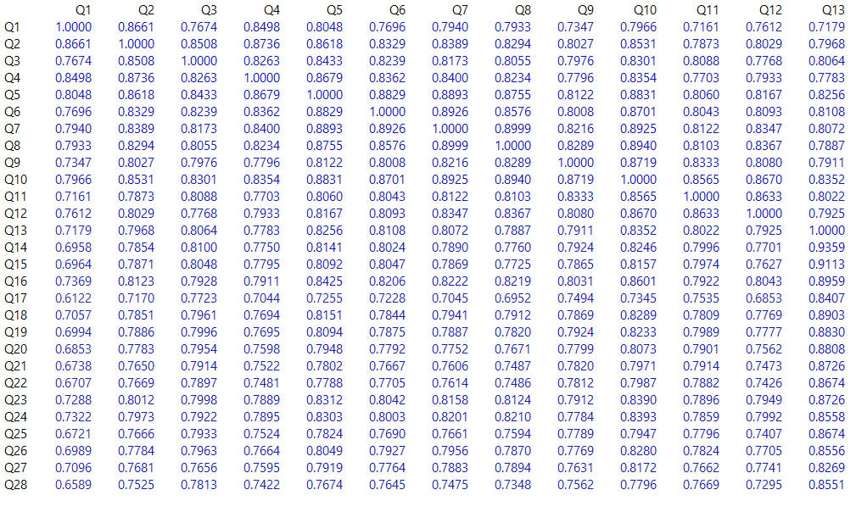
Correlations Continued
What is wrong with these correlations?
Notes:
These are the correlations from the student evaluation data set (28 total questions from 5820 students²). Before, we had noted that we decided to create two principal components to work with rather than working with all 28 questions. With the extreme correlation between questions, we only actually need two principal components to represent this data set. The principal components handles the massive correlation issue between the questions.
Questions were as follows:
Q1: The semester course content, teaching method and evaluation system were provided at the start.
Q2: The course aims and objectives were clearly stated at the beginning of the period.
Q3: The course was worth the amount of credit assigned to it.
Q4: The course was taught according to the syllabus announced on the first day of class.
Q5: The class discussions, homework assignments, applications and studies were satisfactory.
Q6: The textbook and other courses resources were sufficient and up to date.
Q7: The course allowed field work, applications, laboratory, discussion and other studies.
Q8: The quizzes, assignments, projects and exams contributed to helping the learning.
Q9: I greatly enjoyed the class and was eager to actively participate during the lectures.
Q10: My initial expectations about the course were met at the end of the period or year.
Q11: The course was relevant and beneficial to my professional development.
Q12: The course helped me look at life and the world with a new perspective.
Q13: The Instructor's knowledge was relevant and up to date.
Q14: The Instructor came prepared for classes.
Q15: The Instructor taught in accordance with the announced lesson plan.
Q16: The Instructor was committed to the course and was understandable.
Q17: The Instructor arrived on time for classes.
Q18: The Instructor has a smooth and easy to follow delivery/speech.
Q19: The Instructor made effective use of class hours.
Q20: The Instructor explained the course and was eager to be helpful to students.
Q21: The Instructor demonstrated a positive approach to students.
Q22: The Instructor was open and respectful of the views of students about the course.
Q23: The Instructor encouraged participation in the course.
Q24: The Instructor gave relevant homework assignments/projects, and helped/guided students.
Q25: The Instructor responded to questions about the course inside and outside of the course.
Q26: The Instructor's evaluation system (midterm and final questions, projects, assignments, etc.) effectively measured the course objectives.
Q27: The Instructor provided solutions to exams and discussed them with students.
Q28: The Instructor treated all students in a right and objective manner.

Slide 71
Summary
Before a survey is designed, the team should carefully consider how it fits into the STAT Process and where it could provide the most value
Questions should be carefully written to ensure quality data is collected
Descriptive statistics and graphs are some of the most powerful analysis tools for surveys
PCA, Factor Analysis, and Clustering methods can all be used to look at relationships between questions or reduce dimensionality
For more information regarding survey and questionnaire design see the STAT COE’s best practice Survey & Questionnaire Design or consult a STAT Expert

Slide 72
References
https://www.aapor.org/Education-Resources/For-Researchers/Poll-Survey-FAQ/Question-Wording.aspx
https://online.stat.psu.edu/stat100/lesson/2/2.4#main-content
https://stattrek.com/survey-research/survey-bias.aspx
https://www.ssc.wisc.edu/~jpiliavi/357/neuman.pdf
https://www.scribbr.com/methodology/likert-scale/
https://www.peru.edu/oira/wp-content/uploads/sites/65/2016/09/Likert-Scale-Examples.pdf
https://www.ncbi.nlm.nih.gov/pmc/articles/PMC420179/pdf/bmj32801312.pdf
https://www.npmj.org/article.asp?issn=1117-1936;year=2015;volume=22;issue=4;spage=195;epage=201;aulast=Bolarinwa

Slide 73
References cont.
Bartholomew, D.J., Steele, F., Moustaki, I., Galbraith, J. I., Analysis of Multivariate Social Science Data, 2nd Ed., 2008
Big 5 Personality Test (https://ipip.ori.org/new_ipip-50-item-scale.htm, https://www.truity.com/test/big-five-personality-test)
¹Campbell D, Lugger S, Sigler GS, Turkelson C. Increasing awareness, sensitivity, and empathy for Alzheimer's dementia patients using simulation. Nurse Educ Today. 2021 Mar;98:104764.. Epub 2021 Jan 14.
²Gunduz, G. & Fokoue, E. (2013). UCI Machine Learning Repository [[Web Link]]. Irvine, CA: University of California, School of Information and Computer Science.
www.wordcloud.com

