Slide 1

Operational Cyber Resilience
in Engineering and Systems Test
DATAWorks Short Course #2
26-Apr-2022
Interactive Engagement
www.menti.com and use the code 2342 4892

Slide 2
Agenda
Morning (9-12)
  Introductions
  Modeling Security
  Break (10:15)
  Resilience: Measurement and Test Challenges
  Loss-driven Systems Engineering
Afternoon (1-4)
  FOREST - Framework for Operational Resilience in Engineering and System Test
  Deriving Testable Requirements for Resilience
  Case Studies using Jupyter Notebooks - Part 1 (Silverfish)
  Break (2:30)
  Case Studies using Jupyter Notebooks - Part 2 (Pipeline)
  Cyber Engineering and Test Workforce
  Workshop Summary

Slide 3

Introductions

Slide 4
Modeling Security
Tom McDermott

Slide 5
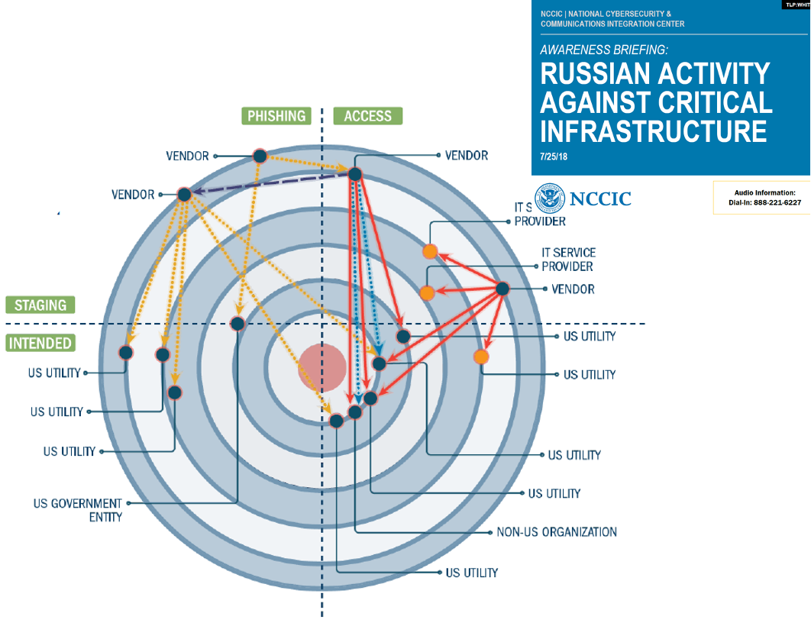
Motivation
Social Engineering
  Research, data harvesting
Physical Engineering
  Components, network ops
Vulnerabilities
Zero day
Attacks
  Exploits,
prioritized loss scenarios
Execute outcomes
  Lack of predictive models
Resilience
  Design-in, test-in
  Performance measures

Slide 6
System Resilience and System Assurance
System Assurance is the justified confidence that a system functions as intended and is free of exploitable vulnerabilities, either intentionally or unintentionally designed or inserted as part of the system at any time during the life cycle.
System “functions as intended” and “free of exploitable vulnerabilities” represent the system’s highest-level properties.
Assurance is a static property of the system as built.
System Resilience is the capacity of a system to maintain state awareness and to proactively maintain a safe level of operational normalcy in response to anomalies including threats of a malicious and unexpected nature.
Agnostic to particulars of attacks; assume attacks will happen.
Resilience is a dynamic property of the system as designed into a set of behaviors.
To be effective in resilience engineering, we must be able to reason about system functions, operational tasks and missions.

Slide 7
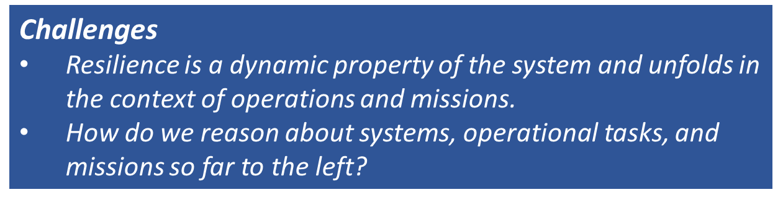
Problem Statement: Engineering Resilience
Add resilience to the engineering trade space
−Characterize benefits and costs (including operational impacts)
−Determine when we have enough resilience
Decompose high-level systems property to derive testable requirements

Slide 8
Overview of Approach
Functional Modeling
−Supports reasoning about resilience early in engineering process
−Mission Aware MBSE meta-model for operational resilience
Loss Driven Engineering
−Identify critical system functions that cannot be lost
−Cyber tabletops with tool and methodology support
−Architect sentinels and other mechanisms to preserve those functions
Operational Perspective
−Decompose resilience mechanisms into testable requirements though an operational lens
−Framework for Operational Resilience in Engineering and System Test (FOREST)

Slide 9
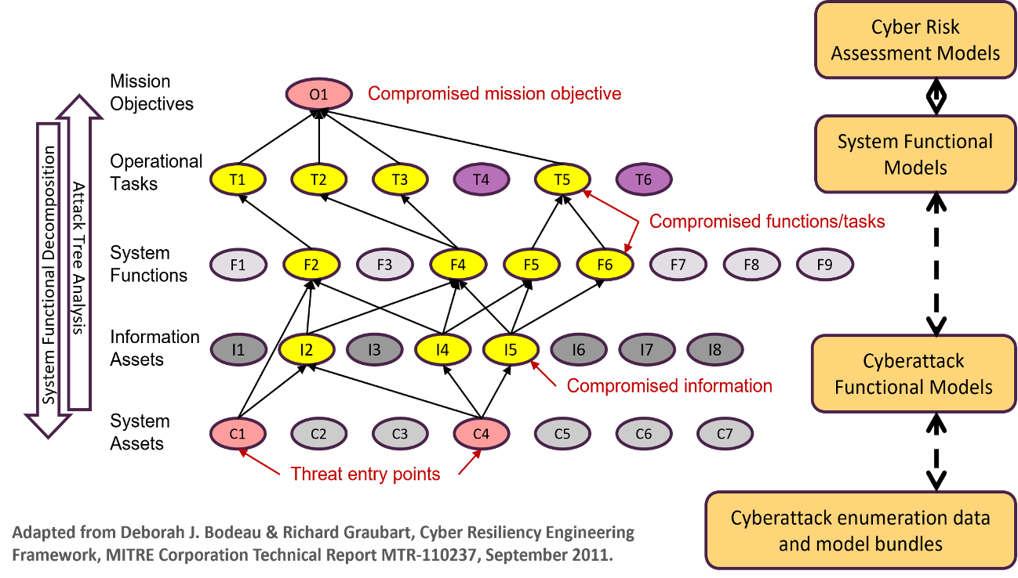
Functional Modeling in Cyber Resilience

Slide 10
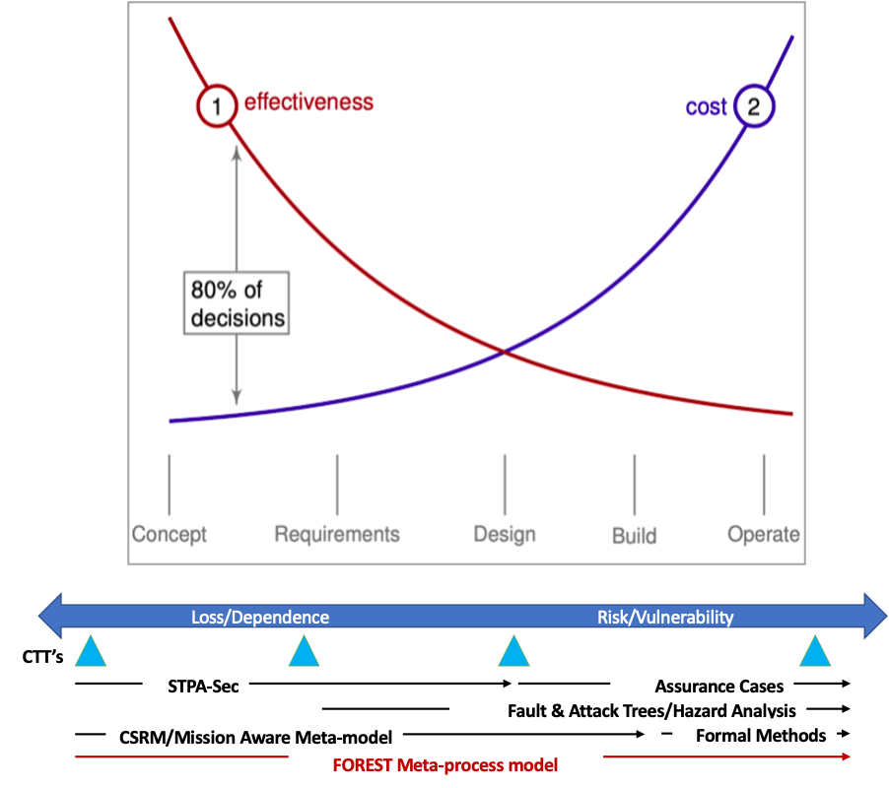
Approach: Resilience and Assurance Methodologies – full System Life Cycle
•Need rigorous methods and tools usable in all stages of the SE process
•From Mission Engineering to Developmental & Operational Test
•Earlier focus on loss causation and resilience
•Later focus on risk management and assurance
•Continuous evaluation of assurance-related quality attributes

Slide 11
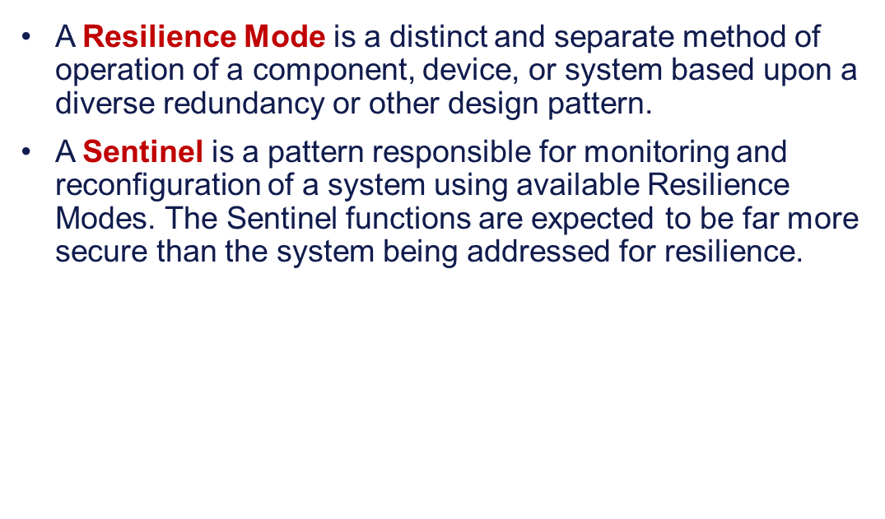
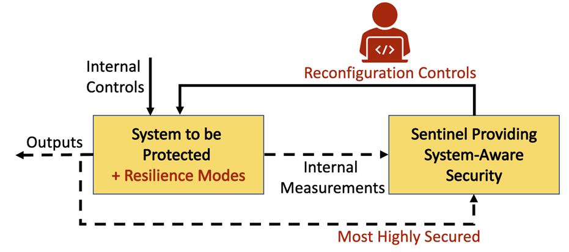
Sentinel-based Resilience Concept

Slide 12
Break

Slide 13
Resilience: Measurement & Test Challenges
Peter Beling

Slide 14
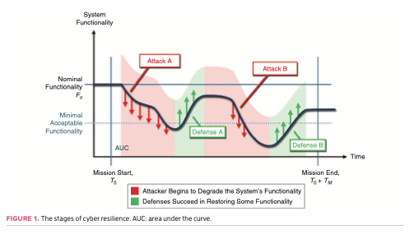
Requirements and Test for Resilience
Resilience is a quality attribute
  Rich notions of measurement
Can we drive down to system requirements?
Can we reason about the behavior of systems that have yet to be built?
Integrated test
  Technology
  People
  Processes
  Decisions
Testable requirements
Source: Kott, A., & Linkov, I. (2021). To Improve Cyber Resilience, Measure It. Computer, 54(2), 80-85.

Slide 15
Loss-driven Systems Engineering
Peter Beling
Tim Sherburne

Slide 16
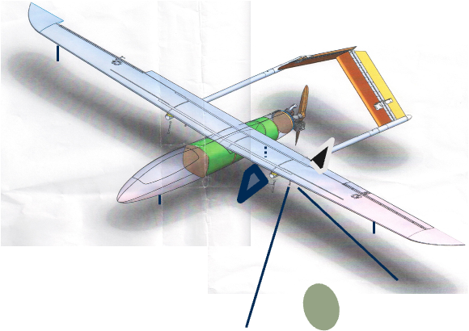
Motivating Scenario
Assurance – Difficult!
Physical points of entry
Off-the-shelf electronics
Insider threat
Resilience
Ensure acceptable mission outcome
Condition on certainty of attack
Point defense rather than perimeter defense

Slide 17
Motivating Scenario
Identify nightmare scenario
Adversary control of navigation function
Behavior-based detection mechanism
Compare outputs of two GPS units
Switch operating mode
Inertial navigation
Additional Benefits:
Reverse asymmetry; erode attacker confidence
Minimize changes to the system while maximizing uncertainty for the attacker

Slide 18
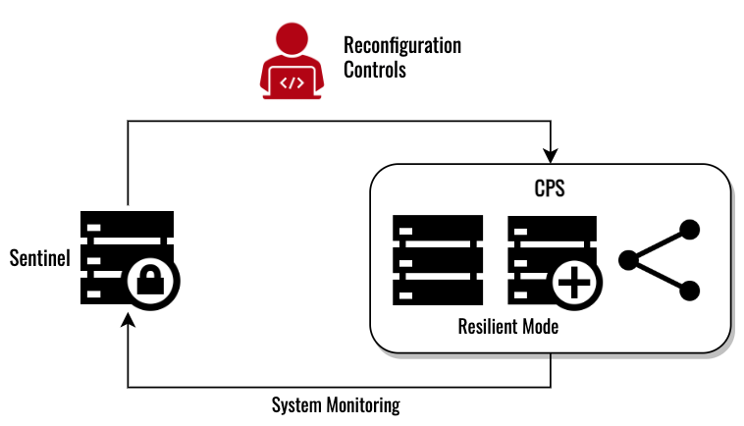
Sentinel-based Resilience Concept
A Resilience Mode is a distinct and separate method of operation of a component, device, or system based upon a diverse redundancy or other design pattern.
A Sentinel is a pattern responsible for monitoring and reconfiguration of a system using available Resilience Modes. The Sentinel functions are expected to be far more secure than the system being addressed for resilience.
CPS - Cyber Physical System

Slide 19
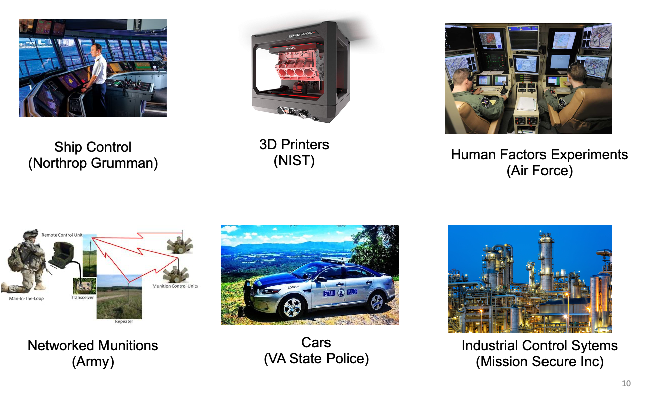
Prior Work using Sentinel-based Resilience

Slide 20
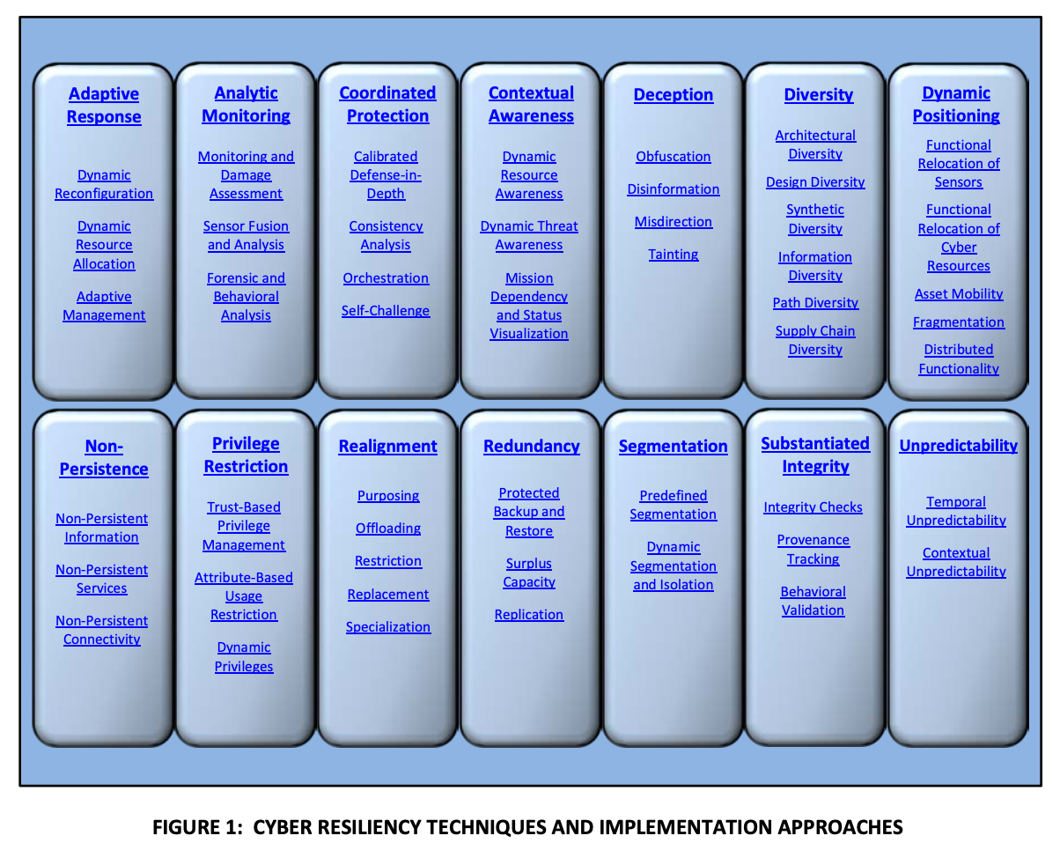
MITRE: Resilience Techniques and Approaches
NIST 800-160 vol 2

Slide 21
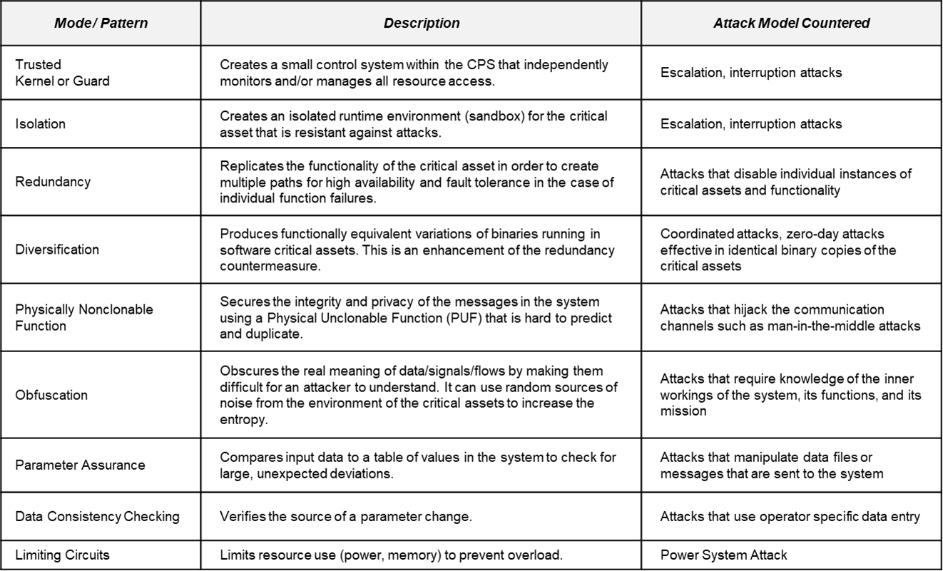
Resilience Modes and Detection Patterns
(UVA, Siemens, SIT)

Slide 22
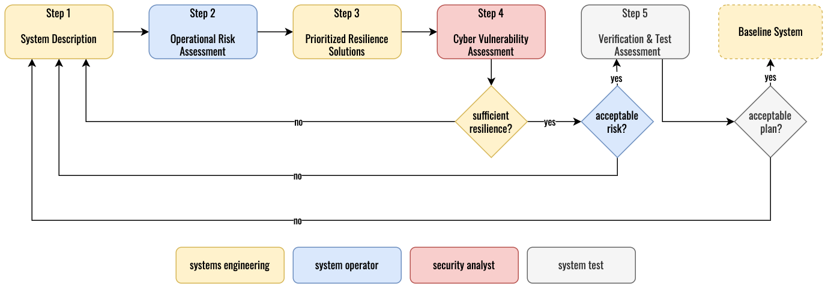
Cyber Security Requirements Methodology
Cyber Security Requirements Methodology (CSRM) is a risk‐based methodology for addressing cyber security during the design phase of cyber-physical system and utilizes four teams of system owners and experts from a wide range of domains. Specifically, the four teams are:
Systems Engineering (SE) Team ‐ The SE team is responsible for managing the CSRM process and developing system designs and definitions that reflect requirements, objectives, constraints, and stakeholder concerns.
Blue Team ‐ The blue team is composed of operationally‐oriented members with experience using similar systems. The blue team is responsible for providing consequences and risks to the CSRM process.
Red Team ‐ The red team is composed of cyber security experts and cyber attack experts who will provide the likelihood of different attacks given the current system design and resilient solutions.
System Test Team ‐ The Test team is responsible for ensuring the current system design, including resilience modes of operation, can be adequately tested.

Slide 23
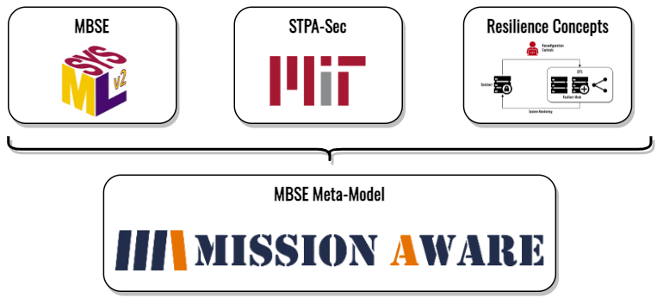
Mission Aware Meta-Model Building Blocks
Vitech MBSE Meta-Model as proxy for SysML v2
  for rich Systems Engineering Semantics
MIT Systems Theoretic Process Analysis (STPA)
  to enable Loss-based Mission / Systems Engineering early in the Life Cycle
Sentinel-based Resilience Concepts
  to provide Mission / System Resilience

Slide 24
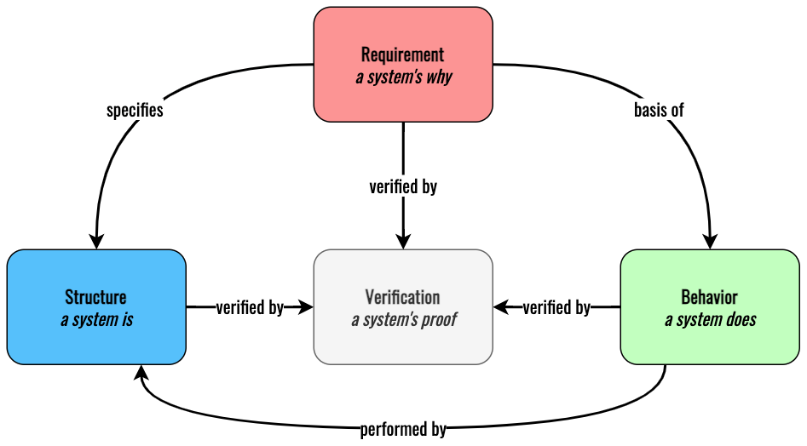

Top-Level MBSE Meta-Model

Slide 25
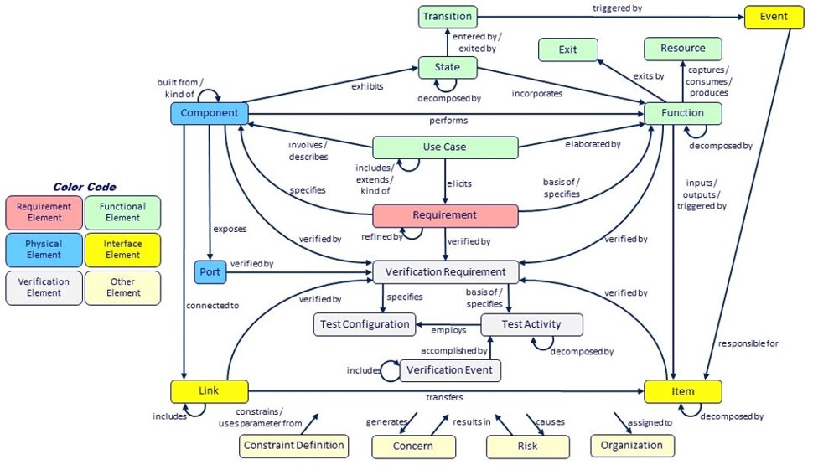
Detailed MBSE Meta-Model
A representation of critical systems engineering concepts and their interrelationships spanning requirements, behavior, architecture, and test. This integrated model presents a high-level view of not only the ultimate specification of a system, but also the journey to that specification – concerns opened and closed, risks identified and managed.

Slide 26
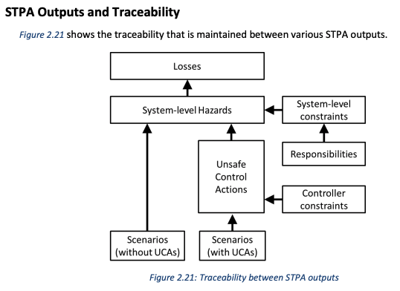
STPA-Sec Overview
STPA is an iterative, methodical hazard analysis technique to identify causes of hazardous conditions intended to improve or promote system safety.
In cyber-physical systems, security can be treated as analogous to safety.
STPA-Sec: addresses adversarial causal factors (spoofed, tampered, etc.)
Leveson, Thomas https://psas.scripts.mit.edu/home/get_file.php?name=STPA_handbook.pdf
STPA-Sec: Young, http://psas.scripts.mit.edu/home/wp-content/uploads/2014/03/Young_STAMP_2014_As-delivered.pdf
A Loss involves something of value to stakeholders. Losses may include a loss of human life or human injury, property damage, environmental pollution, loss of mission, loss of reputation, loss or leak of sensitive information, or any other loss that is unacceptable to the stakeholders.
A Hazard is a system state or set of conditions that, together with a particular set of worst-case environmental conditions, will lead to a loss.
An Unsafe Control Action (UCA) is a control action that, in a particular context and worst-case environment, will lead to a hazard.
A Loss Scenario describes the causal factors that can lead to the unsafe control and to hazards.

Slide 27
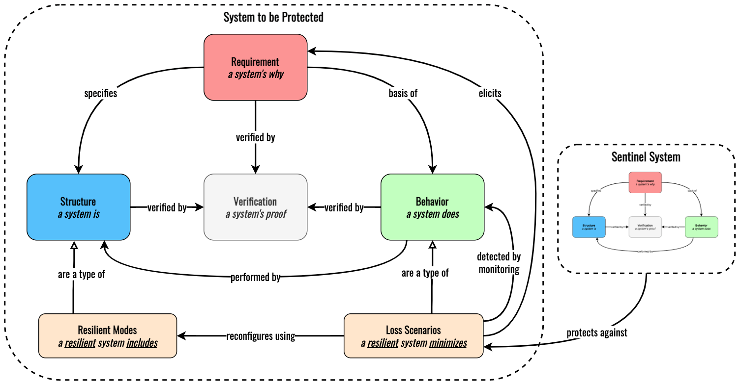
Top-Level Extensions for Mission Aware Meta-Model

Slide 28
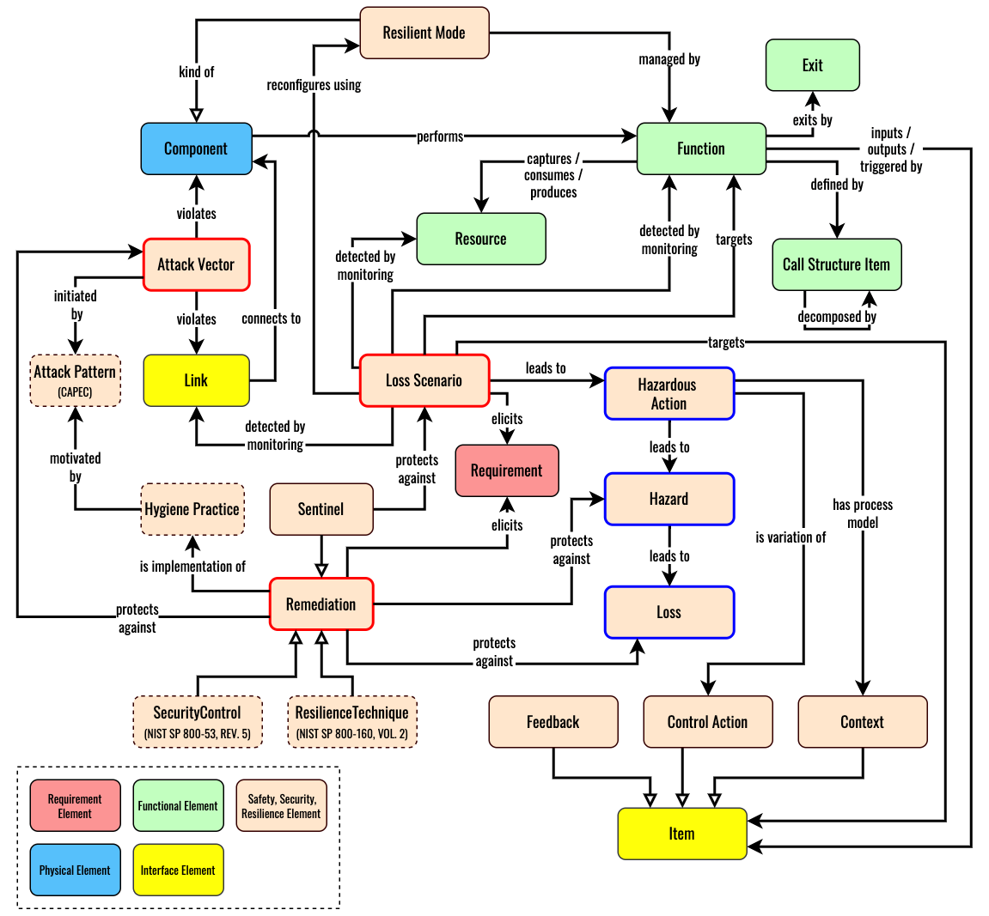
Mission Aware Meta-Model - Detailed View
CSRM Steps & Associated Meta-Model Entities:
System Description (Mission, Architecture, Behavior)
  Use Case / Requirement
  Component, Link
  Function, Exit, Resource, Control-Action, Feedback, Context,
  Call Structure Item
Operational Risk Assessment
  Loss, Hazard, Hazardous Action
Prioritized Resilience Solutions
  Resilient Mode
Cyber Vulnerabilities Assessment
  Loss-Scenario, Remediation, Elicited Requirements

Slide 29
Lunch Break

Slide 30
Framework for Operational Resilience in Engineering and System Test (FOREST)
Peter Beling
Megan Clifford
Tim Sherburne

Slide 31
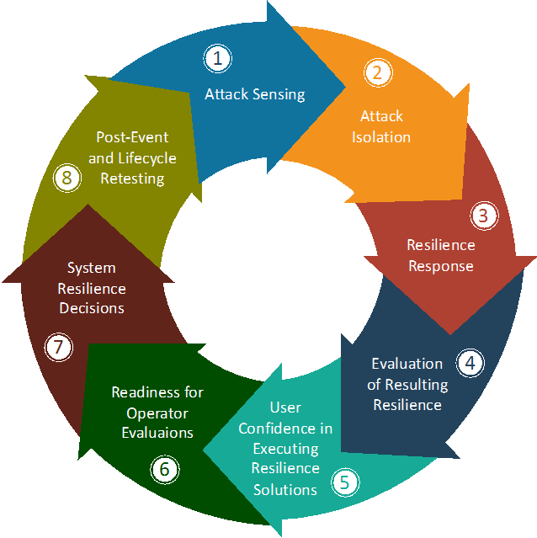
FOREST Framework for Operational Resilience in Engineering and System Test
Decomposition of how systems operate as they undergo adversity and response:
  Technology
  Humans/operators
  Decision orientation

Slide 32
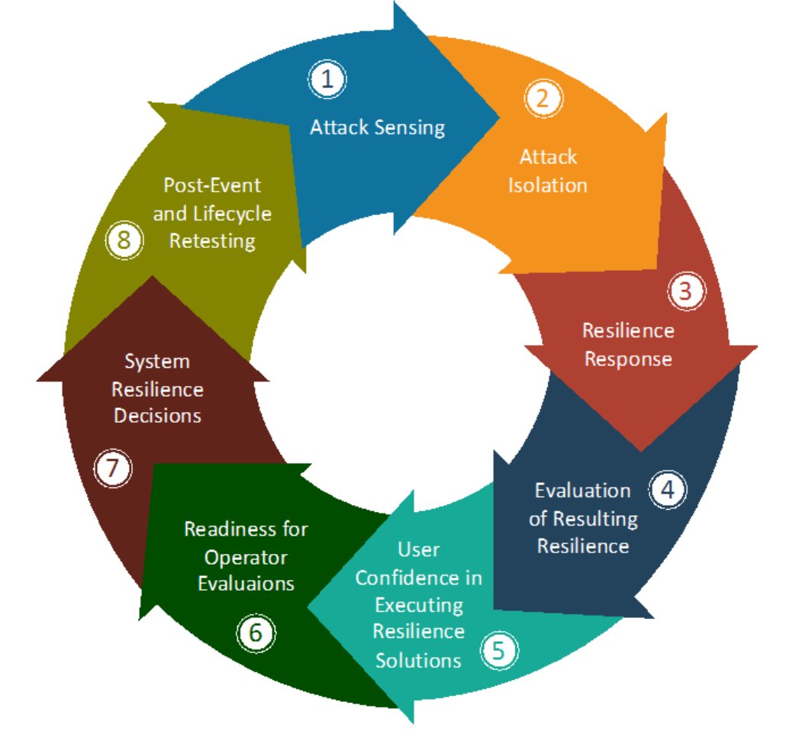
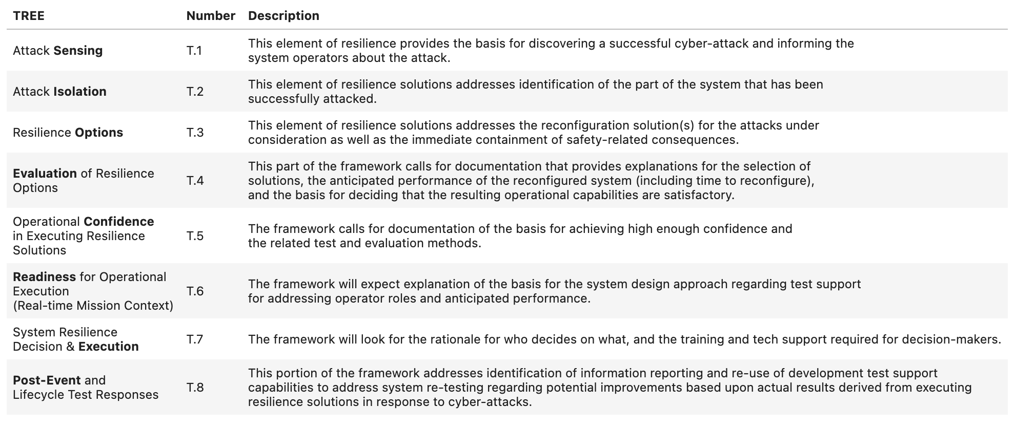
FOREST Framework for Operational Resilience in Engineering and System Test
Testable Requirements Elicitation Element (TREE)

Slide 33
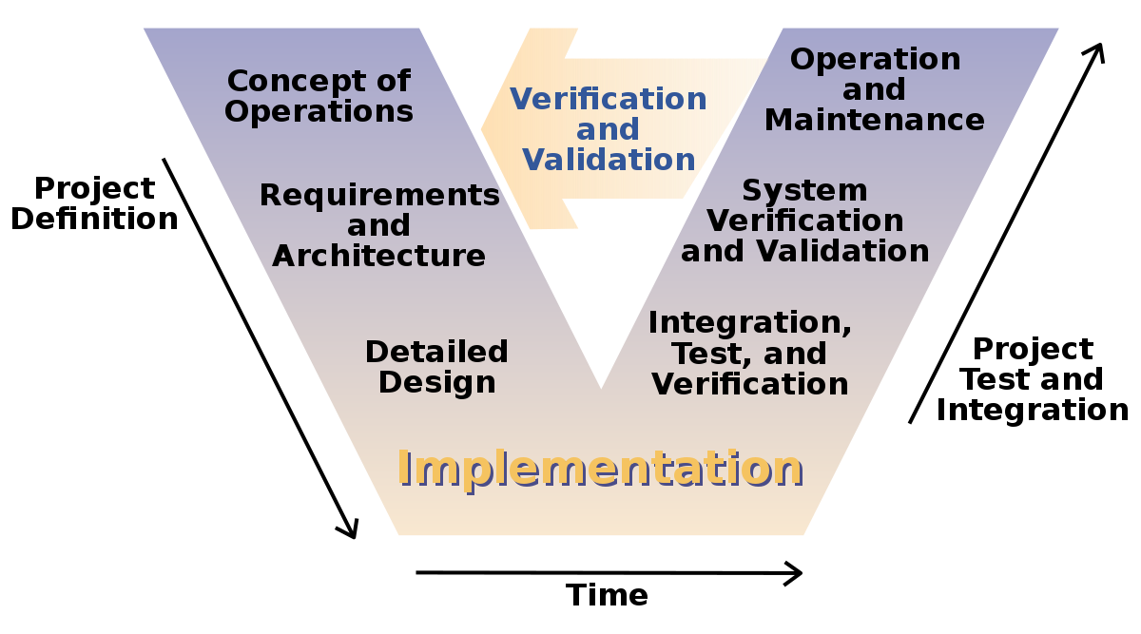
FOREST Framework for Operational Resilience in Engineering and System Test
Continuous evaluation of assurance-related quality attributes

Slide 34
Some Cyber Resilience Challenges for Weapons Systems
Defining requirements for cyber resilience
  Is it enough to say “the system shall have resilience with respect to cyber attacks”?
  How do we reason about the behavior of systems that have yet to be built?
Developmental test
  What are measures and metrics associated with cyber resilience?
  What are the intersections with operational test?
Testable requirements
  How do we anticipate test at the requirements stage?

Slide 35
T&E Considerations per TREE
T1: Sensing
  Timing and Accuracy of Sensing
T2: Isolation
  Accuracy of performing the automated parts of Isolation
  Value of follow on diagnostics as compared to the delay times
T3: Options
  Number Resilient options per Loss Scenario
T4: Evaluation
  Technical Availability of Resilient Modes
  Operator judgement of Usability and Failure Transparency for Resilient Modes
T5: Confidence
  Resilient Mode self-test mechanisms
  Training modules for Resilient Modes
  Operator consistency in Resilient Mode selection and timing
T6: Readiness
  Operational Availability of Resilience Mode
  Mission Survivability with Resilience Mode
  Mission Adaptability for Resilience Mode
T7: Execution
  TSS to enable Emulation of Loss Scenarios with Execution of associated Resilient Modes
    Test Coverage of Resilient Modes
    System Stability with Resilient Modes

Slide 36
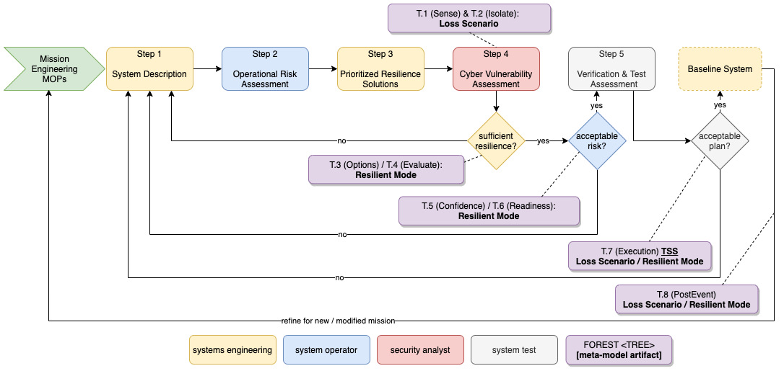
CSRM with TREE Overlay
TREE.1 and TREE.2 ensure appropriate interfaces and mechanisms are defined to enable Sensing and Isolation of each Loss Scenario
TREE.3 and TREE.4 ensure each Loss Scenario has one or more Resilient Mode reconfiguration Options and that appropriate interfaces and mechanisms are defined to enable technical Evaluation of each Resilient Mode
TREE.5 and TREE.6 ensure appropriate interfaces and mechanisms are defined to enable operational judgement of Confidence} and Readiness for usage of each Resilient Mode
TREE.7 ensures all Loss Scenarios and Resilient Modes have appropriate Test Support interfaces and mechanisms to drive and measure Execution.
TREE.8 ensures appropriate Post Event analysis mechanisms exist to adapt the Baseline System for new or refined Missions

Slide 37
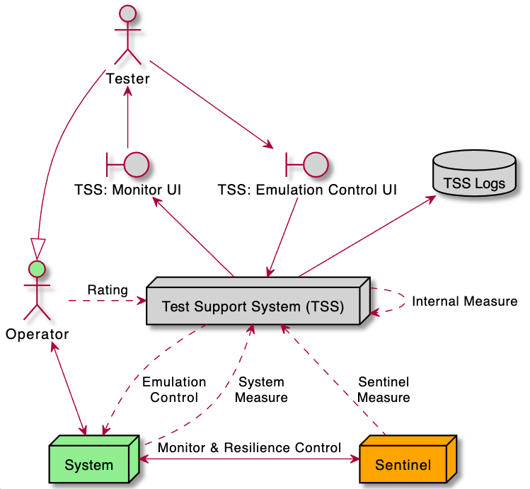
Cyber Resilience Test - Reference Architecture
Many standard tests can be done through manipulation of the external environment
Resilience tests require manipulation of the system’s internal states
Test Support System (TSS) for resilience testing includes mechanisms to:
Control Emulation of Loss Scenarios
Capture Internal measures relating to resilience test execution
Capture System measures relating to Technical resilience performance
Capture Sentinel measures relating to resilience Monitor and Control
Capture Operator ratings relating to Operational resilience performance

Slide 38
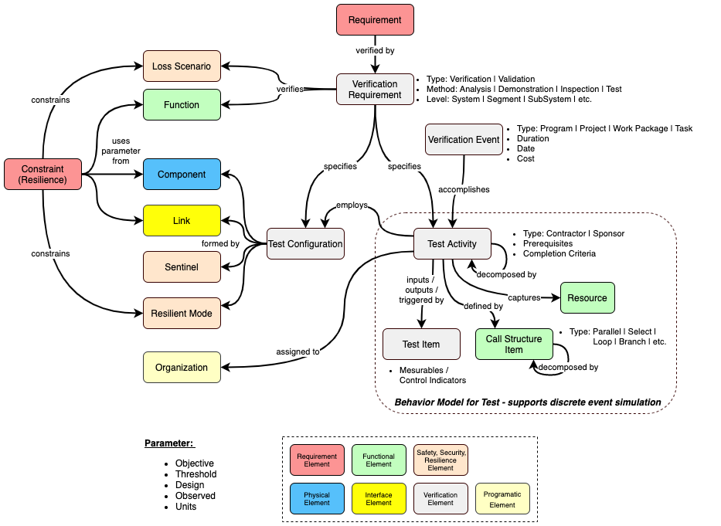
Mission Aware Meta-Model: Verification & Test
Verification & Test Meta-Model Details:
Verification Requirement
  Function, Loss Scenario
Test Configuration
  Component, Link, Resilient Mode, Sentinel
Verification Event / Test Activity
  Test Plan / Strategy
  Simulate Test Resource Utilization
  Verify Resilience Constraints

Slide 39
Deriving Testable Requirements for Resilience
Peter Beling
Megan Clifford
Tim Sherburne

Slide 40
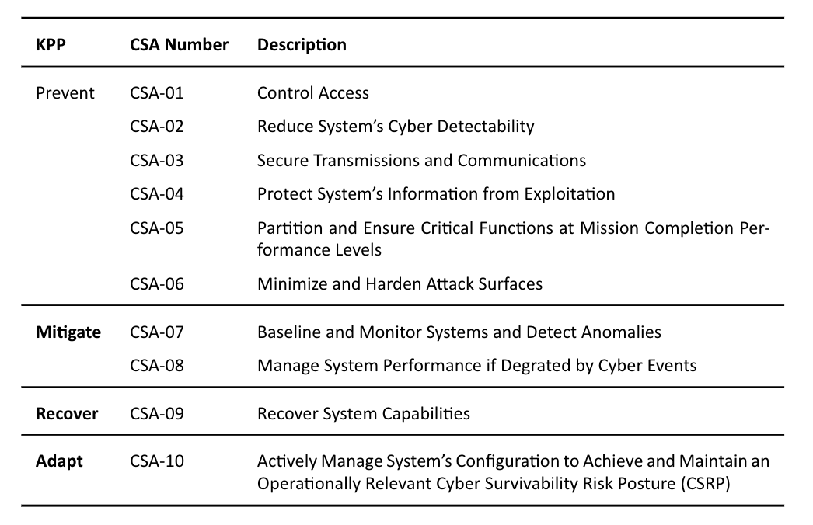
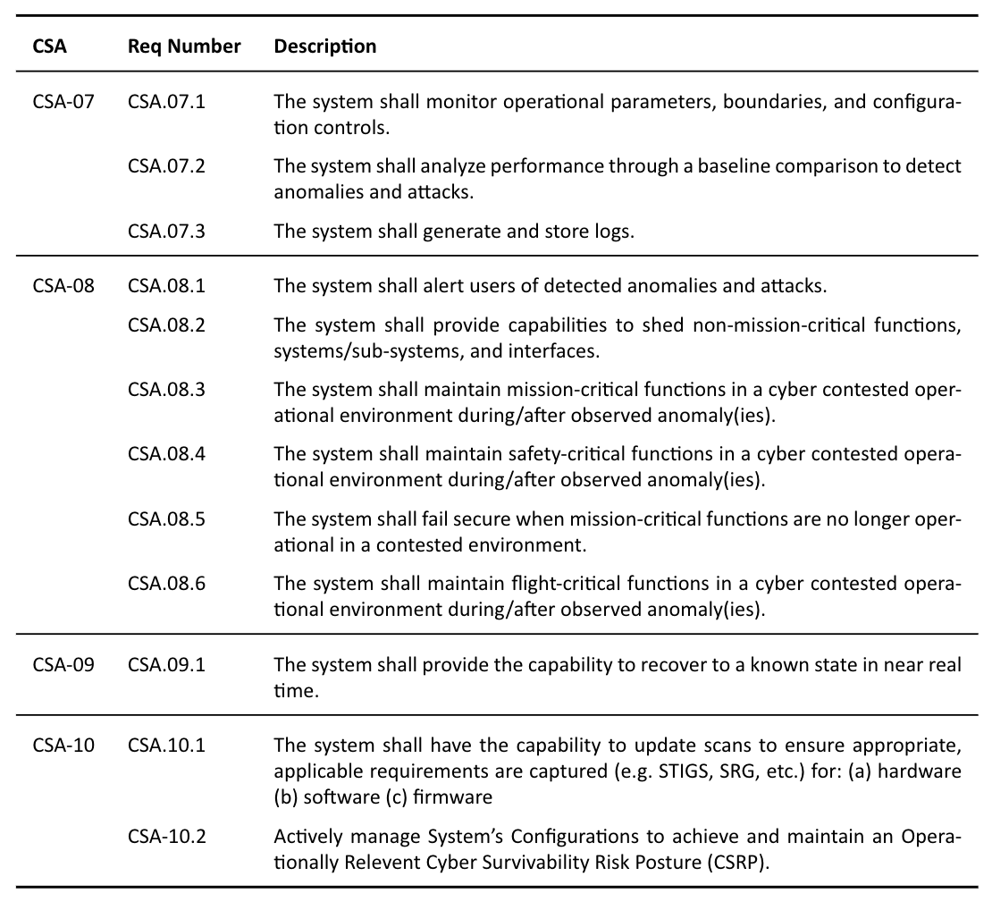
CSA Top-Level Requirements
*MITRE, Relationships Between Cyber Resiliency Constructs and Cyber Survivability Attributes (CSA), 2019
Notes:
We are looking at putting the FOREST (and TREEs) to use in determining metrics to put into specification and then into test against the CSA 07, 08, 09, and 10, especially sine these are all supporting mission defense teams efforts, and while some capabilities may be fully automated, most require human intervention.

Slide 41
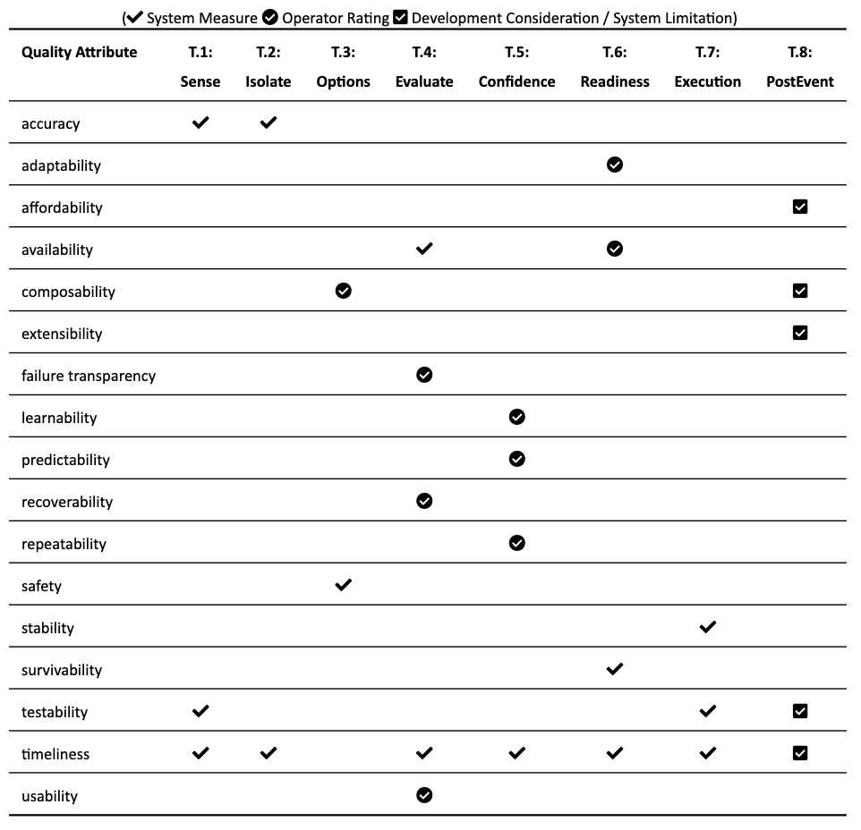
TREE-based Quality Attributes
Quality Attribute Types:
Quantitative: System Measures
Qualitative: Operator Ratings

Slide 42
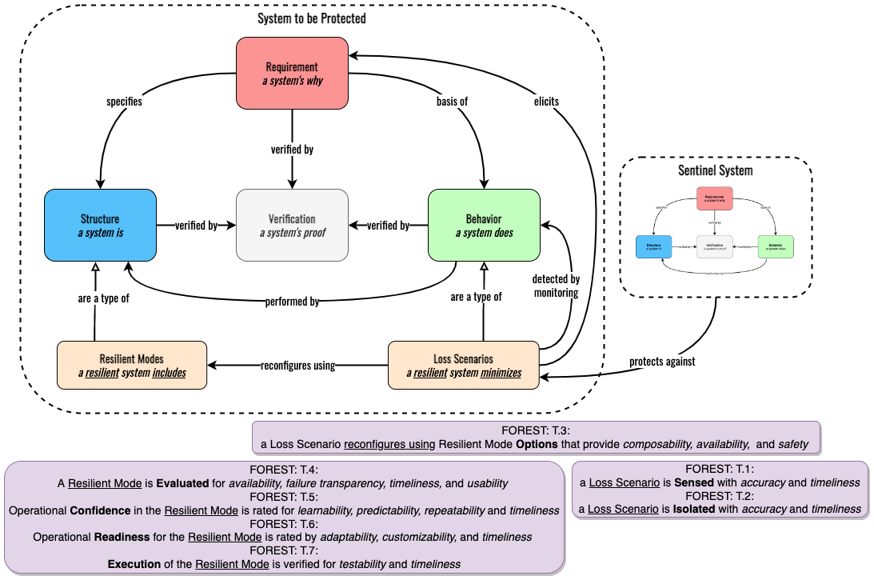
Top-Level Mission Aware Meta-Model with TREE Overlay

Slide 43
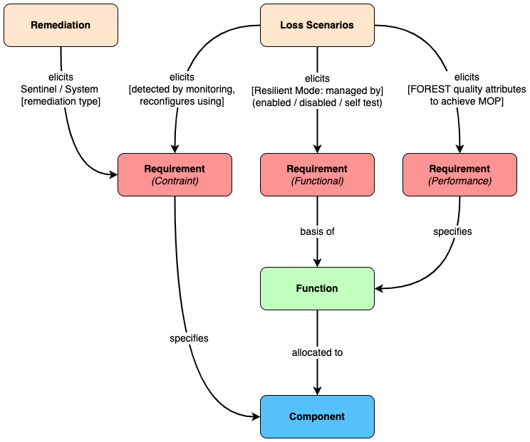
Meta-Model for Requirements Elicitation
The identification of Loss Scenarios and Remediations enables elicitation of various types of System Requirements:
Constraints that provide Sentinel functions
Constraints that enable System Monitoring by a Sentinel
Constraints that provide System Resilient Modes
Functions that enable System Management
(enable / disable / self-test) of Resilient Modes
Performance that bound FOREST quality attributes that achieve Mission MOPs

Slide 44
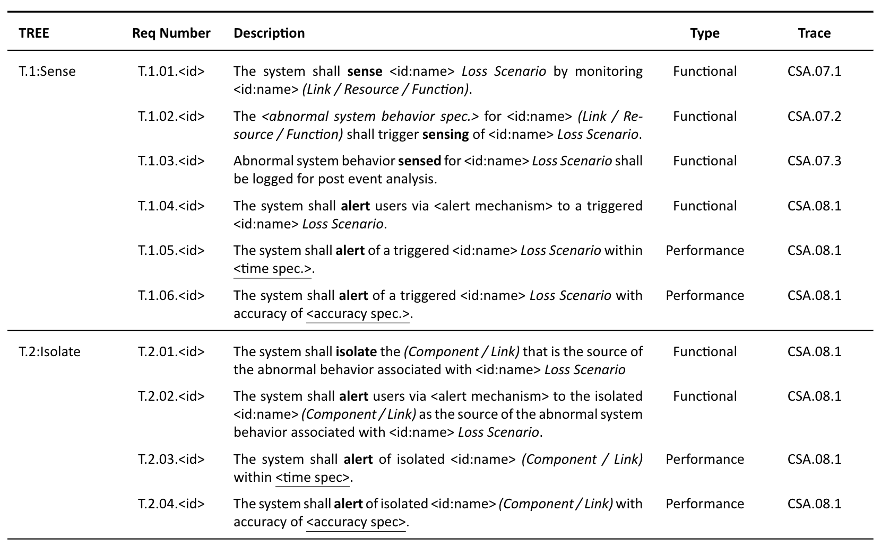
Elicited Requirement Templates (TREE.1 & TREE.2)

Slide 45
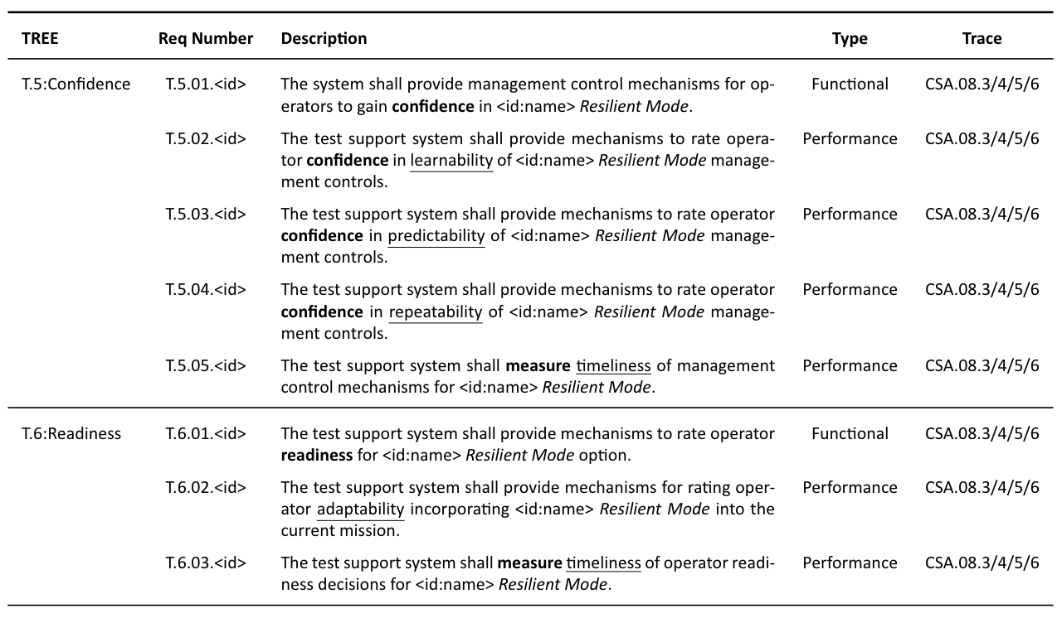
Elicited Requirement Templates (TREE.5 & TREE.6)

Slide 46
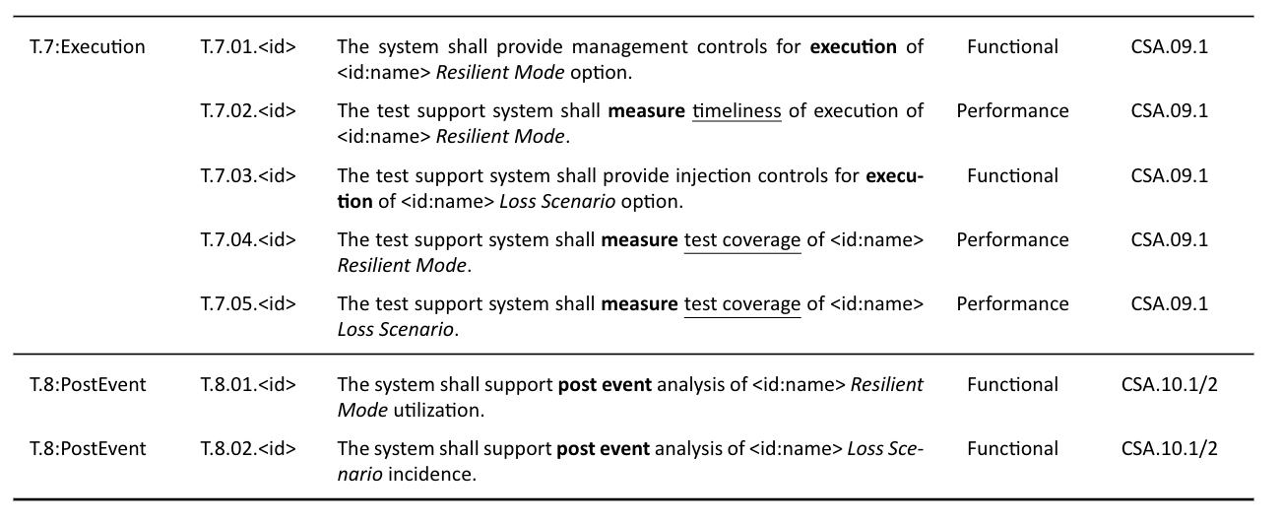
Elicited Requirement Templates (TREE.7 & TREE.8)

Slide 47
Case Study using Jupyter Notebooks - Part 1
Tim Sherburne
Direct from Notebooks: https://bit.ly/ma-nb
https://tsherburne.github.io/de-textbook/lab/index.html
Silverfish Case Study
(Slides as backup)

Slide 48
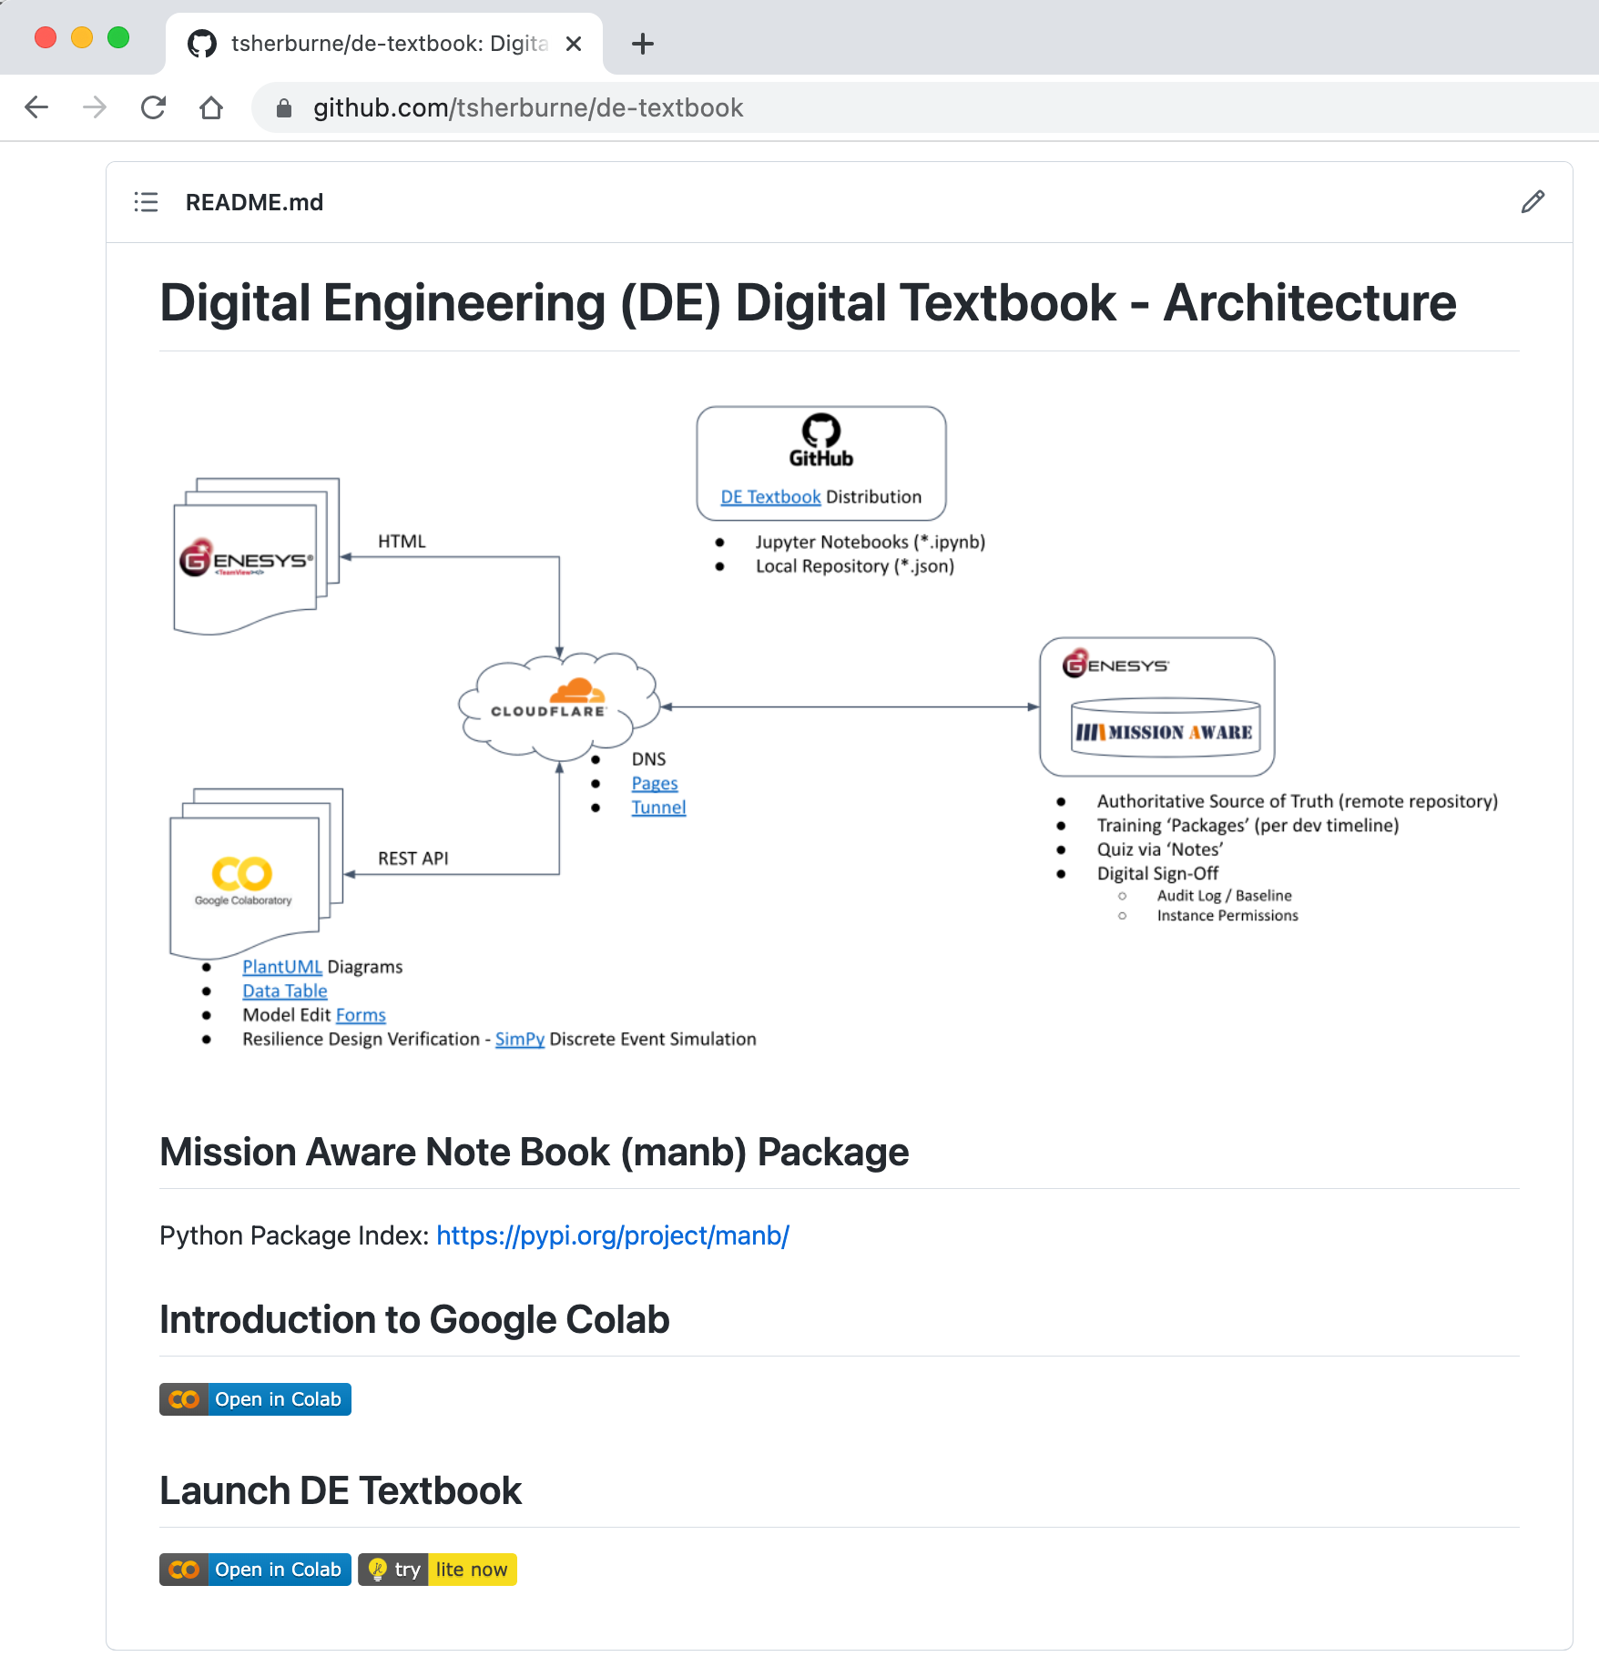
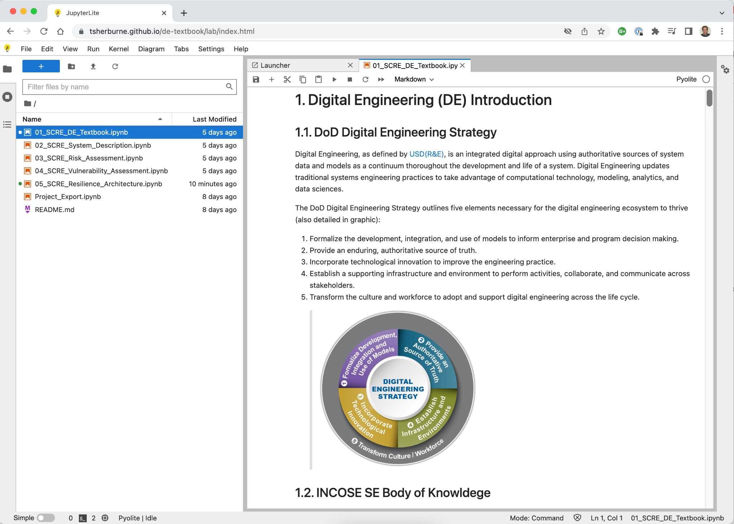
DE Textbook using Jupyter Notebooks
https://github.com/tsherburne/de-textbook https://tsherburne.github.io/de-textbook/lab/index.html

Slide 49
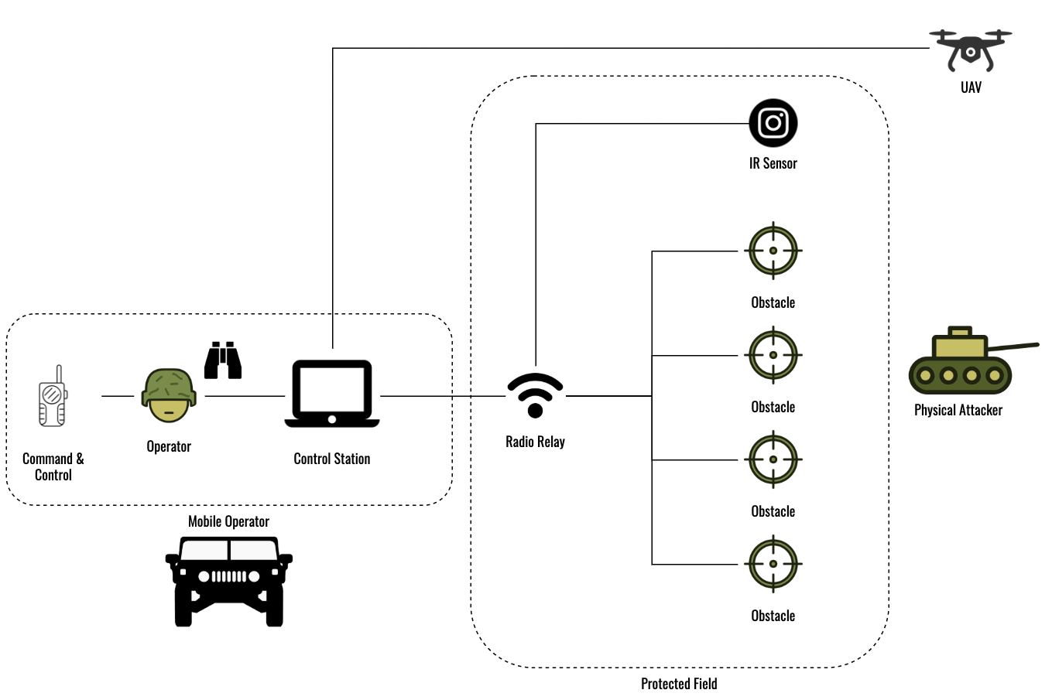
Silverfish Case Study - ConOps
Silverfish is a rapidly deployable set of fifty (50) individual ground-based weapon platforms (referred to as obstacles) controlled by a single operator.
The purpose of the system is to deter and prevent adversaries from trespassing into a designated geographic area that is located near a strategically sensitive location.
The system includes a variety of sensors to locate and classify potential trespassers as either personnel or vehicles. The sensors include obstacle-based seismic and acoustic sensors, infrared sensors and an unmanned aerial vehicle-based surveillance system to provide warning of potential adversaries approaching the protected area.
An internal wireless communication system is used to support communication between the sensors and the operator, and also supports fire control communications between the operator and the obstacles.
The operator is located in a vehicle, and operates within visual range of the protected area. The operator is in communication with a higher-level command and control (C2) system for exchange of doctrinal-related and situation awareness information.

Slide 51
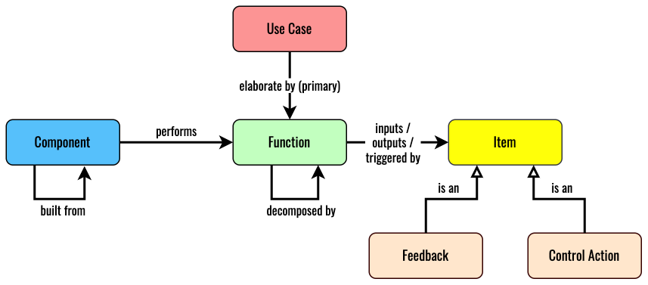
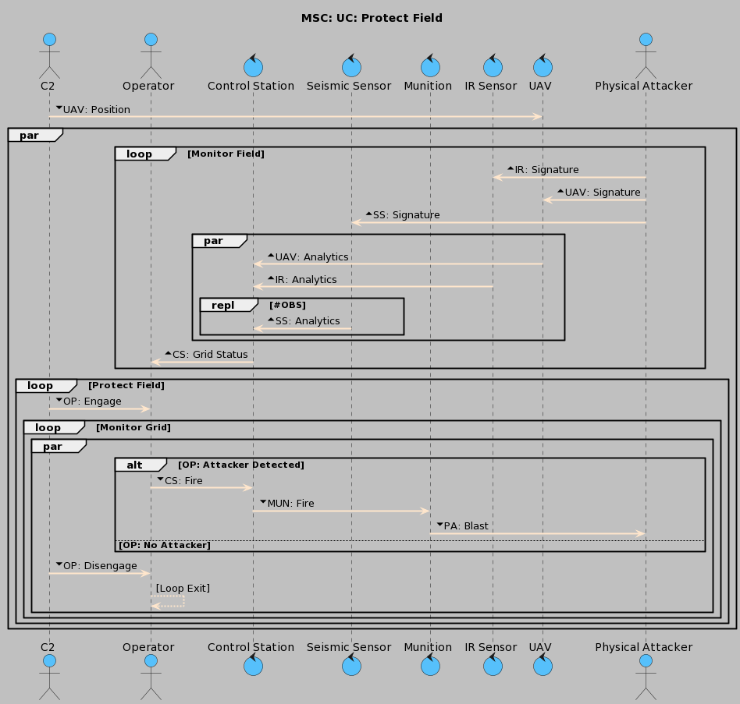
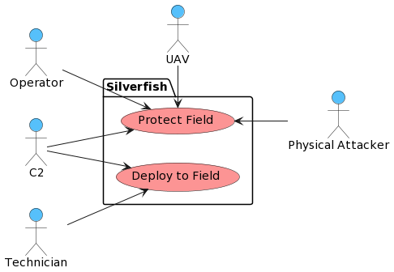
System Description Notebook - Use Cases

Slide 52
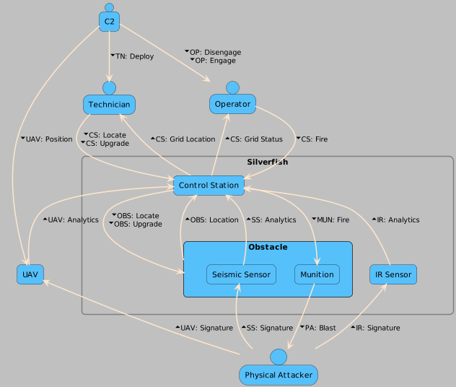
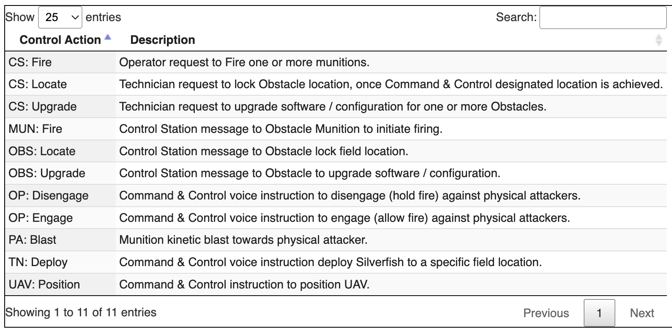
System Description Notebook - Control Structure
Control Action
▼Control Action ▲ Feedback

Slide 54
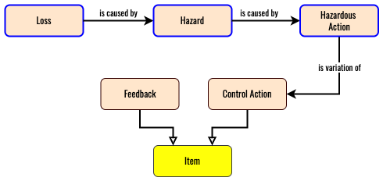
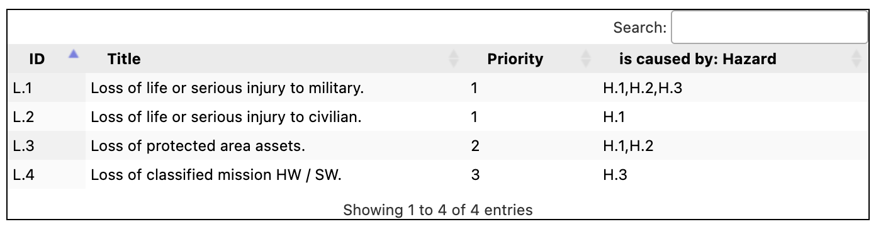
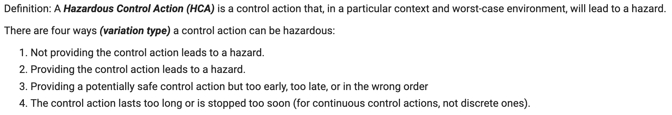
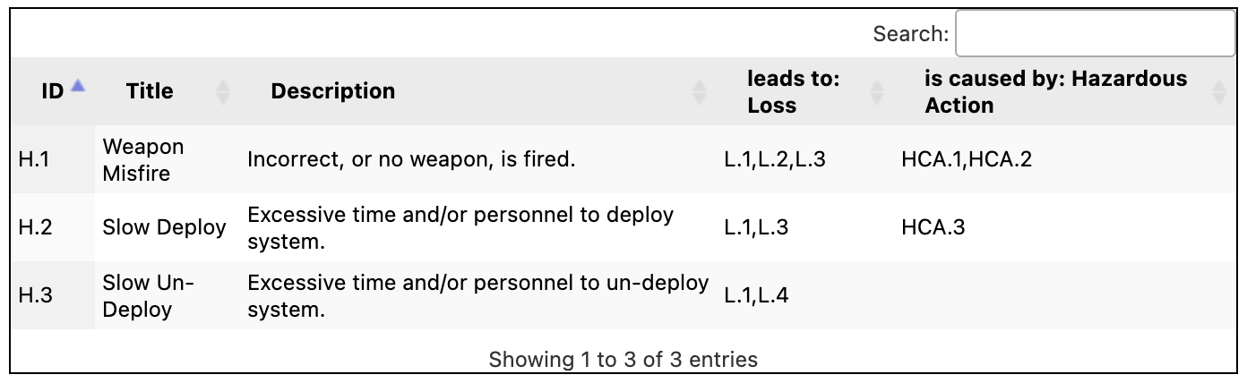
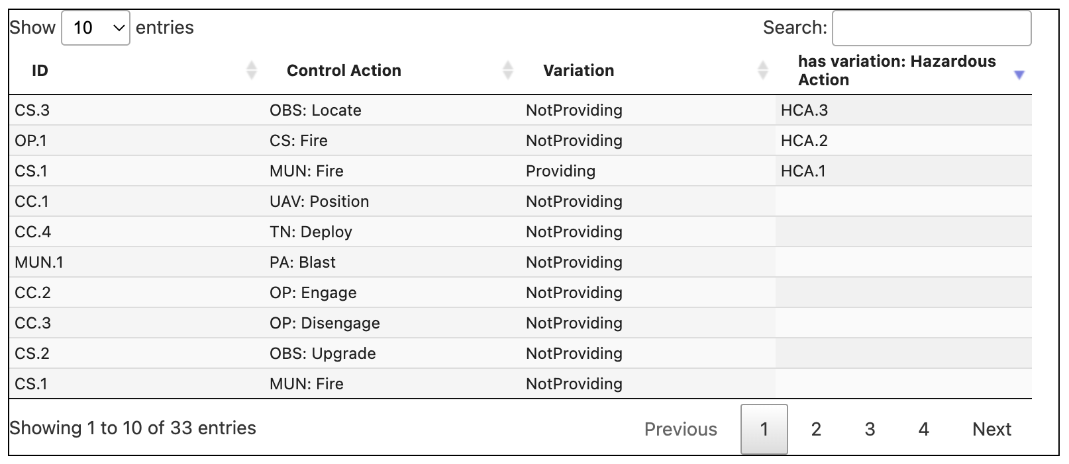
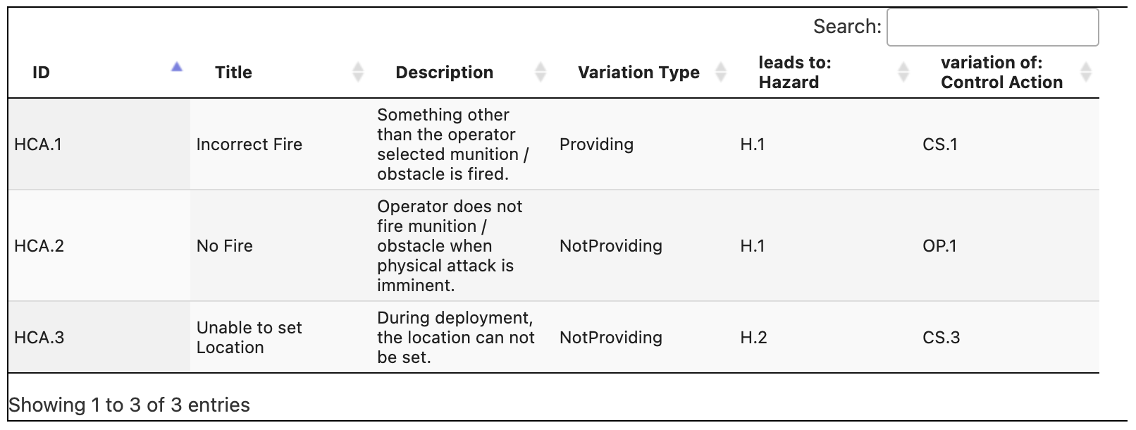
Risk Assessment Notebook
Loss
Hazard
Control Action Analysis
Hazardous Action

Slide 56
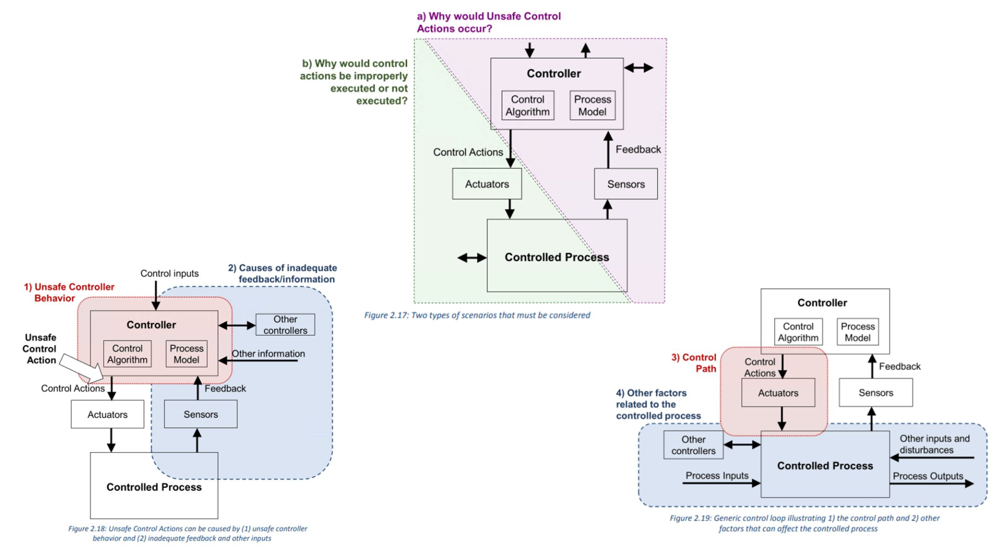
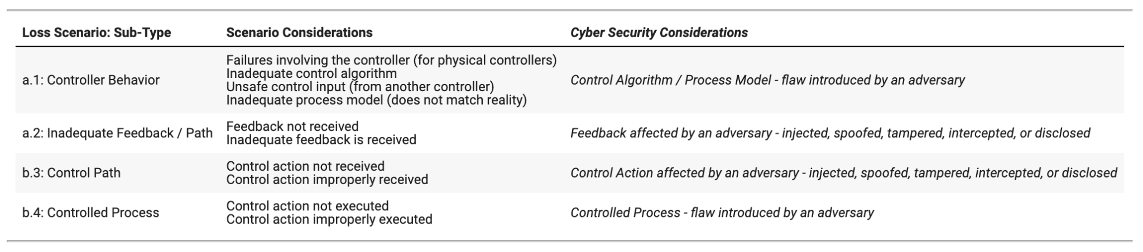
Vulnerability Assessment Notebook - Introduction
Systems Theoretic Process Analysis (STPA) Guidebook (pages 42-49)

Slide 57


Vulnerability Assessment Notebook - Meta-Model

Slide 58




Vulnerability Assessment Notebook - Analysis
Loss Scenario
Loss Scenario Analysis - ‘Targets’ Function
Loss Scenario Analysis - ‘Targets’ Item

Slide 60


Loss Scenario Elaboration

Slide 61


Resilience Architecture
Loss Scenario - Analysis
Resilient Mode

Slide 62
Requirement Elicitation Meta-Model

Slide 63

Elicited Resilience Requirements

Slide 64
Break

Slide 65
Case Study using Jupyter Notebooks - Part 2
Tim Sherburne
Direct from Notebooks: https://bit.ly/ma-nb
https://tsherburne.github.io/de-textbook/lab/index.html
Pipeline Case Study
(Slides as backup)

Slide 66


Pipeline Case Study - ConOps
Field devices are instrumentation, data gathering units and communication systems. The field instrumentation includes flow, pressure, and temperature gauges/transmitters, and other devices to measure the relevant data required.
The information measured by these field instruments is then gathered in local remote terminal units (RTU) that transfer the field data to a central location in real time using communication systems, such as satellite channels
Pipelines are controlled and operated remotely, from what is usually known as the "Main Control Room". The SCADA system at the Main Control Room receives all the field data and presents it to the pipeline operator through a set of screens or Human Machine Interface, showing the operational conditions of the pipeline. The operator can monitor the hydraulic conditions of the line, as well as send operational commands (open/close valves, turn on/off compressors or pumps, change setpoints, etc.) through the SCADA system to the field.

Slide 68


System Description Notebook - Use Cases

Slide 69


System Description Notebook - Control Structure
Control Action
▼Control Action ▲ Feedback

Slide 71




Risk Assessment Notebook
Loss
Hazard
Control Action Analysis
Hazardous Action

Slide 73
Vulnerability Assessment Notebook - Introduction
Systems Theoretic Process Analysis (STPA) Guidebook (pages 42-49)

Slide 74
Vulnerability Assessment Notebook - Meta-Model

Slide 75


Vulnerability Assessment Notebook - Analysis
Loss Scenario Analysis - ‘Targets’ Function
Loss Scenario Analysis - ‘Targets’ Item

Slide 76


Vulnerability Assessment Notebook - Analysis
Loss Scenario

Slide 78

Loss Scenario Elaboration

Slide 79


Resilience Architecture
Loss Scenario - Analysis
Resilient Mode

Slide 80
Requirement Elicitation Meta-Model

Slide 81

Elicited Resilience Requirements

Slide 82
Cyber Engineering and Test Workforce
Tom McDermott

Slide 83

Mastery of Cyber-Physical Security Concepts
Concepts of secure access control to and use of the system and system resources (domain of system security engineering)
Understanding of design attributes that minimize exposure of vulnerabilities to external threats (systems security engineering and dependable computing)
Understanding of design patterns to produce effects that protect and preserve system functions or resources (dependable computing)
Approaches to monitor, detect and respond to threats
and security anomalies (cybersecurity)
Understanding of network operations and external
security services (information systems)
Approaches to maintain system availability under
adverse conditions (all of the above)

Slide 84

National Academies: educational content

Slide 85

Our surveyed education themes

Slide 86



Knowledge Areas and Competencies

Slide 87
Education and Training Recommendations
At the professional level:
best level to introduce different disciplines and domains to the adversarial and subversion characteristics afforded by cyberspace
need for development of a professional certification tailored to the needs of the CPS domain – hardware & software engineering certifications
At the university level:
teach engineers how to produce higher quality secure software, introduce fundamentals, and good coding practices in every discipline
a core cybersecurity 101 course that is tailored to the discipline of interest, but cybersecurity principles should be embedded into existing curricula
At the High School and STEM levels
introduce cybersecurity hygiene and good early coding practices
foster interest in secure cyber-physical systems, programs such as robotics challenges could include security challenges
those with interest in coding should begin practicing safe versus vulnerable coding practices early in education

Slide 88
References
DE Jupyter Notebooks: https://tsherburne.github.io/de-textbook/lab/index.html

