Slide 1
Opportunities and challenges for openly publishing statistics research for national defense applications
Lyndsay Shand, lshand@sandia.gov
SAND2021-4004 C

Slide 2
Background
Benefits to publishing peer-reviewed literature include:
  Dissemination of ideas and adding to the scientific body of knowledge
  Peer-review by a broader community and increase in visibility of the work
  often the primary way to show credibility in academia. There are high expectations to publish as frequently as possible in the most prestigious journals when possible.
Many, if not all of us, in the defense community come from academia and may bring the pressure of publishing with us whether or not it is expected from our employers.
However challenging it may seem at times, publishing our work and sharing it openly with the community is possible and important!

Slide 3
Challenges
Openly publishing on statistics for defense and national security poses certain challenges and is often not straightforward, but research in this area is important to share with the open community to advance the field.
Common Challenges:
Statistics for national defense is a niche audience making target journals and conferences hard to identify.
Data is often sensitive and surrogate data is needed for publication.
Often there is not the same expectation to publish as in Academia.
Results are often shared in internal reports where review is not as rigorous.
Among others.

Slide 4
Round Table Topic #1 Employer Support
What expectations for publication do you have in your current position, if any? Are these expectations reasonable?
Are you encouraged and supported by your funding institution to openly publish?

Slide 5
Round Table Topic #2 – Motivations & Challenges
What motivates you to publish openly?
Why is encouraging publications important?
If you do not publish regularly, what do you feel are some challenges holding you back?

Slide 6
Round Table Topic #3 – Collaboration
Do you collaborate and co-author publications with colleagues outside of your institute, within or outside of the defense community?
Are there opportunities for collaborative work across institutions that might further encourage publications?

Slide 7
Tips & Tricks
Keep tabs on open-source data that can serve as surrogate data. You can often found well-documented data sets in your references!
  Also keep in mind, results based on sensitive data often can be published, i.e. clinical trial results.
Stay involved in the external communities (external to your organization). This is usually a great motivator.
Engage with student interns and PostDocs. This will usually mean you have to work with open data and great motivation to publish since it will lift their future careers.
Seek publications in data science/statistics journals AND applications journals when possible to broaden your audience. Don’t shy away from new or smaller journals if that’s your target audience!

Slide 8
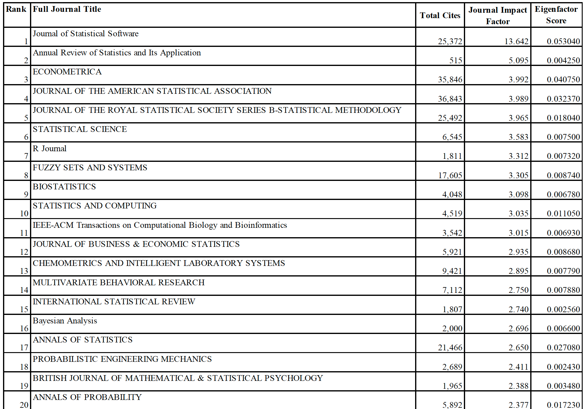
Top 40 open source journals according to the
Journal Citation Report 2019
Selected Category: 'STATISTICS & PROBABILITY

Slide 9
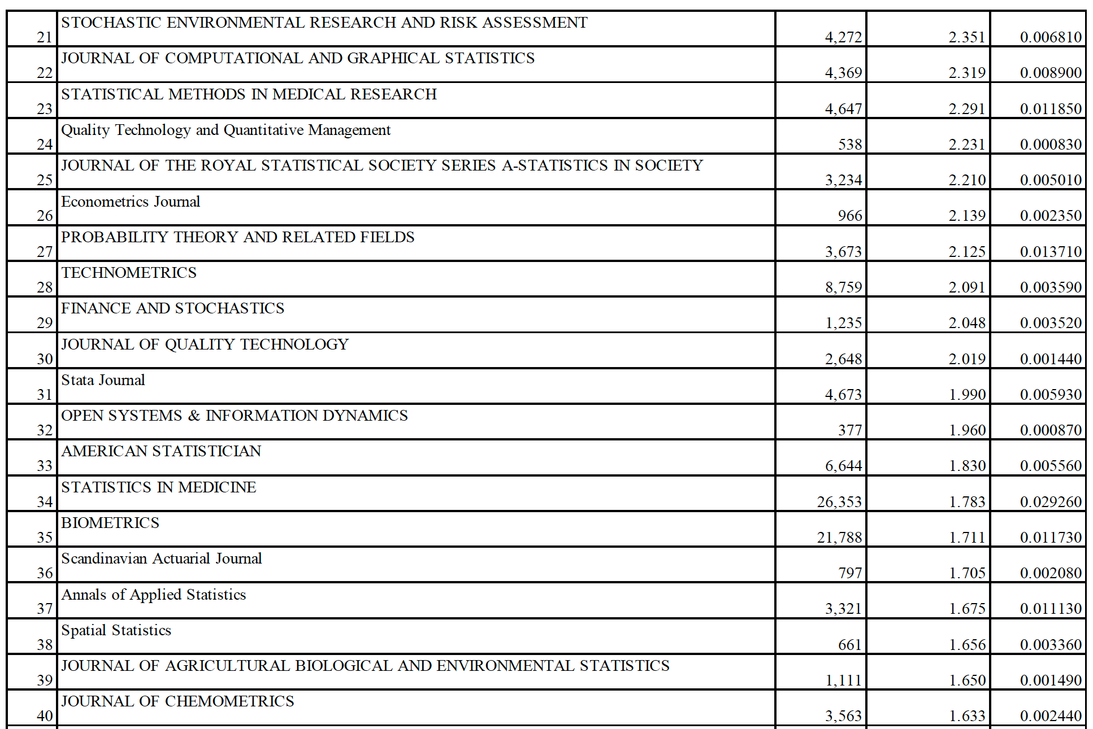
Top 40 open source journals according to the
Journal Citation Report 2019
Selected Category: 'STATISTICS & PROBABILITY

