Slide 1
Uncertainty Quantification and Analysis at The Boeing Company
DATAWorks 2018 Workshop, Springfield, VA
March 20-22, 2018
John Schaefer
The Boeing Company, St. Louis, MO, 63166

Slide 2
Outline
Motivation for UQ in Computational Fluid Dynamics (CFD)
Future of UQ for Aerospace Applications
UQ Applications at Boeing
  Mixed UQ of NASA Common Research Model
  Uncertainty Propagation for Increment Calculations
  Stochastic Aero Database
Conclusions

Slide 3
Present State of CFD Analysis
One of the present shortcomings with CFD application is that there is not a practical rigorous method employed for assessing the variability of the results.
Process that has Received Appropriate Level of Verification & Validation
Modeling error exists due to
assumption of a steady-state solution
over-simplification of BCs
imprecise knowledge of far-field conditions
idealized geometry representation
assumptions about aeroelastic deformations
etc.
Modeling error due to incomplete representation of physics (e.g., RANS)
Series of Simulations
Numerical error due to discretization and convergence
Numerical error can be reduced using
solution-based mesh adaptation
strong solver technology (e.g., GMRES)
Results Interpreted/Confirmed by Subject Matter Expert
To answer this, we need UQ
UQ will provide a rigorous assessment of our confidence in CFD simulations
Results used in Other Analyses
Can we trust these results?
3

Slide 4
Motivation for UQ in CFD
New applications of CFD are requiring indications of confidence not previously expected as deliverables
Use of CFD for certification (FAA) or qualification (meeting requirements) requires rigorous methods for assessing potential variability
UQ is component of DoD Digital Twin/Digital Thread program
By 2030, CQbA is planned to reduce aero-related flight testing dramatically; but requires confidence in CFD
Short term: new programs aim to reduce flight test cost significantly
Requires trusted CFD, which can only be achieved using UQ
Understanding variabilities pre-test will reduce trouble-shooting during flight test
Early exploratory wind tunnel endeavors for new programs impact schedule and add associated cost
Replacing physical tests with CFD is faster and cheaper, but may add risk
Use of UQ to provide confidence in CFD reduces traveled risk throughout program lifetime

Slide 5
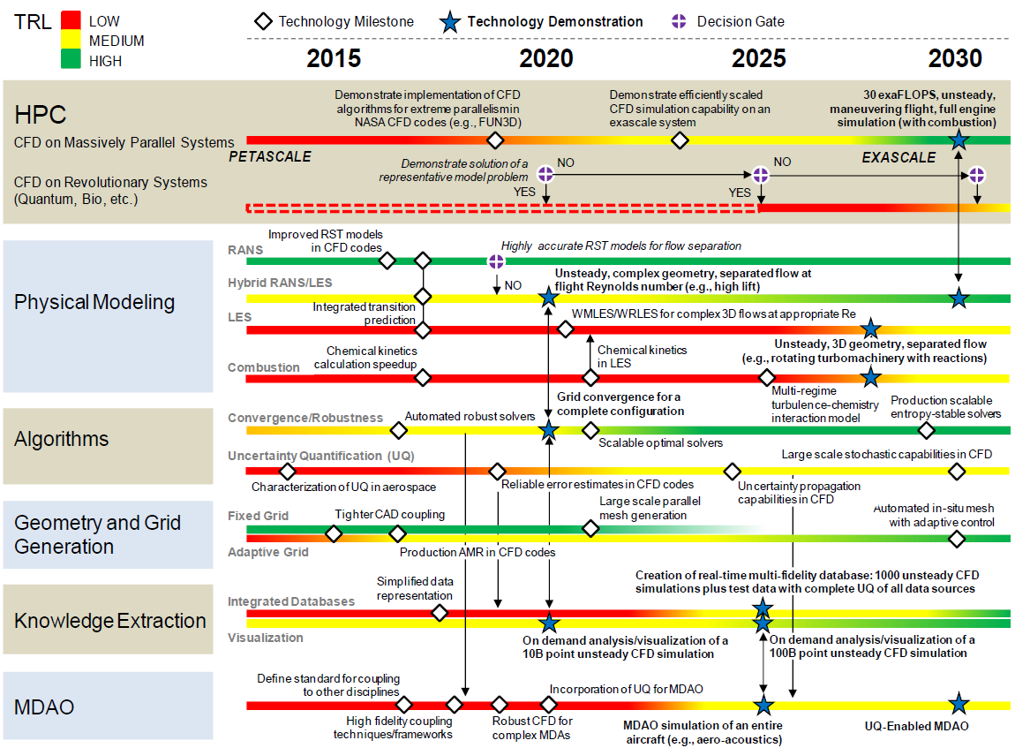
UQ in CFD Vision 2030 Roadmap
5

Slide 6
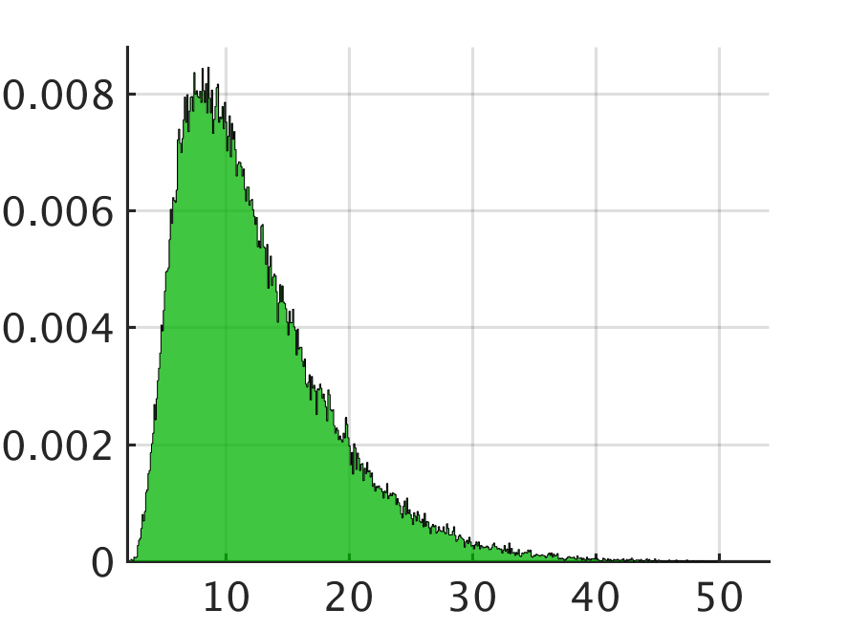
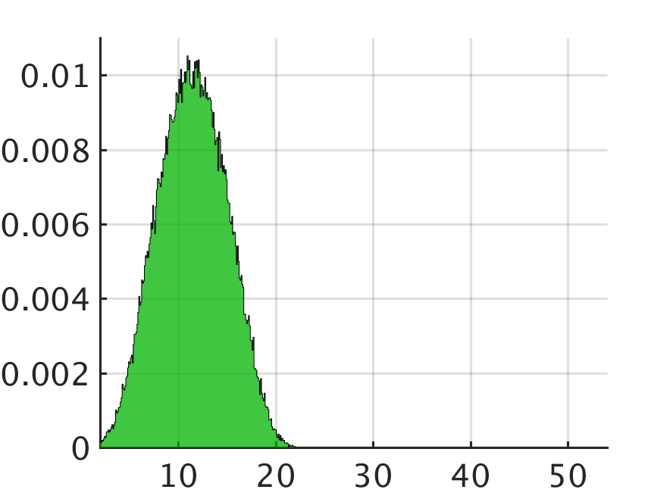
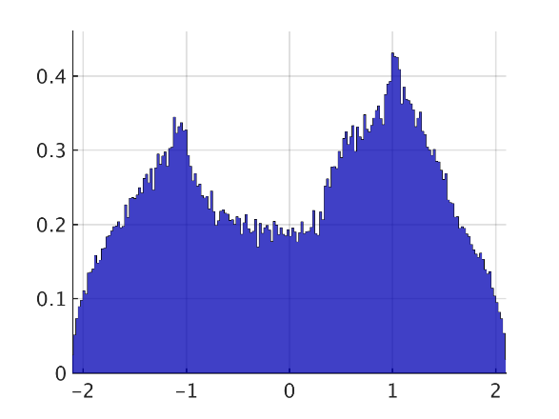



Basics of Uncertainty Quantification (UQ)
What is UQ?
    The process of characterizing all recognized uncertainties in the model and quantifying their effect on the outcomes
Four major components:
  Identify uncertain model inputs/parameters (What are they?)
  Characterize input uncertainties (What is their statistical form?)
  Propagate (How do they evolve through the model?)
  Analyze (What are the impacts of input uncertainty?)
Uncertainty in input parameters propagates through to the output
Probability Density
model
$$x_{1}$$
$$x_{2}$$
$${f(x}_{1},x_{2})$$
6

Slide 7
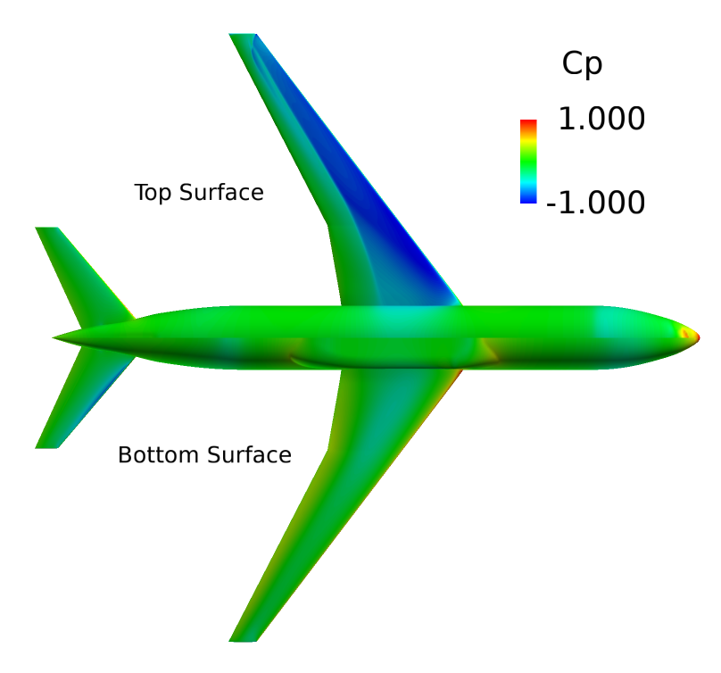
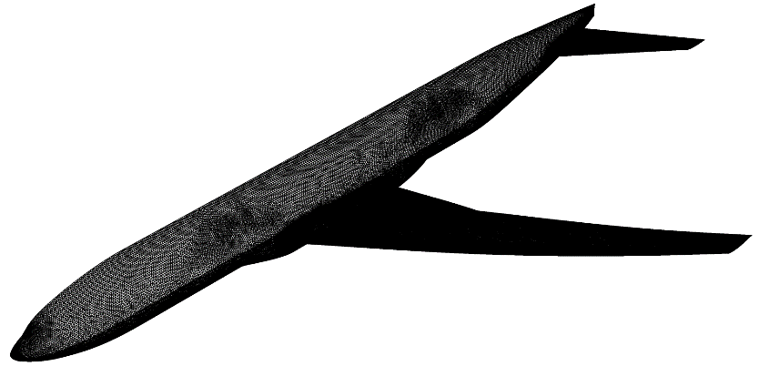
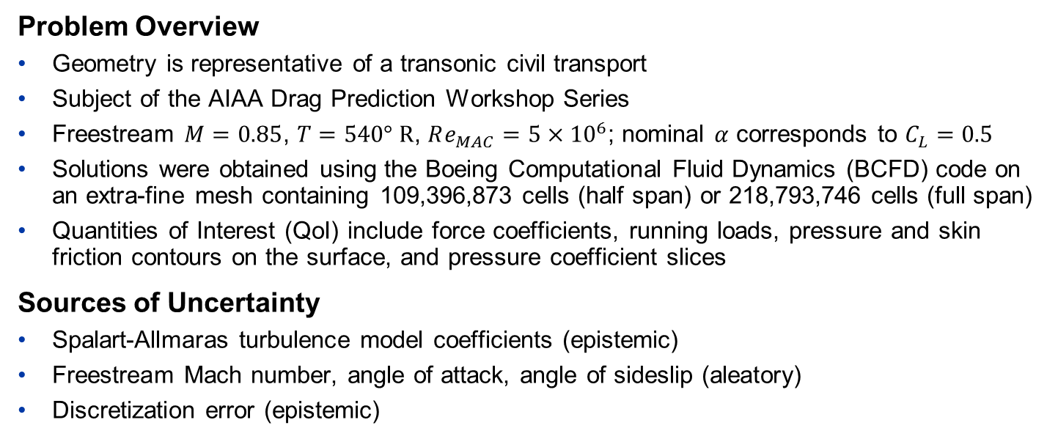
NASA Common Research Model (CRM)
Problem Overview
Geometry is representative of a transonic civil transport
Subject of the AIAA Drag Prediction Workshop Series
Freestream $M=0.85$, $T=540° R$, $Re_{MAC}=5×{10}^{6}$; nominal $α$ corresponds to $C_{L}=0.5$
Solutions were obtained using the Boeing Computational Fluid Dynamics (BCFD) code on an extra-fine mesh containing 109,396,873 cells (half span) or 218,793,746 cells (full span)
Quantities of Interest (QoI) include force coefficients, running loads, pressure and skin friction contours on the surface, and pressure coefficient slices
Sources of Uncertainty
Spalart-Allmaras turbulence model coefficients (epistemic)
Freestream Mach number, angle of attack, angle of sideslip (aleatory)
Discretization error (epistemic)

Slide 8
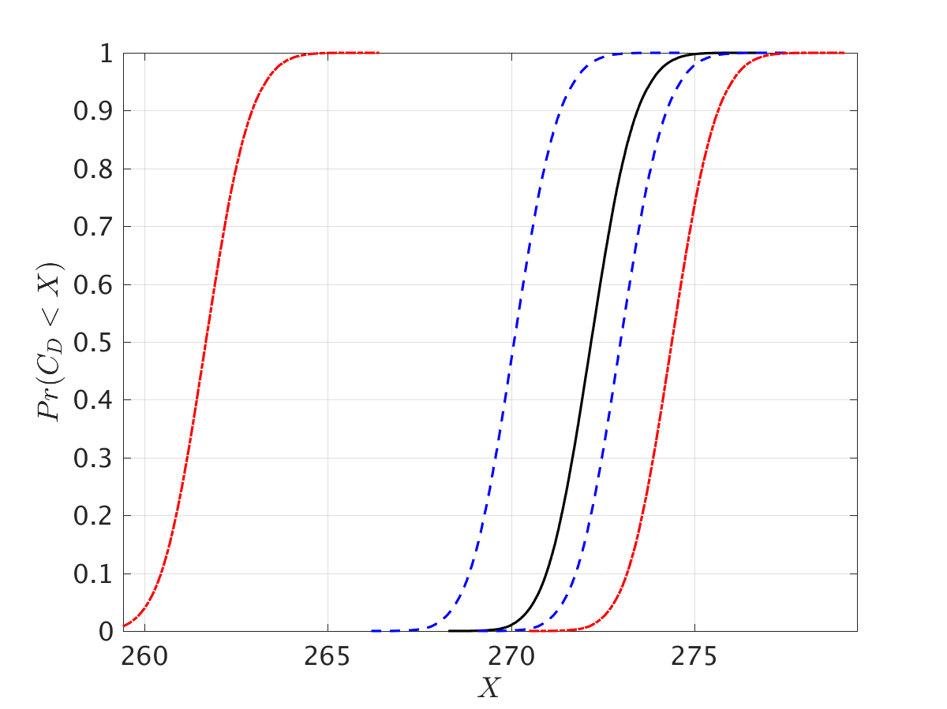
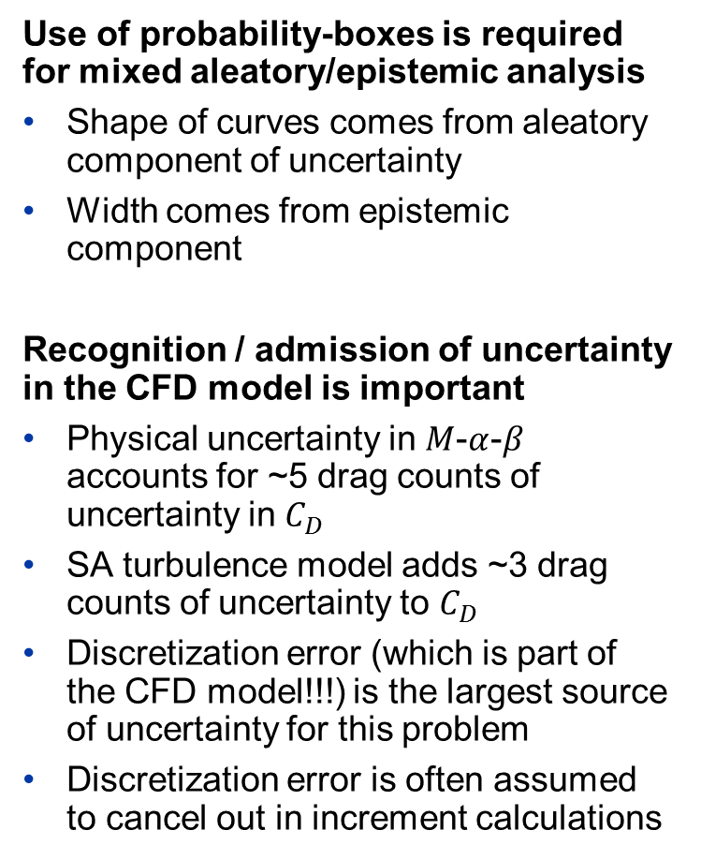

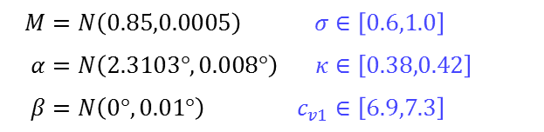
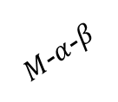
CRM: Probability-Box (p-box) for $C_{D}$
Discretization
SA Model
$M$-$α$-$β$
Use of probability-boxes is required for mixed aleatory/epistemic analysis
Shape of curves comes from aleatory component of uncertainty
Width comes from epistemic component
Recognition / admission of uncertainty in the CFD model is important
Physical uncertainty in $M$-$α$-$β$ accounts for ~5 drag counts of uncertainty in $C_{D}$
SA turbulence model adds ~3 drag counts of uncertainty to $C_{D}$
Discretization error (which is part of the CFD model!!!) is the largest source of uncertainty for this problem
Discretization error is often assumed to cancel out in increment calculations
$$M$$ | $$=N\left(0.85,0.0005\right)$$ | $$σ$$ | $$∈\left[0.6,1.0\right]$$
$$α$$ | $$=N\left(2.3103°,0.008°\right)$$ | $$κ$$ | $$∈\left[0.38,0.42\right]$$
$$β$$ | $$=N\left(0°,0.01°\right)$$ | $$c_{v1}$$ | $$∈\left[6.9,7.3\right]$$
Discretization error bounds from Roache GCI
→ $M$-$α$-$β$ uncertainty characteristic of NASA NTF
→ SA uncertainty described in AIAA Paper 2017-1710

Slide 9
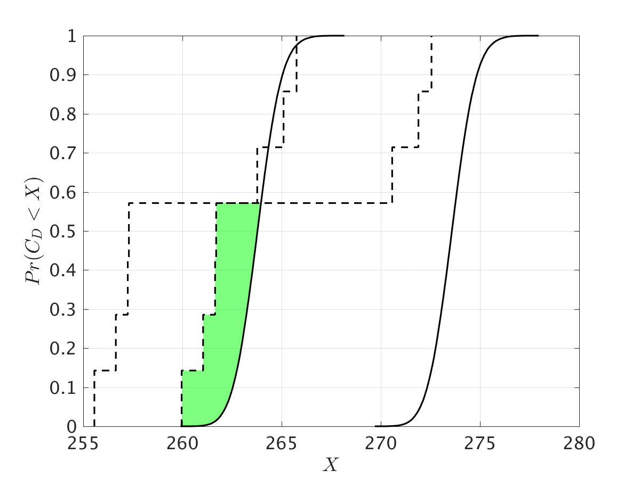
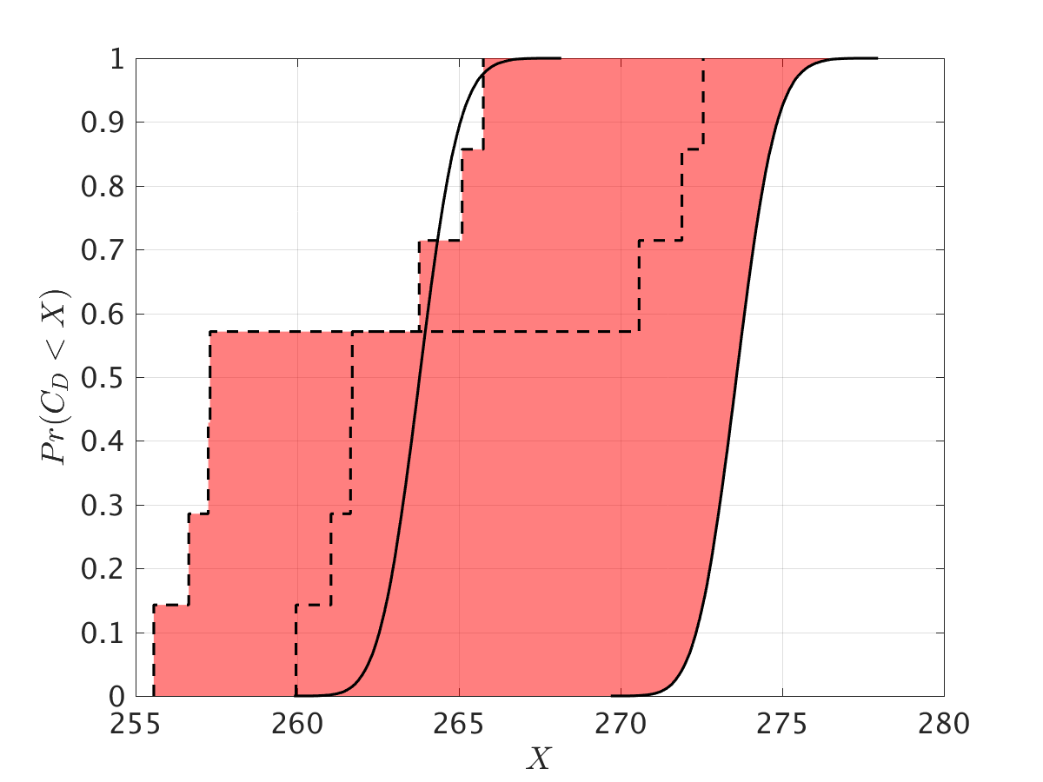

CRM: Validation using Disbelief
Disbelief: Extension of Oberkampf and Roy’s Area Validation Metric
Describes the level of disagreement between two p-boxes in same units as QoI
Original version measures the area between two CDFs, and minimum area between two p-boxes or one p-box and one CDF
Oberkampf and Roy (green) argued that the model should not be punished for deficiencies in the experiment – our philosophy (green + red) is that the “worst-case scenario” should still be acknowledged
Disbelief $∈\left[1.16,13.39\right]$ counts
1.16 counts
13.39 counts
Figure: Minimum (green) and maximum (red) disbelief between p-boxes for BCFD CRM solutions (solid) and wind tunnel data (dashed).

Slide 10
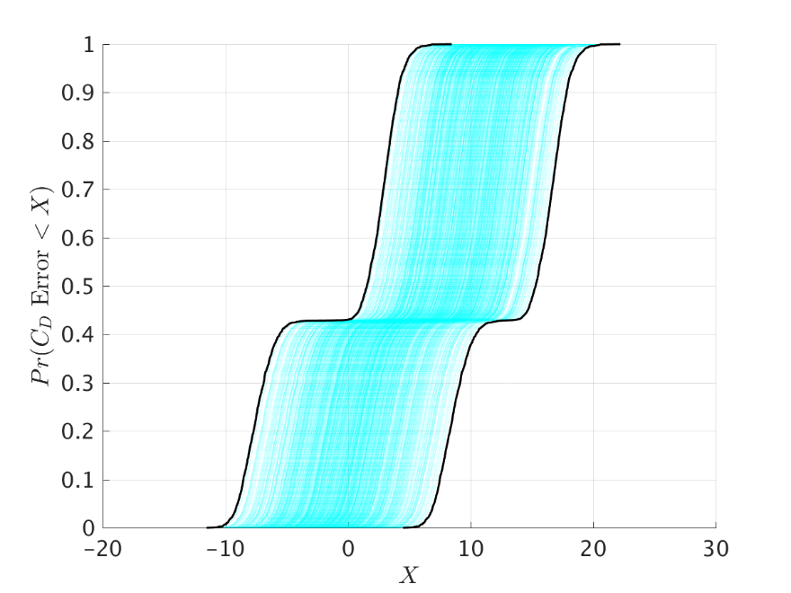
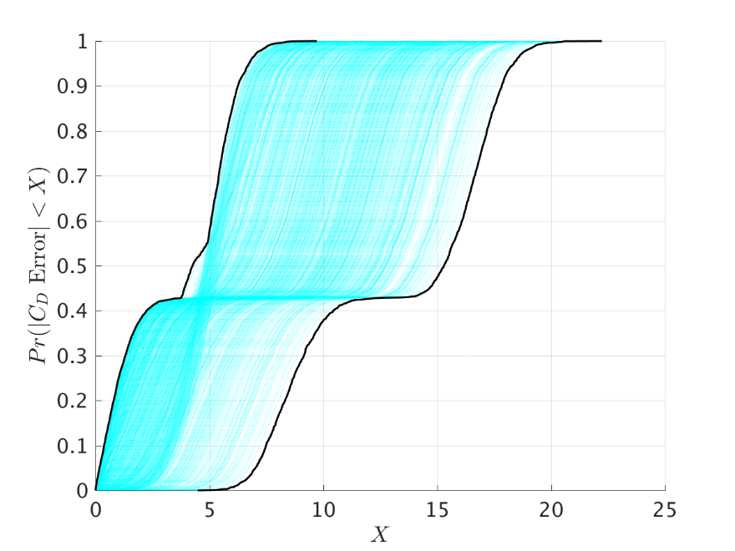
CRM: Validation using Error P-Boxes
Use Second Order Probability (SOP) to quantify error
Outer loop: draw epistemic realizations of simulation and experimental p-boxes (result is a CDF from each p-box)
Inner loop: draw aleatory samples of both epistemic realization CDFs independently, and subtract result of each draw. Construct a CDF of the difference.
Convex hull of all difference CDFs (one for each epistemic draw) is a p-box of the difference
Figure: Relative (left) and absolute (right) error p-boxes comparing BCFD CRM p-box to wind tunnel data p-box.

Slide 11
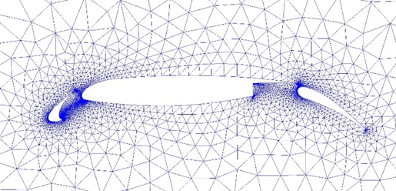
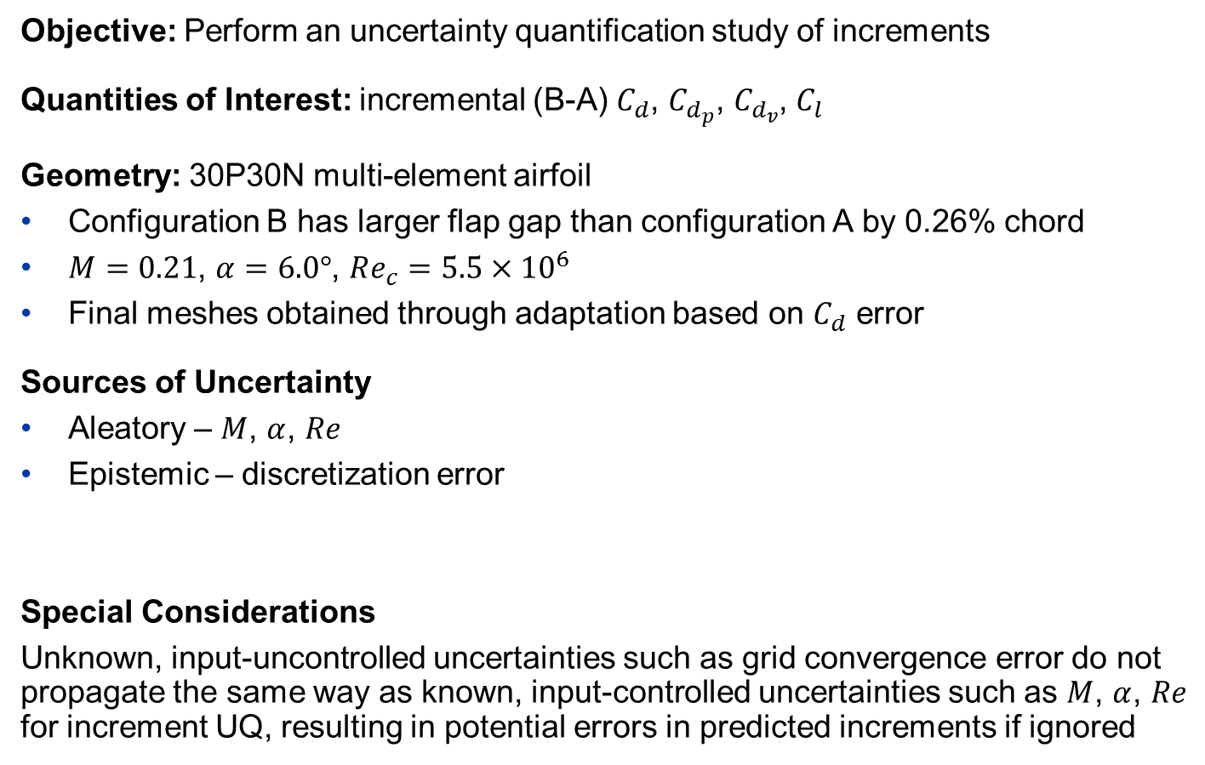
Uncertainty Propagation for Increments
Objective: Perform an uncertainty quantification study of increments
Quantities of Interest: incremental (B-A) $C_{d}$, $C_{d_{p}}$, $C_{d_{v}}$, $C_{l}$
Geometry: 30P30N multi-element airfoil
Configuration B has larger flap gap than configuration A by 0.26% chord
$M=0.21$, $α=6.0°$, $Re_{c}=5.5×{10}^{6}$
Final meshes obtained through adaptation based on $C_{d}$ error
Sources of Uncertainty
Aleatory – $M$, $α$, $Re$
Epistemic – discretization error
Special Considerations
Unknown, input-uncontrolled uncertainties such as grid convergence error do not propagate the same way as known, input-controlled uncertainties such as $M$, $α$, $Re$ for increment UQ, resulting in potential errors in predicted increments if ignored

Slide 12
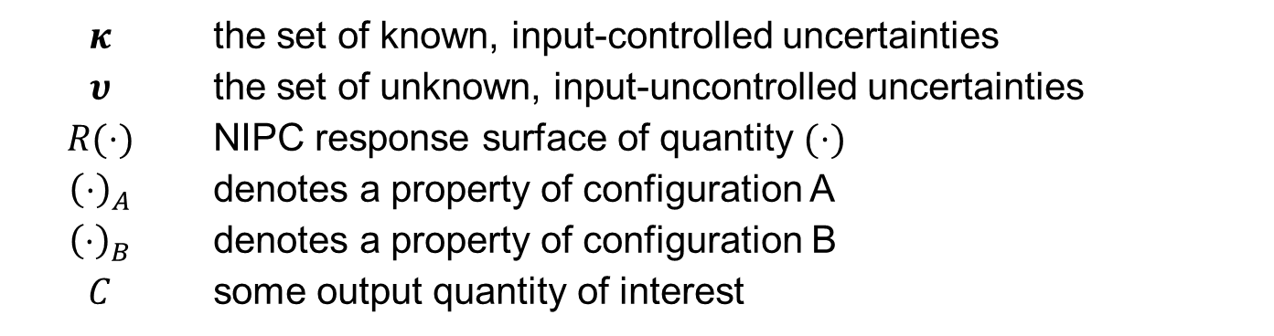
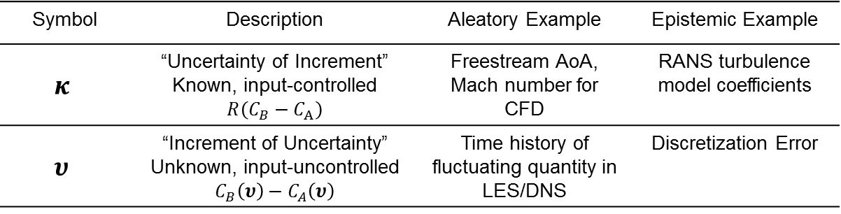
Increment UQ – Nomenclature and Definitions
Symbol | Description | Aleatory Example | Epistemic Example
$$κ$$ | “Uncertainty of Increment” Known, input-controlled $$R\left(C_{B}−C_{A}\right)$$ | Freestream AoA, Mach number for CFD | RANS turbulence model coefficients
$$υ$$ | “Increment of Uncertainty” Unknown, input-uncontrolled $$C_{B}\left(υ\right)−C_{A}\left(υ\right)$$ | Time history of fluctuating quantity in LES/DNS | Discretization Error
Less Increment Uncertainty
$$κ$$ | the set of known, input-controlled uncertainties
$$υ$$ | the set of unknown, input-uncontrolled uncertainties
$$R(⋅)$$ | NIPC response surface of quantity $(⋅)$
$${\left(⋅\right)}_{A}$$ | denotes a property of configuration A
$${\left(⋅\right)}_{B}$$ | denotes a property of configuration B
$$C$$ | some output quantity of interest

Slide 13









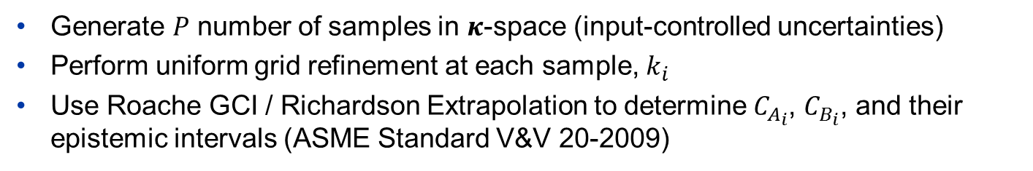




Increment UQ – Sampling Strategy
Generate $P$ number of samples in $κ$-space (input-controlled uncertainties)
Perform uniform grid refinement at each sample, $k_{i}$
Use Roache GCI / Richardson Extrapolation to determine $C_{A_{i}}$, $C_{B_{i}}$, and their epistemic intervals (ASME Standard V&V 20-2009)
$$k_{1}$$
$$k_{2}$$
$$k_{P}$$
$$⋯$$
$$C_{B_{P}}$$
$$C_{B_{1}}$$
$$C_{B_{2}}$$
$$C_{A_{P}}$$
$$C_{A_{1}}$$
$$C_{A_{2}}$$
$$N^{−2/3}$$
$$N^{−2/3}$$
$$N^{−2/3}$$

Slide 14
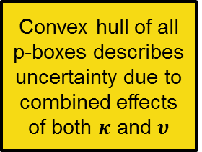

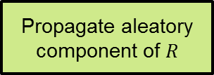
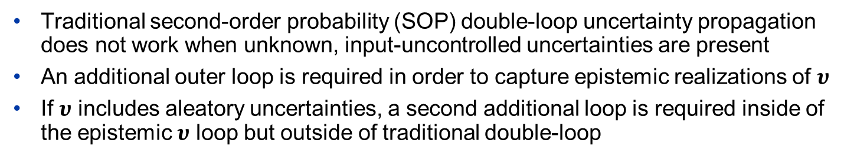




Increment UQ – Uncertainty Propagation
Traditional second-order probability (SOP) double-loop uncertainty propagation does not work when unknown, input-uncontrolled uncertainties are present
An additional outer loop is required in order to capture epistemic realizations of $υ$
If $υ$ includes aleatory uncertainties, a second additional loop is required inside of the epistemic $υ$ loop but outside of traditional double-loop
Outer Loop for $υ$
Pick epistemic realizations of $C_{A_{i}}$, $C_{B_{i}}$, $i=1, 2, …P$
Generate $R\left(C_{B}−C_{A}\right)$ as a function of $κ$ for the given realizations of $C_{A_{i}}$, $C_{B_{i}}$
P-box
Traditional SOP Double Loop for $κ$
Convex hull of all p-boxes describes uncertainty due to combined effects of both $κ$ and $υ$
Pick realizations for epistemic component of $R$
Propagate aleatory component of $R$
CDF

Slide 15
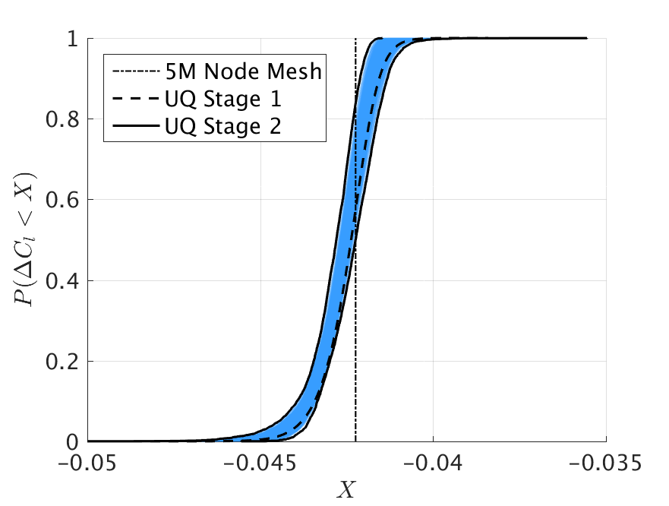
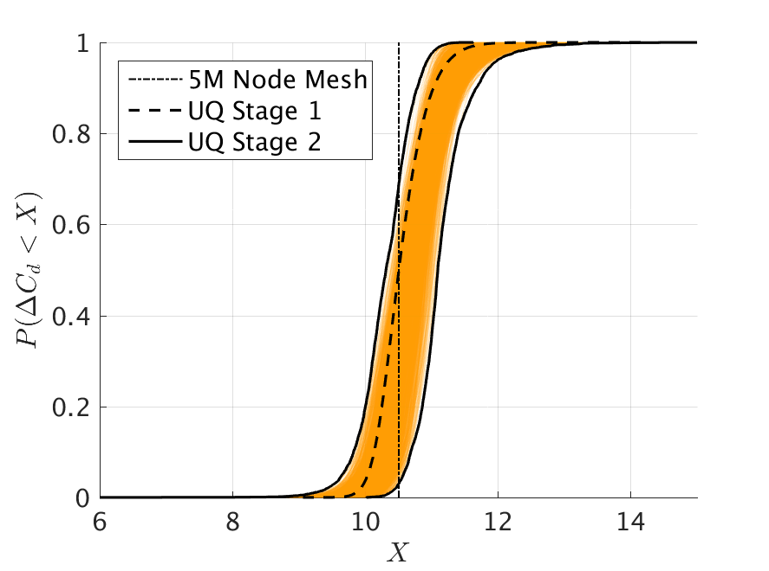


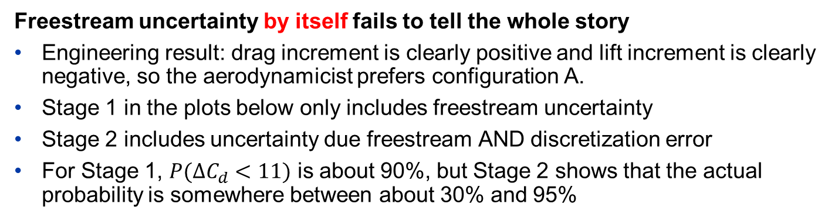

Increment UQ – Lift and Drag P-boxes
Freestream uncertainty by itself fails to tell the whole story
Engineering result: drag increment is clearly positive and lift increment is clearly negative, so the aerodynamicist prefers configuration A.
Stage 1 in the plots below only includes freestream uncertainty
Stage 2 includes uncertainty due freestream AND discretization error
For Stage 1, $P(ΔC_{d}<11)$ is about 90%, but Stage 2 shows that the actual probability is somewhere between about 30% and 95%
$$X=11$$
$$ΔC_{l}=C_{l_{B}}−C_{l_{A}}$$
$$ΔC_{d}=C_{d_{B}}−C_{d_{A}}$$

Slide 16
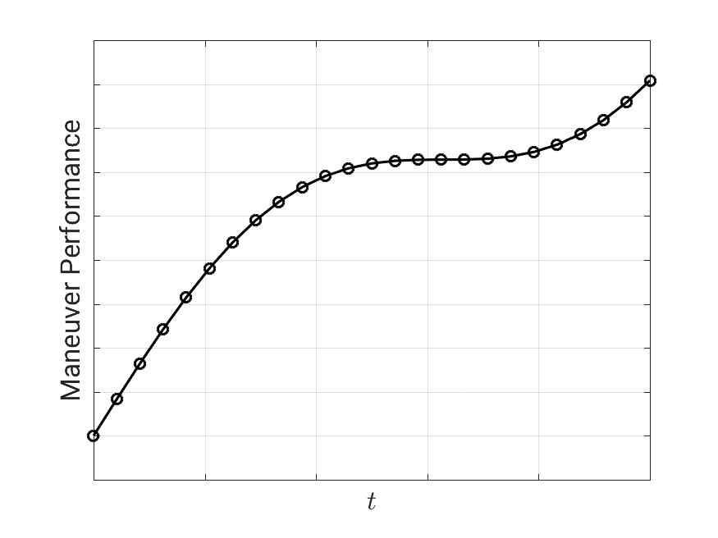
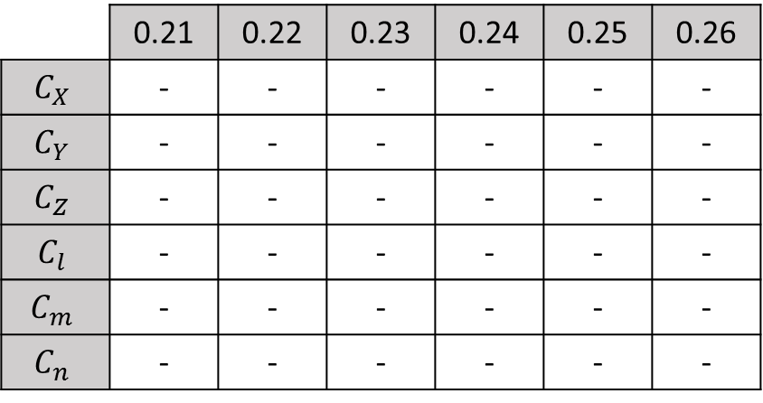
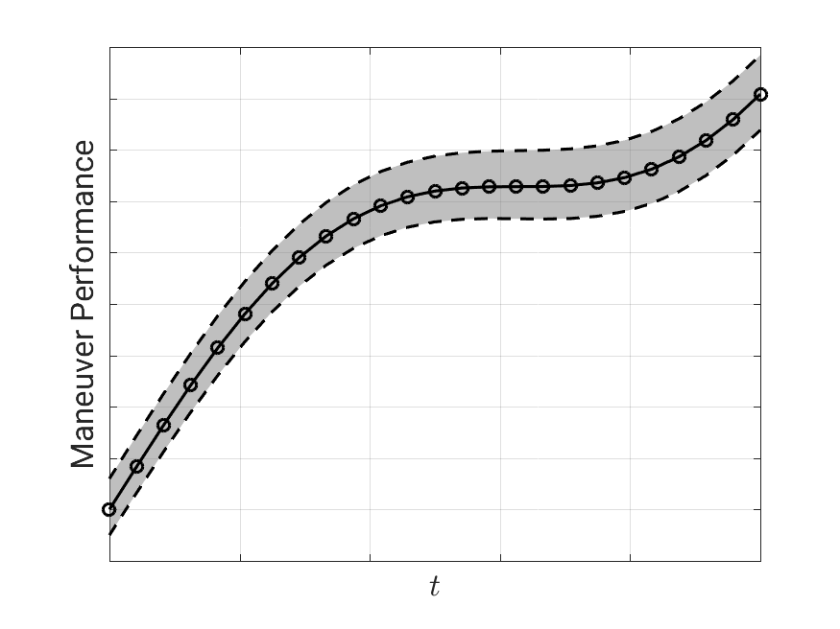









Stochastic Aero Database
Traditional Aero Database
$$⋯$$
6 DOF
$$α=4°$$
$$α=3°$$
$$α=2°$$
$$α=1°$$
Look-up tables of performance
Stochastic Aero Database
6 DOF
$$⋯$$
$$α=4°$$
$$α=3°$$
$$α=2°$$
$$α=1°$$
Look-up tables include uncertainty

Slide 17
Stochastic Aero Database
Motivation for Stochastic Aero Database versus Deterministic
Provides a rigorous method for determining confidence in meeting a mission requirement, an emerging trend in requirements documents
Closes the gap between system-level uncertainty analysis and methods developed to assess aerodynamic force and moment uncertainty
Capabilities and Methods Required
Combination of multiple information sources (e.g., vortex lattice, CFD, wind tunnel) into a single database using multiple-fidelity Kriging meta-modeling
Interpolation of forces/moments AND their uncertainty throughout flight envelope using Gaussian process regression
Spatial and inter-coefficient correlation of uncertainties throughout database maintained using Cholesky decomposition of correlation matrix

Slide 18
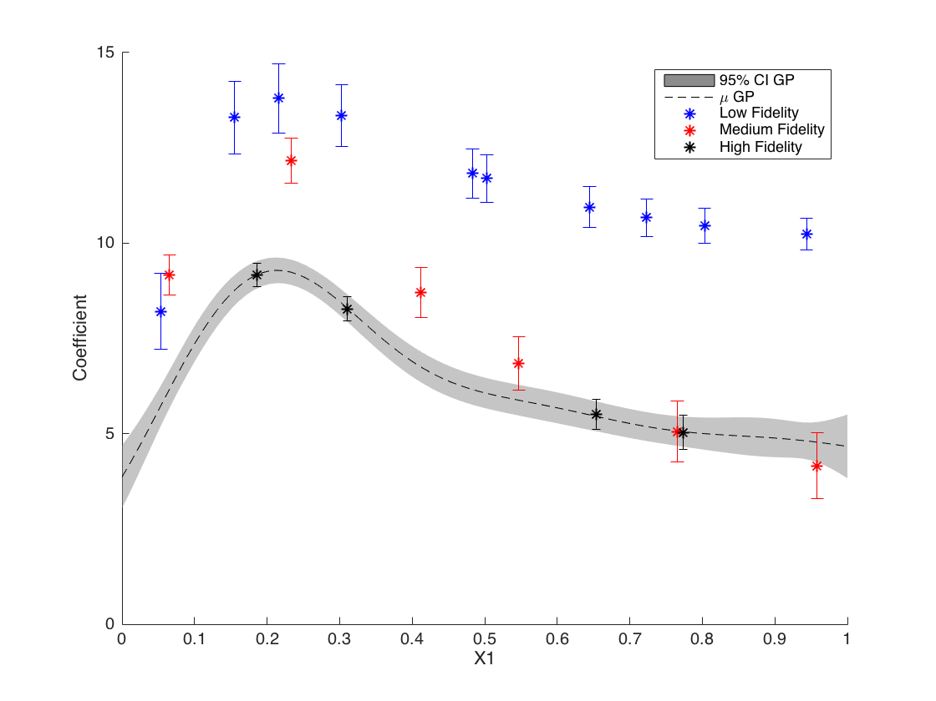
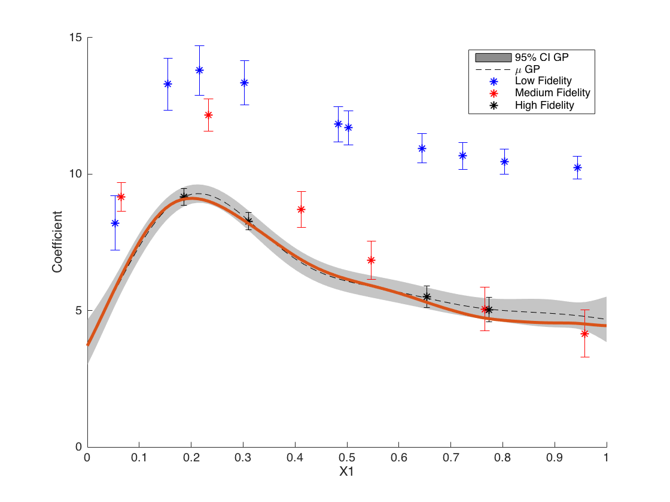
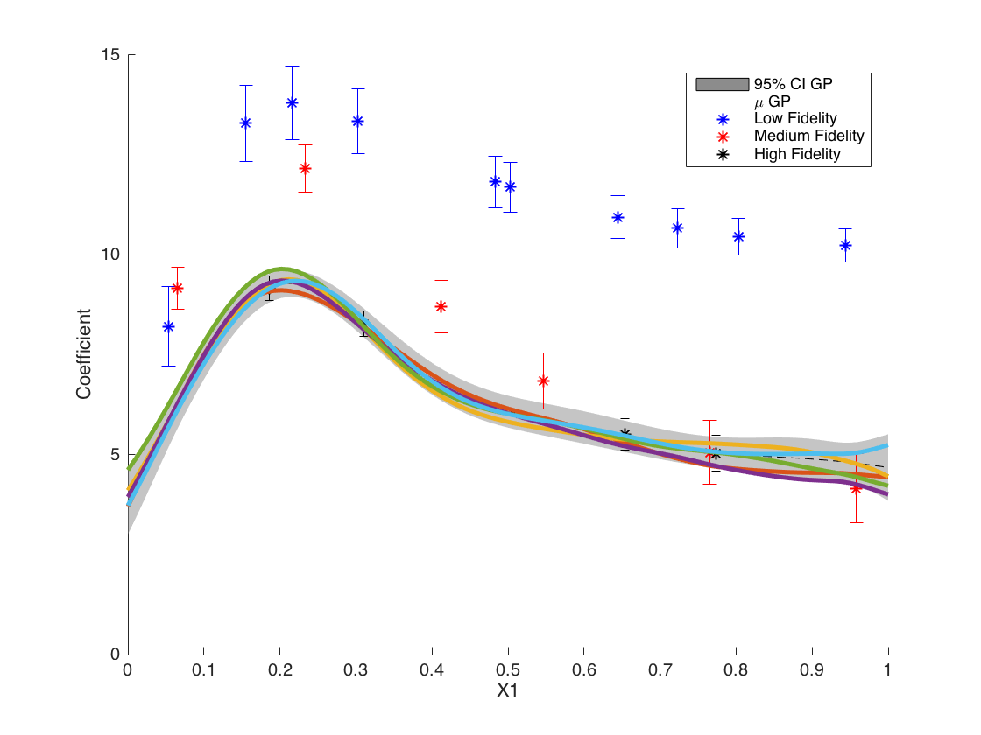
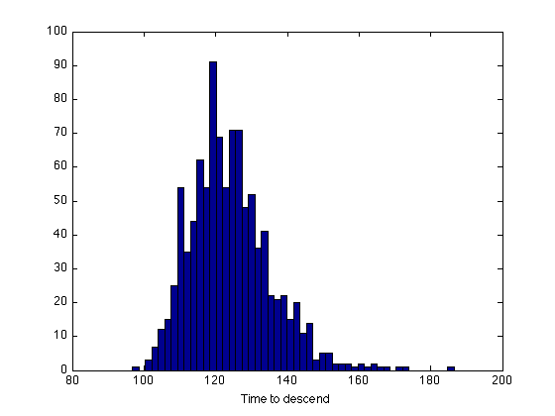
Stochastic Aero Database
Results shown from AIAA Papers 2015-3439 and 2016-3999
Multiple-fidelity Kriging Meta-Model for one aerodynamic coefficient
Individual deterministic sample
Several deterministic samples
Histogram of maneuver performance
Wendorff et al., AIAA 2015-3439: https://arc.aiaa.org/doi/abs/10.2514/6.2015-3439
Wendorff et al., AIAA 2016-3999: https://arc.aiaa.org/doi/abs/10.2514/6.2016-3999

Slide 19
Conclusions
Understanding the uncertainty in CFD is critical
Rigorous UQ provides confidence in CFD results
Potentially large cost savings through reduced wind tunnel and flight test
Model deficiencies should be included in UQ analysis
CRM analysis shows that turbulence model and discretization error are significant contributors to overall uncertainty
Ignoring model uncertainties may result in overly conservative estimates of output uncertainties
Several methods proposed to numerically quantify validation of CFD models
New and efficient methods are needed for challenging aerospace problems
Increment UQ requires outer loop around traditional SOP when input-uncontrolled uncertainties are considered
Stochastic aero databases are valuable, but much more expensive to generate than their deterministic counterparts

Slide 20
Acknowledgements / References
Acknowledgements
The CRM solutions were computed for a project with Oak Ridge National Laboratory. This research used resources of the Oak Ridge Leadership Computing Facility, which is a DOE Office of Science User Facility supported under Contract DE-AC05-00OR22725.
Thanks to Andrew Cary and Mori Mani for their contributions to the CRM and increment UQ studies
Thanks to Andrew Wendorff, Juan Alonso, Brian Whitehead, and Stefan Bieniawski for their work on stochastic aero databases
References
AIAA Paper 2015-3439 (Stochastic aero database)
AIAA Paper 2016-3999 (Stochastic aero database)
AIAA Paper 2017-1710 (SA turbulence model study for CRM)

Slide 21
Backup Slides

Slide 22
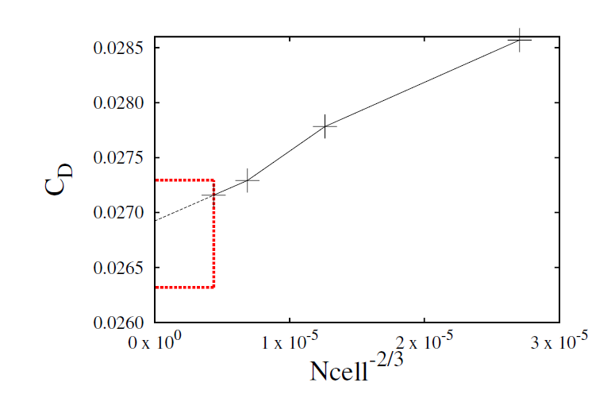
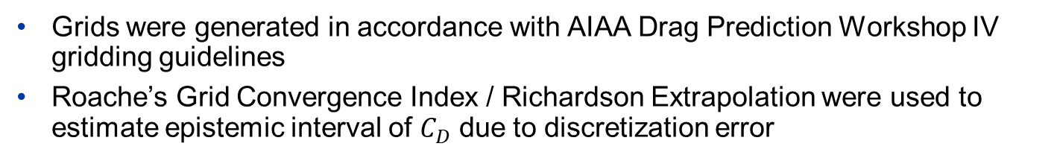
CRM Grid Convergence
Grids were generated in accordance with AIAA Drag Prediction Workshop IV gridding guidelines
Roache’s Grid Convergence Index / Richardson Extrapolation were used to estimate epistemic interval of $C_{D}$ due to discretization error

