Slide 1

Surrogate Models and Sampling Plans for Multi-Fidelity Aerodynamic Performance Databases
Kevin R. Quinlan, Siva Movva, Elizabeth Stein, and Ana Kupresanin
Lawrence Livermore National Laboratory

Slide 2

Outline
Background on Problem
Cokriging Model
  Brief Review of Gaussian Processes
Efficient Sampling Plans
  Space-filling Designs
  Sequential Design of Experiments
Simulation Study with cbaero and cart3D for Stream
Conclusions/Future Work

Slide 3
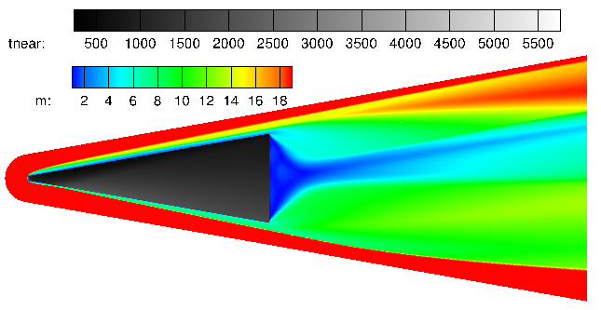
Intro to Flight Performance Integration Project
and Background Motivation
DOE/NNSA’s mission is to ensure safe, secure, and effective systems.
  The Flight Performance Integration project is developing Sora to ensure the viability of current and future systems through high confidence mod/sim.
Industry state-of-the-art for characterizing vehicle aerodynamic performance involves 10³-10⁵ RANS CFD simulations AND extensive wind tunnel testing
  This takes ~12-18 months to complete
Lower fidelity simulations used to design vehicle OML are typically discarded
  We are proposing to keep and leverage that data to be ~20x faster in building the aero db!
STREAM Vehicle
(Mach 20, 21km altitude, 5° AOA)
Near Wall Fluid Temp
Mach Number
Notes:
The motivation for this research is to provide data that will aid the government in its goal to ensure a safe, secure, and effective systems. The best way to do this is through simulation, and the flight performance integration project is developing Sora to ensure the viability of both current and future systems.

Slide 4



An Introduction to Sora (LLNL’s Flight Sim Suite)
Position
Time
weather model
Density, Temperature
Turbulence
$$Δt$$
Loading
Aero database
Rigid-body
dynamics
Sora calculates flight vehicle’s state history for payload performance as a function of time coupled to exterior environment variables.
+
Structural
dynamics
+
Thermo-
dynamics
Credit: Dr. Dan Driver
Notes:
Sora is a flight modeling suite that assesses nuclear explosives package (NEP) in flight environments. Along a potential flight trajectory sora calculates the flight vehicle’s state history for payload performance as a function of time coupled to exterior environment variables. The exterior environment variables are informed by the weather model and the aero database. The aero database is where I fit in here.

Slide 5
Multi-Fidelity Model Setup
Field Data
Inviscid Forces
Viscous Forces
Aero Coefficients
(Lift/Drag)
+
=
Simulation Fidelity
High Fidelity
(Many hours)
US3D
US3D
Medium Fidelity
(Minutes)
Cart3D
Low Fidelity
(Seconds)
cbaero
cbaero

Slide 6
Multi-Fidelity Model Setup
Field Data
Inviscid Forces
Viscous Forces
Aero Coefficients
(Lift/Drag)
+
=
Simulation Fidelity
High Fidelity
(Many hours)
US3D
US3D
Medium Fidelity
(Minutes)
Cart3D
Low Fidelity
(Seconds)
cbaero
cbaero

Slide 7
Multi-fidelity Modeling - Big Picture
Main Goal: Generate an accurate surrogate model
  Leverage fast low-fidelity simulations to improve high-fidelity predictions
  High-fidelity codes are time-consuming to run (require SME interaction AND lots of compute cycles)
Low-fidelity simulations give approximations of the response
  Missing Physics
    Simplifying assumptions: inviscid, irrotational flow
  Approximations of difficult calculations
    Engineering correlations unanchored until sufficient high-fidelity RANS CFD coverage of flight envelope
Gaussian Process models are effective surrogates and use them to model low-fidelity simulations and differences
Principles from design of computer experiments allow us to efficiently generate samples

Slide 8
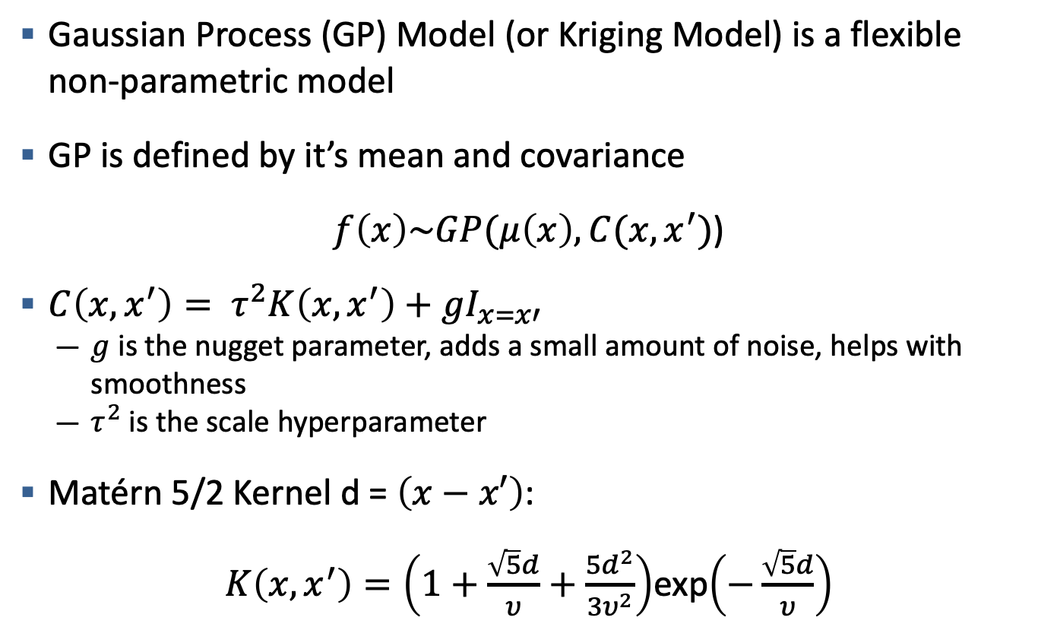
Review of Gaussian Processes
Gaussian Process (GP) Model (or Kriging Model) is a flexible non-parametric model
GP is defined by it’s mean and covariance
$f\left(x\right)\sim GP(μ\left(x\right), C(x,x^{′})$)
$C\left(x,x^{′}\right)= τ^{2}K\left(x,x^{′}\right)+gI_{x=x′}$
  $g$ is the nugget parameter, adds a small amount of noise, helps with smoothness
  $τ^{2}$ is the scale hyperparameter
Matérn 5/2 Kernel d = $\left(x−x′\right)$:
$K\left(x,x^{′}\right)=\left(1+\frac{\sqrt{5}d}{υ}+\frac{5d^{2}}{3υ^{2}}\right)$exp$\left(−\frac{\sqrt{5}d}{υ}\right)$

Slide 9
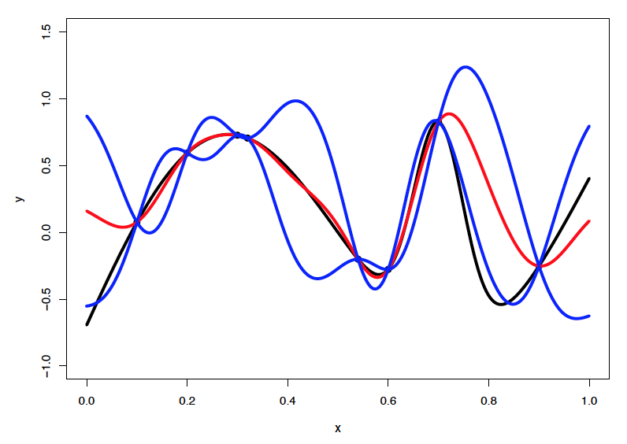
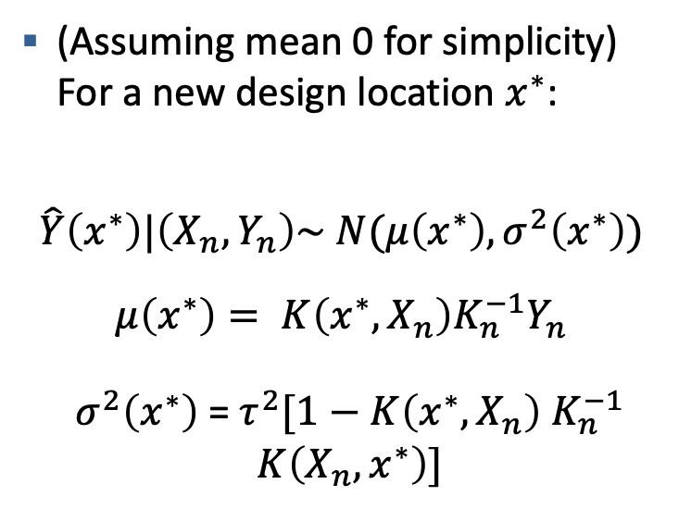
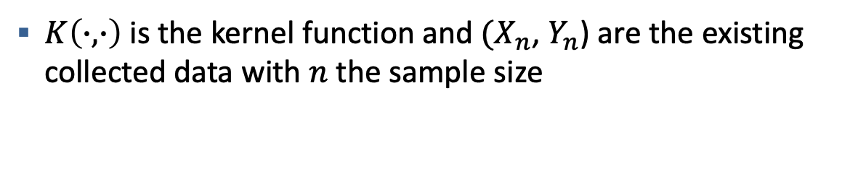
Review of Gaussian Processes
(Assuming mean 0 for simplicity) For a new design location $x^{∗}$:
$$\hat{Y}\left(x^{∗}\right)|\left(X_{n},Y_{n}\right)\sim N(μ\left(x^{∗}\right),σ^{2}\left(x^{∗}\right))$$
$$μ\left(x^{∗}\right)= K\left(x^{∗},X_{n}\right)K_{n}^{−1}Y_{n}$$
$σ^{2}\left(x^{∗}\right)$ = $τ^{2}[1−K\left(x^{∗},X_{n}\right)$ $K_{n}^{−1}$ $K\left(X_{n},x^{∗}\right)]$
$K\left(∙,∙\right)$ is the kernel function and $(X_{n}$, $Y_{n}$) are the existing collected data with $n$ the sample size

Slide 10
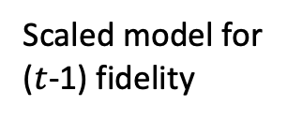
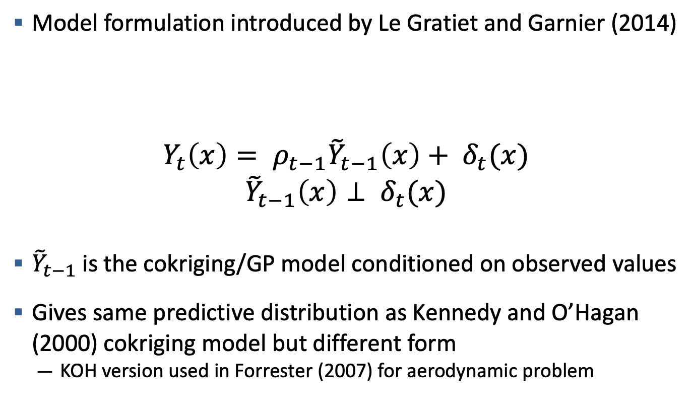
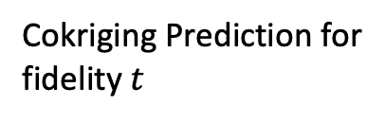
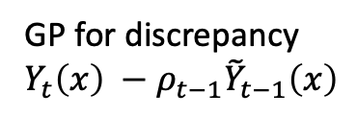
Recursive Cokriging model
Model formulation introduced by Le Gratiet and Garnier (2014)
$$Y_{t}\left(x\right)= ρ_{t−1}{\tilde{Y}}_{t−1}\left(x\right)+ δ_{t}(x)$$
$${\tilde{Y}}_{t−1}\left(x\right)⊥ δ_{t}(x)$$
${\tilde{Y}}_{t−1}$ is the cokriging/GP model conditioned on observed values
Gives same predictive distribution as Kennedy and O’Hagan (2000) cokriging model but different form
  KOH version used in Forrester (2007) for aerodynamic problem
Cokriging Prediction for
fidelity $t$
Scaled model for
($t$-1) fidelity
GP for discrepancy
$Y_{t}\left(x\right) −$ $ρ_{t−1}{\tilde{Y}}_{t−1}\left(x\right)$

Slide 11
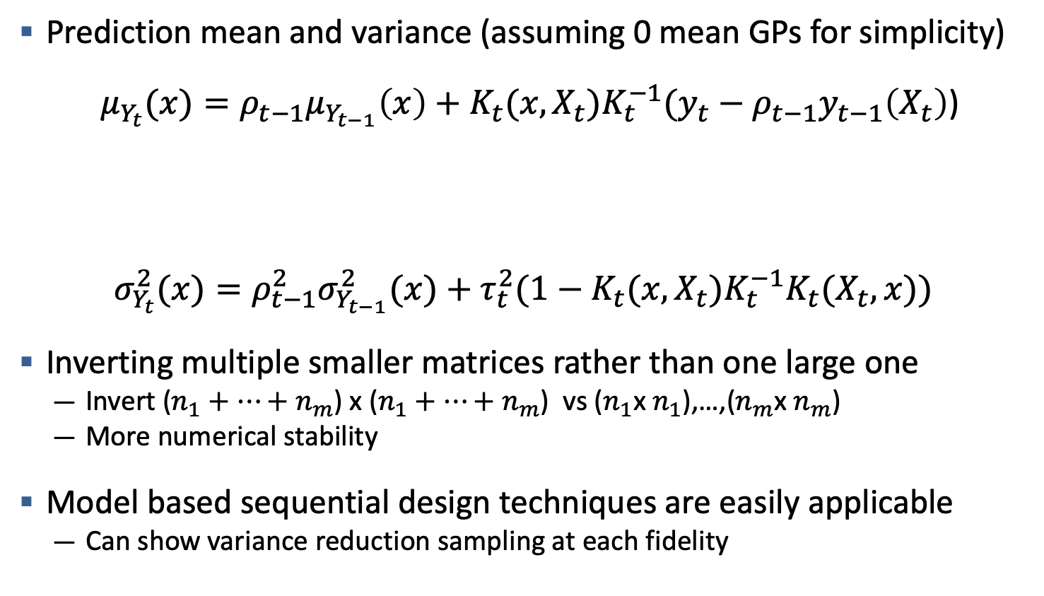
Recursive Cokriging Model
Prediction mean and variance (assuming 0 mean GPs for simplicity)
${μ_{Y_{t}}(x)=ρ_{t−1}μ}_{Y_{t−1}}\left(x\right)+K_{t}(x,X_{t})K_{t}^{−1}(y_{t}−ρ_{t−1}y_{t−1}\left(X_{t}\right)$)
$$σ_{Y_{t}}^{2}(x)=ρ_{t−1}^{2}σ_{Y_{t−1}}^{2}(x)+τ_{t}^{2}(1−K_{t}(x,X_{t})K_{t}^{−1}K_{t}(X_{t},x))$$
Inverting multiple smaller matrices rather than one large one
  Invert ($n_{1}+⋯+n_{m}$) x ($n_{1}+⋯+n_{m}$) vs ($n_{1}$x $n_{1}$),…,($n_{m}$x $n_{m}$)
  More numerical stability
Model based sequential design techniques are easily applicable
  Can show variance reduction sampling at each fidelity
Contribution of lower fidelities
Contribution of level t

Slide 12
Multi-Fidelity Cokriging Examples
Three level modification of example in Forrester et al 2007
Confidence Interval for high-fidelity only contains mean function,
but this doesn’t really tell us much

Slide 13
Multi-Fidelity Cokriging Examples

Slide 14
Multi-Fidelity Cokriging Example
Cart 3D Inviscid Lift
CBAERO Inviscid Lift
Angle of Attack
Angle of Attack
Mach
Mach

Slide 15
Multi-Fidelity Cokriging Example
Cart 3D Inviscid Lift
Cokriging Model
High-Fidelity Only
RMSE = 0.038
RMSE = 0.117
With limited (7) Cart3D samples, the cokriging model gives a closer approximation

Slide 16
Generating Quality Data With Design of Experiments
Problem: After initial space-filling design, need to efficiently sample new parameter sets to improve cokriging model fit for aero-coefficients
Space-filling assumes very little about the response
  Still possible to sequentially “fill the space”
Use initial GP fit to inform future points
  Assuming stationary response
  Assuming initial hyperparameter estimates aren’t too bad
Big Picture: We can minimize summaries of the GP prediction variance to select optimal design points

Slide 17
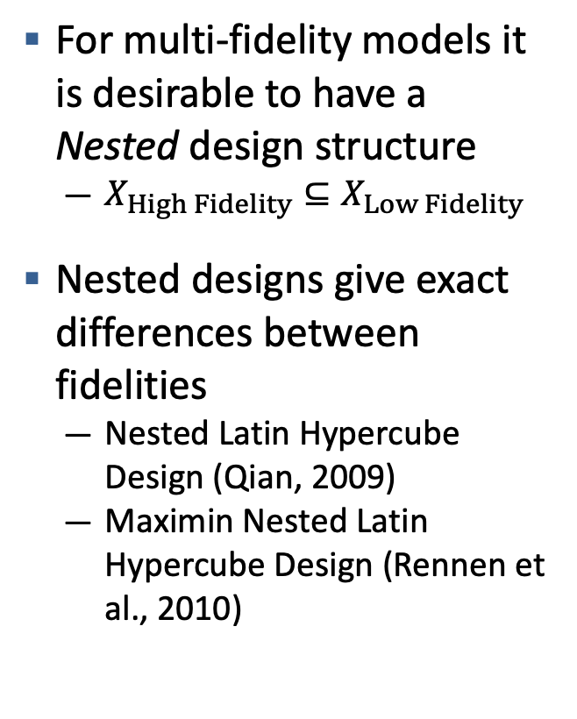
Multi-Fidelity Space-Filling Designs
For multi-fidelity models it is desirable to have a Nested design structure
  $X_{High Fidelity}⊆X_{Low Fidelity}$
Nested designs give exact differences between fidelities
  Nested Latin Hypercube Design (Qian, 2009)
  Maximin Nested Latin Hypercube Design (Rennen et al., 2010)
Non-nested Designs lead to
uncertainty at observed points

Slide 18
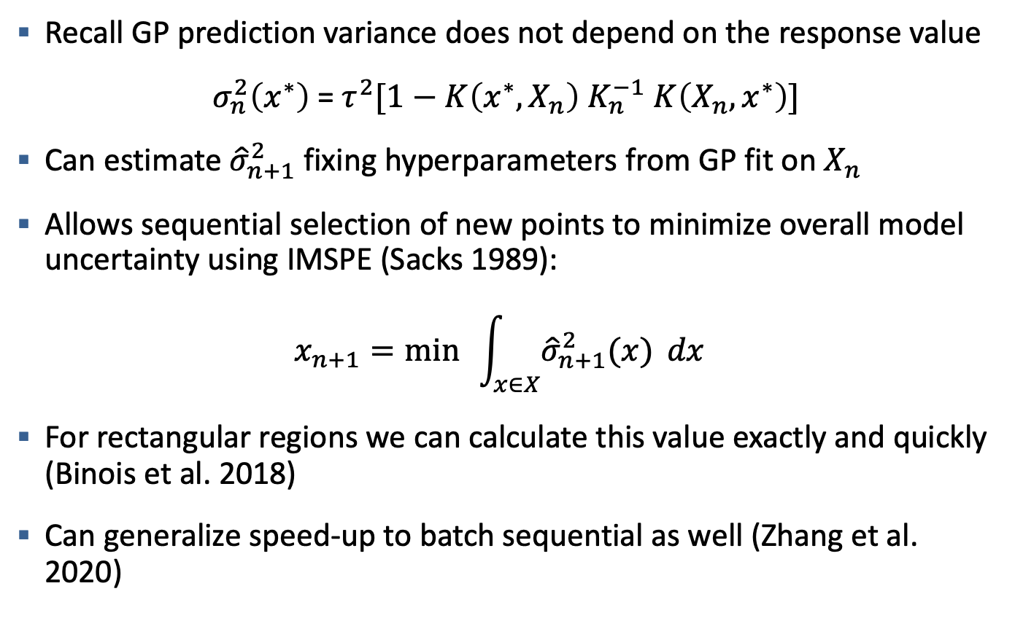
Integrated Mean Square Prediction Error (IMSPE)
Recall GP prediction variance does not depend on the response value
$σ_{n}^{2}\left(x^{∗}\right)$ = $τ^{2}[1−K\left(x^{∗},X_{n}\right)$ $K_{n}^{−1}$ $K\left(X_{n},x^{∗}\right)]$
Can estimate ${\hat{σ}}_{n+1}^{2}$ fixing hyperparameters from GP fit on $X_{n}$
Allows sequential selection of new points to minimize overall model uncertainty using IMSPE (Sacks 1989):
$$x_{n+1}=\min{ }\int_{x∈X}^{ }{{\hat{σ}}_{n+1}^{2}(x)} dx$$
For rectangular regions we can calculate this value exactly and quickly (Binois et al. 2018)
Can generalize speed-up to batch sequential as well (Zhang et al. 2020)

Slide 19
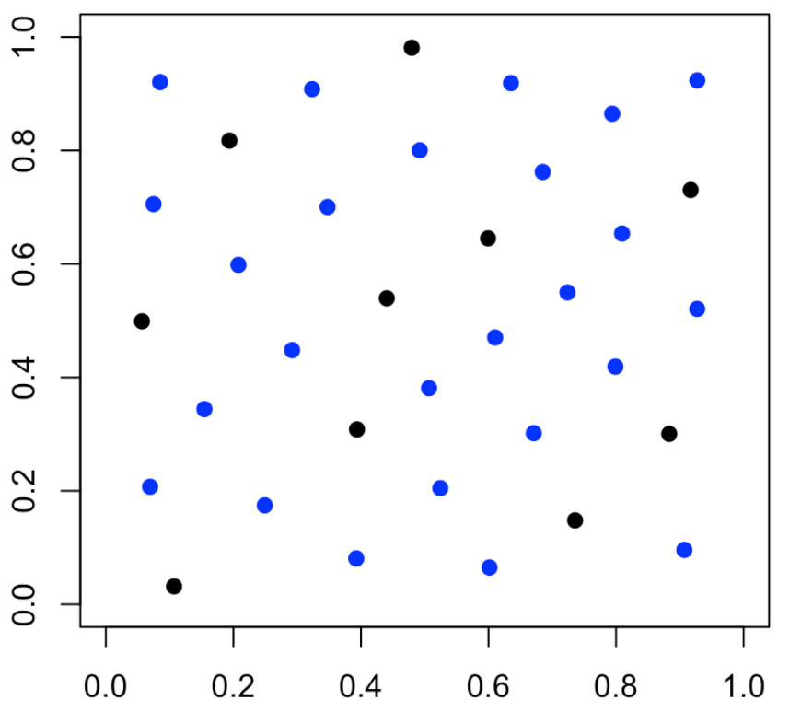
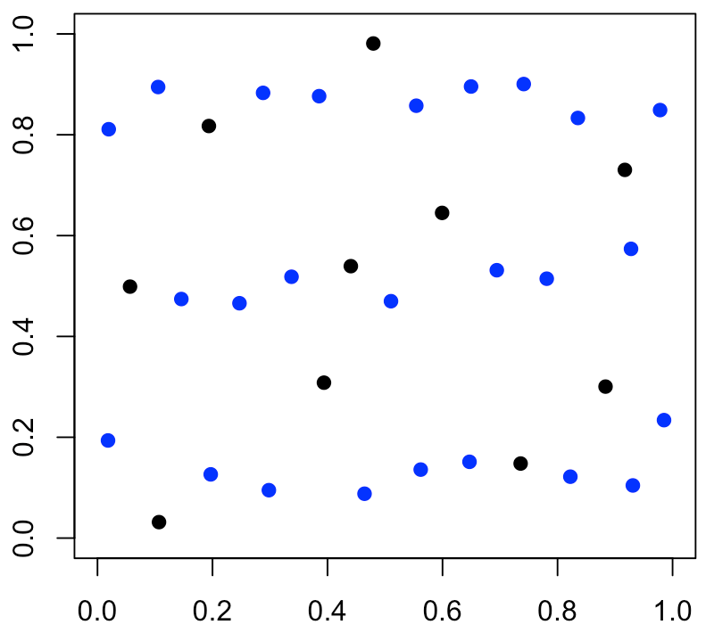
Sequential Design Examples
N = 25 new points, same 10 point starting design
Lengthscale = (0.1,0.1)
Lengthscale = (0.1,1)
The design on the right the longer length scale pushes points further away
Time to generate designs: 6-7 minutes on a Macbook Pro

Slide 20
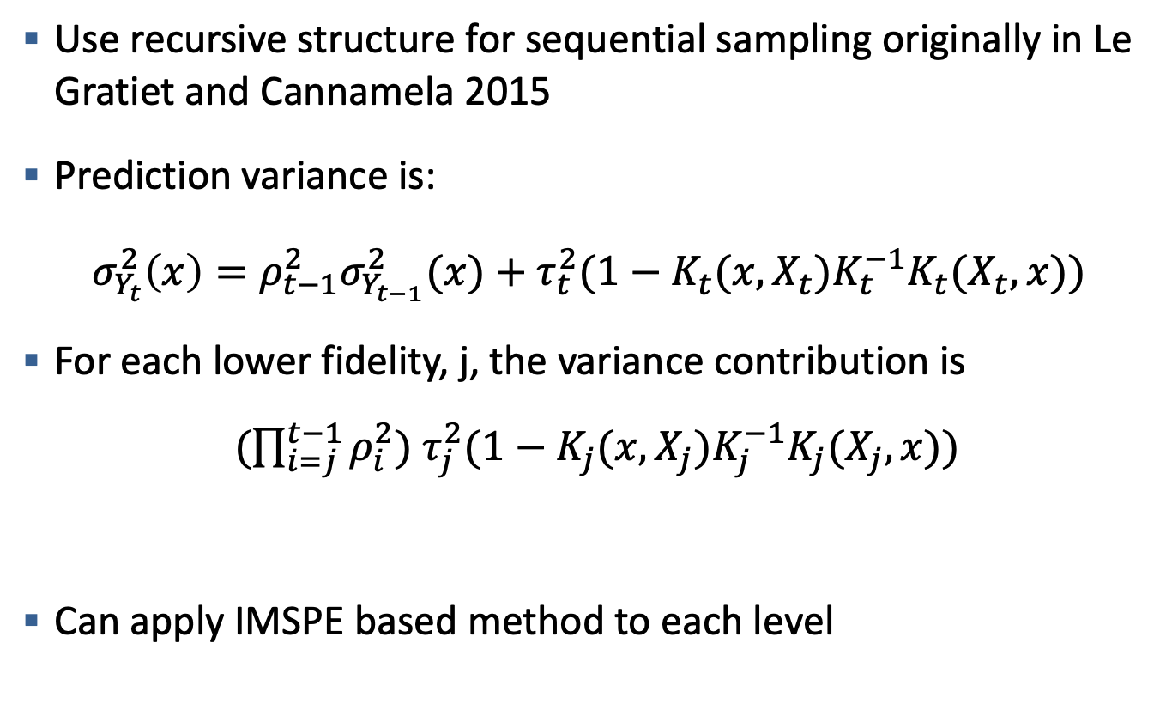
Sequential Design with Cokriging Model
Use recursive structure for sequential sampling originally in Le Gratiet and Cannamela 2015
Prediction variance is:
$$σ_{Y_{t}}^{2}\left(x\right)=ρ_{t−1}^{2}σ_{Y_{t−1}}^{2}(x)+τ_{t}^{2}(1−K_{t}(x,X_{t})K_{t}^{−1}K_{t}(X_{t},x))$$
For each lower fidelity, j, the variance contribution is
$(\prod_{i=j}^{t−1}{ρ_{i}^{2}})$ $τ_{j}^{2}(1−K_{j}(x,X_{j})K_{j}^{−1}K_{j}(X_{j},x))$
Can apply IMSPE based method to each level
Constant
Prediction Variance for level j

Slide 21
Sequential Design Optimization Algorithm
Minimize IMSPE for a given number of additional points
Initialize points with optimized MaxPro distance
Use Particle Swarm Optimization (PSO) (Kennedy and Eberhart, 1995) with Federov-Exchange Algorithm (Federov, 1972)
Federov-exchange optimizes one point at a time holding the others constant and cycles through points
PSO is a metaheuristic optimization technique to search over the parameter space
  Not guaranteed to find global optima, but this can be a complex optimization space

Slide 22
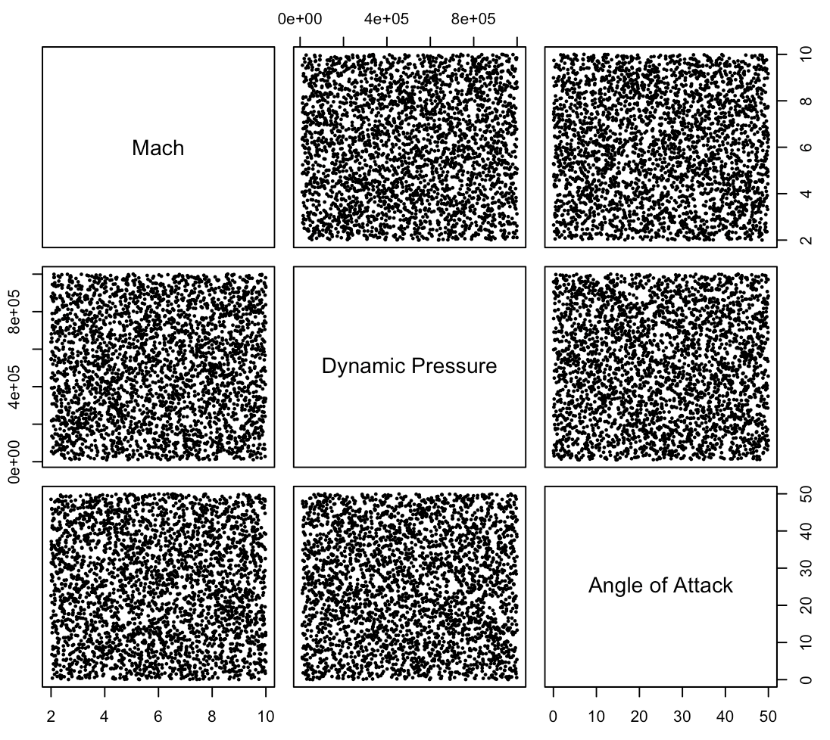
Stream Simulation Study
Generated reference dataset of 3000 CBAERO + Cart3D samples
  Generated with LHD
Compare different sampling methods using RMSE
Dynamic Pressure is only used in viscous solvers (ignored here)

Slide 23
Multi-Fidelity Cokriging Example
Cart 3D Inviscid Lift
CBAERO Inviscid Lift
Angle of Attack
Angle of Attack
Mach
Mach

Slide 24
Response for Drag
Cart 3D Inviscid Drag
CBAERO Inviscid Drag
Angle of Attack
Angle of Attack
Mach
Mach

Slide 25
Stream Simulation Study
Goal is to compare different sampling strategies as we increase Cart3D samples
Method 1: Maximin Latin Hypercube Design (Mm LHD)
  Space-filling design, but optimization does not always give same design
  Slightly unfair comparison, not a sequential method (should perform better)
Method 2: One-at-a-time sampling using IMSPE
  100 Maximin cbaero + 5 cart3D samples add one additional sample at each iteration
Method 3: Batch Sampling using IMSPE
  100 Maximin cbaero + 10 cart3D samples, add 5 samples per batch
Method 4: Sequential Sampling for both fidelities
  70 Maximin + 30 (batches of 10) sequential cbaero samples, and 5 Maximin + one-at-a-time for cart3D
Method 5: Random Sampling
  100 Random cbaero samples + random cart3D samples

Slide 26
Results Drag
Cokriging Average RMSE for Drag
RMSE (log scale)
Cart3D Samples

Slide 27
Results Lift
Cokriging Average RMSE for Lift
RMSE (log scale)
Cart3D Samples

Slide 28
Results
Cokriging RMSE Drag
Cokriging RMSE Lift
Cart3D Samples
Cart3D Samples

Slide 29
Conclusions
Multi-Fidelity cokriging models leverage lower-fidelity simulations to improve high-fidelity flight envelope aerodynamic performance predictions with fewer high-fidelity predictions
Techniques from design of computer experiments literature to efficiently sample the input space
  We can leverage the model fit to inform the location of future samples
Works best when all assumptions are met
  Still worked better over space-filling design in the long run for Lift
These methods allow for an efficient turn around time by reducing the number of samples needed
  Could build an aero db in ~1 month
  Especially important moving towards non-ballistic systems with higher dimensional input space (control surface deflections)

Slide 30
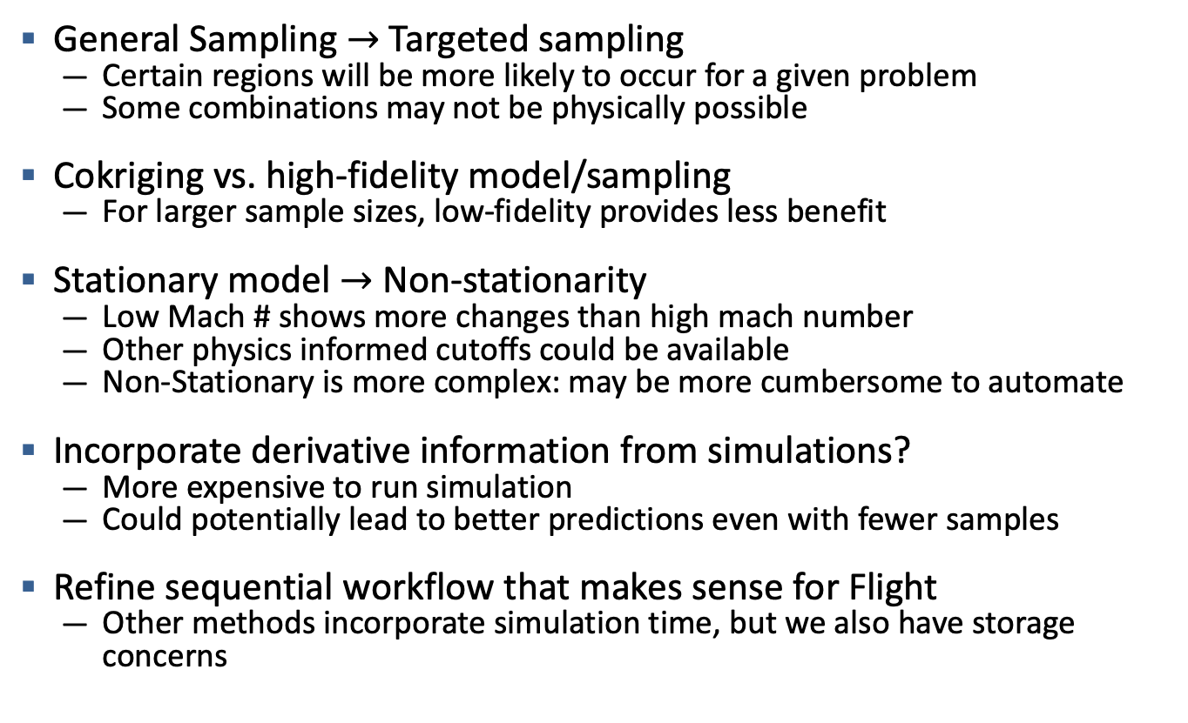
Future Work
General Sampling $→$ Targeted sampling
  Certain regions will be more likely to occur for a given problem
  Some combinations may not be physically possible
Cokriging vs. high-fidelity model/sampling
  For larger sample sizes, low-fidelity provides less benefit
Stationary model $→$ Non-stationarity
  Low Mach # shows more changes than high mach number
  Other physics informed cutoffs could be available
  Non-Stationary is more complex: may be more cumbersome to automate
Incorporate derivative information from simulations?
  More expensive to run simulation
  Could potentially lead to better predictions even with fewer samples
Refine sequential workflow that makes sense for Flight
  Other methods incorporate simulation time, but we also have storage concerns

Slide 31

Work in Progress : Aero Performance Roadmap
Building a Multi-Fidelity Aero Database for our legacy ballistic system
Validating Multi-Fidelity approach against existing experimental wind tunnel data:
  Collaboration with NASA Ames : Mike Aftosmis and David Kinney
    Identified a newly published set of experimental data from NASA Langley that was published at January’s AIAA SciTech conference
    Establish workflow for generating aerodynamic data for control surfaces
    Compare Multi-Fidelity Aero Database predictions to the experimental data
    Add a level for the experimental data in the Multi-Fidelity model
AIAA-2021-1074

Slide 32
References
Binois, Mickaël, Jiangeng Huang, and Robert B. Gramacy. "Replication or exploration? Sequential design for stochastic simulation experiments." Technometrics 61.1 (2019): 7-23.
Fedorov, V. V. (1972), Theory of Optimal Experiments, New York: Academic Press.
Forrester, Alexander IJ, András Sóbester, and Andy J. Keane. "Multi-fidelity optimization via surrogate modelling." Proceedings of the royal society a: mathematical, physical and engineering sciences 463.2088 (2007): 3251-3269.
Joseph, V. Roshan, Evren Gul, and Shan Ba. "Maximum projection designs for computer experiments." Biometrika 102.2 (2015): 371-380.
Kennedy, Marc C., and Anthony O'Hagan. "Predicting the output from a complex computer code when fast approximations are available." Biometrika 87.1 (2000): 1-13
Kennedy, James, and Russell Eberhart. "Particle swarm optimization." Proceedings of ICNN'95-international conference on neural networks. Vol. 4. IEEE, 1995.

Slide 33
References II
Le Gratiet, Loic, and Josselin Garnier. "Recursive co-kriging model for design of computer experiments with multiple levels of fidelity." International Journal for Uncertainty Quantification 4.5 (2014).
Le Gratiet, Loic, and Claire Cannamela. "Cokriging-based sequential design strategies using fast cross-validation techniques for multi-fidelity computer codes." Technometrics 57.3 (2015): 418-427.
Qian, Peter ZG. "Nested Latin hypercube designs." Biometrika 96.4 (2009): 957-970.
Rennen, Gijs, Bart Husslage, Edwin R. Van Dam, and Dick Den Hertog. "Nested maximin Latin hypercube designs." Structural and Multidisciplinary Optimization 41.3 (2010): 371-395.
Sacks, Jerome, William J. Welch, Toby J. Mitchell, and Henry P. Wynn. "Design and analysis of computer experiments." Statistical science (1989): 409-423.
Zhang, Boya, Robert B. Gramacy, Leah Johnson, Kenneth A. Rose, and Eric Smith. "Batch-sequential design and heteroskedastic surrogate modeling for delta smelt conservation." arXiv preprint arXiv:2010.06515 (2020).

Slide 34
Disclaimer
This document was prepared as an account of work sponsored by an agency of the United States government. Neither the United States government nor Lawrence Livermore National Security, LLC, nor any of their employees makes any warranty, expressed or implied, or assumes any legal liability or responsibility for the accuracy, completeness, or usefulness of any information, apparatus, product, or process disclosed, or represents that its use would not infringe privately owned rights. Reference herein to any specific commercial product, process, or service by trade name, trademark, manufacturer, or otherwise does not necessarily constitute or imply its endorsement, recommendation, or favoring by the United States government or Lawrence Livermore National Security, LLC. The views and opinions of authors expressed herein do not necessarily state or reflect those of the United States government or Lawrence Livermore National Security, LLC, and shall not be used for advertising or product endorsement purposes.

Slide 35
Multi-Fidelity Cokriging Example
Cart 3D Inviscid Lift
Cokriging Model
High-Fidelity Only
RMSE = 0.0069
RMSE = 0.013
15 High Fidelity Points

Slide 36
CBAERO Inviscid Lift Difference
Most differences occur at low Mach Number (partially at around Mach 3)

Slide 37
Cokriging Code Capabilities: Multi-fidelity Sensitivity Analysis
Approximate Main Effects Total Drag cbaero
First Order Sensitivity Values:
0.018, 0.014, 0.996
Total Sensitivity Values:
4e-03, -3e-04, 0.98
Main Effect
Scaled Input

Slide 38
Cokriging Code Capabilities: Fast Leave-one-out Predictions
Data is from simulated example in MuFiCokm package in R

Slide 39
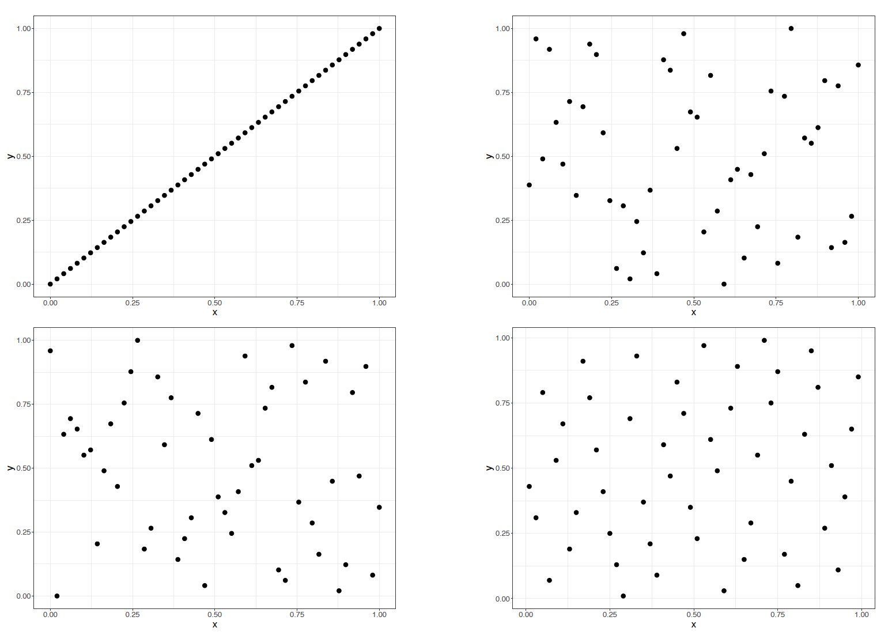
Latin Hypercube Design (LHD)
${(N!)}^{(k−1)}$ choices of LHD (N runs, k inputs) how to choose?

