Slide 1
Evaluating HSI with AI-Enabled Systems:
What should you consider in a TEMP?
Dr. Jane Pinelis, Chief, TE&A − Joint Artificial Intelligence Center
Rachel Haga, Daniel Porter, Brian Vickers − Institute for Defense Analyses
DATAWorks 2021
4/13/2021

Slide 2
1
2
3
4
Offloading warfighter work to AI doesn’t make HSI less important.
It makes it more important than ever.

Slide 3
What are we talking about today?
1
HSI-AI Framework Overview
2
Some Topics in the HSI-AI Framework
Mental Models, Workload, Trust, and Function Allocation
3
Current HSI with Complex Systems
4
Takeaways

Slide 4
HSI is about preserving and enhancing performance
1
2
3
4
Observe
Orient
Decide
Act
O
“I need to understand and predict the situation. I need what I need to know, when I need to know it, in a way that I understand.”
O
D
“I need to be able to make good decisions about where and how to use this system.”
A
“I need to be able to get the system to do what I need and intend it to do.”

Slide 5
What you need for effective employment is also what you need for ethical employment
Ethical
HSI
Effective

Slide 6
Quality HSI drives both effective and ethical employment
1
2
3
4
“I need to understand and predict the situation. I need what I need to know, when I need to know it, in a way that I understand.”
O
DoD Ethical AI Principles
Responsible
Equitable
Traceable
Reliable
Governable
O
“I need to be able to make good decisions about where and how to use this system.”
D
“I need to be able to get the system to do what I need and intend it to do.”
A

Slide 7




Framework focuses on working-level testers’ tasks
1
2
3
4
<2% of T&E workforce with any HSI-relevant background
Need to empower non-experts to get 80-90% solution
TEMPS
Educate testers about concepts and AI-specific concerns
Test Plans
Explain existing techniques, develop new ones
Negotiating
Empower testers by implementing best practices as policy
Products
Provide repos, widgets, and guides for common tasks

Slide 8
1
2
3
4
Observe
and Orient
Decide
Act
Boundary Awareness
Trust / Reliance
Usability
Mental Model
Over-trust / Misuse
Perceived Utility
Process Transparency
Complacency
Perceived Ease of Use
Situational Awareness
Under-trust / Disuse
Affordances
Perceived vs. Actual
Envelope Understanding
Handling Qualities
Information Quality
Emergence
User Intentions
Accuracy
“Off-label” Use
Behavioral Prediction
Utility
Tolerance for Misuse
Function Allocation
Timeliness
Unpredictable Behavior
Oversight/Control
Relevance
Workload
Handoff/Intervention
Completeness
Low Workload
Training, TTPs, CONOPS
Interpretability
Inattention
Middleware
Parsimony
High Workload
Messaging Clarity
Task Shedding
Appropriate Medium
Invisible Work
…
Judgment & Decision Making
Heuristics & Biases

Slide 9


Building Mental Models
1
2
3
4
O
O
A
D
Humans form mental models of automation that allow them to infer the current state of a system from incomplete information and make predictions about future states based on the current one.
Experienced
AIES
Operators
Experienced Legacy
Operators
Novice
AIES
Operators
Experienced
AIES
Operators
System’s underlying model
Warfighter’s mental model of system behavior

Slide 10

Calibrating Trust
1
2
3
4
O
O
A
D
Trust is a person's belief that something can be depended on in vulnerable or uncertain situations. The critical outcome of trust is reliance, which is the behavioral, continued use of a system.

Slide 11
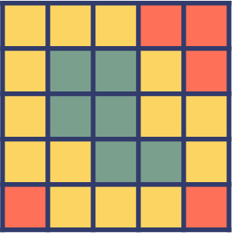
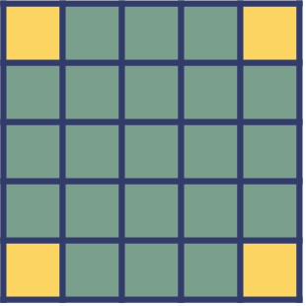
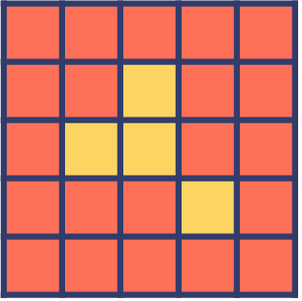
Calibrating Trust
1
2
3
4
O
O
A
D
Trust is a person's belief that something can be depended on in vulnerable or uncertain situations. The critical outcome of trust is reliance, which is the behavioral, continued use of a system.
Calibrated Trust occurs when the warfighter’s operational reliance aligns with the system performance for a given context.
Environment
Calibrated
Trust
Over-Trust
Under-Trust
Task
System performance
Warfighter’s trust and subsequent reliance on the system

Slide 12

Calibrating Workload
1
2
3
4
O
O
A
D
Workload comprises the physical, mental, and temporal resources required by the current tasks relative to the resources available
to the person.
Engaged & Effective
Inattentive, Unengaged
Over-whelmed

Slide 13
Assigning Function Allocation
1
2
3
4
O
O
A
D
Function allocation is the assignment of the collective taskwork between human and automated agents (including both AIES and traditional software tools) required to achieve mission goals.
Autonomy
Authority
Responsibility
Which agent is capable of completing the task?
Which agent is assigned to a task?
Which agent is accountable for the outcome?

Slide 14

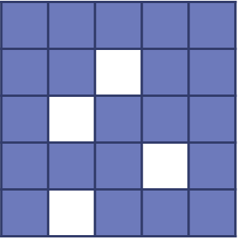

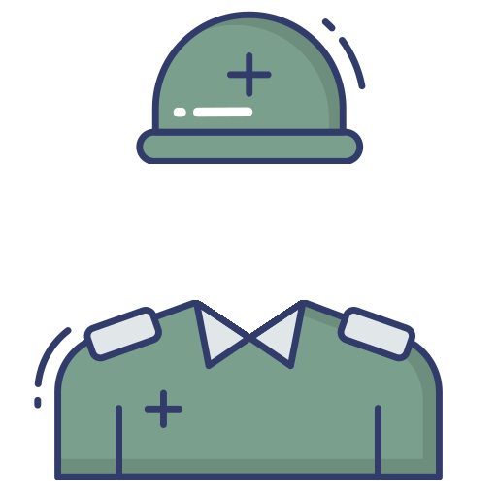

Assigning Function Allocation
1
2
3
4
O
O
A
D
Function allocation is the assignment of the collective taskwork between human and automated agents (including both AIES and traditional software tools) required to achieve mission goals.
Confirm that all agents are capable of completing their assigned tasks
Confirm that taskwork is intentionally assigned, and that the warfighter is not given the
“leftover allocation”
Confirm that all
“invisible work” is accounted for in the CONOPS and test scenarios.

Slide 15
1
2
3
4
Airspeed sensors
blocked
Unexpected high workload spike
Under- developed mental model
Pilots uncertain of function allocation
AP, FD, stall protections terminated
Over-trust has led to complacency
The automation does not display the error
Pilots fail to diagnosis problem
On June 1, 2009, a completely functional Airbus A330 crashed into the Atlantic Ocean, killing all 228 people on board.

Slide 16
1
2
3
4
Airspeed sensors
blocked
Unexpected high workload spike
Under- developed mental model
Pilots uncertain of function allocation
AP, FD, stall protections terminated
Over-trust has led to complacency
The automation does not display the error
Pilots fail to diagnosis problem
Poor HSI can cost people their lives
But we can learn from the past

Slide 17





1
2
3
4
In a world of
AI and Autonomy, the human is still relevant
The JAIC is putting together an HSI-AI Framework to identify issues
This has all happened before and it will happen again

Slide 18
Questions?

