Slide 1

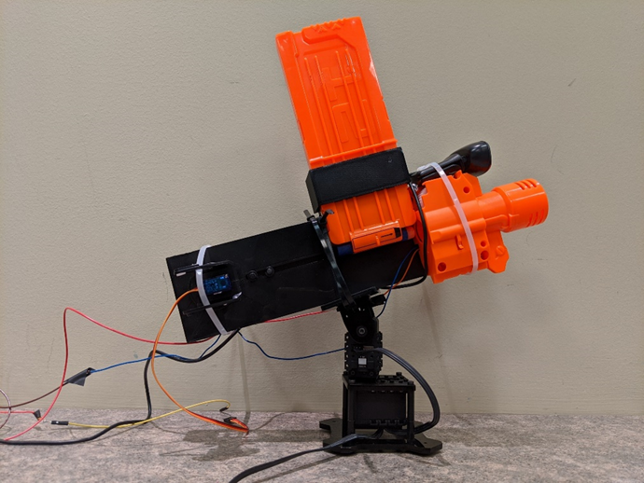
Taking Down a Turret: Introduction to Cyber Operational Test and Evaluation
DATAWorks 2020 Mini-Tutorial
Peter Mancini, Project Leader
Lee Allison Mark Herrera Jason Schlup Kelly Tran
May 29, 2020

Slide 2
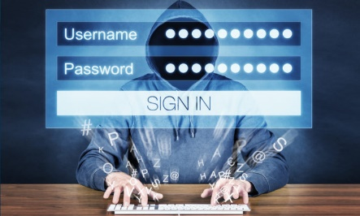

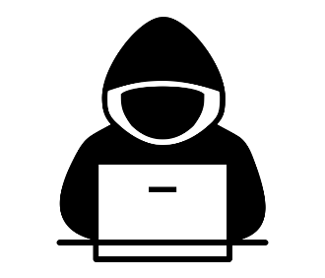


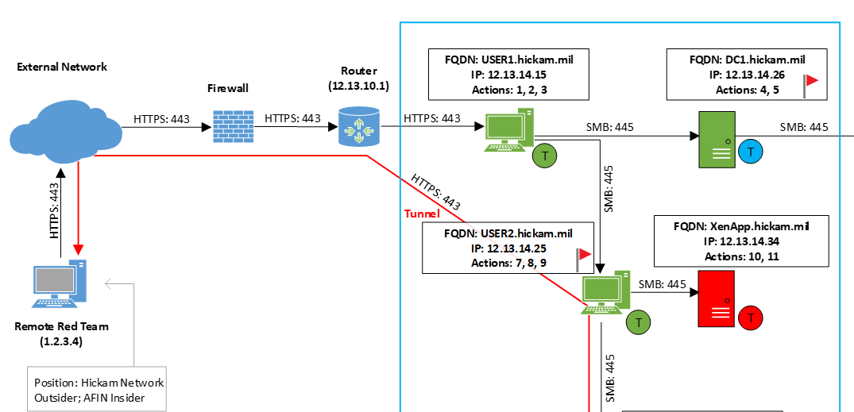
Roadmap for today’s presentation
Introduction to cyber testing and attack methods
Cyber attack demonstration
Analysis of cyber attack data

Slide 3
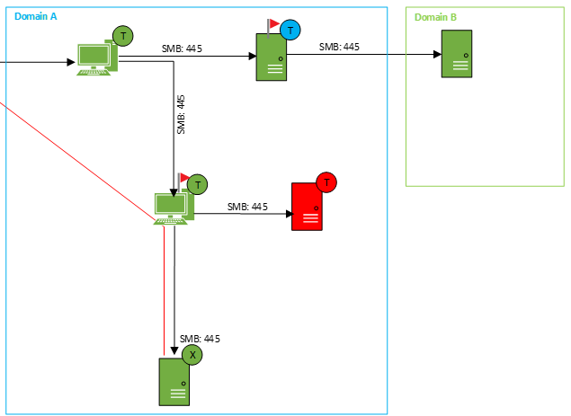
Cybersecurity test and evaluation begins with understanding the problem
What is the purpose of this test?
Example: Can an adversary access a particular system?
Example: Can an adversary affect the mission?

Slide 4
Cybersecurity test and evaluation begins with understanding the problem
What is the purpose of this test?
Example: Can an adversary access a particular system?
Example: Can an adversary affect the mission?
What questions do we want to answer?
Example: How does the system respond to cyber intrusion?
Example: How do operators respond to an observed cyber effect?
How are we collecting information?
How are we analyzing the data?
These questions must be answered BEFORE conducting the test

Slide 5
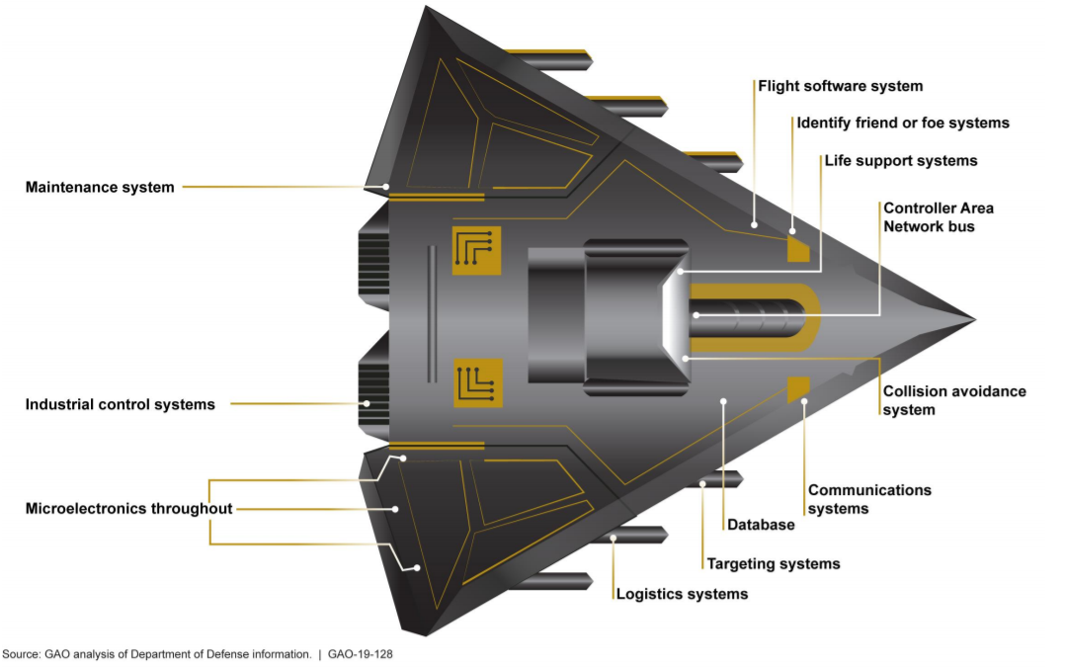
Understanding the entire attack surface is critical to comprehensively testing the system

Slide 6
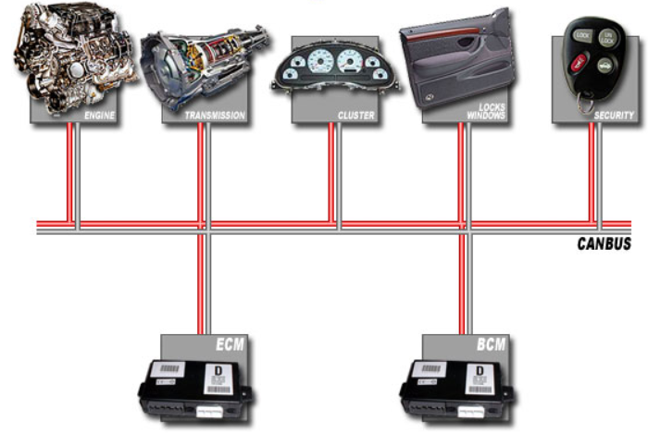
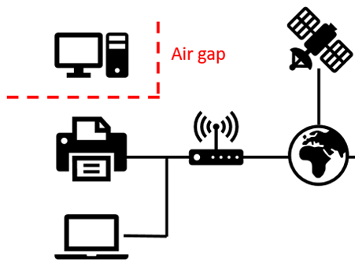
Understanding the entire attack surface is critical to comprehensively testing the system
Most systems likely contain non-IP based interfaces
Systems not connected to the internet are still vulnerable
Engine
Transmission
Electronics
CAN Bus
Engine Control Module
Body Control Module

Slide 7
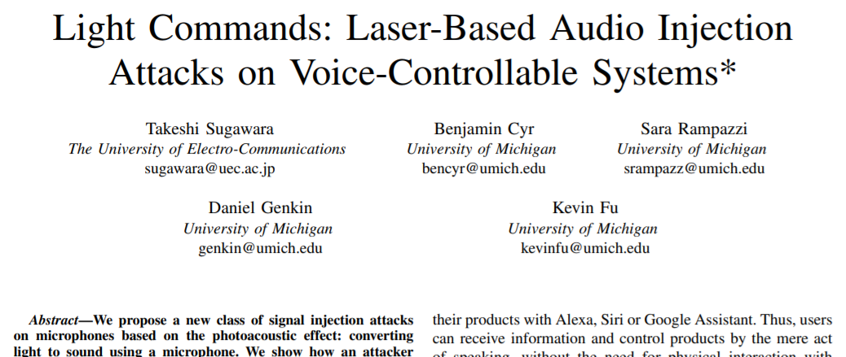
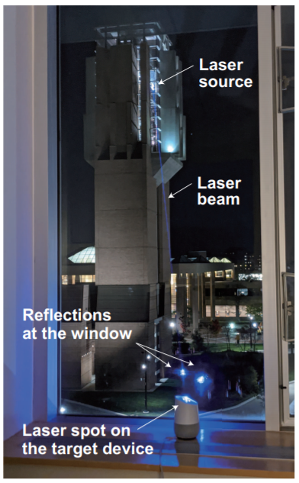
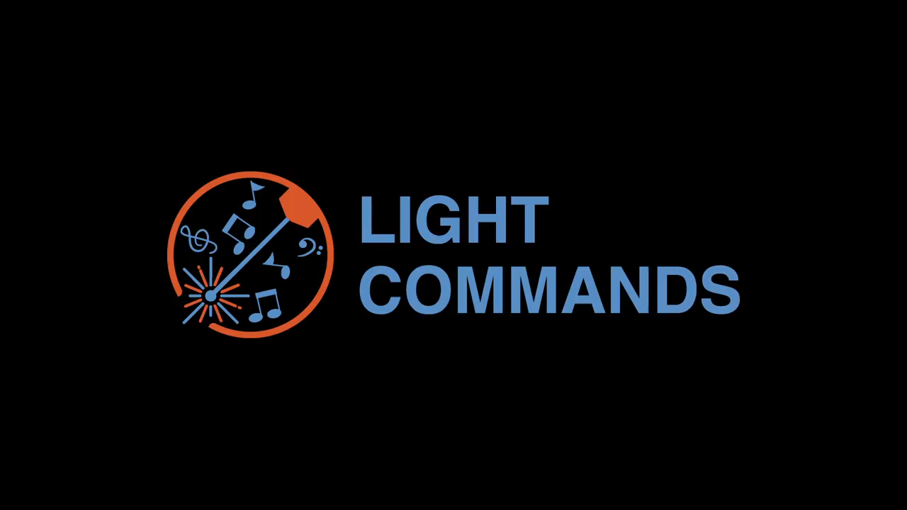
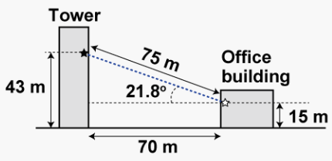
Hackers get creative: Surely your smart assistant won’t respond to light?
https://www.youtube.com/watch?v=EtzP-mCwNAs

Slide 8
We use a cyber attack framework to describe adversarial cyber operations
Prepare
Methods (Tools, Techniques)
Reconnaissance (Foot Print)
Attack
Access Network (Ingress)
Maneuver (Lateral Movement)
Assess
Tactical (Persist, Egress)
Operational (Continue, Stop)
Collection (Scan, Enumerate)
Create Effect (Objective)
Confidentiality
Integrity
Availability

Slide 9

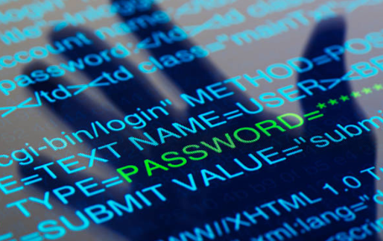

Cyber in the news: The usual suspects
Phishing
The fraudulent attempt to obtain sensitive information by disguising oneself as a trustworthy entity.
Password Cracking
The process of recovering passwords from data that have been stored in or transmitted by a computer system.
Data Breach
The intentional or unintentional release of secure or private/confidential information to an untrusted environment.

Slide 10








Cyber in the news: The usual suspects
Iranian Hackers Attack State Dept. via Social Media Accounts
Timeline, cost unclear as New Orleans works to restore computer network after cyberattack
The New York Times Nov 24, 2015
The Times-Picayune Dec 19, 2019
Baltimore transfers $6 million to pay for ransomware attack
Hackers Demanding Ransoms Paralyze City Computer Systems In The U.S.
The Baltimore Sun Aug 28, 2019
NPR June 13, 2019
State of Stolen Credentials in the Dark Web from Fortune 500 Companies
U.S. HVAC Firm Reportedly Linked To Target's Data Security Breach
Immuniweb.com Oct 30, 2019
NPR Feb 5, 2014

Slide 11
Our demonstration uses real attacker and defender tools
Kali Linux
Free-to-use exploitation platform with hundreds of tools for multiple purposes
Metasploit
Framework to establish command and control of a target system
John the Ripper
Easy-to-use password cracking utility with pre-built password lists
Wireshark
Network analysis tool to identify what information is flowing on the network
Nmap
Network scanning utility to identify other systems on a network
Windows Event Viewer/rsyslog
Log files that monitor system activities
Social Media
An excellent source of open-source intelligence gathering

Slide 12
Disclaimer: Try this at home!
All of these tools are free and legal to use (usually)
Learning by doing is the best method
Don’t be afraid to break your virtual machines

Slide 13
Second disclaimer: Do not try this not at home!
Do not use your company-owned machine
Do not try any of what you're about to see unless you have the proper approvals (and it's legal)
Be very careful if you are connected to the internet
Better yet, don’t do this while connected to the internet
Keep your live systems secure and fully patched

Slide 14
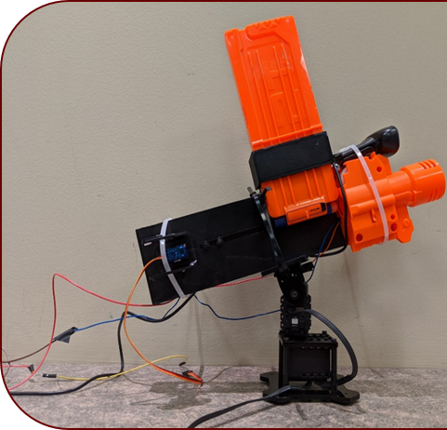
Today’s Demonstration: Hacking a Turret

Slide 15
Let’s hack Peter’s Office Nerf Turret (ONT)
Peter wants to keep his office free of distractions
Peter’s laptop is connected to an internal network
ONT has been configured to not fire at Peter and his boss (R. Tool)
ONT is controlled by an unknown device
Peter has a network defense team (NDT) monitoring his systems

Slide 16
Introduction Video

Slide 17





Here’s what we know so far
Internal Network
10.10.10.1/24
?
?
Internet
ONT
IP Address?
Attacker
10.10.10.10
Pete
IP Address?

Slide 18





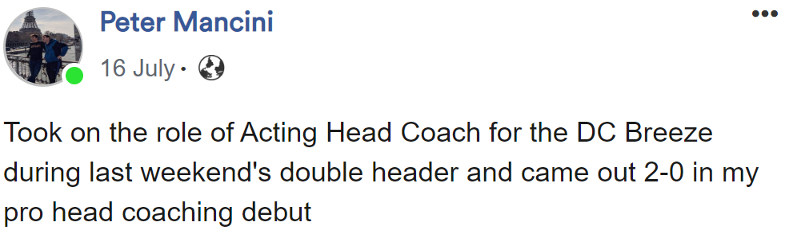
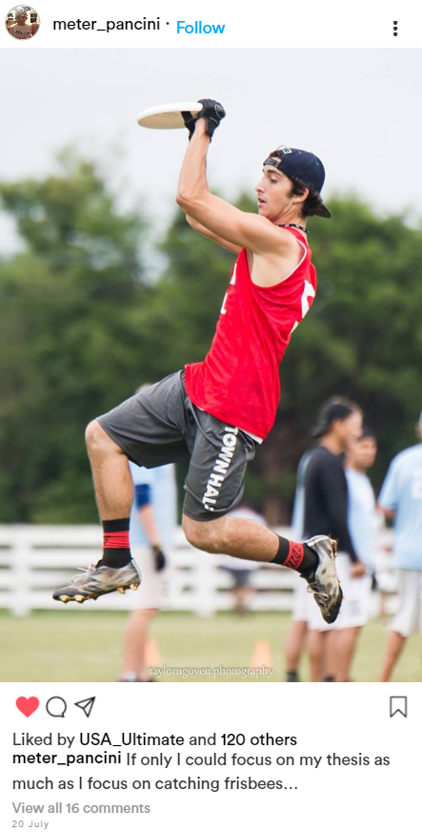


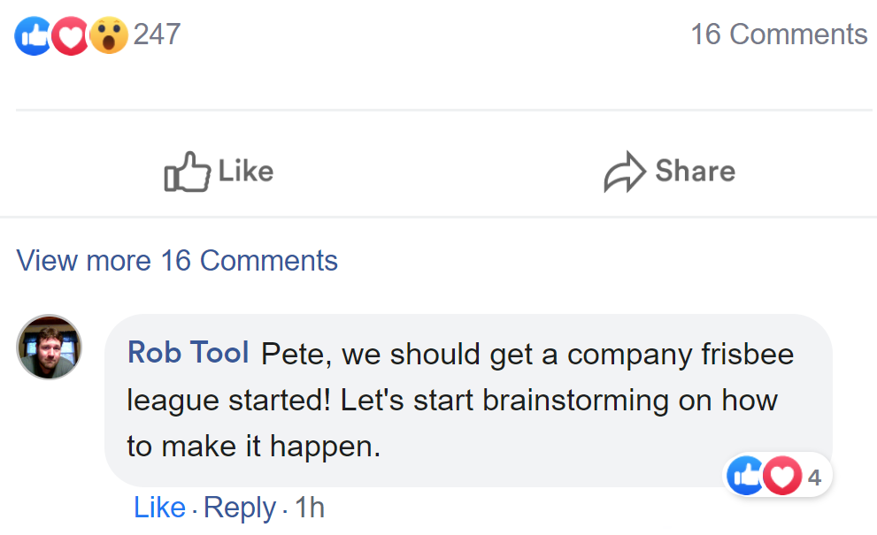
Recon: What does Peter like to do?
Research Staff Member at Analytics for Defense
Intelligence
NADI
Analytics for Defense Intelligence

Slide 19
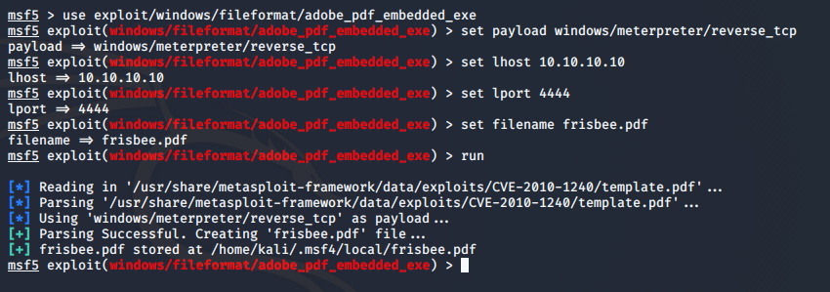
Ingress: Peter really wants to play Ultimate Frisbee with coworkers – let’s spearphish him!
Create malicious PDF that will connect his computer to attacker
Listening host (lhost) set as the attacker laptop (10.10.10.10).
Listen on port 4444
Malicious PDF filename set to frisbee.pdf

Slide 20
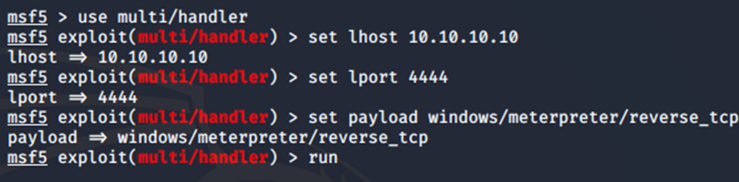
Ingress: Peter really wants to play Ultimate Frisbee with coworkers – let’s spearphish him!
Set up listener to await Peter’s opening of the PDF
DEMO

Slide 21
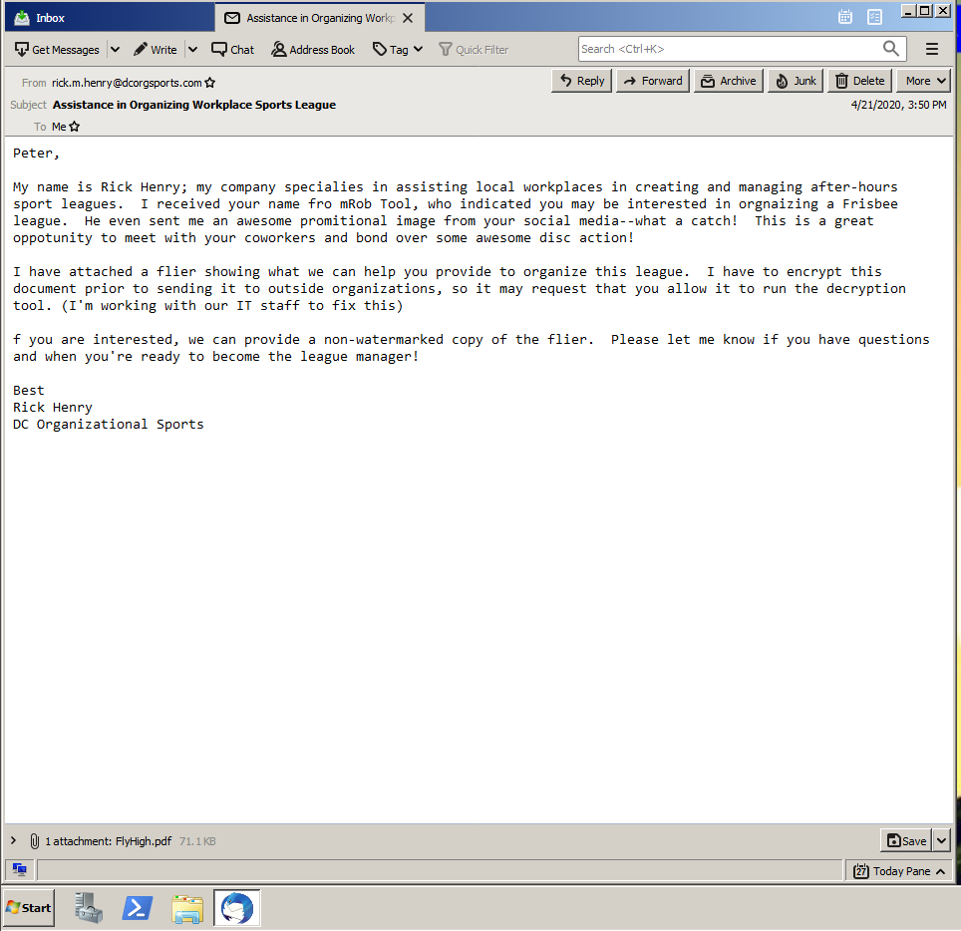
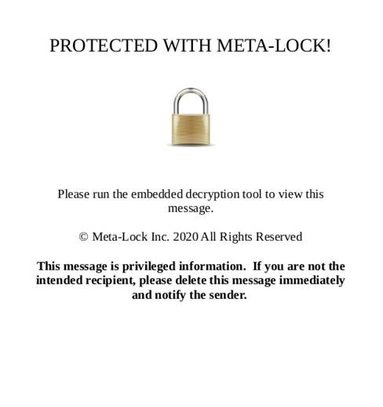
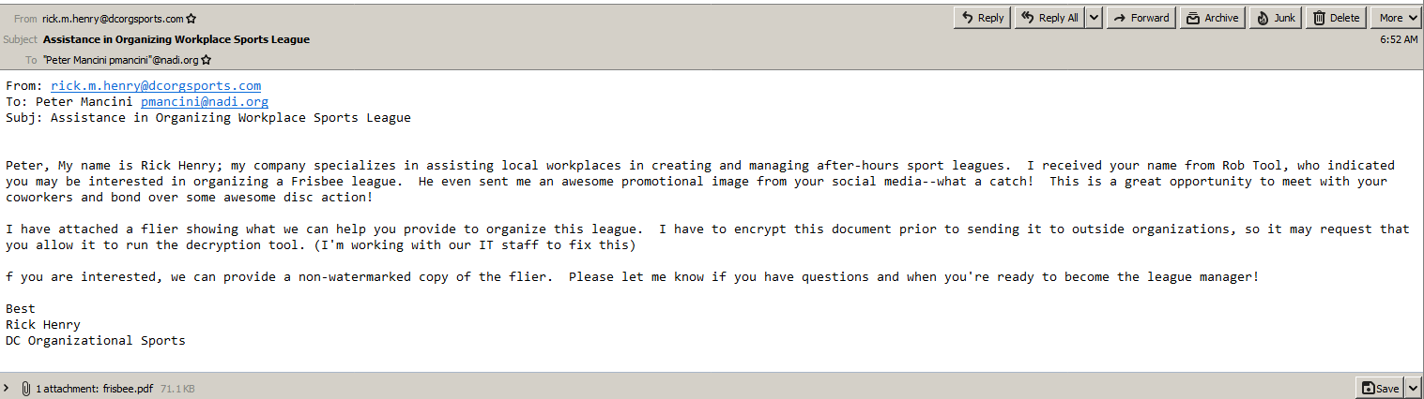
Ingress: Peter really wants to play Ultimate Frisbee with coworkers – let’s spearphish him!

Slide 22
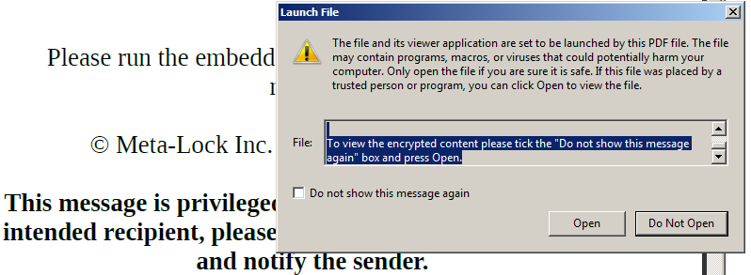

Ingress: Peter really wants to play Ultimate Frisbee with coworkers – let’s spearphish him!
Once Peter opens the PDF, we have access to his system
DEMO

Slide 23
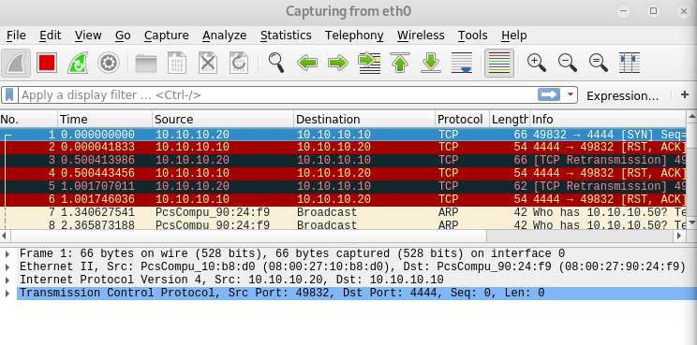
Defensive Observation: Why is Peter communicating with an unknown IP address on port 4444?
Wireshark output:
(Peter)
(Attacker)

Slide 24


Big Picture: We have successfully phished Peter and gained access to his system
Who actually uses phishing and who actually falls for it?
Hillary Clinton campaign
crowdstrike.com
United States, Viktor Borisovich Netyksho, and Robert S. Mueller. 2018. United States of America v. Viktor Borisovich Netyksho [and 11 others], defendants: case 1:18-cr-00215-ABJ. http://purl.fdlp.gov/GPO/gpo115873.

Slide 25
Here’s what we know so far
Internal Network
10.10.10.1/24
?
?
Internet
ONT
IP Address?
Attacker
10.10.10.10
Pete
10.10.10.20

Slide 26
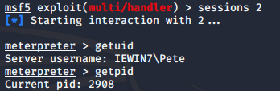
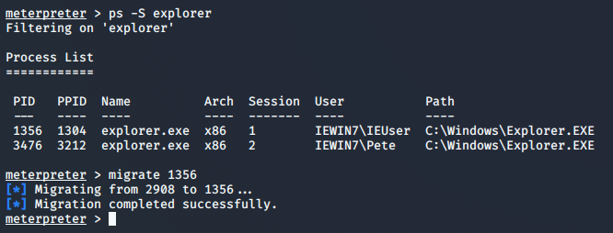
Persist: Peter may close this program – let’s embed ourselves deeper in his system
The meterpreter command getpid tells us we are running as process 2908. Note: Process IDs (PIDs) vary
Migrating to explorer.exe (PID 3476) ensures that we maintain persistent presence on the victim’s computer.
DEMO

Slide 27

Big Picture: We have inserted ourselves into a long-lived process. Does this actually happen?
Emotet Banking Trojan: Stealing banking info
malwarebytes.com
https://www.us-cert.gov/ncas/alerts/TA18-201A

Slide 28

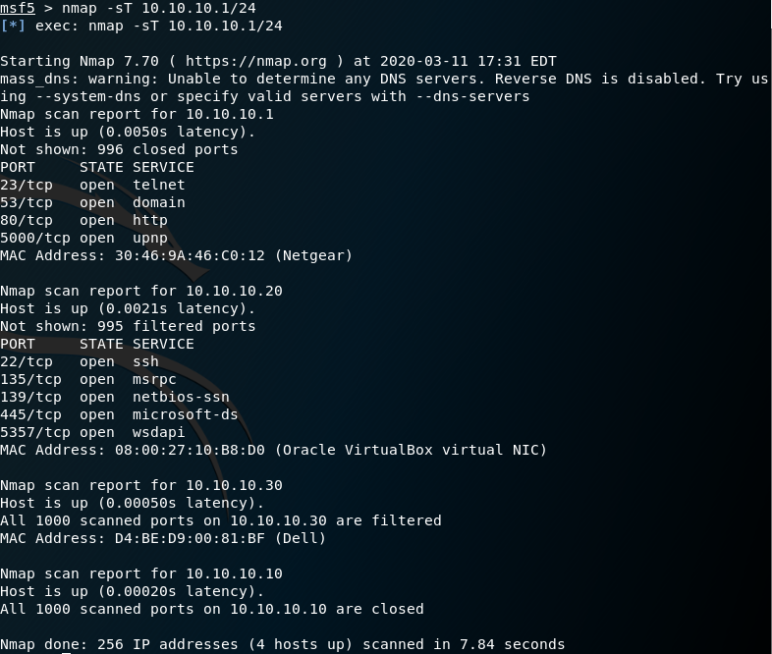
Maneuver: This may or may not be the turret – what else can we see?
Peter’s laptop
Unknown
device
(Likely the turret, all ports filtered)
DEMO

Slide 29
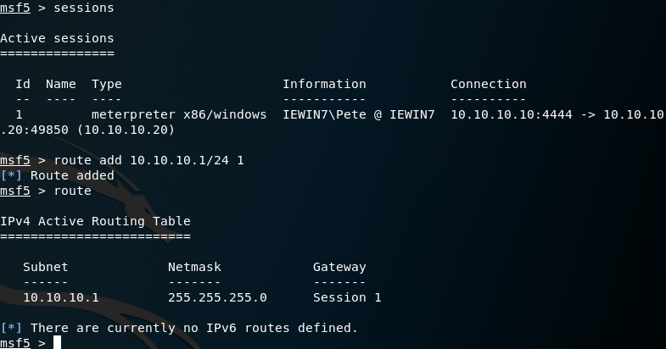
Maneuver: There’s a device filtering packets – can we scan from Pete’s computer?
Current Metasploit session
Route traffic through session 1 (Pete)

Slide 30
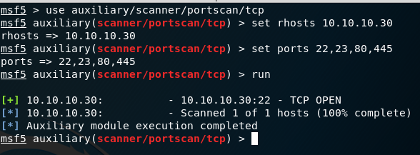
Maneuver: What does a scan of the unknown device reveal?
Scan common ports on unknown machine
Port 22 open (possibly ssh)
Using ssh would allow us to blend in with normal traffic. We will attempt to find credentials to allow an ssh connection.
DEMO

Slide 31
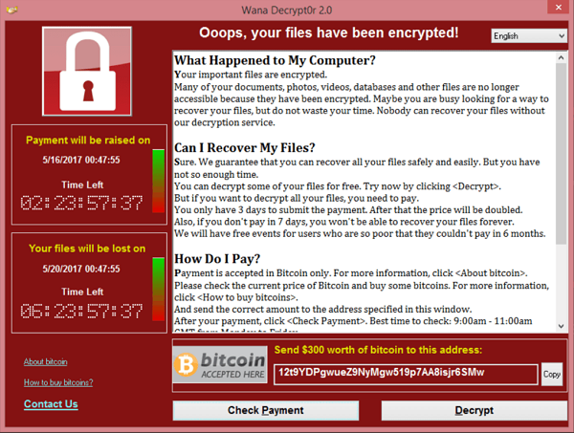
Big Picture: Does discovery end when you enter a network? WannaCry doesn’t think so!
https://www.secureworks.com/research/wcry-ransomware-analysis

Slide 32
Here’s what we know so far
Internal Network
10.10.10.1/24
10.10.10.30
?
Internet
ONT
IP Address?
Attacker
10.10.10.10
Pete
10.10.10.20

Slide 33
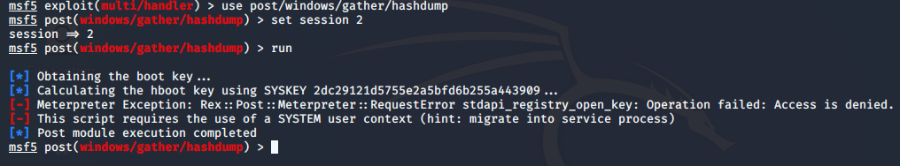
Maneuver: We don’t have credentials yet, so let’s fix that problem!
use post/windows/gather/hashdump
Operation failed: Access is denied.

Slide 34
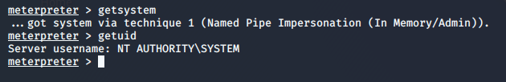
Privilege Escalation: We cannot dump credentials as a standard user. Get to SYSTEM!
The meterpreter command getsystem escalates user privileges to the SYSTEM level.

Slide 35
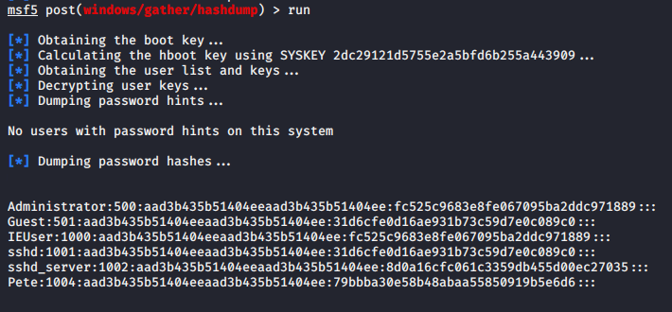
Maneuver: Now that we are an administrator of Peter’s computer, let’s dump credentials
DEMO

Slide 36

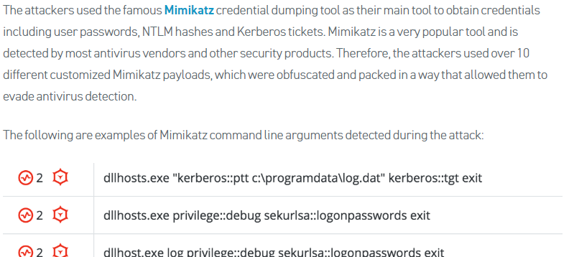
Big Picture: Surely, advanced threats do something more advanced than hashdump or Mimikatz…
Operation Cobalt Kitty: A Large-Scale APT in Asia Carried out by the OceanLotus Group
Cybereason May 24, 2017
https://www.cybereason.com/blog/operation-cobalt-kitty-apt

Slide 37
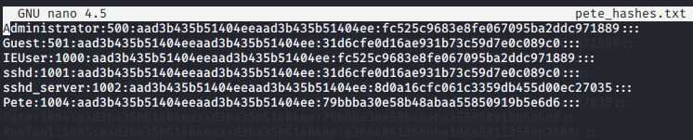
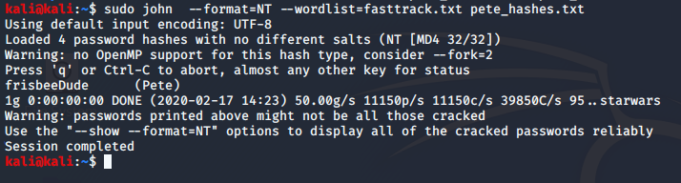

Maneuver: We don’t actually have Peter’s password. We will need to crack his hash first.
Save password hashes to pete_hashes.txt
Crack passwords contained in pete_hashes.txt by running the file through John the Ripper
Username: Pete
Password: frisbeeDude
DEMO

Slide 38
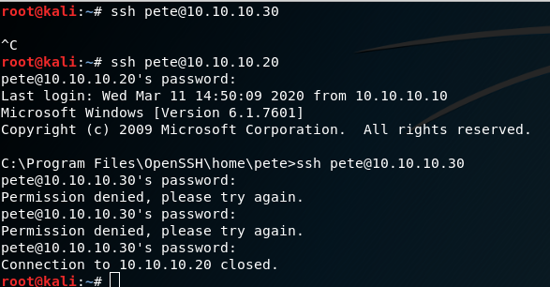
Maneuver: Can we access the unknown machine using the stolen credentials?
Our nmap scan showed us that the port corresponding to secure shell (ssh) was open on both machines. Let’s try to connect to this new machine using Pete’s laptop credentials.
We can ssh to Pete’s computer using Pete’s credentials!
It appears those credentials do not work for this new machine… 🙁

Slide 39
Defender Observation: Someone attempted to log in with an invalid user ID
Event log output:
Someone used an account that does not exist…
17:53:19 dirac sshd[3809]: Invalid user pete from 10.10.10.20 port 50633
17:53:53 dirac sshd[3809]: Failed password for invalid user pete from 10.10.10.20 port 50633 ssh2

Slide 40
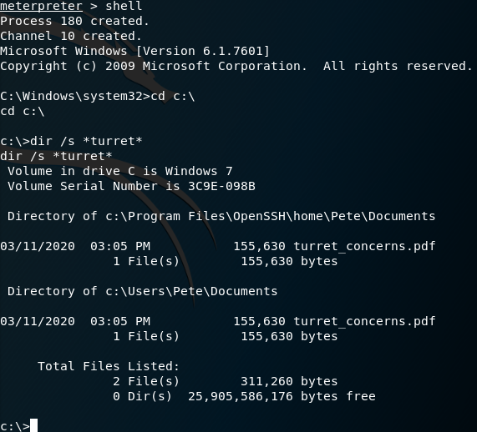
Maneuver: Those credentials did not work…are there other clues on Peter’s computer?
There’s information about the turret in Pete’s Documents! Use meterpreter’s download function.
DEMO

Slide 41
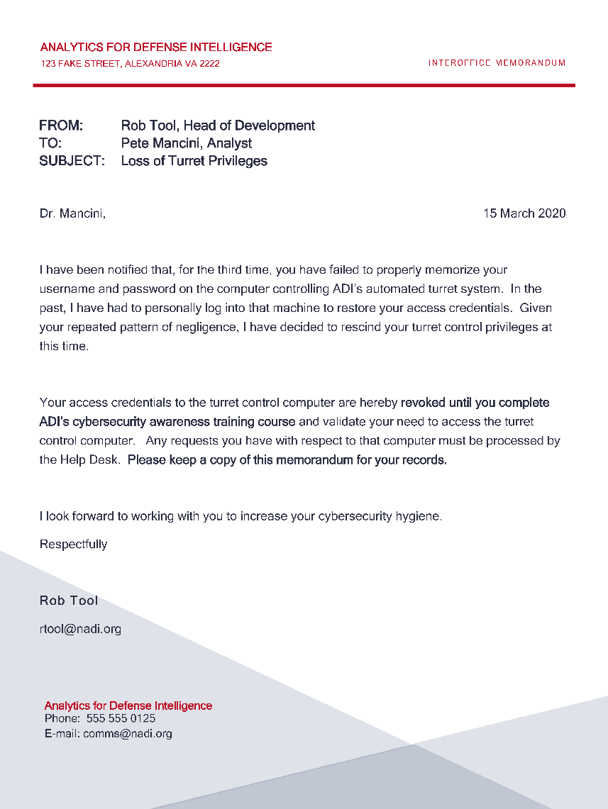
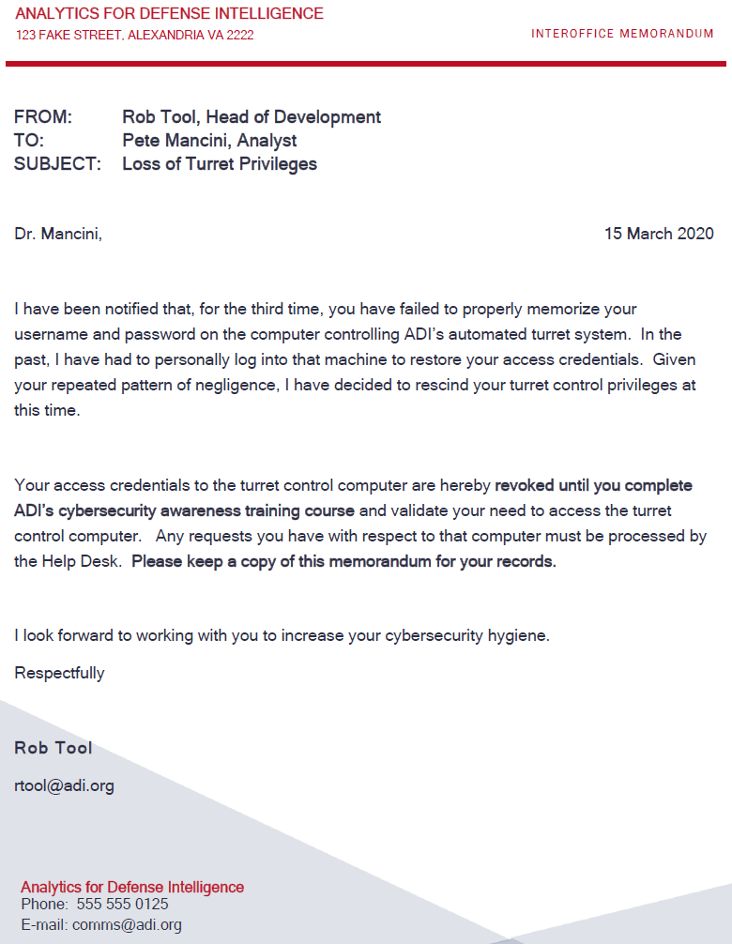
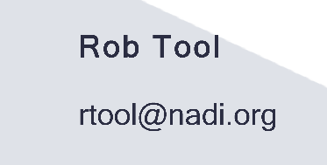
Maneuver: It seems Pete has some correspondence about problems with the turret…
Name and job title
Confirmation of valid account on turret machine
Name and email

Slide 42
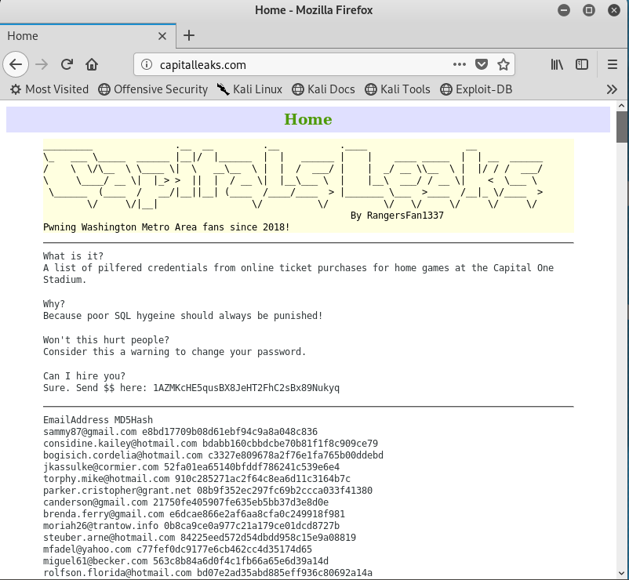
Maneuver: Let’s try to gather open-source intelligence for more information on Mr. Tool
Perform search for password dumps on the internet
It appears Rob Tool is a fan of the Capitals, and he has an account on a compromised Capitals fan-site!
email: rtool@nadi.org
MD5 hash: 2e5dd3f697f67c19b7856f1a5f406445

Slide 43
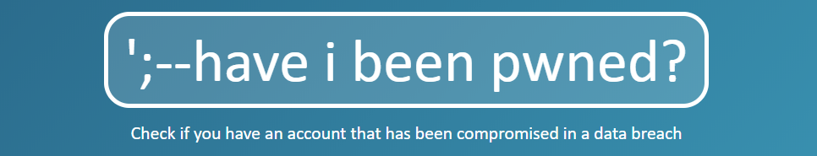
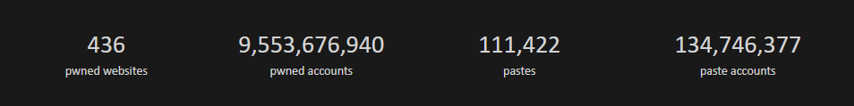
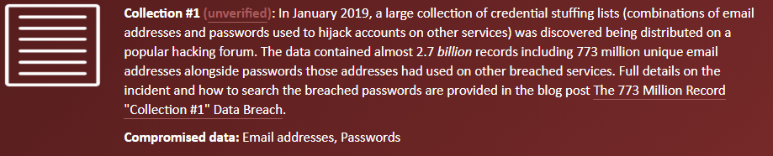
Big Picture: You can see if you’ve been “pwned.” Spoiler alert: You probably have.
Source: haveibeenpwned.com

Slide 44
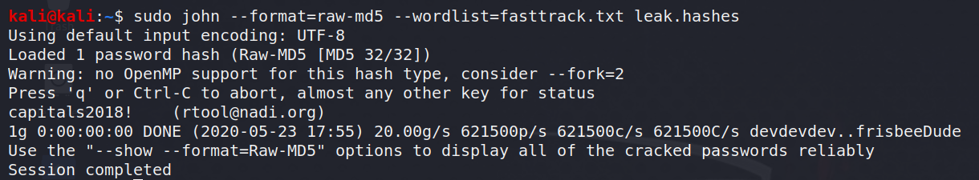
Maneuver: We have the hash of one of Mr. Tool’s passwords. Let’s ask John the Ripper to crack it.
email: rtool@nadi.org
MD5 hash: 2e5dd3f697f67c19b7856f1a5f406445
email: rtool@nadi.org
password: capitals2018!
DEMO

Slide 45
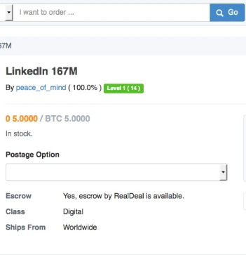
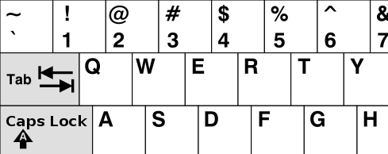
Big Picture: Credential dumps may get leaked to pastebin or sold on the dark web!
TOP PASSWORDS FROM 2019
1 - 123456 (rank unchanged from 2018) 2 - 123456789 (up 1) 3 - qwerty (Up 6) 4 - password (Down 2) 5 - 1234567 (Up 2) 6 - 12345678 (Down 2) 7 - 12345 (Down 2) 8 - iloveyou (Up 2) 9 - 111111 (Down 3) 10 - 123123 (Up 7) 11 - abc123 (Up 4) 12 - qwerty123 (Up 13) 13 - 1q2w3e4r (New)
https://www.vice.com
https://www.prweb.com

Slide 46
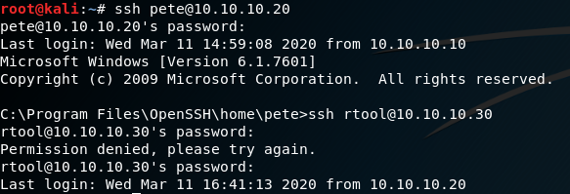
Maneuver: Do the stolen username and password work as credentials for the turret?
capitals2018!
🙁
R. Tool may or may not have an account. What else do we know?
R. Tool likes changing passwords
The turret first shot us in 2019
Surely, the password isn’t “capitals2019!”...........
capitals2018!
🙂
capitals2019!

Slide 47
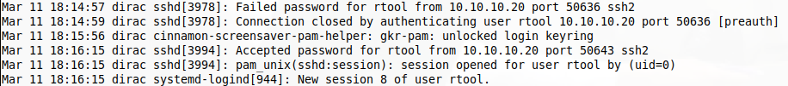
Defender Observation: Defender sees that someone used a valid account but an invalid password
Event log output:
Current attempt (valid user, invalid password)
18:14:57 dirac sshd[3978]: Failed password for rtool from 10.10.10.20 port 50636 ssh2
Recall previous attempt (invalid user)
17:53:19 dirac sshd[3809]: Invalid user pete from 10.10.10.10 port 50633
Successful login
18:16:15 dirac sshd[3994]: Accepted password for rtool from 10.10.10.10 port 50643 ssh2
18:16:15 dirac sshd[3994]: pam_unix(sshd:session): session opened for user rtool by (uid=0)
18:16:15 dirac system-logind[944]: New session 8 of user rtool.

Slide 48


Maneuver: What machine are we on now and what other devices does this machine communicate with?
Arp cache and nmap scan tell us
The device we gained access to communicates with a raspberry pi at 169.254.240.109 Note: IP address varies
Virtual network computing (vnc) is open (port 5900)
The raspberry pi is running Linux
DEMO

Slide 49
Here’s what we know so far
Internal Network
10.10.10.1/24
10.10.10.30
Internet
ONT
IP Address?
Attacker
10.10.10.10
Pete
10.10.10.20

Slide 50



Maneuver: We have found a connected device named ONT. What else can we find?
Before modification
After modification
DEMO

Slide 51


Big Picture: Technical data on the internet can be a treasure trove for attackers
Hackers Remotely Kill a Jeep on the Highway—With Me in It
Wired.com Jul 21, 2015
Secret Service Investigates Breach at U.S. Govt IT Contractor
Krebsonsecurity.com Sep 09, 2019

Slide 52

Defender Observation: Do we have any forensics that can point to a modification?
Linux stores command history in a “bash_history” file

Slide 53
Effect: Now we wait…

Slide 54
Analysis of a cyber attack and defensive capabilities

Slide 55


Our analysis combines data from multiple sources to construct an end-to-end picture of the attack
Offensive data
Statistical model
Defensive data
Taxonomies

Slide 56

A defined taxonomy enhances communication of results between collaborators

Slide 57
Analyze attacks like this demo to help determine the status of cyber defenses
Prepare actions:
Activity No. | Antec. | Node | Target IP | Tactic | Technique | Tool | Tool Type | Red Team Success
1 | N/A | Prepare | N/A | People Information Gathering | Mine Social Media | Browser | Native | Success
2 | 1 | Prepare | N/A | Build Capabilities | Obtain/Re-use Payloads | Metasploit | Foreign | Success
Network defenders do not have opportunities to detect prepare actions, so we will not consider them in the detection rates
Above data are from presentation demonstration only

Slide 58
Analyze attacks like this demo to help determine the status of cyber defenses
Peter’s computer actions:
Activity No. | Antec. | Node | Target IP | Tactic | Technique | Tool | Tool Type | Red Team Success
3 | 2 | Ingress | 10.10.10.20 | Initial Access | Spearphishing Attachment | Email | Native | Success
4 | 3 | Ingress | 10.10.10.20 | Command and Control | Standard Non-Application Layer Protocol | Metasploit | Foreign | Success
5 | 4 | Ingress | 10.10.10.20 | Discovery | Process Discovery | ps | Foreign | Success
6 | 5 | Ingress | 10.10.10.20 | Defense Evasion | Process Injection | Metasploit | Foreign | Success
7 | 6 | Ingress | 10.10.10.20 | Discovery | Remote System Discovery | nmap | Foreign | Success
8 | 7 | Ingress | 10.10.10.20 | Command and Control | Connection Proxy | Route | Foreign | Success
9 | 8 | Ingress | 10.10.10.20 | Discovery | System Service Discovery | Metasploit | Foreign | Success
10 | 8 | Ingress | 10.10.10.20 | Credential Access | Credential Dumping | hashdump | Foreign | Failure
11 | 8 | Ingress | 10.10.10.20 | Privilege Escalation | Process Injection | getsystem | Foreign | Success
12 | 11 | Ingress | 10.10.10.20 | Credential Access | Credential Dumping | hashdump | Foreign | Success
13 | 12 | N/A | N/A | Credential Access | Brute Force | John | Foreign | Success
14 | 12 | Ingress | 10.10.10.20 | Initial Access | External Remote Services | ssh | Native | Success
14e | 12 | Ingress | 10.10.10.20 | Initial Access | Valid Accounts | ssh | Native | Success
Above data are from presentation demonstration only

Slide 59
Analyze attacks like this demo to help determine the status of cyber defenses
ONT controller actions:
Activity No. | Antec. | Node | Target IP | Tactic | Technique | Tool | Tool Type | Red Team Success
15 | 14 | Lateral | 10.10.10.30 | Lateral Movement | Remote Services | ssh | Native | Failure
15e | 14 | Lateral | 10.10.10.30 | Initial Access | Valid Accounts | ssh | Native | Failure
16 | 4, 15 | Ingress | 10.10.10.20 | Discovery | File and Directory Discovery | dir | Native | Success
17 | 16 | Ingress | 10.10.10.20 | Collection | Data from Local System | Metasploit | Foreign | Success
17e | 16 | Lateral | 10.10.10.30 | Exfiltration | Exfiltration Over Command and Control Channel | Metasploit | Foreign | Success
18 | 17 | N/A | N/A | Technical Information Gathering | Acquire OSINT Data Sets and Information | Browser | Native | Success
19 | 18 | N/A | N/A | Credential Access | Brute Force | John | Foreign | Success
20 | 12 | Lateral | 10.10.10.30 | Lateral Movement | Remote Services | ssh | Native | Failure
20e | 12 | Lateral | 10.10.10.30 | Initial Access | Valid Accounts | ssh | Native | Failure
21 | 20 | Lateral | 10.10.10.30 | Lateral Movement | Remote Services | ssh | Native | Success
21e | 20 | Lateral | 10.10.10.30 | Initial Access | Valid Accounts | ssh | Native | Success
22 | 21 | Lateral | 10.10.10.30 | Discovery | Remote System Discovery | arp | Native | Success
23 | 22 | Lateral | 10.10.10.30 | Discovery | Peripheral Device Discovery | nmap | Foreign | Success
24 | 23 | Objective | 10.10.10.30 | Discovery | File and Directory Discovery | dir | Native | Success
25 | 24 | Objective | 10.10.10.30 | Impact | Stored Data Manipulation | nano | Native | Success
Above data are from presentation demonstration only

Slide 60
Define the attack actions taken (ingress to objective)
Activity No. | Antec. | Node | Target IP | Tactic | Technique | Tool | Tool Type | Red Team Success
3 | 2 | Ingress | 10.10.10.20 | Initial Access | Spearphishing Attachment | Email | Native | Success
4 | 3 | Ingress | 10.10.10.20 | Command and Control | Standard Non-Application Layer Protocol | Metasploit | Foreign | Success
5 | 4 | Ingress | 10.10.10.20 | Discovery | Process Discovery | ps | Foreign | Success
6 | 5 | Ingress | 10.10.10.20 | Defense Evasion | Process Injection | Metasploit | Foreign | Success
7 | 6 | Ingress | 10.10.10.20 | Discovery | Remote System Discovery | nmap | Foreign | Success
8 | 7 | Ingress | 10.10.10.20 | Command and Control | Connection Proxy | Route | Foreign | Success
9 | 8 | Ingress | 10.10.10.20 | Discovery | System Service Discovery | Metasploit | Foreign | Success
10 | 8 | Ingress | 10.10.10.20 | Credential Access | Credential Dumping | hashdump | Foreign | Failure
11 | 8 | Ingress | 10.10.10.20 | Privilege Escalation | Process Injection | hashdump | Foreign | Success
12 | 11 | Ingress | 10.10.10.20 | Credential Access | Credential Dumping | Mimikatz | Foreign | Success
14 | 12 | Ingress | 10.10.10.20 | Initial Access | External Remote Services | ssh | Native | Success
15 | 14 | Lateral | 10.10.10.30 | Lateral Movement | Remote Services | ssh | Native | Failure
16 | 4, 15 | Ingress | 10.10.10.20 | Discovery | File and Directory Discovery | dir | Native | Success
17 | 16 | Ingress | 10.10.10.20 | Collection | Data from Local System | Metasploit | Foreign | Success
20 | 12 | Lateral | 10.10.10.30 | Lateral Movement | Remote Services | ssh | Native | Failure
21 | 20 | Lateral | 10.10.10.30 | Lateral Movement | Remote Services | ssh | Native | Success
22 | 21 | Lateral | 10.10.10.30 | Discovery | Remote System Discovery | arp | Native | Success
23 | 22 | Lateral | 10.10.10.30 | Discovery | Peripheral Device Discovery | nmap | Foreign | Success
24 | 23 | Objective | 10.10.10.30 | Discovery | File and Directory Discovery | dir | Native | Success
25 | 24 | Objective | 10.10.10.30 | Impact | Stored Data Manipulation | nano | Native | Success
Above data are from presentation demonstration only

Slide 61

Quantify this attack using two factors: tool type and authentication type
Tool Type | # Actions
Foreign | 11
Native | 9
TOTAL | 20
11/20 = 55%
Foreign Tool Use
Authentication Type | # Actions
Unauthenticated | 1
Authenticated | 2
TOTAL | 3
1/3 = 33%
Unauthenticated Accesses
Detected? | Yes
Defended? | No
Above data are from presentation demonstration only

Slide 62
Track detections across multiple attacks
Attack # | Fraction Unauthent. Access | Fraction Foreign Tool Use | Detected? | Example
1 | 0.33 | 0.55 | 1 | Demo
2 | 0 | 0 | 0 | Insider
3 | 1 | 1 | 1 | Outsider
4 | 1 | 0 | 0 | Open Website
5 | 0 | 1 | 1 | Nascent Insider
6 | 0 | 0.5 | 0
7 | 0 | 0.33 | 0
8 | 0 | 0.8 | 1 | Signature Detection
9 | 0 | 0.8 | 0
10 | 1 | 0 | 1
Above data are notional only

Slide 63
Track detections across multiple attacks
With increasing amounts of data, investigate the importance of our chosen factors
Attack # | Fraction Unauthent. Access | Fraction Foreign Tool Use | Detected?
1 | 0.33 | 0.55 | 1
2 | 0 | 0 | 0
3 | 1 | 1 | 1
4 | 1 | 0 | 0
5 | 0 | 1 | 1
6 | 0 | 0.5 | 0
7 | 0 | 0.33 | 0
8 | 0 | 0.8 | 1
9 | 0 | 0.8 | 0
10 | 1 | 0 | 1
Above data are notional only

Slide 64

With increasing amounts of data, investigate the importance of our chosen factors
Today’s demonstration
We use these statistical methods with real data (not shown here).
Above data are notional only

Slide 65
The two factors provide insight about trends in detection rates against specific types of attacks
Network defenses can easily identify foreign tool signatures, but signatures can change
Well-configured defenses can find unauthenticated accesses (e.g., exploits) or signatures of foreign tools
Authenticated accesses and native tools are difficult to detect because they look like standard network use
Unauthenticated accesses may be exploits (easier to detect) or credential-less (look like valid users)
Above data are notional only

Slide 66
We are constantly looking for other predictors of detection and ways to increase analytical rigor
The correct factors for predicting detection rates may change based on the assessed systems and networks:
Probability to defend? Probability to react?
Authorized vs. unauthorized unauthenticated access?
Number of actions in an attack (dwell time of attack)?
Common adversarial or native tools (e.g., PowerShell)?

Slide 67


Useful cyber testing requires understanding, planning, and analytical rigor
Cyber test and evaluation begins with understanding the problem.
e.g., systems architecture, software configuration, operational use
Data cannot easily be collected in hindsight.
Sufficient planning is required to identify appropriate metrics and determine how to collect that data.
Collecting data from multiple attacks or tests allows for the use of rigorous analytical methods in cyber testing.

