Slide 1
Collaborative Human AI Red Teaming
DATAWorks 2021 - Test & Evaluation Methods for Emerging Technology and Domains
04/16/21
Galen Mullins
Gautam Vallabha
Aurora Schmidt
Sam Barham
Sean McDaniel
Eric Naber
Tyler Young

Slide 2
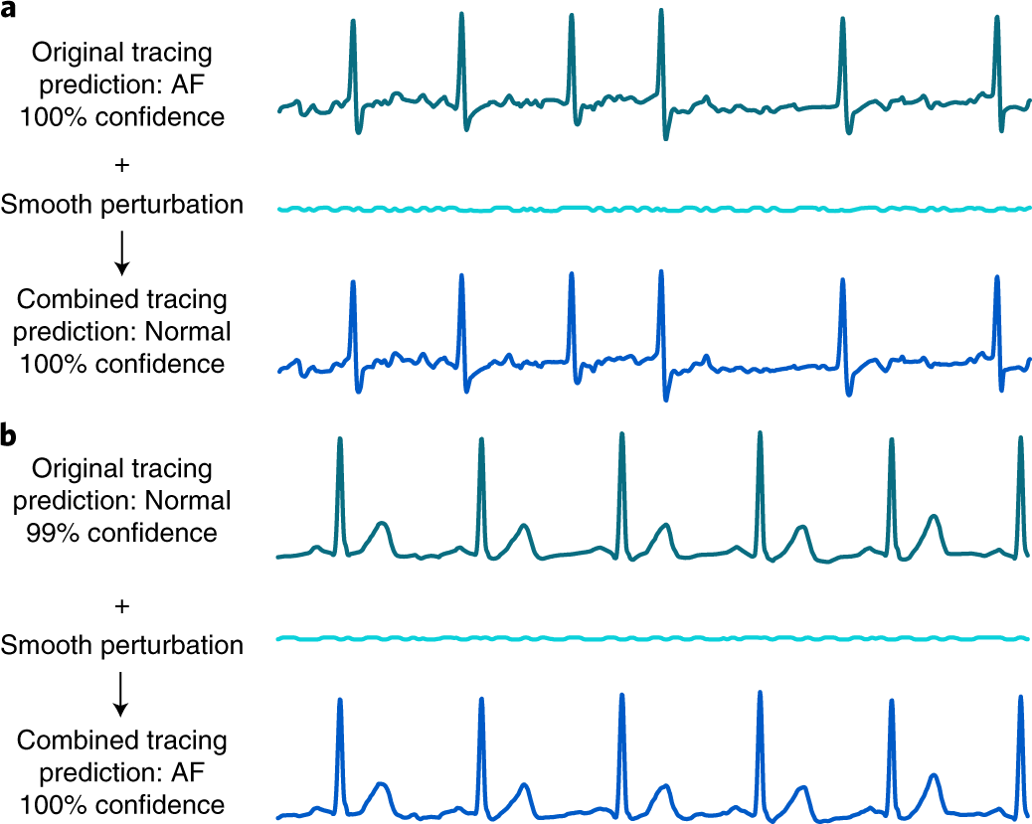
CHART: Collaborative Human AI Red-Teaming
CHART
Generate a system model
Identify Vulnerabilities
Demonstrate Vulnerabilities
Original Sensor data
(Classification: Heart attack)
Integrated
Integrates vulnerability detection (via knowledge base) and risk assessment (via simulation; see "adversarial")
Adversarial
Probes system from every angle, both in role of Environment and as Volitional Attacker (human "hacker");
End-to-end
Entire application is represented explicitly, across its entire lifecycle, from data collection, to training procedure, to deployed model.
AI01:Adversarial
Perturbations
Add tailored noise to data leaving the sensor to cause the AI to misclassify it
+
Smooth perturbations
AI02:Model Extraction
=
Use targeted queries to the model to reverse engineer its weights and architecture
Adversarial Sensor data
(Classification: Normal Rhythm)
Team: Galen Mullins, Gautam Vallabha, Sean McDaniel, Eric Naber, Sam Barham, Tyler Young, Aurora Schmidt

Slide 3
Industry focus on Adversarial example generation
Multiple adversarial attack toolkits in development
IBM AI Robustness Toolkit (ART)
MITRE ATT&CK
Baidu Red Teaming
ARMORY
RobustML
Focus of all major efforts is on images and convolutional neural networks
These organizations treat adversarial image generation and ad-hoc attacks as equivalent to red teaming.
Notes:
https://github.com/IBM/adversarial-robustness-toolbox
https://calypsoai.com/insights/calypso-newswire/ai-red-teaming-using-a-cutting-edge-military-technique-to-safeguard-your-ai/
https://www.robust-ml.org/
https://attack.mitre.org/

Slide 4
Identified Tech Gaps
Cybersecurity & AI threats are handled completely separately.
Focus on “breaking” the AI model without regard to the entire system.
No known threat-modeling/vulnerability analysis tools model systems with AI components
Current adversarial attack tools (useful for vulnerability analysis) require the intervention of experts in Adversarial Machine Learning (AML), and are not suitable for the use of traditional information security practitioners
With the exception of IBM’s ART, most adversarial attack tools are immature and poorly documented
  It is difficult to quickly apply attacks to new models and datasets – a necessary step in risk assessment

Slide 5

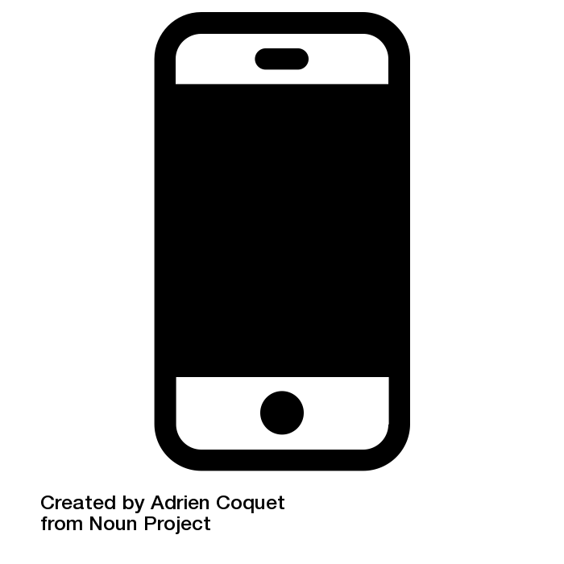
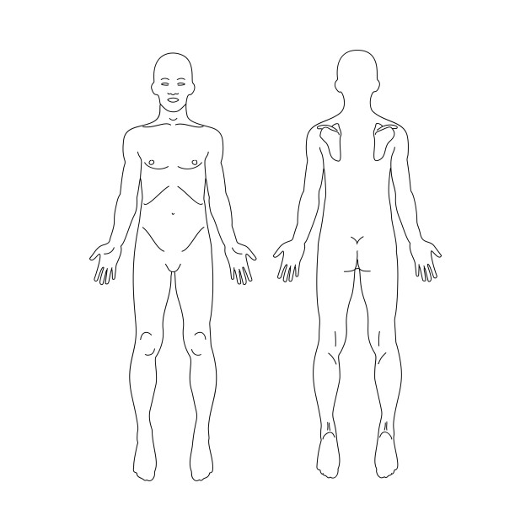
Deep Dive Scenario (I) – ECG Telemedicine
Public Databases
AWS Cloud
Legend
Training data Collection
Preprocessing
Training
Data
Entities
Bulk Data
Sources
Model Data
A.I.
Singular Data
Transform
Public Databases
Manipulation
Testing data Collection
Preprocessing
Testing
Deploy
Patient
Azure Cloud
Mobile Phone
Classification A.I.
Looking Good!
Preprocessing
Report Generation
Sensor
Send Data
Email Dr.
Log Activity
Log meals
Charge device
Calibrate device
Device App
Front
Back
Device is working and 35% and charged
Storage
Processed ECG
Raw ECG Signal
Patient’s PII
Notes:
Similar to the AliveCor system

Slide 6
Sample Irruptions from the ECG domain
Irruption Name | Category | Condition | Mitigation
Adversarial ECG signal injected in device | Adversarial example | Device access is not protected AND Training is not robust to adversarial perturbation | Secure data transmission Detect and clean adversarial inputs Adversarial training
Misconfigured sensors | Common corruption | Sensors are not calibrated Device has incorrect sensor info | Design device to check & verify sensor calibration; Detect pattern of misconfigured sensor
Sensor drift | Distribution drift | Physical sensor response changes over time | Design device to check sensor range Implement pre-input filter (e.g., remove baseline drift)
Misclassified natural variation | Natural adversarial examples | Training set does not include sufficient natural variation (e.g. body types) | Ensure training set is more representative of operational variation
Corrupted or Poisoned training data | Non-validated data | Training data is obtained from unknown source or transmitted in insecure manner | Verify training-data provenance Transmit data using secure channel
Corrupted test data | Non-validated data | Test data is obtained from unknown source or transmitted in insecure manner | Verify test-data provenance Transmit data using secure channel
Biased sampling during training | Biased training | Randomization during training is not verified/checked | Implement unit test to verify randomization and sampling
Incorrect model quantization | Incorrect Deployment | Quantized model not verified against complete test set | Test quantized model against complete test set and realistic noise Incorporate quantization into training

Slide 7
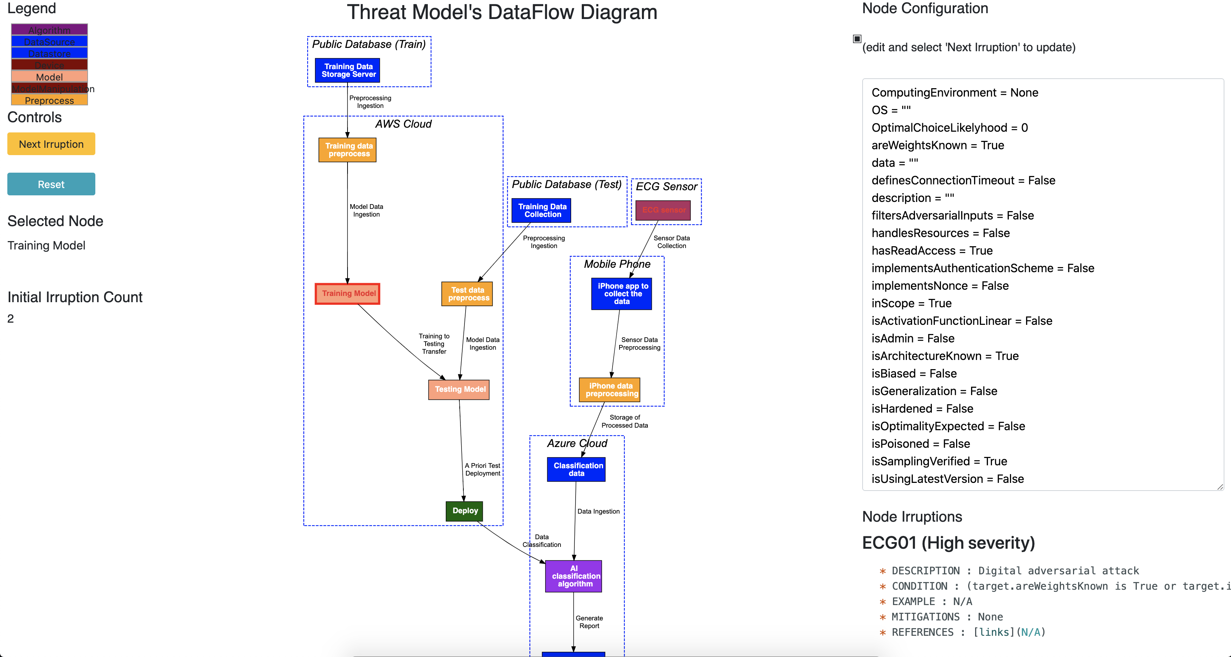
AITM ECG Model

Slide 8
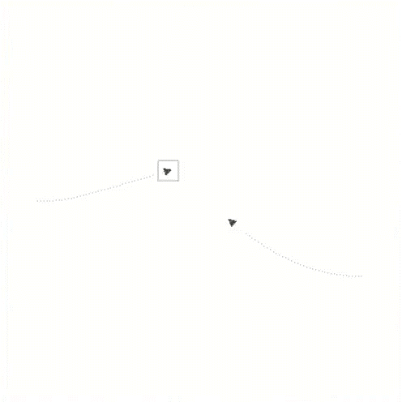
Deep Dive Scenario (II) – Collision Avoidance
PYUXV: RL Model driving UAS Collision Avoidance
  JHU APL Project, used as a platform vulnerability testing for z3 attack
  Real-time, safety-critical example
  Mission similar to that of the TCAS/ACAS-X system, deconflict vertical/horizontal airspace
  Trained to avoid incoming aircraft, even adversarial ones to 98% success rate at avoiding NMAC
Unmanned Aerial Vehicle
Comms
State Estimator
RL Model
Training Sim
Sensor
Environment
Actuators
Notes:
Cataloging and Reviews of tools
Additional documentation
(area 2, understand which weapons will have which impacts on specific systems)
Strengths and weaknesses of tools
Increase power of threat models to include more threats
Show how various attacks would affect the missions of the system. How do we assess whether this attack disrupts the mission. Need to be able to translate an attack
(demonstrate state-of-the art attacks)

Slide 9
Sample Irruptions from the UAV domain
Irruption Name | Category | Condition | Mitigation
Corrupted or Poisoned Training Data | Poisoning Attack | Training data set not validated | Verify training-data provenance
 |  | Set transmission is insecure | Transmit data using secure channel
Sensor Reference Point Shifting | Perturbation Attack or Incorrect Deployment | External reference points obscured or spoofed | Design device to check & verify sensor calibration
 |  | Sensors miscalibrated or susceptible to drift | Detect pattern of misconfigured sensor
Invalid Input Range | Exploit Software Dependencies | Code execution not robust for all inputs | Static code analysis
 |  |  | Fuzz Testing
Sensor Update Blocking | Perturbation Attacks | Insecure sensor link | Heartbeats
 |  |  | Network authentication
Policy Induction Attack | Adversarial Example in Physical Domain | Observation state externally accessible AND | Retrain networks on set of perturbed adversarial examples
 |  | System observable to train adversary's mimic network
Comms Version Downgrade Attack | System Capability Reversion | Backwards compatibility support for less capable versions | Enforce minimum version requirements
 |  |  | Test coverage for all supported versions
(TCAS/ACAS) Unauthenticated/Spoofed Mode C Messages | Non-validated Data Movement | No sender authentication | Sensor validation against other sources
 |  |  | Network authentication
(TCAS/ACAS) Spoof GPWS Radio Altimeter Reflections | Altering Data Not Used in the Model to Change Model Behavior | Attacker access to physical airspace near landing/takeoff AND | Filter spurious reflections
 |  |  | Sensor validation against other sources
 |  | Ground altitude derived from radio altimeter
And 37 More...
Notes:
Cataloging and Reviews of tools
Additional documentation
(area 2, understand which weapons will have which impacts on specific systems)
Strengths and weaknesses of tools
Increase power of threat models to include more threats
Show how various attacks would affect the missions of the system. How do we assess whether this attack disrupts the mission. Need to be able to translate an attack
(demonstrate state-of-the art attacks)

Slide 10
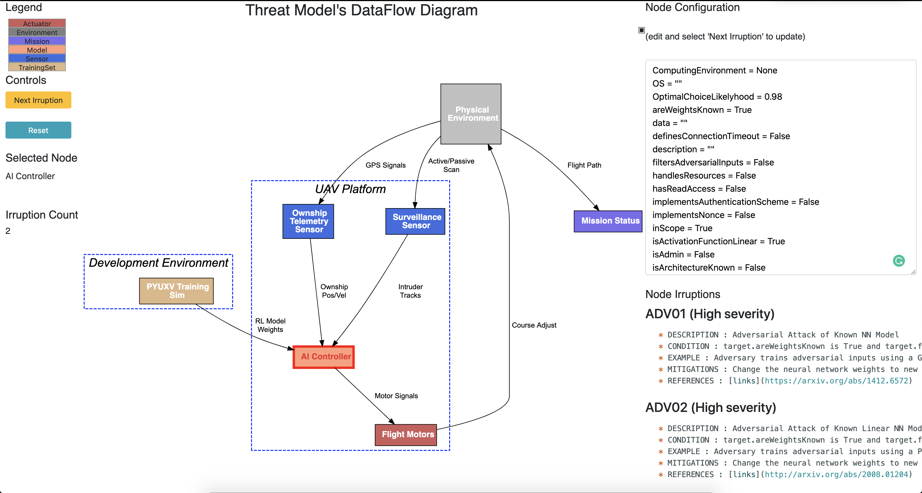
AITM Model for an RL controlled UAV

Slide 11
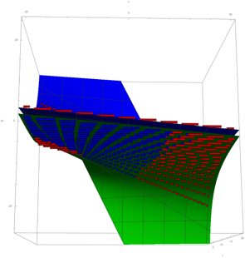
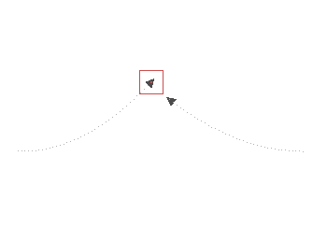
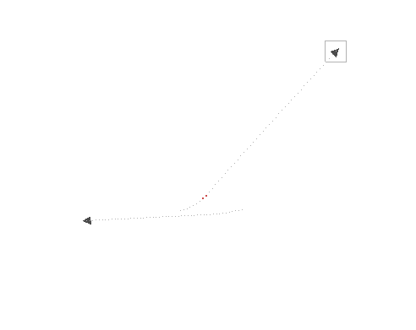
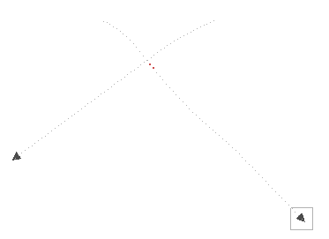
AITM Identified Irruptions in Action
Z3 attack on PYUXV
Preconditions:
  Known network weights
  Piecewise linear activation function (e.g. ReLU or HardTanH)
Approach: Static analysis of network to identify where model makes unsafe choices
  5977 unsafe states identified
Informs adversarial collision path
  Approach in this way and the victim
  aircraft will not be able to avoid
1) Adverse Approach Angles/Velocities Identified
2) Adverse Approach Angles/Velocities Demonstrated
Notes:
Cataloging and Reviews of tools
Additional documentation
(area 2, understand which weapons will have which impacts on specific systems)
Strengths and weaknesses of tools
Increase power of threat models to include more threats
Show how various attacks would affect the missions of the system. How do we assess whether this attack disrupts the mission. Need to be able to translate an attack
(demonstrate state-of-the art attacks)

Slide 12
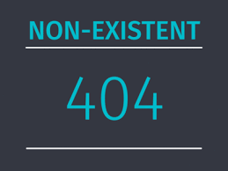



AI Red Teaming: From Nothing to an Art to a Science
Testing AI systems will follow the path of most new disciplines: the path from a nascent field, to a field more art than science, to a field more science than art
Apply the hard lessons learned from cyber security testing’s maturation
  Cyber necessitated testing to extend from functional testing to now also include testing potential attacks
  Red-teaming has been critical to moving cyber testing down the nothing-art-science path
    Initially no standard testing approaches exist and all testing is custom red-teaming
    Over time, best practices emerge and become foundational/procedural (science), and red-teaming becomes more specialized
Nascent Field
Art
Science

