Slide 1



Equipment Failure Report (EFR) Analysis Using an R Shiny Dashboard
DATAWorks 2021
12-14 April
R. Cole Molloy Statistician
Robert.Molloy@jhuapl.edu

Slide 2
Agenda
Motivation
Data Description
Text Preprocessing Overview
Dashboard
Conclusions & Next Steps
14 April 2021
2

Slide 3





Motivation
Data Mining Equipment Failure Reports (EFRs) is a crucial part of sustainment efforts
- Reading through thousands of EFRs is inefficient and long-term trends and relationships can be lost
Why Analyze EFRs with Data Mining Techniques?
Logistics (Coordinate Spares)
Inform Reliability Estimates (e.g., Mean Time Between Failures)
Investigate Time and/or Component-based Trends
Determine which Parts are Failing and Why
Objective: Generate a user-friendly dashboard that would allow Subject Matter Experts to quickly digest data from thousands of EFRs
14 April 2021
3

Slide 4
EFR Data Description
Each time an equipment failure occurs, an EFR should be filed to document the problem, how it was diagnosed and how it was corrected
EFRs contain both structured and unstructured data
Structured variables are quantitative and qualitative
  Location
  Date Event Occurred
  Action Taken (Adjustment, Repair, No Corrective Action, Replacement)
  Part Number
  EFR Number (Unique identifier)
Unstructured variables are free-form text entries
  Narrative
SAMPLE NARRATIVE
FIRST INDICATION OF PROBLEM: Preventive Maintenance During conduct of Standard Maintenance Procedure 123.
PROBLEM/HOW ISOLATED: Visual (or other senses) During conduct of SMP 123, at step 7c, it was found that widget B (P/N 654) was broken.
PROBABLE CAUSE: Normal use/wear
ACTION TAKEN: Problem Completely Corrected Widget replaced in accordance with procedure DISPOSITION: Returned to Service
RECOMMENDATIONS/REMARKS: None.
SAFETY HAZARD: No Apparent Safety Hazard
14 April 2021
4

Slide 5
Text Preprocessing Overview
Step 1: Preprocessing the free-form text data
Remove punctuation
Remove stop words
  Worked with Subject Matter Experts (SMEs) to determine custom stop words based on domain vernacular
Extract meaningful numbers
  Part numbers
Documentation numbers
Maintenance numbers
SAMPLE NARRATIVE
Identify and correct typos in the text
Correct for synonyms and acronyms
Stem the words
FIRST INDICATION OF PROBLEM: Preventive
Maintenance During conduct of Standard Maintenance Procedure 123.
PROBLEM/HOW ISOLATED: Visual (or other senses) During conduct of SMP 123, at step 7c, it was found that widget B (P/N 654) was broken.
PROBABLE CAUSE: Normal use/wear
ACTION TAKEN: Problem Completely Corrected Widget replaced in accordance with procedure DISPOSITION: Returned to Service
RECOMMENDATIONS/REMARKS: None.
SAFETY HAZARD: No Apparent Safety Hazard
- Repairs, Repaired, Repairing Repair
14 April 2021
5

Slide 6

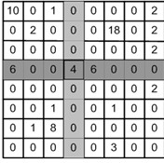
Text Preprocessing Overview
Step 1: Structuring Unstructured Text Fields
“Bag of words” approach to Natural Language Processing (NLP)
  Knows nothing about word proximity
  Strictly views word counts
Put text fields into a Document Term Matrix (DTM)
Each row represents a document
Each column represents a different term
Number in cell indicates the number of times that the
term appeared in that EFR
  There are many different weighting schemes that could be applied to a DTM
    Term frequency
    Binary
    Term frequency-inverse document frequency (tf-idf)
EFR 1
EFR 2
EFR 3
EFR 4
EFR 5
EFR 6
EFR 7
EFR 8
14 April 2021
6

Slide 7


Text Preprocessing Overview
Step 3: Incorporating Structured Data
Augmented DTM
- Add columns to DTM based what data you want to keep
Easy to work with in R with data frames and dplyr package
Allows for doing typical bag-of-word operations with filters applied
Once free-form text has been converted into a matrix and combined with the structured variables, the EFRs are ready for data mining.
EFR 1
EFR 2
EFR 3
EFR 4
EFR 5
EFR 6
EFR 7
EFR 8
123 | ADJ | A | Jan08
321 | REP | B | Aug11
456 | NCA | B | Jun13
654 | RPL | C | Feb05
789 | RPL | A | Mar19
987 | NCA | A | Dec12
135 | REP | C | Jul14
531 | ADJ | B | Oct03
14 April 2021
7

Slide 8
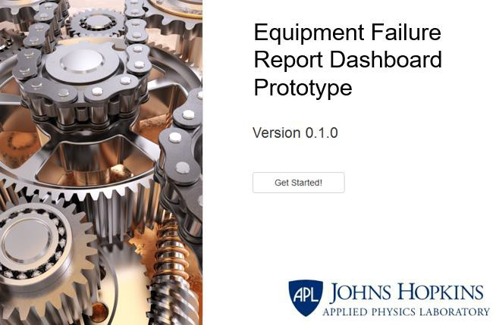
EFR Dashboard
Accelerates the analysis process for Subject Matter Experts
Main Components
  Filtering Through Sidebar
  Visualizing EFR frequency over time
  Data Upload/Download Data Subset
  Topic Modeling
    View most correlated terms for each topic
    Visualize topics over time and by other categorical variables (e.g., location)
  Viewing Raw Data
14 April 2021
8

Slide 9


Tools Used
R
  Open source statistical programming language
  Highly adaptable through the use of user-submitted packages
  Key R packages utilized
    Tm
      Text mining package that helps with text-preprocessing
      Allows for both standard methods (like removing punctuation), as well as custom methods when working with text
    Shiny
      Package for creating interactive dashboard as a web application hosted on a local
machine or a server
      Allows real-time analysis to promote data exploration
    Plotly
      Package for creating interactive, publication-quality graphs
    TopicModels
      Uses Latent Dirichlet Allocation (LDA) to return a set of topics and the terms most
associated with each topic
14 April 2021
9

Slide 10
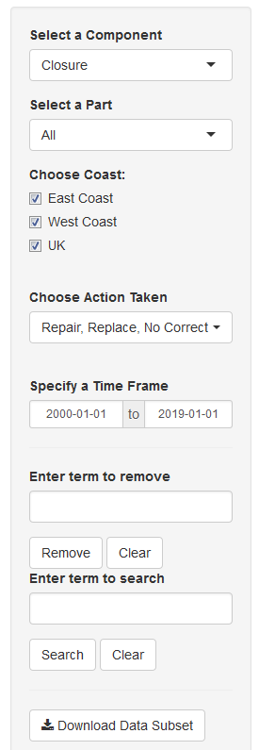
The Sidebar
Widget 1
Remains the same throughout the dashboard
Allows analyst to choose subsets of data based on:
Choose Location:
A
B
C
Component
Part Number/Description
Location
Action Taken
Time Frame
Download current subsets of data
Capability to search for and/or delete text in the DTM
14 April 2021
10

Slide 11
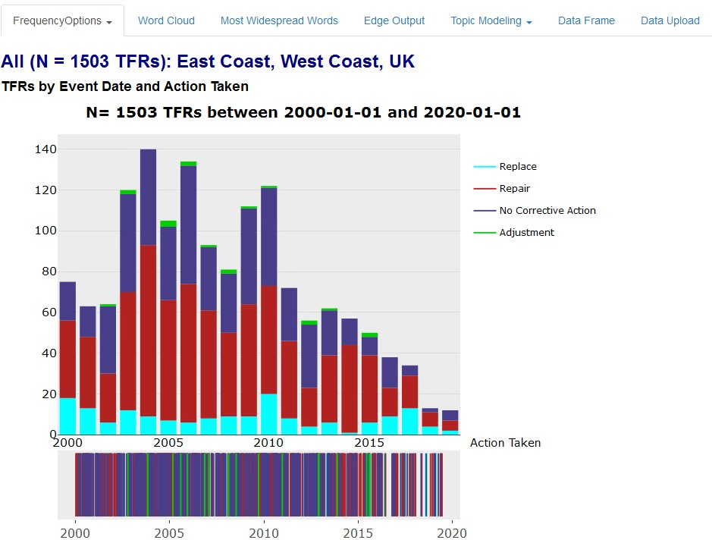
Visualizations for EFR Frequency
User selects a component, part, coast, corrective action(s) and a time frame
All (N= 1503 EFRs): Locations A, B, C
EFRs by Event Date and Action Taken
Widget 1
Choose Location:
Barplot shows all EFRs by year for the selected subset, broken out by action taken
Fringe plot shows the EFRs for the selected time frame
A
B C
Visualizations are interactive
User can click on the legend to remove EFRs for certain Actions and mouse-over the plot for additional information
14 April 2021
11

Slide 12
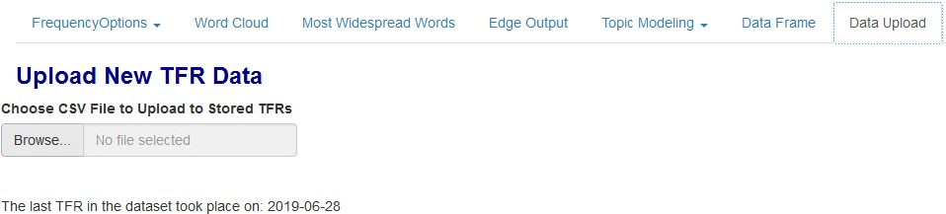
Data Upload and Download
EFRs are received by JHU/APL quarterly as CSV files
- It was important for analysts to be capable of immediately uploading new files so that their analyses are as current as possible
Widget 1
Upload New EFR Data
Choose CSV File to Upload to Stored EFRs
Choose Location:
The last EFR in the dataset took place on: 2019-06-28
A
B C
Data Upload
  Accepts any CSV file
  Removes duplicates
  Performs all data preparation
Data Download
  Downloads current view of the data
  Allows analysts to put subset CSVs into other programs, such as MATLAB
14 April 2021
12

Slide 13
Topic Modeling
Topic Modeling is an unsupervised learning method that can be used to group EFRs based on the words used in the narratives. An EFR could fall into multiple topics, or none at all.
The “Topic Modeling” tab of the dashboard displays the result of topic modeling on any filtered set of EFRs
The user inputs a desired number of topics, between 2 and 20.
Latent Dirichlet Allocation (LDA) is performed on the EFRs.
  Key assumptions:
    There exist latent objects that mediate between tokens and documents, called topics
    Each EFR is a probability distribution of topics
    Each topic is a probability distribution of tokens
  Using the observed frequencies of tokens in each EFR, estimate the distribution of topics in each EFR
  Result is a list of topics and their most important tokens, and a list of topic proportions for each EFR
An EFR can be an even mixture of all topics, completely concentrated in a single topic, or any other combination between these extremes
A EFR is assigned to a topic if the fitted topic proportion exceeds 𝟏/# 𝑻𝒐𝒑𝒊𝒄𝒔
  A EFR can therefore be “in” multiple topics simultaneously
Topic interpretation is left to the user
14 April 2021
13

Slide 14
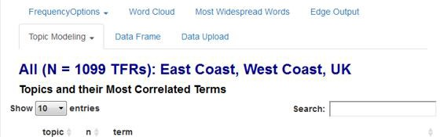


Topic Modeling Output
Widget 1
All (N= 1503 EFRs): Locations A, B, C
Choose Location:
A
B C
 |  | 1 | 189 | conduct, note, support, miss, bent, boom, part, ring, fue, done, reveal, psi, actuator, reduce, constraint
 |  | 2 | 253 | charge, battery, dead, rust, corrode, terminal, piece, cause, spare, new, change, remove, dispose, motor, indicator
 |  | 3 | 202 | unit, accomplish, support, side, request, install, section, gray, job, static, proof, respect, hexnut, pop, latch
 |  | 4 | 288 | leak, drops, gasket, crack, metal, oil, part, seal, diagnose, enlarge, level, problem, test, pressure, system
 |  | 5 | 189 | paint, inspect, closure, foam, tactical, induct, require, repair, perform, rework, inch, expend, insulation, greater, use
 |  | 6 | 121 | widget, work, platform, cable, ring, remove, tape, conduct, transfer, replace, test, residual, use, repair, contain
 |  | 7 | 225 | inch, end, side, unit, approximate, receive, pound, contact, measure, exist, refer, expire, incorporate, reduce, specific
#2: Batteries are being replaced due to corrosion
Subject Matter Expert Input
#4: Oil leaks are occurring due to cracked gaskets
Topic Modeling allows the user to quickly generate key themes from the EFRs without having to read all of them
14 April 2021
14

Slide 15
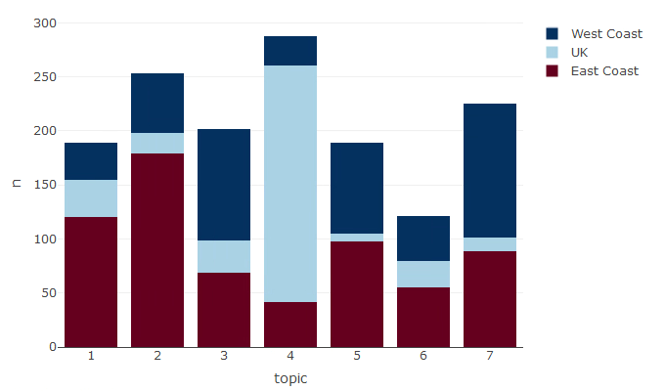

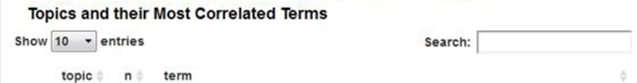
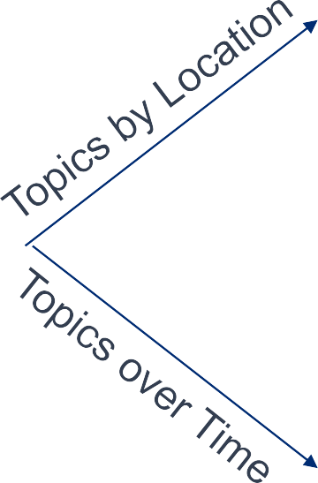
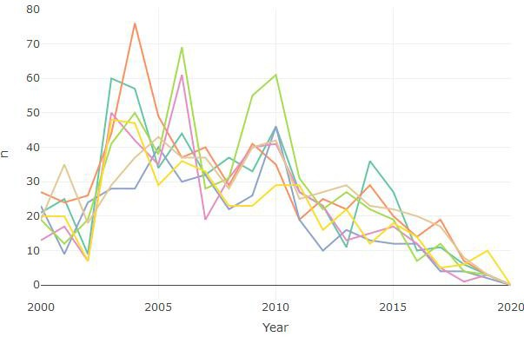


Topic Modeling Visualizations
Allows analysts to make sense out of different topics by showing their prevalence
over time and by location
A B C
All (N= 1503 EFRs): Locations A, B, C
Most of the EFRs in Topic #4 were from Location B
1 | 189 | conduct, note, support, miss, bent, boom, part, ring, fue, done, reveal, psi, actuator, reduce, constraint
2 | 253 | charge, battery, dead, rust, corrode, terminal, piece, cause, spare, new, change, remove, dispose, motor, indicator
3 | 202 | unit, accomplish, support, side, request, install, section, gray, job, static, proof, respect, hexnut, pop, latch
4 | 288 | leak, drops, gasket, crack, metal, oil, part, seal, diagnose, enlarge, level, problem, test, pressure, system
5 | 189 | paint, inspect, closure, foam, tactical, induct, require, repair, perform, rework, inch, expend, insulation, greater, use
6 | 121 | widget, work, platform, cable, ring, remove, tape, conduct, transfer, replace, test, residual, use, repair, contain
7 | 225 | inch, end, side, unit, approximate, receive, pound, contact, measure, exist, refer, expire, incorporate, reduce, specific
Topics #4 and #5 peaked together in 2006. They could be related failure modes.
14 April 2021
15

Slide 16
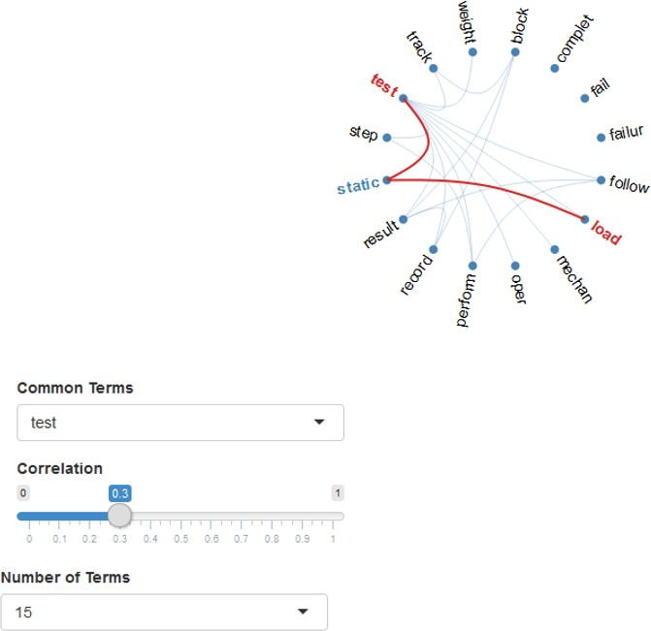
Visualizations for Text Correlations
The user chooses a term from the drop-down list of “common terms”. The top 30 terms are available, and will dynamically change based on the combination of filters
Widget 1
Choose Location:
A
B
C
Terms with a correlation coefficient ≥ the selected limit will be connected
  Correlation coefficient is computed by using the term columns in the DTM
User can view 5, 10, 15 or 20 correlated terms at a time
14 April 2021
16

Slide 17
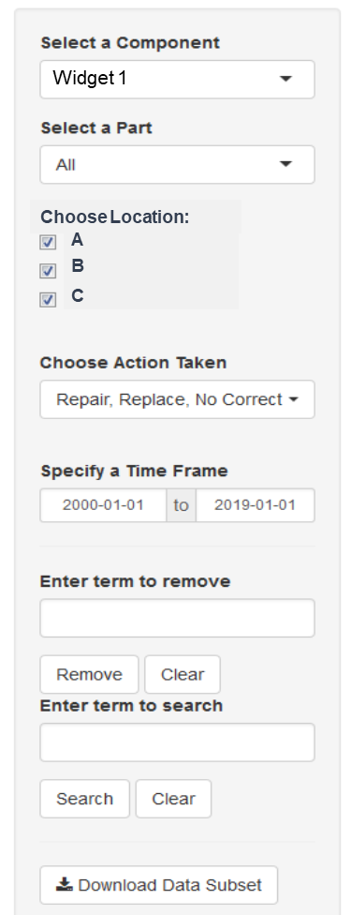
Viewing Raw Data
Displays an EFR in its raw form
User is able to search the EFRs for key words
Useful in conjunction with other analyses to better understand what is happening (e.g., identifying the key theme of a topic)
EFRs by Event Date and Action Taken
P/N
Date
Action
Component
Loc
Text
246 | 11Mar16 | Replace | Widget 1 | B | Found a broken screw which was then replaced
579 | 27Jan17 | No Corrective Action | Widget 1 | A | Lever C was badly bent out of shape, but still usable
133 | 14Jul18 | Replace | Widget 1 | A | Battery was not holding a charge. Upon inspection corrosion was discovered. Battery was replaced with a spare
555 | 25Feb19 | Repair | Widget 1 | C | Crack in gasket 4 was causing an oil leak. Technician was able to seak the cracks without having to replace the part.
14 April 2021
17

Slide 18
Conclusions and Next Steps
The EFR Dashboard has been instrumental in furthering sustainment efforts
  Analysts are able to quickly look into various pieces of equipment to determine which components are breaking the most often and identify common failure modes
    Recommendations can be made to refresh pieces of equipment that fail regularly
Code was written in a modular matter so prototype tools that are successful can be
quickly added into the dashboard
Code developed for this dashboard could be utilized on other data sources including both structured and unstructured data
Next Steps
  Link additional data sources to look for trends
  Incorporate part number hardware trees to help organize EFRs
  Explore other analyses
    More research into traditional clustering (k-means, hierarchical)
    Implement supervised learning to explore the ability of unstructured text to predict miscellaneous variables e.g., time to repair
  Modifying hyper parameters for topic modeling
    Auto-suggesting an optimal number of clusters
    Assume the data follows distributions other than default
14 April 2021
18

