Slide 1
Considerations for AI in Decision Making
Joseph Lyons, Ph.D. Airmen Systems Directorate 13 APR 21

Slide 2
Challenge Question
When should we allow software to make an important decision?
When the humans have sufficient transparency to understand:
Performance thresholds
Intent of the system
Training/development pedigree
Traceability of the system’s decision logic
When the humans have sufficient experience with the system in variety of contexts
When the system has a strong track record of reliable performance
When humans have observed the system make errors and those errors are stable
When the implications of human-machine symbiosis for decision making/interaction are known
When the system can significantly & consistently outperform humans and humans accept that behavior

Slide 3
Challenge Question
Transparency – methods for shared awareness/intent (Lyons, 2013)
Performance thresholds
Reliability/performance key for trust (Hancock et al. 2011; Hoff & Bashir, 2015)
Intent
What expectations should I have in relation to this technology
Benevolent-framed communications can reduce workload (Panganiban et al., 2019) and increase trust/trustworthiness perceptions (Lyons et al., 2020; 2021)
What was the intent of the designers? (Ho et al., 2017a)
What expectations does it have of me?
Training pedigree
How much testing has been done, what kind of testing? (Ho et al., 2017a)
Decision logic – how does it work, what are its assumptions?
Solutions for testers/designers may be different than those for operators

Slide 4
Challenge Question
What is Sufficient Experience?
Variety of task contexts
Machines should be stressed tested for as many possible situations as feasible
Know that you can’t test everything – so choose variety when selecting scenarios
Pilot anecdote – trust is event driven not always temporally driven
Machine learning systems
How much training is “sufficient”?
Training data (Lyons et al., 2018)
Variety
How recent?
Assumptions that might influence bias

Slide 5
Challenge Question
Track record of high performance
Demonstrated reliability/performance remains the strongest antecedent of trust (Hancock et al., 2011; Ho et al., 2017b)
However, experience need not be direct to influence trust
Trust can be shared through tight social groups (Ho et al., 2017a)
That means we should follow novel systems are they are fielded to monitor performance and adjust where needed
Objective performance and subjective perceptions of performance are not equal
Operator misattributions of technology malfunction can degrade trust – even when the system did exactly what it was designed to do
Lots of times this is due to operator’s not understanding how the technology works
Poor design to make the system’s behavior transparency to the operator

Slide 6
Challenge Question
Understanding errors and having stability of errors
Stability of error doesn’t mean “lack of error”
Communicating error information adds predictability
Could be a positive element for training
Error types
Miss
False alarm
Easy errors versus hard errors
Time scale of errors
May need to think about trust repair
Need to be able to attribute cause of errors

Slide 7
Challenge Question
What does it mean to have a machine as a partner?
Lots of research going on this space
Agent must be able to assume a role within a team and communicate on behalf of that role, working toward a common goal (McNeese et al., 2018)
Need to know who is on the team, what roles are needed, what the team goals are, need communication capabilities (McNeese et al., 2018)
Team dynamics
Agents as leaders/followers – how to avoid overtrust (Robinette et al., 2016)
Learning systems – overtrust is likely when agent recommendations are said to be based on a learning algorithm – people may attribute meaning “intelligence” to nonsensical act
Team processes
Common ground may be harder (Demir et al., 2017)
Understanding team roles & how they shift dynamically can be hard
Impact social cues & social affordances
Need to ensure that expectations are aligned to actual capabilities

Slide 8
Challenge Question
Knowing what is acceptable?
Murphy & Woods 2009
We should use ethical standards in the design and use of robots
Robots must respond appropriately for their role
Robots should have some autonomy to be self-protective while ensuring effective transfer of control to humans
These are more focused on humans – expectations, appropriateness, standards
Need to understand norms
Need to understand context
This is a huge research need – autonomy that can understand context
Implications for cockpit autonomy – urgency of an incoming threat
C2 autonomy – IMPACT

Slide 9
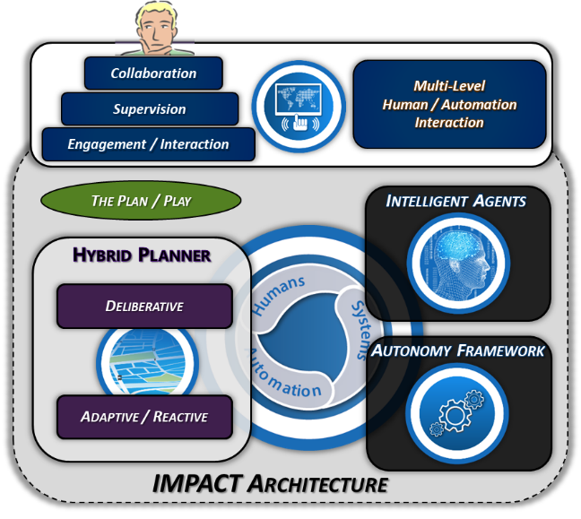
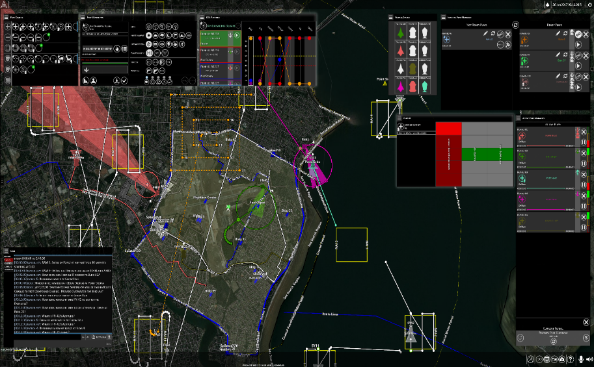
Intelligent Multi-UxV Planner w/Adaptive Collaborative Control Technologies
IMPACT
AI Enabled Battle Management Command & Control (C2)
Scenario: Base Security Capability Focus: Force Multiplication
Enables distributed teaming of operator(s) to manage multiple unmanned vehicles (air, ground, sea) maximizing Human-Autonomy Teaming Agility via:
Flexible Play Calling
Intelligent Decision-Aids
Cooperative Control Algorithms
Intuitive Human-Machine Interfaces
Manual
Operator develops COAs & planning – hands on interactions
Play Calling
Operator intent translated to actionable COAs
Auto-Initiated Plays
System authorized to act on behalf of operator based on pre-existing contract
Low
Level of Autonomy
High
Full Spectrum of Control

