Slide 1
U.S. ARMY ABERDEEN TEST CENTER
Unclassified
D-Optimally Based Sequential Test Method for Ballistic Limit Testing with a Change in Mechanism
Apr 2020
LEONARD C. LOMBARDO
Unclassified

Slide 2
Overview
Ballistic limit testing of armor is testing in which a kinetic energy threat is shot at armor at varying velocities.
  Threat striking velocity and penetration result are recorded.
  Data is analyzed using a generalized linear model to model probability of penetration as a function of threat velocity.
Model parameter estimates are used as an input to models such as in Modular
Unix-Based Vulnerability Estimation Suite (MUVES), a DoD software tool used to analyze weapon system vulnerability and munition lethality.
Generally in ballistic limit testing, the probability of penetration is assumed to be monotonically increasing with threat velocity. This is not the case when there is a change in mechanism.
One model that is used when there is a change in mechanism is the Chang Bodt model¹.
A D-optimal based sequential shot selection method (similar to the Neyer D-Optimal approach²) was developed to select shot velocities for the Chang Bodt model.
Notes:
Definition of ballistic limit testing
Results of ballistic limit testing are inputs to models such as MUVES
Probability of penetration typically assumed to be monotonically increasing with threat velocity – not the case when there is a change in mechanism.
For a more complicated response, we need a more complex model – one such model is the Chang Bodt model which is the focus of this talk.
That brings us to the motivation for this work:
The current sequential test methods are not efficient.
Chang and Bodt recommended a modified up-and-down approach.
TOP 10-2-218 spends 80 shots over a velocity range below the V0 just to check if there is at least on complete over that range. After that depending on the outcome of the first 80 shots, 60 shots are recommended using the modified Langlie or shots taken at specified increments over a specified range. Therefore, 140 shots are spent just to find the lower V50 value.
These are reasonable approaches given the complexity of the problem and the state of the art at the time they were developed, but we can do better.
Primarily for characterization of body armor, ATC has used Neyer’s D-optimal method. In test design there are many optimality criteria. The D-optimal method balances efficiently estimating both parameters of interest: the V50 and sigma which represents the slope of the response curve.
This work focuses on applying the D-optimal approach to the more complex Chang Bodt model.

Slide 3
Change in Mechanism
In this context, a change in mechanism is when the threat-target interaction behavior changes over a given velocity range such that the probability of penetration is no longer monotonically increasing with increasing velocity.
Shatter gap^{3,4} is a common example:
  At low velocities, the threat stays intact and the armor stops the threat.
  At intermediate velocities, the threat may stay intact but penetrate the armor or may shatter and not penetrate the armor.
  At high velocities, the shattered threat has sufficient energy to penetrate the armor.
Notes:
Definition of a change in mechanism – the threat-target interaction behavior changes over a given velocity range such that the probability of penetration is no longer monotonically increasing with increasing velocity.
Shatter gap is probability the most common cited example.

Slide 4
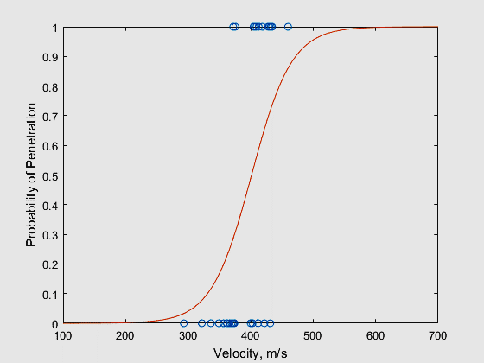
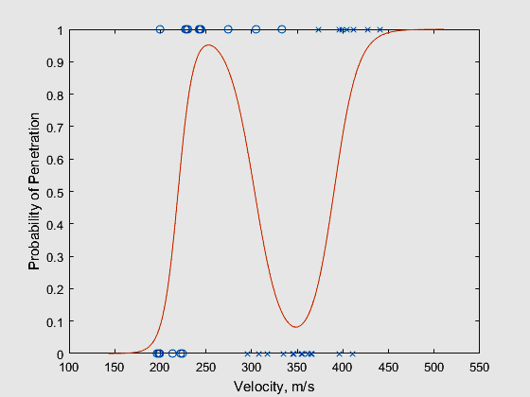
Single Mechanism vs. Two Mechanisms
Single Mechanism
Two Mechanisms
Notes:
Shown here is a comparison of a response with a single mechanism and a response with two mechanism.
In both instances we are modeling the probability of penetration as a function of velocity shown by the red lines. Individual data points are shown in blue.
For the response with a single mechanism, the probability of penetration monotonically increases with increasing velocity.
For the response with two mechanisms, the probability of penetration increases, decreases, then increases again as threat velocity increases. Note that the data points are shown as both circles and x’s representing the two different mechanisms.
A couple of notes:
Several methods have been proposed for modeling the change in mechanism so why choose the Chang Bodt model?
The Chang Bodt model makes more sense intuitively than say a higher order polynomial and is more consistent with how we model a single mechanism.
The Chang Bodt model allows for a certain amount of complexity that is necessary to allow for different slopes of the two mechanisms compared to a cubic fit.
The Chang Bodt model appears to give more conservative estimates of extreme quantiles than higher order polynomials or splines.

Slide 5
Test Design Considerations
Can the mechanism be determined for each shot (high speed x-ray or post shot x-rays)?
How much overlap is there between mechanisms?
Is one of the outcomes rare (e.g., the threat tends to shatter before an intact threat would be likely to penetrate)?
Notes:
We have a few test design considerations:
Can the penetration mechanism be determined for each shot?
Possible methods include high speed x-ray or post shot x-rays.
If we can determine the mechanism, then we can use that information in the analysis.
How much overlap is there between mechanisms?
So what is meant by that? Is it easy to see just be looking at completes and partials that there are two different mechanisms (not much overlap) or does it just look like one big mess of mixed results (a lot of overlap)?
If there is a lot of overlap, then determining the mechanism for each shot is helpful and sometimes necessary. It can be easy to over-fit a model. Physical evidence of a change in mechanism is preferred over simply relying on a statistical measure such as an information criterion. Lastly, if there is a lot of overlap, it may be easy to “miss” the presence of one of the mechanisms in cases where the mechanism is not known.
If there is not a lot of overlap, then knowing the mechanism is still preferred but not as critical.
Is one of the outcomes rare?
The example given here rarely having a penetrating intact round.
In this case, knowing the mechanism is critical – it would be very easy to miss the intact round mechanism.

Slide 6
Likelihood Function for the Chang Bodt Model (Known Mechanism)
$p_{1}=Pr\left(y=1|m=0\right)$
$p_{2}=Pr\left(y=1|m=1\right)$
$p_{m}=Pr\left(m=1\right)$
 | $$m=0$$ | $$m=1$$
$$y=0$$ | $$Pr\left(m=0∩y=0\right)$$ $$\left(1−p_{m}\right)\left(1−p_{1}\right)$$ | $$Pr\left(m=1∩y=0\right)$$ $$p_{m}\left(1−p_{2}\right)$$ | $$\left(1−p_{m}\right)\left(1−p_{1}\right)+p_{m}\left(1−p_{2}\right)$$
$$y=1$$ | $$Pr\left(m=0∩y=1\right)$$ $$\left(1−p_{m}\right)p_{1}$$ | $$Pr\left(m=1∩y=1\right)$$ $$p_{m}p_{2}$$ | $$\left(1−p_{m}\right)p_{1}+p_{m}p_{2}$$
 | $$\left(1−p_{m}\right)$$ | $$p_{m}$$
$$L\left(θ|x\right)=\prod_{i}{Pr\left(y_{i},m_{i}|x_{i};θ\right)}=p_{m}^{m_{i}}p_{2}^{m_{i}y_{i}}{\left(1−p_{2}\right)}^{m_{i}\left(1−y_{i}\right)}{\left(1−p_{m}\right)}^{\left(1−m_{i}\right)}p_{1}^{\left(1−m_{i}\right)y_{i}}{\left(1−p_{1}\right)}^{\left(1−m_{i}\right)\left(1−y_{i}\right)}$$
$$\ln{L\left(θ|x\right)}=\left\{\begin{matrix}\sum_{i}{\ln\left(1−p_{m}\left(x_{i}\right)\right)+y_{i}\ln\left(p_{1}\left(x_{i}\right)\right)+\left(1−y_{i}\right)\ln\left(1−p_{1}\left(x_{i}\right)\right); m=0} \\ \sum_{i}{\ln\left(p_{m}\left(x_{i}\right)\right)+y_{i}\ln\left(p_{2}\left(x_{i}\right)\right)+\left(1−y_{i}\right)\ln\left(1−p_{2}\left(x_{i}\right)\right); m=1}\end{matrix}\right.$$
Notes:
Now I want to introduce the likelihood function for the Chang Bodt model when the mechanism is known.
Why is the likelihood function important?
Maximum likelihood techniques are used to iteratively determine the parameter estimates.
This work focuses on the a D-optimal method for shot velocity selection. D-optimal methods select points to maximize the determinant of the information matrix. The information matrix is negative the expectation of the second derivative of the log-likelihood function.
So the likelihood function provides the foundation for the test method and the analysis.
Let’s start going through some of the equations.
y=1 denotes a complete penetration. Conversely, y=0 is a partial penetration.
Following the same approach, m=0 denotes the first mechanism and m=1 denotes the second mechanism.
With that said, p1 is the probability of a complete penetration for the first mechanism, p2 is the probability of penetration for the second mechanism, and pm is the probability of obtaining the second mechanism. These are all assumed to be functions of velocity, in our examples they will follow the logistic distribution, and will each have two parameters: mu and a scale parameter. The model therefore has a total of six parameters.
The confusion matrix shows the probability for each of the four possibilities. For our shatter gap example, probability of an intact partial, probability of an intact complete, probability of a shattered partial, and probability of a shattered complete.
Note the equation on the margin for a complete penetration, is the equation used to generate the response curve from a couple of slides ago.
The likelihood function is simply the product of all the probabilities for the data and parameter estimates.
In practice we use the log-likelihood shown at the bottom.
A couple other things to notice:
Knowing the mechanism allows us to simplify the problem quite a bit.
The Fortran code presented by Chang and Bodt indicates that this is generally the form that they used with a simplifying assumption of setting the scale parameter based on the step size they chose for the up-and-down method. They then solved for each of the three values of mu.

Slide 7
Chang Bodt D-Optimal Method
(Known Mechanism)
The previous log-likelihood function is equivalent to three separate log-likelihood functions.
To obtain unique estimates, there needs to be a zone of mixed results (ZMR).
The first step is an initial design to obtain a ZMR for each of the three log-likelihood functions:
  Overlap of partials and completes for the first mechanism.
  Overlap of partials and completes for the second mechanism.
  Overlap between mechanisms.
Once a ZMR is obtained for each log-likelihood functions, unique parameters are determined and the next shot is at the D-optimal point.
Notes:
As just mentioned, knowing the mechanism allows us to simplify the model into three separate GLMs.
To obtain unique estimates, there needs to be a zone of mixed results:
Overlap of partials and completes for the first mechanism.
Overlap of partials and completes for the second mechanism.
Overlap between mechanisms.
Once we obtain the three ZMRs unique parameters are determined and the next shot is at the D-optimal point.

Slide 8
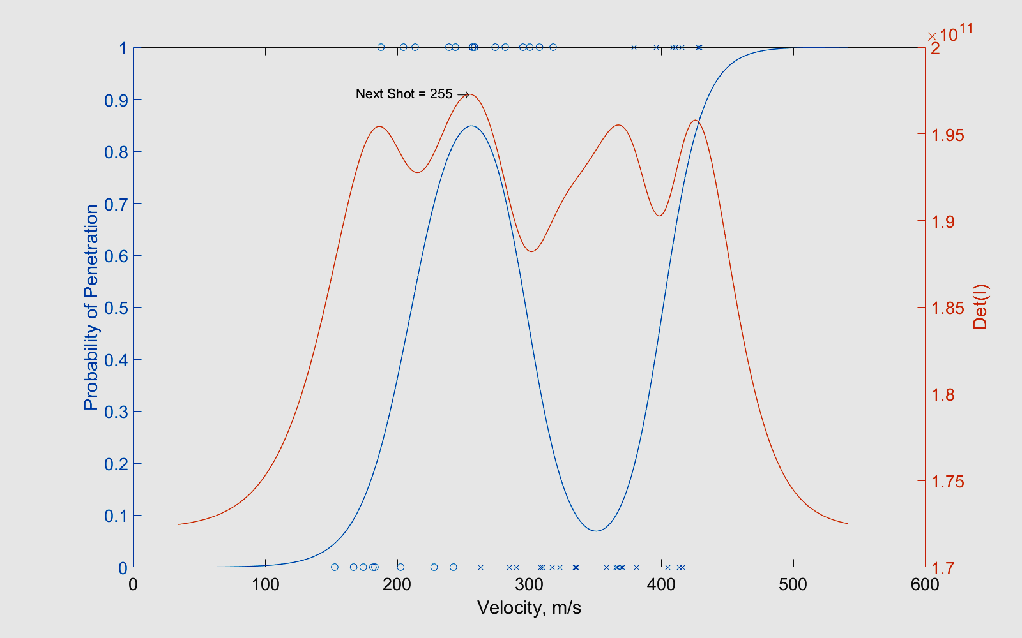
Example with Known Mechanism
(Known Mechanism)
Notes:
Shown is an example of a known mechanism.
On the left axis is the probability of penetration vs velocity. In blue is the individual data points and the response curve under the Chang Bodt model.
On the right axis is the determinant of the information matrix as a function of the next shot velocity. Recall that the D-optimal method attempts to select points that maximize the determinant of the information matrix, so for our example the next shot would be 255 m/s. Shown here there are 4 peaks, but there can be up to 6.

Slide 9
Simulation Study Setup
Four truth sets explored:
  μ₁ = μ_{m} - 1σ; μ₂ = μ_{m} + 1σ; σ₁ = σ₂ = σ_{m} = σ
  μ₁ = μ_{m} - 2σ; μ₂ = μ_{m} + 2σ; σ₁ = σ₂ = σ_{m} = σ
  μ₁ = μ_{m} - 3σ; μ₂ = μ_{m} + 3σ; σ₁ = σ₂ = σ_{m} = σ
  μ₁ = μ_{m} - 4σ; μ₂ = μ_{m} + 4σ; σ₁ = σ₂ = σ_{m} = σ
Probabilities p₁, p₂, and p_{m} all followed a logistic distribution.
Initial guesses were exact.
Sample sizes varied from 40 to 100 in increments of 20.
Notes:
To evaluate the performance of this new test method, a simulation study was conducted.
Four truth sets were explored.
In this case, the mus for the mechanisms are symmetric about the mu for pm with deltas varying from 1 to 4. The underlying scale parameters are all equal.
Probabilities p1, p2, and pm all followed a logistic distribution.
Initial guesses are exact.
Sample sizes were varied from 40 to 100 in increments of 20.

Slide 10
Parameter Median Bias
Notes:
The first evaluation metric was parameter median bias. Recall we have 6 parameters, a mu and sigma for each of the three probability equations p1, p2, and pm.
The first thing to notice is the values for mu have negligible medium bias as expected for a balanced design.
The values for sigma, however, had a considerable small sample bias. This too comes at no surprise since small sample bias for sigma is well known.
As expected as sample size increases, bias goes towards zero.
Lastly, as delta decreases, the median bias for sigma decreases. Consider a low velocity partial for the first mechanism. This point provides some information for p1, but little information for pm, and no information for p2. As delta becomes smaller, the shots tend to provide more information to the other curves, though still separated by mechanism.

Slide 11
Parameter RMSE
Notes:
The second evaluation metric is root mean square error.
As expected, as the sample size increases, RMSE decreases.
Again, as delta decreases, the shots provide more information to pm so you see a decrease in RMSE for both Mu and Sigma.

Slide 12
Likelihood Function for the Chang Bodt Model (Unknown Mechanism)⁵
$p_{1}=Pr\left(y=1|m=0\right)$
$p_{2}=Pr\left(y=1|m=1\right)$
$p_{m}=Pr\left(m=1\right)$
 | $$m=0$$ | $$m=1$$
$$y=0$$ | $$Pr\left(m=0∩y=0\right)$$ $$\left(1−p_{m}\right)\left(1−p_{1}\right)$$ | $$Pr\left(m=1∩y=0\right)$$ $$p_{m}\left(1−p_{2}\right)$$ | $$\left(1−p_{m}\right)\left(1−p_{1}\right)+p_{m}\left(1−p_{2}\right)$$
$$y=1$$ | $$Pr\left(m=0∩y=1\right)$$ $$\left(1−p_{m}\right)p_{1}$$ | $$Pr\left(m=1∩y=1\right)$$ $$p_{m}p_{2}$$ | $$\left(1−p_{m}\right)p_{1}+p_{m}p_{2}$$
 | $$\left(1−p_{m}\right)$$ | $$p_{m}$$
$$L\left(θ|x\right)=\prod_{i}{Pr\left(y_{i}|x_{i};θ\right)}={\left(\left(1−p_{m}\right)p_{1}+p_{m}p_{2}\right)}^{y_{i}}{\left(\left(1−p_{m}\right)\left(1−p_{1}\right)+p_{m}\left(1−p_{2}\right)\right)}^{\left(1−y_{i}\right)}$$
$$\ln{L\left(θ|x\right)}=\left\{\begin{matrix}\sum_{i}{\ln\left(\left(1−p_{m}\right)\left(1−p_{1}\right)+p_{m}\left(1−p_{2}\right)\right); y=0} \\ \sum_{i}{\ln\left(\left(1−p_{m}\right)p_{1}+p_{m}p_{2}\right); y=1}\end{matrix}\right.$$
Notes:
If the mechanism is unknown, then we use likelihood on the margin.
Again in practice, we use the log-likelihood. Immediately, we see that maximizing the log-likelihood is a nonlinear optimization problem.
This is the approach that Joe Collin’s used in his technical report that I’ve referenced.
Unless the range had planned to collect information to determine the mechanism for each shot, this will be the situation we find ourselves in.

Slide 13
Chang Bodt D-Optimal Method
(Unknown Mechanism)
Approximates the known mechanism likelihood function when there is little overlap between the mechanisms (i.e., easy to discern which mechanism the points likely belong to even if technically unknown).
As before, initial design is used to achieve overlap of the data. We don’t know the mechanism, so instead we achieve three regions of overlap in partials and completes to approximate the known mechanism result.
As before, subsequent velocities are the D-optimal points.
Not recommended for instances:
  When there is a lot of overlap between the two mechanisms.
  When one of the outcomes is rare.
Notes:
Approximates the known mechanism when there is little overlap between mechanisms.
As before, an initial design is used to achieve overlap of the data. We don’t know the mechanism so instead we achieve three regions of overlap in partials and completes to approximate the known mechanism result.
A quick note here:
This is a more challenging optimization problem than the early situation of knowing the mechanism.
A method of quickly assessing an initial guess is necessary because we don’t want to wait very long between shots using a brute force method. I also implemented a profile likelihood based routine to resolve many convergence issues, but sometimes we will have convergence problems.
As a catch-all, a D-optimal method for a cubic fit is used when convergence fails.
However, when we do get convergence, D-optimal points are based on the Chang-Bodt model.
This approach is not recommended when there is a lot of overlap between the two mechanisms or when one of the outcomes is rare as previously discussed.

Slide 14
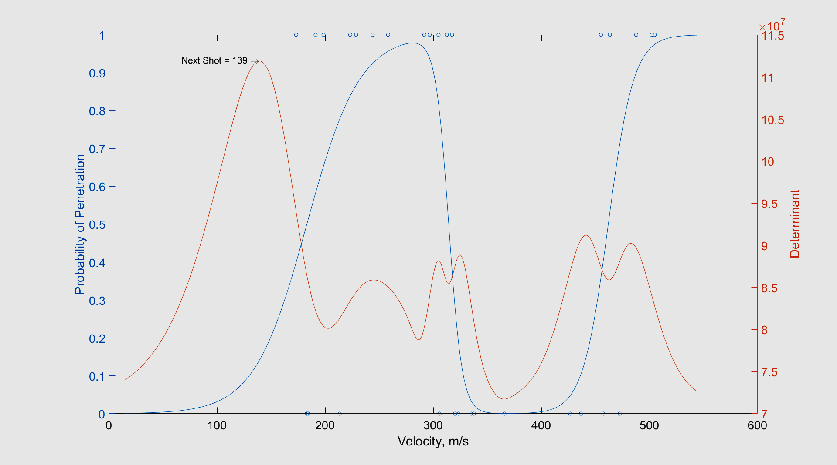
Example with Unknown Mechanism
Notes:
Shown here is an example when the mechanism is not known.
Looking at the data, we see that the lowest velocity was a complete, so the routine correctly recommends a low velocity of 139 m/s.

Slide 15
Simulation Study Setup
Three truth sets explored:
  μ₁ = μ_{m} - 3σ; μ₂ = μ_{m} + 3σ; σ₁ = σ₂ = σ_{m} = σ
  μ₁ = μ_{m} - 4σ; μ₂ = μ_{m} + 4σ; σ₁ = σ₂ = σ_{m} = σ
  μ₁ = μ_{m} - 5σ; μ₂ = μ_{m} + 5σ; σ₁ = σ₂ = σ_{m} = σ
Probabilities p₁, p₂, and p_{m} all followed a logistic distribution.
Initial guesses were exact.
Sample sizes varied from 40 to 100 in increments of 20.
Notes:
To assess the performance of the method when the mechanism is unknown I conducted another simulation study.
This time we varied delta from 3 to 5.
Everything else is similar to the previous simulation study.

Slide 16
Parameter Median Bias
Notes:
Again, relatively negligible bias for mu.
Sigma is biased and that sigma bias for pm decreases with decreasing detla.

Slide 17
Parameter RMSE
Notes:
Here we see to competing observations:
As delta decreases, the RMSE for sigma decreases.
However, the RMSE for um increases.
Without knowing the mechanism for each shot it is difficult to estimate um when there is a lot of overlap of the mechanisms. As delta decreases, the data looks like on big zone of mixed results.

Slide 18
Conclusions
A more complicated model such as the Chang Bodt model is needed when there is a change in mechanism.
A D-optimal method has been presented for cases in which the mechanism is known and for cases in which the mechanism is unknown.
Knowing the mechanism is preferred; especially when there is overlap between the mechanisms.
Model parameters may be used as inputs to models such as MUVES.
Notes:
A more complicated model is needed when there is a change in mechanism.
A D-optimal sequential shot selection method was presented for cases in which the mechanism is known and cases in which the mechanism is unknown.
Generally, knowing the mechanism is preferred.
Model parameters are used as inputs to models such as MUVES.

Slide 19
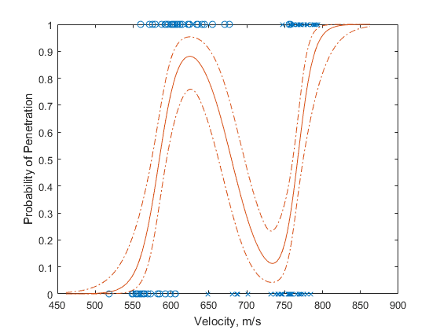
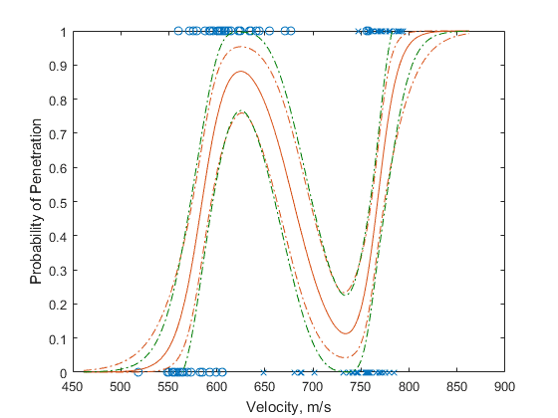
Future Work

Slide 20
References
Chang AL, Bodt BA. JTCG/AS interlaboratory ballistic test program—final report. Aberdeen Proving Ground (MD): Army Research Laboratory (US); 1997 Dec. Report No.: ARL-TR-1577.
Barry T. Neyer, A D-Optimality Based Sensitivity Test, Technometrics, 36, pp 61-70 (1994).
TOP 10-2-218. Shatter Gap Testing of Ceramic Body Armor 2009.
TOP 02-2-710A. Ballistic Tests of Armor Materials 2016.
Collins J. Quantal response: nonparametric modeling. Aberdeen Proving Ground (MD): Army Research Laboratory (US); 2017 Jan. Report No.: ARL-TR-7925.

Slide 21
Relative Median Bias Comparison for Delta = 3
Notes:
No large bias for mu.
Generally, smaller bias for sigma when mechanism is known.

Slide 22
Relative RMSE Comparison for Delta = 3
Notes:
Most obvious takeaway is the relatively large RMSE for um for unknown mechanism, especially for small samples.

Slide 23
Relative Median Bias Comparison for Delta = 4
Notes:
Similar to the previous example – no large bias for mu, generally better performance when mechanism is known.

Slide 24
Relative RMSE Comparison for Delta = 4
Notes:
Pretty similar performance.

