Slide 1
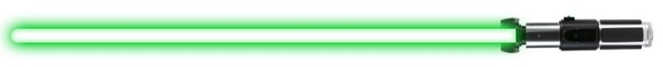


JEDIS
JMP Experimental Design Iterative Solver
JMP Experimental Design Iterative Solver

Slide 2
What is JEDIS?
JEDIS is a JMP Add-In for automating
Design of Experiments (DOE) power calculations

Slide 3

JEDIS simplifies answering questions like the following:
How many runs does my DOE need for 90% power across my factor-space?
Typical Researchers

Slide 4
Traditional DOE methods require iterative estimation to size a design for a specific power
Repeat until design provides desired power
Define factors
and levels
Estimate design size required*
Determine if power is sufficient
  * For factorial designs: the number of design replications
  For optimal designs: the number of individual samples

Slide 5
JEDIS iterates through designs for you
Define factors and levels
Define input ranges
Run JEDIS
Select design
  Inputs Ranges:
  Number of replicates/runs
  Signal-to-Noise Ratio
  Alpha (1-Confidence)

Slide 6
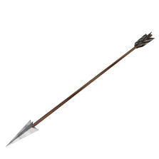


Consider this motivational problem:
How many shots must the archer take to show, with confidence, his ability to hit the target’s center under varying conditions?

Slide 7
The first step for all DOEs is defining factors and levels
Response | Factors | Levels
Miss distance from center | Range from target | 10 m
 |  | 30 m
 |  | 50 m
 | Angle of shot | 15°
 |  | 30°
 |  | 45°
 |  | 60°
Miss distance
Angle
Range

Slide 8
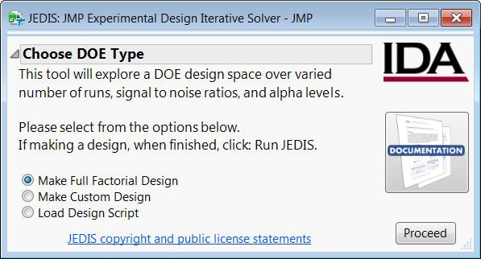
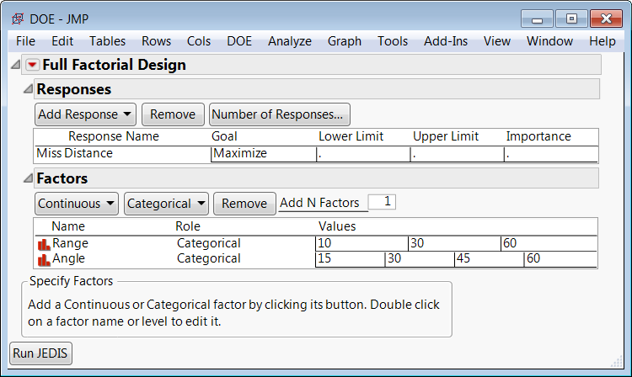
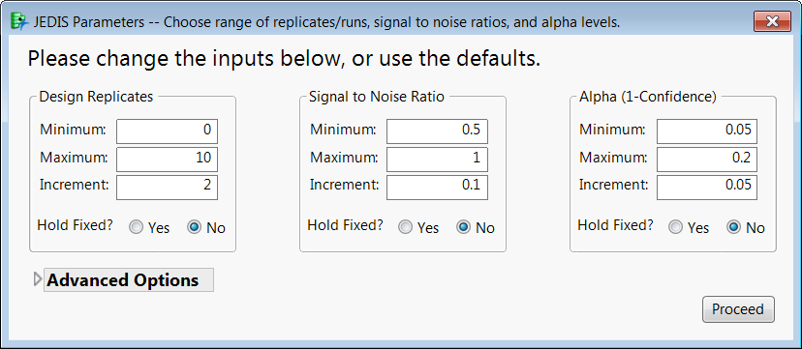
Lets walk through JEDIS for this example archery DOE
Step 1
Open JEDIS and choose
“Make Full Factorial Design”
Step 2
Construct DOE by adding factors and levels as normal in JMP
Step 3
Specify ranges for parameters and then let JEDIS run

Slide 9
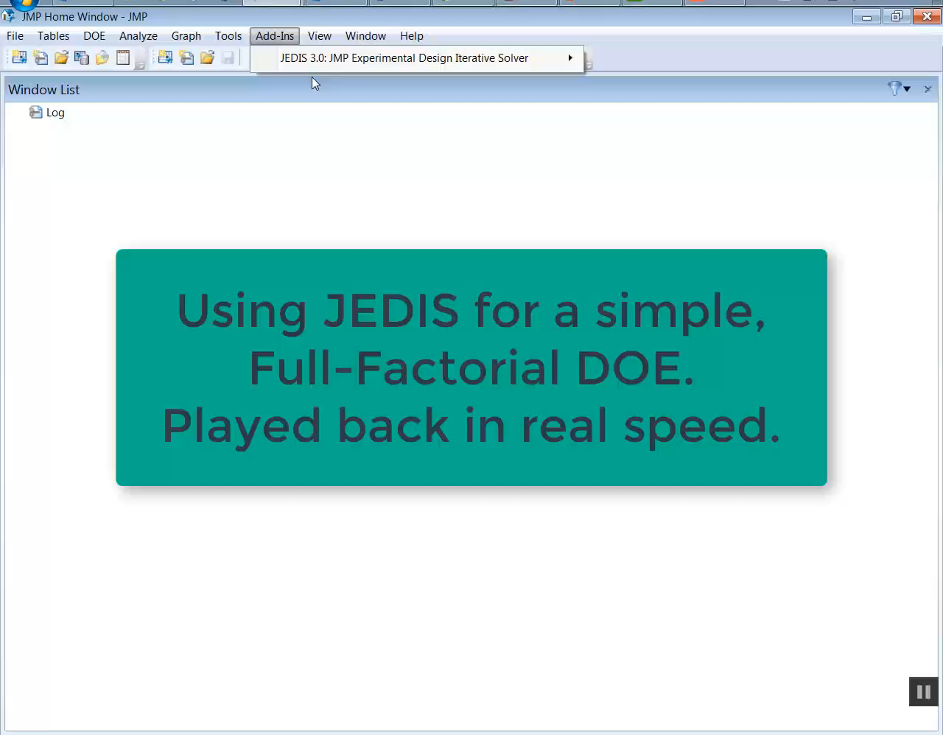

Video demo of JEDIS for archery DOE, in real time

Slide 10
Recall our original motivation for JEDIS:
How many runs does my DOE need for 90% power across my factor-space?
Typical Researchers

Slide 11
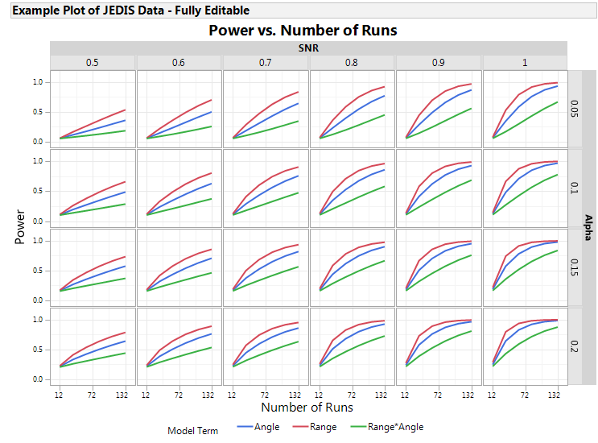
For this example, 90% power across all factors is possible at 80% confidence with 132 shots for a SNR of 1
1 SNR
90% power
80% conf.
132 shots

Slide 12
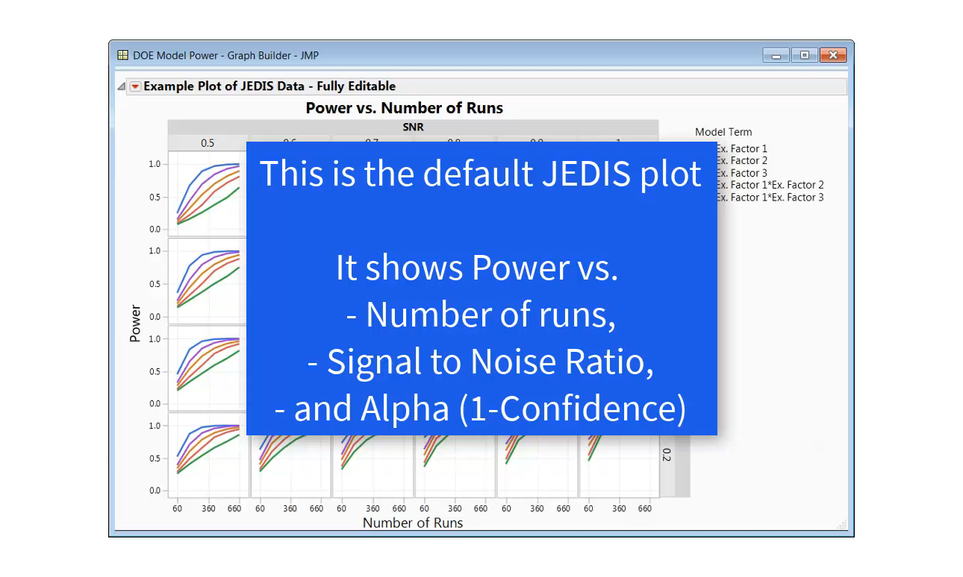
Lets explore the default JEDIS plot and some other plotting options available to you in JMP

Slide 13
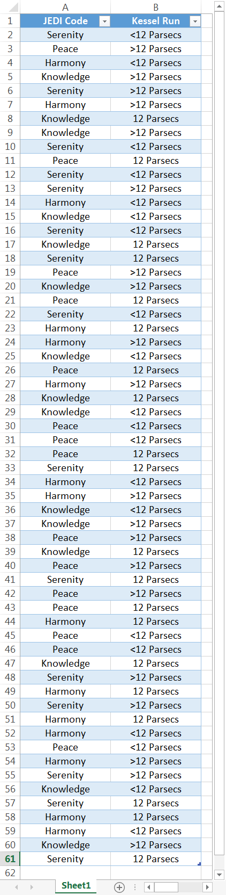
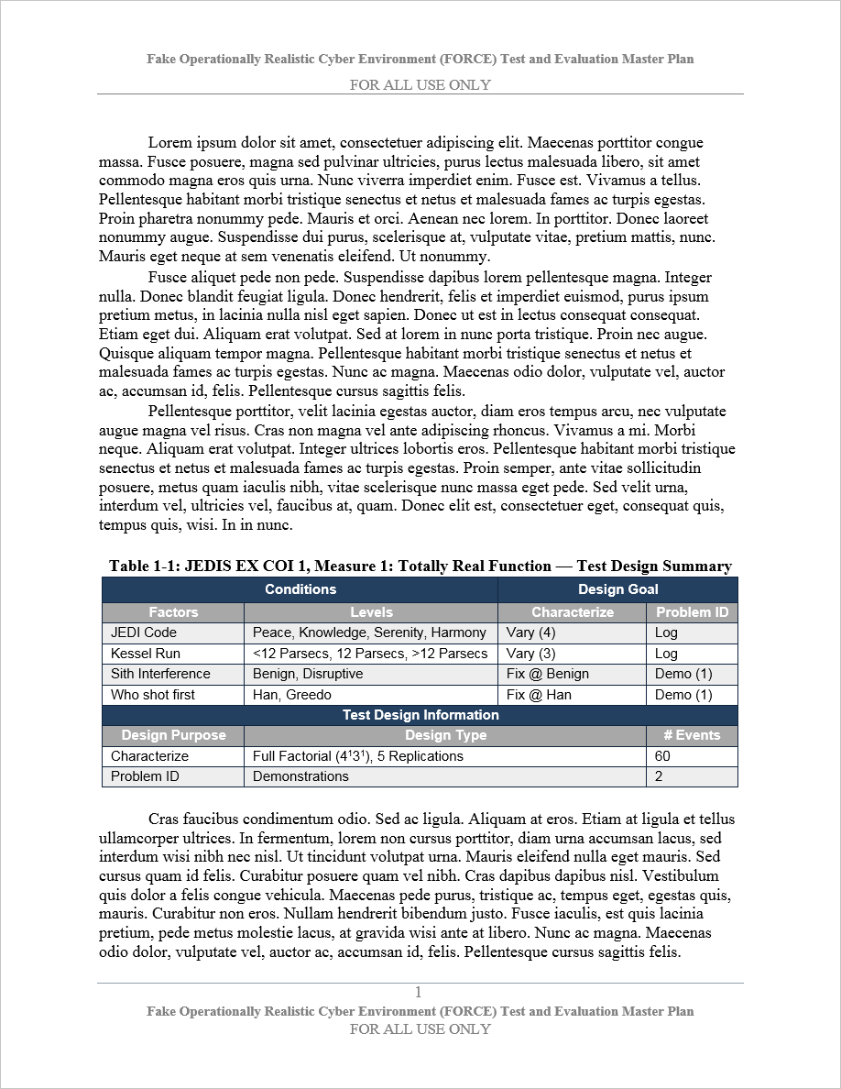
JEDIS (Light) also works for pre-made designs
Perhaps you read a design in a test-planning document and you’d like to explore it over a range of SNR and Alpha

Slide 14
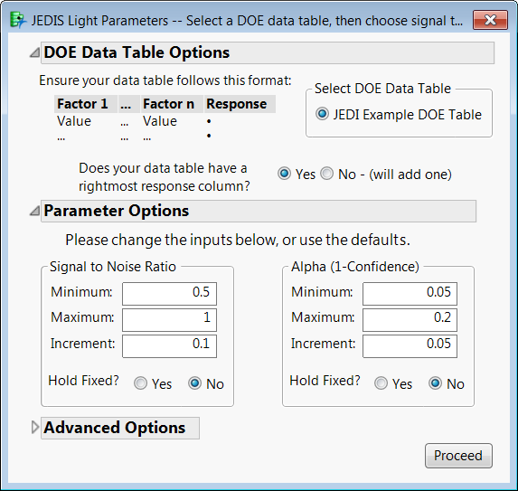
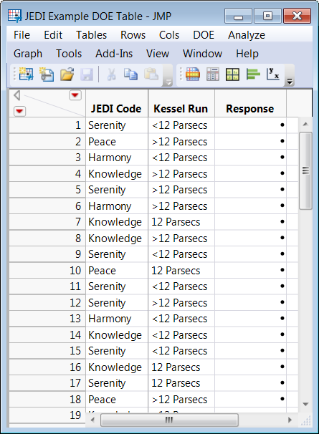
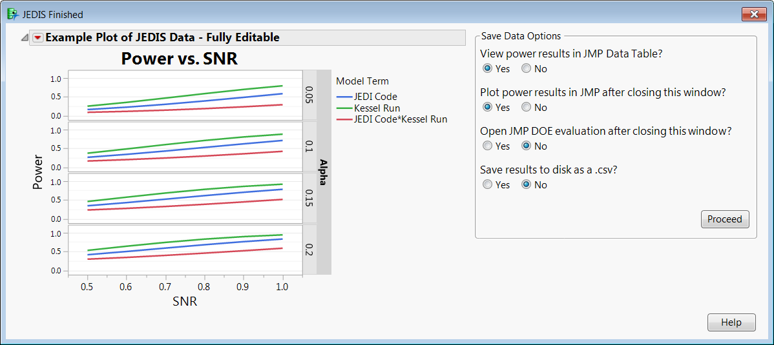
JEDIS Light follows the same general procedure as JEDIS

Slide 15
Wrap up: JEDIS is an easy to use tool for DOE automation
✓ Fully GUI based
✓ Enables exploration of design replicates, SNR, and alpha
✓ Allows DOE construction on-the-fly or loading from script
✓ Handles full factorial, D/I/α-optimal, and disallowed combinations
✓ Writes results in easy to use format (Tidy data)
✓ Automatically generates interactive data visualizations

Slide 16
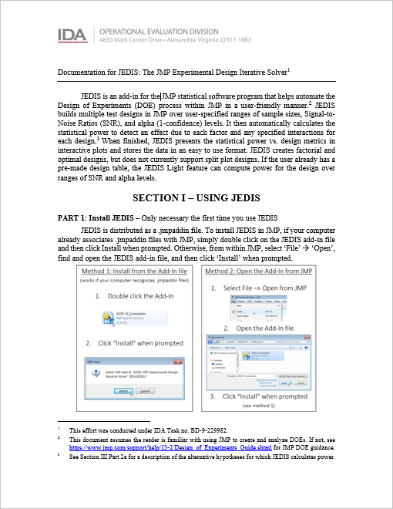
Step-by-step instructions and detailed documentation accessible from JEDIS main menu
2
3
4
5
6
7
8
9
10

Slide 17
Questions?

Slide 18
Remaining slides are back up.
JEDIS how-to and extra notes.

Slide 19
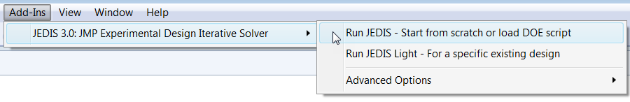
How to use JEDIS

Slide 20
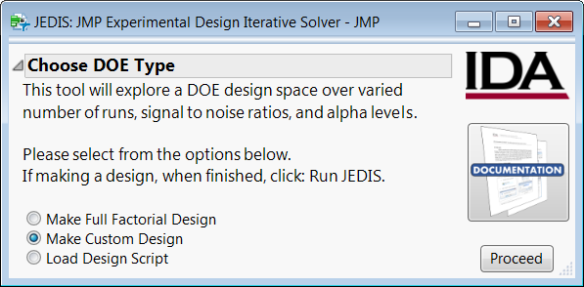
Step 1: Select JEDIS from JMP Add-Ins menu*
Step 2: Choose type of DOE to run, or load a design script
*See final slide for JEDIS installation instructions

Slide 21
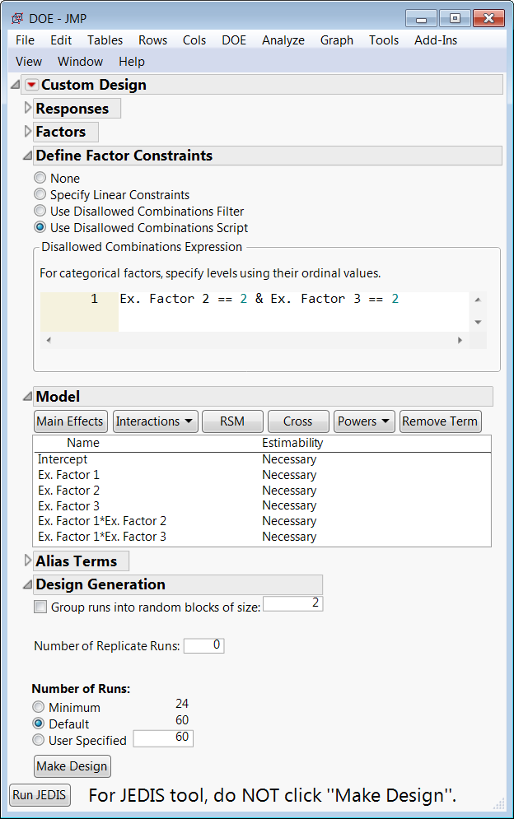
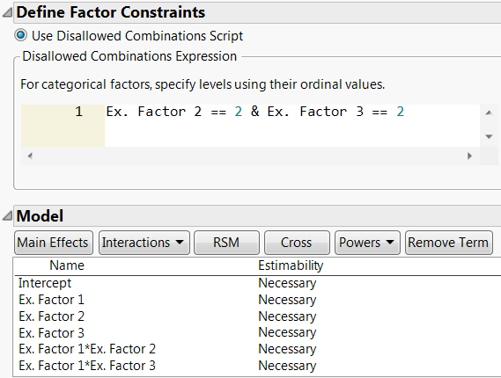
Step 3: Follow normal JMP procedures to set up DOE
Factors
Levels
Model Terms
Disallowed combinations
Clicking ‘Make Design’ will run the JMP design builder, not JEDIS. Click ‘Run JEDIS’ instead.

Slide 22
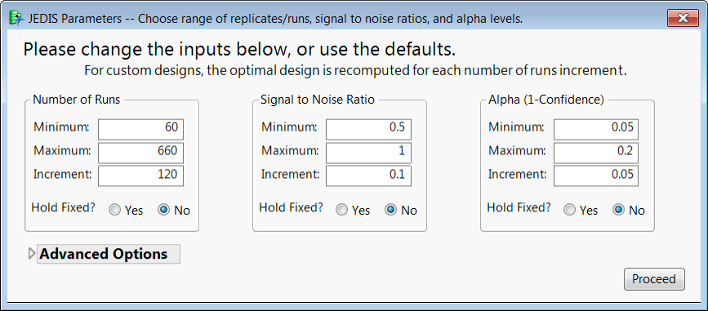
Step 4: Specify parameters for power calculations

Slide 23
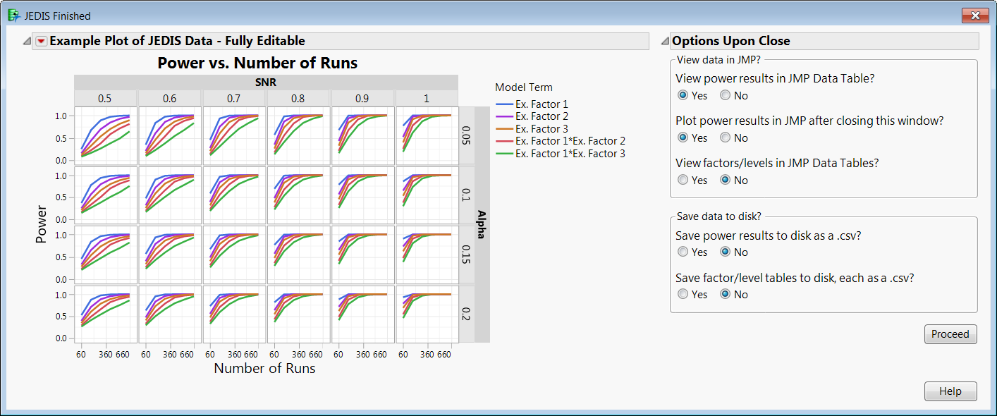
Step 5: After running, view and save results

Slide 24
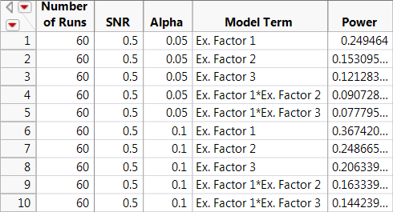
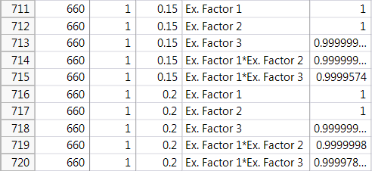
Step 6: Now you have your data – explore as you please!
Data saved in Tidy format
One variable per column &
One observation per row

Slide 25
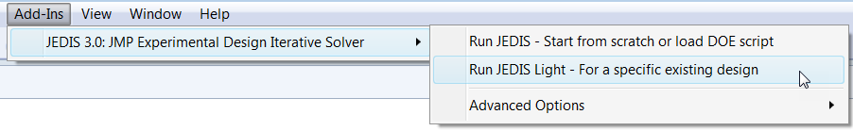
How to use JEDIS Light

Slide 26
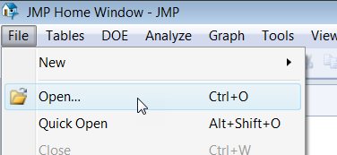
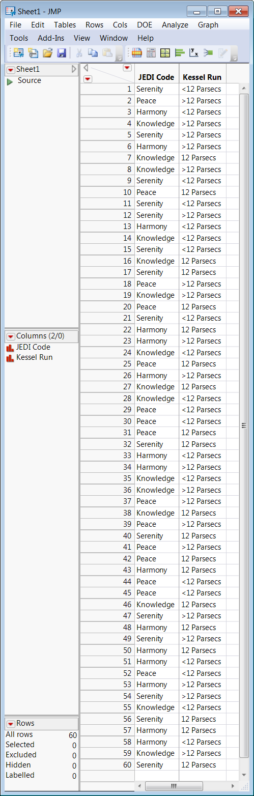
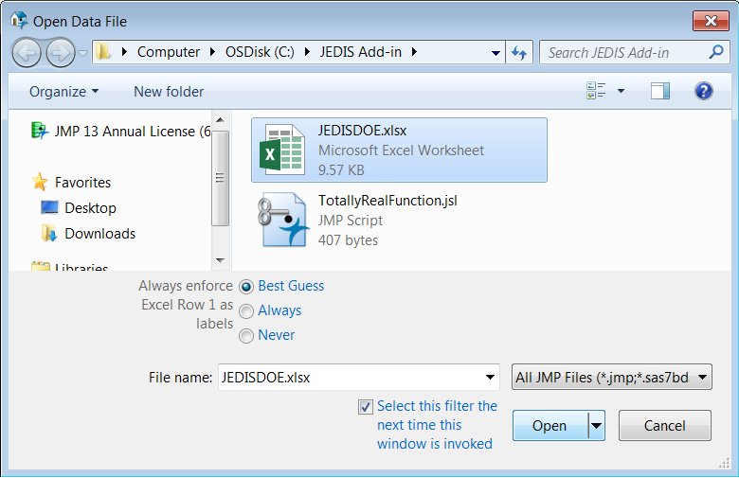
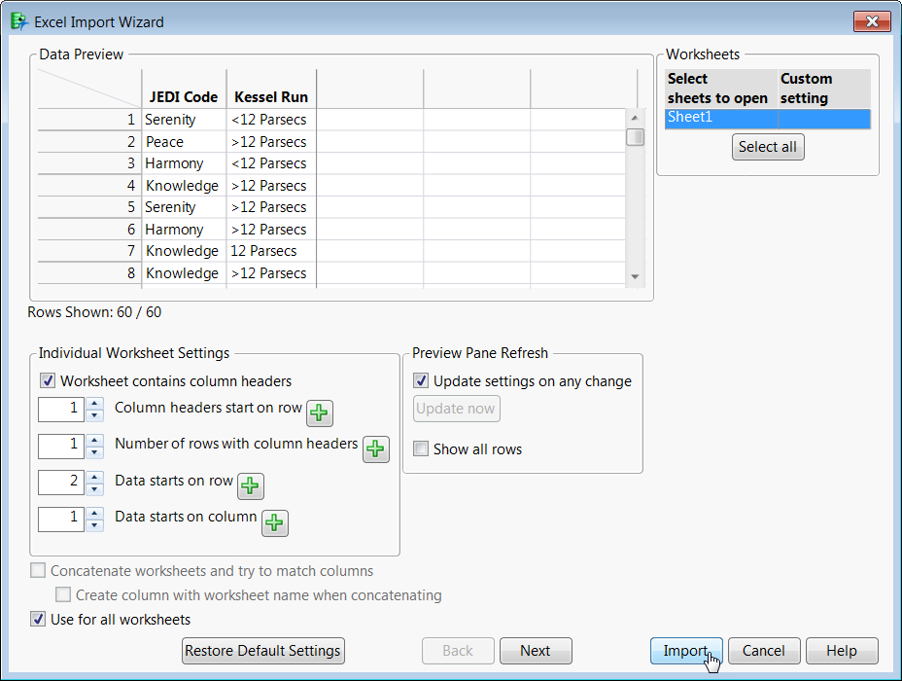
Step 1: Open your design table in JMP

Slide 27
Step 2: Run JEDIS Light from JMP Add-Ins menu
Step 3: Verify table formatting & specify parameters

Slide 28
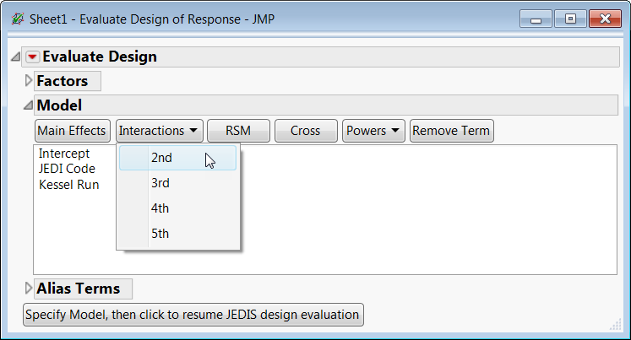
Step 4: Specify the model, add interactions if desired

Slide 29
Step 5: View and save results, just like in JEDIS

Slide 30
Extra Notes and Tips

Slide 31
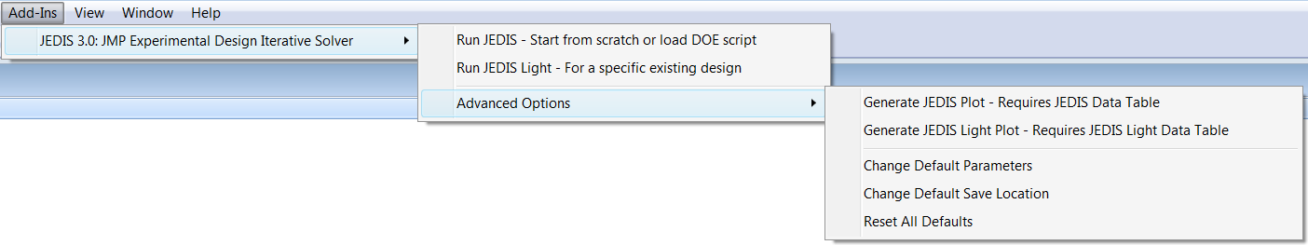
JEDIS add-in menu advanced options
From the JEDIS Advanced Options menu
you can replot any saved JEDIS data
and modify any default JEDIS parameters

Slide 32
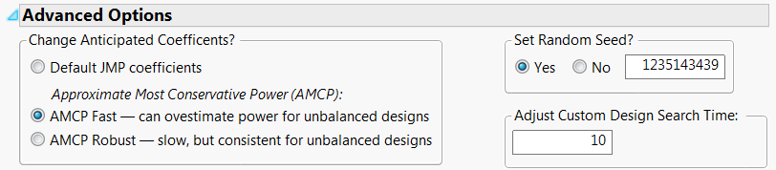
JEDIS parameter advanced options
Change Anticipated Coefficients
Allows you to select the alternative hypotheses with which JEDIS will test your DOE
Set Random Seed
Allows you to specify the random seed used for design generation
Adjust Custom Design Search Time
Allows you to specify how long JMP will search for an optimal solution to a design
Notes:
Much more detail in documentation
Change Anticipated Coefficients
JMP’s default approach is a straightforward means to generating an alternative hypothesis of a specified effect size, but can result in an optimistic estimate of the power to distinguish between a factor's levels.
The Most Conservative Power (MCP) alternative hypothesis is the hypothesis that results in the least power for a specified effect size. While an exact MCP exists for a given design, its computation is not implemented in JMP, so JEDIS approximates it.

Slide 33
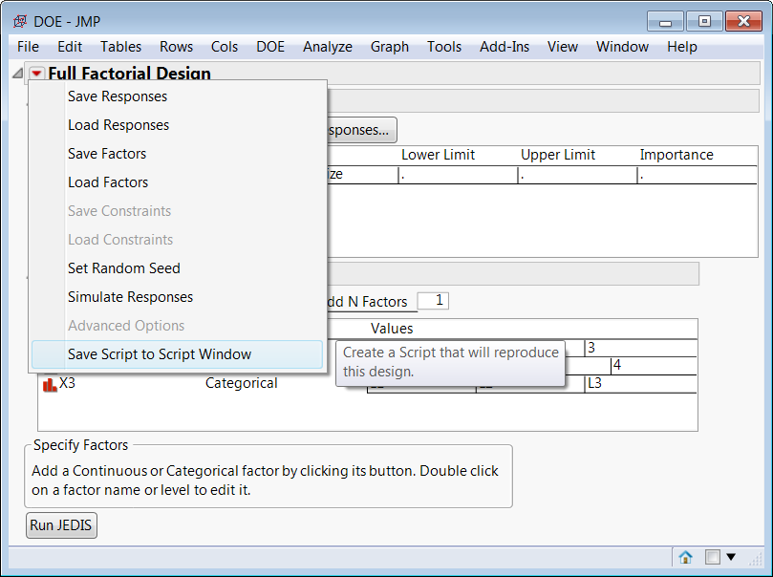
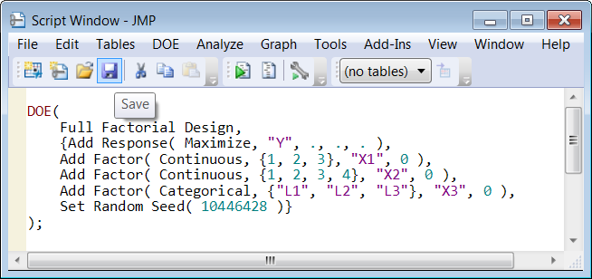
How to save a DOE script in JMP in three clicks
1.
2.
3.

Slide 34
Notes about saving scripts
Saving must be done before pressing the “Run JEDIS” button!
Saving a script is a JMP feature available in ANY window.
Saving scripts is not specific to JEDIS, but right now it is the only way to save a DOE for later use.

Slide 35
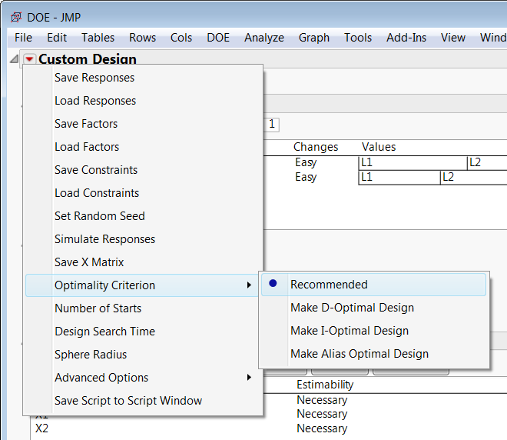
How to change JMP’s custom design optimality criterion
1.
2.
3.
JEDIS uses JMP’s recommended optimality criterion by default, but you can select the type you want when you construct your DOE.

Slide 36

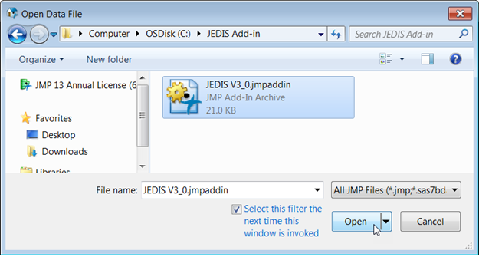
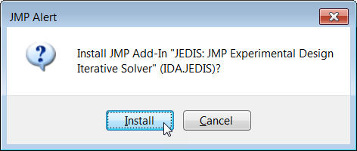
How to install the JEDIS JMP Add-In
Method 1: Install from the Add-In file (works if your computer recognizes .jmpaddin files)
Double click the Add-In
Click “Install” when prompted
Method 2: Open the Add-In from JMP
Select File –> Open from JMP
Open the Add-In file
Click “Install” when prompted
(see method 1)

