Slide 1
U.S. ARMY EVALUATION CENTER
Creating Shiny Apps in R for Sharing Automated Statistical Products
Randy Griffiths

Slide 2
Goal
Understand basic structure of Shiny app code
Produce simple apps
Feel confident that you can create more complicated apps

Slide 3
Agenda
Assumptions & Disclaimers
What is a Shiny app?
How to make a Shiny app
Your turn

Slide 4
Assumptions
R and R Studio are installed on your computer
Working knowledge of R language
Never made a Shiny application

Slide 5
Miscellaneous
install.packages(“shiny”) if you have not already done so
Get to know your neighbor
You may need a friend as you work problems

Slide 6
Disclaimers
I am not a computer scientist
I don’t write elegant or efficient code
I am not an expert with web-page design
My knowledge of HTML and using CSS themes is embarrassing
I have not worked with Shiny for very long
I made my first app in December 2016
https://aec-doe.shinyapps.io/Reliability_Quick_Calculations/
https://aec-doe.shinyapps.io/Likert_plots/
My first Shiny apps are still being used in AEC
If I can do it, so can you

Slide 7
What is a Shiny app?
“Shiny is an R package that makes it easy to build interactive web apps straight from R. You can host standalone apps on a webpage or embed them in R Markdown documents or build dashboards. You can also extend your Shiny apps with CSS themes, htmlwidgets, and JavaScript actions.” (https://shiny.rstudio.com/)

Slide 8
When is a Shiny app useful?
You want to share a specific type of analysis with many users with different data or other user input. You can do it in R but don’t trust them to use your code.

Slide 9
How to make a Shiny app Where to begin
Shiny website has a lot of free training material and a lot of code.
https://shiny.rstudio.com/
Many examples with executable code
Widget Gallery (under Widgets) is extremely useful
Understand
User interface (UI) and server functions

Slide 10
What is a Shiny app?
Host Server running R
Client Web-browser (UI)
Receives input from UI for computing (math, plots, etc.)
Creates objects and sends specified output to the UI
Collects input from UI and sends to server for computing
Receives output from server for display

Slide 11
How to make a Shiny app UI Page Layout
shinyUI() wraps the UI content
fluidPage() is the most flexible page layout
You can split your “page”, or UI, into rows which can have columns
I’ve never needed more rows than I was allowed
Column widths are defined on a 12 point scale within a row
Actual width will be scaled dynamically to fill the browser’s width
Host Server running R
Client Web-browser (UI)

Slide 12

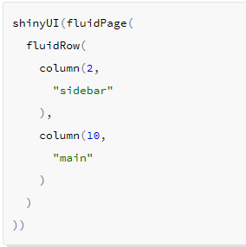
How to make a Shiny app UI Page Layout
Host Server running R
Client Web-browser (UI)

Slide 13
How to make a Shiny app UI Page Layout
UI sends objects to the server via a list called “input”
Shiny has many functions that create objects automatically and adds them to the input list which can be called on by the server as input$name
The widgets page has many useful examples
sliderInput(“name”, …)
radioButtons(“name”, …)
fileInput(“name”, …)
numericInput(“name”, …)
Host Server running R
Client Web-browser (UI)

Slide 14
How to make a Shiny app Server receives UI input
shinyServer() includes the content sent to the UI and accepts a function as the argument. It is typically used with a function which takes two parameters: lists named input and output
shinyServer(function(input, output){
code
})
Defining new output elements to be sent to UI is done by
output$name <- stuff
Host Server running R
Client Web-browser (UI)

Slide 15
How to make a Shiny app Server using input from UI
Functions we will use to output results to UI include
ouput$plotName <- renderPlot({})
output$tableName <- renderTable({})
Host Server running R
Client Web-browser (UI)

Slide 16
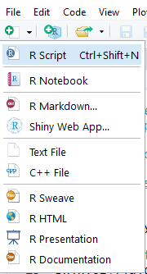
How to make a Shiny app Getting started
Using R-Studio
Open new shiny Web App file to see an app structure
Easier to develop apps using separate ui and server files (choose that option)
ui.R structures the html file based on layout functions and receives objects from server.R
server.R does the “R stuff” and receives objects from ui.R (user inputs)
Passing objects between server and ui creates an interactive web app
Host Server running R
Client Web-browser (UI)

Slide 17
How to make a Shiny app Getting started
Add user options to the first column
What are the histogram inputs that you typically manipulate?
Look at the Widget code on the shiny app site for ideas
https://shiny.rstudio.com/gallery/widget-gallery.html
Recommendation: check box for auto-saving your files before each build
Host Server running R
Client Web-browser (UI)

Slide 18
How to make a Shiny app Make a plot from user input
Practice
Provide a plot of random data from a distribution chosen by the user.
Useful code:
fluidPage() divide your page into two sections: input from user and the plot
fluidRow(column(2, …), column(10,…)) defines a row with 2 columns of relative widths 2 and 10
br() is a vertical break
if(input$dist == 'norm'){
x <- rnorm(100)
} else if(input$dist == 'exp'){
x <- rexp(100)
} else {
x <- rlnorm(100)
}

Slide 19
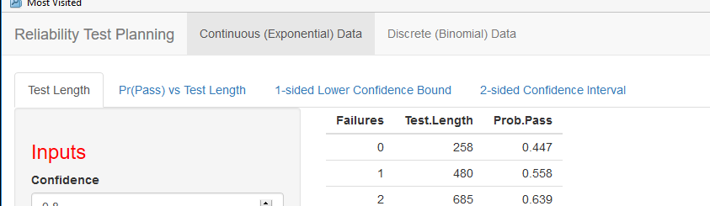
Adding Complexity
Before long you notice your app is getting very cluttered. What can you do?
Add tabs along the top of page with navbarPage()
Add tabs within a page with tabsetPanel()
Look into shinydashboard for more complicated structure
navbarPage
tabsetPanel

Slide 20
Adding Complexity
Using your existing app, add 3 tabs
Plot (already coded)
Data table
output$table <- renderTable() with tableOutput(“table”)
Table of summary statistics
renderPrint(summary(data)) with verbatimTextOutput()
tabsetPanel(
tabPanel(“Tab 1”, …),
tabPanel(“Tab 2”, …),
tabPanel(“Tab 3”, …)
)
Extra Credit
reactive({})
Notes:
Start small. First add a single tab for the plot and make sure it runs.

Slide 21
Advice
Develop R code for a specific product first
You don’t want to be troubleshooting shiny code and complex code for output at the same time
Better to ensure code works well for specific output outside of Shiny, then wrap that code in a Shiny app
“Run App” as often as possible
Don’t write a lot of code then try to run the app. It will likely be painful to debug

