Slide 1
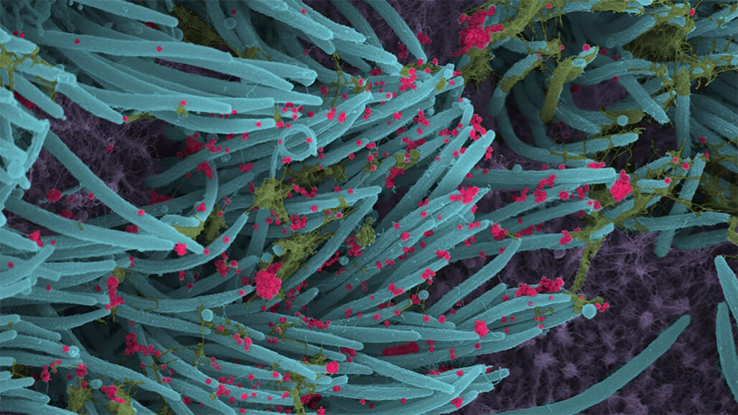
Empirical Analysis of COVID-19 in the U.S.
Dr. Emily Heuring
Add CUI line 4

Slide 2
Early in the pandemic, the sponsor identified a need for empirical data and analysis to support decision making
Traditional epidemiology models (SEIR) show what can happen, not what will happen
Changes in behavior change the trajectory of the spread of the virus
Sponsor identified a need to compile a large data set of empirical data from a variety of sources
It is important to identify the factors most associated with both mitigation and spread of the virus

Slide 3
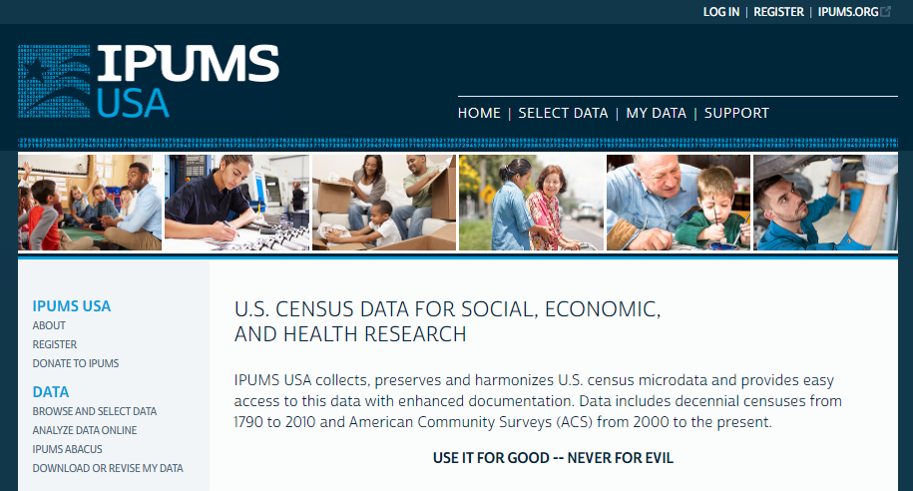
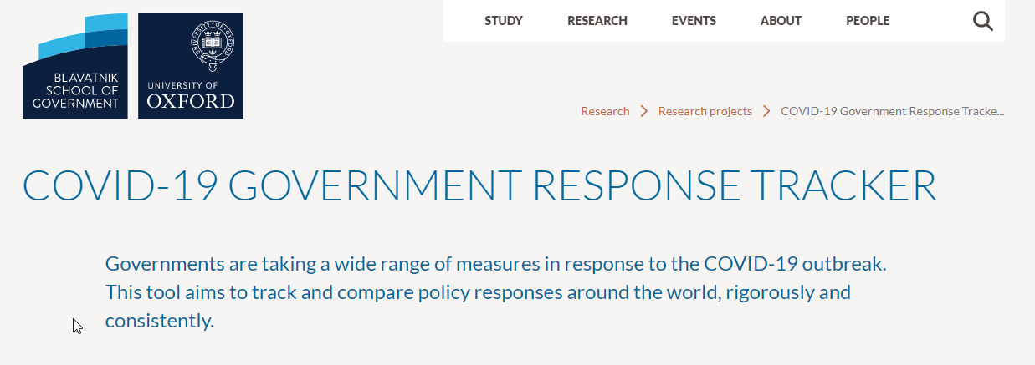
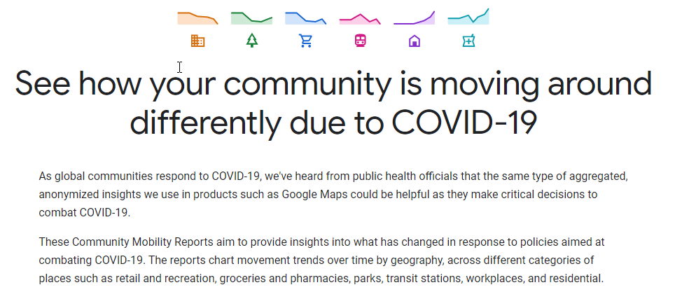
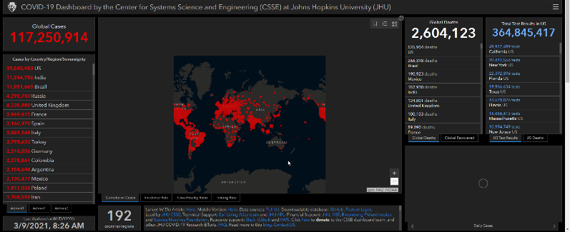
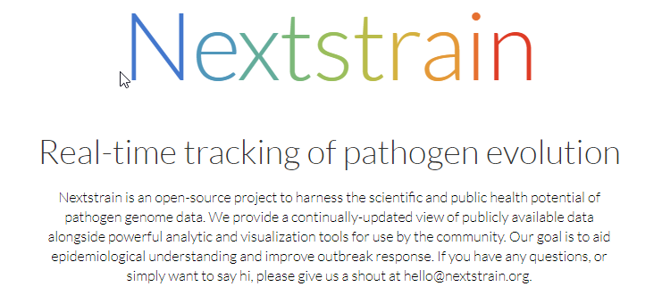
COVID-19 is the first pandemic in history in which vast amounts of data are openly accessible to the public

Slide 4
True Prevalence of COVID-19 vs Reported Case Counts

Slide 5
COVID-19 case counts have been chronically underreported from the beginning of the pandemic
Causes of underreporting:
Inadequate testing supplies and access during initial months
Those who had mild/asymptomatic cases weren’t aware that they had COVID-19 and did not get tested
We use serology data to estimate true COVID-19 prevalence in the U.S.
Serology testing detects antibodies to SARS-CoV-2 from previous infection
Although many city and state-level seroprevalence estimates were published, many had biased sampling techniques
We prefer CDC’s seroprevalence methods: https://www.cdc.gov/coronavirus/2019-ncov/cases-updates/geographic-seroprevalence-surveys.html
Compare the antibody prevalence to the number of reported cases at multiple points in time
Ten sample locations initially (has since been expanded)
Assume that for a given day, all regions in the U.S. had the same underreporting ratio
Assume no antibody decay (conflicting data in the literature)

Slide 6
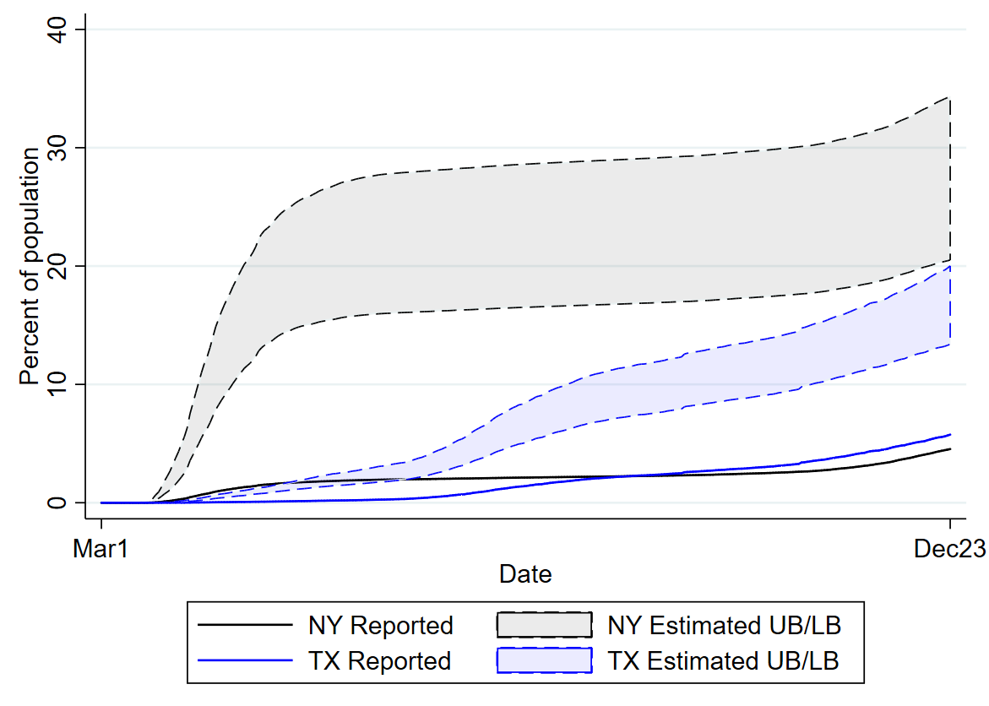
True prevalence estimates create a clearer picture of the pandemic
Estimated vs Reported Share of Population Infected
Cumulative
Notes:
TX has more reported cases per 100k, but NY still has more estimated cases.

Slide 7
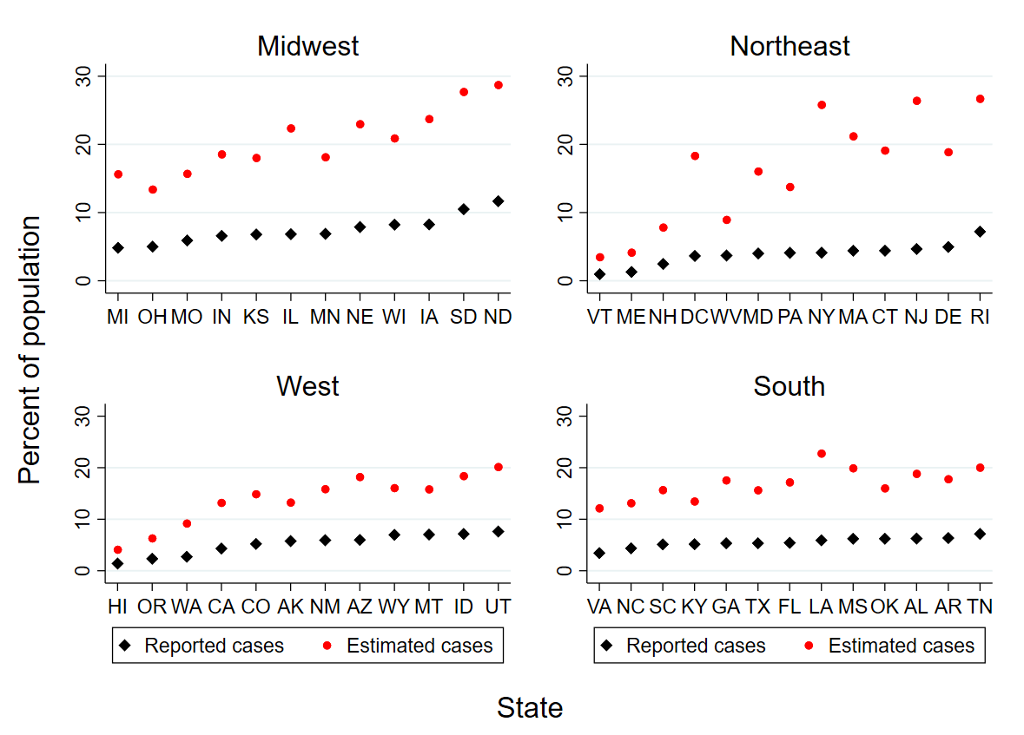
Using seroprevalence data, we can estimate the percentage of the population in each state who have been infected with COVID-19
Data as of December 16

Slide 8
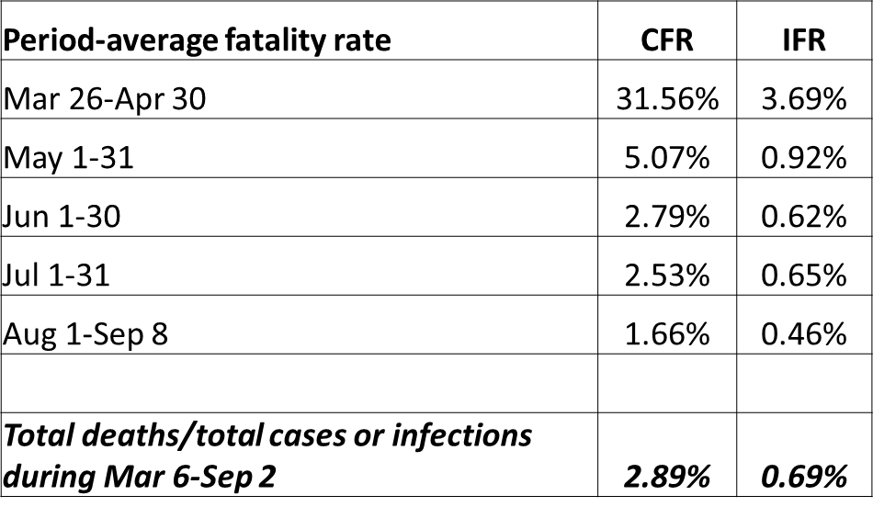
With true prevalence estimates, we can calculate infection fatality rates for the U.S.

Slide 9
Effect of mitigation policies on the spread of COVID-19

Slide 10
We examined how mitigation policies over the course of the pandemic affected COVID-19 case growth or decline
To reduce bias from many mitigation policies being implemented simultaneously, we use a two-stage approach:
How policies affect mobility (first stage)
How changes in mobility from policies affect new cases (second stage)
We find evidence that policies aimed at retail and recreation traffic decrease new cases

Slide 11
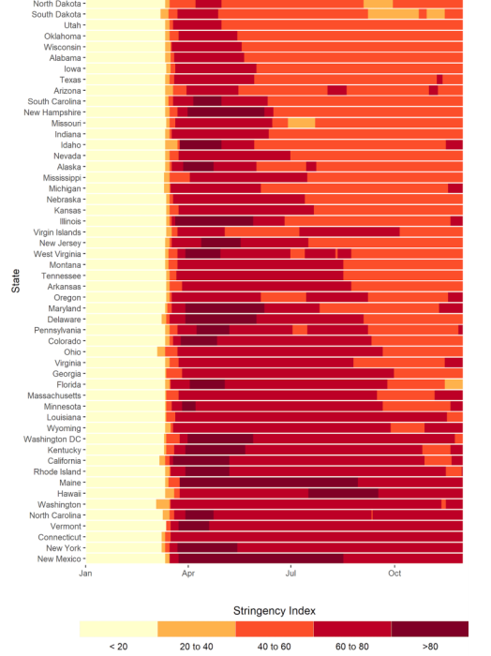
Example policy data – Oxford’s Policy Stringency Index
Oxford US State Policy Stringency Index
Measure | Name | Type | Targeted/general?
Containment and closure
C1 | School closing | Ordinal | Geographic
C2 | Workplace closing | Ordinal | Geographic
C3 | Cancel public events | Ordinal | Geographic
C4 | Restrictions on gathering size | Ordinal | Geographic
C5 | Close public transport | Ordinal | Geographic
C6 | Stay-at-home requirements | Ordinal | Geographic
C7 | Restrictions on internal movement | Ordinal | Geographic
C8 | Restrictions on international travel | Ordinal | No
Health systems
H1 | Public information campaign | Ordinal | Geographic
U.S. Stringency Index Rating Over time
Laura Hallas, Ariq Hatibie, Saptarshi Majumdar, Monika Pyarali, Thomas Hale. “Variation in US states’ responses to COVID-19 2.0.” Blavatnik School of Government Working Paper. Available: www.bsg.ox.ac.uk/covidtracker

Slide 12
In the U.S. in 2020, mobility to most places fell below baseline except in parks and residential locations
Mobility to most places was below the baseline for most of 2020
Parks and residential mobility was above baseline as people stayed home or went outside
Gradual decline at end of CY20/early CY21 as cases increased
Missing data from
some states
Use cell-phone mobility data as a proxy for adherence to mitigation policies

Slide 13
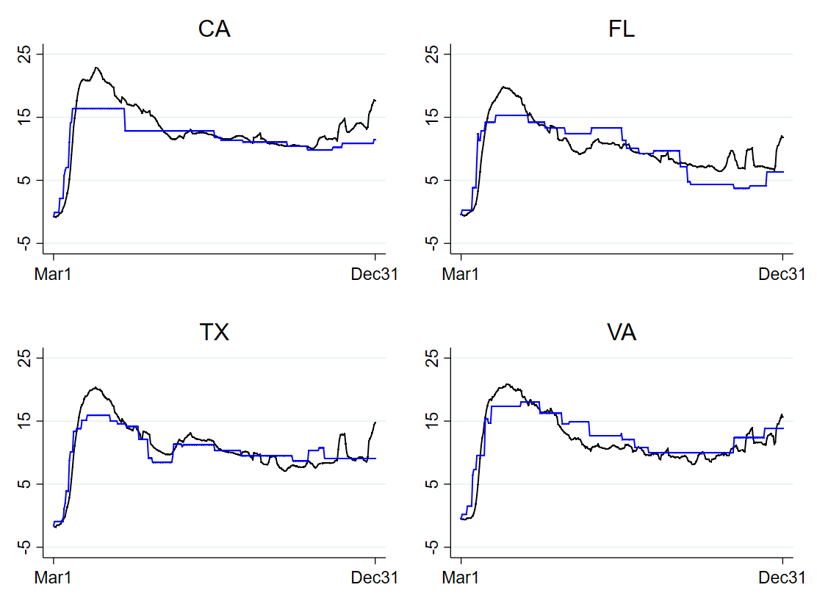
Mitigation policy stringency is strongly correlated with increased residential mobility
% change from Jan 2020
raw % change in mobility
% change in mobility
due to policies
Notes:
linear regression
Changes in Residential Mobility vs Mitigation Policy Stringency Oxford
Black Lines are Total Mobility (Left Axis), Blue are Policy Effects (Right Axis),
For the blue lines we have purged the mobility data of non-policy factors and then look at how policy data explains the remaining variation
The coefficients on the size and decay of the policy effect are calculated using the full national sample. So if a states true reduction is consistently way less than the predicted reduction, it means that state is less responsive to policy than the national average.

Slide 14
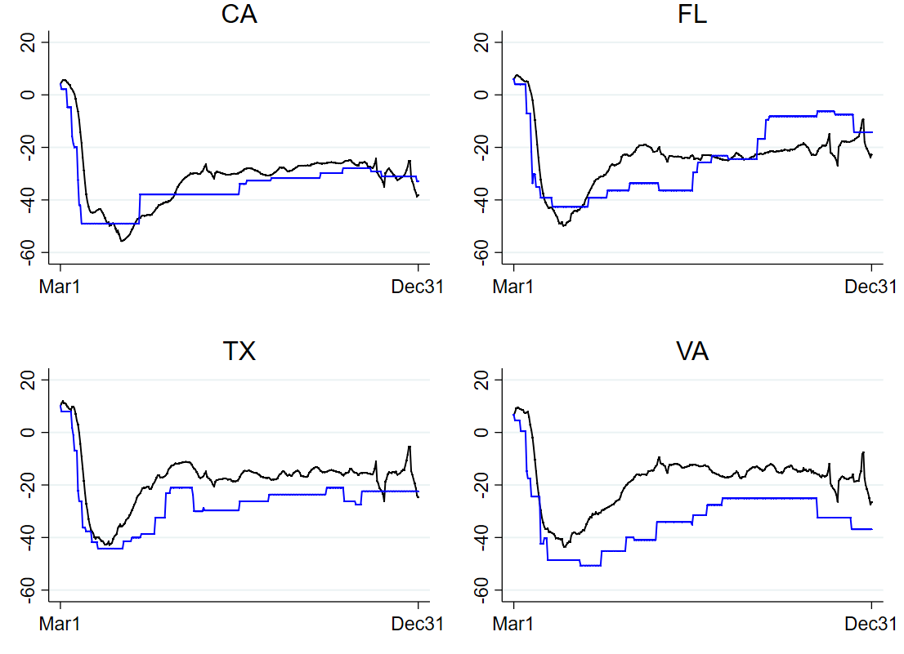
Mitigation policy stringency is also strongly correlated with reduced mobility to retail and recreation locations
% change from Jan 2020
raw % change in mobility
% change in mobility
due to policies
Notes:
linear regression
Changes in Residential Mobility vs Mitigation Policy Stringency Oxford
Black Lines are Total Mobility (Left Axis), Blue are Policy Effects (Right Axis),
For the blue lines we have purged the mobility data of non-policy factors and then look at how policy data explains the remaining variation. The coefficients on the size and decay of the policy effect are calculated using the full national sample. So if a states true reduction is consistently way less than the predicted reduction, it means that state is less responsive to policy than the national average.

Slide 15
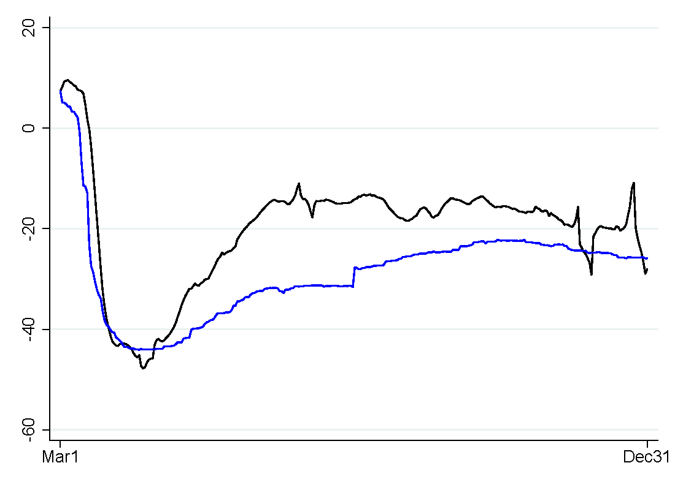
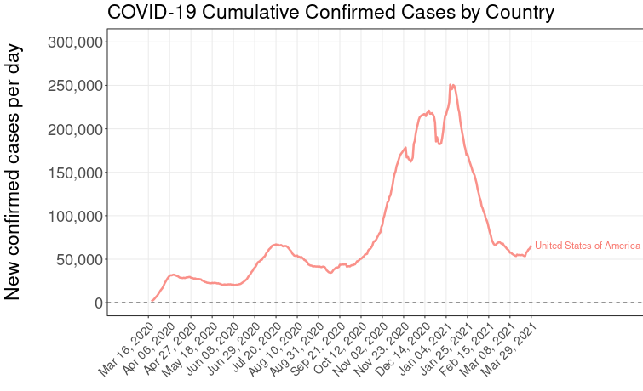
How do reductions in mobility to retail and recreation locations affect COVID-19 case counts?
U.S mobility
U.S COVID-19 Cases (7-day moving avg)
% change from January 2020
raw % change in mobility
https://test-science.shinyapps.io/covid-19-tracker/
% change in mobility due to policies

Slide 16
Mitigation policies that decreased traffic to retail and recreation locations decreased COVID-19 case counts in the U.S.
U.S. | Avg Oxford Stringency Index Rating | Avg. percent change in retail & recreation mobility from policies | Avg Oxford Stringency Index Rating | Avg. percent change in retail & recreation mobility from policies
 | March 2020 – July 2020 |  | Aug 2020- Dec 2020
 | 68.8 | -25.2% | 58.3 | -15.4%
First
stage
results
Policies reduced traffic to retail and recreation locations by ~15-25%
U.S. | Avg. percent change in retail & recreation mobility from policies | Avg change in cases per 100k from policies | Avg. percent change in retail & recreation mobility from policies | Avg change in cases per 100k from policies
 | March 2020 – July 2020 |  | Aug 2020- Dec 2020
 | 25.2% | -17.8 | 15.4% | -10.9
Second
stage
results
The reduction in traffic to retail and recreation locations reduced COVID-19 case counts by ~10-17 cases per 100,000 per day

Slide 17
Genomic sequencing surveillance

Slide 18
Rapid, high-throughput genomic sequencing has resulted in unprecedented insight into how SARS-CoV-2 is evolving
PANGO (Rambaut et al. 2020 Nat Microbiol) is the algorithm behind the new lineages making the news.
Lineages reflect:
A virus’s ancestry
Geographic location
A new mutation (in that lineage)
Lineages DO NOT reflect:
Whether a mutation is meaningful
Whether a mutation is unique (the same mutation can occur in different lineages)

Slide 19
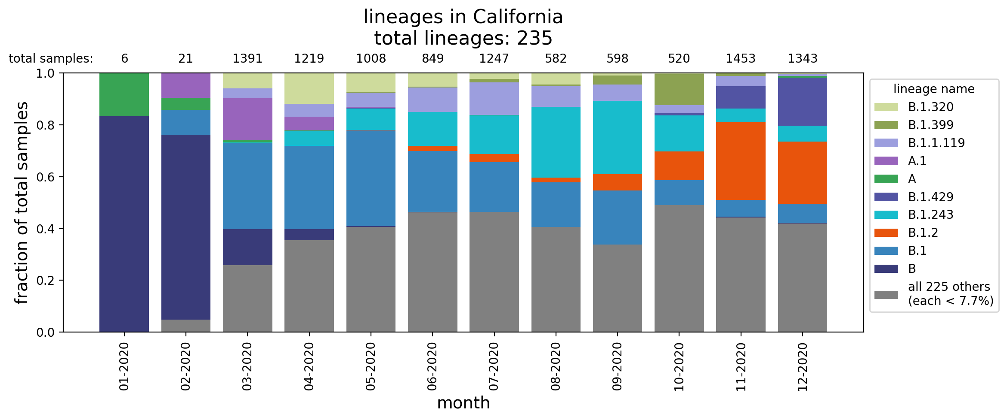
Using genomic sequence data, we can track lineages over time in the U.S.

Slide 20
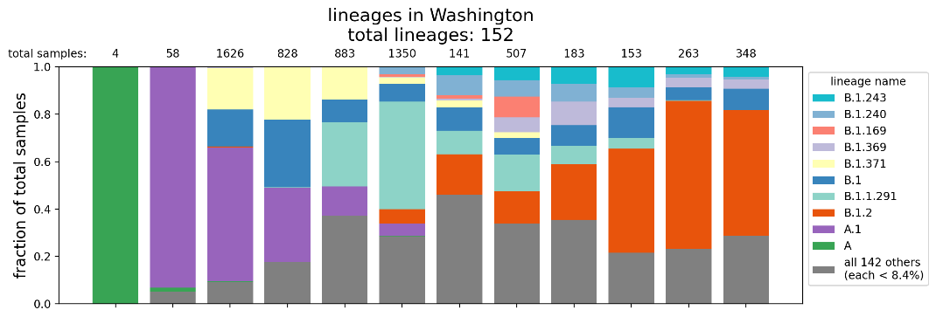
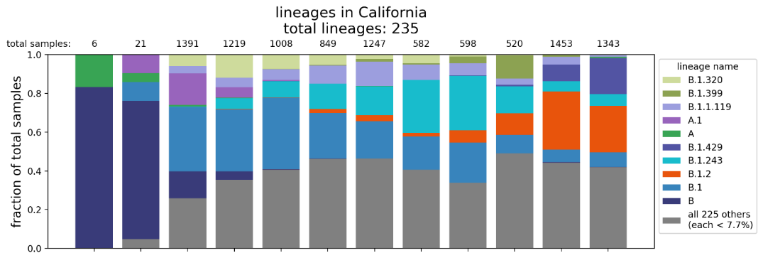
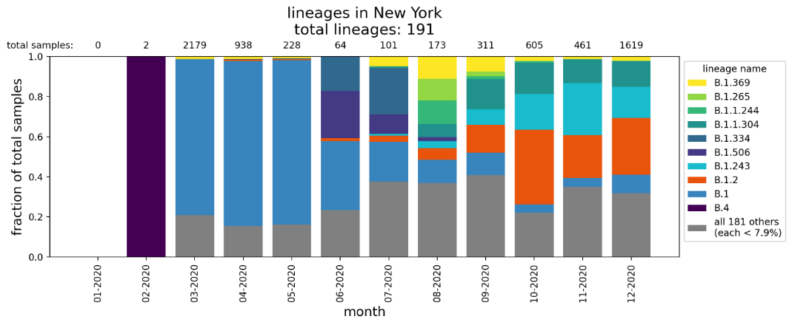
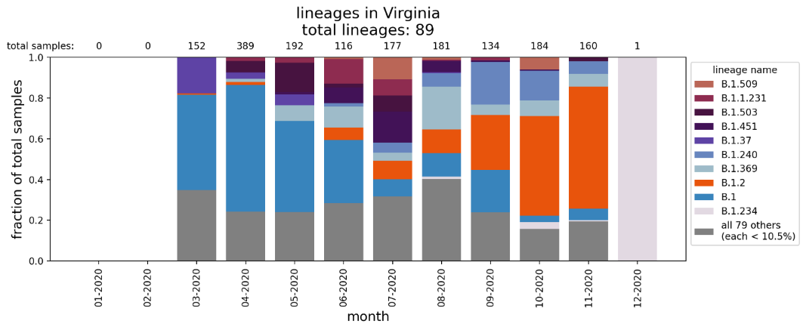
SARS-CoV-2 lineages have ebbed and flowed over the course of the pandemic in the U.S.
It is easy to determine what a virus’s genetic sequence is. It is more difficult to tell what the sequence means. Lineage names reflect sequence, not meaning
Things that may cause a lineage to be come predominant:
Founder effect – the reduction in genetic variation when a small subset of a large population is used to establish a new population
One or repeated superspreader events with that lineage
Small-number statistics/undersampling/biased sampling
A mutation with a biological mechanism that facilitates higher infectivity/spread

Slide 21
Thoughts on a pandemic in the time of “Big Data”
More data is good!
Allows for real-time analysis to support deployment of resources and policy implementation
Where more data or new data might complicate things:
Lack of insight into data collection issues, important caveats, issues that might affect analysis and interpretation
Example: Early in the pandemic, some states were reporting both PCR and serology test results into a rolled-up number, providing a false picture of real-time spread of the virus
Lack of experience with certain data types
Example: Genomic sequencing generating concern about emerging variants

Slide 22
Institute for Defense Analyses COVID-19 Team
Mr. Nathaniel Cleaves
Mr. Daniel Chaiken
Dr. Katherine Fisher
Dr. Kristen Guerrera
Mr. Ryan Murphy
Mr. Chris Oswald
Dr. Bryan Roberts
Dr. Zach Szlendak

