Slide 1
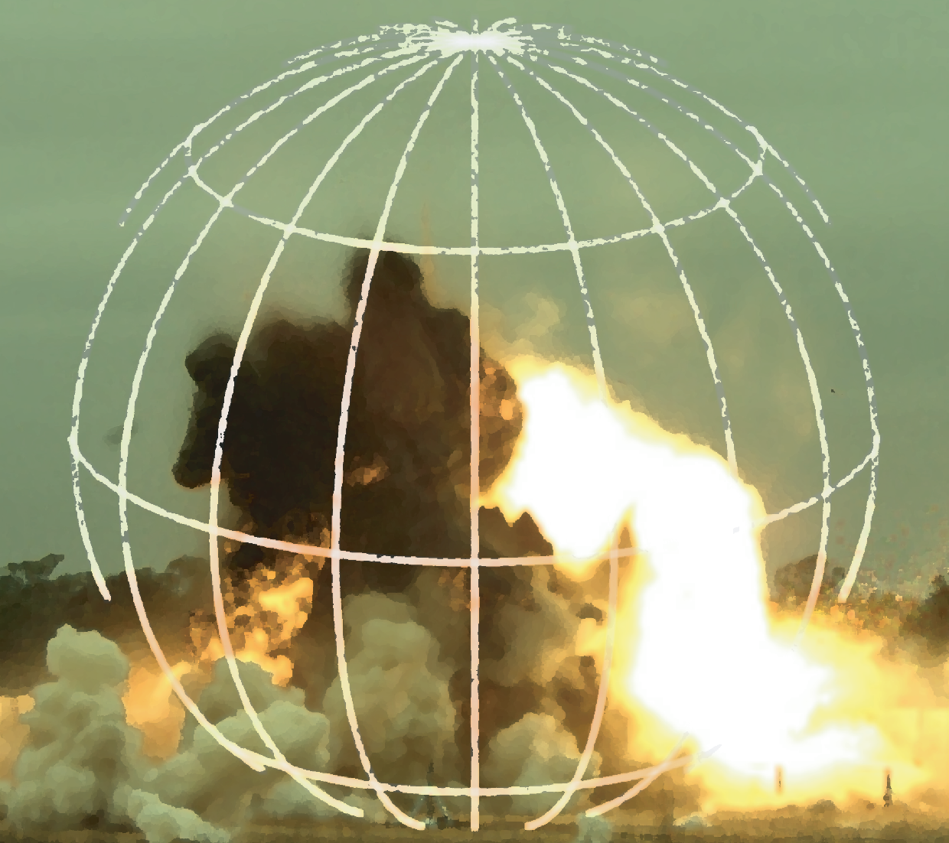
Warhead Arena Analysis Advancements
04/12/2021
By Tom Johnson, John Haman, Kerry Walzl, Heather Wojton and Mark Couch
Institute for Defense Analyses, Alexandria, VA
Thomas Hatch-Aguilar
Naval Air Warfare Center Weapons Division, China Lake, Ridgecrest, CA
Dave Higdon
Virginia Tech Department of Statistics, Blacksburg, VA
Notes:
* Add AW test real life pic

Slide 2
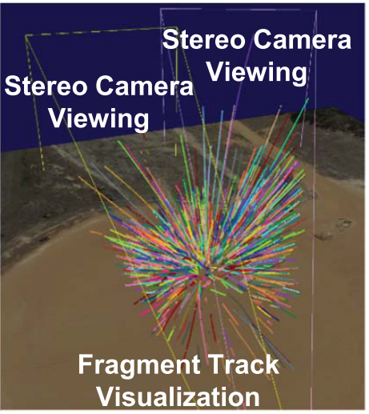
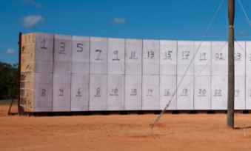

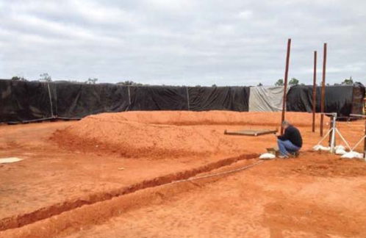
Advances in data collection accommodate new statistical analyses
Traditional Arena testing
Optical tracking
Slow, manually intensive
But importantly for our work…
Zonal data (Z-data) is low resolution
  provides mass and velocity within zones
  One measure per zone
  Kludges detonations together
Full 3D view
High resolution data
Emerging technology
IDA Research:
How should we analyze the new data?
High Speed Cameras may soon replace
soft-catch bundles and time of arrival screens
Setting up an “arena”
Notes:
"Colosseum" by DimitraTzanos is licensed with CC BY-NC-ND 2.0. To view a copy of this license, visit https://creativecommons.org/licenses/by-nc-nd/2.0/
IDA Research: How many detonations? Let’s make a call-out to sample size determination near the energy test.

Slide 3
What we have done
Optical tracking requires new statistical analyses to use all the data
We proposed exploratory data analyses, because
We need a simple summary statistic to compare and contrast detonations
We developed a novel model for complex data, because
A model based on observed detonations is a prerequisite for generating results for use in AJEM
Models provide a basis for sample size determination
Notes:
Mark note: combine on 1 slide, and connect to research objectives. If we want to keep the separate, Mark says ok.
Need to mention, John will give first portion (EDA), Tom will give second portion (Meta-model)
Mention this is the first part of the brief.

Slide 4
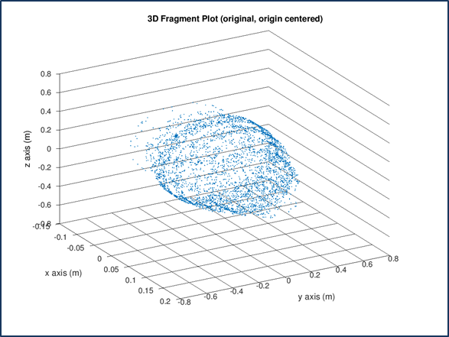
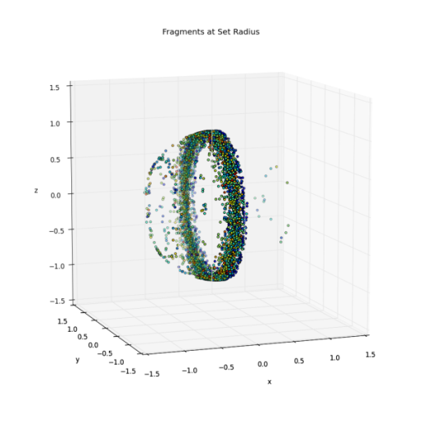
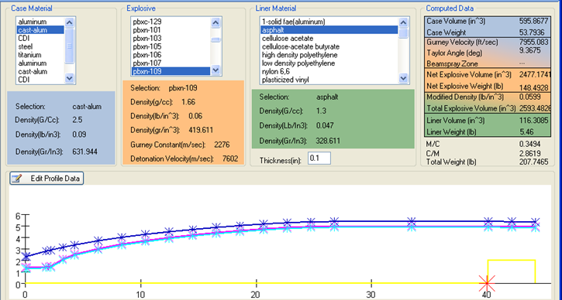
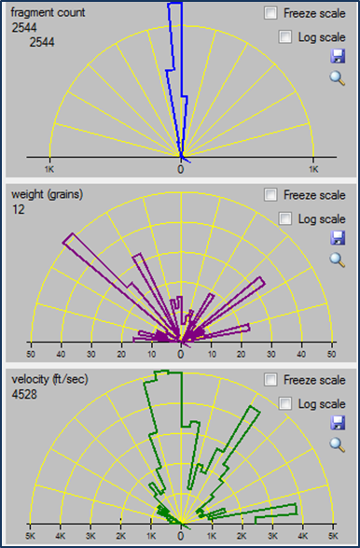
We demonstrate our analysis concept on ELSA M&S data
Extended Legacy Statistical Analysis (ELSA) is a fast-running fragmentation M&S code developed and maintained by the NAVAIR Lethality Analysis Group at China Lake
ELSA M&S output has a similar format as the anticipated data from the new test instrumentation
We generated 25 ELSA data sets to demonstrate our concept

Slide 5
Why do we use EDA techniques?
We propose two techniques for different high level questions
Goodness-of-fit statistics (Energy test)
  Are the detonations similar or different?
Data transformations (Box-Cox)
  Is there any correlation between the warhead characteristics?

Slide 6
The energy test detects differences between detonations
“Within” Detonation Distance
“Between” Detonation Distance
Relatively small between fragmentation discrepancy
Vel.
Relatively large between fragmentation discrepancy
The energy test is a powerful, non-parametric test that alerts us to significant differences in the multivariate mass/velocity distributions between detonations
Mass
Notes:
Are the data statistically different?
Two-sample goodness-of-fit tests are needed to ‘boil down’ mass and velocity
We apply the $energy$ two-sample goodness of fit test*, which assesses if the mass/velocity pairs from two detonations differ
Advantages: Non-parametric and powerful
When detonations differ, the energy statistic, $T$, is large.
The statistic applies for any list of numeric data, and we are not limited to just analyzing mass and velocity
* Energy tests are inspired by physics, but do not measure the kinetic energy of an explosion

Slide 7
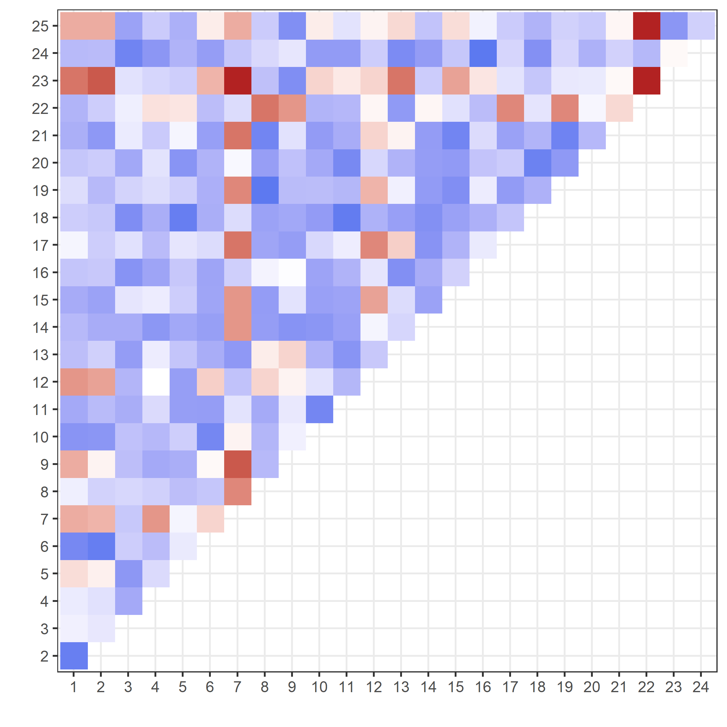



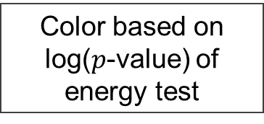
Compare all detonations against each other with two-sample energy tests
22 & 23
We can find detonations that statistically differ from other detonations in our collection
In ELSA data:
Detonations 7, 22, and 23 may differ the most when compared to all other detonations
Perhaps #12 is also peculiar…
Detonation
  Very Different
  Very Similar
  Indeterminate
7
Color based on log($p$-value) of energy test
Detonation

Slide 8
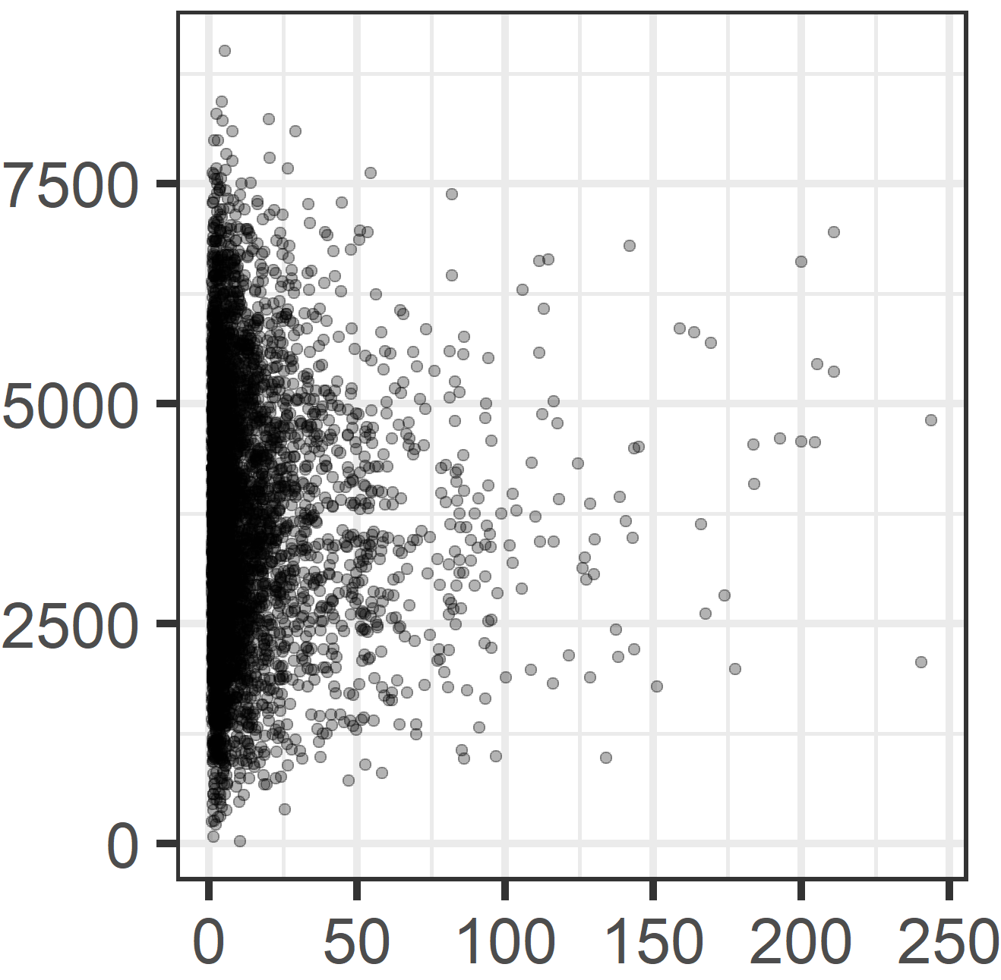
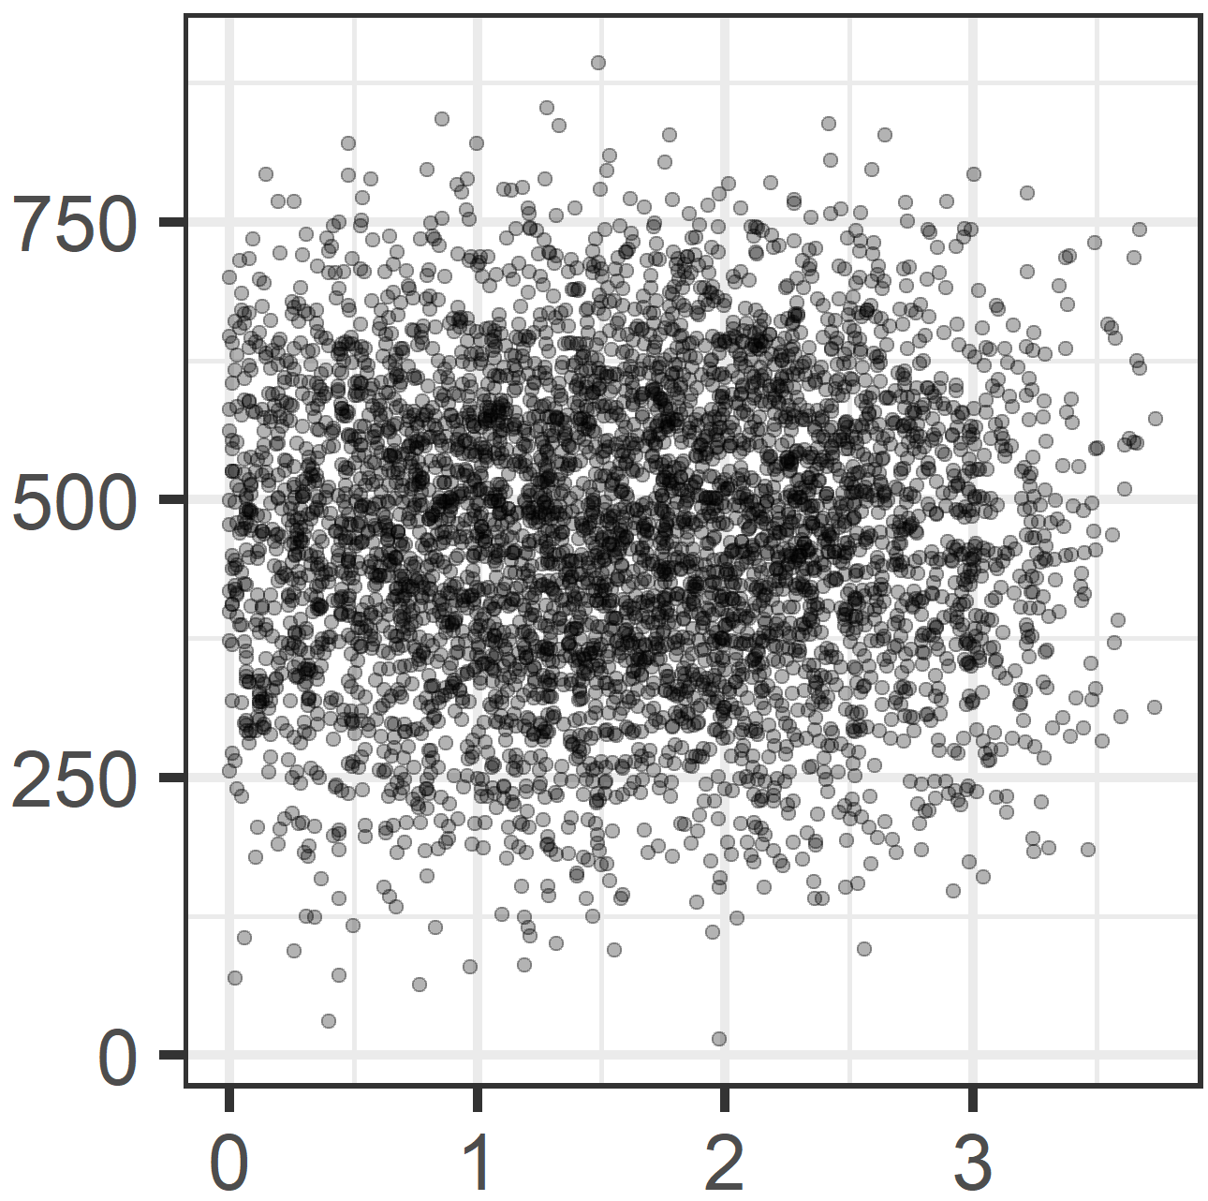

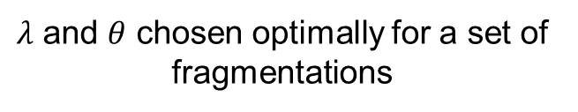
We use a power transform to convert highly skewed fragmentations to symmetric distributions
Ugly raw fragmentation data
Box-Cox power transform!
Variable transforms are a simple way to make the data more symmetric.
Otherwise, means and variances do not summarize the data well.
Box-Cox transform is a traditional transform that brings skewed data towards a Normal distribution:
$$B.C. Mass=\frac{Mass^{λ}−1}{λ}$$
$$B.C. Velocity=\frac{Velocity^{θ}−1}{θ}$$
(ft/s)
Velocity
Clean and beautiful data,
No outliers!
Mass
(grains)
Box-Cox Vel.
Transforming reveals negligible correlation between Mass and Velocity (no patterns)
Box-Cox Mass
$λ$ and $θ$ chosen optimally for a set of fragmentations

Slide 9
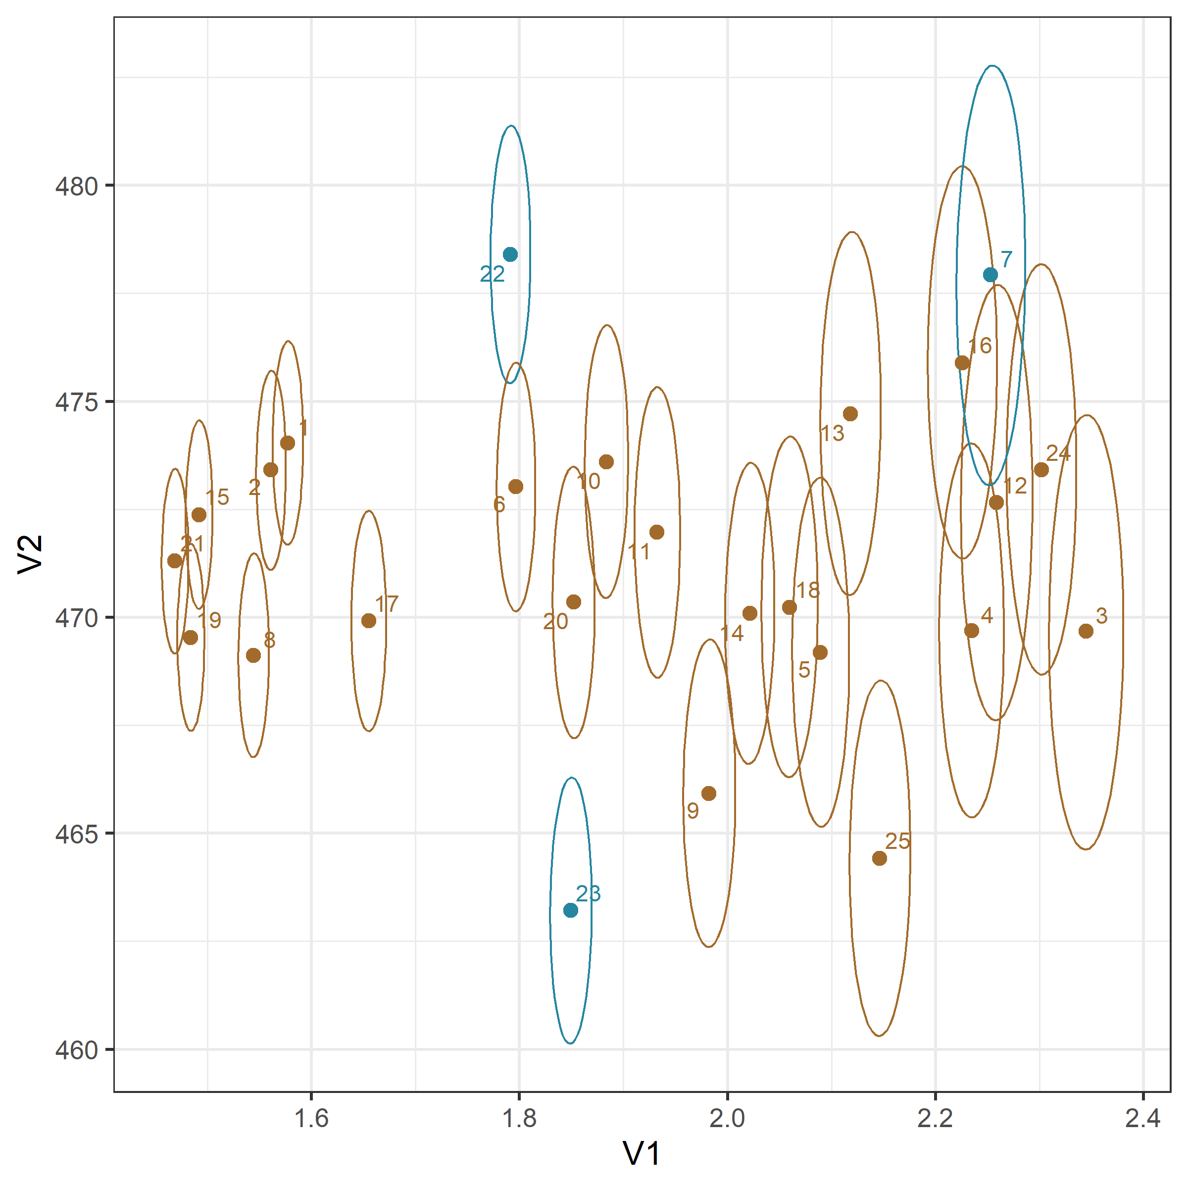
Clusters and correlations across all fragmentations
Comparison of all fragmentations:
Mean and 50% confidence intervals
Variance within and between detonations increases with mass and velocity
  # 7 has fastest average velocity and very high average mass
  # 22 also has a high velocity, and isn’t part of a cluster
  # 23 has lowest velocity, and differs significantly from other warheads
  Several clusters of similar fragmentations appear
Confidence intervals are not tilted → Negligible correlation between mass and velocity
But if a correlation was present, we would have detected it
~Normal data → Analysis of Variance
Average Box-Cox Velocity by warhead
Average Box-Cox Mass by warhead

Slide 10
Warhead Fragmentation Model
Notes:
Thanks, John
He just showed us some high-level analysis which were useful for summarizing and comparing detonations,
But now we’ll get into a lower-level type analysis, called Warhead fragmentation model, where we’re interesting in modeling the detailed fragmentation characteristics of a detonation.

Slide 11
We formulate a model to make use of full 3D data
We propose a Bayesian Spatial Process Convolution Model
Features of this model include:
  Custom built, not available “off the shelf”
  Compatible with ELSA M&S, optical tracking, and finite element method data
  Accommodates smooth, continuous predictions across the entire factor space
  Is adaptable, which will be useful for data fusion, and for integrating with AJEM
  Inference is straightforward, which will be useful for comparison and validation
  Computationally efficient for many data points and few factors

Slide 12
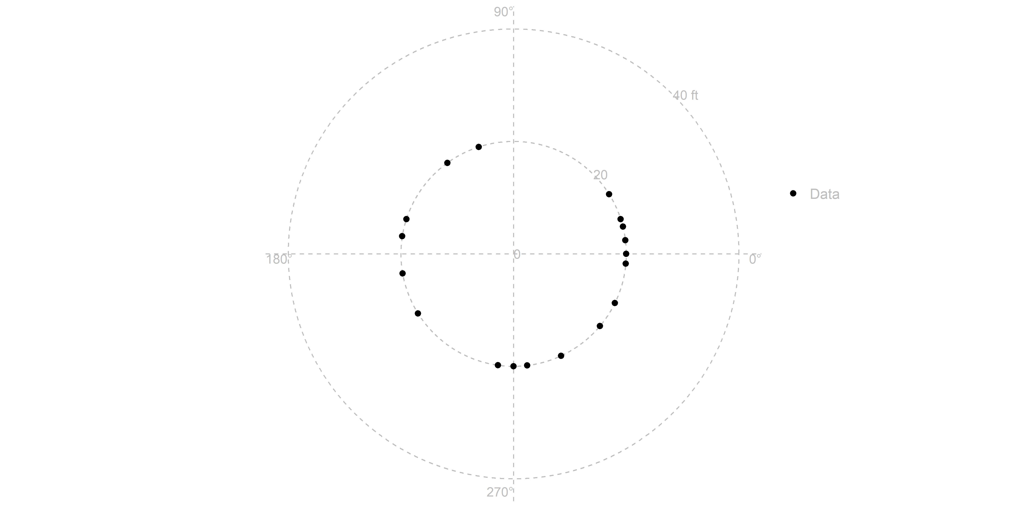
To illustrate the model, consider a simple example
A warhead detonation disperses 18 frags
This is a top view of an arena test
Axes show the distance from the warhead detonation
We want to model frag characteristics (i.e., mass, velocity, density) when the frags are 20 feet from the detonation
(warhead tail)
(warhead nose)

Slide 13
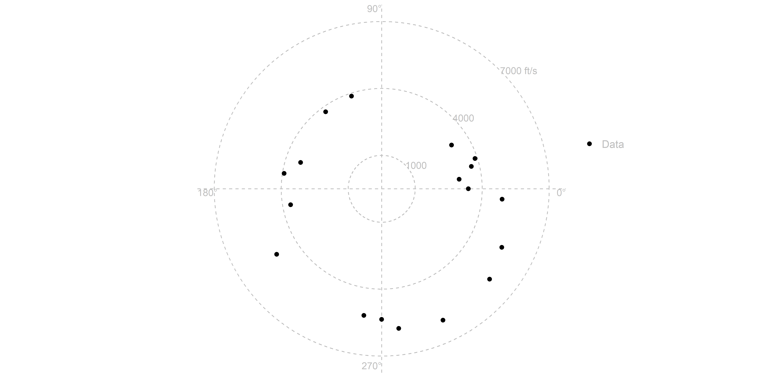
Here is the velocity of each frag
The axes are now in feet per second
The data is the frag velocity at 20 feet from the detonation
(warhead tail)
(warhead nose)

Slide 14
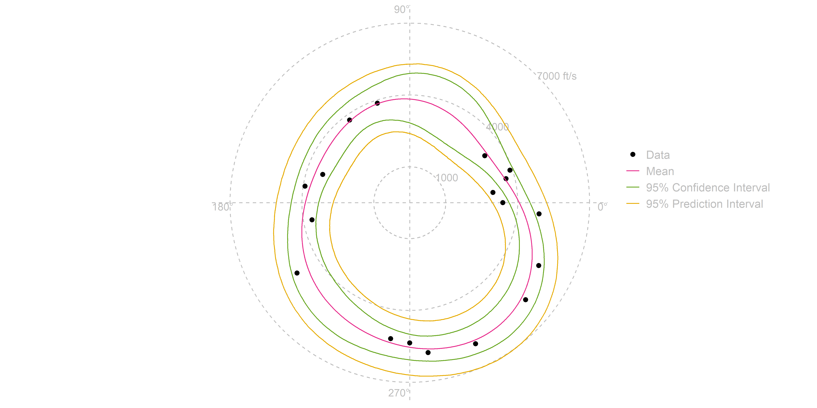
Here is the model fit to the velocity frag data
The model is called a “Bayesian Spatial Process Convolution Model”¹
The mean is continuous from 0 to 360 degrees.
There is a 95 percent probability that the mean would lie between the confidence interval
There is a 95 percent probability that the data would lie between the prediction interval
* Note that the confidence interval is actually a credible interval, and the prediction interval is a posterior predictive interval, but we’ve streamlined terms for this brief.
¹ Higdon, Dave. "Space and space-time modeling using process convolutions." In Quantitative methods for current environmental issues, pp. 37-56. Springer, London, 2002.

Slide 15
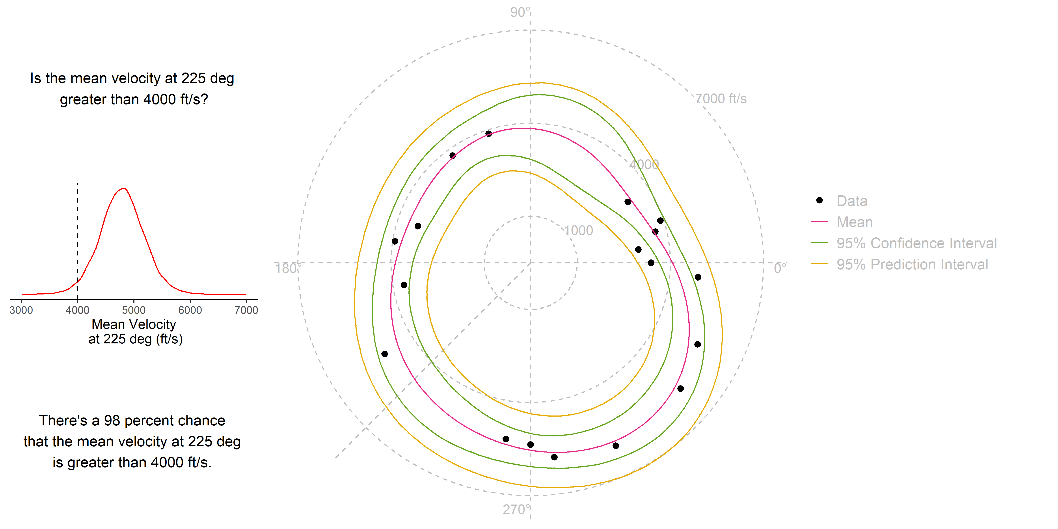
Inference and uncertainty quantification is built into this model

Slide 16
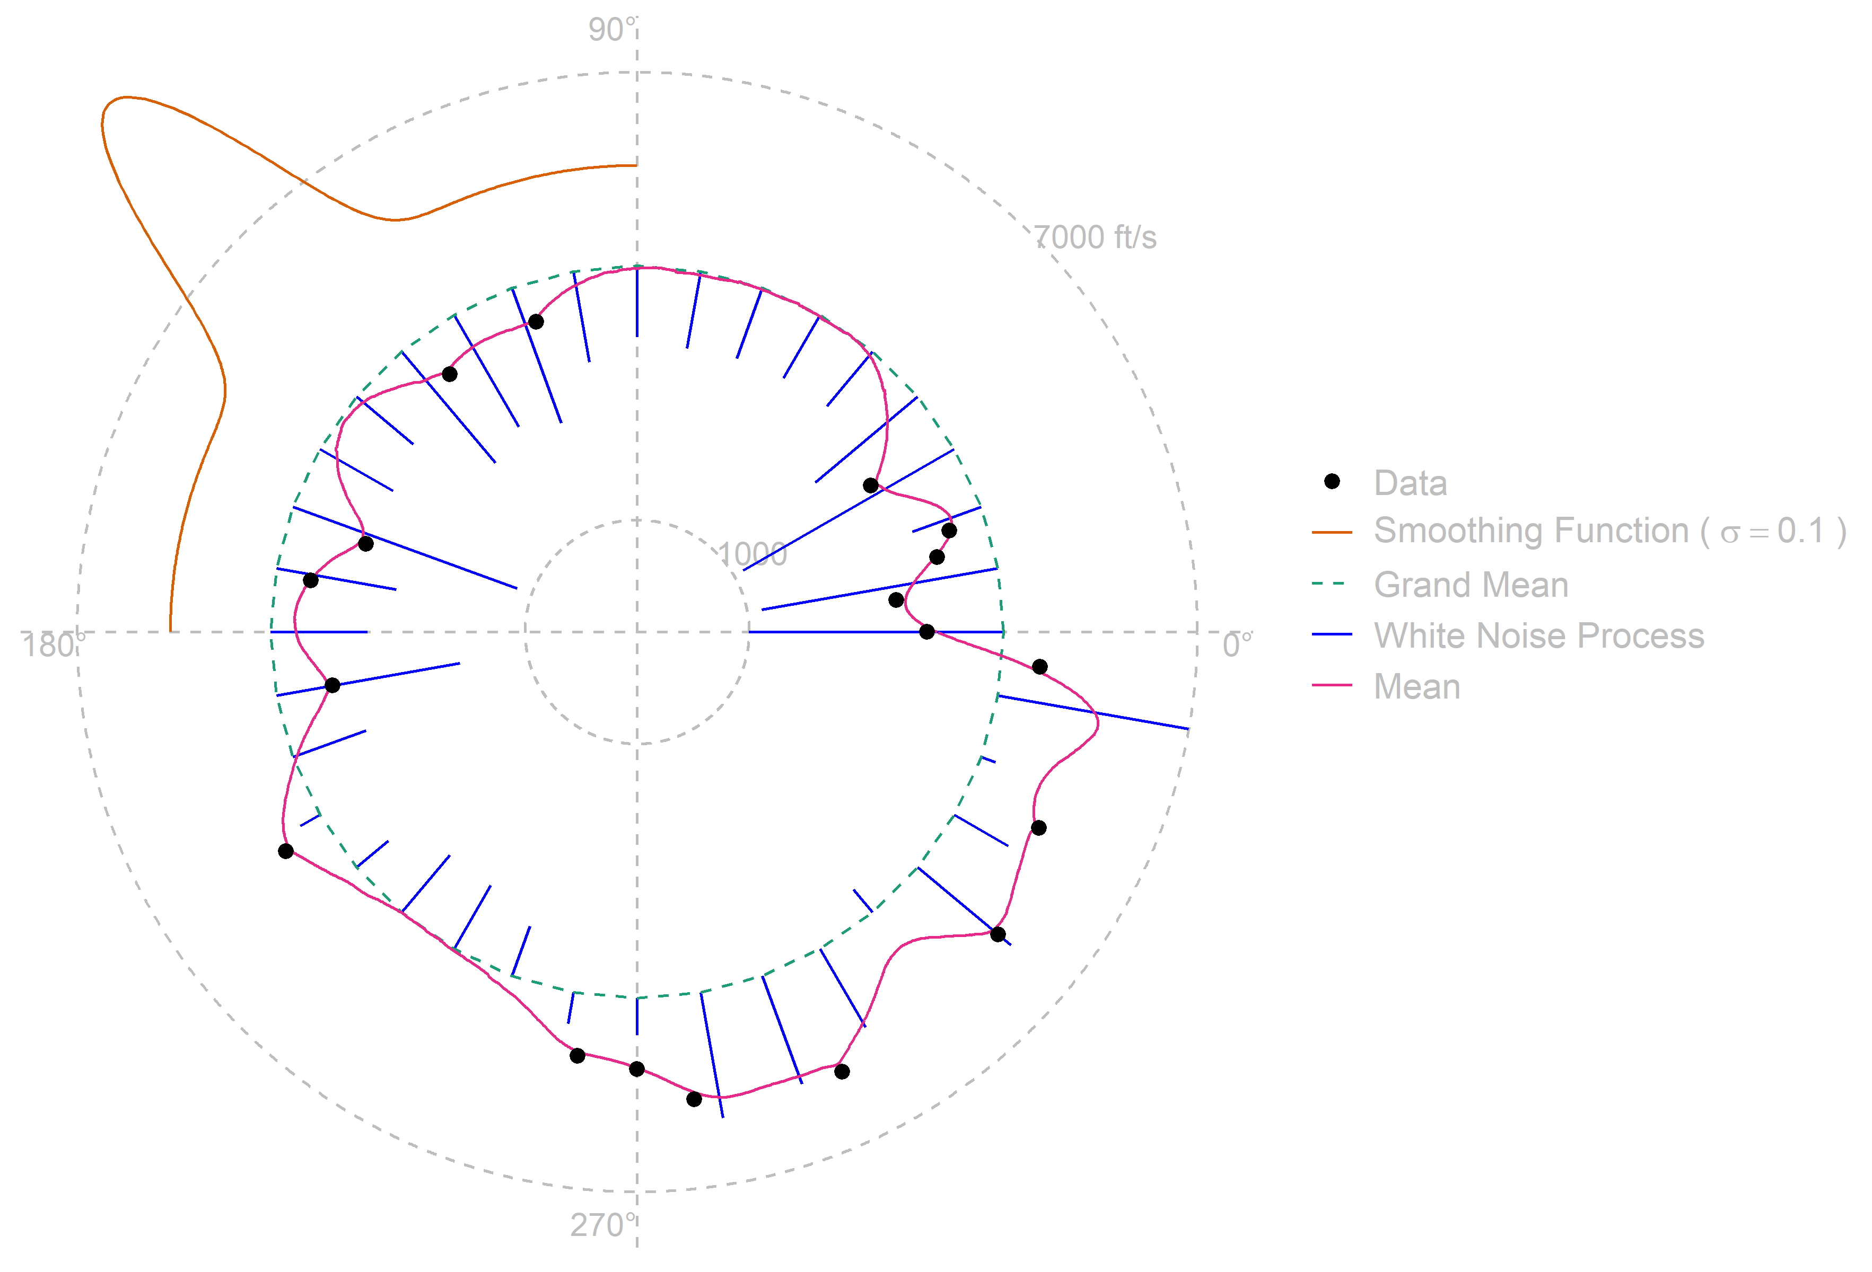
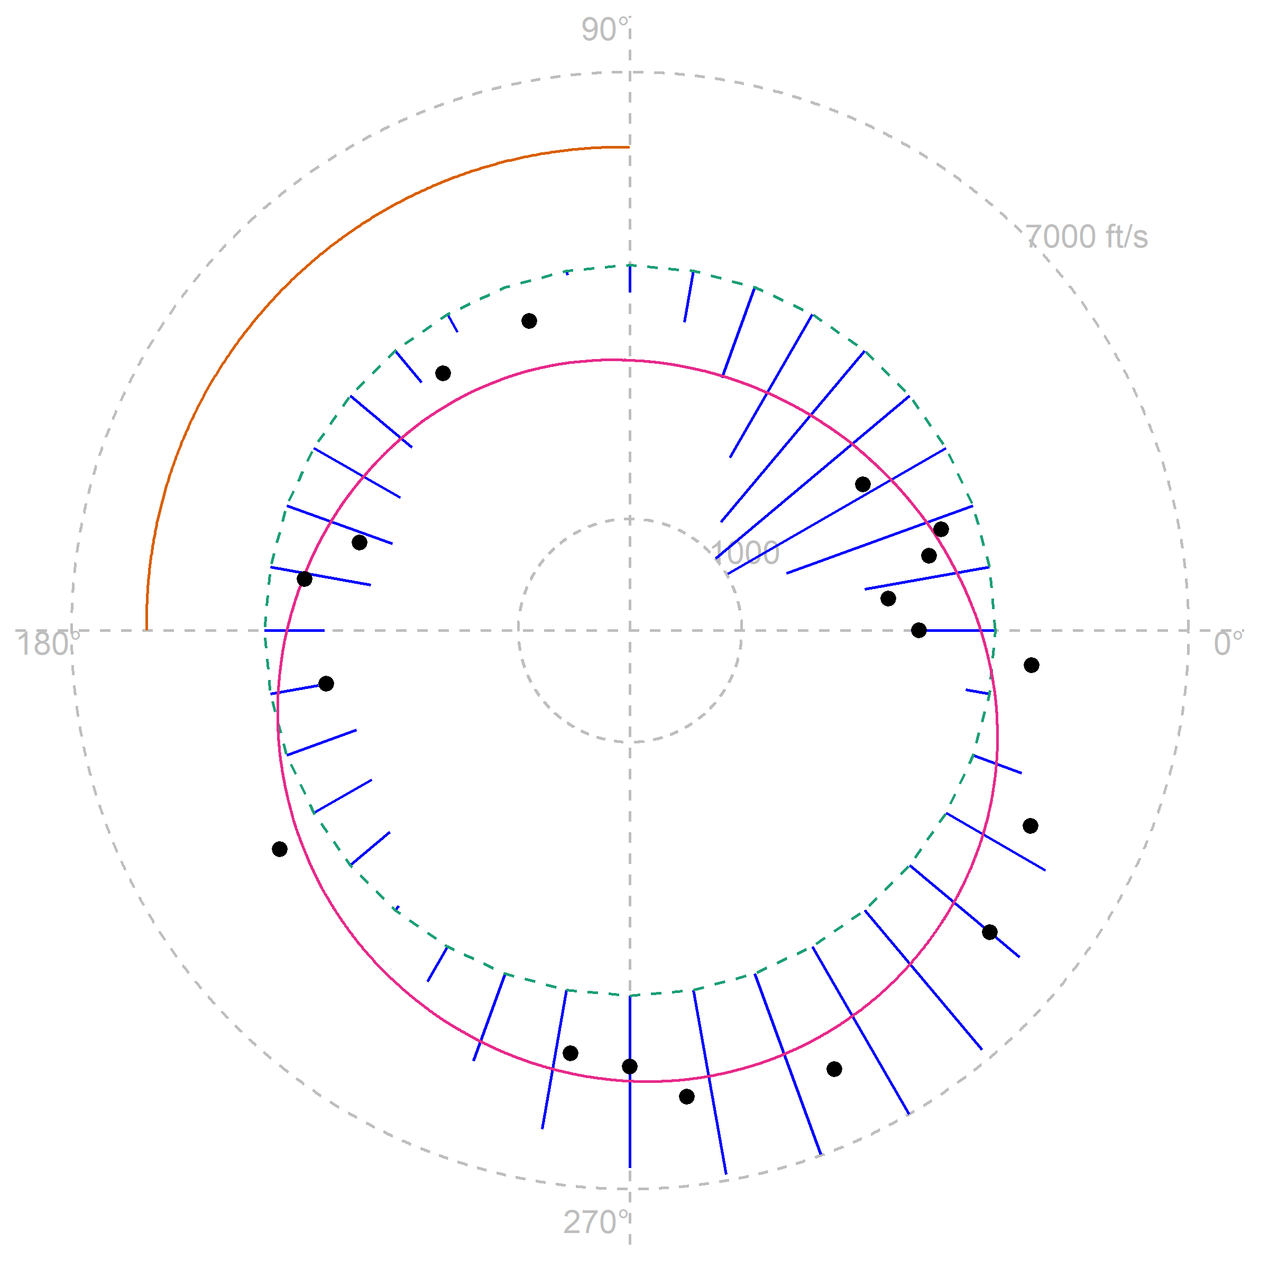
How do we know which model is a good fit? Two extremes:
“Over smoothing” the data. Model no good.
“Under smoothing” the data. Model no good.
We optimize a Bayesian probability to find a good compromise.

Slide 17
Circular Warhead Fragmentation Model
Fit to ELSA Data

Slide 18
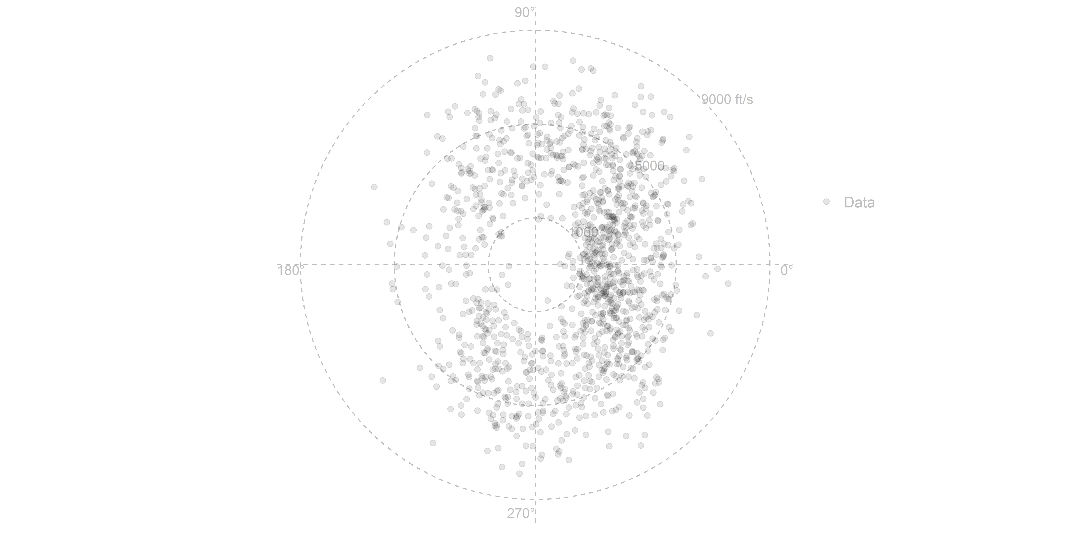
Here is the ELSA velocity data
Data is from detonation #7
There are 1,256 fragments
Velocities are observed at 20 feet from the detonation
In its original form, the data is spherical, but we’ve projected it to a circle (i.e., collapsed it to a top-down view)

Slide 19
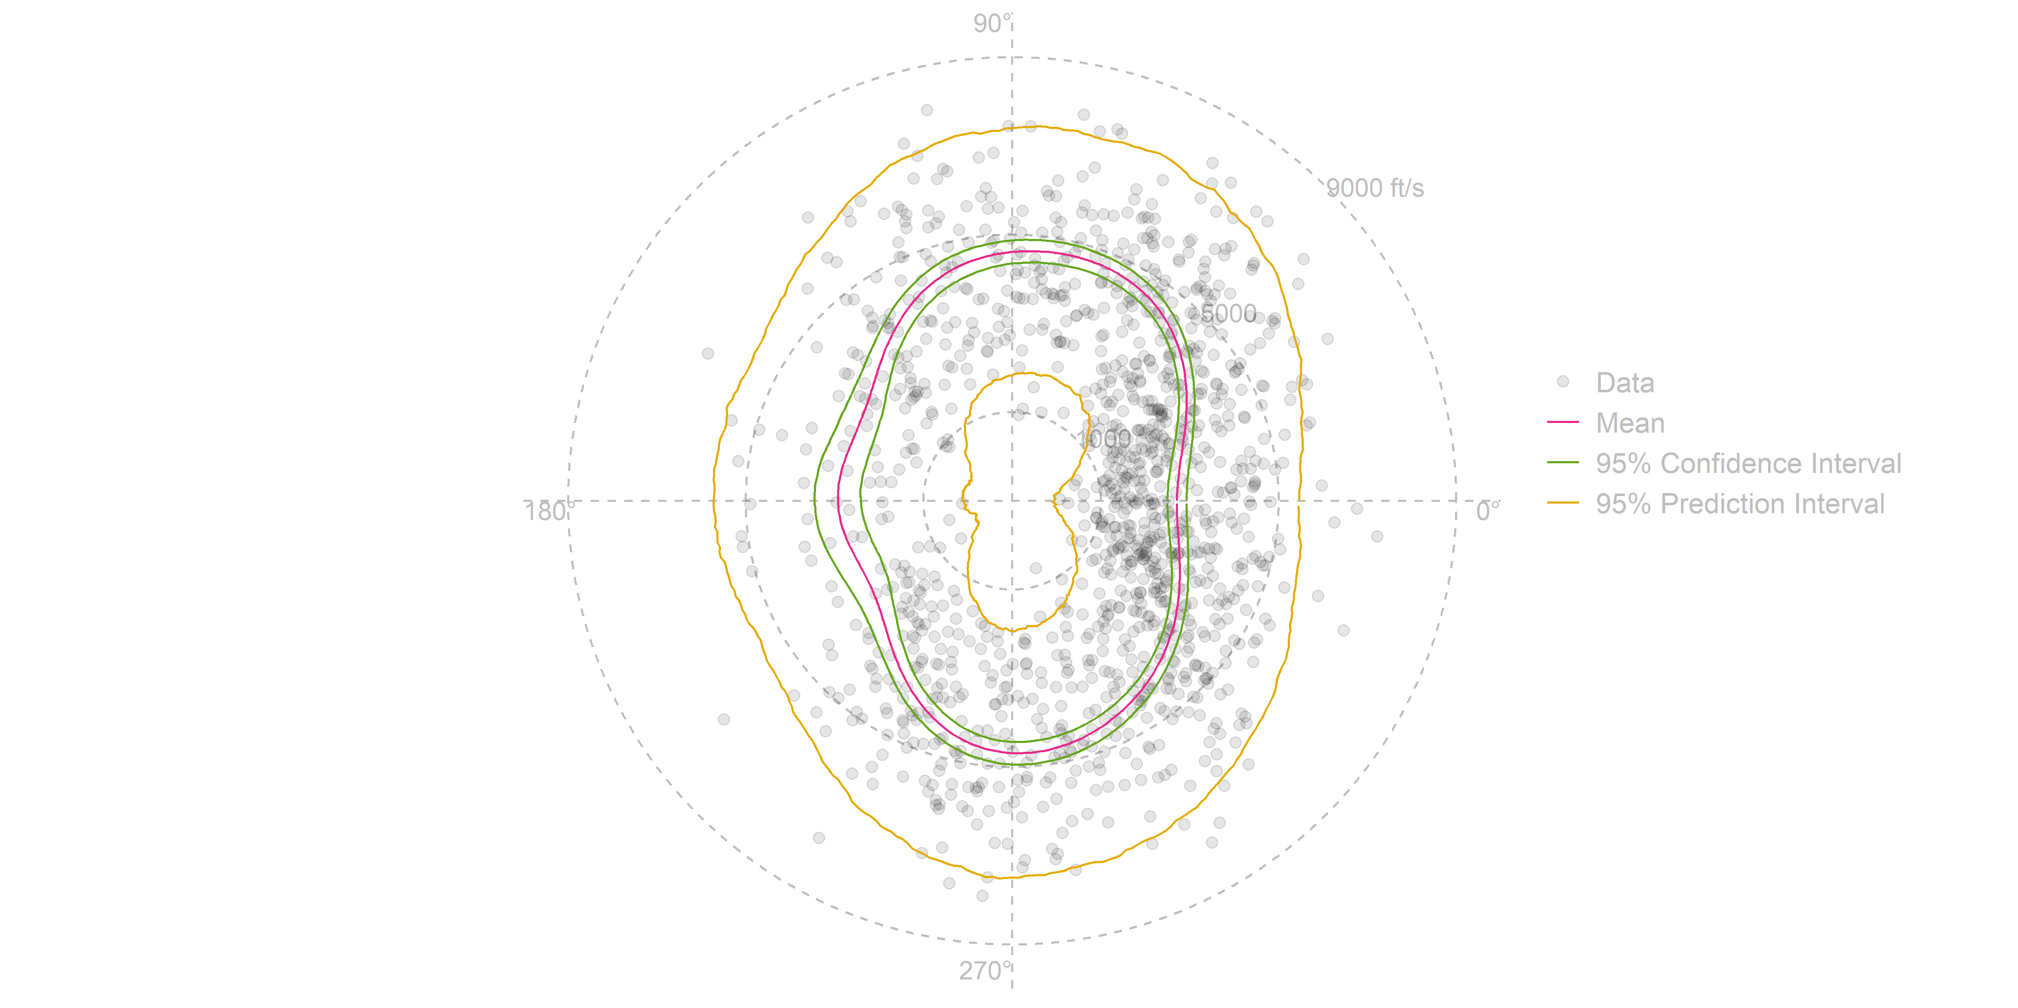
Here is the model fit to the ELSA velocity data
Data is from detonation #7
There are 1,256 frags
Velocities are observed at 20 feet from the detonation
In its original form, the data is spherical, but we’ve projected it to a circle (i.e., collapsed it to a top-down view)

Slide 20
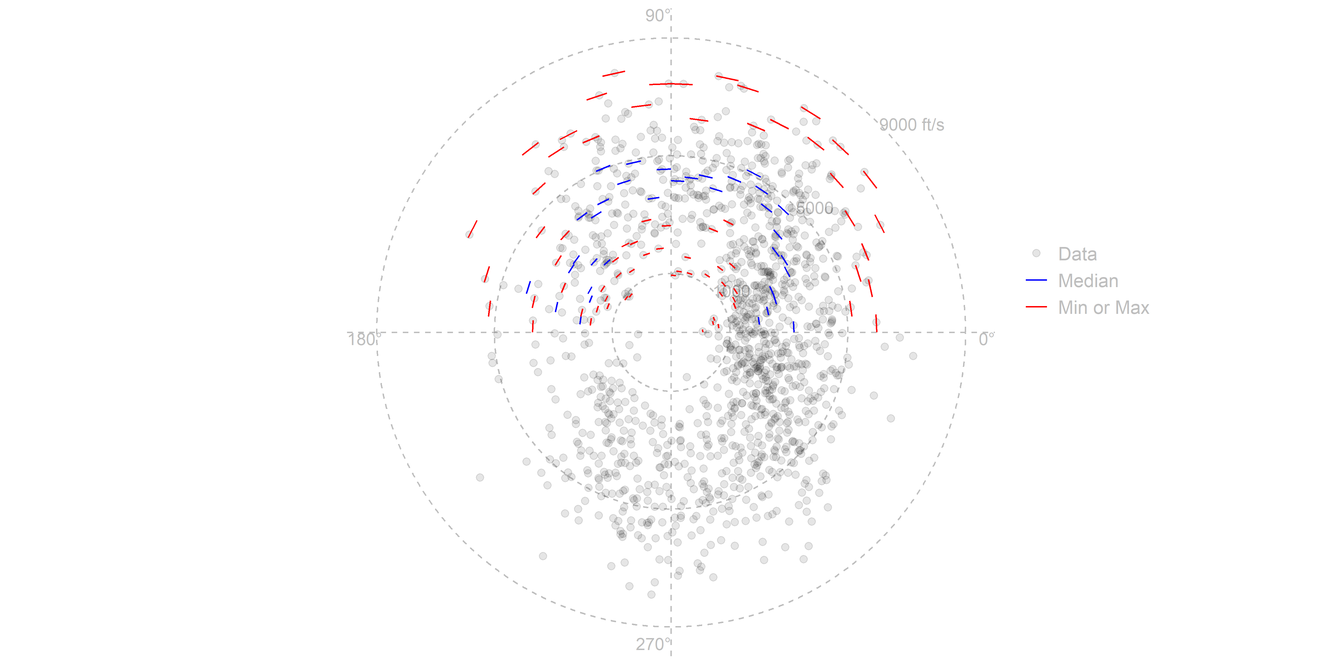
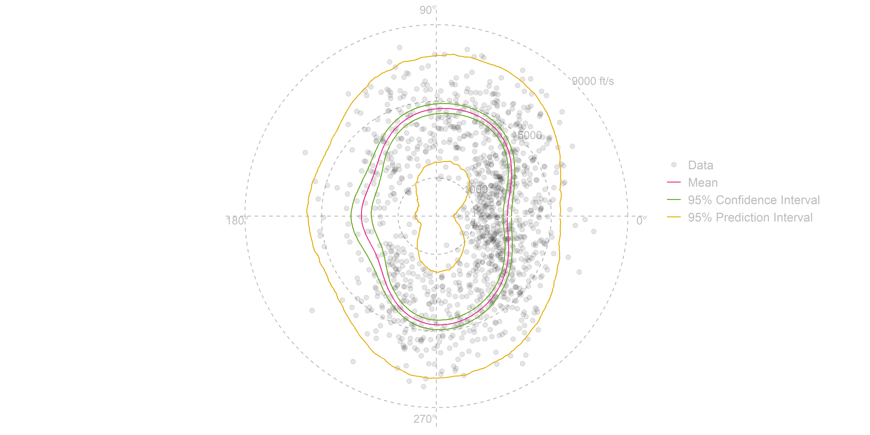
A Z-data file is a worse model of the data
Z-data Representation of Fragment Velocity
New Model Representation of Fragment Velocity
Z-data files bin the data, and compute median, min
No statistical inference, poor uncertainty quantification
Assumes symmetry, susceptible to over-fitting
This model is fit across all the data
Enables statistical inference, better prediction accuracy, and better uncertainty quantification
Notes:
Faint blue line connecting bins

Slide 21
Spherical Warhead Fragmentation Model
Fit to ELSA Data

Slide 22
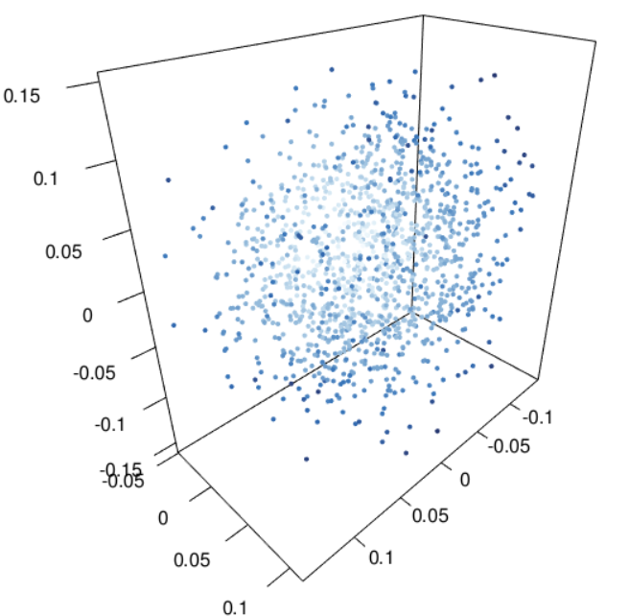
Raw data from detonation #7
Three-dimensional fragmentation data
X,Y,Z coordinates of the positions of fragments
The positional data is hard to interpret
Statistical models reveal patterns in data

Slide 23
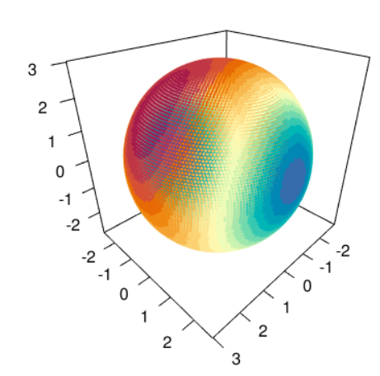
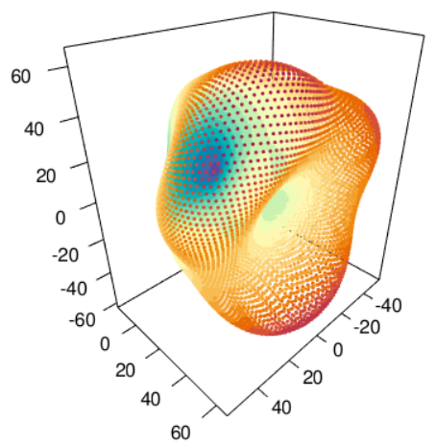
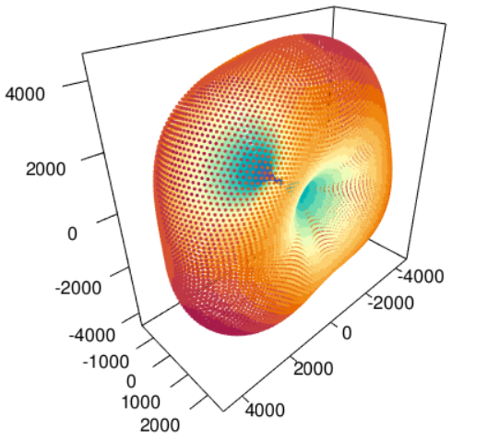
Spherical model fit results – predicted fragment mass, velocity, density
Fragment Velocity
Fragment Mass
Fragment Density
Square Donut
Sphere
Dutch Baby?

Slide 24
Summary and Impact
Future Work
Without better data analysis methods, optical tracking improvements may not be realized in our evaluations
Improving analysis means improvements to lethality & vulnerability M&S fidelity
Sample size determination
Confidence bands that preserve physical properties
Model checking strategies
Easy to use R package for the above

