Slide 1

DISTRIBUTION STATEMENT A: Approved for public release; distribution is unlimited.
PRISM (Performance Related and Integrated Suite of Models) in Support of Defense System Architecting and Design Decisions
Michael Greco
Matthew Cilli
Computer Scientist
Systems Engineer
CCDC-Armaments Center Systems Analysis
Johns Hopkins University Applied Physics Lab
02 February 2021

Slide 2
ABSTRACT
Informed enterprise and program decision making is central to DoD’s Digital Engineering’s purpose statement. Decision analysis serves as a key mechanism to link the voice of the sponsor/end user with the voice of the engineer and the voice of the budgetary analyst in order to enable a closed loop requirements writing approach that is informed by rigorous assessments of a broad range of system-level alternatives across a thorough set of stakeholder value criteria to include life-cycle costs, schedule, performance, and long term viability. The decision analytics framework employed by the U.S. Army’s Combat Capabilities Development Command (CCDC) Armaments Center (AC) is underpinned by a state-of-the-art modeling and simulation framework called PRISM (Performance Related and Integrated Suite of Models) developed at CCDC-AC. PRISM was designed in a way to allow performance estimates of a weapon system to evolve as more information and higher fidelity representations of those systems become available. PRISM provides the most up to date performance estimates into the decision analysis framework so that decision makers have the best information available when making complex strategic decisions. This briefing will unpack PRISM and highlight the model design elements that make it the foundation of CCDC-AC’s weapon system architecture and design decision making process.

Slide 3
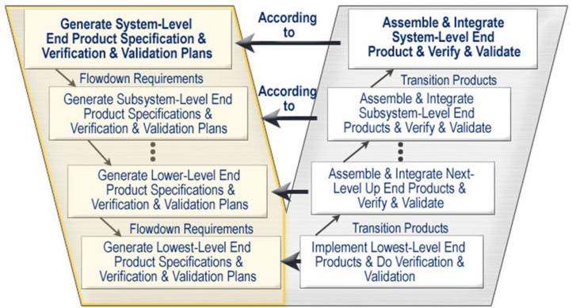
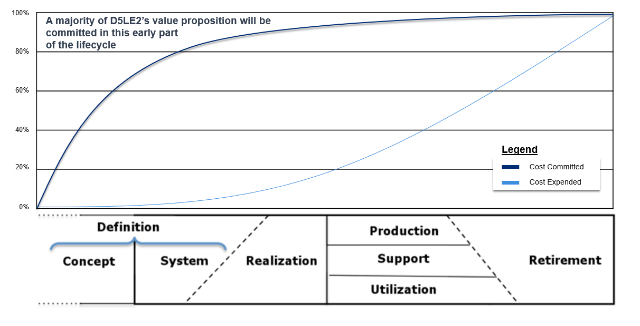
Presentation Context
Possibility to influence impacts and costs
Cumulative impacts and costs
Impacts and Costs
This presentation will showcase a unique modeling and simulation approach to support defense system architecture and design evaluation & decision making.
System Life Cycle Process Models: Vee. (2015, December 1). SEBoK, . Retrieved 16:04, July 22, 2018 from http://sebokwiki.org/w/index.php?title=System_Life_Cycle_Process_Models:_Vee&oldid=51690
System Integration. (2018, October 16). SEBoK, . Retrieved 13:23, October 20, 2018 from https://www.sebokwiki.org/w/index.php?title=System_Integration&oldid=54408
This material is used under a Creative Commons Attribution-NonCommercial ShareAlike 3.0 Unported License from The Trustees of the Stevens Institute of Technology.

Slide 4
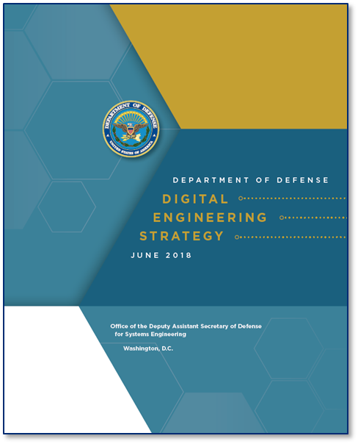
Decision making is central to DoD’s Digital Engineering’s purpose statement
Formalize the development, integration, and use of models to inform enterprise and program decision making
Provide an enduring, authoritative source of truth
Incorporate technological innovation to improve the engineering practice
Establish a supporting infrastructure and environments to perform activities, collaborate, and communicate across stakeholders
Transform the culture and workforce to adopt and support digital engineering across the lifecycle

Slide 5
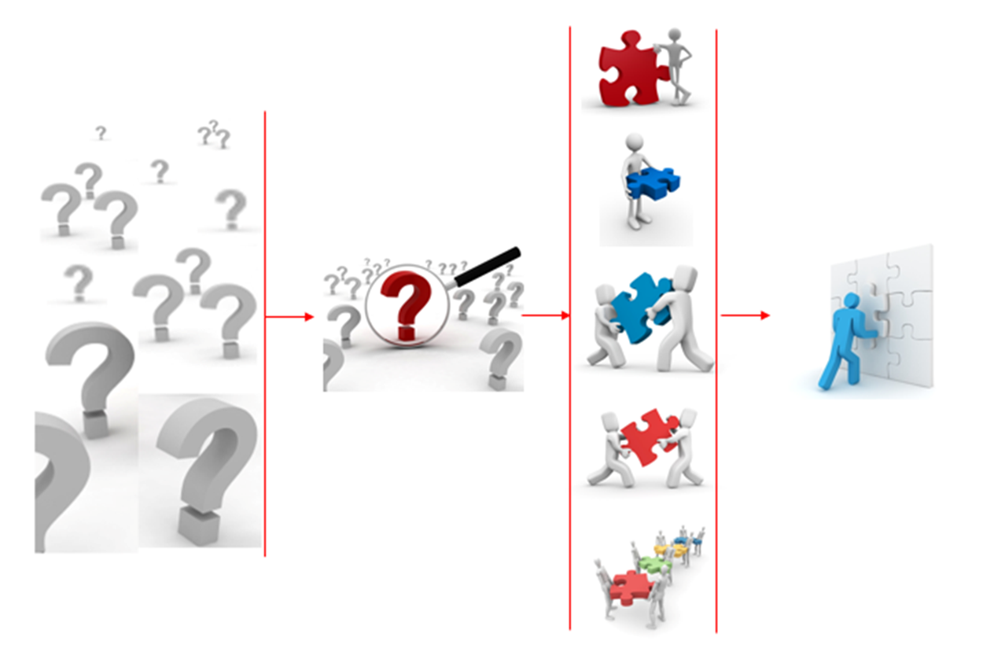
Thoughtfully structured analyses facilitate synthesis and aid decision making

Slide 6
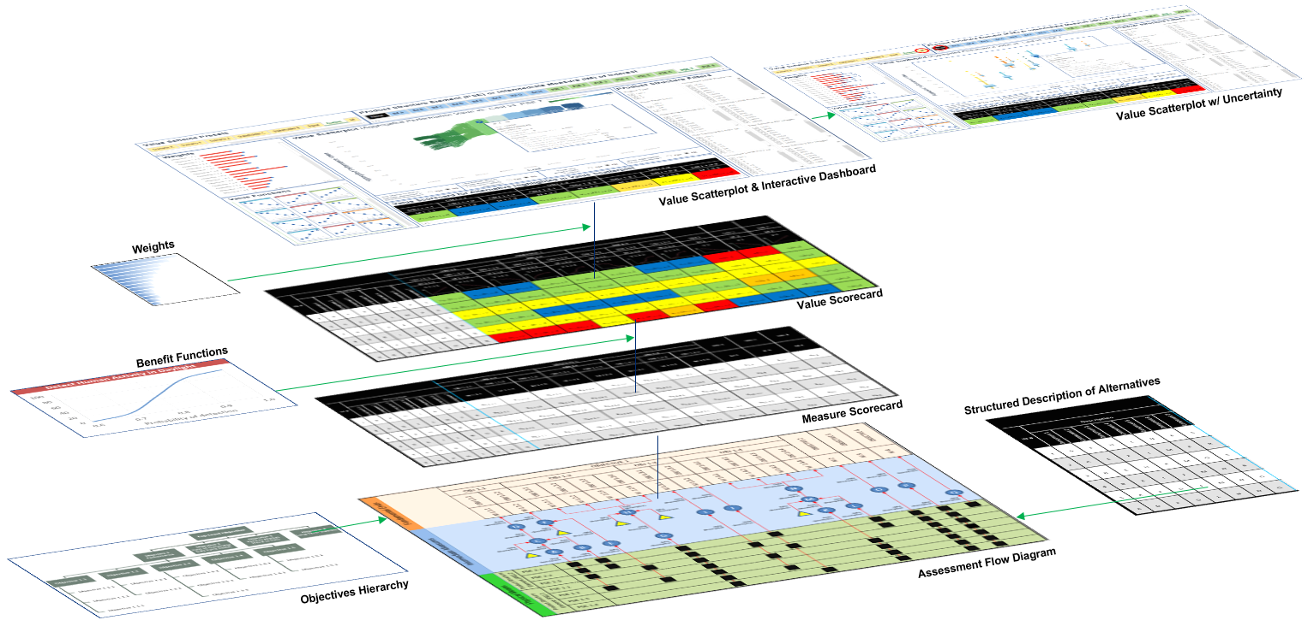
US Army Armaments Center employs a value-focused, data-driven, quantitatively-reasoned decision-making capability

Slide 7
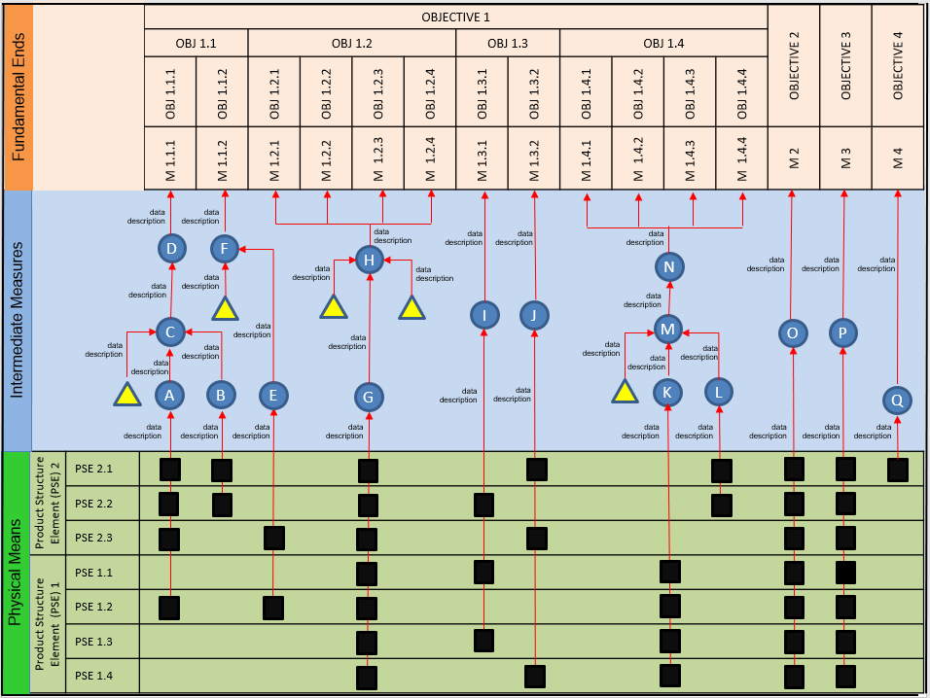
The decision making process rests on a foundation of well Structured quantitative analysis
An Assessment Flow Diagram
links each fundamental objective (the thing(s) we care about – our goal(s))
to concept fragments - the elements of the system-of-interest’s product structure (the things that we can control – our design decisions)
through a set of intermediate relationships and the associated models.
Decision nodes are represented by boxes
Assumptions represented by triangles
Models represented by circles
Arrows between node pairs indicate influences
Text next to arrows describe data flowing on influence arrow
Facilitates cross-discipline communication
Clarifies cause & effect relationships
Reveals complexity of interrelationships between design variables
Structures quantitative modeling
text

Slide 8
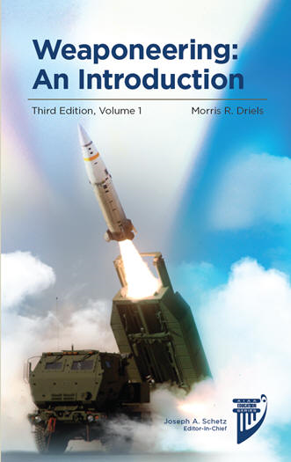
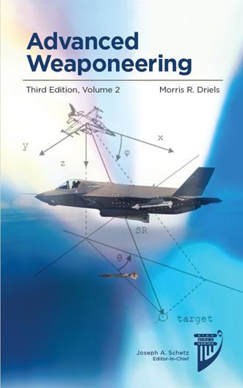
Quantitative analysis includes performance modeling

Slide 9
Quantitative Modeling and Simulation
The decision analysis process needs relevant and timely inputs for objective system performance.
PRISM, a modeling and simulation framework developed at US Army Armaments Center.
Aggregate
(Force on force)
Decision Support
Model
System Performance
(Entity)
Engineering
(Physics)
Traditional modeling and simulation pyramid with decision analysis.

Slide 10
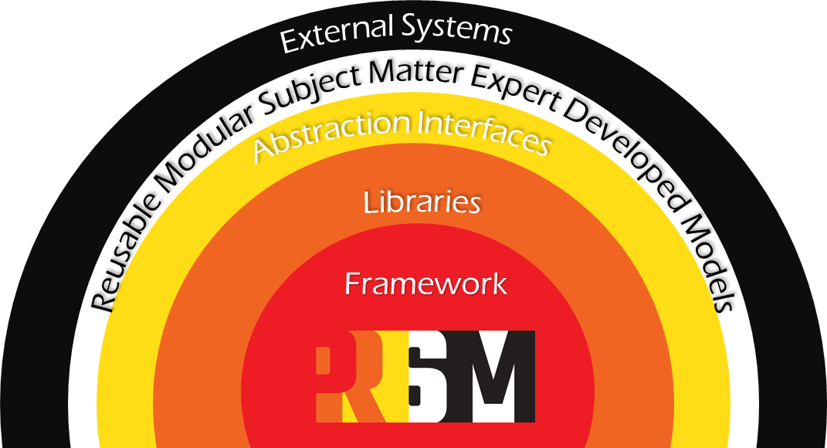
PRISM (Performance Related and Integrated Suite of Models)
Modeling and Simulation Framework
Framework code
Fast, lightweight libraries.
Subsystem Interfaces and abstraction layers
Reusable models developed by Subject Matter Experts.
External Systems:
Hardware in the loop
Other modeling and simulation environments.
The PRISM modeling and simulation ecosystem.

Slide 11






Prototype Fast
PRISM was designed to maximize the reusability of existing system and sub system models.
Reuse proven physics based models developed by subject matter experts.
Deliver early insights into system performance.
Subject Matter Expert Developed Models
Movement
Fuzing
Warheads
Sensors
Threats
Engagement Algorithms
Platforms
Environment

Slide 12
PRISM’s Key Aspects
Abstraction Interfaces
Mathematical Libraries
Source Control and Collaboration with Git
Interoperability with Force on Force simulations
Develop
Windows / Linux Desktops are used for small scale analysis
High Performance Computers for large scale monte carlo analysis.
Specialty machines for hardware in the loop execution.
Matlab/Simulink
Fortran
C++
Software Development Kit
Collaboration with government and contractor design engineers.
Exercise
Integrate

Slide 13


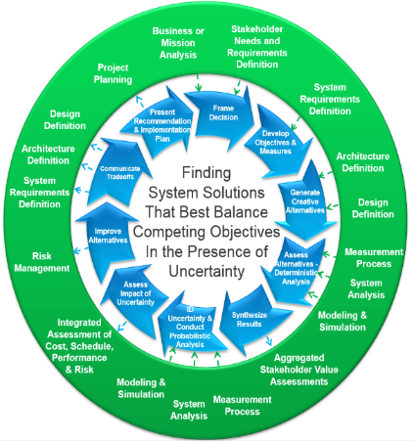
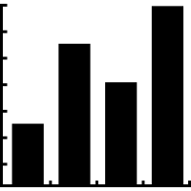
Iterate Often
Design Engineers develop model representations of their component
Lethality and Effectiveness engineers combine design engineers components into system representations.
Models will need to be updated
Analysis will need to be reran
Being able to react quickly and confidently to the needs of DoD Decision makers is key.
With PRISM’s plugin architecture it makes it easy to update individual models.
No need to recompile the entire framework, build the plugin and you are ready to go.
Design engineers receive instructions from decision makers and stakeholders to make updates.
US Army weapon systems and threat systems interact in a dynamic monte-carlo simulation using standard and high performance computers.
Decision analysis engineers use the decision analysis framework and tools to synthesizes weapon performance results with other data.
Simulation outcomes are post processed and reduced into a meaningful set of results.

Slide 14
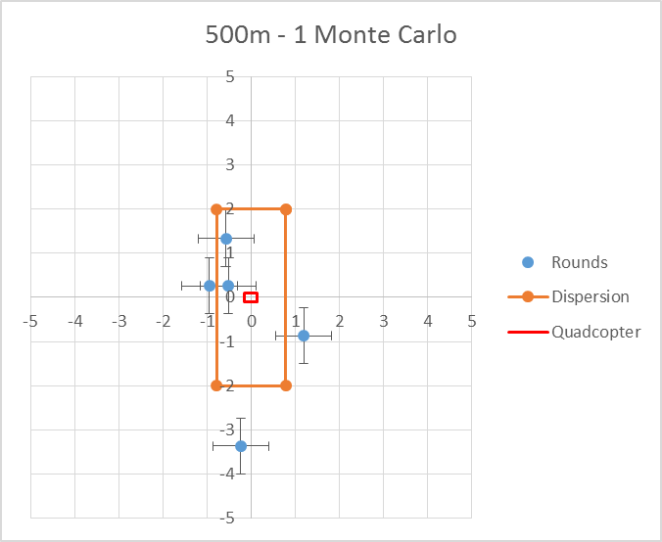
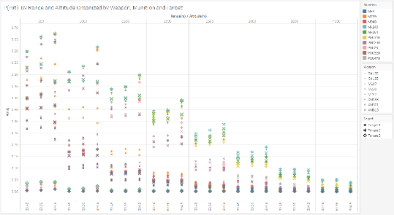
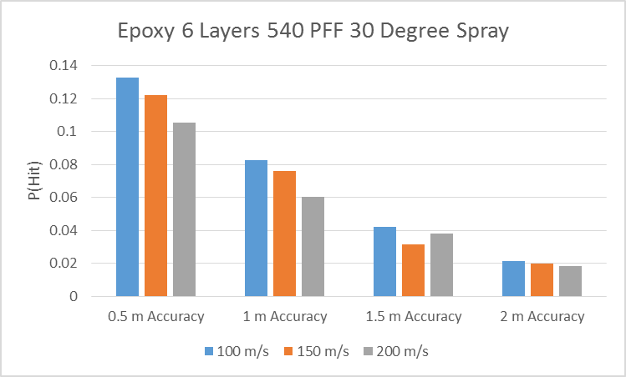
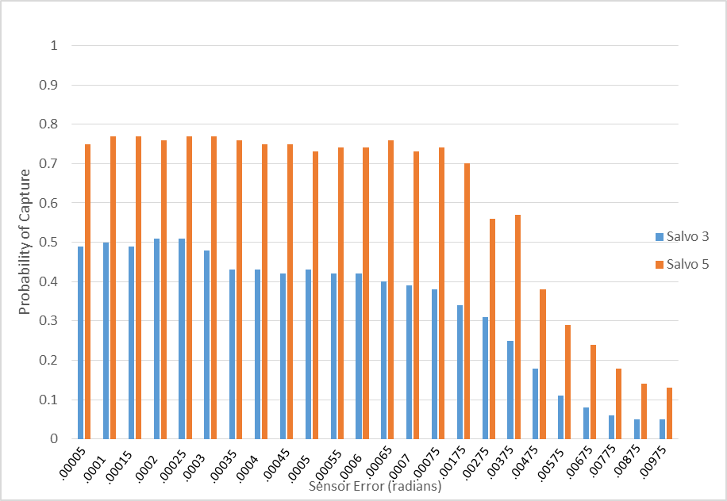
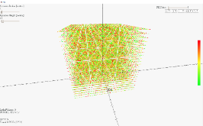
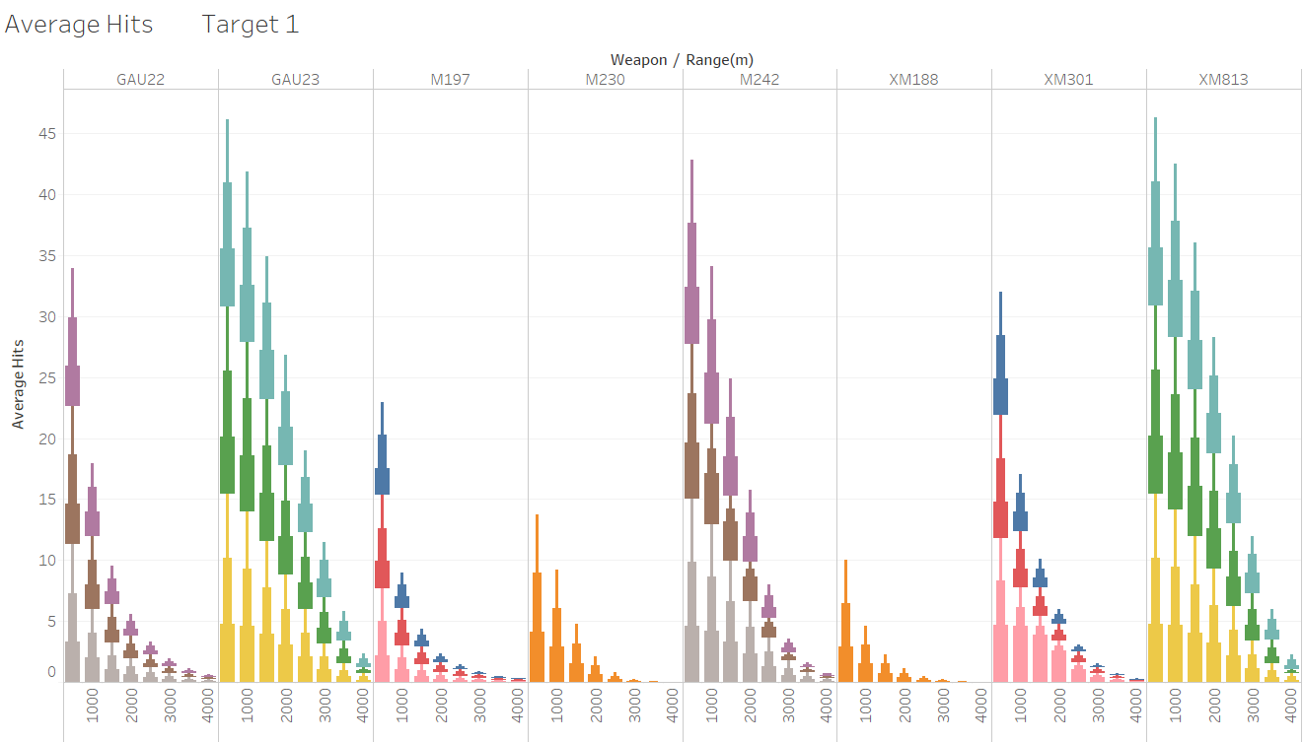


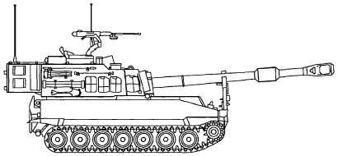

Trade Study Performance Analysis
Independent simulation execution
Easily scriptable XML input system
Repeatable simulation outcomes
Generate statistical insights into system performance.
Example: Analyze the performance difference between 4 potential fuze types.
Scenario Definition
Swap Fuze System Model
Weapon System Performance Data to support design decision
Fuze A
Results A
Fuze B
Results B
Fuze C
Results C
Fuze D
Results D

Slide 15
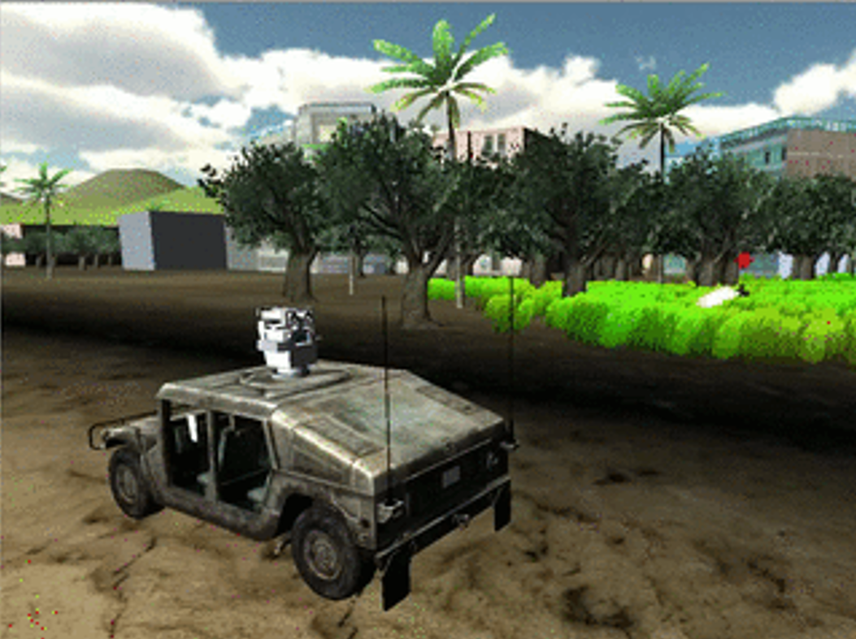

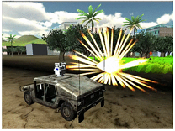
Exercising Tactical Hardware
Low cost per test run
Easily repeatable environment
Generate statistical insights
Play back simulation events
Hardware and Software in the Loop
Close to real time network messaging
Switch
Tactical Weapon Control Hardware
Scene generation
Threat behavior
Environment effects
Sensor emulation
Lethal mechanisms
Weapon Fire Message
End game effectiveness
Weapon / Threat Interaction
Weapon Lethality
Collateral Damage
Mission Outcome
Success
Failure

Slide 16

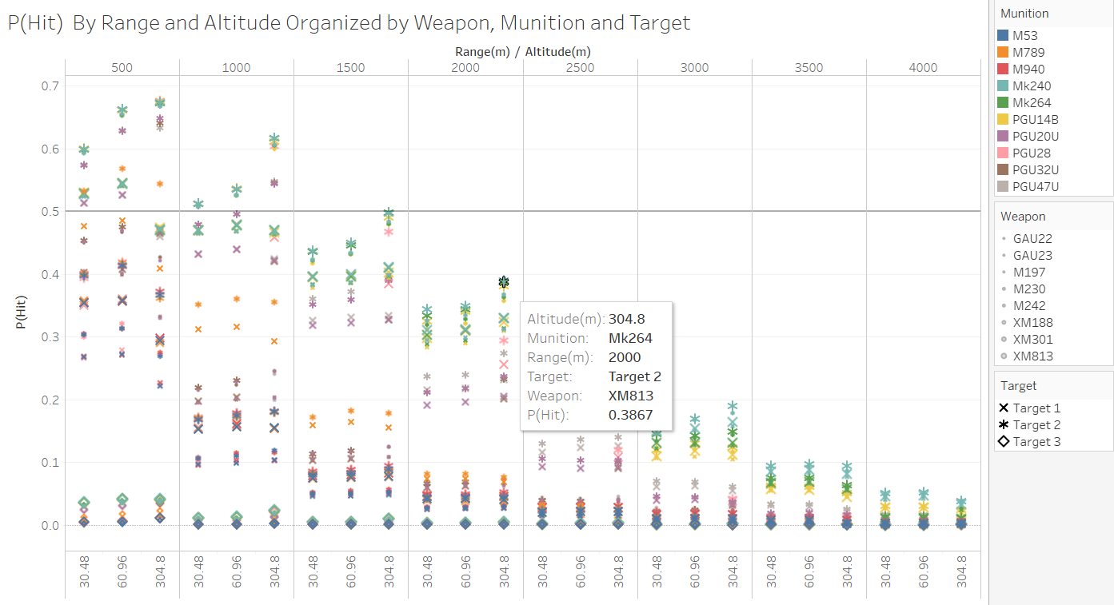
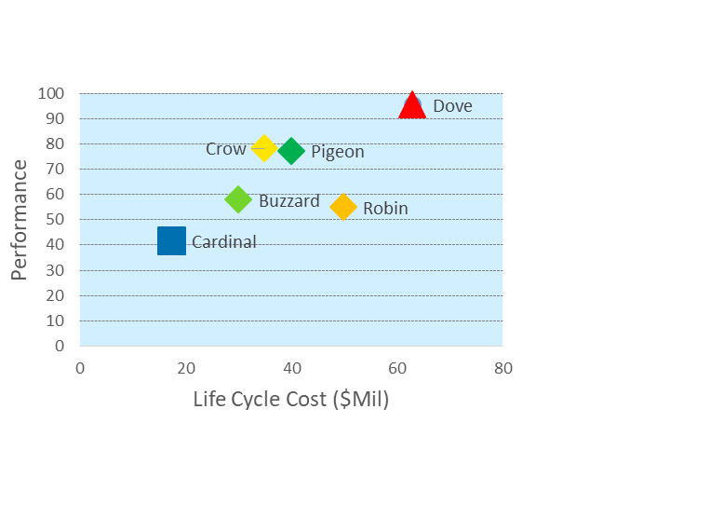
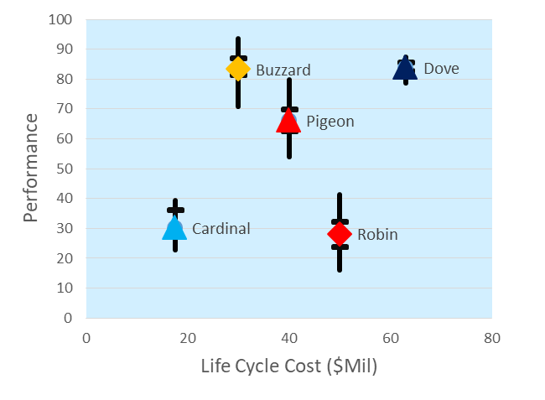
PrISM
SME Developed System and Sub System Models
Movement
Fuzing
Warheads
Sensors
Models representing different parts of a weapon system, threat systems, and the environment. Use SME developed models where available. Grow with the project by being able to replace lower fidelity for higher fidelity models.
Quickly able to react to analysis needs by maximizing model reuse.
Modularly compose simple or complex scenarios.
Flexible:
Work in a variety of operating modes: Single execution runs, large scale monte-carlo analysis on high performance machines, distributed simulation actor, hardware in the loop.
Cross Platform:
Build on any machine that has a GNU compatible compiler (Windows, Linux, Mac).
Fully Government Developed and Controlled
Developed at CCDC/AC Systems Analysis Division as a modular way to analyze weapon system performance.
Threats
Weapon System Algorithms
Platforms
Environment
Run PRISM scenarios on high performance cluster machines, workstations, or distributed.
Weapon System Performance Data
Generate statistics related to weapon system performance.
Aggregated Decision Analysis Views
Supply system performance data into a decision analysis framework in order to help decision makers intuitively optimal solutions.

Slide 17
THANK YOU!

