Slide 1


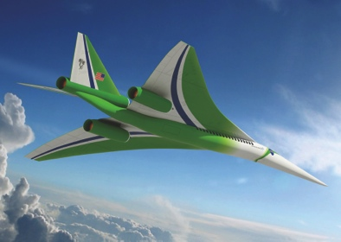

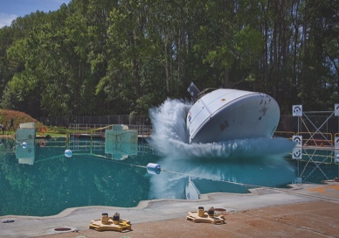
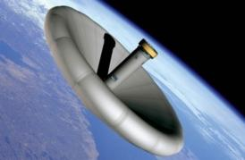

L A N G L E Y R E S E A R C H C E N T E R
Machine Learning to Assess Pilots’ Cognitive State
March 21, 2018
Tina Heinich
AST, Data Systems
Computer Engineer, OCIO Data Science Team
Notes:
My name is Tina Heinich, I'm a computer engineer at NASA Langley Research Center.
Talking to you about a project I'm working on called Crew State Monitoring
The goal of this:
=======
Can we use data from physiological sensors to predict a pilot's cognitive state in real time? I'm going to be talking about the methods we used to pursue that goal, and the work still do be done.
=======

Slide 2
Summary
Goal
The Data
Challenges
Current Pipeline
Future Work
Notes:
Just a sneak peak of what we're talking about. Going to go over the goal, an exploration of our dataset, our current pipeline and results, and a talk about the future work of the project.

Slide 3
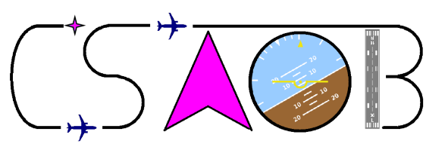
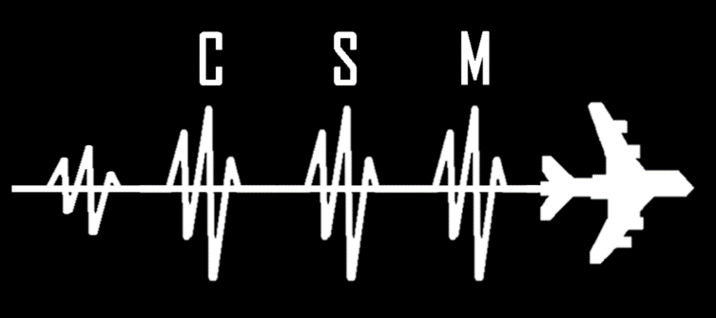
The Team
Tina Heinich (NASA)
Angela Harrivel (NASA)
Chad Stephens (NASA)
Robert Milletich (Booz Allen Hamilton)
Kellie Kennedy (NASA)
James Comstock (NASA)
Alan Pope (NASA Distinguished Research Associate)
Charles Liles (NASA)
Mary Carolyn Last (Analytical Mechanics Assoc.)
Nijo Abraham (NASA)
Nick Napoli (UVA)
And many more….
Notes:
This project is run by the Crew Systems and Aviation Operation Branch and led by Angela Harrivel. My team, the Data Science Team, is providing support in parsing the data and creating predictive models.
A lot of intelligent folks have worked on this project. This shows the people that worked on the project during this "leg", but we've also had an amazing rotating roster of interns, contractors, and civil servants help out with this.
While I am certainly happy to answer any questions about this project, Angela Harrivel is the lead for this project, and is probably your best point of contact for this.

Slide 4
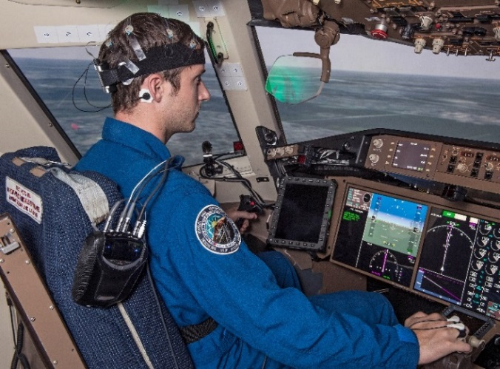
Goal of CSM
In 2001-2010, Commercial Aviation Safety Team (CAST) identified unsafe cognitive states as a key factor in almost all studied airplane accidents.
Want to predict if a subject is currently in an unsafe cognitive state
Create a machine learning model that can reliably predict the cognitive state a subject is in using various physiological sensors
Specific Goal: Using previously collected
data in a non-flight scenario, can we
predict cognitive states in an actual
flight simulation?
Notes:
In a decade long study (2001-2010) the Commercial Aviation Safety Team (CAST) identified crew distraction/poor attention management as being a key player in airplane accidents world wide. Because of this, they recommended more training in attention management.
The tool we are developing would be used to aid in the training. As I mentioned before, the overall goal of CSM is to create a tool that can in real time, predict a pilot's cognitive state. The idea is that during training, a trainer can monitor a pilot's cognitive state. For example, they could see if the pilot tended to enter these unsafe states, or if they are able to quickly recover from them. The pilots themselves could also later see how they did, and be aware of their own habits and tendencies.
To do all of this, we need a model that can predict if a person is in an unsafe cognitive state. The CSM tool collects a suite of physiological data, so our specific goals are:
create a machine learning model that can use physiological data to determine cognitive states.
create a model that runs fast enough to predict in real time.
Because it is difficult to get sim time to collect data for learning, can we use a model trained on non-flight data (for example watching videos or playing tetris) to predict on a flight simulation?

Slide 5
Cognitive States
Startle/Surprise (SS)
  Includes the “onset” as well as the initial 13 seconds “recovery” afterwards
Channelized Attention (CA)
  Subject is focused on one particular task/input to the exclusion of all other tasks/inputs
Low Workload (LW)
  Demand requires minimal resources to complete
“Other”
  Not really a class, but whenever a pilot is NOT experiencing these states
Notes:
First, let's talk a little about the cognitive states we're trying to predict.
In this research, we're primarily focused on these states: Startle Surprise, Channelized Attention and Low Workload.
SS is straight forward; it's when you were startled by some stimulus. There's a lot of research in the "startle pattern" and recovery from it. The thing to note is what we label as Startle Surprise includes the onset as well as 13 seconds of the recovery afterwards
CA is when you are hyper focused on one particular thing to the exclusion of all others.
LW is when your task load doesn't require much effort on your part; think menial jobs and such.
There's also "Other", which is just the catch all label for "it wasn't one of these unsafe states“
We have also looked at other states and hope to do more work in them.
High workload, is where your task load is high enough that you're starting to stress about it (think juggling multiple tasks at once).
Nominal workload is not unsafe, but is when the task load is just enough to keep you occupied, but not enough to overwhelm you.
Diverted Attention, when you get distracted by something .
Confirmation Bias, where you 100% you know the answer...so much so that there's no need to look at all the evidence! And if any evidence proves you wrong, the evidence is wrong!

Slide 6
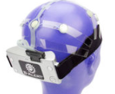
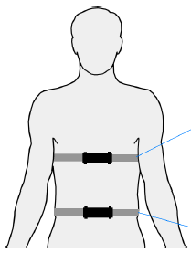
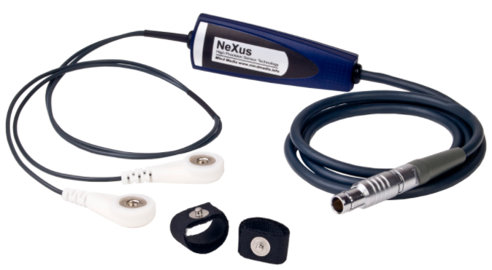
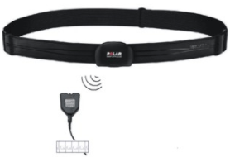
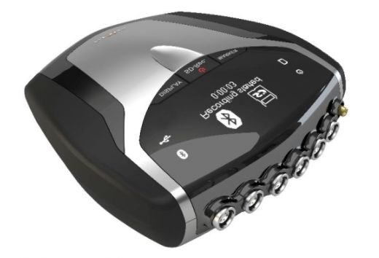
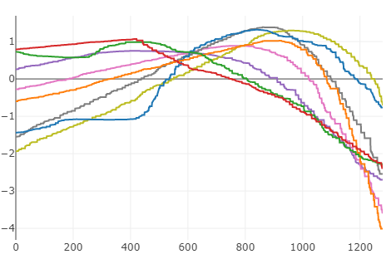
Physiological Modalities
20-channel Electroencephalography (EEG)
  ABM B Alert X24
Galvanic Skin Response (GSR)
  NeXus-10
Electrocardiogram (EKG)
  NeXus-10
Respiration (R)
  NeXus-10
Notes:
This research focuses on 4 modalities: a 20-channel EEG, Galvanic Skin Response, an 3-node EKG, and a Respiration signal.
We have also looked at using
eye tracking with the SmartEye system and
fNIRS (with the Imagent by ISS Inc),
but for various reasons (mostly related to sensor issues) couldn't be included in the full analysis. If we have some time I'll make some notes about these, because in separate analysis both have promising results in predicting cognitive states.

Slide 7
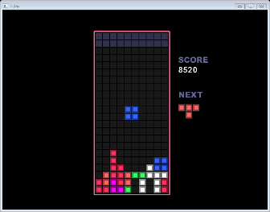

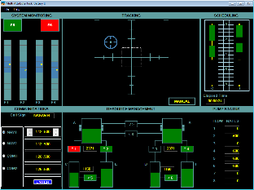
Tour of the Data
The Experiments
Data was collected for 13 crews of pilot and copilot (26 total participants)
  Because of various data collection issues, we concentrate primarily on 5 full crews (10 pilots)
Benchmark Tasks
  6 minute tasks that induce various cognitive states
  Tasks were done on two different days
    Known as “Day 1 Benchmark” and “Day 2 Benchmark”
Line-Oriented Flight Training (LOFT) Data
  Flight scenario with full flight
Notes:
We collected datasets form 13 crews with a pilot and a copilot
Each dataset consisted of
Benchmark tasks designed to induce various cognitive states. For example, for Startle/Surprise, pilots were shown 2 jump scares from a movie, and Channelized Attention was induced by playing Tetris.
Benchmarks were collected on two different days (known as Day 1 and Day 2 Benchmark)
The crew was also put into a flight simulator and put through a full flight. The flight included various events to induce unsafe cognitive states. Startle was induced by a wake hazard event during flight and a runway incursion event on landing (a fancy way of saying when they tried to land in a foggy environment, another aircraft or firetruck appeared on the runaway and they had to abort landing). Channelized Attention was induced by a hydraulic system pressure alert and a trailing edge flap asymmetry problem.
Low workload did not specifically have any events marked out, but labels for low workload were added after the fact during times when the pilots were not actively engaged.

Slide 8
Tour of the Data
The Features
EEG
  Focus on MVP Channels
  Summary Statistics :
    Quantiles: Q005, Q995, Q75 and Inter-Quantile Range
    Skew and Kurtosis
    Variance
  4 Power Band Features
    Alpha Band Mean (4-8 Hz)
    Beta Band Mean (8-13 Hz)
    Theta Band Mean (13-22 Hz)
  Engagement Index and Task Load Index
ECG
  Heart Rate Variability Mean and Variance
  Summary Statistics
    Quantiles: q005 and IQR
    Skew and Kurtosis
    Variance
GSR
  Avg Slope and Drop Score
    “drop score” essentially counts how often the slope drops under a given threshold
  Summary Statistics
    Quantiles: q975
    Variance
    Skew
Respiration
  Respiration Rate
  Summary Statistics
    Quantiles q75, q975, and q025
    Skew and Kurtosis
    Variance
Data was divided into sliding 5 second windows with 1 second stride.
Within each window, features for each modality were calculated.
Notes:
We followed a sliding window scheme, with a 5 second window size and a 1 second stride. Every window we calculated various features within each modality, and placed those features onto a 1 dimensional vector.
EEG we primarily focused on collecting features from 7 important channels, calculating PSD power band features.
We also calculated Engagement Indices and Task Load Indices, which are ratios and summations across select channels.
EKG we focused on calculating Heart Rate Variability feature
GSR was about looking at slope based feature
Respiration we looked at Respiration Rate.
In all modalities, we looked as specific summary statistics performed on the signal.
91 BEST_CHANNELS = ['EEG_FP1', 'EEG_Fz', 'EEG_F7', 'EEG_F8', 'EEG_T5', 'EEG_O1', 'EEG_O2']
Engagement Index
∑(beta) / [ ∑(alpha) + ∑(theta) ]
(∑ of Cz, Pz, P3, P4)
Task Load Index
Fz theta / Pz alpha

Slide 9
Tour of the Data
Various Notes
There is a class imbalance between SS, CA, and LW
Class labels are largely based on state induction (not actual cognitive state)
We can’t rely on the sensor data always being there
  Sometimes a sensor falls off, or gets skewed a little
There is often variance between the different datasets
 | Bench1 | LOFT
CA Windows | 2852 | 2932
LW Windows | 2841 | 6669
SS Windows | 241 | 282
Other Windows | 3504 | 31173
Future Work Note: Currently have experts and flight instructor reviews of the data recordings so to improve the class labels/find other cognitive states in the data.
Notes:
Before we take a look at this data, I wanted to give some notes:
We're dealing with a decent class imalance issue. Not a lot of SS data, and in the LOFT there is significantly more LW data than anything else. And our "other" class out shines EVERYBODY (especially in the LOFT).
In addition, the labelling is done primarily on "intention". The pilot was supposed to be in this state...but it is possible they were not. We use these auto labels in this analysis, but there is a current effort to review this labels to validate them/find new cognitive states (if any) in the LOFT
There is also, perhaps unsurprisingly, a lot of variance between the different data sets. What do I mean? Let's go into THAT in detail...

Slide 10
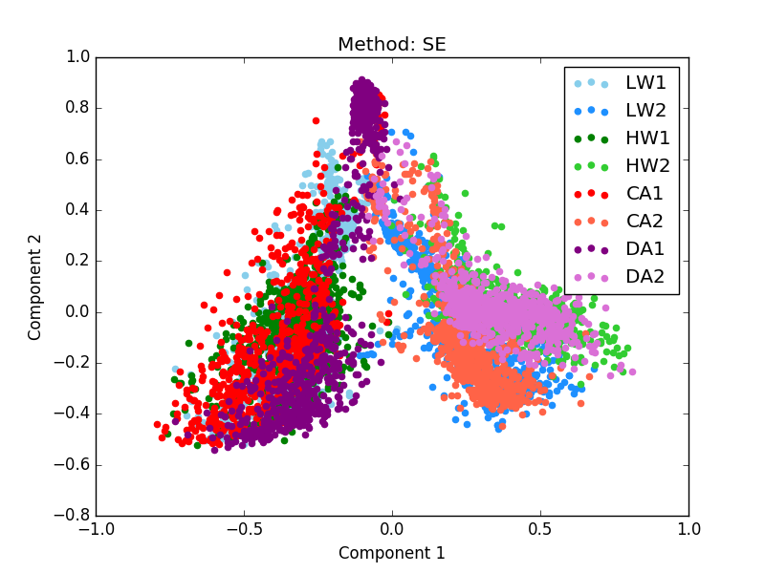
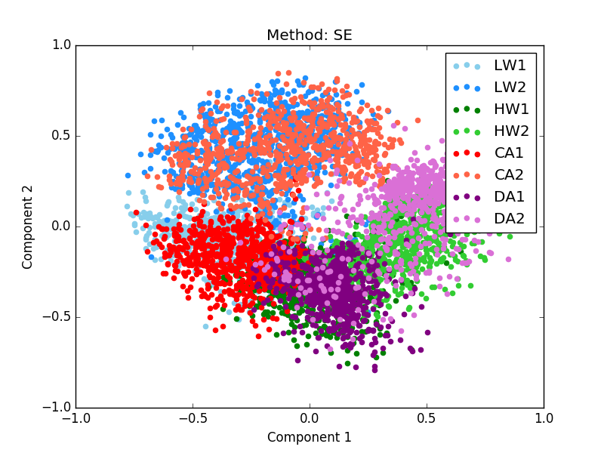
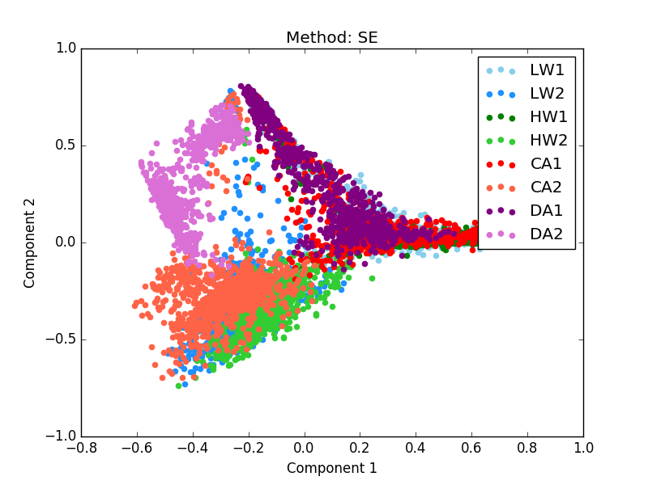
Variance Challenge
Differences between Days
Found that a model built on Day 1 Bench won’t necessarily work on Day 2 Bench
Crew 7
Crew 11
Crew 13
Notes:
Here's our first variance challenges: differences between days.
One of the first things we noticed is that, in general, a person's data from one day doesn't really look like it did in the previous day.
That's what these plots are trying to show. These are using spectral embedding to get our data down to two dimensions. In general, the light colors are your day two data, and your dark colors are your day one. (The exception is LW, where this is switched) You can see that for Crews 7 and 13, you can pretty easily find a line that separates the two days. Crew 11, there's isn't as much of a clean line, but data from the same day definitely clusters together easier than data from the same class.
In fact, using a gradient tree booster, we found we were able to predict with almost perfect accuracy. whether or not a sample was from day 1 or day 2 (concentrating on only one pilot).
Meanwhile, building a model on day one and trying to predict on day two led to very poor accuracy.
This we can guess is for a lot of reasons
Some is sensor related: these sensors were removed and replaced between experiments. Taking the respiration for example, if it's a little tighter or looser the previous day, the raw amplitudes will be higher or lower even if the respiration wave is roughly the same. These kinds of differences are easily accounted for with standardization: zero mean, unit variance.
This didn't account for everything, however. In the end, at least for this analysis, we decided to concentrate on only building models for the same day they'll be used (introducing the concept of the models "expiring"), and leaving the issue of generalizing over major temporal differences for another day.

Slide 11
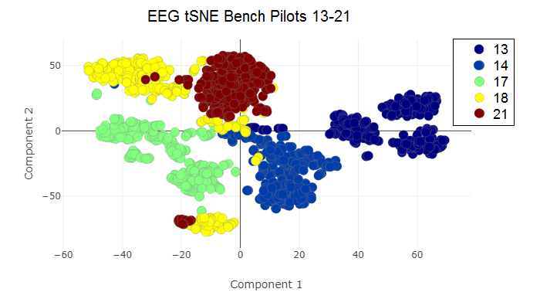
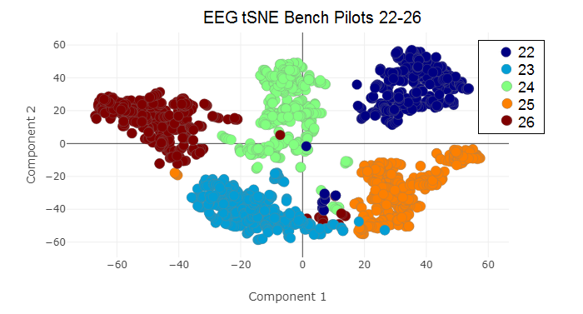
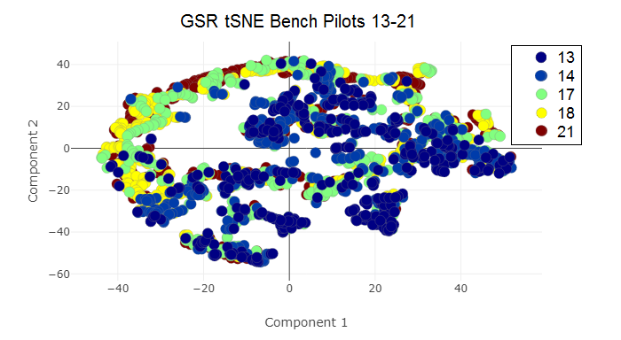
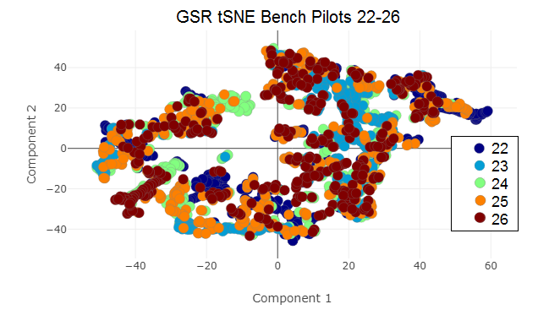
Variance Challenge
Differences between Pilots
Hard to predict from pilot to pilot; variance is more pronounced in certain modalities
Notes:
One of the themes we've found across all our data is there's a good amount of variance from pilot to pilot (people are different: surprise!). In fact, like Day1/Day2 differences, sometimes you can almost predict between different pilots better than you can predict cognitive states.
This variance is more pronounced in certain modalities. EEG data, for example, is very prone to this. See how there really isn't much overlap between pilots. (Forgive the fact that this is separated into two groups; it's difficult to visualize all 10 pilots at once)
Meanwhile, GSR is a lot more intermixed. On the first one there's definitely some differences between 17,18, 21 and 13/14, but there's overlap, and at least there's these two major groups. 22 and 26, all seem pretty intermixed. This kind of makes sense; EEG is an extremely complex signal looking at brain waves, whereas GSR, at the end of the day, is focused on one phenomena: was there a drop in the signal, and if so what did that drop look like?

Slide 12
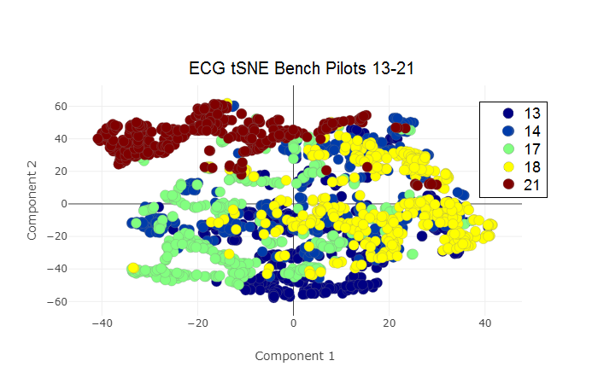
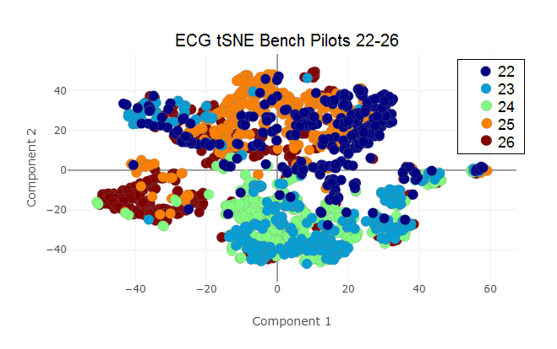
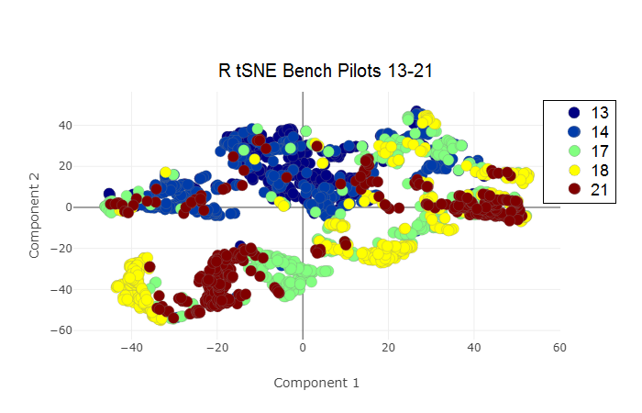
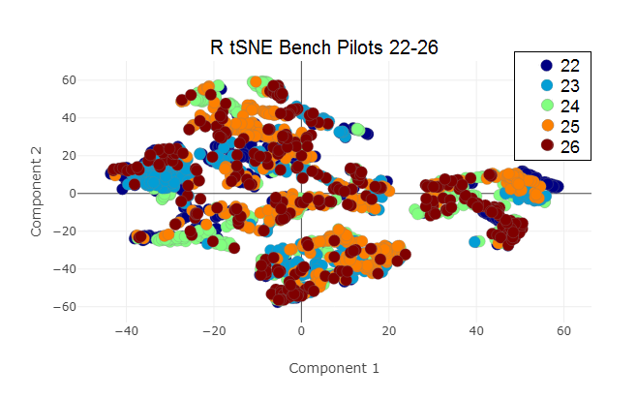
Variance Challenge
Differences between Pilots
Notes:
Here's looking at the other modalities, ECG and Respiration. Both of these are like GSR; there are groups of multiple pilots, and they kinda stick together.

Slide 13
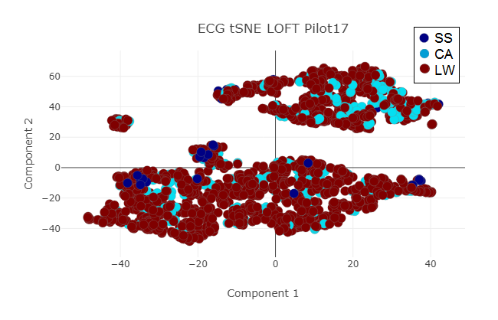
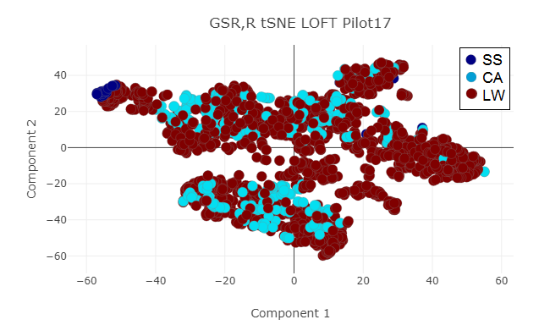
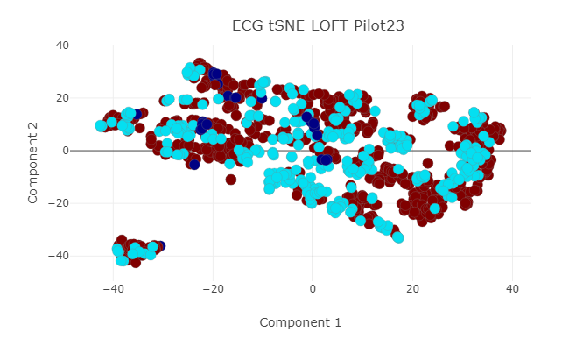
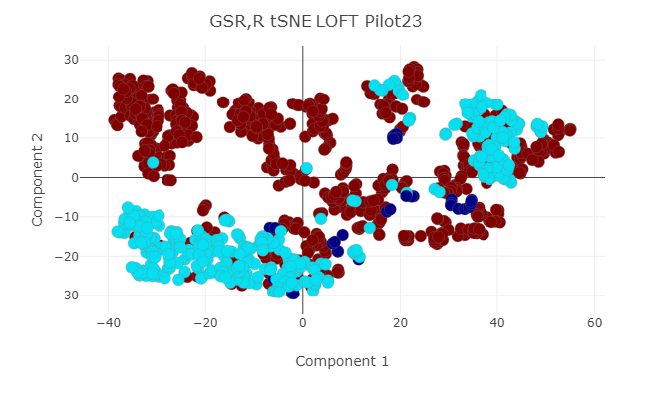
Variance Challenge
Preferred Modalities
SS = Startle/Surprise
CA = Channelized Attention
LW = Low Workload
Notes:
In a continuation of the difference between pilots, we also found a bit of a bias between which modality a pilot tended to "prefer" (meaning that modality indicated X class more than others).
We did a ton of analysis looking at all the different modalities and modality combos, and found that for the most part, each pilot had one modality set that worked really well. It just isn't necessarily the same, and it'll change based on what state we're interested in.
For Example, in Pilot 17 GSR + Respiration seemed to do a better job of differeniating SS (although neither really did the job to split CA and LW).
Of course, for Pilot 23, we see that neither modality/modality set really did the job for predicting SS (although GSR/R did okay), however GSR and R does a great job of splitting up CA and LW.
I'll also point out as we look at these that this is the first time we've looked at LOFT tSNEs. LOFT is a more difficult beast, being more real time data, and in many cases we saw this overlap between CA and LW.

Slide 14
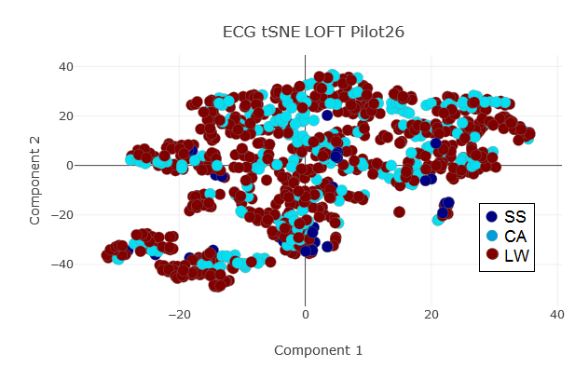
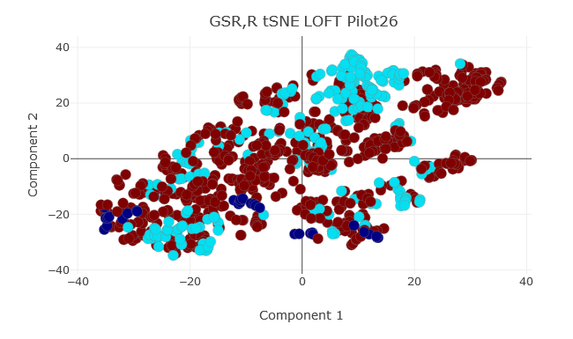
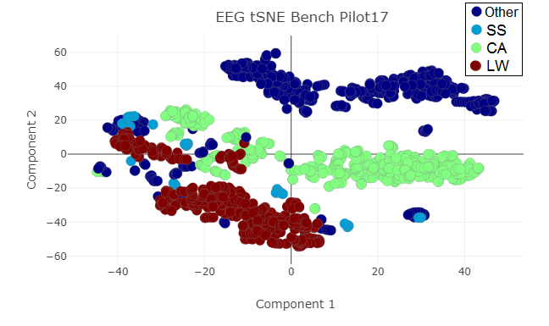
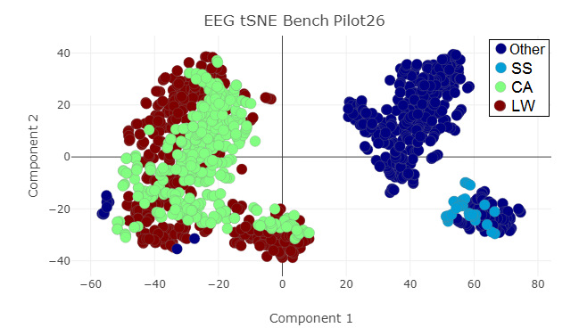
Variance Challenge
Preferred Modalities
Notes:
Here's the same two plots but for Pilot 26. You can see that neither really worked all that well.
Let's take a look at some Benchmark EEG, though (LOFT EEG tended to be very noisy). For Pilot 17, this actually worked great at differentiating between classes. It worked well for Pilot 26 as well, although did a much better job at differentiating SS from everything else.
In addition to just people being different and reacting a different way, sometimes this can be attributed to a sensor being set slightly off, or failing all together. We have one pilot who completely lost GSR in Benchmark (so obviously, other modalities have to pick up the slack). This isn't as "model-breaking", but it is interesting, and gives us the idea that we can't just throw all modalities together and expect a good result; we have to pick and choose our modalities, ignore bad ones, allow good ones, etc.

Slide 15
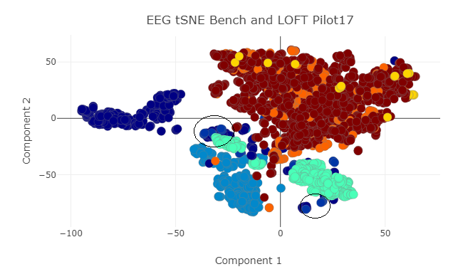
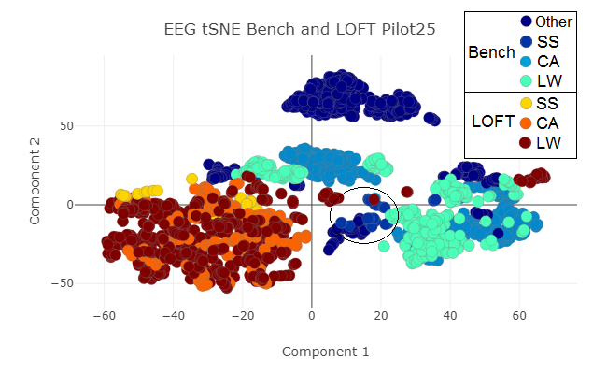
Variance Challenge
Difference Between LOFT and Benchmarks
Often difficult to translate between benchmark and LOFT
Notes:
And finally, let's talk about the difference between benchmark and LOFT. We found in many cases there was a large difference between benchmark and LOFT. In other words, it's hard to generalized between benchmark tasks and LOFT tasks.
And like the others, it depends on the modality or pilot. For pilots 17 and 25, the variance is more pronounced in EEG. (Even though it's doing a good job of differentiating classes as well)

Slide 16
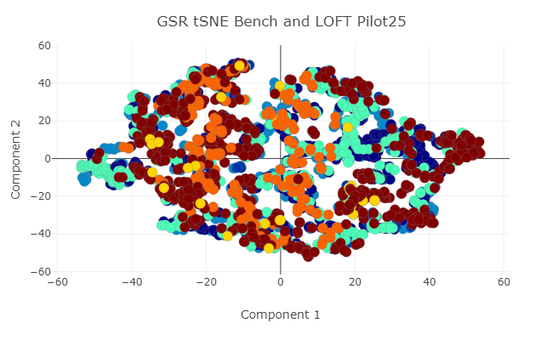
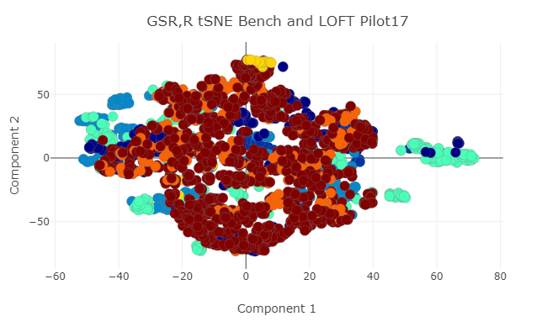
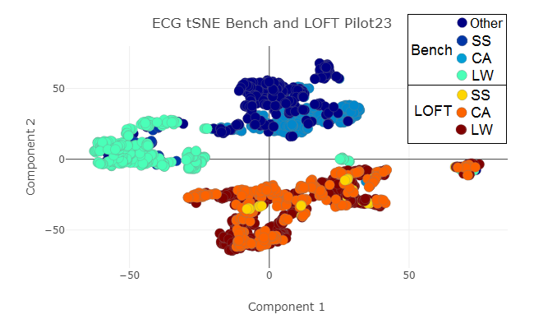
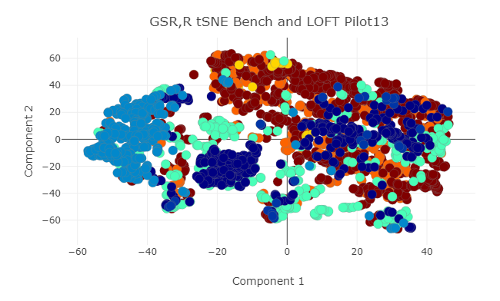
Variance Challenge
Notes:
So here's some of the other modalities. There's a lot more overlap in the GSR. Same story with Pilot 17 GSR,R. Pilot 13's GSR/R, it's a bit of a mixed bag. For ECG Pilot 23, it's a lot more stark.
Not all of our plots are this bad; it depends. So obviously, we need to do more work in taking away this variance. But it helps to have a model framework to test out and see how well we're meeting the goal: (Can we use benchmark data to predict on LOFT, same day, same pilot?). So with all of these thoughts in mind, let's look at the model generating pipeline itself....

Slide 17
The Pipeline
Training a Pilot Dependent Model
Input raw sensor data
  SS, LW, and CA Day 1 Benchmarks
  66% holdout of LOFT
Generate features
Create X State Detector for each state
Each detector is comprised of multiple anomaly/novelty detectors (with the state being the anomaly) each built with a different modality combination
Each anomaly detector is trained with benchmark data and individually tuned on the LOFT holdout
Super Model
Wrapper to hold all the state detectors
Voting Ensemble
(SS vs Other)
Voting Ensemble
(CA vs Other)
Anomaly Detector based on R
OC SVM or Isolation Forest
Anomaly Detector based on GSR + EEG
OC SVM or Isolation Forest
Anomaly Detector based on ...
OC SVM or Isolation Forest
Majority Vote to answer
“SS? Yes or No”
Notes:
This is the pipeline we created for a pilot dependent, single day model
- Overall what we do is train a model off of benchmark tasks, validate that model by hyperparameter tuning using a holdout of LOFT data, and deploy the model on the remaining LOFT.
The model we create is essentially an ensemble of anomaly/novelty detectors. (Specifically, One Class SVMs or Isolation Forests respectively.)
We create a "Voting Ensemble" that is an X State Detector, meaning it's only purpose is to predict whether a sample is X State, or not.
This voting ensemble is comprised of multiple anomaly detectors, one for each possible modality combination (for example one for EEG only, and one for GSR, Respiration, and EEG). All of these models vote to see what they think is the correct answer. Majority wins. You can also get a "quick and dirty" probability metric by returning the ratio of # of yes votes versus total number of models.
In our case, we have 3 "states" not including "Other", so we would have one State Detector for Startle/Surprise, one for Channelized Attention, and one for Low Workload.
Theoretically we can combine all of the different state predictions into one prediction (perhaps by one state taking precedence or looking at the probabilities), but these results I wills show you them separately.
So why did we do this? Well a lot of reasons.
We validate on LOFT data because we were unable to generalize our features from bench to LOFT without any information of what LOFT will look like. Doing this validation step substantially helped the models and makes them more useable.
As I mentioned before, we found that every pilot had some modality combinations that worked well, but we couldn't ever find one that worked "the best". This ensemble approach is a way to combine all of these models and hope that by voting, they will "sort out themselves" the correct answer. We did find that this ensemble way out performed taking the average of all the individual modality combination models.
Also this method makes it very easy to add/remove new modalities. For example, the current analysis we're doing has added back in Eye Tracking Data, but due to technical difficulties we sometimes can't use GSR and we are no longer using Respiration. The ensemble can be configured to use only the modalities you want to use.
Anomaly detectors are used to deal with our class imbalance issue. Plus conceptually, most of these states are in fact anomalies (you are hopefully not always startled or channelized!)
The States themselves are kept separate partially because we're still in development, so it's easier to add new states this way, but also because it's hard to say definitely that you can't be in two or three states at once. For example, you're probably not startled and channelized at the same time, but maybe you're experiencing CA and LW at the same time? We saw a lot of overlap between CA and LW data in LOFT, so perhaps this would be explained by that.

Slide 18
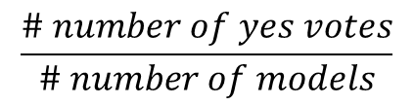
The Pipeline
Testing
Deploy on remaining 34% of LOFT
For each testing window:
  Generate features
  For each state detector:
    Run data through each model in the ensemble and gather predictions
    Hold a simple majority vote to choose the prediction
    Alternative: return the probability:
Super Model
Wrapper to hold all the state detectors
Voting Ensemble
(SS vs Other)
Voting Ensemble
(CA vs Other)
Anomaly Detector based on R
OC SVM or Isolation Forest
Anomaly Detector based on GSR + EEG
OC SVM or Isolation Forest
Anomaly Detector based on ...
OC SVM or Isolation Forest
$$\frac{\# number of yes votes}{\# number of models}$$
Majority Vote to answer
“SS? Yes or No”
Notes:
This is the pipeline we created for a pilot dependent, single day model
- Overall what we do is train a model off of benchmark tasks, validate that model by hyperparameter tuning using a holdout of LOFT data, and deploy the model on the remaining LOFT.
The model we create is essentially an ensemble of anomaly/novelty detectors. (Specifically, One Class SVMs or Isolation Forests respectively.)
We create a "Voting Ensemble" that is an X State Detector, meaning it's only purpose is to predict whether a sample is X State, or not.
This voting ensemble is comprised of multiple anomaly detectors, one for each possible modality combination (for example one for EEG only, and one for GSR, Respiration, and EEG). All of these models vote to see what they think is the correct answer. Majority wins. You can also get a "quick and dirty" probability metric by returning the ratio of # of yes votes versus total number of models.
In our case, we have 3 "states" not including "Other", so we would have one State Detector for Startle/Surprise, one for Channelized Attention, and one for Low Workload.
Theoretically we can combine all of the different state predictions into one prediction (perhaps by one state taking precedence or looking at the probabilities), but these results I wills show you them separately.
So why did we do this? Well a lot of reasons.
We validate on LOFT data because we were unable to generalize our features from bench to LOFT without any information of what LOFT will look like. Doing this validation step substantially helped the models and makes them more useable.
As I mentioned before, we found that every pilot had some modality combinations that worked well, but we couldn't ever find one that worked "the best". This ensemble approach is a way to combine all of these models and hope that by voting, they will "sort out themselves" the correct answer. We did find that this ensemble way out performed taking the average of all the individual modality combination models.
Also this method makes it very easy to add/remove new modalities. For example, the current analysis we're doing has added back in Eye Tracking Data, but due to technical difficulties we sometimes can't use GSR and we are no longer using Respiration. The ensemble can be configured to use only the modalities you want to use.
Anomaly detectors are used to deal with our class imbalance issue. Plus conceptually, most of these states are in fact anomalies (you are hopefully not always startled or channelized!)
The States themselves are kept separate partially because we're still in development, so it's easier to add new states this way, but also because it's hard to say definitely that you can't be in two or three states at once. For example, you're probably not startled and channelized at the same time, but maybe you're experiencing CA and LW at the same time? We saw a lot of overlap between CA and LW data in LOFT, so perhaps this would be explained by that.

Slide 19
Results
SS Detector Metrics
CA Detector Metrics
Pilot | AUC | ACC | SS ACC | Other
13 | 0.5073 | 0.9029 | 0.0909 | 0.9236
14 | 0.6309 | 0.8849 | 0.3636 | 0.8981
17 | 0.7504 | 0.5099 | 1 | 0.5008
18 | 0.5495 | 0.8162 | 0.2727 | 0.8263
21 | 0.8945 | 0.7929 | 1 | 0.7889
22 | 0.6772 | 0.7165 | 0.6364 | 0.718
23 | 0.8752 | 0.9283 | 0.8182 | 0.9323
24 | 0.662 | 0.6012 | 0.7273 | 0.5968
25 | 0.7034 | 0.6812 | 0.7273 | 0.6794
26 | 0.7384 | 0.6644 | 0.8182 | 0.6585
Avg | 0.6989 | 0.7499 | 0.6455 | 0.7523
STD | 0.1179 | 0.1314 | 0.2916 | 0.1388
Pilot | AUC | ACC | CA ACC | Other
13 | 0.4991 | 0.5643 | 0.3554 | 0.6429
14 | 0.6321 | 0.754 | 0.3636 | 0.9006
17 | 0.4554 | 0.4189 | 0.51 | 0.4008
18 | 0.5291 | 0.3278 | 0.83 | 0.2282
21 | 0.6438 | 0.7606 | 0.404 | 0.8836
22 | 0.6388 | 0.5271 | 0.8676 | 0.41
23 | 0.4617 | 0.3531 | 0.8091 | 0.1143
24 | 0.5771 | 0.675 | 0.2636 | 0.8905
25 | 0.6354 | 0.5336 | 0.8378 | 0.433
26 | 0.4448 | 0.349 | 0.6351 | 0.2545
Avg | 0.5517 | 0.5263 | 0.5876 | 0.5158
STD | 0.0789 | 0.1558 | 0.2236 | 0.2799
AUC: Receiver Operating Characteristic Area Under the Curve
ACC: Straight Accuracy Metric
X ACC: How well did we predict the state?
Other: How well did we predict “Other” as “Other”?
Notes:
Metrics are reported for each pilot, using a weighted ROC AUC score, a straight Accuracy metric, and an individual look at the two classes (state vs other) I didn't show LW vs ALL, because although we did try it, the results were pretty bad. Which makes sense; these are anomaly detectors, and I wouldn't say LW is much of an anomaly. So this methodology at least using this pipeline didn't work for LW.
For SS, it actually worked alright (although it again worked better for one pilot. We had a lot of times where the models preferred one state over the other (often preferring SS, but not always), but bolded is Pilot 23, who did super fabulous amazing. All in all, an average AUC of just shy of 0.7, and an average ACC of 0.75.
CA didn't do as great, but it again depended on the pilot. This might also be because CA is much less of an anomaly as SS. Some pilots did okay-ish, but on overage, accuracies weren't much better than chance, and none of the models are WOW AMAZING!!!!!

Slide 20
Takeaways and Future Work
Generalization is difficult (in general ☺)
  Some modalities are easier to generalize than others
  Some state detection is easier to generalize than others
  Some machine learning tools can be used to mitigate some of this
Work is continuing on many avenues:
  Different Features
  Different Modalities
  Different Sensors
  Concentrating on Startle/Surprise
Notes:
The biggest take away you should have is generalization is difficult (in general). Some times it's easier, some times it hard, but in general, as soon as you start looking at a different dataset, we start losing. We can do some things on the featurizing, machine learning side, but really the real fix is to get more data and more information.
Like I said, this is still a work in progress, and we're working on many different avenue. We've had new data come in, so we're checking out different features, modalities, and even sensors for the same modalities. Currently we're focused on a SS-only model that is pilot independent, and we're having some success with that.

Slide 21
Questions?
Commercial Aviation Safety Team, “Airplane State Awareness Joint Safety Analysis Team Interim Report,” URL: http://www.skybrary.aero/index.php/Commercial_Aviation_Safety_Team_%28CAST%29_Reports [cited 5 March 2017]
Harrivel, Angela R., et al. “Prediction of Cognitive States during Flight Simulation using Multimodal Psychophysiological Sensing.” AIAA Information Systems-AIAA Infotech @ Aerospace, May 2017, doi:10.2514/6.2017-1135.
Christensen, J. C., Estepp, J. R., Wilson, G. F., Russel, C. A.,“The effects of day-to-day variability of physiological data on operator functional state classification,” NeuroImage, Vol.59,2012, pp.57–63.
Berka, C., Levendowski, D. J., Lumicao, M. N., Yau, A., Davis, G., Zivkovic, V. T., Olmstead, R. E., Tremoulet, P. D., Craven, P. L., “EEG Correlates of Task Engagement and Mental Workload in Vigilance, Learning, and Memory Tasks,” Aviation, Space and Environmental Medicine, Vol. 78, No. 5, 2007, Section II.
Li, F., “Improving Engagement Assessment by Model Individualization and Deep Learning,” Dissertation, Old Dominion University, 2015.
Gross, J. J. and Levenson, R. W. Emotion elicitation using films. Cognition & Emotion, Vol. 9, 1995, pp. 87-108.
Pope, A. T., Bogart, E. H., Bartolome, E. S., “Biocybernetic system evaluates indices of operator engagement in automated task,” Biological Psychology, Vol. 40, 1995, pp. 187-195.
Santiago-Espada, Y., Myer, R. R., Latorella, K. A., & Comstock, J. R. (2011). The Multi-Attribute Task Battery II (MATB-II) Software for Human Performance and Workload Research: A User's Guide. NASA, Langley Research Center. Hampton: NASA/TM-2011-217164, L-20031, NF1676L-12800.
“Scikit-Learn.” Scikit-Learn: Machine Learning in Python, 0.19.0, scikit-learn.org/stable/index.html.
Bao, Forrest Sheng. “PyEEG.” PyEEG Reference Guide, 0.02 r1, pyeeg.sourceforge.net/.
Python Core Team. “Python.” Python Software Foundation, 3.6.3, https://www.python.org
A. Gramfort, M. Luessi, E. Larson, D. Engemann, D. Strohmeier, C. Brodbeck, L. Parkkonen, M. Hämäläinen, MNE software for processing MEG and EEG data, NeuroImage, Volume 86, 1 February 2014, Pages 446-460, ISSN 1053-8119
A. Gramfort, M. Luessi, E. Larson, D. Engemann, D. Strohmeier, C. Brodbeck, R. Goj, M. Jas, T. Brooks, L. Parkkonen, M. Hämäläinen, MEG and EEG data analysis with MNE-Python, Frontiers in Neuroscience, Volume 7, 2013, ISSN 1662-453X

