Slide 1
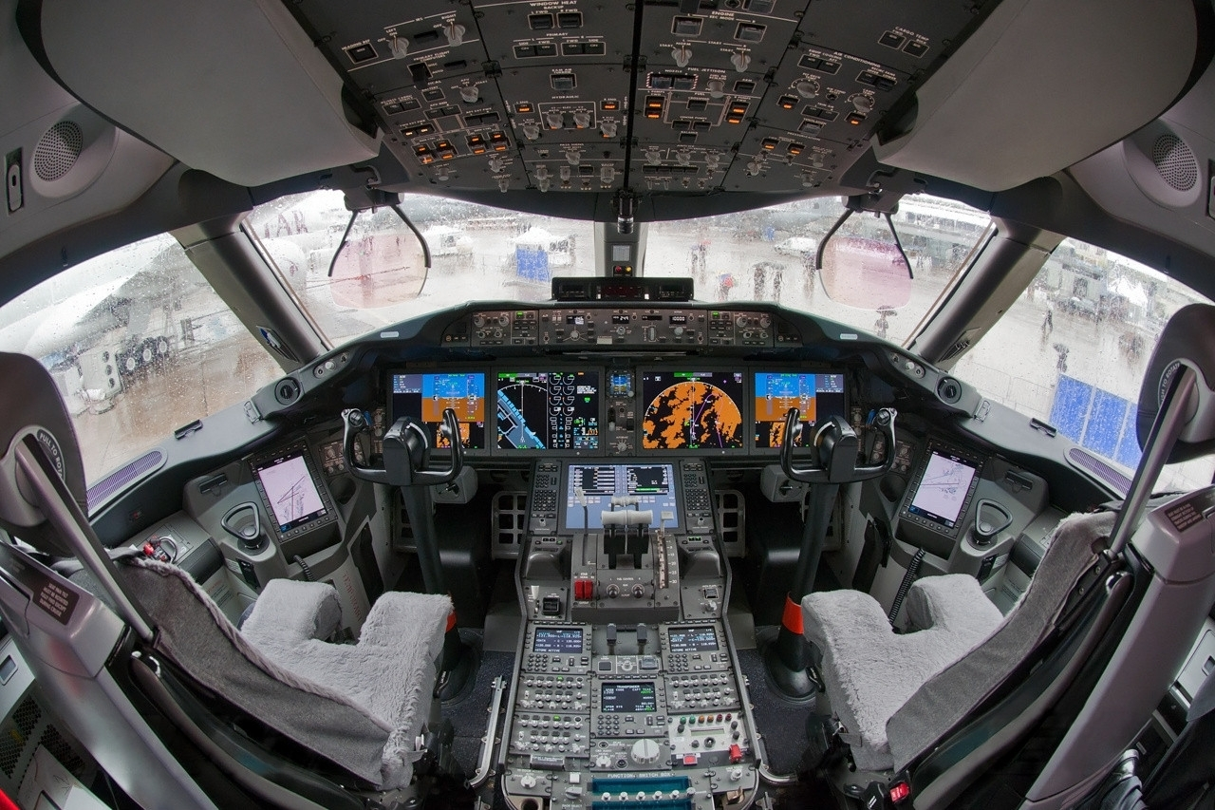


MITIGATING PILOT DISORIENTATION WITH
SYNTHETIC VISION DISPLAYS
Kathryn Ballard
Trey Arthur
Kyle Ellis
Renee Lake
Stephanie Nicholas
Lance Prinzel

Slide 2
What is the problem?
Why NASA?
What are synthetic vision displays?
How were they tested?
How did pilot subjects affect testing and analysis?

Slide 3
Fatal Accidents | Worldwide Commercial Jet Fleet | 2006 to 2015
Boeing Statistical Summary of Commercial Jet Airplane Accidents Worldwide Operations, 2016

Slide 4
Fatal Accidents | Worldwide Commercial Jet Fleet | 1987 to 2005
Boeing Statistical Summary of Commercial Jet Airplane Accidents Worldwide Operations, 2006

Slide 5








Slide 6
Airplane State Awareness (ASA)
Joint Safety Analysis Team (JSAT)
STUDIED 18 LOSS OF CONTROL – IN FLIGHT ACCIDENTS AND INCIDENTS (2001-2010)
Majority of these accidents involved loss of attitude (spatial disorientation) and/or loss-of-energy state awareness
Design and research “Virtual Day-VMC” or “Synthetic Vision” display technologies

Slide 7
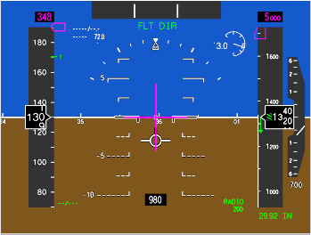
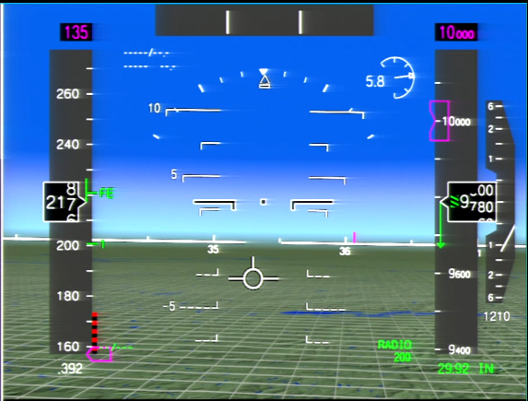
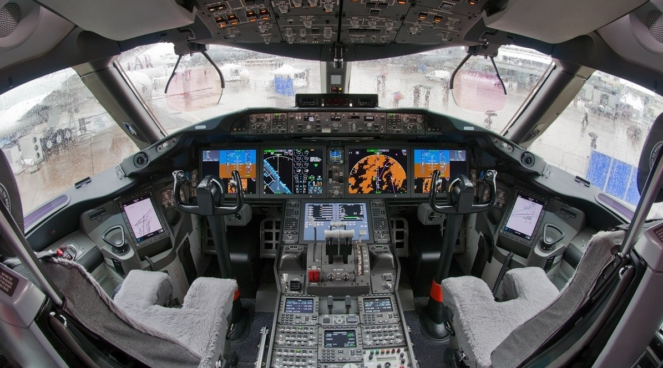
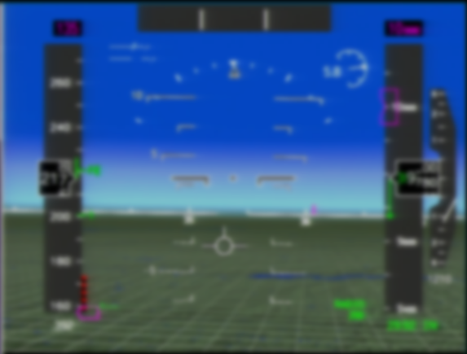
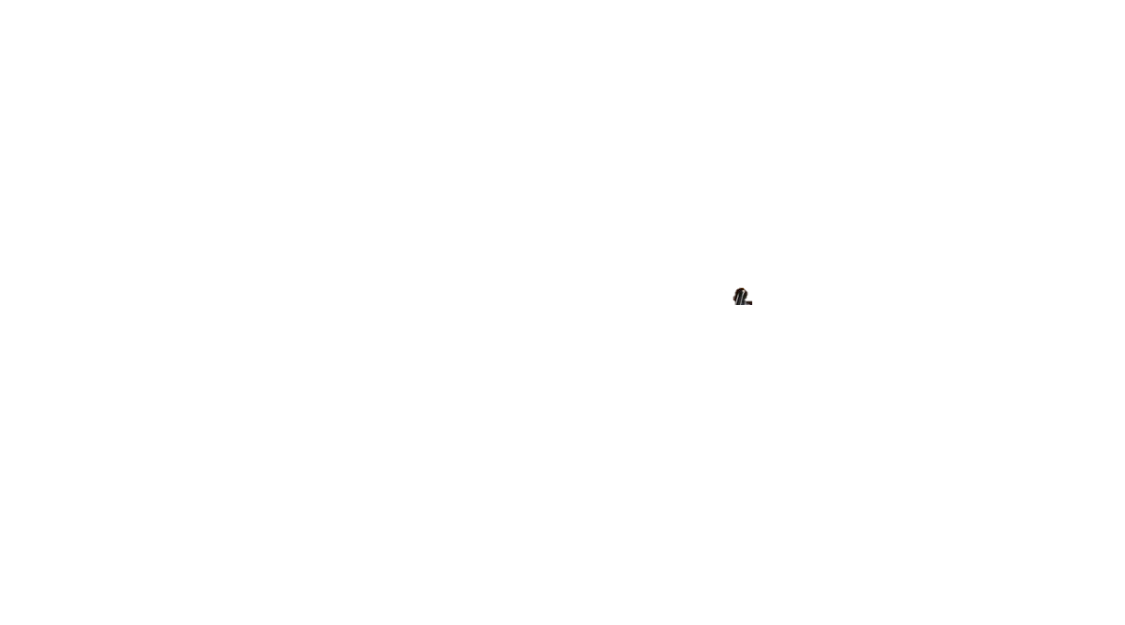
Traditional Blue-Over-Brown vs Synthetic Vision Display
upload.wikimedia.org/wikipedia/commons/4/44/Boeing_787-8_N787BA_cockpit.jpg

Slide 8
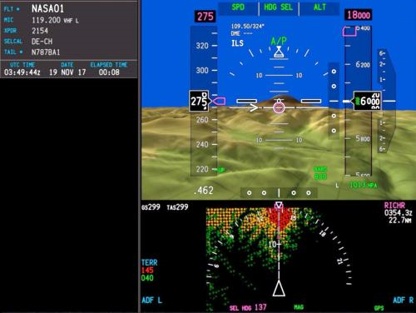
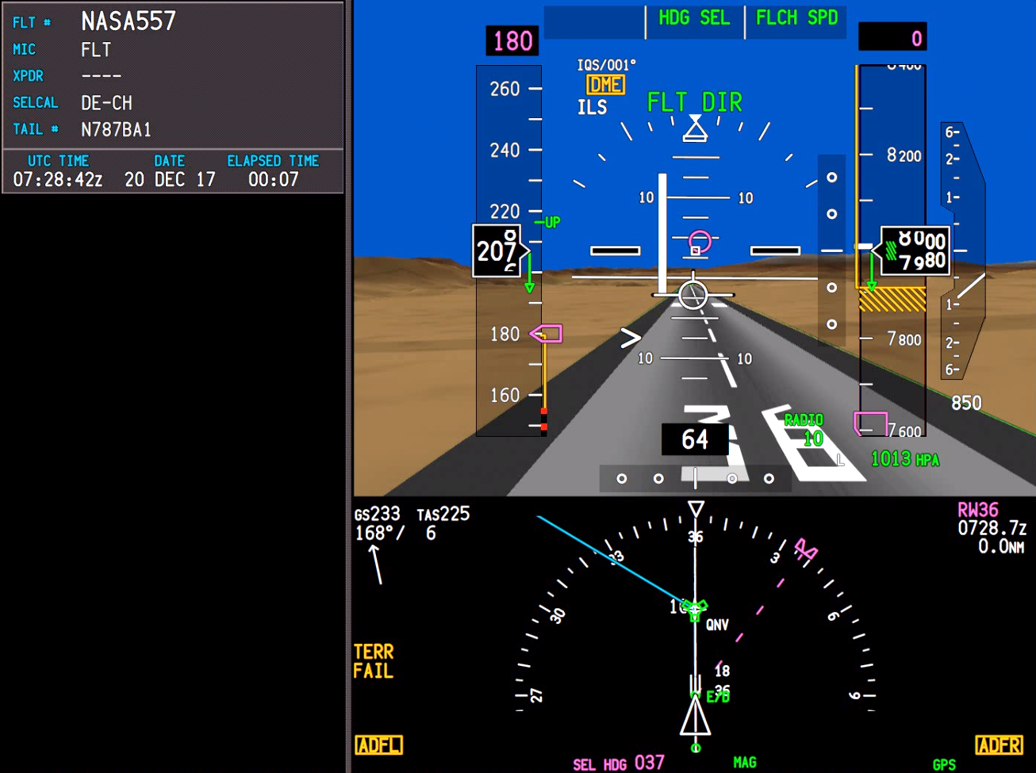
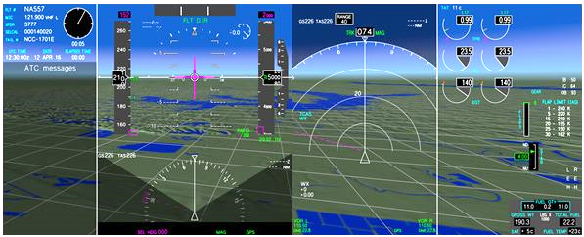
Synthetic Vision Displays

Slide 9
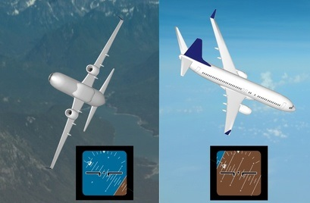
AFDC Research Questions
Do synthetic vision displays improve spatial awareness during unusual attitudes?
www.linkaviation.com/images/410_unusual_attitude.jpg

Slide 10
AFDC Research Questions
Do synthetic vision displays improve spatial awareness during unusual attitudes?
How should synthetic vision displays be presented?
Can synthetic vision displays provide enough visual dominance to overcome physical illusions?

Slide 11
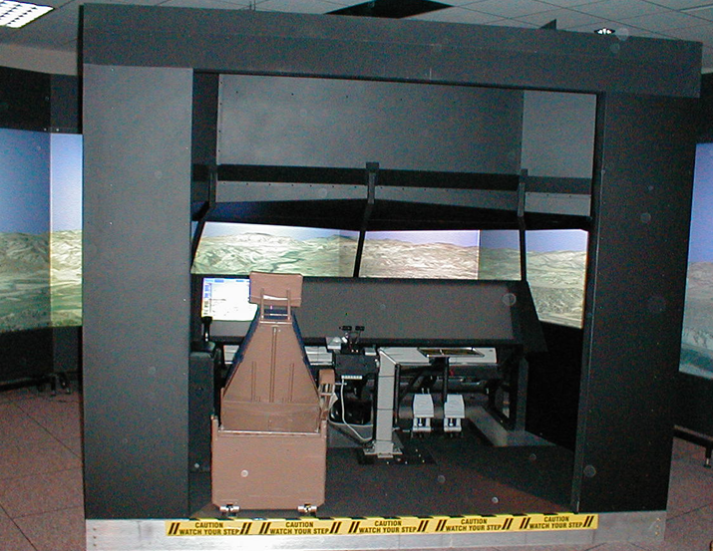
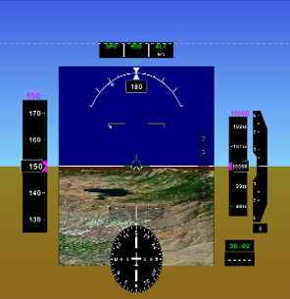
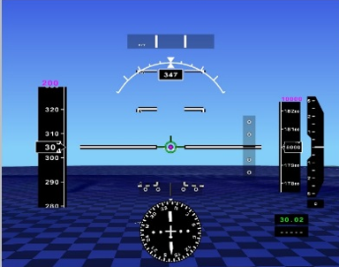
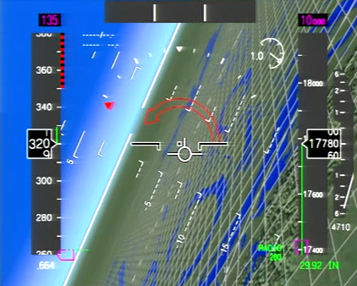
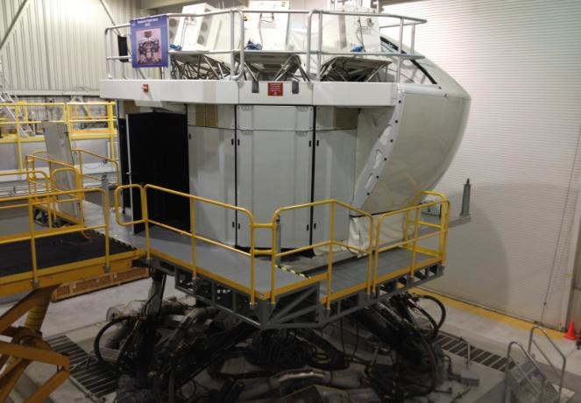
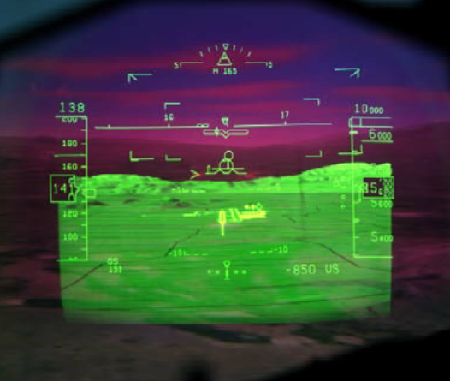
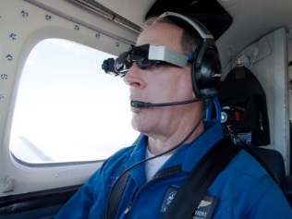
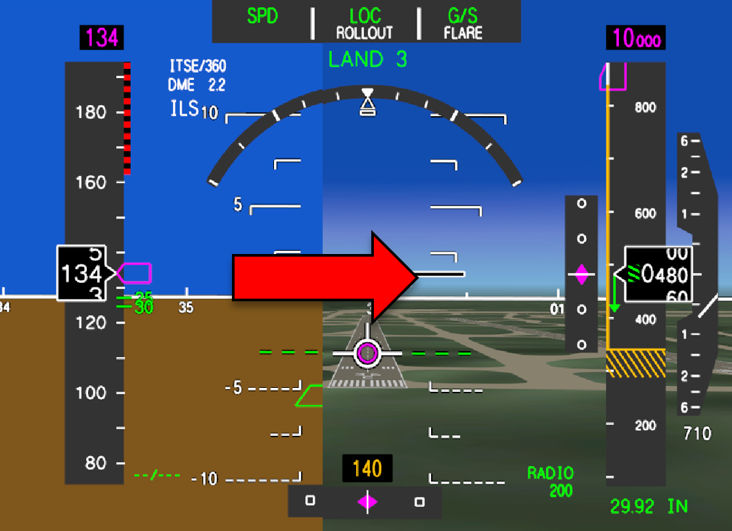
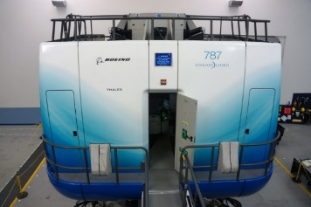
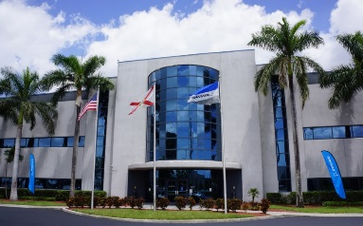
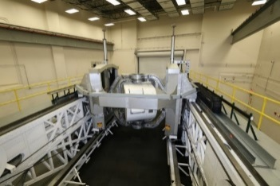
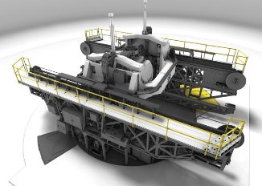
2015
MARCH
JULY
Attitude Recognition
Design of Virtual Day-VMC Displays
2016
MAY
Attitude Awareness – UARs and SPOT Scenarios
AUGUST
Head-Up and Head-Worn Display Simulator and Flight Test
2017
APRIL
Display Transition During Recovery
2018
JANUARY
APRIL/MAY
Low-Hour and International Pilots UARs and LOFT Scenarios
Energy and Attitude State – Extreme Upsets and Recovery

Slide 12
NASA Langley Experiment
Keep or remove synthetic vision during unusual attitude recovery
Experiment Design
Balancing act between:
  Facility schedule
  Available pilots
Tested 12 pilots, around 1.5 hours each
  Able to complete a repetition of the run matrix

Slide 13
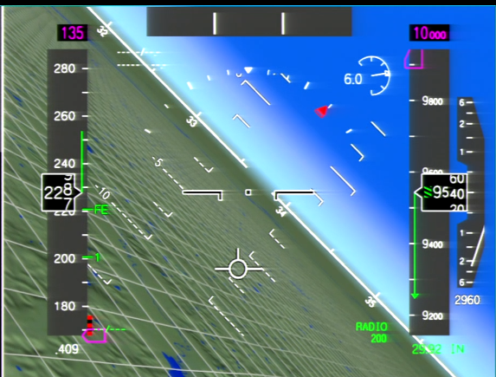
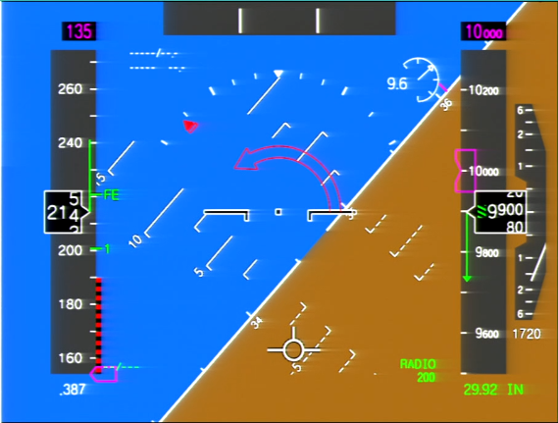
NASA Langley Experiment
Keep or remove synthetic vision during unusual attitude recovery
Keep synthetic vision during unusual attitudes
Pull synthetic vision during unusual attitudes
Baseline
Each pilot flew 4 unusual attitude recoveries at different orientations at each of three display configurations, then repeated everything

Slide 14

Analysis Methods
A variety of mixed models were used to test the hypothesis of the form:
$$H_{0}:Display does not affect variable of interest$$
$$H_{A}:Display does affect the variable of interest$$
Model: $Variable of Interest\sim Display+Orientation+Display:Orientation+1|Pilot$
Linear mixed model | Continuous normal variables | Max roll, max pitch, max alpha, delta altitude, delta speed
Generalized linear mixed model with a log link | Time to event variables | Time to first pitch input, time to first roll input, Time to first correct roll
Generalized linear mixed model, Poisson family | Discrete count variable | Number of roll reversals
Cumulative link mixed model | Ordered discrete variable | Total UAR score
α = 0.05/12 = 0.004

Slide 15
Boeing Facility Experiment
Synthetic Vision vs Blue-over-Brown with International Pilots
Experiment Design
Balancing act between:
  Boeing facility schedule
    Nearly all time slots were midnight – 4am
  Researcher staffing
  International pilots
    There was a pilot strike before testing was supposed to start
Worked with 12 crews, two hours each
  Limited the number of unusual attitude recoveries (no repetition – less power)

Slide 16
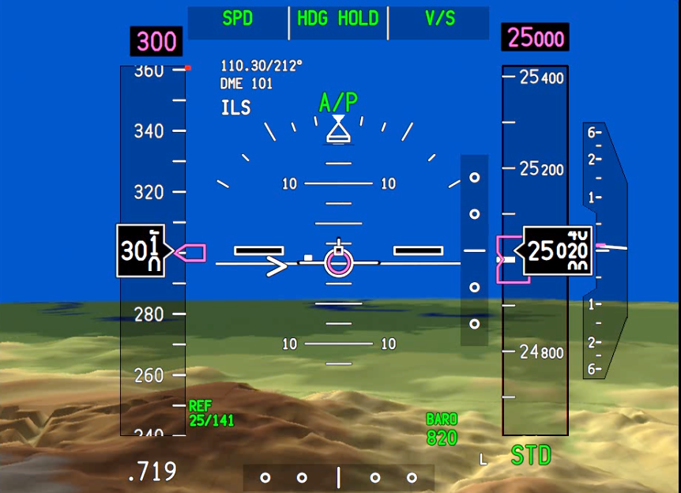
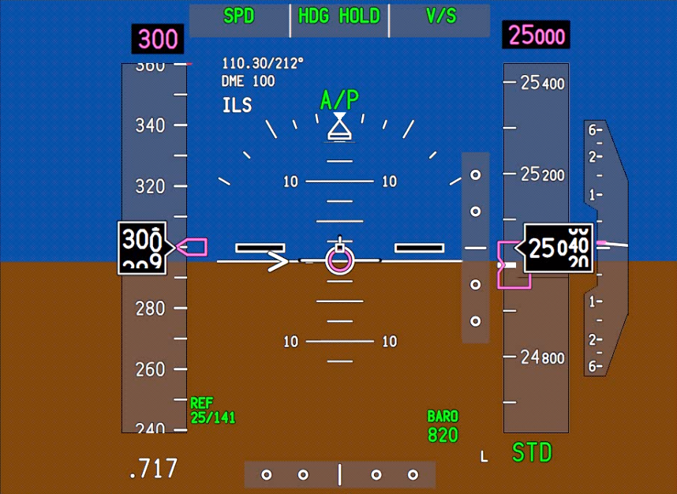
Boeing Facility Experiment
Synthetic Vision vs Blue-over-Brown with International Pilots
Synthetic Vision
Baseline
Each crew flew 4 unusual attitude recoveries at different orientations at two display configurations

Slide 17

Analysis Methods
Two mixed models will be used to test the hypothesis of the form:
$$H_{0}:Display does not affect variable of interest$$
$$H_{A}:Display does affect the variable of interest$$
Model: $Variable of Interest\sim Display+Orientation+Display:Orientation+1|Pilot$
Linear mixed model | Continuous normal variables | Max roll, max pitch, max alpha, delta altitude, delta speed
Generalized linear mixed model with a log link | Time to event variables | Time to first pitch input, time to first roll input, Time to first correct roll
Generalized linear mixed model, Poisson family | Discrete count variable | Number of roll reversals
Cumulative link mixed model | Ordered discrete variable | Total UAR score
Subjective questionnaire data may give more insights.

Slide 18
DRD Facility Experiment
Synthetic Vision with Background Attitude Indicator vs Blue-over-Brown
Disorientation
Research Device
Experiment Design
Balancing act between:
  DRD Facility
  Pilot availability
  Pilot fortitude
    Subjected to vestibular illusions and up to 3g’s of force during each unusual attitude recovery
We plan to recruit 24 pilots who will spend around six hours at the facility

Slide 19
DRD Facility Experiment
Synthetic Vision with Background Attitude Indicator vs Blue-over-Brown
Daily Experiment Schedule
Pilot 1 completes unusual attitude recoveries
Pilot 2 joins Pilot 1 for a Special Purpose Orientation Training run
Pilot 1 completes illusion runs
Pilot 2 completes unusual attitude recoveries
Pilot 2 completes illusion runs

Slide 20
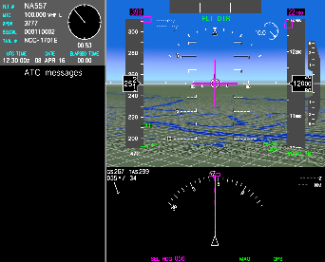
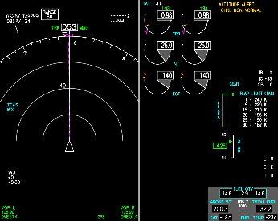
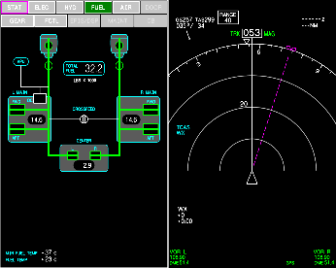
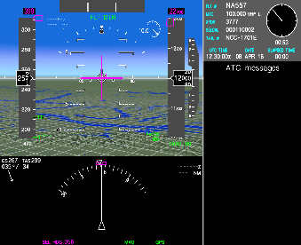
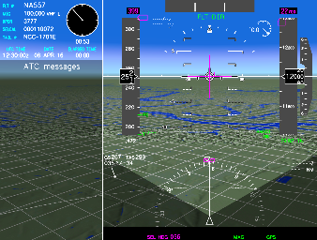
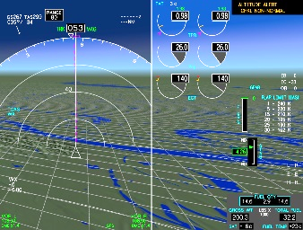
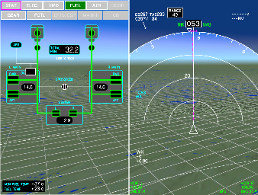
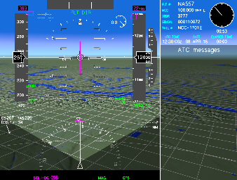
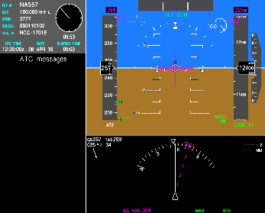
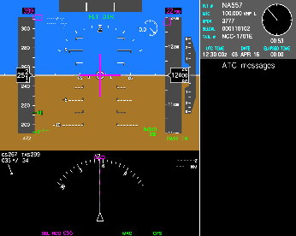
DRD Facility Experiment
Synthetic Vision with Background Attitude Indicator vs Blue-over-Brown
Synthetic vision
Background attitude indicator
Baseline
Each pilot will fly 4 unusual attitude recoveries at different orientations at each of three display configurations, then repeat everything.

Slide 21

Analysis Methods
Mixed models will be used to test the hypothesis of the form:
$$H_{0}:Display does not affect variable of interest$$
$$H_{A}:Display does affect the variable of interest$$
Model: $Variable of Interest\sim Display+Orientation+Display:Orientation+1|Pilot$
Linear mixed model | Continuous normal variables | Max roll, max pitch, max alpha, delta altitude, delta speed
Generalized linear mixed model with a log link | Time to event variables | Time to first pitch input, time to first roll input, Time to first correct roll
Generalized linear mixed model, Poisson family | Discrete count variable | Number of roll reversals
Cumulative link mixed model | Ordered discrete variable | Total UAR score

Slide 22
AFDC Experiment Series Summary
Data collection and analysis still ongoing
Very positive feedback from pilots
Test Planning
  Consider facility and pilot constraints
Analysis
  Each pilot has a unique recovery style so a mixed effects model is appropriate
  With pilot as a random effect, each pilot’s performance is compared to themselves

Slide 23

Questions?
Disorientation Research Device video – “Kraken”
Wright-Patterson Air Force base in Dayton, OH

Slide 24
Back up slides

Slide 25
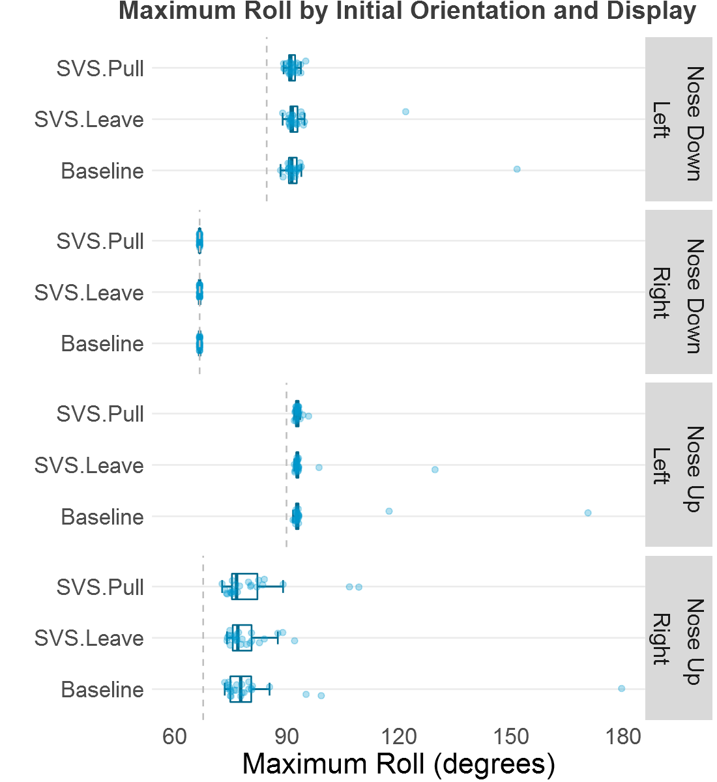
Langley Experiment Results
The initial orientation of the aircraft was a bigger factor than display type in some metrics of interest
  Max roll
  Max pitch
  Delta altitude
Initial roll degree

Slide 26
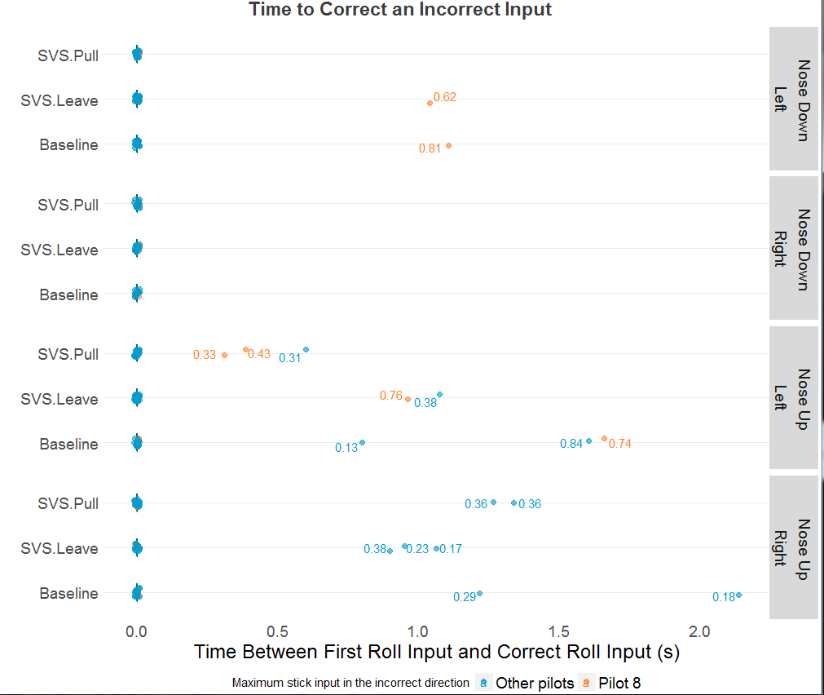
Langley Experiment Results
Most incorrect roll inputs happened in nose up scenarios
Not enough data to compare displays

Slide 27
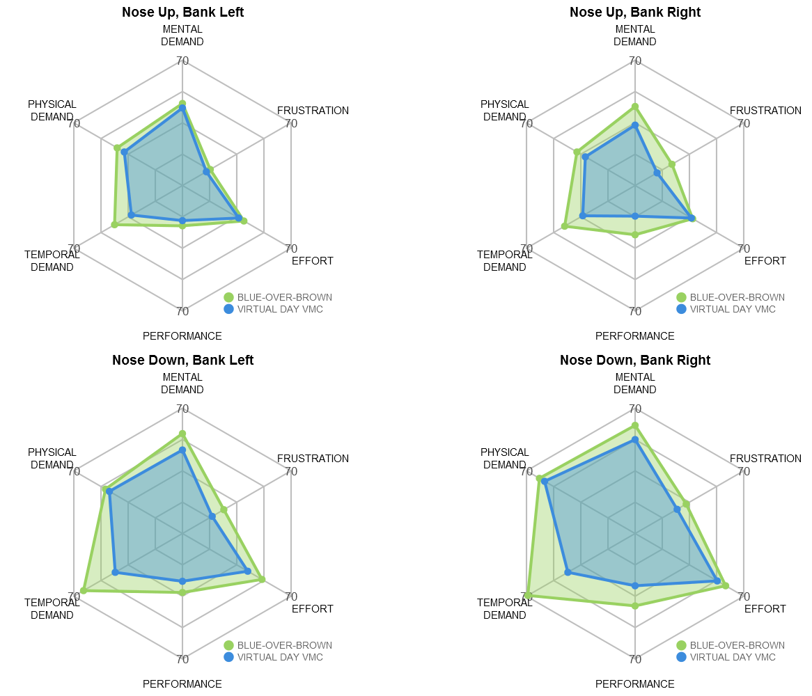
Boeing Experiment: Pilot Workload by Orientation

