Slide 1

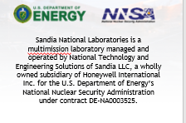
Adoption Challenges in Artificial Intelligence and Machine Learning for Analytic Work Environments
Approved for public release; distribution is unlimited.
Laura A. McNamara, PhD
Cognitive Systems Research and Development
ISR Advanced Exploitation and Human-Systems Integration
Sandia National Laboratories, Albuquerque, NM 87185
DATAWorks Seminar, 17 April 2020

Slide 2
TOPICS
UNCLASSIFIED – UNLIMITED RELEASE
The literature on innovation diffusion is worth reading.
Algorithmic technologies have very specific adoption challenges.
Organizational factors in government settings can play an important role in shaping how people make use of algorithmic technologies.
Artificial Intelligence and Machine Learning innovations need thoughtful, deliberate, context-aware strategies to deal with these challenges.
UNCLASSIFIED – UNLIMITED RELEASE

Slide 3
Innovation Diffusion

Slide 4

Categories and Characteristics of Adopters
Characteristics of Technologies
The Decision Process
The S-Curve of Diffusion

Slide 5
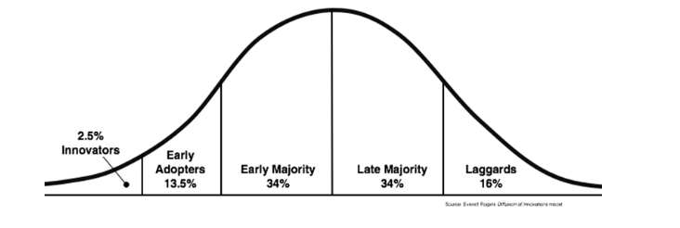
EVERETT ROGERS’ ADOPTER CATEGORIES
Notes:
Innovators - These are people who want to be the first to try the innovation. They are venturesome and interested in new ideas. These people are very willing to take risks, and are often the first to develop new ideas. Very little, if anything, needs to be done to appeal to this population.
Early Adopters - These are people who represent opinion leaders. They enjoy leadership roles, and embrace change opportunities. They are already aware of the need to change and so are very comfortable adopting new ideas. Strategies to appeal to this population include how-to manuals and information sheets on implementation. They do not need information to convince them to change.
Early Majority - These people are rarely leaders, but they do adopt new ideas before the average person. That said, they typically need to see evidence that the innovation works before they are willing to adopt it. Strategies to appeal to this population include success stories and evidence of the innovation's effectiveness.
Late Majority - These people are skeptical of change, and will only adopt an innovation after it has been tried by the majority. Strategies to appeal to this population include information on how many other people have tried the innovation and have adopted it successfully.
Laggards - These people are bound by tradition and very conservative. They are very skeptical of change and are the hardest group to bring on board. Strategies to appeal to this population include statistics, fear appeals, and pressure from people in the other adopter groups.

Slide 6
CHARACTERISTICS OF INNOVATIONS
VISBILITY. How visible is this technology? How impactful is it? To what extent are its benefits describable to others?
COMPATIBILITY. How well does the technology fit into existing ways of doing work? Does the technology support the tasks and outcomes that people are responsible for achieving?
TESTABILITY. Can people experiment with, try out, get to know the technology, without making a wholesale commitment?
COMPLEXITY. How difficult is it for the target user group to develop an accurate working mental model of the technology, so they can apply it effectively in their work?
RELATIVE ADVANTAGE. Compared to existing ways of doing work, what benefits does this bring? How much work is required for the technology to be useful?
Notes:
Visbility – AKA observability, communicability.
Testability – AKA trialability.

Slide 7
DIFFUSION IS EXPLORATORY DECISION-MAKING
Existing Context:
Decision-making framework: Optional/individual, collective, or top-down (authoritarian)
Social network and communication patterns
Perceived/recognized need
Individual differences
Knowledge
Persuasion
Decision
Implementation
Confirmation
Learn about the innovation, how it functions, who’s using the innovation and why.
This is where the innovation characteristics come into play: visibility, trialability,
relative
advantage, etc.
Let’s try it! (Adopt)
Continued integration into practice
Discontinue use.
Meh, not for us. (Reject)
Reconsider, revisit, try out
Confirm rejection.
Notes:
Anpother thing, which I don’t have on this slide – what kind of environment is this? Is the innovation decision optional? Is it something that’s decided by authority? or is it somehwre in the middle – a collective decision? Externalities dominate those.
Existing context, or what Rogers calls “prior conditions”
Knowledge – how well do the potential adopters understand what this innovation is, what it brings?

Slide 8
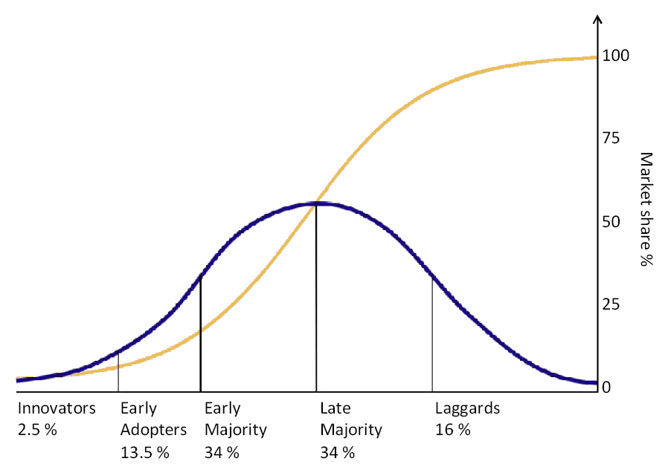
THE DIFFUSION S-CURVE

Slide 9
Algorithmic technologies have specific innovation challenges.

Slide 10
CHARACTERISTICS OF ALGORITHMS AS INNOVATIONS
COMPATIBILITY. I’ve got a target deck, customers and deadlines. Will this new system enable me to get my work done, or is this a distraction?
COMPLEXITY. It’s difficult to understand how the technique is operating on my data. What does it take to master this system, to really understand it?
VISBILITY. Hmm. I’ve heard about these data analysis techniques. One of the guys in the next pod is working with a team on a data analysis pipeline. It looks interesting.
TESTABILITY. How do I try this out? What risk am I taking on? Can I use it side-by-side with what I’ve got already?
RELATIVE ADVANTAGE. I’m already completing my target deck and reporting products on time, to customer satisfaction. Why do I need something else?

Slide 11
Multidisciplinary work environments can be challenging, too.

Slide 12
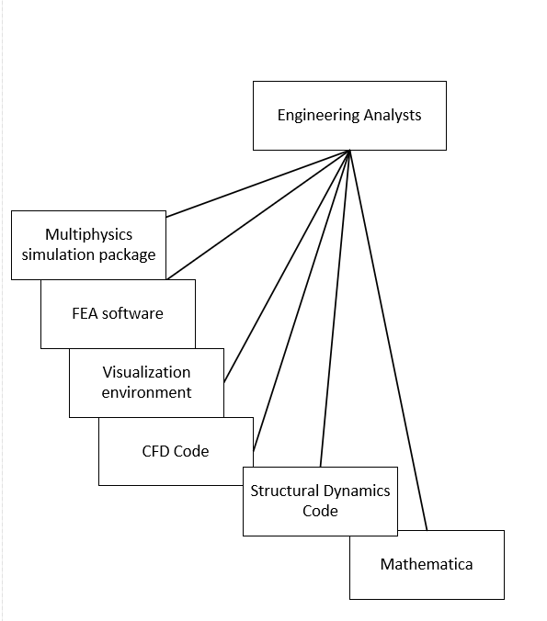
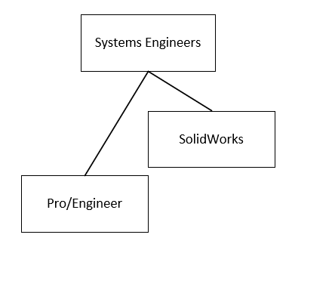
THE MATERIAL CULTURE OF WORK

Slide 13
THE MATERIAL CULTURE OF WORK

Slide 14
Algorithmic technologies need thoughtful, deliberate diffusion strategies.

Slide 15
FACILITATING DIFFUSION
DON’T BLAME THE LUDDITES. It’s called correspondence bias, we all do it, and it’s a dangerous trap.
EXAMINE THE ENVIRONMENT. Structural factors, such as funding sources and delivery schedules, can impede diffusion – or facilitate it.
WHAT IS THE TARGET DOMAIN GENERATING? If you can support people in developing their deliverables, you build trust and promote their success.
COMMIT TO A LONG-TERM PARTNERSHIP. Working side-by-side to integrate your approaches into a the existing analytic workflow, probably over a significant period of time as a committed team member, is a great way to tackle the adoption challenges we’ve discussed.

Slide 16
Thank you.
Contact me if you want to discuss further:
lamcnam@sandia.gov, or (505) 844-1366.

