Slide 1
Estimating Pure-Error from Near Replicates in Design of Experiments
Caleb King
Research Statistician Developer
JMP Division, SAS Institute
Caleb.King@JMP.com
Thomas Bzik
Statistical Consultant
bziktj@verizon.net
DATAworks 2021, April 12-14, virtual
Peter Parker
National Aeronautics and Space Administration
Hampton, VA 23681
peter.a.parker@nasa.gov

Slide 2
Pure-Error in Design of Experiments
Pure-error estimates are based on exact replicates - powerful and highly desirable in practice
  Serve as model-independent estimate of experimental variability
  A key component in Lack-of-Fit testing
  Very easy to explain and approachable to non-statisticians
In practice, precise genuine replicates are often not achievable
  We often lack control precision/efficiency to set the factor levels (independent variable)
It is often much easier to measure the actual factor levels of intended replicates, resulting in “near replicates”

Slide 3
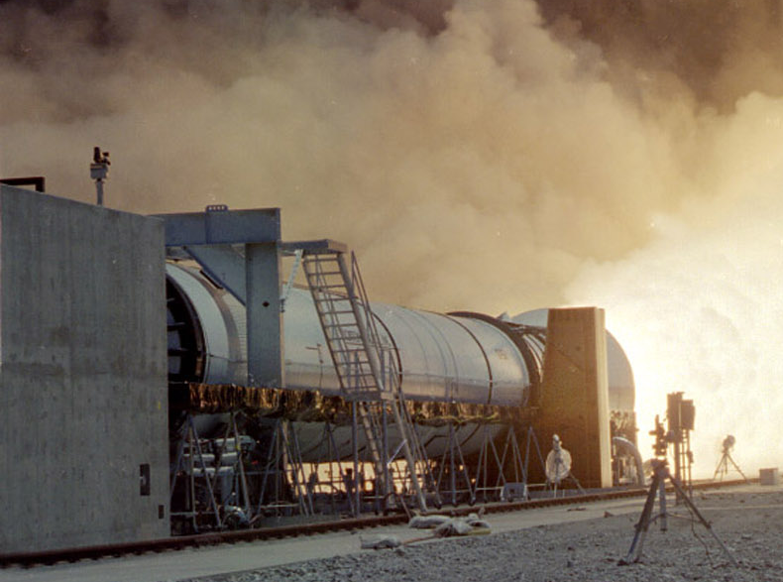
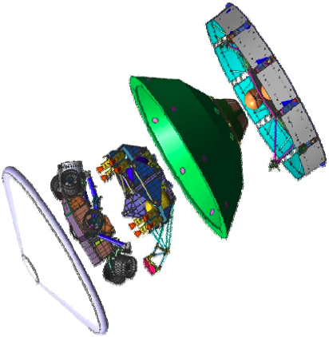
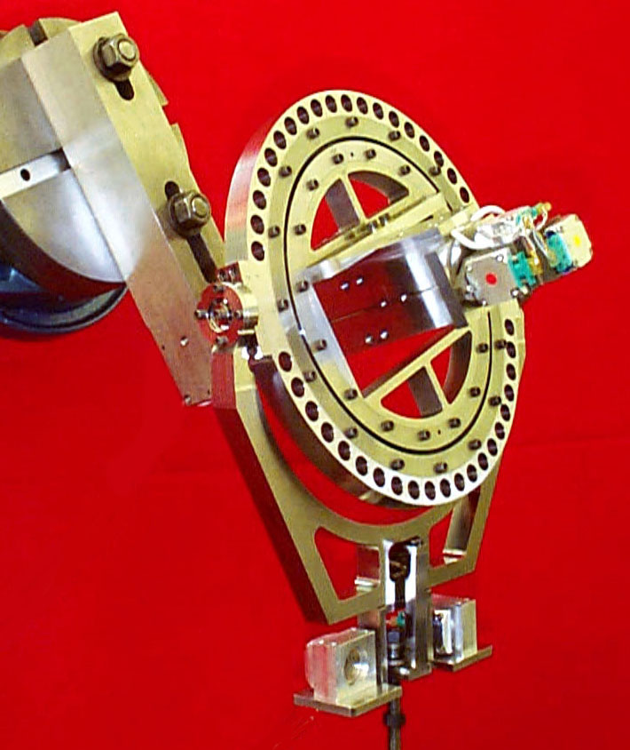
Relevant in Characterization Experiments
High-precision measurement systems with accurate set-point measurements (feedback/monitor), but not controlled
Lack of fit is important to isolate in the total uncertainty (residual)
Guides strategic investment in improving calibration models
  Invest in the apparatus
  Explore high-order designs/models

Slide 4
Some Approaches in the Literature
Montgomery, Martin, and Peck (1980), "Interior Analysis of the Observations in Multiple Linear Regression," Journal of Quality Technology, 12(3), pg. 165-173.
Joglekar, Schuenemeyer, and LaRiccia (1989), “Lack-of-Fit Testing When Replicates are not Available,” The American Statistician, 43(3), pg. 135-143.
Su and Yang (2006), “A Note on Lack-of-Fit Tests for Linear Models Without Replication,” Journal of the American Statistical Association, 101, pg. 205-210
Christensen (1989) “Lack-of-Fit Test Based on Near or Exact Replicates,” The Annals of Statistics, 17, pg. 673-683.
Christensen and Sun (2010) “Alternative Goodness-of-Fit Tests for Linear Models,” Journal of the American Statistical Association, 105, pg. 291-301.
In practice, none have been satisfactory solutions, nor are they widely used

Slide 5
WHAT CAN BE DONE WITH NEAR REPLICATES?
Naïve Approach
Just pretend they are true replicates
  Could lead to overestimation of PE depending on the transfer function from x to y.
Residual Adjusted Approach
Adjust the near replicates to be estimated pure replicates.
  This is the methodology we propose.

Slide 6
Presentation Outline
Introduce our methodology to convert Near replicates to Estimated replicates
Present a Theoretical Justification for our methodology
Conduct a Simulation Study to test methodology performance and robustness
Summary and Practitioner Guidance

Slide 7

RESIDUAL ADJUSTED APPROACH: DESCRIPTION
Fit the assumed regression model
Identify the set(s) of near replicates (typically the intended replicates)
For each set of near replicates:
  Calculate the average of the near replicates (${\overline{X}}_{set,obs}=\frac{1}{R}\sum_{r=1}^{R}{X_{r, set, obs}}$)
  Use the regression model to correct each point’s observed response to the estimated response at the average ($Y_{r, set, adj}=Y_{r, set, obs}−(X_{r, set, obs}−{\overline{X}}_{set,obs})\hat{β}$)
  Use these corrected values to estimate PE for each set
  Pool PE estimates if there are multiple sets of near replicates
Corrected values are only used for PE estimation, nothing else

Slide 8
RESIDUAL ADJUSTED APPROACH : BASIC VISUALIZATION
The point on the right will be adjusted downward by the impact of slope difference from the local average.
The point on the left will be adjusted upward by the impact of slope difference from the local average.
Y
Intended Replicates
The middle point will be barely adjusted upward.
Regression Model to be Tested for LOF
Average
X
Notes:
After the adjustment, the local Y variation from the estimated model is removed.
(is this phrase still needed?)

Slide 9
RESIDUAL ADJUSTED APPROACH : BASIC VISUALIZATION
Naive Approach View
Pretend All at the Same X
Residual Adjusted View
Corrected by Model to Same X
Near Replicate View
Typically Excessive Variation in This View
Typically Less Variation in This View

Slide 10
RESIDUAL ADJUSTED APPROACH : SIMPLE EXAMPLE
X | Y
1.0 | 15.0
1.8 | 19.0
2.0 | 20.0
2.2 | 21.0
3.0 | 25.0
True Model: Y = 10 + 5X (without any simulated error)
Fitted Model: Y = 10 + 5X
The near replicates were three attempts to get X=2
Naïve estimate of PE variance = Variance (19, 20, 21) = 1
X | Y | X Offset | Adjust Amount | Adjusted Y
1.8 | 19.0 | 0.2 | 1 | 20.0
2.0 | 20.0 | 0.0 | 0 | 20.0
2.2 | 21.0 | -0.2 | -1 | 20.0
Average of Near Replicates = Mean(1.8, 2.0, 2.2) = 2.0
(In practice, the center of mass will rarely be equal to the target)
X Offset = Average - X
Adjust Amount = X offset * est. slope = X offset * 5
Adjusted Y = Y + Adjust Amount
Corrected PE variance = Variance (20, 20, 20) = 0
Correction for more complex models uses all slope estimates involving X in the model

Slide 11
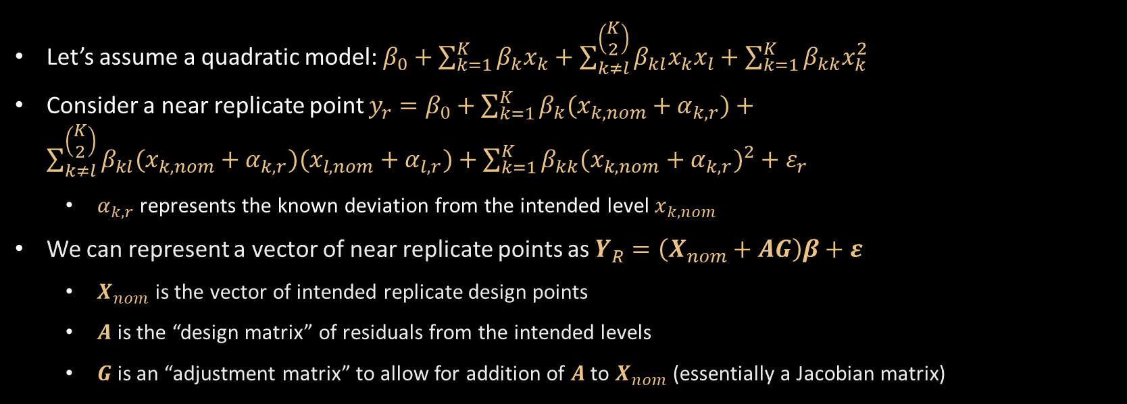
Theoretical justification: Notation
Let’s assume a quadratic model: $β_{0}+\sum_{k=1}^{K}{β_{k}x_{k}}+\sum_{k≠l}^{\left(\begin{matrix}K \\ 2\end{matrix}\right)}{β_{kl}x_{k}x_{l}}+\sum_{k=1}^{K}{β_{kk}x_{k}^{2}}$
Consider a near replicate point $y_{r}=β_{0}+\sum_{k=1}^{K}{β_{k}(x_{k,nom}+α_{k,r})}+\sum_{k≠l}^{\left(\begin{matrix}K \\ 2\end{matrix}\right)}{β_{kl}(x_{k,nom}+α_{k,r})(x_{l,nom}+α_{l,r})}+\sum_{k=1}^{K}{β_{kk}{(x_{k,nom}+α_{k,r})}^{2}}+ε_{r}$
  $α_{k,r}$ represents the known deviation from the intended level $x_{k,nom}$
We can represent a vector of near replicate points as $Y_{R}=\left(X_{nom}+AG\right)β+ε$
  $X_{nom}$ is the vector of intended replicate design points
  $A$ is the “design matrix” of residuals from the intended levels
  $G$ is an “adjustment matrix” to allow for addition of $A$ to $X_{nom}$ (essentially a Jacobian matrix)
The theory will hold for any higher polynomial model as well.

Slide 12

Theoretical justification: Pure-error estimate
The general pure-error estimate is represented as ${\hat{σ}}^{2}=\frac{g\left(Y_{R}^{′}\right)\left(I_{R}−\frac{1}{R}J_{R}\right)g(Y_{R})}{R−1}$
  $I_{R}$ is the R-dimensional identity matrix
  $J_{R}$ is an R x R matrix of 1’s
If $g\left(Y_{R}\right)=Y_{R}$, then this will give the naïve estimate.
If $g\left(Y_{R}\right)=Y_{R}−\left(I_{R}−\frac{1}{R}J_{R}\right)X_{R}\hat{β}$, then this will give the residual adjusted estimate.

Slide 13


Theoretical justification: Comparison
Naïve Method
Residual Adjusted Method
Expectation of Pure-Error Estimate
  $E\left({\hat{σ}}^{2}\right)=σ^{2}+\frac{β^{′}G^{′}A^{′}\left(I_{R}−\frac{1}{R}J_{R}\right)AGβ}{R−1}$
Bias-Correction
  Let $B=\frac{β^{′}G^{′}A^{′}\left(I_{R}−\frac{1}{R}J_{R}\right)AGβ}{R−1}$ represent the additive bias.
  $E\left({\hat{σ}}^{2}−B\right)= σ^{2}\left\{1−\frac{tr\left[\left(I_{R}−\frac{1}{R}J_{R}\right)AG{(X^{′}X)}^{−1}G^{′}A^{′}\left(I_{R}−\frac{1}{R}J_{R}\right)\right]}{R−1}\right\}$
Expectation of Pure-Error Estimate
  $E\left({\hat{σ}}^{2}\right)=σ^{2}\left\{1−\frac{tr\left[\left(I_{R}−\frac{1}{R}J_{R}\right)AG{(X^{′}X)}^{−1}G^{′}A^{′}\left(I_{R}−\frac{1}{R}J_{R}\right)\right]}{R−1}\right\}$
The Residual Adjusted Method is a natural correction to the naïve method.

Slide 14
Theoretical justification: additional notes
Since the multiplicative bias is less than or equal to 1, it indicates that the residual adjusted estimator tends to underestimate the true pure-error.
The standard residual adjusted method can also be bias-corrected, by simply dividing by the multiplicative bias.
The distribution of the residual adjusted bias-corrected pure-error estimator, while not known to closed form, can be approximated with a chi-squared distribution with degrees of freedom equal to the trace of the multiplicative bias.

Slide 15
Simulation study: outline of study
We conducted a simulation study to explore further the behavior of the residual adjusted method in comparison with the naïve method.
Scenario 1: Simple Linear Model (for baseline illustration)
  Two 6-run designs; one with 3 replicate centerpoints, one with 3 replicate “edgepoints” (X=1)
  Assess pure-error estimate
Scenario 2: Three-Factor Multivariate Model with Interaction
  Three 15-run Central Composite Designs; two with replicate centerpoints (3 and 5 times), one with 3 replicate edgepoints (X1=1,X2=1,X3=1)
  Assess pure-error estimate and Type I error for LOF testing (target is 5%)
Scenario 3: Three-Factor Multivariate Model with Interaction and Quadratic
  Same designs as Model 2
  Quadratic term is not fit, resulting in true LOF
  Assess pure-error estimate and power for detecting LOF
Scenario 4: More Extreme LOF
  Same designs
  Additional interaction and quadratic terms not fit; increase error variance
  Assess pure-error estimate and power for detecting LOF
For each model, we will assess sensitivity of the pure-error estimates to range deviation, the standard deviation around the target value.

Slide 16
Simulation study: outline of study
Range Deviation | Rational?
0 | NA
0.01 | Yes
0.05 | Yes
0.1 | Maybe
0.2 | Stretch
0.5 | No
1 | No
Higher dimensional models will only be examined in a more rational range
In the simulations, we will only consider range deviations within its realm of likely application.

Slide 17
Simulation study: scenario 1 pure-error estimates
True Model: $Y=100+20X+ε; ε\sim Normal(0,1)$
3 Replicate Centerpoints
3 Replicate Edgepoints
Range Deviation | Naïve Method | Residual Adjusted Method | Bias-Corrected Residual Adjusted Method
0 | 0.9996 | 0.9996 | 0.9996
0.01 | 1.0342 | 1.0008 | 1.0009
0.05 | 1.7302 | 0.9986 | 0.9996
0.1 | 4.7033 | 0.9954 | 1.0001
0.2 | 10.9948 | 0.9856 | 0.9993
Range Deviation | Naïve Method | Residual Adjusted Method | Bias-Corrected Residual Adjusted Method
0 | 1.0003 | 1.0003 | 1.0003
0.01 | 1.0385 | 1.0002 | 1.0002
0.05 | 1.8178 | 0.9988 | 0.9994
0.1 | 5.5359 | 0.9953 | 0.9984
0.2 | 13.6601 | 0.9856 | 1.0004

Slide 18
Simulation study: scenario 2 pure-error estimates
True Model: $Y=50+20X_{1}+5X_{2}−5X_{3}−5X_{1}X_{2}+ε; ε\sim Normal(0,1)$
3 Replicate Centerpoints
3 Replicate Edgepoints
Range Deviation | Naïve Method | Residual Adjusted Method | Bias-Corrected Residual Adjusted Method
0 | 1.0007 | 1.0007 | 1.0007
0.01 | 1.0490 | 1.0008 | 1.0008
0.05 | 1.4317 | 0.9985 | 0.9993
0.1 | 7.0097 | 0.9939 | 0.9971
0.2 | 14.1136 | 0.9869 | 1.0004
Range Deviation | Naïve Method | Residual Adjusted Method | Bias-Corrected Residual Adjusted Method
0 | 1.0010 | 1.0010 | 1.0010
0.01 | 1.0928 | 1.0002 | 1.0004
0.05 | 2.4154 | 0.9953 | 0.9991
0.1 | 5.8832 | 0.9912 | 1.0006
0.2 | 34.2235 | 0.9489 | 1.0012

Slide 19
Simulation study: scenario 2 Type I Error Rates
True Model: $Y=50+20X_{1}+5X_{2}−5X_{3}−5X_{1}X_{2}+ε; ε\sim Normal(0,1)$
3 Replicate Centerpoints
3 Replicate Edgepoints
Range Deviation | Naïve Method | Bias-Corrected Residual Adjusted Method
0 | 0.0498 | 0.0498
0.01 | 0.0483 | 0.0498
0.05 | 0.0365 | 0.0497
0.1 | 0.0069 | 0.0497
0.2 | 0.0056 | 0.0483
Range Deviation | Naïve Method | Bias-Corrected Residual Adjusted Method
0 | 0.0499 | 0.0499
0.01 | 0.0469 | 0.0502
0.05 | 0.0224 | 0.0495
0.1 | 0.0136 | 0.0489
0.2 | 0.000029 | 0.0436

Slide 20
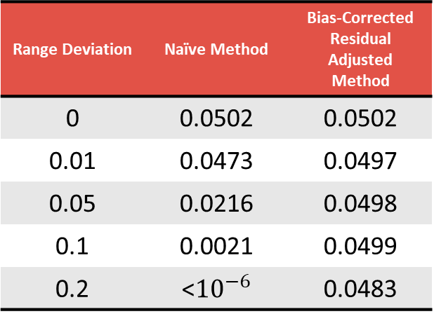
Simulation study: scenario 2 pure-error estimates and Type I Error Rates
True Model: $Y=50+20X_{1}+5X_{2}−5X_{3}−5X_{1}X_{2}+ε; ε\sim Normal(0,1)$
5 Replicate Centerpoints
Range Deviation | Naïve Method | Residual Adjusted Method | Bias-Corrected Residual Adjusted Method
0 | 0.9993 | 0.9993 | 0.9993
0.01 | 1.0421 | 1.0006 | 1.0006
0.05 | 1.7824 | 0.9989 | 0.9996
0.1 | 6.5091 | 0.9984 | 1.0015
0.2 | 20.8881 | 0.9892 | 1.0014
Range Deviation | Naïve Method | Bias-Corrected Residual Adjusted Method
0 | 0.0502 | 0.0502
0.01 | 0.0473 | 0.0497
0.05 | 0.0216 | 0.0498
0.1 | 0.0021 | 0.0499
0.2 | <${10}^{−6}$ | 0.0483

Slide 21
Simulation study: scenario 3 pure-error estimates
True Model: $Y=50+20X_{1}+5X_{2}−5X_{3}−5X_{1}X_{2}+5X_{1}^{2}+ε; ε\sim Normal(0,1)$
3 Replicate Centerpoints
3 Replicate Edgepoints
Range Deviation | Naïve Method | Residual Adjusted Method | Bias-Corrected Residual Adjusted Method
0 | 0.9983 | 0.9983 | 0.9983
0.01 | 1.0316 | 1.0012 | 1.0012
0.05 | 1.5899 | 1.0009 | 1.0016
0.1 | 3.6500 | 1.0107 | 1.0134
0.2 | 12.2593 | 1.4461 | 1.4703
Range Deviation | Naïve Method | Residual Adjusted Method | Bias-Corrected Residual Adjusted Method
0 | 1.0008 | 1.0008 | 1.0008
0.01 | 1.0544 | 1.0064 | 1.0065
0.05 | 2.7183 | 1.1770 | 1.1816
0.1 | 3.8995 | 1.5651 | 1.5773
0.2 | 29.6467 | 2.3621 | 2.4873

Slide 22
Simulation study: scenario 3 power to detect lack-of-fit
True Model: $Y=50+20X_{1}+5X_{2}−5X_{3}−5X_{1}X_{2}+5X_{1}^{2}+ε; ε\sim Normal(0,1)$
3 Replicate Centerpoints
3 Replicate Edgepoints
Range Deviation | Naïve Method | Bias-Corrected Residual Adjusted Method
0 | 0.8011 | 0.8011
0.01 | 0.7878 | 0.7977
0.05 | 0.6386 | 0.7955
0.1 | 0.3281 | 0.7721
0.2 | 0.1132 | 0.6732
Range Deviation | Naïve Method | Bias-Corrected Residual Adjusted Method
0 | 0.8113 | 0.8113
0.01 | 0.7964 | 0.8114
0.05 | 0.4025 | 0.7391
0.1 | 0.3328 | 0.6224
0.2 | 0.0426 | 0.4026

Slide 23
Simulation study: scenario 3 pure-error estimates and power
True Model: $Y=50+20X_{1}+5X_{2}−5X_{3}−5X_{1}X_{2}+5X_{1}^{2}+ε; ε\sim Normal(0,1)$
5 Replicate Centerpoints
Range Deviation | Naïve Method | Residual Adjusted Method | Bias-Corrected Residual Adjusted Method
0 | 0.9994 | 0.9994 | 0.9994
0.01 | 1.0542 | 1.0001 | 1.0002
0.05 | 2.6239 | 1.0003 | 1.0012
0.1 | 5.7257 | 1.0025 | 1.0053
0.2 | 16.8530 | 1.1639 | 1.1796
Range Deviation | Naïve Method | Bias-Corrected Residual Adjusted Method
0 | 0.9996 | 0.9996
0.01 | 0.9992 | 0.9995
0.05 | 0.8956 | 0.9994
0.1 | 0.5504 | 0.9989
0.2 | 0.0131 | 0.9907

Slide 24
Simulation study: scenario 4 pure-error estimates
True Model: $Y=50+20X_{1}+5X_{2}−5X_{3}−5X_{1}X_{2}+5X_{1}^{2}+5X_{2}X_{3}−3X_{2}^{2}+3X_{3}^{2}+ε; ε\sim Normal(0,4)$
3 Replicate Centerpoints
3 Replicate Edgepoints
Range Deviation | Naïve Method | Residual Adjusted Method | Bias-Corrected Residual Adjusted Method
0 | 3.9993 | 3.9993 | 3.9993
0.01 | 4.0255 | 3.9939 | 3.9939
0.05 | 5.5235 | 3.9994 | 4.0020
0.1 | 6.4455 | 4.0071 | 4.0172
0.2 | 28.1179 | 4.1196 | 4.1898
Range Deviation | Naïve Method | Residual Adjusted Method | Bias-Corrected Residual Adjusted Method
0 | 4.0009 | 4.0009 | 4.0009
0.01 | 4.1046 | 4.0079 | 4.0088
0.05 | 5.0234 | 4.2254 | 4.2354
0.1 | 7.8110 | 5.4974 | 5.5712
0.2 | 43.5795 | 9.7558 | 10.5807

Slide 25
Simulation study: scenario 4 power to detect lack-of-fit
True Model: $Y=50+20X_{1}+5X_{2}−5X_{3}−5X_{1}X_{2}+5X_{1}^{2}+5X_{2}X_{3}−3X_{2}^{2}+3X_{3}^{2}+ε; ε\sim Normal(0,4)$
3 Replicate Centerpoints
3 Replicate Edgepoints
Range Deviation | Naïve Method | Bias-Corrected Residual Adjusted Method
0 | 0.3200 | 0.3200
0.01 | 0.3186 | 0.3208
0.05 | 0.2408 | 0.3164
0.1 | 0.2069 | 0.3153
0.2 | 0.0544 | 0.3369
Range Deviation | Naïve Method | Bias-Corrected Residual Adjusted Method
0 | 0.3429 | 0.3429
0.01 | 0.3355 | 0.3417
0.05 | 0.2919 | 0.3304
0.1 | 0.1955 | 0.2652
0.2 | 0.0376 | 0.1104

Slide 26
Simulation study: scenario 4 pure-error estimates and power
True Model: $Y=50+20X_{1}+5X_{2}−5X_{3}−5X_{1}X_{2}+5X_{1}^{2}+5X_{2}X_{3}−3X_{2}^{2}+3X_{3}^{2}+ε; ε\sim Normal(0,4)$
5 Replicate Centerpoints
Range Deviation | Naïve Method | Residual Adjusted Method | Bias-Corrected Residual Adjusted Method
0 | 4.0043 | 4.0043 | 4.0043
0.01 | 4.0523 | 3.9999 | 4.0001
0.05 | 5.3547 | 3.9978 | 4.0009
0.1 | 8.1995 | 3.9994 | 4.0114
0.2 | 28.0967 | 4.0609 | 4.1154
Range Deviation | Naïve Method | Bias-Corrected Residual Adjusted Method
0 | 0.6956 | 0.6956
0.01 | 0.6911 | 0.6980
0.05 | 0.5596 | 0.7096
0.1 | 0.3220 | 0.6650
0.2 | 0.0581 | 0.6216

Slide 27
SUMMARY
In practice, it is more common to record near replicate levels than enforce exact replicates.
The residual adjusted approach is a simple, natural correction adjustment of the naïve approach in estimating pure-error from near replicates.
In the absence of LOF, the bias-corrected residual adjusted method will generate a consistent, unbiased estimate of pure-error. It also maintains a stable Type I error compared to the naïve method.
In the presence of LOF, the bias-corrected residual adjusted method is less sensitive to range deviation than the naïve method. It also tends to have significantly more power in detecting LOF.

