Slide 1



The Use of DOE vs OFAT in the Calibration of AEDC Wind Tunnels Rebecca Rought AEDC/TSTA 22 March 2018
Arnold Engineering Development Complex
Approved for Public Release, Distribution Unlimited

Slide 2
Introduction
Motivation
Provide updated calibrations of the AEDC wind tunnels using statistically defensible test methods
Calibrating Wind Tunnels at AEDC
Calibration effort began in 2013, previously most tunnels had not been calibrated in more than 20 years
One-Factor-at-a-Time (OFAT) test matrices historically used
Check calibrations focusing on desired customer test conditions also used
In 2014, Design of Experiments (DOE) introduced for calibrations
All operational AEDC tunnels calibrated since 2013
Tunnels 4T, 16T, B, and NFAC calibrated using DOE
Tunnels A and C calibrated using OFAT methods
Jan
Feb
Mar
Apr
May
Jun
Jul
Aug
Sep
Nov
Oct
Dec
Jan
Feb
Mar
Apr
May
Jun
Jul
Aug
Sep
Oct
Nov
Dec
Feb
Mar
Apr
May
Jun
Jul
Aug
Sep
Oct
Nov
Dec
Feb
Mar
Apr
May
Jun
Jul
Aug
Sep
Oct
Nov
Dec
Jan
Jan
2013
2014
2015
2016
Tunnel A
Tunnel B
Tunnel B
4T
Tunnel C
Tunnel B
16T
16T
Tunnel A
Tunnel C
40x80
Mach 8
Mach 6
Mach 10
Mach 8
Mach 10
DOE
OFAT

Slide 3
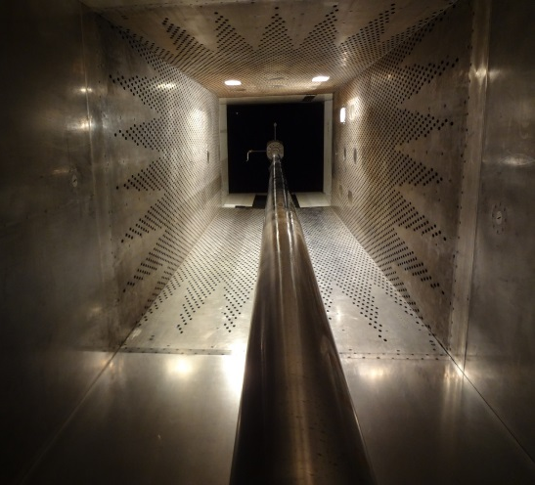
DOE vs OFAT
Why DOE?
Capture any systematic errors in calibration through randomization
Develop statistically robust response surface models to cover entire operating envelope
Better overall uncertainty quantification
AEDC’s 4-ft Aerodynamic Wind Tunnel 4T
Concerns over DOE
Fewer points than typically acquired for tunnel calibrations may cause flow features to be missed
Acquired points are not necessarily at typical test conditions
Operational Constraints
Tunnel 4T Calibration conducted using both methods
OFAT results compared to model results using DOE to prove adequacy
Cost analysis of methods performed

Slide 4
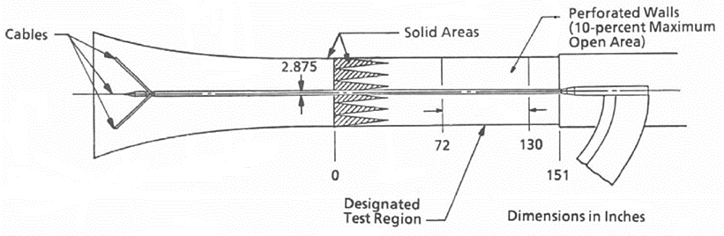
4T Calibration Overview
To PES
Plenum
Pc
Flow
Pa
Pt
4ft x 4ft x 12.5 test section
Mach 0.05 - 2.5
Pt range: 200 – 3400 psfa
DM = Ma(f(Pa/Pt)) – Mc(f(Pc/Pt))
Tunnel Calibration defined by parameter DM = M_{free stream} – M_{plenum}
Depending on region of performance map, DM is a function of total pressure (Pt), plenum Mach number (MC), wall porosity, wall angle, and nozzle contour
Operational constraints include main drive configuration, switching between PES/IDS mode, and PES staging

Slide 5
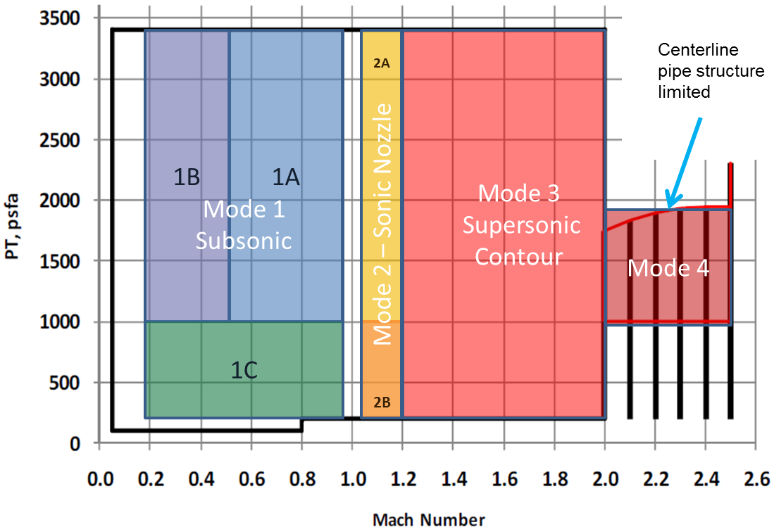
DOE Matrices
4 Different Modes of Operation
Subsonic
Sonic Nozzle
Supersonic Contours
Mach 2+
Sonic and Subsonic Modes divided into multiple models
Low Pt increases measurement uncertainty
Main drive configuration change at Mach 0.6
Performance map divided into 7 different models
Multiple models more accurately capture tunnel behavior
Reduction in number of reconfigurations for hard to change variables
Factor | Model
 | 1A | 1B | 1C | 2A | 2B | 3 | 4
Pt | X | X | X | X | X | X | X
Mc | X | X | X | X | X | X
Porosity |  |  |  | X | X | X
Wall Angle |  |  |  |  |  | X | X
Contour |  |  |  |  |  |  | X

Slide 6
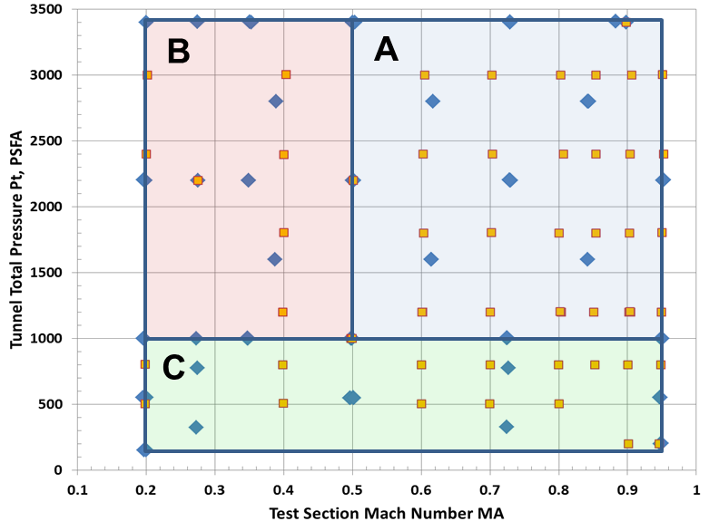
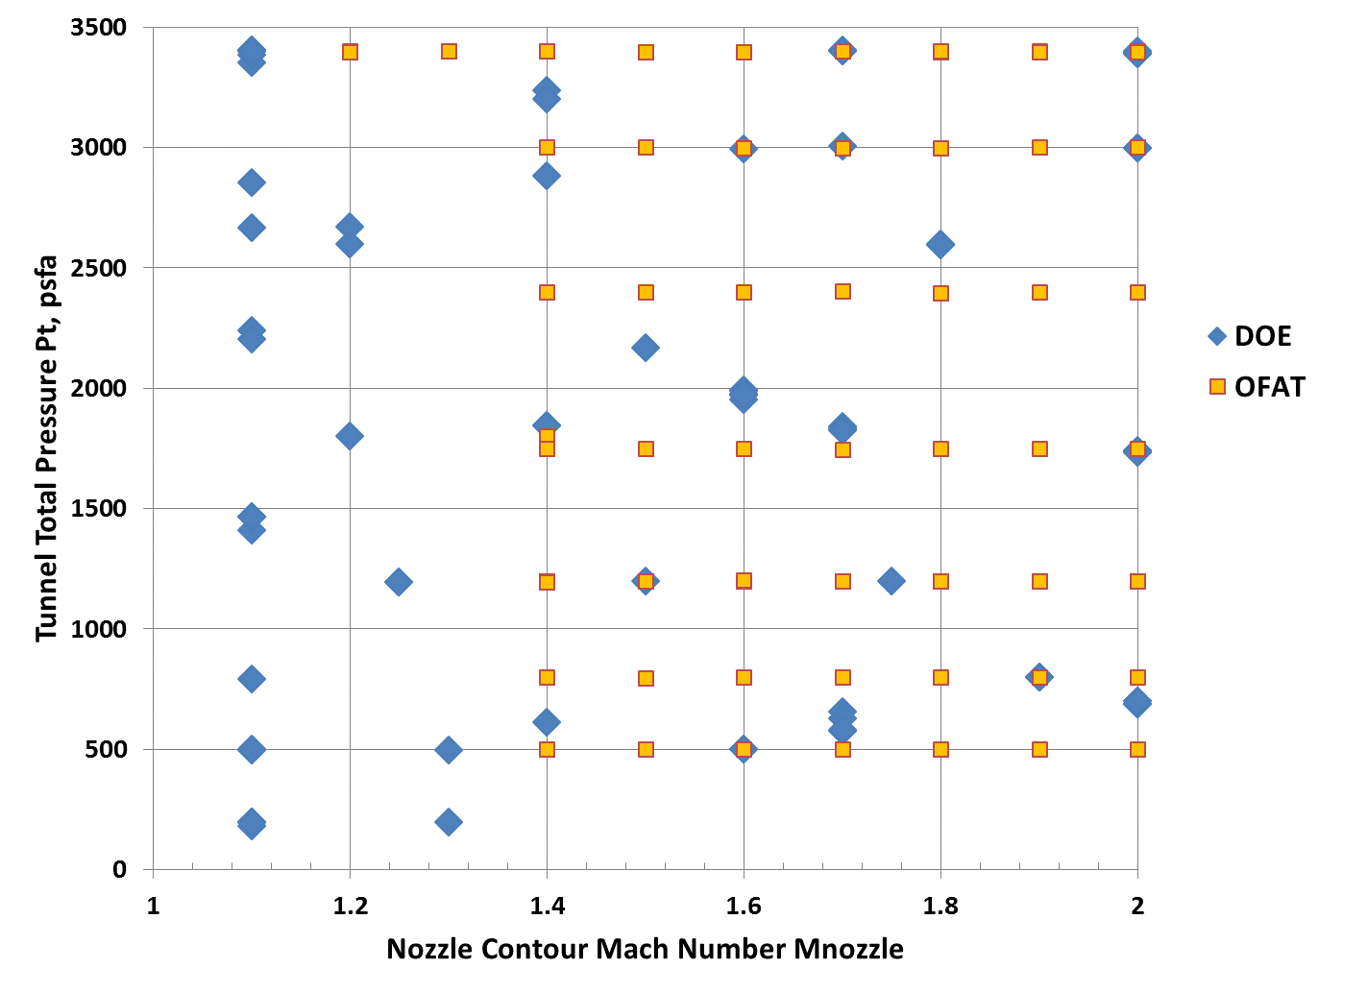
Comparison to OFAT Test Matrix
Relative Test Time Comparison, OFAT / DOE
Tunnel Mode | Data Points | Avg Time per Point | Total Time
Subsonic | 63 / 47 | 1.0 / 1.4 | 63 / 65.8
Sonic | 30 / 57 | 1.0 / 0.7 | 30 / 39.9
Supersonic | 169 / 67 | 1.0 / 2.9 | 169 / 194.3
Mach 2+ | 19 / 45 | 1.0 / 1.2 | 19 / 54
Total | 281 / 216 | 1.0 / 1.6 | 281 / 354
DOE points require more time per point to collect
High number of DOE points to increase power / reduce model variance.

Slide 7
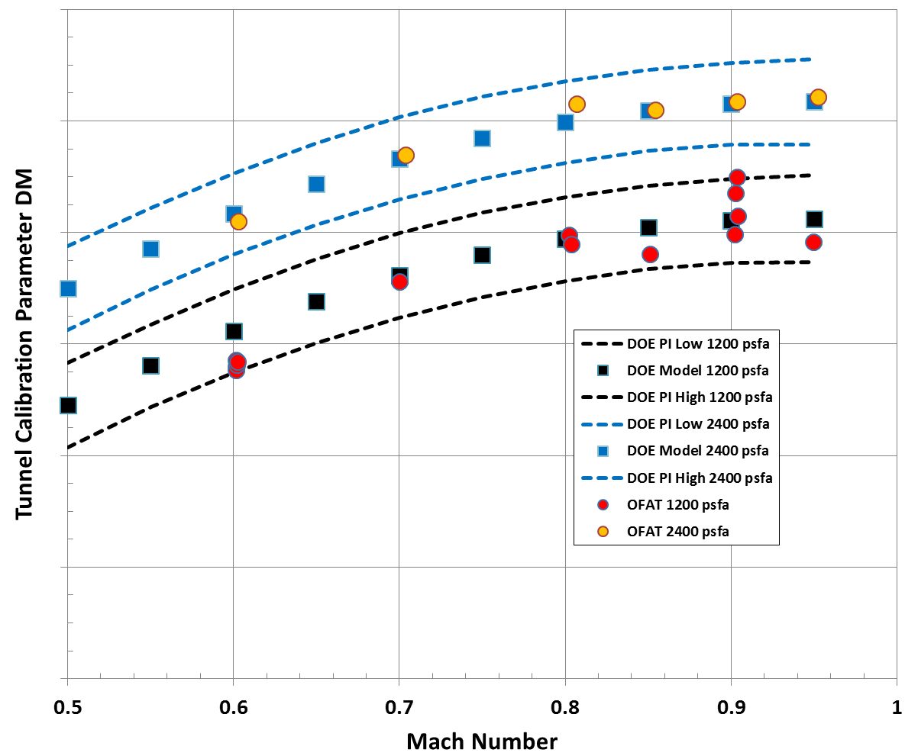
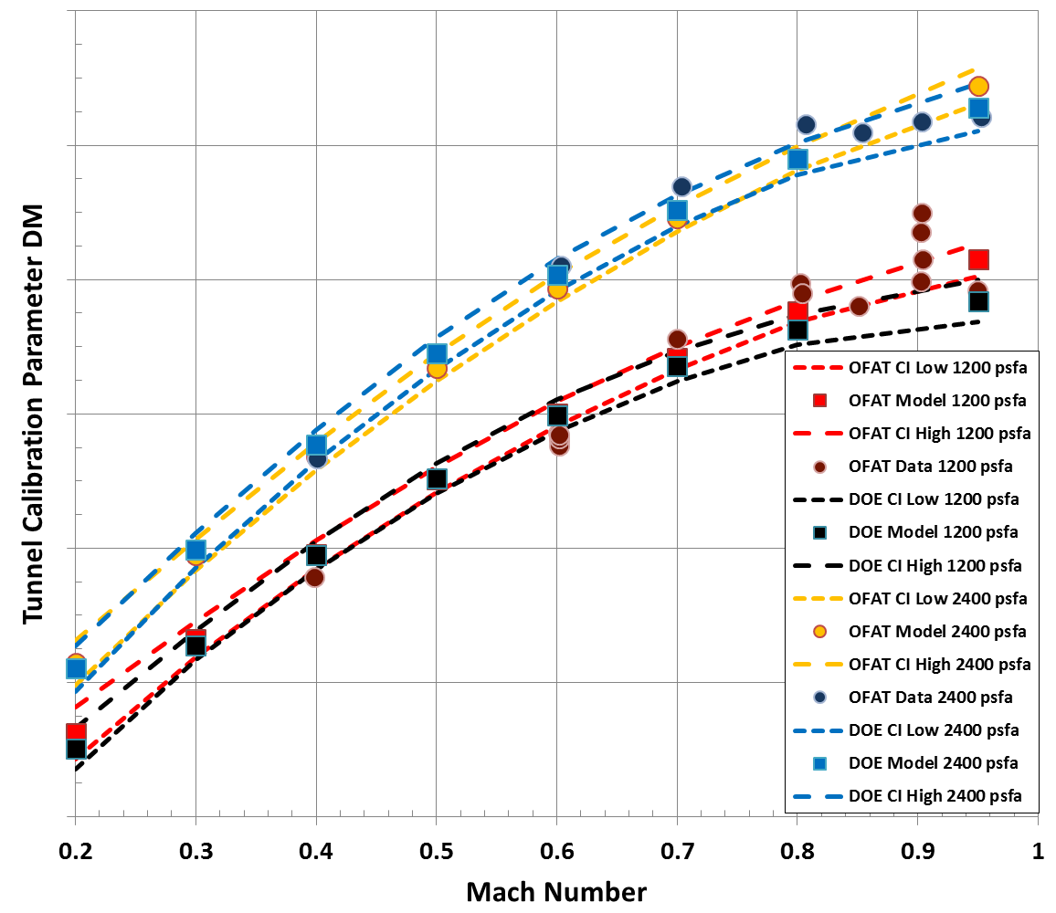
Comparison to OFAT Results - Subsonic
OFAT points used as confirmation points for the DOE models and fell within the prediction interval
OFAT and DOE models compared favorably to each other with overlapping confidence intervals.
Good agreement indicates systematic errors are controlled by instrument calibrations operating procedure

Slide 8
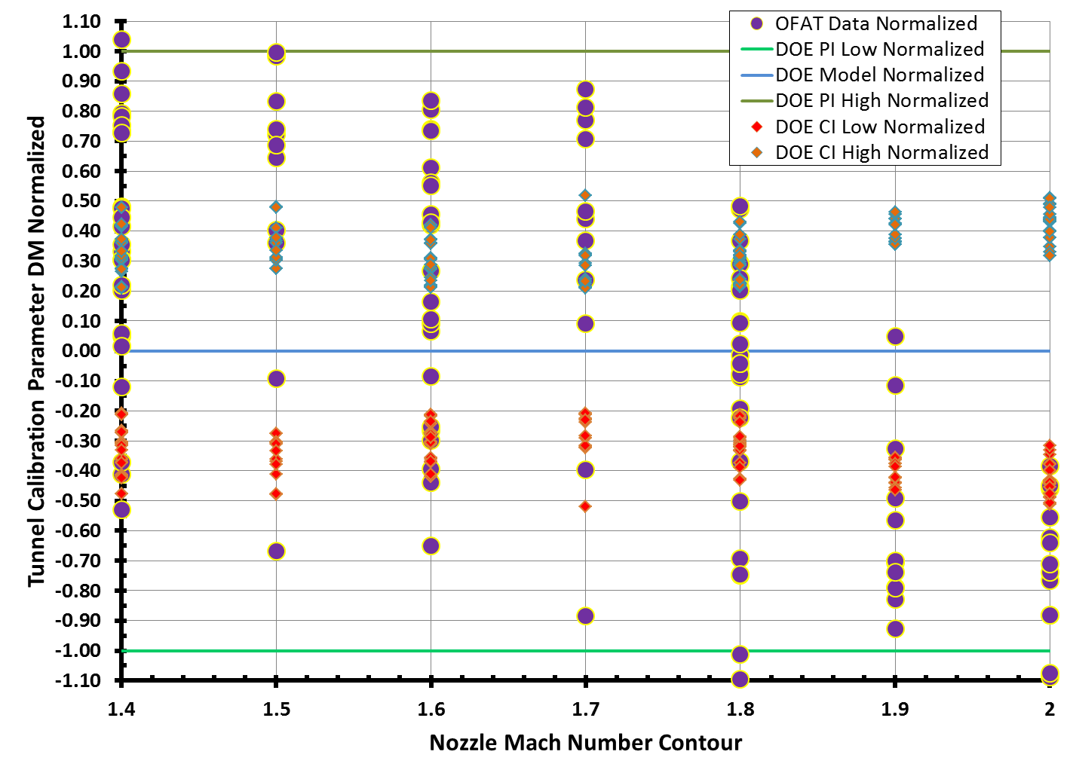
Comparison to OFAT Results - Supersonic
The DM for both the DOE and OFAT data sets was normalized using the DOE model and prediction interval.
OFAT data agreement with the DOE model is acceptable

Slide 9
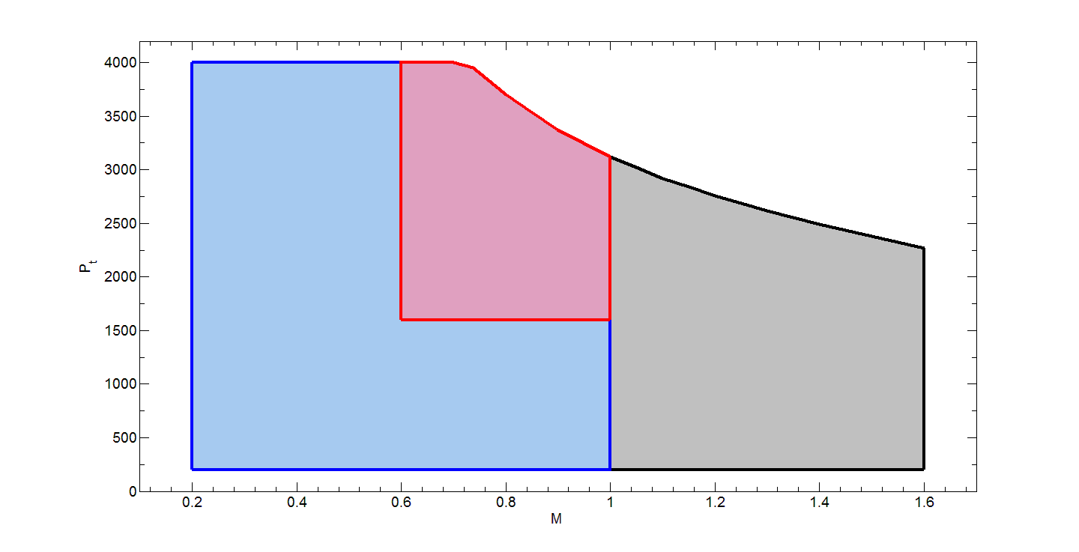
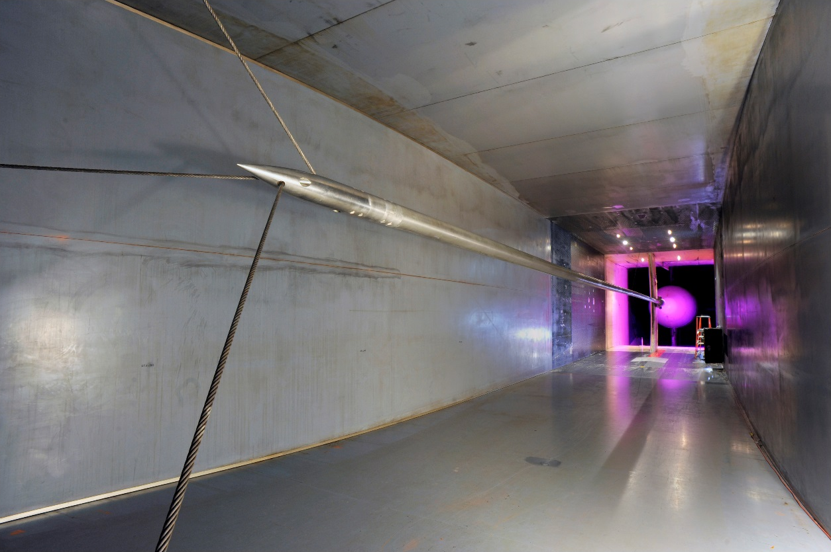
16T Calibration
16 ft x 16 ft Transonic Wind Tunnel
Mach 0.05 – 1.6
Pt 200 – 4000 psf
Calibration parameter DM dependent on MC, Pt
Supersonic Mach number contours have unique calibration equations
B
C
A
Test matrix divided into 3 sections
Subsonic DOE (A)
Subsonic critical region OFAT(B)
Supersonic OFAT (C)
Critical region modeled to reduce drag count uncertainty
Initially a DOE matrix, but converted to OFAT due to operational constraints

Slide 10
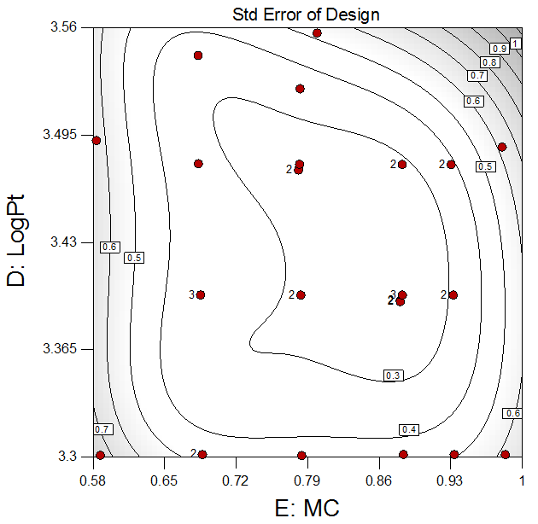
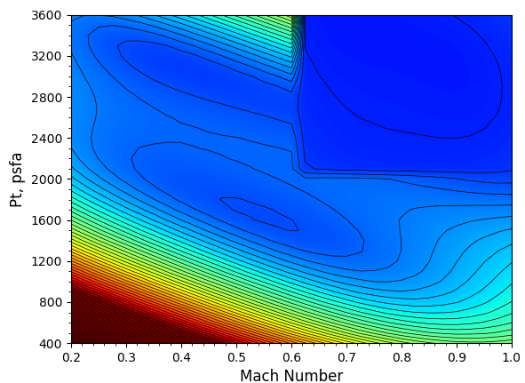
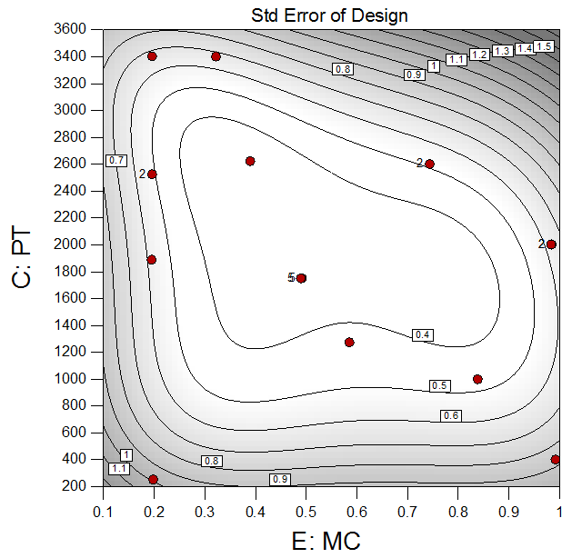

16T Calibration Uncertainty
Uncertainty in $M_{∞}$
Standard error of model important to the overall free stream Mach number uncertainty.
Monte Carlo uncertainty contours for 16T show minimized uncertainty where standard error is lowest

Slide 11
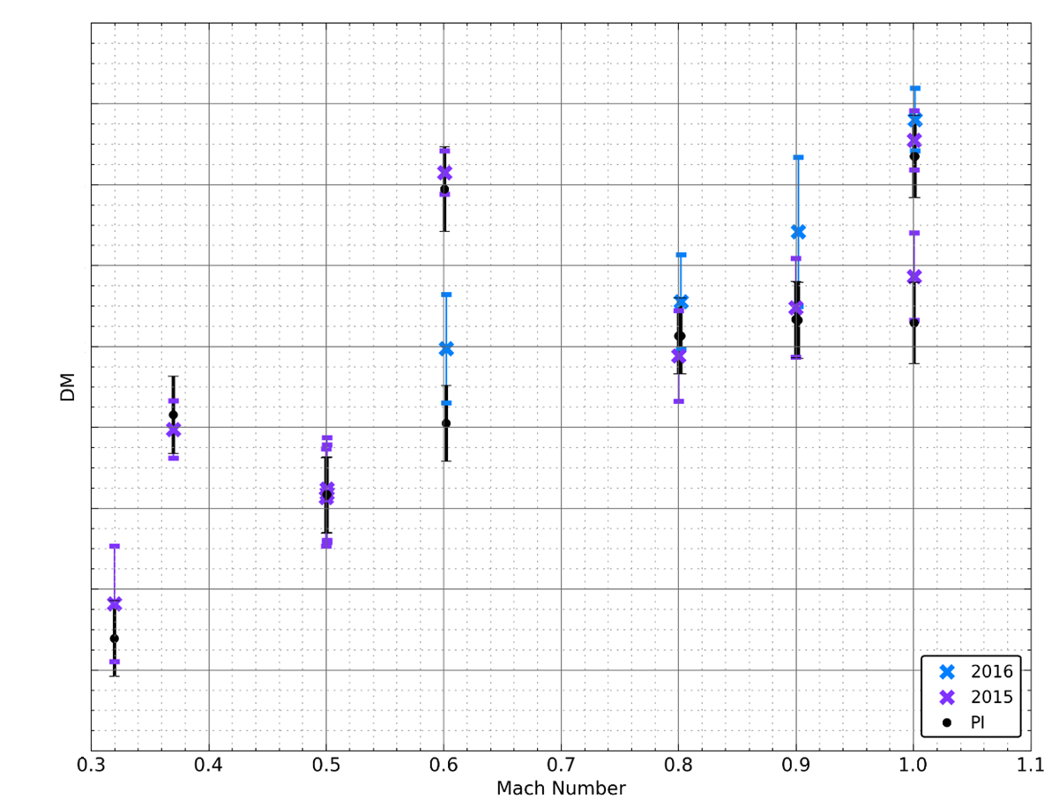
16T Confirmation Points
Data were collected during a second entry a year after the calibration model was developed
Newly acquired data and associated uncertainty compared to model prediction intervals (PI)
Uncertainty bands and prediction intervals overlapped
Confirmation points from original data set also shown
Confirmation points fell within PI

Slide 12
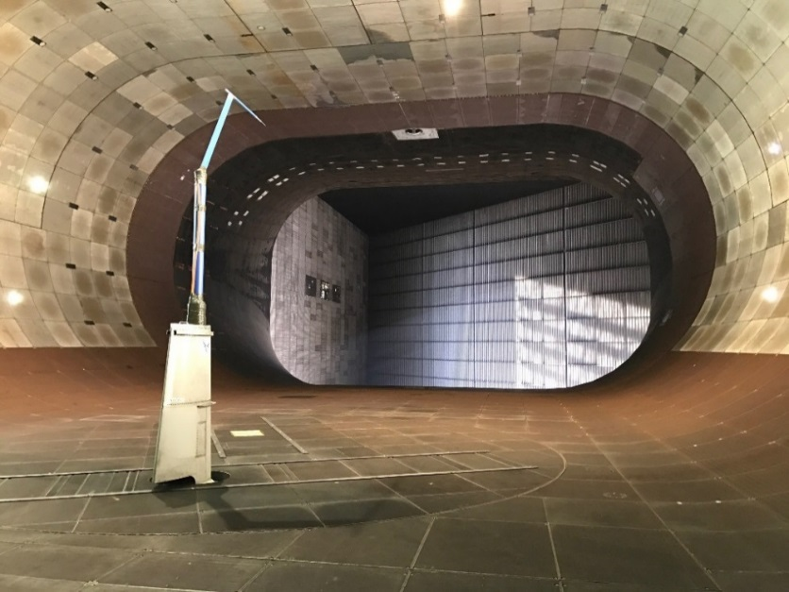
NFAC Calibration
40 ft x 80 ft subsonic tunnel
q_{max} < 280 psf
DOE used to achieve 2 objectives:
Response surfaces of the calibration
Statistical significance of operational factors
Door position (Open or Closed)
Operating Mode (IFC vs Utility)
Fan blade angle
Probe Position
Matrix design for sufficient power to determine factor significance
Blocking applied to study uncontrolled factors such as time of day and tunnel run time
Initial runs conducted to find tunnel boundaries prior to implementation of DOE matrix
High uncertainty, low dynamic pressure region modelled independently

Slide 13
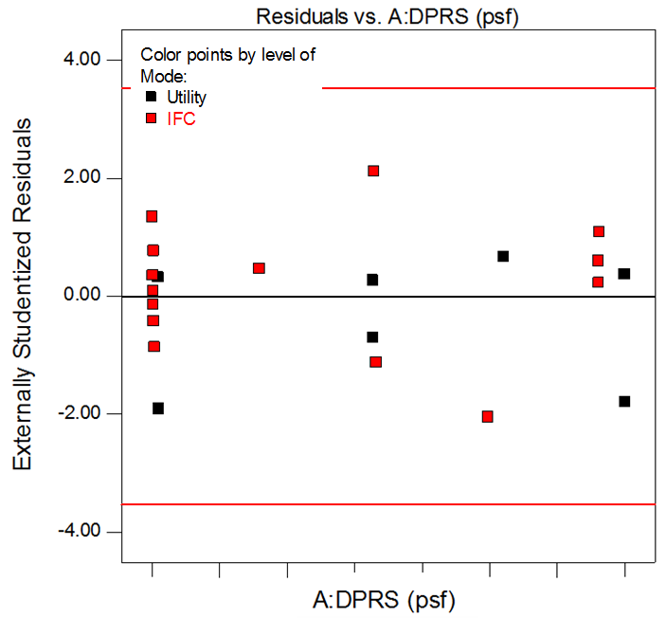
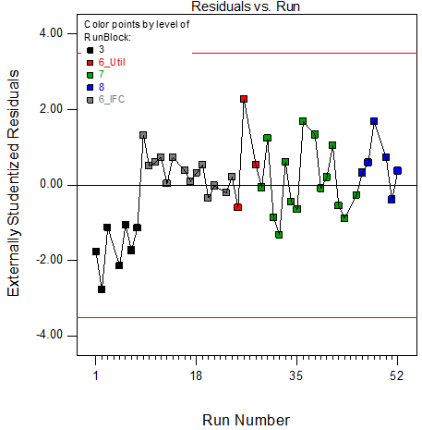
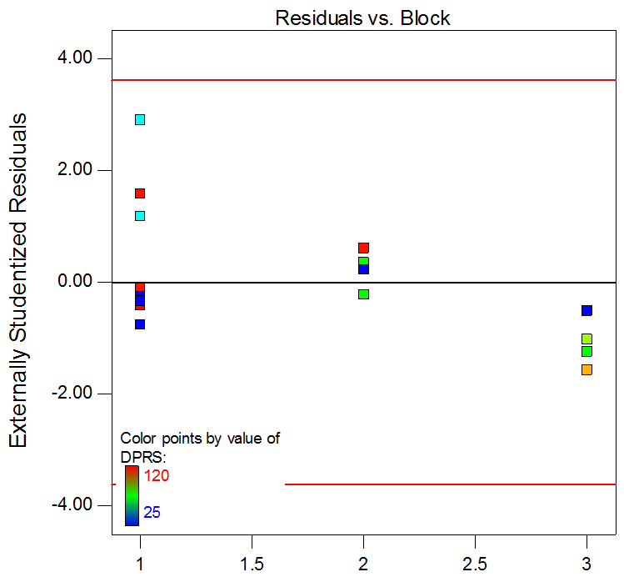
NFAC Calibration
Door Open Runs
Door Open Runs
Door Closed Runs
Door Open runs were combined into a single data set with operation mode a categorical factor
P-values indicated mode not significant
Model indicated no patterns in the residuals
Door Closed runs showed a slight, not statistically significant drift with time
Blocking was used to account for these effects
Door closed runs were statistically different from door open runs

Slide 14
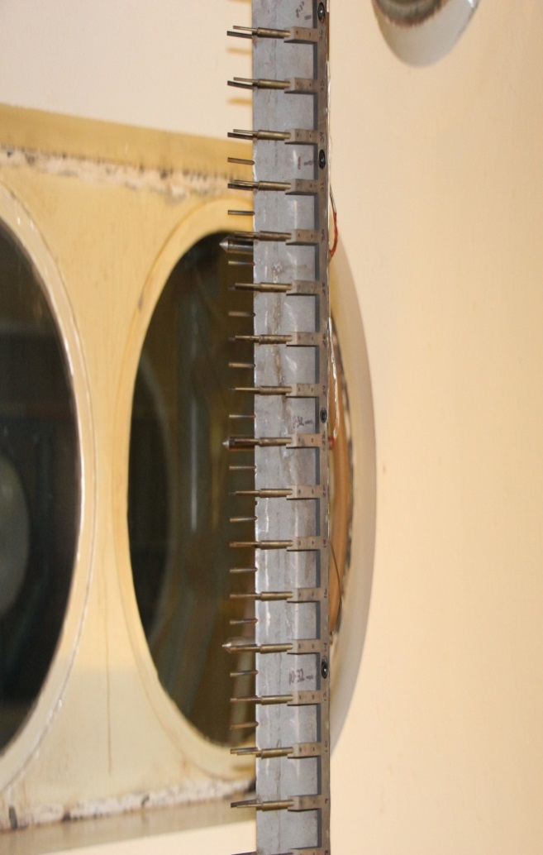
Tunnels B and C
Fixed Mach number nozzles, 50 in diam. test section
Tunnel B: Mach 6 and 8
Tunnel C: Mach 10
Despite similarities in tunnels, DOE was only used for the Tunnel B Mach 8 calibration
Mach 6 calibrated prior to use of DOE at AEDC
Time consuming to reach points on performance map boundaries
Tunnel C (Mach 10) is more difficult to operate. There are no “easy-to-change” variables
Tunnel operation risky with operating procedure set to reduce risk.
Systematic errors captured by taking multiple repeat points
Statistical process control methods applied to develop measure of tunnel repeatability
Regression analysis was used to provide statistically sound model based on OFAT data

Slide 15
Conclusions
DOE used to provide statistical foundation for tunnel calibration models
4T Calibration showed agreement between OFAT and DOE
Power calculations and standard error plots ensure calibration points adequately cover performance map
DOE accounts for any systematic errors
Prediction intervals provide a metric to compare with future data to detect tunnel changes
While few points required than OFAT, DOE is not necessarily the less expensive option
Added operational stresses can cause an increase in data point acquisition time
For some AEDC wind tunnels (Tunnel C), DOE is not practical due to operation constraints on randomization
Multiple models can be used to cover performance map
Reduce Mach number uncertainties in certain regions
Account for additional tunnel variables not present over entire map
DOE will be used in future calibration at AEDC where appropriate

Slide 16
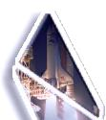
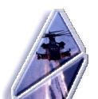
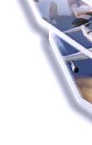
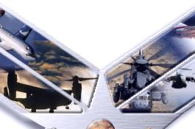
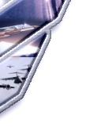
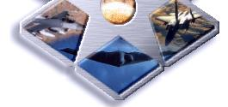
Questions

