Slide 1

A HellerVVA Problem:
The Catch-22 for Simulated Testing
of Fully Autonomous Systems
Dr. Daniel J. Porter
dporter@ ida.org
May 15th, 2020
Notes:
We’ve been thinking a lot about how we’re going to get enough evidence that systems that can make decisions for themselves will behave in an acceptable manner.
Now, there’s way too much to test with these systems—we can’t do it exhaustively, especially not live.
So we’re going to need to rely a lot on inference and on simulation.
But that also means we have to VV&A those simulations.
So today, let’s talk about why for fully autonomous systems, especially those trained with machine learning, this might be kind of hard.

Slide 2
Correlation == Causation
(as least to Machine Learning)
Notes:
So what’s the root of all this difficulty?
It’s because machine learning makes no distinction between correlation and causation. It can learn something that’s associated with what you what, but not what you actually want.
The machine learning mechanisms we have at this time are the same that pigeons and even invertebrate sea slugs have. It’s not what people think of when they think about human learning.
When I hear someone say “I trained an AI to blank” I just mentally replace “AI” with “pigeon” to decide how skeptical I am

Slide 3
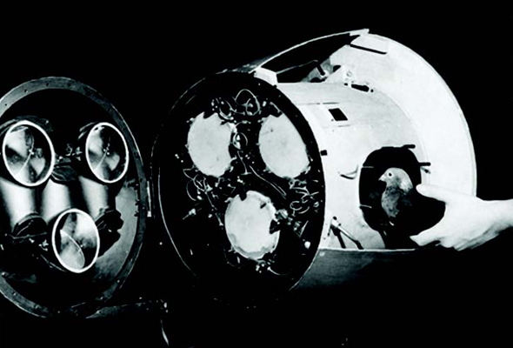
Neural network guided munitions, c. 1944
Notes:
And frankly, that might sometimes be a little unfair to the pigeon.
The pigeon and the AI will both learn something when you train them on a task, but that might be something stupid that only works in the test cases and not in real life.

Slide 4
Lack of confidence in causal factors makes
both generalizing and VV&A problematic.
Notes:
If we can’t be confident in what causes the system to make its decisions, both generalizing so that we don’t have to test exhaustively, and VV&A our sims so that we don’t have to test everything live become really hard.
Let’s talk about that first part.

Slide 5
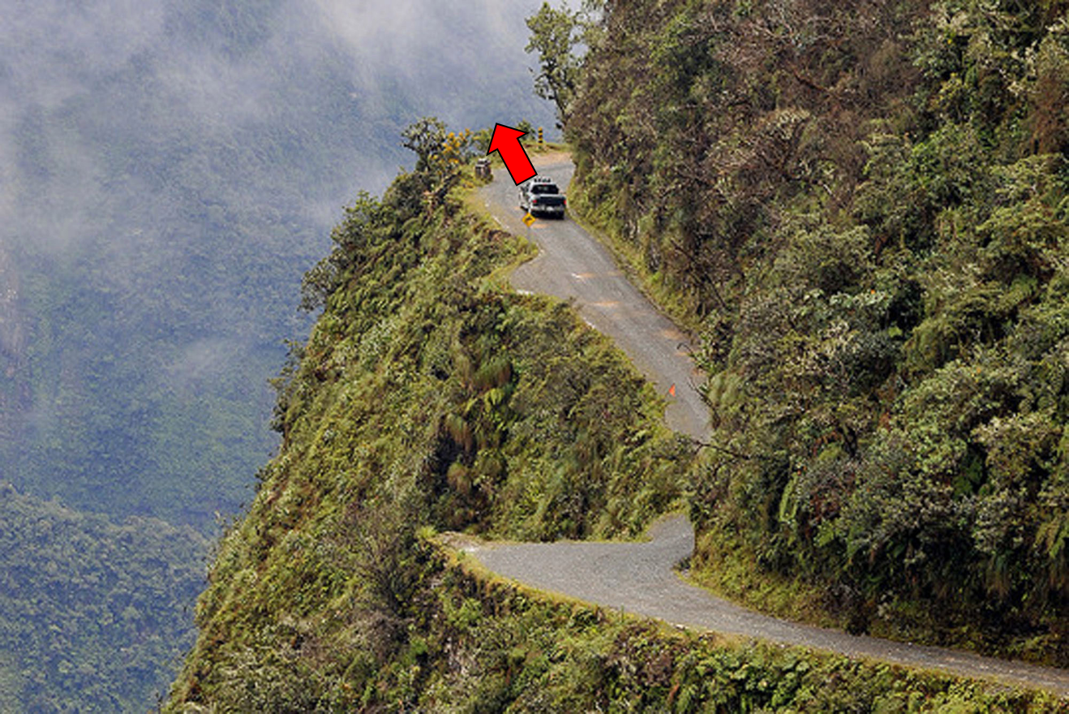
Inferring behavior requires understanding the decisions that causally drive those behaviors
100/100
Notes:
Have autonomous car
Tested first curve 100x, never drove off
But what about next curve? Drive off cliff == unintended
Apply curve 1 results, you assert similarities matter to system and differences do not
We assert we understand the causality of its decisions

Slide 6
We cannot generalize behavior from black boxes
Behavior
Produced
Actuators
?
Procedure:
Straight Ahead
Goal:
Stay on Road
Perception:
No sharp rise
Sensors
Notes:
But when system is a black box, you can’t really validly make those assertions.
Might understand sensors/LIDAR, might understand mechanics, but that doesn’t tell you how it makes decisions

Slide 7
Perception, goals, and procedure selection are the basic decisions that drive behaviors
Behavior
Produced
Actuators
Procedure Selection
Goal
Perception
Sensors
Notes:
To predict decisions, you’d need to know AT MINIMUM goals, © perception, © procedures © and how they interact ©
**Walk through idea of decision making**
These are the fundamental atoms of decision making, these are what cause behaviors, and to make valid generalizations, we need to at least have a useful model, a la George Box, of how they work

Slide 8

Diagnosing unintended behavior will require unobtrusive instrumentation on decision processes
Behavior
Produced
“Cognitive Instrumentation”
We need to instrument these across entire system lifecycle
Actuators
Actuators
Procedure Selection
Procedure Selection
Procedure Selection
We’re used to instrumenting these in test
Goal
Goal
Perception
Perception
Sensors
Sensors
Notes:
Can usually objectively record behaviors ©
Used to instrumenting © sensors and actuators to diagnose
Paradigm shift we need is also instrument system decision processes. At the minimal granularity, © this should tell us what goal it was pursuing, what it perceived, and the action it tried to execute.
Some are calling this © “cognitive instrumentation”
These three boxes are the fundamentals of having a model of system

Slide 9
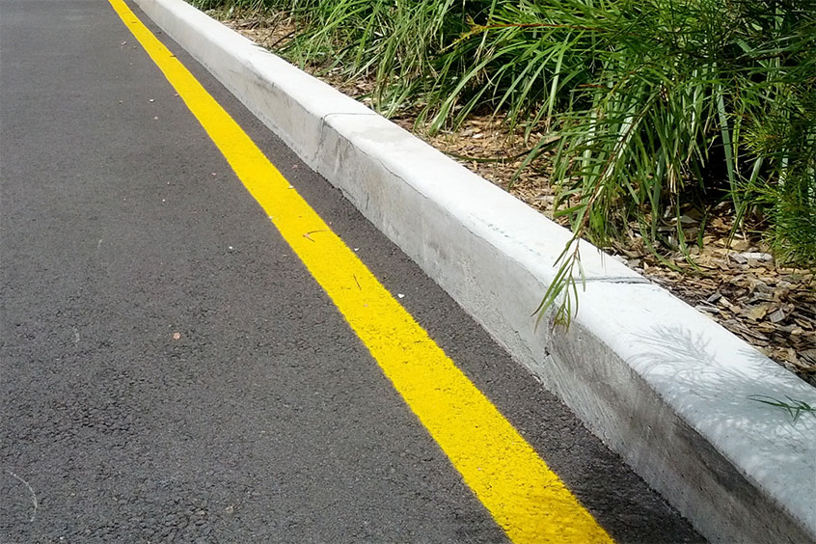
Notes:
Take an autonomous car with dual passive video and LIDAR sensors
Imagine you believed edge of road perception == color contrasts © ©
**narrate yellow line curb**

Slide 10
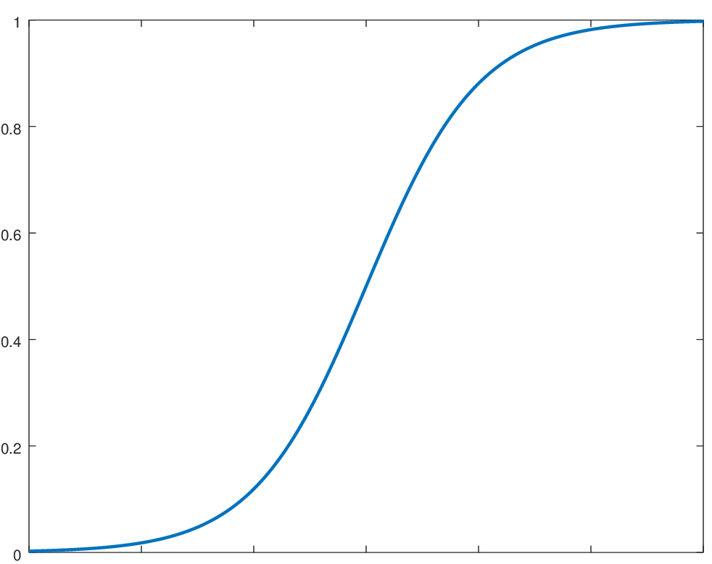
We ultimately want to validly generalize across information dimensions to avoid unintended behaviors
Probability of Avoidance
Road Edge Contrast Value?
Notes:
If that’s how you believe the car perceives the edge of the road, the obvious question is: how much contrast does it need to safely stay on the road?
That’s something we can test.
Might pick some test points varying contrast and observe its behavior, make inferences across dimension
**Explain graph**
Problem is that real world dimensions are confounded

Slide 11
Notes:
Maybe your training environmental always had rise in elevation ©
There was a road, or a sidewalk, or a berm of some kind everywhere.’
Machine learning could have learned to use that just as easily as the color contrast.

Slide 12
Test points can help invalidate assumptions about decision making processes
100/100
Notes:
First curve has both color contrast and rise
Second curve only color contrast
Different perception models make different predictions here.

Slide 13
Notes:
If see it drives off cliff, that’s evidence against my model that the edge of the road is defined by color contrast
But knowing contrast is wrong would have helped me from being in a position where the system performs this unintended behavior

Slide 14
We have to obtain, verify, validate, and accredit models of system decision making
Behavior
Produced
Actuators
Procedure:
Straight Ahead
Procedure Selection
Goal:
Stay on Road
Perception:
No Sharp Rise
LIDAR / Video
Notes:
Have to get a model of how we think system makes its decisions, but then have to put in the work to show it’s good enough.
Have to OVVA

Slide 15
We need to ensure the information dimensions varied in test are the causal drivers and not just correlated
Probability of Avoidance
Road Edge Contrast Value?
Notes:
So that we’re confident we’re varying the right information in test

Slide 16
We need to ensure the information dimensions varied in test are the causal drivers and not just correlated
Probability of Avoidance
Rise in Elevation (cm)
Notes:
And that the inferences we make between and beyond our test points are valid.

Slide 17
How to obtain, verify, validate, and accredit system decision models
Notes:
Let’s talk about how to do this OVVA process.

Slide 18
VV&A needs to happen for more than one thing
Decision Model
What causally drives each of these decision types?
VV&A
Simulation Environment for Testing Behavior
Procedural
Executive
Perceptual
OVVA
Notes:
Now, to avoid some confusion, VV&A applies to more than one thing
When I talk about OVVA, we’re trying to © **discuss box**
That’s OVVA ©
But we also need to VV&A the simulation environment © where we will test the system behavior.
Challenge: Can’t fully VV&A either box without the other.
To verify behavioral sim, need to understand perception first ©

Slide 19
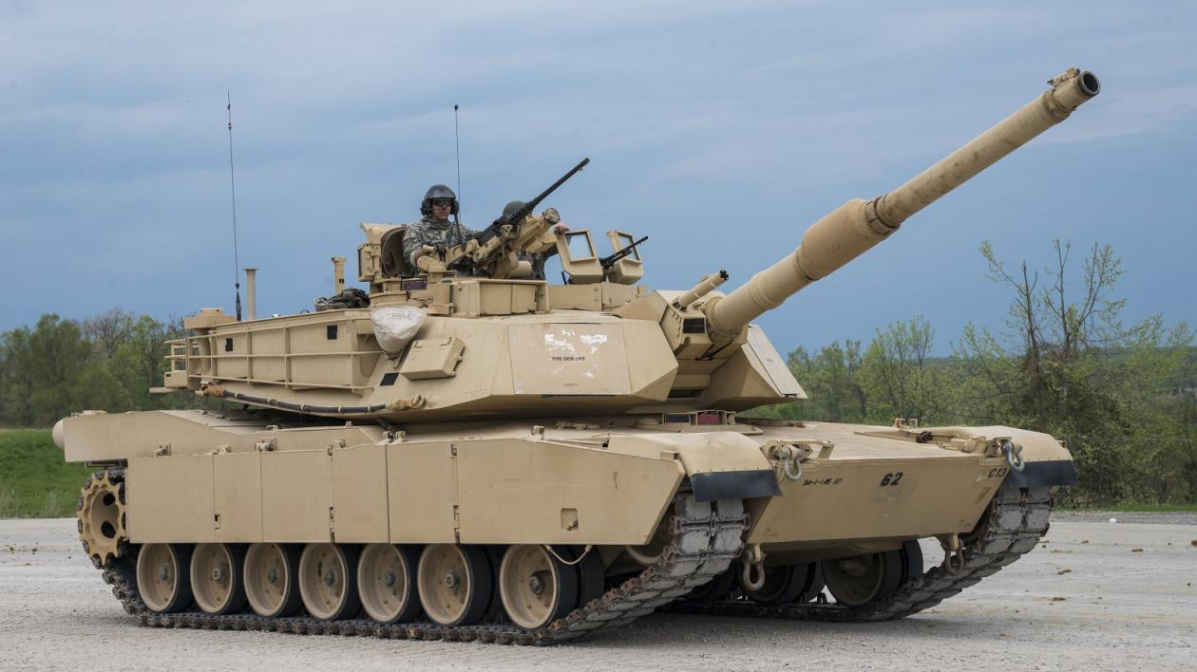
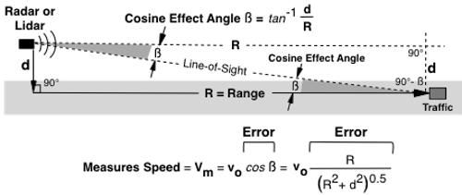
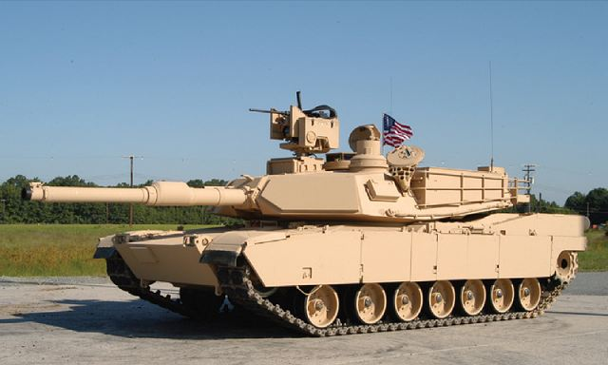

Sensor physics can be valid without the environmental features being valid and representative
θ is a causal driver of threat perception
$$θ$$
Behavioral sim doesn’t vary barrel angle

Slide 20
VV&A needs to happen for more than one thing
Decision Model
What causally drives each of these decision types?
VV&A
Simulation Environment for Testing Behavior
Procedural
Executive
Perceptual
OVVA
Notes:
To verify behavioral sim, need to understand perception first
But we’re also going to need the simulated behavior to help test © the decision model.
There are different things that need to be VV&Aed. The confusing part is that the different VV&A processes will need to spiral through each other.
We’re getting closer to our title, about why this loop will be hard for fully autonomous systems

Slide 21
OVVA requires iterative test and evaluation
Obtain & Initially Verify System Decision Model
Validate/Invalidate Model from Behavior
Continue Building Body of Evidence for Performance
Notes:
OVVA is going to be iterative. E.g. elevation not color contrast, need to go back
This happens before performance confirmation. This is a necessary but not sufficient condition

Slide 22
OVVA requires iterative test and evaluation
Obtain & Initially Verify System Decision Model
Validate/Invalidate Model from Behavior
Continue Building Body of Evidence for Performance
Obtain Valid Test Data
Training Data V&V
Design Analysis
VV&A Environment (Traditional & New)
Model Induction
Module Injection
Test Simulated Behavior
Limited Safety Release
Test Live Behavior
Validate Simulated Behavior
Notes:
Just flashing this up, these boxes have a lot that go into them.

Slide 23
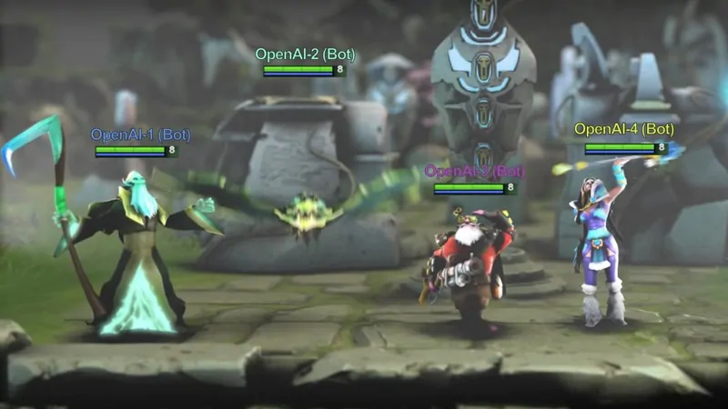
System design alters how to obtain decision model
Modular
Traditional Software
Hybrid Architectures
ACT-R
Sub-symbolic
Symbolic
Deep Neural Nets
e.g. OpenAI Five
Monolithic
Notes:
How to obtain model depends on how the system is designed
**Orient and explain graph**

Slide 24
System design alters how to obtain decision model
Modular
Obtain through Design
Sub-symbolic
Symbolic
Obtain through
Data
Monolithic

Slide 25
System design alters how to obtain decision model
Modular
Obtain through Design
Sub-symbolic
Symbolic
Obtain through
Data
Monolithic

Slide 26
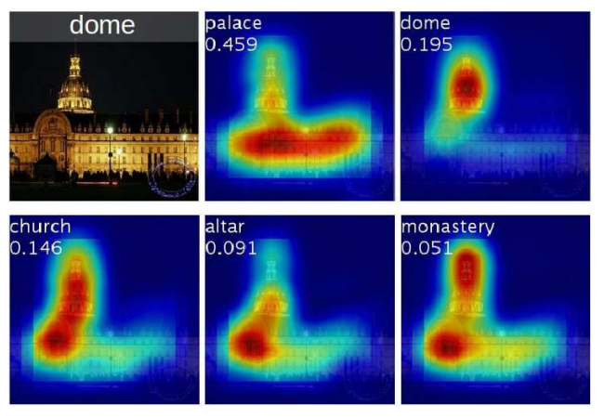



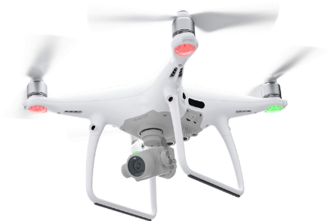
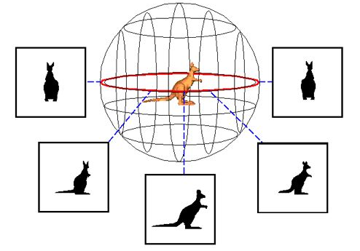
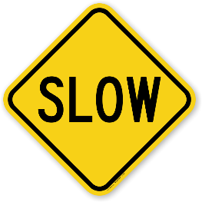
Model induction has promising data-driven techniques, but may be insufficient for embedded full autonomy
Input
Output
E.g., Saliency Mapping
A
B
C
D
A
B
C
D
A
B
C
D
I
II
III
IV
I
II
III
IV
I
II
III
IV
Assumption:
Have valid inputs
D
Palace
https://arxiv.org/pdf/1512.04150.pdf
Full autonomy can change the information acquired
Need model to VV&A sim
Need sim for safety release

Slide 27
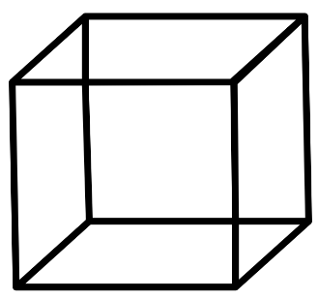
Sequential experimentation is (likely) the most efficient method for model induction
Experiments, data, and observations
Test Design 1
Analysis
1
Test Design 2
Analysis
2
Test Design 3
Analysis
3
Theories, hypotheses, expert opinion
Screening Designs
Interaction Designs
Higher-Order Designs
Validation Designs
Notes:
Sequential

Slide 28

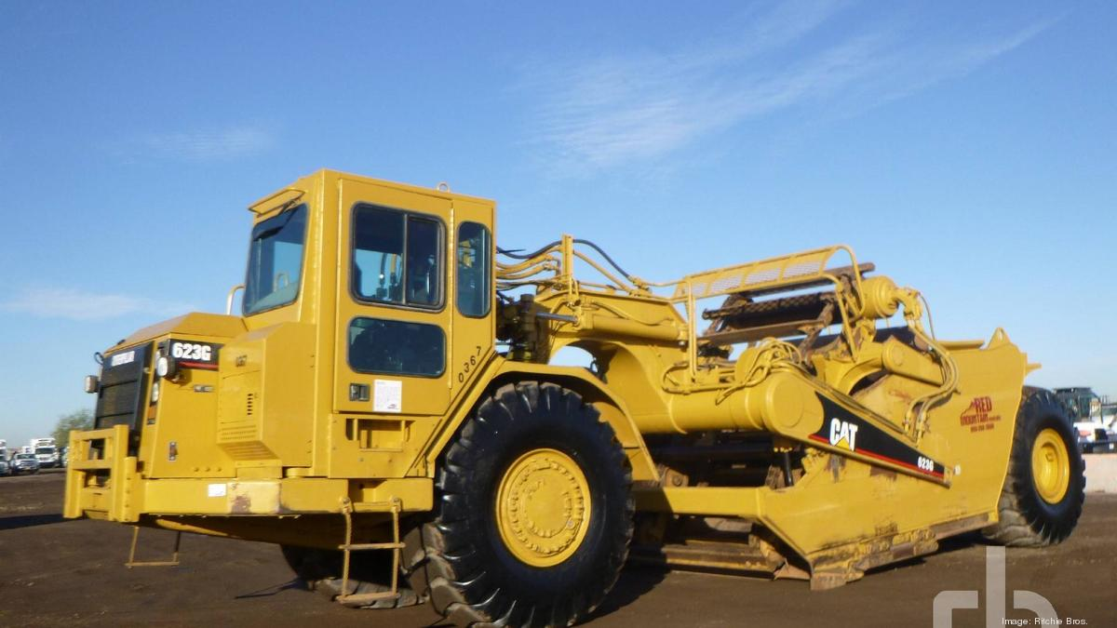
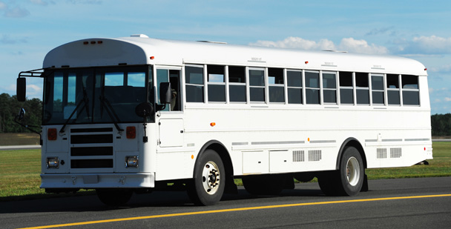
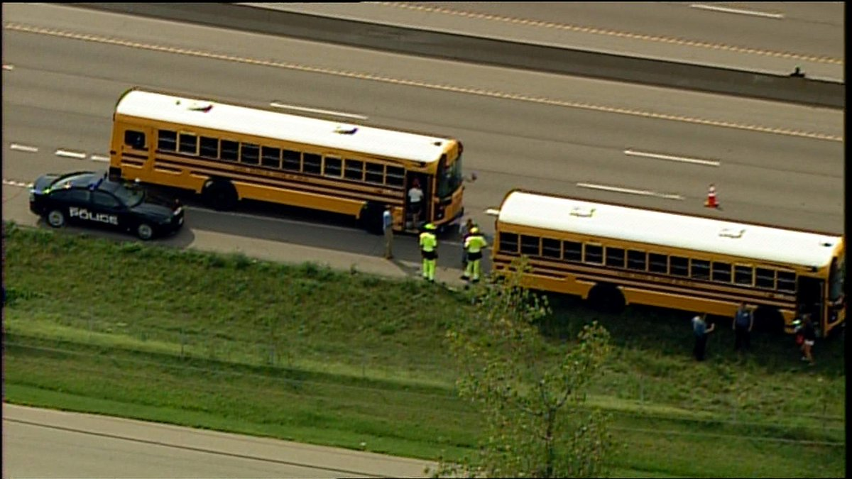
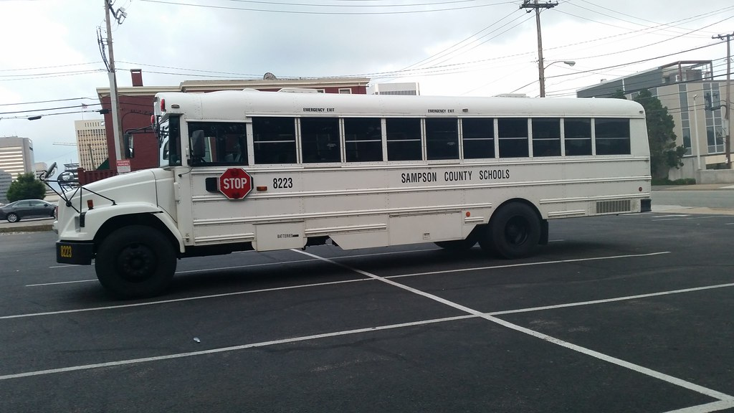
Bus!
Bus!
Not a bus :(
Not a bus :(
Bus!

Slide 29
Sub-symbolic, monolithic systems will demand much
greater quantities of data to obtain decision models.
These data may be expensive for both time and resources.

Slide 30
System design alters how to obtain system model
Modular
Obtain through Design
Sub-symbolic
Symbolic
Obtain through
Data
Monolithic

Slide 31
Modular architectures’ decision models can be initially verified through cascading compositional verification
SPATIAL
LOCALIZER
OBJECT
IDENTIFIER
Top-down
OBJECT
ASSEMBLER
Bottom-up
This is a toy example, not a design recommendation
EDGE
DETECTOR
SHAPE
BUILDER
VIDEO FEED
Notes:
Sequential testing will need

Slide 32
Bayesian network models can quantify uncertainty in decision making across distributed modules
Outputs must feed subsequent inputs
Module
1
Module
2
Quantify uncertainty and propagate
Module
1
Module
2
Module
…
Module
n
Propagating uncertainty across multiple modules provides uncertainty estimates in all or part of the decision model, supporting verification

Slide 33
Conclusions
Valid inference requires understanding decision causality
  How does environmental information change behavior?
Need to obtain, verify, validate, and accredit decision models
  System design affects OVVA process
Fully autonomous systems make getting OVVA data hard
  Hybrid modular systems can mitigate these challenges

