Slide 1
Assessing Human-Autonomy Interaction in Driving-Assist Settings
Missy Cummings
Duke University

Slide 2
The Conundrum of Partial Autonomy
Driving
Computer
Humans
Level 2+
Need consistent and timely handover alerting to maintain continuity

Slide 3
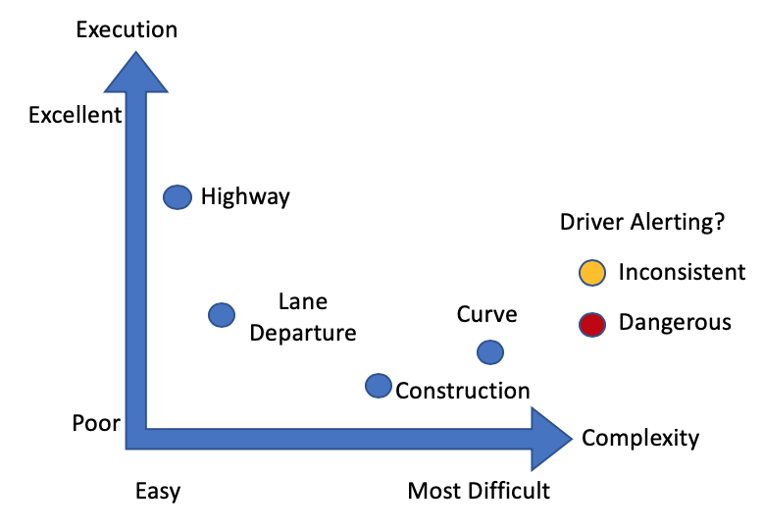
Test Outline
4 tests
  Curve
  Construction
  Lane departure
  Highway
NCCAR track
Three 2018 Tesla Model 3s randomly selected
  10 randomized runs each
  1 driver w/ 1 assistant
  Confound between the car and the software version.
  Could only control some internal settings
  6 hour window (11am-5pm in March)
?

Slide 4
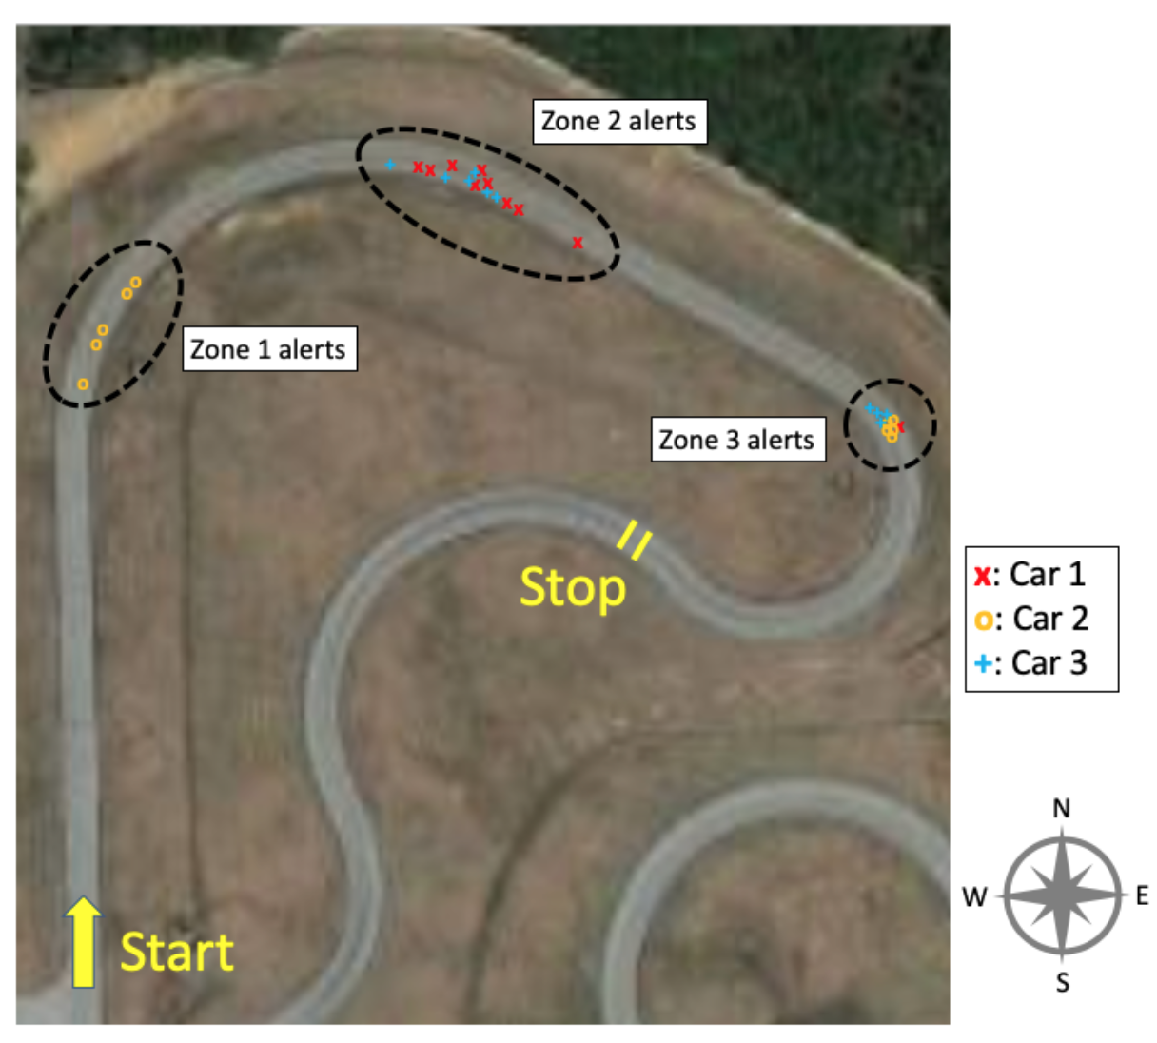
Curve Test
Autopilot safely stopped the cars in all 30 trials.
High variability for receiving 1st takeover alert (3 distinct clusters), but once initiated, consistent timing for 2nd and 3rd
In 30% of trials, cars travelled 26s beyond LLM before warning the driver.
Distances between LLM & initial alert could be as short as 43 ft (13 m), as late as 1255 ft (383 m)
  Very inconsistent
Some evidence that sun angle and brightness may influence perception systems
Last lane marking

Slide 5
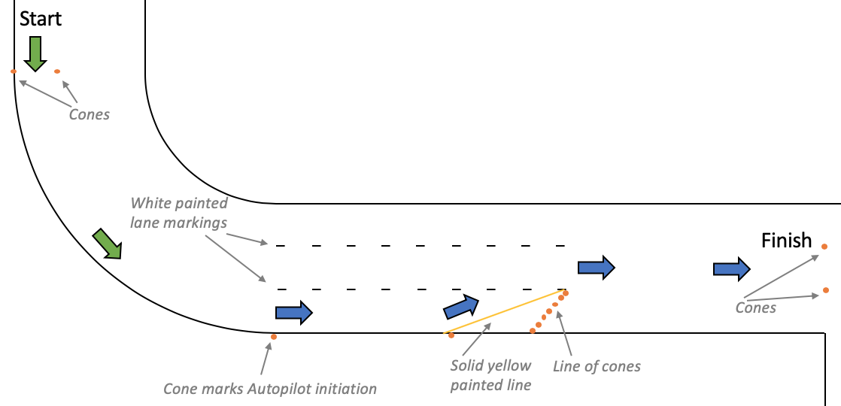
Test 2 Environment
Same 3 Teslas
  Disabled Car 2’s FSD visualization
  Same times of day
10 runs each
  Randomized
25 mph
Autopilot initiated at lane lines
7 cones, painted yellow line

Slide 6
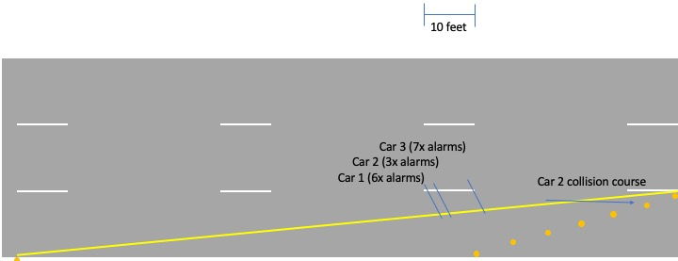
Construction Zone Test
Car 2 was full self-driving

Slide 7
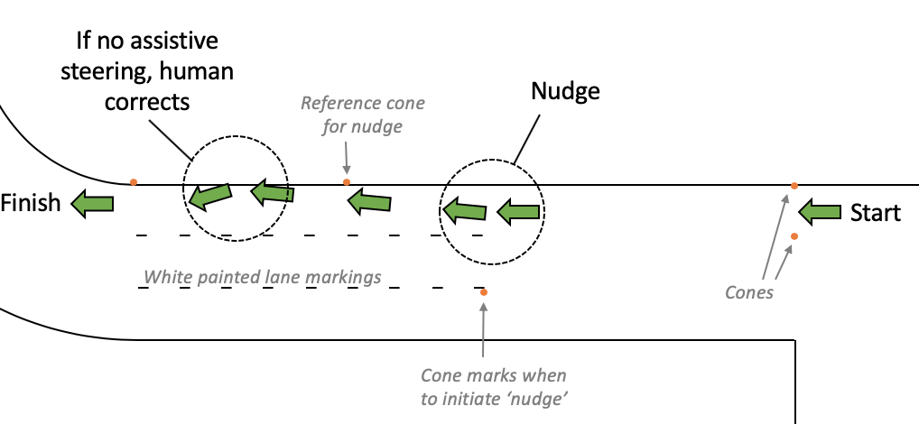
Emergency Road Departure Test
  Angle of wheel rotation measured from cameras, ANOVA with car & outcome (none/alarm/assist) as predictors. No statistical difference in wheel angle inputs.
  50% trials would have ended with distracted driver off the road, only 21% had any active emergency steering.

Slide 8
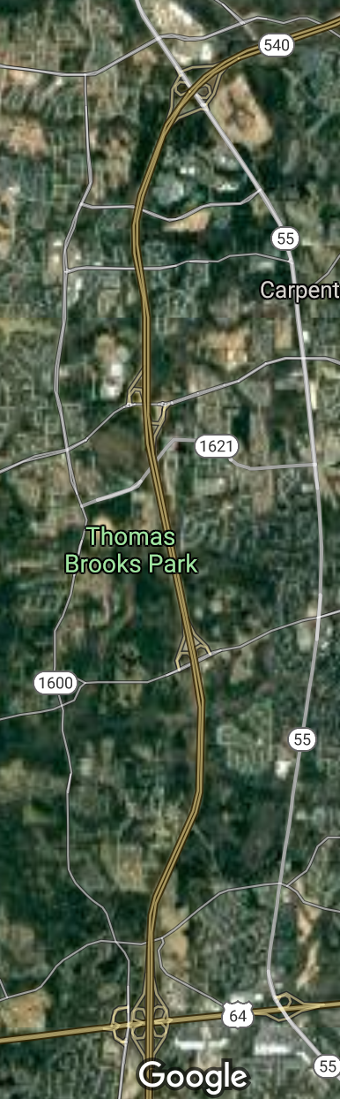
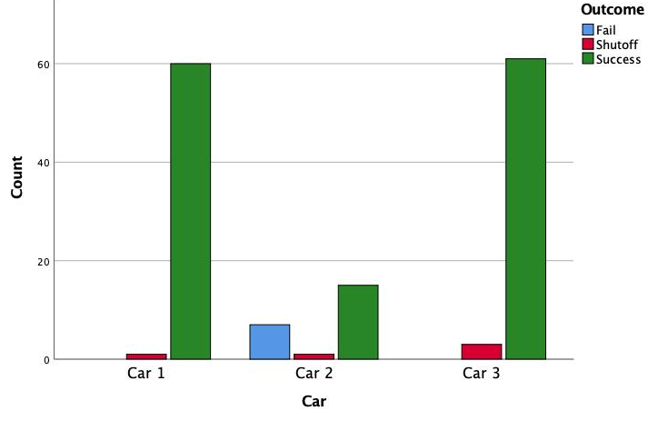
Highway Driver Monitoring Test
162 total events
  FSD car was a problem
Success, shutoff, failure
  Driver responds to alert and autopilot continues
  Driver responds to alert and autopilot shuts off unexpectedly
    3.6% of successful trials
  Driver never alerted, car makes unsafe move
    A failure ended that trial for safety
Fails N = 7, or 30%
While hands off alerting was generally consistent, 30s is a long time to not be paying attention at 70mph
  Car 3: 43.8s at ~55mph & Car 1: 43.4s at ~63mph
  Time to clear each alarm was consistent
Notes:
t=-2.634, dof 77.614, unequal variance, p=.010

Slide 9
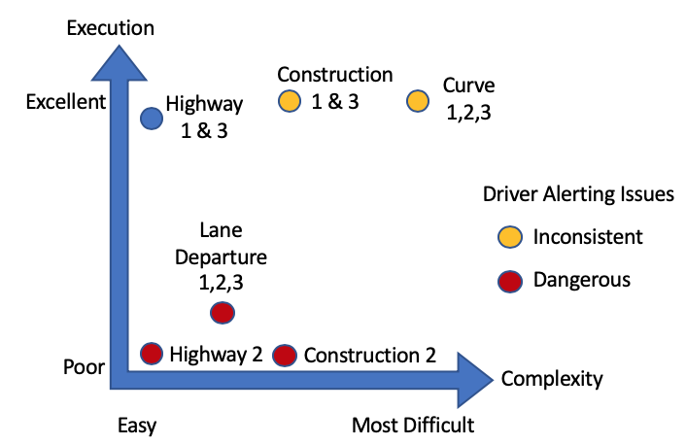
Meta-analysis
Perception systems for Cars 1 & 3 seemed consistent across tests
  Sometimes good (const. & hwy), sometimes bad (lane departure)
Autopilot handover alerting was extremely inconsistent for all 3 cars
  Unexpected handovers can be critical under time pressure – mode confusion
?
Driving monitoring system mostly consistent
  Completely failed in 30% of Car 2 trials
  Is linear time between hands-off notifications a good idea?
Car 2 performance a mystery
  Performed best in most difficult scenario, consistent in successful highway trials (roughly 1/3 of other cars) but was unsafe in 3 of 4 tests
  Problems with software OTA updates could be a significant albatross
  Are drivers being used for beta testing?

Slide 10
Questions?

