Slide 1
The Effect of Extremes in Small Sample Size on Simple Mixed Models:
A Comparison of Level-1 and Level-2 Size
Kristina Carter, Heather Wojton,
Stephanie Lane, & Jonathan Snavely
Institute for Defense Analyses
DATAWorks 2018

Slide 2
Background & Overview
Operational testing
Operational performance = f(operator, system)
Mixed model analysis
  Addresses some challenges
  Raises others
Quantify challenges
  Can mixed models be used in operational settings where sample sizes are small?
Provide recommendations
Notes:
Operational performance is a function of both the operator and the system, not only the system.
Sampling challenges particularly in some areas such as with air and satellite systems

Slide 3

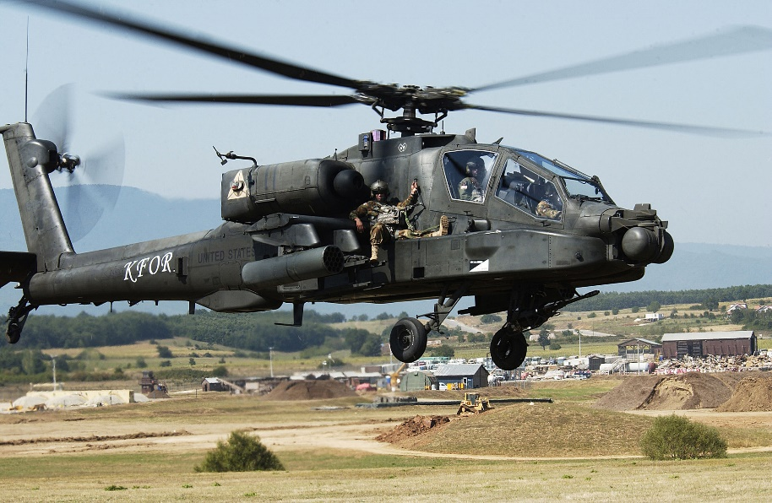
Scenario
Testing: Gathering information
Evaluating: Drawing conclusions
Notes:
Images 1 & 2
Perhaps we’re interested in comparing our newer system, on your right, to our older system, on your left, and we want to know whether the new, more expensive system, is better than the old one.

Slide 4
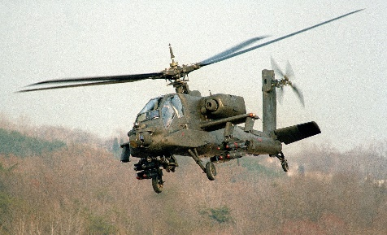

Drawing Conclusions
Systems Different
<
Systems Equivalent
=
Notes:
Talk about interest in an improved system not a different system. If we want to detect improvements in the system.

Slide 5

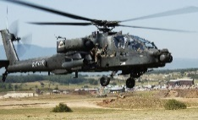


Drawing Conclusions
Determination
<
=
Systems Different
Systems Equivalent
Power
Systems Different
<
1 – β =
P(a ≠ b | a ≠ b)
β =
P(a = b | a ≠ b)
Reality
Type II Error
Type I Error
=
Systems Equivalent
α =
P(a ≠ b | a = b)
1 – α =
P(a = b | a = b)
Confidence
Notes:
There are two possibilities for each of our decisions. If we determine that the systems are different from each other, they could, in fact, be different.
The smaller your beta, the higher your power, and we like to have our risk of Type II error, be no more than 20%, so we want at least a power of 80%. Later on I’ll refer to .8 as an important value for power later on, so that’s why

Slide 6








Power
Additional factors affecting power:
Acceptable risk level, α
α = P(a ≠ b | a = b)
risk of making a Type I Error
Magnitude of the effect (SNR), δ/σ
Size of the sample, N
Positively related to Power
-
$$\text{X}$$
________
$$\text{X}$$
$${\text{σ}}_{pooled}$$
Notes:
Sdpooled = sqrt.[(var1 + var2) / 2]
As you have more observations, your variability decreases, so your power increases

Slide 7




Repeated Measures Design
$$\text{X}$$
-
$$\text{X}$$
________
$${\text{σ}}_{pooled}$$
Veteran
Legacy System
Speed
Accuracy
Perceived ease of use
Novice
New System
Speed
Accuracy
Perceived ease of use

Slide 8
Repeated Observations
Legacy System
Speed (5 times)
Accuracy (5 times)
Perceived ease of use (5 times)
New System
Speed
Accuracy
Perceived ease of use

Slide 9
Mixed Models for Repeated Measures
Linear Model
Operator Model
Mixed Model
System Model
average usability
error
y_{ij} = β_{0j} + β_{1j}X_{ij} + ε_{ij}
usability
system used
average
effect size
operator experience
β_{0j} = γ₀₀ + γ₀₁Z_{j} + ζ_{0j}
unique averages
β_{1j} = γ₁₀ + γ₁₁Z_{j} + ζ_{1j}
y_{ij} = γ₀₀ + γ₀₁Z_{j} + γ₁₀X_{ij} + γ₁₁Z_{j}X_{ij} + ζ_{0j} + ζ_{1j}X_{ij}+ ε_{ij}
Notes:
fixed factor: a factor with chosen levels
random factor: a factor with randomly sampled levels
With a multilevel model, we can model the variance in the intercepts and the slopes, we don’t have only one intercept and slope as in a simple linear model, for each individual person we have a personalized intercept and a personalized slope; perhaps, for instance, the veteran pilot has greater accuracy on the
Operator model, models characteristics of the operators themselves

Slide 10
Mixed Models for Repeated Measures
Repeated Measures Mixed Model
Level 1: Different observations of a single operator
Level 2: Different operators
Intraclass Correlation (ICC)
level-2 variance
$$ICC=\frac{between operator variance }{between operator variance + within operator variance }$$
level-1 variance
Notes:
The intraclass correlation (ICC) is a measure of the extent to which the clustering of level-1 measures in level-2 accounts for the variance in Y. ICC is determined by the ratio of the level-2 variance to the total variance:
ICC = $\frac{σ_{0}^{2}}{σ_{0}^{2}+σ^{2}}$

Slide 11


Benefits of Mixed Models
Account for dependence within operators
Account for varying dependency within operators
T1 Perceived ease of use
T2 Perceived ease of use
r ≠ 0
T3 Perceived ease of use
T1 Perceived ease of use
T2 Perceived ease of use
r = .80
T3 Perceived ease of use
r = 0.50

Slide 12
Benefits of Mixed Models
Don’t require complete data
T1 Perceived ease of use
T2 Perceived ease of use
T3 Perceived ease of use
T1 Perceived ease of use
T2 Perceived ease of use
T3 Perceived ease of use
Notes:
A lot of statistical tests will either get rid of

Slide 13
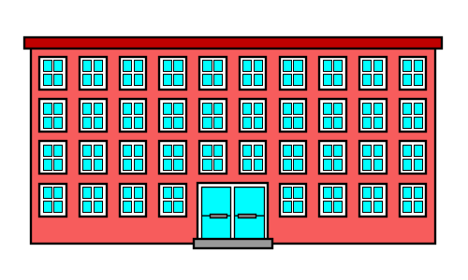





Looming Disadvantage
Previous research indicates sample sizes of at least 30 at the highest level should be used.
At least 30 schools
Notes:
Because mixed models use maximum likelihood estimation, large sample sizes
For interest in the fixed parameters only, recommendation of 30-10
At least 30 schools, and that’s if we’re only interested in the effect of a fixed factor, like gender, on how the STEM intervention is working, not if we’re interested in throwing in other things, like the kids Socioeconomic status, or their parents’ level of education.
-This is how mixed models are most commonly used in behavioral research but this corresponds directly to our circumstance, of taking multiple observations of the same pilot; in that case, instead of looking at 30 different schools and looking at children within those schools we would be looking at 30 different pilots and at multiple observations within the same pilot.

Slide 14
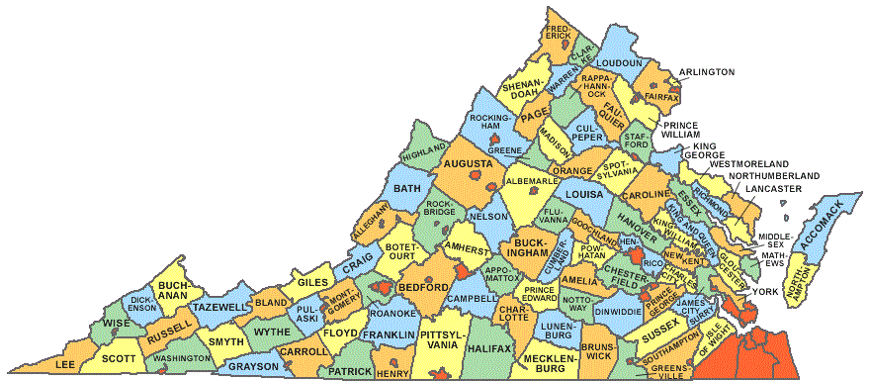

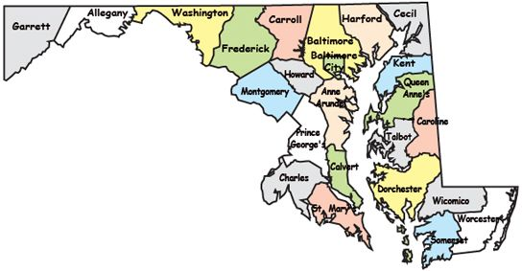
Scenario
Higher numbers needed than are easily available….
School Districts
N = 134
School Districts
N = 24
….or even possible
Notes:
What does this mean for me, when I’m trying to study how usable pilots find the new system? There’s no way I can use a mixed model to study my pilots because there’s no way I can get 30 pilots for my test.
This is not limited to DOD research, for instance, school district example

Slide 15
Gaps in the Literature
How bad is “too small”?
  Lower limit of 10
    Simplest mixed model not explored:
    y_{ij} = γ₀₀ + γ₁₀X_{ij} + γ₀₁Z_{j} + γ₁₁Z_{j}X_{ij} + ζ_{0j} + ζ_{1j}X_{ij}+ ε_{ij}
    y_{ij} = γ₀₀ + γ₁₀X_{ij} + ζ_{0j} + ε_{ij}
Small acceptable risk (α ≤ .05)
  DOD uses α ≤ .2
Small effect size
  Behavioral research often looking at tiny impacts
  Impacts at that level not of interest to DOD
Small intraclass correlation
  Higher intraclass correlation exists in within-person designs
Overall Problem:
Academic recommendations inconsistent with applied research realities
Notes:
Overall Problem: Academic recommendations inconsistent with applied research realities

Slide 16
Current Study
Even in small total sample conditions, bias of fixed effect estimates will be minimal
Increasing level-2 sample size has a greater positive effect on power than increasing level-1 sample size
Smaller sample sizes will have adequately high power and low type I error rate under conditions and standards common in operational testing
  Higher type I error risk levels
    Power levels at DOD standard of α ≤ .2
  Larger effect sizes
    Power at effect sizes relevant in applied research
  Higher ICC levels
    ICC levels common to repeated measures designs
Notes:
Quantify how bad “too small”
Are small sample sizes useful for simplest model?
Examine power sample sizes less than 10

Slide 17
Method: Simulation Study
Continuous increases in level-2 sample size
  N = 4 to N = 30
Continuous increases in baseline observations
  N = 2 to N = 10
Varying levels of SNR
  SNR = 0, .3, .5, .8, 1
Varying level-2 variance
  ICC = .075, .25, .5, .8
1,000 datasets generated each
  Total sampling conditions: 243
  Total conditions: 243 x 5 x 4 = 4,860 Total mixed models* = 4,860 x 1,000 = 4,860,000
Notes:
So that the relationship between my level-2 variance and my overall variance could reflect some different conditions common in research in this area.
Convergence failure rates of the mixed model estimation procedure varied according to ICC. In the lowest ICC conditions, the failure ranged from 0.13% to 0.17%, in the highest ICC conditions, failure rate ranged from 0.008% to 0%. Reported results exclude estimates that failed to converge.
Mixed models

Slide 18
Method: Simulation Study
FIML used to estimate fixed effects
  Fixed effect type I error, bias, and power of interest
Likelihood-ratio test used to compare full and reduced models
  Mitigates impact of downwardly biased standard error estimates
Convergence failure
  Negatively related to ICC
  0.13% - 0.17% to 0.008% - 0%
Notes:
Full maximum likelihood (FIML) was used to estimate fixed effects and, following the recommendations of West, Welch, & Galecki (2015), a likelihood-ratio test was used to compare the full model, with the fixed effect, to a reduced model without one.

Slide 19
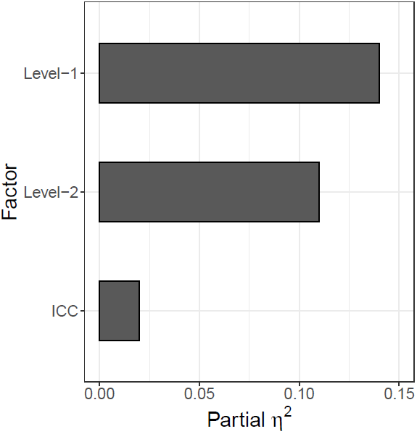
Results: Type I Error
Factor Impacts on Type I Error
Type I Error:
Proportion of models for which the fixed effect was found to be statistically significant despite having a slope equal to zero.
Type I error rate at the p ≤ .01 level depicted, overall patterns present remained the same at higher alpha rates.
0.14
β = -0.36
0.11
β = -0.30
0.02
β = -0.14

Slide 20
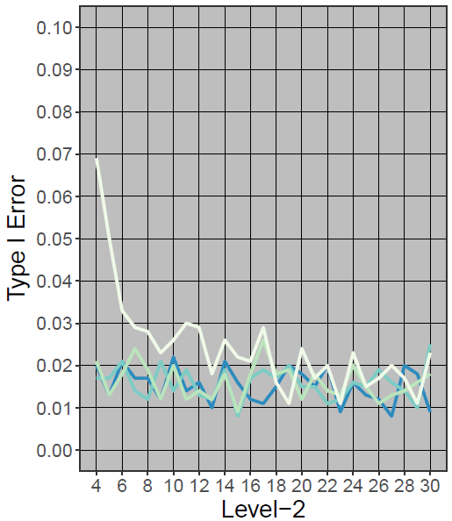
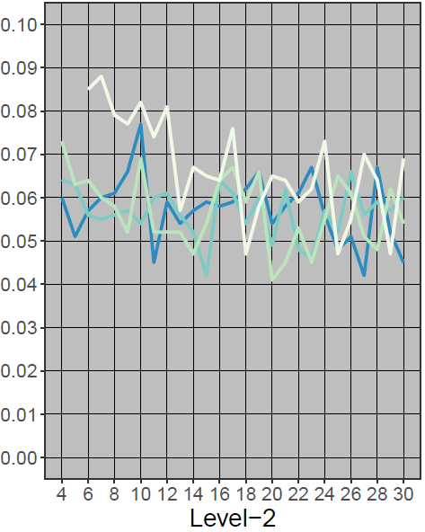
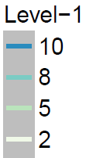
Results: Type I Error
α = .01
α = .05

Slide 21
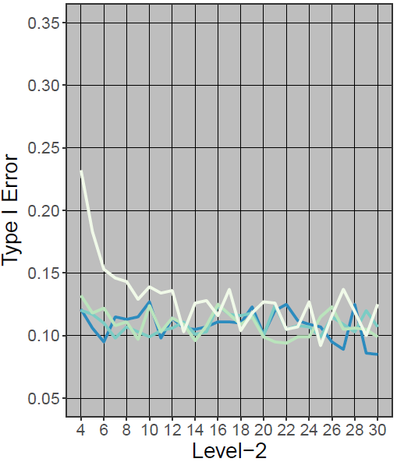
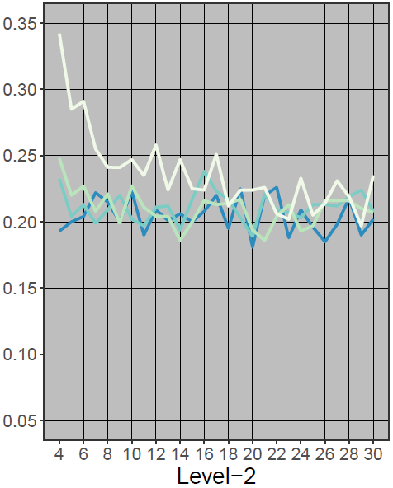
Results: Type I Error
α = .1
α = .2

Slide 22
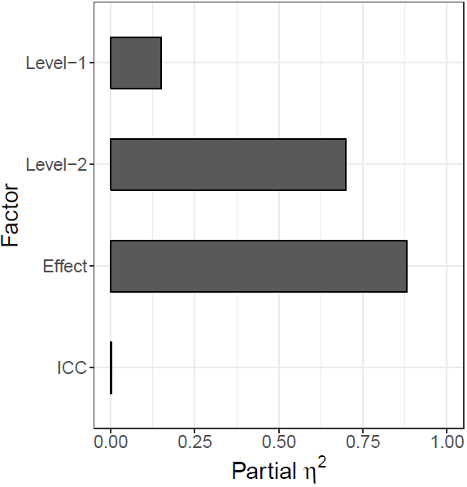
Results: Power
Factor Impacts on Power
Power:
Proportion of models in which the fixed effect (slope > 0) was statistically significant.
Power at the p ≤ .01 level depicted, overall patterns present remained the same at higher alpha rates.
0.15
β = 0.13
0.70
β = 0.46
0.88
β = 0.82
0.002
β = -0.01

Slide 23
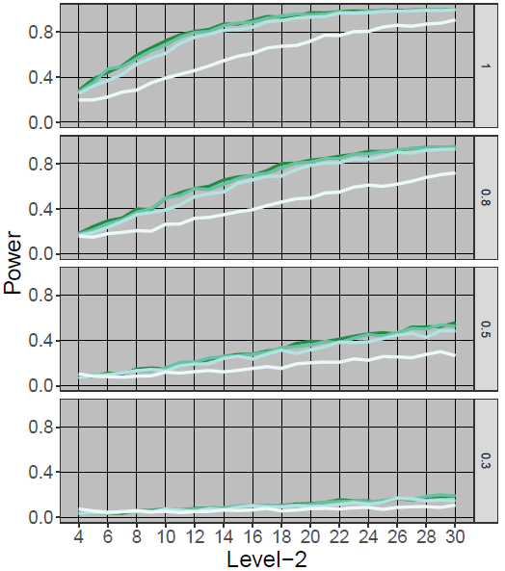
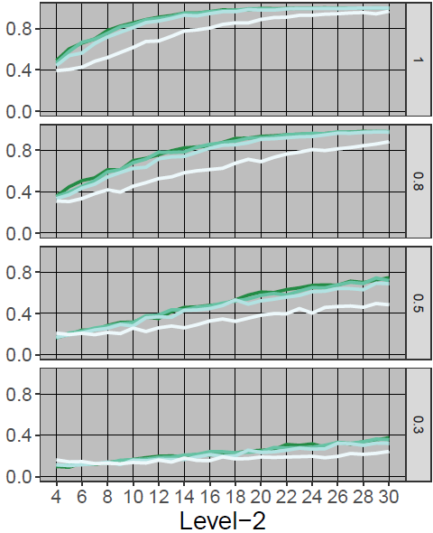
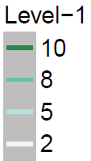
Results: Power
α = .01
α = .05
Notes:
With ICCs ranging from .3 - .5
Specifically power to detect
At higher levels of level-2 variance, this is the most conservative estimates

Slide 24
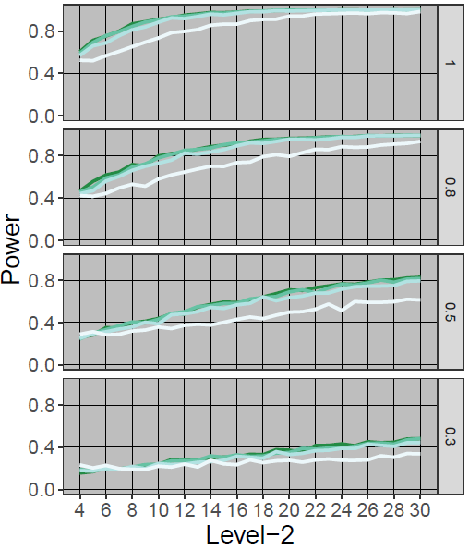
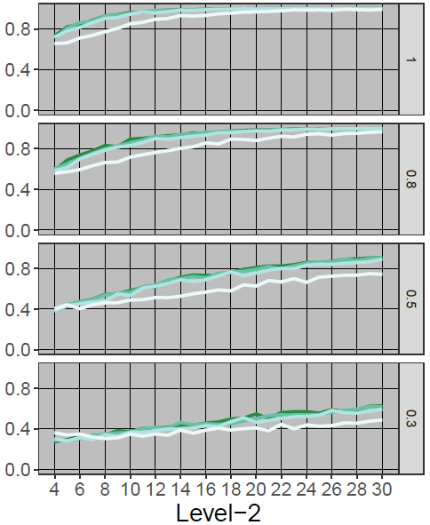
Results: Power
α = .1
α = .2
Notes:
Alphas = .1 and .2

Slide 25
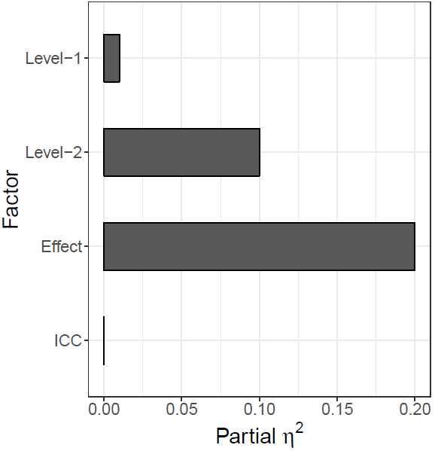
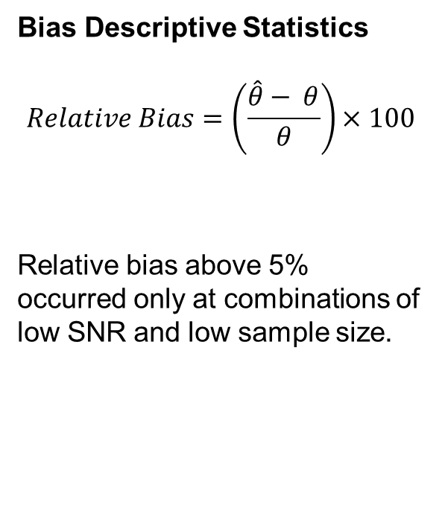
Results: Bias
Factor Impacts on Bias
Bias Descriptive Statistics
$$Relative Bias=\left(\frac{\hat{θ}− θ}{θ}\right)×100$$
Relative bias above 5% occurred only at combinations of low SNR and low sample size.
0.01
β = -0.07
0.10
β = -0.28
0.20
β = -0.43
0.0001
β = 0.01
Notes:
Type I error rate at the p ≤ .01 level was regressed on ICC, level-1 sample-size, and level-2 sample size.
Across all conditions for which relative bias could be computed (i.e., effect size > 0), relative bias ranged from -16.27% to 14.32%.

Slide 26
Conclusions
Smaller samples of participants can attain sufficient power in certain circumstances:
  when a single fixed effect factor is of interest
  when the minimum effect worth detecting is large (i.e., effect size = 1 or higher)
  when inflation in type I error is adjusted for by stricter standard
Under these conditions, fixed effect bias is low, inflations in type I error are manageable, and power is adequate despite small sample sizes.
Notes:
Our findings suggest that much smaller sample sizes, including sample sizes of 10 and under, can attain sufficient power in certain circumstances: when a single fixed effect factor is of interest, when greater risk of type I error is acceptable and thus can be adjusted for, and when the minimum effect worth detecting is large (i.e., effect size = 1 or higher). This study demonstrates that under these conditions, fixed effect bias is low, inflations in type I error are manageable, and power is adequate despite small sample sizes.

Slide 27
Implications
For operational research….
  Mixed models are a viable alternative, with minor adjustments
  Account for typically encountered challenges
  Enable analysts to take advantage of data already available
If you want to use mixed models with operators ≤ 10, you will only be able to detect large effect sizes
  Sampling numbers recommended here not unreasonable
  Higher numbers available, mixed models can detect lower effect sizes
Notes:
For some systems we can assess hundreds of operators, in these cases, we do want that higher N, and mixed models would still be helpful, in fact they’d be even more powerful. But for some systems such as aircraft and satellite, where sampling samples are smaller, we can still attain sample sizes approaching 10, and in some cases more. If you have more, you should use them, as you’ll be able to detect smaller SNRs but remember to adjust your alpha accordingly anyway.

Slide 28
Further Research
Only simplest model examined here
  Binary vs. continuous predictors
  Adding in fixed parameters, e.g., time of day
  Cross level interactions, e.g., system-pilot experience interaction
  Variance components, e.g., pilot unit
Impact of missing data
  Previous research indicates not problematic
  Not tested on sample sizes this small
Using mixed models with empirical operator data
Notes:
Current sample size recommendations for if you are interested in:
Interest in fixed parameters 30 groups with at least 30 cases per groups
Cross level interactions at least 50 groups with at least 20 cases per group
Variance components at least 100 groups with at least 10 cases per group

Slide 29
Selected References
Bell, B. A., Morgan, G. B., Schoeneberger, J. A., Loudermilk, B. L., Kromrey, J. D., & Ferron, J. M. (2010). Dancing the sample size limbo with mixed models: How low can you go. SAS Global Forum, 4, 11-14.
Cohen, J. (1988). Statistical power analysis for the behavioral sciences. Lawrence Earlbaum Associates. Hillsdale, NJ, 20-26.
de Leeuw, J., & Kreft, I. (1986). Random coefficient models for multilevel analysis. Journal of Educational Statistics, 11(1), 57-85.
Hox, J. J., Moerbeek, M., & van de Schoot, R. (2010). Multilevel analysis: Techniques and applications. Routledge.
Kreft, I. G., Kreft, I., & de Leeuw, J. (1998). Introducing multilevel modeling. Sage.
Maas, C. J., & Hox, J. J. (2005). Sufficient sample sizes for multilevel modeling. Methodology, 1(3), 86-92.
McNeish, D. M., & Stapleton, L. M. (2016). The effect of small sample size on two-level model estimates: A review and illustration. Educational Psychology Review, 28(2), 295-314.
Rucker, A. (2014). Improving statistical rigor in defense test and evaluation: Use of tolerance intervals in designed experiments. Defense Acquisition Research Journal: A Publication of the Defense Acquisition University, 21(4).
Sawilowsky, S. S. (2009). New effect size rules of thumb. Journal of Modern Applied Statistical methods, 8 (2), 597-599.
Scherbaum, C. A., & Ferreter, J. M. (2009). Estimating statistical power and required sample sizes for organizational research using multilevel modeling. Organizational Research Methods, 12(2), 347-367.
Snijders, T. A., & Bosker, R. J. (1994). Modeled variance in two-level models. Sociological methods & research, 22(3), 342-363.
West, B. T., Welch, K. B., & Galecki, A. T. (2014). Linear mixed models: A practical guide using statistical software. Boca Raton: CRC Press.

Slide 30

Questions

