Slide 1

Interface Design for Analysts in a Data and Analysis-rich Environment
Karin Butler, Human Factors
Notes:
Increasingly humans will rely on the outputs of our computational partners to make sense of the complex systems in our world. To be employed, the statistical and algorithmic analysis tools that are deployed to analysts’ toolboxes must afford their proper use and interpretation. Interface design for these tool users should provide decision support appropriate for the current stage of sensemaking. Understanding how users build, test, and elaborate their mental models of complex systems can guide the development of robust interfaces.

Slide 2
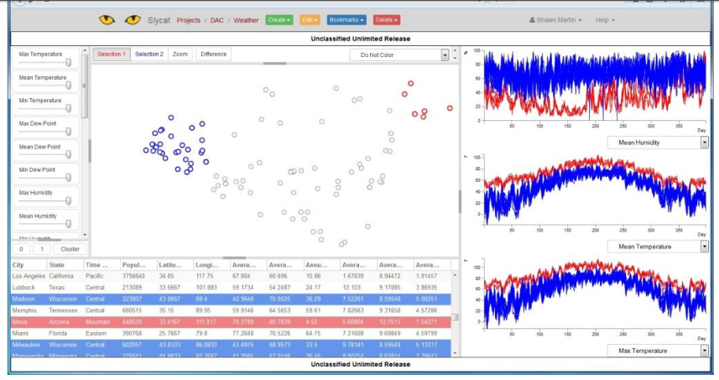
Improving Analysis, Search, and Visualization of ‘Big Data’
Analysis of complex, multivariate time series data from tests of device performance
Stevens Adams, Haass, Matzen, & King (2016)
Notes:
Image from Stevens Adams S., Haass M.J., Matzen L.E., King S. (2016) Assessment of Expert Interaction with Multivariate Time Series ‘Big Data’. In: Schmorrow D., Fidopiastis C. (eds) Foundations of Augmented Cognition: Neuroergonomics and Operational Neuroscience. AC 2016. Lecture Notes in Computer Science, vol 9744. Springer, Cham. doi: 10.1007/978-3-319-39952-2_22
Computational partners allow for time-series data to be visualized and subsets of data based on categorizations to be compared.
“As systems are developed and modernized, human factors analysis can ensure that new interfaces meet requirements for usability, to do the work that has always been done, but to also identify opportunities for further understanding. For workers assessing device performance by analyzing complex, multivariate time series data, human factors analysis of information gathering, work flows and decision making using both online measures from eye movement monitoring and subjective measures from interviews led to the development of the dial-a cluster (DAC) interface. This interface allows analysts to inspect multiple waveforms at a time, as well as view other important metadata and interactively adjust the influence of each time series to change the visualization. Technicians using this tool indicated that the interactivity and the linked visualization were key features that supported gaining insight into the data sets, allowing them to perform new analyses in order to identify trends and outliers.”

Slide 3
Allocation of Function
Human Strengths
Creative
Adaptive
Goal Driven
Multipurpose
Multimodal
Teachable
Efficient
Empathetic
Intuition
Will-to-Live
Human Weaknesses
Memory
  Declarative
  Retrospective
  Prospective
  Procedural
Computation
Vigilance
Endurance
Distractible
Speed
Allocate computational functions to automated systems to be more quickly and accurately performed.

Slide 4
Full Autonomy vs. Human Computer Integration
No Automation
Partial Automation
Full Autonomy
I, for one, welcome our new computer overlords. -Ken Jennings (2011)
on being beaten by Watson on Jeopardy!

Slide 5
Challenges of Partial Automation
Characterization of Human Interactions with Automation
  Use/disuse is influenced by mental workload, trust, and risk
  Misuse caused by violations of the assumption of the automation
    Lack of understanding of automation requirements
  Abuse: Use of automation negatively affects human user, redefining their role as a by-product of the automation
Parasuraman & Riley (1997)

Slide 6









Growing Collections of Data and Analyses

Slide 7
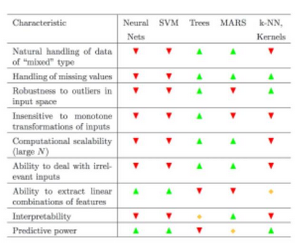
Incorporating Statistical Learning and Other Data Science Techniques
From The Elements of Statistical Learning: Data Mining, Inference, and Prediction by Hastie, Tibshirani, and Friedman (2016)

Slide 8
Binary Code Reverse Engineers
Simulating how a computer system would process instructions and inputs.
Workflow
  is hypothesis-driven and discovery-based
  demands high cognitive load
  demands integration of information across days/weeks
  could utilize more automated tools for asking specific question about code
Mental models are complex and include uncertainty.

Slide 9

Growing Collections of Data and Analyses

Slide 10

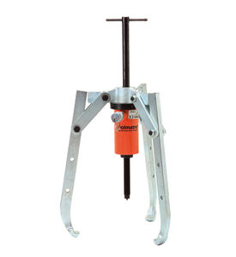
Human Factors Consideration: Selection and Use
How are computational partners integrated into a workflow?
  What knowledge do users require to select computational tools?
  How cognitively demanding is selection?
  How cognitively demanding is use?
  How are outputs used to understand the system or situation?
Notes:
Teamwork Image from pexels.com – Creative Commons Zero (CC0) license
Bearing puller image from pexels.com – Creative Commons Zero (CC0) license

Slide 11
Situational Awareness
Three components
  Perception of the elements in the environment within a volume of time and space
  Comprehension of their meaning, and
  Projection of their status in the near future.
Complex, dynamic domains (military command and control, emergency services, aviation)
Does not fully capture the need to integrate information across time to make decisions.
Notes:
Simulating the computer state(s) that the code supports.

Slide 12
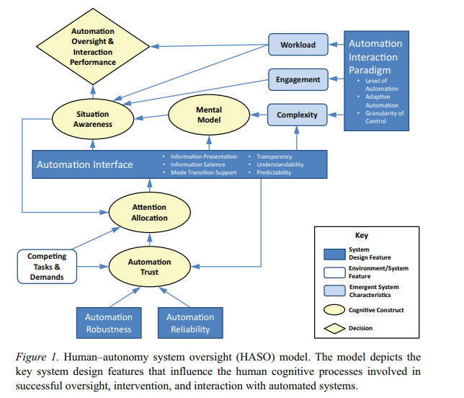
Human-Autonomy System Oversight Model
20 Guidelines for the Design of Human-Autonomy Systems (Endsley, Bolte, & Jones, 2003) focusing on three areas 1) support of human understanding of autonomous system 2) minimize the complexity of the autonomous system and 3) support of situation awareness
Endsley (2017)

Slide 13
Sensemaking
Sensemaking is the ability to give meaning to an ambiguous situation, one with high complexity or uncertainty, in order to make a decision.
Seven types of sensemaking processes in data-frame theory
    Connect data to a frame
    Elaboration of the frame
    Questioning the frame
    Reframing
    Preserving the frame
    Comparing frames
    Seeking the frame: Searching for a new representation of hypothesis
Mental models = Data + Frame
Klein, Phillips, Rall & Peluso (2007)

Slide 14
Demands of Analyst Interfaces in an Analysis-rich world
  Use: Influenced by mental workload, trust, and risk
    Workload
      selecting the right analysis
      evaluating analysis results and
      integrating analysis results
    Trust
      using tool correctly, all required parameters
      uncertainty in output

Slide 15
Demands of Analyst Interfaces in an Analysis-rich world
  Misuse: Failures that occur when people inadvertently violate critical assumptions and rely on automation inappropriately
    Provide feedback on critical assumptions

Slide 16
Heuristics for Trusted Autonomy
Visibility of current systems behavior
Visibility of probable system behavior
Accessibility of system rationale
Visibility of system capabilities & limitations
Awareness of latencies & delays
Transparency of failure
Fit with users and operations.
Jackson, Prasov, Vincent, & Jones (2016)

Slide 17
Using Computational Tools for Sensemaking
Outputs of tools are mapped to mental representations or hypotheses that are consistent with those data.
  Which mental representations are appropriate?
  How can we support easier mapping?

Slide 18
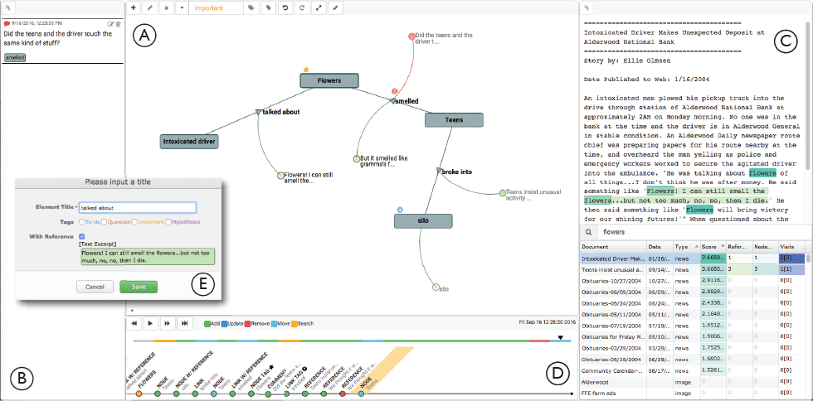
How Can the Work of Computational Partners be Communicated to Human Users?
Hypothesis-Driven Knowledge Sharing
Knowledge-Transfer Graph
Zhao, Glueck, Isenberg, Chevalier, & Khan (2018)
Notes:
Collaborative root cause analysis
Visualization of knowledge structure that can be readily created as discovery process unfolds that can include annotations regarding unfinished work and unexplored hypotheses. Recording discoveries, recording hypotheses and data that informed decision about a hypothesis, access to original sources, tools to limit set that is currently within attentional focus (maybe for a high-level overview, maybe to answer a reductionist question about a specific part of the knowledge structure)
Zhao, J., Glueck, M., Isenberg, P., Chevalier, F., & Khan, A. (2018). Supporting handoff in asynchronous collaborative sensemaking using knowledge-transfer graphs. IEEE Transactions on Visualization and Computer Graphics, 24 (1), 340-350. DOI: 10.1109/TVCG.2017.2745279.
The Knowledge-Transfer Graph (KTGraph) supports the externalization of the analytic process through dedicated graph elements. Nodes and links to describe discovered concepts and relationships; integrated links to source material (green), comments (red), and tags (e.g., golden star and red question mark badges), as well as an interactive playback of graph creation help support handoff of partial findings to subsequent investigators.
The KTGraph interface. An investigator uses the Graph Panel (A) To externalize their investigation. They can review comments related to the investigation in the Comments Panel (B). The Dataset Panel (C) Displays the dataset under investigation. The Timeline Panel (D) Enables investigators to playback the investigative history. An input dialog (E) Is popped-up when creating a new node or link.

Slide 19
Conclusions
Consideration of how analysis-based automated tools will be used within unique workflows
  What are the frames used to make sense of the workflow?
  What information is needed for hypothesis generation?
  What information is needed for discovery?
  What needs to be remembered in long-term memory?
  What needs to be remembered in short-term memory?

Slide 20
References
Endsley, M.R. (2017). From h ere to autonomy: Lessons learned from human-automation research. Human Factors, 59, 5-27.
Jackson, K., Prasov, Z., Vincent, E., & Jones, E. (2016). A heuristic based framework for improving design of unmanned systems by quantifying and assessing operator trust, Proceedings of the Human Factors and Ergonomics Society, 1694-1698.
Klein, G., Phillips, J.K., Rall, E.L., Peluso, D.A. (2007). A data-frame theory of sensemaking, In R.R. Hoffman (Ed.), Expertise Out of Context: Proceedings of the Sixth International Conference on Naturalistic Decision Making (pp. 113-155). Mahwah, NJ, US: Lawrence Erlbaum Associates.
Parasuraman, R. & Riley, V. (1997). Humans and automation: Use misuse, disuse, abuse. Human Factors, 39(2), 230-253.
Stevens Adams S., Haass M.J., Matzen L.E., King S. (2016) Assessment of Expert Interaction with Multivariate Time Series ‘Big Data’. In: Schmorrow D., Fidopiastis C. (eds) Foundations of Augmented Cognition: Neuroergonomics and Operational Neuroscience. AC 2016. Lecture Notes in Computer Science, 9744. doi: 10.1007/978-3-319-39952-2_22
Zhao, J., Glueck, M., Isenberg, P., Chevalier, F., & Khan, A. (2018). Supporting handoff in asynchronous collaborative sensemaking using knowledge-transfer graphs. IEEE Transactions on Visualization and Computer Graphics, 24 (1), 340-350. DOI: 10.1109/TVCG.2017.2745279.

