Slide 1
The Keys to Successful Collaborations during Test and Evaluation
Panel Discussion
DATAWorks 2021
Moderator: Christine Anderson-Cook, LANL

Slide 2
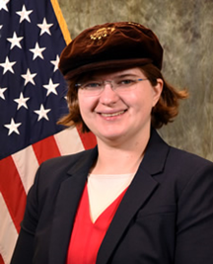
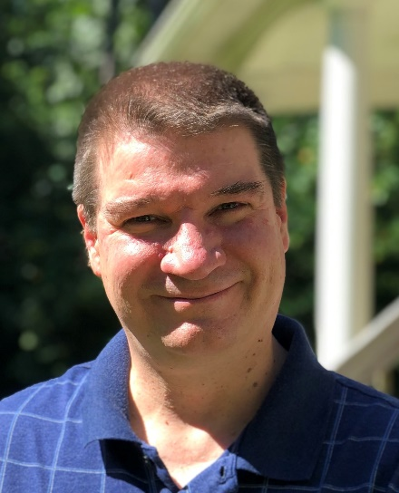
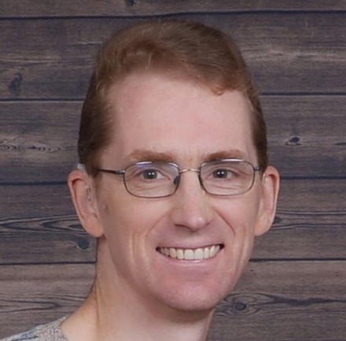
Panelists
Sarah Burke, Ph.D.
STAT COE
John Haman, Ph.D.
IDA
Willis Jensen, Ph.D.
WL Gore
Peter Parker, Ph.D.
NASA

Slide 3
Outline
Ideal Collaborations
Preparation – motivation and training
Process – managing a collaboration
Final Thoughts – diversity, challenges
(25 min)
Questions from audience
(15 min)
Questions from audience
(15 min)
Questions from audience
Please type your questions into the Q&A window

Slide 4
Ideal Collaborations
What does the ideal collaboration look like?
What’s the best experience you’ve had?
What made it so successful?

Slide 5
Preparation
2. What drives the need for collaboration in your work?

Slide 6
Preparation
3. What would you have liked to have had during on-boarding in your job to prepare you for facilitating collaborations?

Slide 7
Process
4. Who should be included in a team when collaborating?
How is a multi-collaborative team formed?

Slide 8
Process
5. What human elements are involved to ensure a successful collaboration?
How can you help facilitate collaboration, particularly with team members that are more outspoken than others?

Slide 9
Process
6. What do you wish subject matters would do to help support successful collaboration?

Slide 10
Final Thoughts
7. Describe a collaboration experience that was not successful.
What lessons did you learn from that experience?
How would you do things differently in the future?

Slide 11
Final Thoughts
8. What is the hardest thing you’ve had to face when sitting down with system experts?
What are some of the barriers you’ve faced during collaborations and what techniques did you implement to mitigate those barriers?

Slide 12
Final Thoughts
9. Describe your experiences or techniques for successful collaboration among a diverse team (e.g., across generations or gender).

Slide 13
Final Thoughts
10. How do you balance the competing objectives of multiple stakeholders to keep everyone happy?

