Slide 1
Fast, Unbiased Uncertainty Propagation with Multi-model Monte Carlo
Geoffrey Bomarito¹, James Warner¹, Samantha Nieomoeller^{1,2}, Luke Morrill¹, Patrick Leser¹, William Leser¹, Robert A. Williams¹, Soumyo Dutta¹
  NASA Langley Research Center, Hampton, VA
  University of California – Los Angeles, Los Angeles, CA
This material is a work of the U.S. Government and is not subject to copyright protection in the United States.

Slide 2

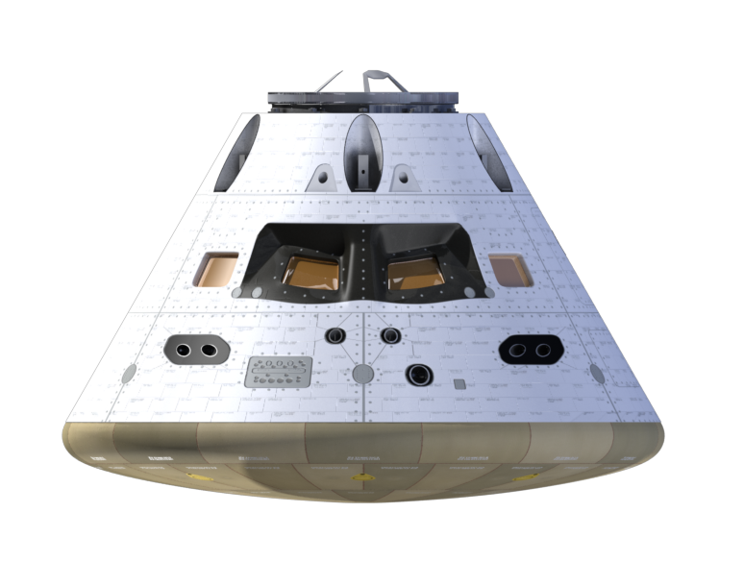

Uncertainty Propagation
How does uncertainty in model inputs affect predictions of output?
Inputs
Model
Outputs
Probability
Probability
Input 1
Output 1
Inputs
Outputs
Prob
Model
Initial Speed
Probability
Probability
Prob
Atm. Pressure
Landing Latitude
Landing Longitude
Prob
Wind direction
Notes:
So we set out to make it easy to compare methods and implement new ones, and ended up finding some improvements along the way

Slide 3
Monte Carlo (MC) Simulation
Inputs
Prob
Prob
Outputs
Model
Initial Speed
Initial Speed
Prob
Prob
Probability
Probability
Atm. Pressure
Atm. Pressure
Prob
Landing Latitude
Landing Longitude
Wind direction
Prob
Wind direction
Let’s estimate expected value (i.e. expected landing location) using MC
1) Draw random inputs
2) Evaluate model
3) Form estimator
Unbiased:
Model
Solution Time:
Mean Squared Error = bias + variance
HiFi model cost

Slide 4

Low-fidelity MC with Machine Learning (ML) Surrogates
1) Draw random inputs
2) Evaluate model
3) Form estimator
Unbiased:
Model
Solution Time:
Model cost
How can we improve calculation time?
Solution Time:
ML Surrogate
Surrogate cost
Biased:
Surrogate cost << Model cost
Mean Squared Error = bias + variance
bias $→$ irreducible error!

Slide 5

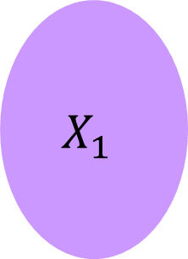
Multi-model Monte Carlo
1) Draw random inputs
2) Evaluate model
3) Form estimator
Model
0
$${ X}_{0}$$
samples
$$X_{1}$$
samples
Constructed to be
Unbiased and Fast!
ML Surrogate
1

Slide 6

Example: Multi-Level Monte Carlo MLMC
[1]
Unbiased
Main Idea: Use a surrogate and
correct with high-fidelity model
Solution Time:
Can Extend to More Models
Variance of difference of successive
models should be decreasing
[1] Giles, M B. Operations Research (2008)

Slide 7
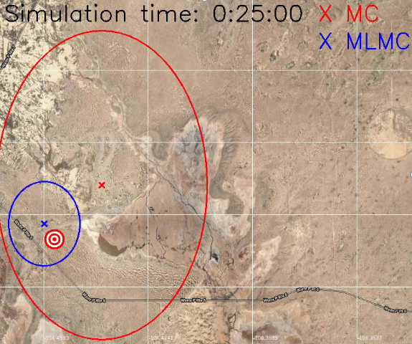
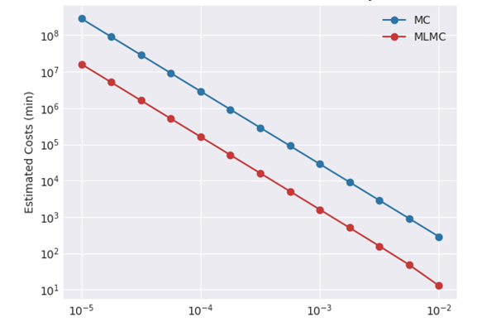
MLMC Results
Accuracy in Expected Landing Location
Mean Squared Error
More confidence with less time/resources

Slide 8
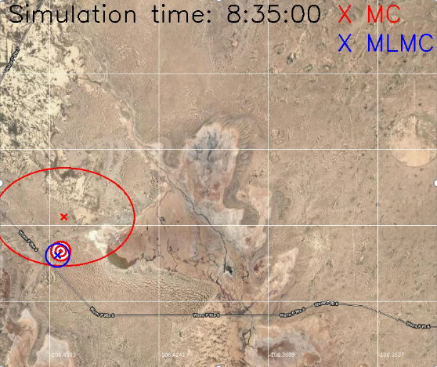
MLMC Results
Accuracy in Expected Landing Location
Mean Squared Error
More confidence with less time/resources

Slide 9
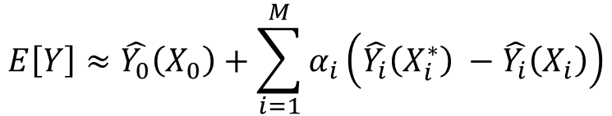
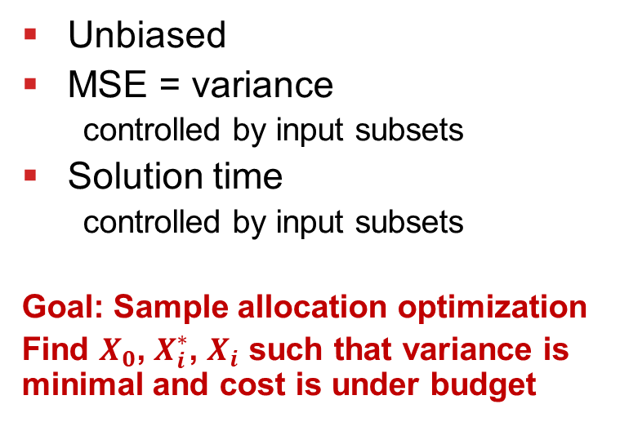
Approximate Control Variates (ACV)
[2]
1) Draw random inputs
2) Evaluate model
3) Form estimator
Model
0
$$E\left[Y\right]≈\hat{Y_{0}}\left(X_{0}\right)+\sum_{i=1}^{M}{α_{i}}\left(\hat{Y_{i}}\left(X_{i}^{∗}\right) −\hat{Y_{i}}\left(X_{i}\right)\right)$$
Surrogate 1
1
Unbiased
MSE = variance
  controlled by input subsets
Solution time
  controlled by input subsets
Goal: Sample allocation optimization
Find $X_{0}$, $X_{i}^{∗}$, $X_{i}$ such that variance is minimal and cost is under budget
…
Surrogate M
M
[2] Gorodetsky, A A., et al. Journal of Computational Physics (2020)

Slide 10



Sample Allocation Optimization
adjusting size and overlap changes MSE and cost
$$z_{1}$$
$$z_{0}$$
$$z_{1}^{∗}$$

Slide 11



Sample Allocation Optimization
$$z_{1}$$
there are many configurations
$$z_{0}$$
$$z_{1}^{∗}$$

Slide 12



Sample Allocation Optimization
more complicated with more models
$$z_{1}$$
$$z_{2}^{∗}$$
$$z_{2}$$
$$z_{0}$$
$$z_{1}^{∗}$$
The domain of optimization is huge!

Slide 13
Parametrically-defined ACV (PD-ACV)
[3]
Domain of all possible
ACV sample allocations
MLMC allocations
Other ACV allocations
global
optimum
PD-ACVs are generalized versions of existing methods that cover more allocations
Parametrically-defined allocations
The best method is problem dependent,
but it’s better to search more area
[3] Bomarito, Geoffrey F., et al. arXiv preprint arXiv:2012.02750 (2020).

Slide 14
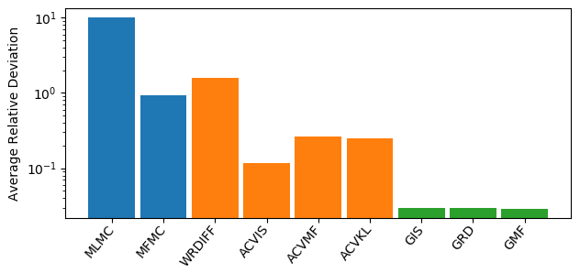
Random Model Scenarios
Choose number of models [2-6]
Sample random correlation matrix
Sample random variances
Sample random model costs (relative to hifi cost)
Perform allocation optimization for all algorithms (fixed cost budget)
~5 Million
MLMC
ACV
PD-ACV
Results Moving Forward: Multi-Model MC = PD-ACV

Slide 15
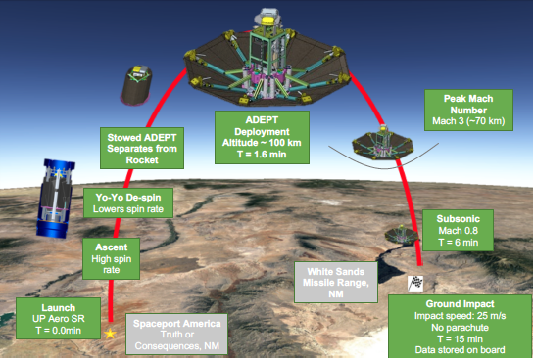
Application
Analysis of the Adaptable Deployable Entry & Placement Technology (ADEPT) Sounding Rocket 1 (SR-1) test flight
ADEPT SR-1 Test Flight Schematic [4]
Trajectory quantities of interest (QOIs) Considered
Program to Optimize Simulated Trajectories II (POST2) was used to model the flight trajectory
The accuracy of multi-model MC QoI estimates was quantified versus both high- and low-fidelity MC
[4] Dutta et al. AIAA Aviation 2019 Forum
75 random input parameters; 15 QoIs

Slide 16
Trajectory Simulation Models
Trajectory Simulation Model Run Times
High-fidelity model:
  POST2 with time step sec
Low-fidelity models:
  Reduced physics: POST2 with simplified atmosphere model
  Coarse time step: POST2 with sec
  Machine learning: Support vector machine (SVM) regression trained with input/output data from 250 POST2 simulations
Model | Run Time (sec) | Speedup (X)
High Fidelity | 2.2 x 10² | 1.0 x 10⁰
Reduced Physics | 4.7 x 10¹ | 4.6 x 10⁰
Coarse Time Step | 2.8 x 10⁰ | 7.8 x 10¹
Machine Learning | 7.0 x 10⁻⁴ | 3.1 x 10⁵
Correlation of low-fidelity models with respect to the high-fidelity model

Slide 17
Estimator Variance Comparison
For a computational budget of 10⁴ seconds, the sample allocation optimization was solved for two cases
  Vector Opt.: minimizes variance for all QoIs simultaneously
  Scalar Opt.: minimizes variance for each QoI individually
Multi-Model MC Variance Reduction Vs. High-Fidelity MC
For a computational budget of 10⁴ seconds,

Slide 18
Estimator Accuracy vs. Run Time
The MSE was calculated for high-, low-, and multi-model MC estimators versus a reference solution using high-fidelity MC with 100,000 samples
MSE versus Run Time for Several Trajectory QoIs
MSE
Mean Squared Error (MSE) = bias + variance
Run Time

Slide 19
Estimator Accuracy vs. Run Time
The MSE was calculated for high-, low-, and multi-model MC estimators versus a reference solution using high-fidelity MC with 100,000 samples
MSE versus Run Time for Several Trajectory QoIs

Slide 20
Estimator Accuracy vs. Run Time
The MSE was calculated for high-, low-, and multi-model MC estimators versus a reference solution using high-fidelity MC with 100,000 samples
MSE versus Run Time for Several Trajectory QoIs
Higher correlations yield large accuracy improvement relative to high-fidelity MC
Low-to-high fidelity model correlation
Lower correlations yield accuracy comparable to high-fidelity MC

Slide 21
Conclusions & Future Work
Multi-model MC approach leverages speed of surrogate models combined with accuracy (unbiasedness) of high-fidelity models
Established the Multi-model MC approach to trajectory simulation as an alternative to standard MC that relies exclusively on a high- or low- fidelity model
Demonstrated the potential to deliver up to two orders of magnitude accuracy improvement
Future Work:
  Develop low-fidelity models that have higher correlation with respect to the high-fidelity model for dynamic trajectory QoIs
  Extend the multi-model MC approach to predict more advanced statistical quantities (probability distributions, rare event probabilities, landing ellipses, etc.)

Slide 22
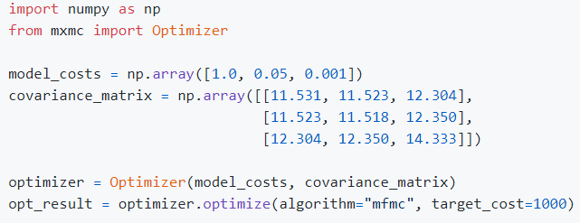
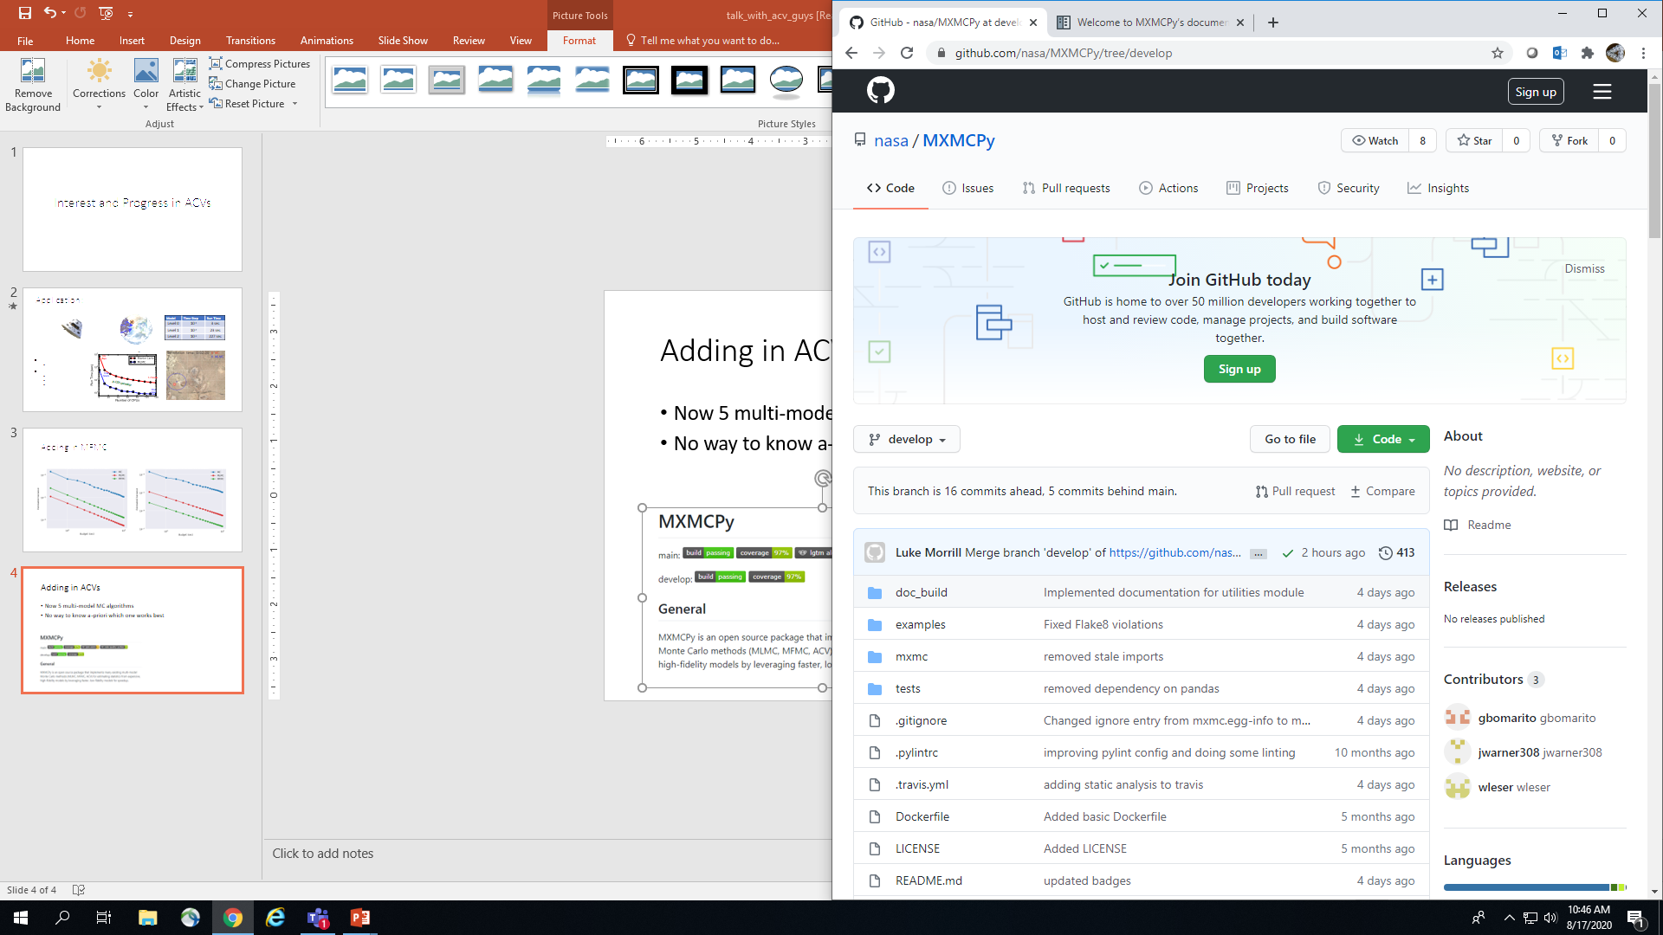
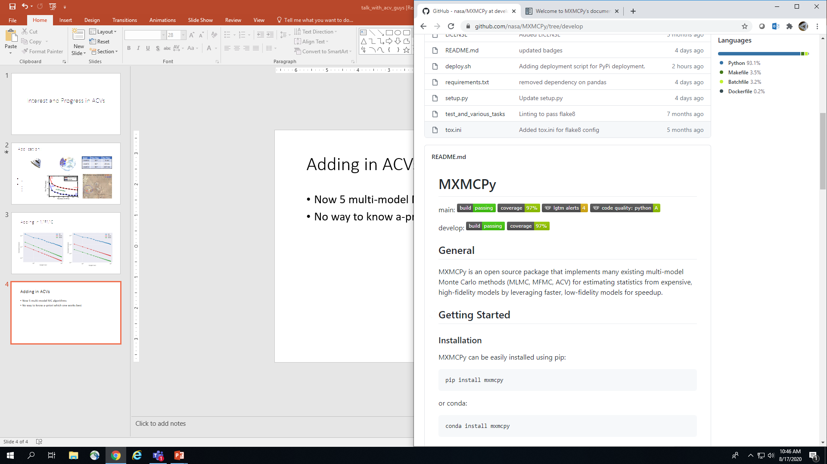
MXMCPy
The best method is problem dependent
github.com/nasa/MXMCPy
Simple interface to
  compare and use different algorithms
  implement new estimators

Slide 23
Thank You
geoffrey.f.bomarito@nasa.gov
References:
[1] Giles, M. B., “Multilevel Monte Carlo path simulation,” Operations Research, Vol. 56, No. 3, 2008
[2] Gorodetsky, A., Geraci, G. , Eldred, M., and Jakeman, J. D., “A generalized approximate control variate framework for multifidelity uncertainty quantification,” Journal of Computational Physics, Vol. 408, 2020.
[3] Bomarito, G. F., Leser, P. E., Warner, J. E., and Leser, W. P., “On the optimization of approximate control variates with parametrically defined estimators,” arXiv preprint arXiv:2012.02750 (2020).
[4] Dutta, S., and Green, J. S., “Flight mechanics modeling and post-flight analysis of ADEPT SR-1,” AIAA Aviation 2019 Forum, AIAA, Dallas, TX, 2019.

