Slide 1
Metrics for Assessing Underwater Demonstrations for Detection and Classification of Unexploded Ordnance
Jacob Bartel
Shelley Cazares
09/March/2021
jbartel@ida.org; 703 845 2172
Notes:
This briefing discusses metrics for assessing underwater demonstrations for the detection and classification of Unexploded Ordnance (UXO). This is work that has been done at IDA for our sponsor in DASD Environment.

Slide 2
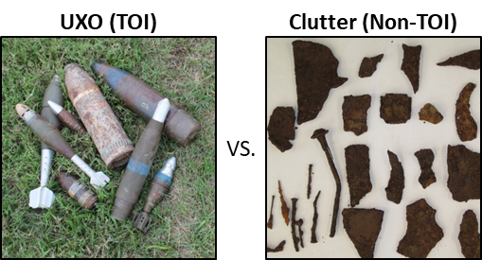
Unexploded Ordnance (UXO) versus Clutter
UXO are duds: munitions that were previously armed and fired but did not explode
UXO can still pose a risk of detonation, even decades later
Millions of acres of land in the continental U.S. are contaminated with UXO, due to their previous uses as military training camps and test ranges
UXO
Clutter
jbartel@ida.org
Notes:
Unexploded Ordnance or UXO refers to munitions that were previously armed and fired, but did not explode. These UXO duds can still pose a risk of detonation, even decades later. Although most people think of UXO in the context of World War II era bombs in Europe, or Vietnam era bombs in Southeast Asia, millions of acres of land in the continental United States are contaminated with UXO, due to their previous uses as military training camps and test ranges.

Slide 3
Introduction
SERDP sponsors testbeds to demonstrate novel systems for the detection and classification of unexploded ordnance (UXO) in underwater environments
The Institute for Defense Analyses (IDA) previously scored SERDP’s and ESTCP’s terrestrial demonstrations, and is now involved in underwater scoring
Designing and scoring these ‘blind tests’ is a complicated process
Interpreting the scores properly reveals subtleties in constructing Receiver-Operating Characteristic (ROC) curves
SERDP = Strategic Environmental Research and Development Program
ESTCP = Environmental Security Technology Certification Program
jbartel@ida.org
Notes:
The Strategic Environmental Research and Development Program (SERDP) sponsors testbeds to demonstrate novel systems for the detection and classification of UXO in underwater environments. IDA, having previously led the scoring of land based UXO detection and classification system tests, is now involved in underwater test scoring. Designing and scoring these blind tests is a complicated process. Interpreting the scores properly reveals some subtleties even in familiar places, such as when constructing Receiver-Operating Characteristic (ROC) curves.

Slide 4
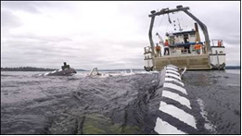
Problem Description
MuST Acoustic System
UXO remediation efforts require information on location and state of targets at sites
Novel technologies for UXO detection + classification in underwater sites are being developed:
  Acoustic, EMI, etc. based sensors for detection
  Human or machine learning based classification
    Differentiate between a Target of Interest (TOI) such as a UXO vs. a non-TOI such as clutter
First tests in a relevant environment have begun
First evaluations of those tests have also started
water
line
Alarm
!
system
seabed
floor
found TOI
EMI = Electromagnetic Induction
jbartel@ida.org
Notes:
The problem the UXO remediation community is tackling is how to best remediate or manage a site suspected of containing UXO underwater. While different sites may approach the remediation/management problem differently, one requirement that will always be necessary is information. SERDP’s goal is to promote the creation of systems that are capable of detecting and classifying UXO in an underwater environment, and to evaluate those systems. These novel technologies often revolve around acoustic or electromagnetic induction (EMI) sensors for detection, with a human or machine learning based classification procedure. On the right I show a photo of the MuST acoustic system, developed by APL at the University of Washington. The primary goal of a system is to differentiate between targets of interest (TOIs), which are items that could be dangerous like UXO, versus non-TOIs such as clutter. An example of a TOI would be an unexploded 155mm howitzer round, and an example of a non-TOI would be a discarded scuba tank.
These technologies are not yet mature, as underwater testing in a relevant environment has just begun. Simultaneously, the first evaluations of those tests are being performed by IDA. Currently, these technologies are at the ‘blind test’ stage, performed at controlled testing sites.

Slide 5

Blind Test Setup
4. Ground Truth collection and removal
1. Testbed design
2. Target emplacement
3. Blind test of system
(Bird’s Eye View of Test Site)
(Side View of Test Site)
(Side View of Test Site)
(Side View of Test Site)
water
line
water
line
water
line
Diver with Geolocation system
Diver with Geolocation system
Alarm
!
Target
system
seabed
floor
Target
seabed
floor
seabed
floor
Emplaced Targets:
TOI (UXO)
Target
Non-TOI (Clutter)
Testbed is designed to randomly distribute targets (TOI and non-TOI)
Divers emplace targets (buried or proud) at testbed
Demonstrators (blind to ground truth) deploy their system within the test area and collect data
Divers collect ground truth (geolocation, orientation, burial depth, etc.) and remove targets
Demonstrators create a blind ‘call list’ detailing what they detected and classified
https://commons.wikimedia.org/w/index.php?curid=77236961
jbartel@ida.org
Notes:
Here is a general overview of the type of blind test that is used to evaluate one of these novel systems. First, a testbed is designed by selecting TOI and non-TOI to emplace in a roughly random pattern. TOI typically consist of inert munitions or surrogate munitions, and non-TOIs may be any number of different clutter objects that are typical in an underwater environment, like discarded scuba tanks or crab pots. Next, these targets are emplaced in the test area by divers, who may either bury the target in the sediment of the test area, or leave the target proud on the surface, depending on the testbed design specifications. Once all targets are emplaced, a demonstrator will deploy their system in the test area, scanning to collect data that can later be analyzed, in order to detect and classify the targets, offline. Finally, divers once again re-enter the test area to collect ground truth (consisting of coordinates of the emplaced targets, their orientations, and burial depths) and then remove the emplaced items. Afterwards, offline, the demonstrators of the UXO system create a ‘call list’ which is a list of detected items that they identified as possible targets, ranked by the likelihood of each item being a TOI. The ground truth is kept sequestered, and so the demonstrators have to create this list ‘blind’, using only the data they collected during the test. This ‘call list’ is then sent to the scoring team to be scored, such as IDA.

Slide 6

Two Underwater Demonstrations Sites to Date
Sequim Bay, WA
Boston Harbor, MA
https://mapswire.com/countries/united-states/
jbartel@ida.org
Notes:
To date, there are two sites that have supported demonstrations– one in Boston Harbor, MA, and one in Sequim Bay, WA.

Slide 7

What kinds of scores are calculated?
After ground truth is collected and the demonstrator submits their call list to the scoring team…
Two types of scores are needed:
Probability of False Alarm (Pfa):
describes how often the system creates a False Positive (FP), i.e., a False Alarm
Probability of Detection (Pd,c):
describes how often the system avoids a False Negative (FN), i.e., a missed Target of Interest (TOI)
Error Type 1:
False Alarm
i.e., False Positive (FP)
Error Type 2:
Missed TOI
i.e., False Negative (FN)
No Error
water
line
false alarm
!
true alarm
!
system
seabed
floor
missed TOI
found TOI
False Positives and Negatives trade off of each other:
As one count gets better, the other can get worse
jbartel@ida.org
Notes:
After the blind test is over, and ground truth has been collected by the diving team, and the demonstrator has turned over their call list to the scoring team, it is possible to begin scoring the demonstration. Broadly speaking, in order to score a demonstration, two types of scores are needed– a score related to the Probability of False Alarm (Pfa), or how often a system creates a False Positive (FP), and a score related to the Probability of Detection and Correct Classification (Pd,c), or how often the system finds the TOI– that is, how often it avoids a False Negative (FN) or misses the TOI. False Positives and False Negatives generally trade off of each other: as one gets better, the other may get worse.
On the right hand side there is an illustration that shows the two types of error types described here, False Alarms and missed TOIs.

Slide 8
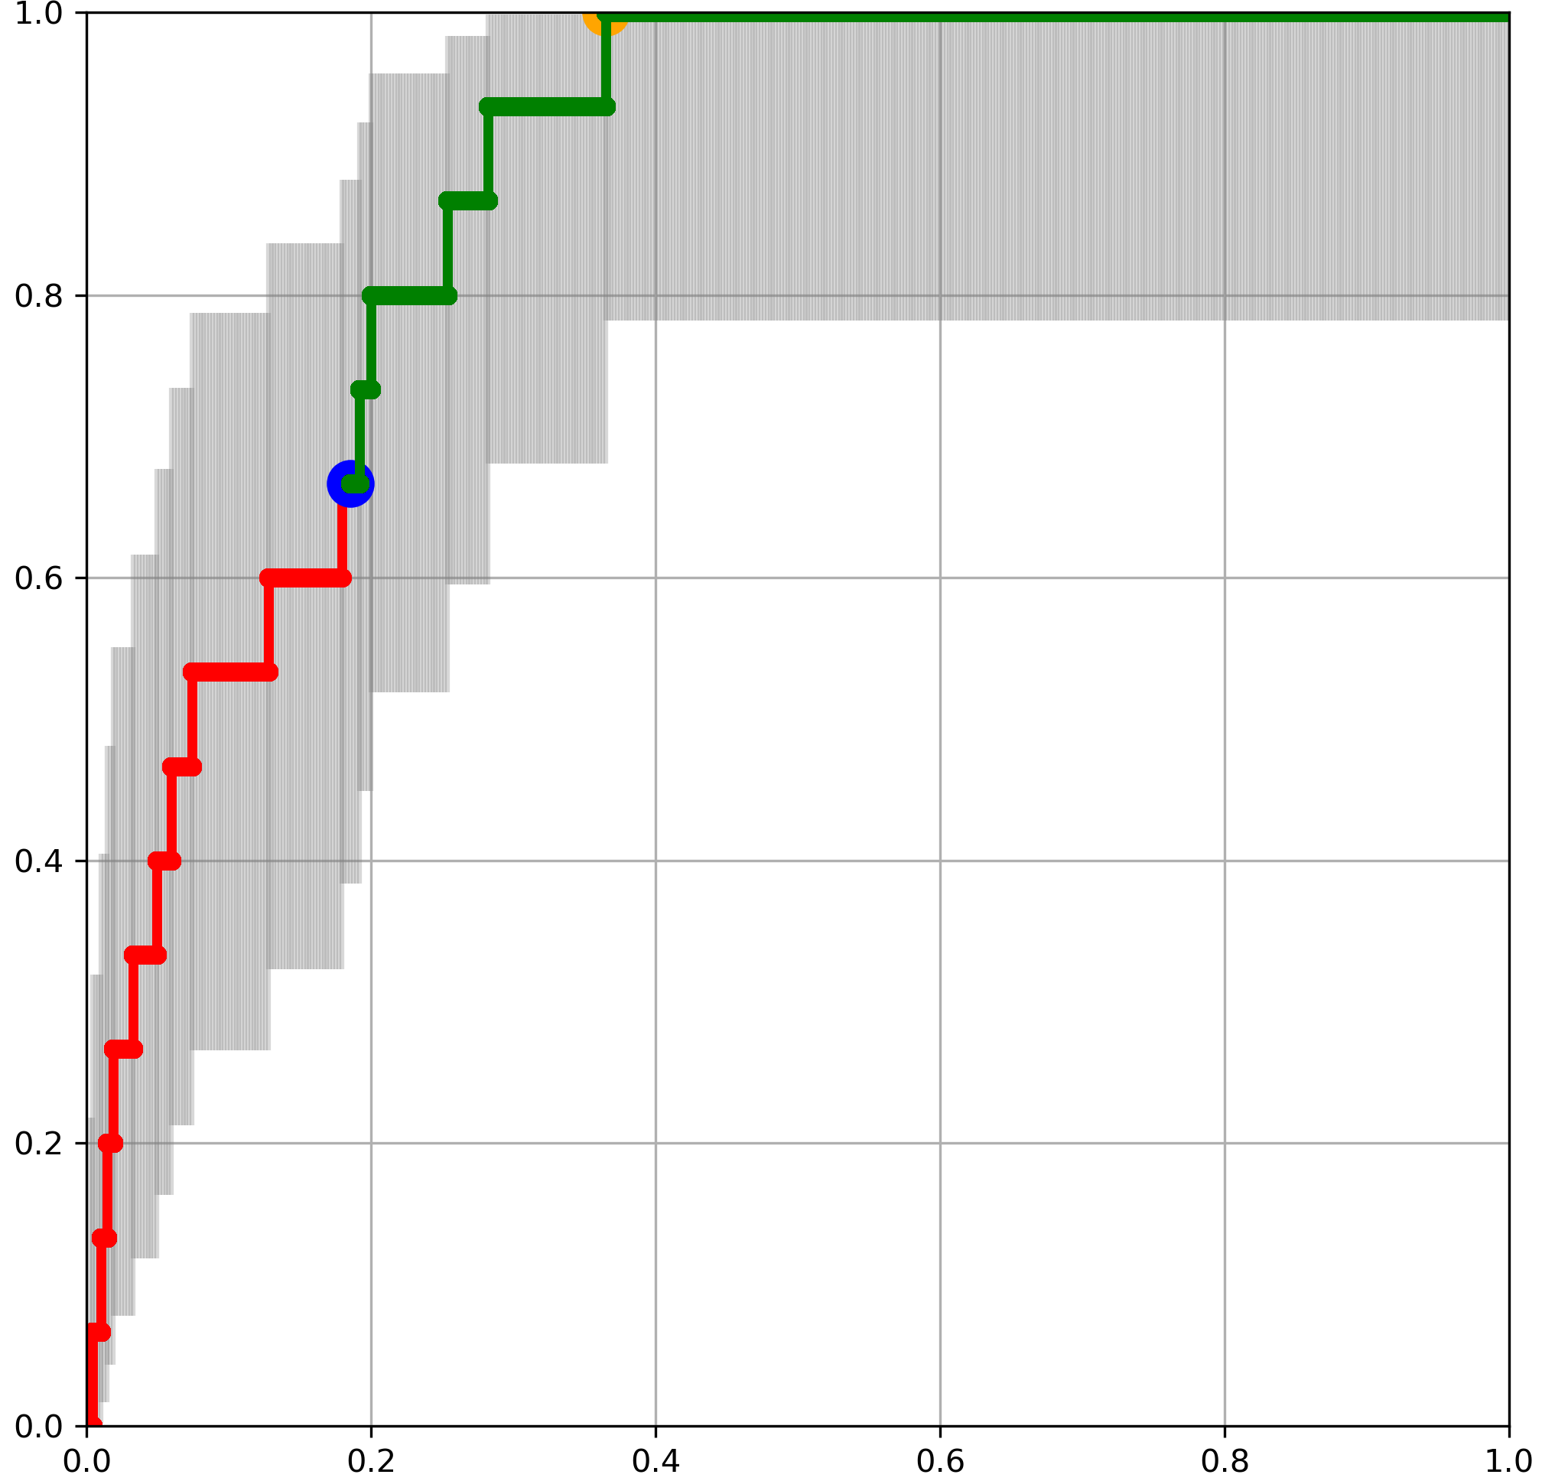
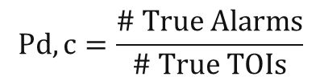
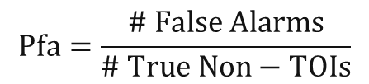
ROC Curve
Receiver-Operating Characteristic (ROC) Curve
Once you have Pd,c and Pfa from a blind test you can create a ROC curve…
Ideal Goal
NOTIONAL
$$Pd,c=\frac{\# True Alarms}{\# True TOIs}$$
$$Pfa=\frac{\# False Alarms}{\# True Non−TOIs}$$
Pd,c
Prospective
“TOI vs Non-TOI”
classification
threshold
Pfa
jbartel@ida.org
Notes:
Finally, once you have calculated the Pd,c and Pfa of each item on the demonstrator’s call list, based on the ground truth, you can simply create a ROC Curve, seen on the right hand side. This is a notional ROC curve from a notional system, based on notional data.
ROC curves help us visualize the tradeoff between False Negatives and False Positives – between Pd,c and Pfa
Each point on the ROC curve corresponds to a different classification threshold. A vertical grey line is drawn through each point, to indicate the 95% confidence interval around that point’s Pd,c value on the Y axis. Each point’s confidence interval was calculated with the beta distribution approximation to the binomial distribution, with no adjustments for multiple comparisons.
The blue dot is the prospective classification threshold– the threshold selected by the demonstrators during the blind test to differentiate between TOI and Non-TOI targets, without any knowledge of ground truth.
Many of you in the audience are already very familiar with ROC curves.

Slide 9
ROC Curve
Receiver-Operating Characteristic (ROC) Curve
Once you have Pd,c and Pfa from a blind test you can create a ROC curve…
NOTIONAL
$$Pd,c=\frac{\# True Alarms}{\# True TOIs}$$
$$Pfa=\frac{\# False Alarms}{\# True Non−TOIs}$$
Pd,c
Prospective
“TOI vs Non-TOI”
classification
threshold
…But wait!
Pfa
jbartel@ida.org
Notes:
But that’s not the end of the story! It turns out, the definitions of Pd,c and Pfa are actually much more complicated than this.

Slide 10

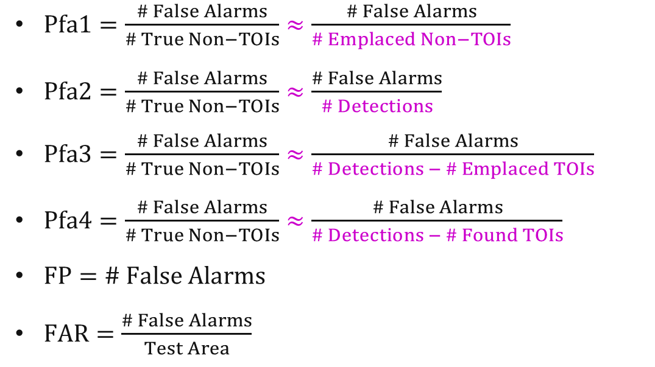
Assumptions Required for Underwater Demonstrations
Textbook definition
IDA definition
There are many valid definitions for the ROC curve x-axis metric, all based on underlying assumptions
Y-Axis Metrics
$Pd,c=\frac{\# True Alarms}{\# True TOIs}≈\frac{\# True Alarms}{\# Emplaced TOIs}$
X-Axis Metrics
NOTIONAL
$Pfa1=\frac{\# False Alarms}{\# True Non−TOIs}≈\frac{\# False Alarms}{\# Emplaced Non−TOIs}$
$Pfa2=\frac{\# False Alarms}{\# True Non−TOIs}≈\frac{\# False Alarms}{\# Detections}$
$Pfa3=\frac{\# False Alarms}{\# True Non−TOIs}≈\frac{\# False Alarms}{\# Detections − \# Emplaced TOIs}$
$Pfa4=\frac{\# False Alarms}{\# True Non−TOIs}≈\frac{\# False Alarms}{\# Detections − \# Found TOIs}$
$FP=\# False Alarms$
$FAR=\frac{\# False Alarms}{Test Area}$
?
?
jbartel@ida.org
Notes:
Underwater environments present very large challenges to test and evaluation. One of these challenges is the difficulty in compiling ground truth due to logistics and safety constraints. In an ideal world, we would compile ground truth for every item in our test site– every TOI and every piece of clutter (like every rock, every anchor, or every tool dropped by a fisherman). In the real world, it would take too much time and funding to do that underwater. Therefore, we have to make some assumptions about what kinds of items are present in our site. And those assumptions affect the x and y axes of our ROC curves.
There are actually many valid definitions for the x and y axes that could be used, depending on what story you’d like to tell. In each of these equations, we present the ‘textbook’ definition of the quantity we’re referring to (if we had perfect ground truth), and then the IDA definition, which is designed to be workable given the real world data that we can actually acquire in these tests.
Starting from the top: the definition of Pd,c is fairly standard, with one modification to the textbook definition in the IDA definition: we assume that the number of true TOIs is approximately equal to the number of emplaced TOIs we have the divers put down in the test area. In other words, we are assuming that there are no native UXO or UXO-like objects in the test area. This assumption must be made, because otherwise you cannot define the actual number of True TOIs.

Slide 11

Assumptions Required for Underwater Demonstrations
Textbook definition
IDA definition
There are many valid definitions for the ROC curve x-axis metric
Y-Axis Metrics
$Pd,c=\frac{\# True Alarms}{\# True TOIs}≈\frac{\# True Alarms}{\# Emplaced TOIs}$
X-Axis Metrics
NOTIONAL
$Pfa1=\frac{\# False Alarms}{\# True Non−TOIs}≈\frac{\# False Alarms}{\# Emplaced Non−TOIs}$
$Pfa2=\frac{\# False Alarms}{\# True Non−TOIs}≈\frac{\# False Alarms}{\# Detections}$
$Pfa3=\frac{\# False Alarms}{\# True Non−TOIs}≈\frac{\# False Alarms}{\# Detections − \# Emplaced TOIs}$
$Pfa4=\frac{\# False Alarms}{\# True Non−TOIs}≈\frac{\# False Alarms}{\# Detections − \# Found TOIs}$
$FP=\# False Alarms$
$FAR=\frac{\# False Alarms}{Test Area}$
Pd,c
Pfa1
Note the
units and scale!
jbartel@ida.org
Notes:
Next, on the X-Axis, we see four different possible definitions for Pfa. Pfa, in the textbook definition, is a metric where the number of False Alarms a system creates (numerator) is normalized to the number of True Non-TOIs (or clutter objects) that are present at the site (denominator). However, the ‘number of True non-TOIs’ is a number that is difficult to capture, and so approximations or replacements must be made for the denominator.
First, Pfa #1, assumes that the only non-TOIs that are in the test area are the ones that the divers emplaced as part of the test. This sounds good– however the problem is that often there are many Non-TOIs that occur naturally in test bed areas– such as trash, rocks, anchors, and so on. So in reality, the number of emplaced Non-TOIs in a test area may actually be quite far off from the true number of non-TOIs.

Slide 12

Assumptions Required for Underwater Demonstrations
Textbook definition
IDA definition
There are many valid definitions for the ROC curve x-axis metric
Y-Axis Metrics
$Pd,c=\frac{\# True Alarms}{\# True TOIs}≈\frac{\# True Alarms}{\# Emplaced TOIs}$
X-Axis Metrics
NOTIONAL
$Pfa1=\frac{\# False Alarms}{\# True Non−TOIs}≈\frac{\# False Alarms}{\# Emplaced Non−TOIs}$
$Pfa2=\frac{\# False Alarms}{\# True Non−TOIs}≈\frac{\# False Alarms}{\# Detections}$
$Pfa3=\frac{\# False Alarms}{\# True Non−TOIs}≈\frac{\# False Alarms}{\# Detections − \# Emplaced TOIs}$
$Pfa4=\frac{\# False Alarms}{\# True Non−TOIs}≈\frac{\# False Alarms}{\# Detections − \# Found TOIs}$
$FP=\# False Alarms$
$FAR=\frac{\# False Alarms}{Test Area}$
Pd,c
Pfa2
Note the
units and scale!
jbartel@ida.org
Notes:
This takes us to Pfa #2, where the number of False Alarms (numerator) is normalized to the number of detections the UXO system found when surveying the test area (denominator). In effect, this Pfa metric shows how much the classification part of the UXO system cut down on its own detections. In other words, at each point in the ROC curve, this Pfa metric tells you how many false positives are required to achieve a certain Pd,c value, as a fraction of the total number of detections the system made.

Slide 13

Assumptions Required for Underwater Demonstrations
Textbook definition
IDA definition
There are many valid definitions for the ROC curve x-axis metric
Y-Axis Metrics
$Pd,c=\frac{\# True Alarms}{\# True TOIs}≈\frac{\# True Alarms}{\# Emplaced TOIs}$
X-Axis Metrics
NOTIONAL
$Pfa1=\frac{\# False Alarms}{\# True Non−TOIs}≈\frac{\# False Alarms}{\# Emplaced Non−TOIs}$
$Pfa2=\frac{\# False Alarms}{\# True Non−TOIs}≈\frac{\# False Alarms}{\# Detections}$
$Pfa3=\frac{\# False Alarms}{\# True Non−TOIs}≈\frac{\# False Alarms}{\# Detections − \# Emplaced TOIs}$
$Pfa4=\frac{\# False Alarms}{\# True Non−TOIs}≈\frac{\# False Alarms}{\# Detections − \# Found TOIs}$
$FP=\# False Alarms$
$FAR=\frac{\# False Alarms}{Test Area}$
Pd,c
Pfa3
Note the
units and scale!
jbartel@ida.org
Notes:
However, some detections are not False Positives– and so the X axis of the ROC curve shouldn’t “ding” the system for detecting a UXO or other TOI-like object. To account for this, Pfa #3 removes the number of emplaced TOIs from the denominator, so that the denominator is now the maximum number of False Positives that the system achieved in the demonstration. This Pfa metric is one of the more intuitive and widely used definitions for Pfa in underwater demonstrations.

Slide 14

Assumptions Required for Underwater Demonstrations
Textbook definition
IDA definition
There are many valid definitions for the ROC curve x-axis metric
Y-Axis Metrics
$Pd,c=\frac{\# True Alarms}{\# True TOIs}≈\frac{\# True Alarms}{\# Emplaced TOIs}$
X-Axis Metrics
NOTIONAL
$Pfa1=\frac{\# False Alarms}{\# True Non−TOIs}≈\frac{\# False Alarms}{\# Emplaced Non−TOIs}$
$Pfa2=\frac{\# False Alarms}{\# True Non−TOIs}≈\frac{\# False Alarms}{\# Detections}$
$Pfa3=\frac{\# False Alarms}{\# True Non−TOIs}≈\frac{\# False Alarms}{\# Detections − \# Emplaced TOIs}$
$Pfa4=\frac{\# False Alarms}{\# True Non−TOIs}≈\frac{\# False Alarms}{\# Detections − \# Found TOIs}$
$FP=\# False Alarms$
$FAR=\frac{\# False Alarms}{Test Area}$
Pd,c
Pfa4
Note the
units and scale!
jbartel@ida.org
Notes:
Finally, the number of potential False Positives at every point in the ROC curve does not stay constant– because as one goes along the ROC curve from bottom-left to top-right, some TOIs are detected and classified correctly. So to account for this, Pfa #4 only subtracts, from the number of detections in the denominator, the number of found TOIs at each point in the ROC curve. This makes the denominator a variable, not a constant, as others were.

Slide 15

Assumptions Required for Underwater Demonstrations
Textbook definition
IDA definition
There are many valid definitions for the ROC curve x-axis metric
Y-Axis Metrics
$Pd,c=\frac{\# True Alarms}{\# True TOIs}≈\frac{\# True Alarms}{\# Emplaced TOIs}$
X-Axis Metrics
NOTIONAL
$Pfa1=\frac{\# False Alarms}{\# True Non−TOIs}≈\frac{\# False Alarms}{\# Emplaced Non−TOIs}$
$Pfa2=\frac{\# False Alarms}{\# True Non−TOIs}≈\frac{\# False Alarms}{\# Detections}$
$Pfa3=\frac{\# False Alarms}{\# True Non−TOIs}≈\frac{\# False Alarms}{\# Detections − \# Emplaced TOIs}$
$Pfa4=\frac{\# False Alarms}{\# True Non−TOIs}≈\frac{\# False Alarms}{\# Detections − \# Found TOIs}$
$FP=\# False Alarms$
$FAR=\frac{\# False Alarms}{Test Area}$
Pd,c
FP
Note the
units and scale!
jbartel@ida.org
Notes:
Pfa-type metrics are very commonly used in ROC curves. However, there are additional alternatives, including simply using the number of False Alarms.

Slide 16
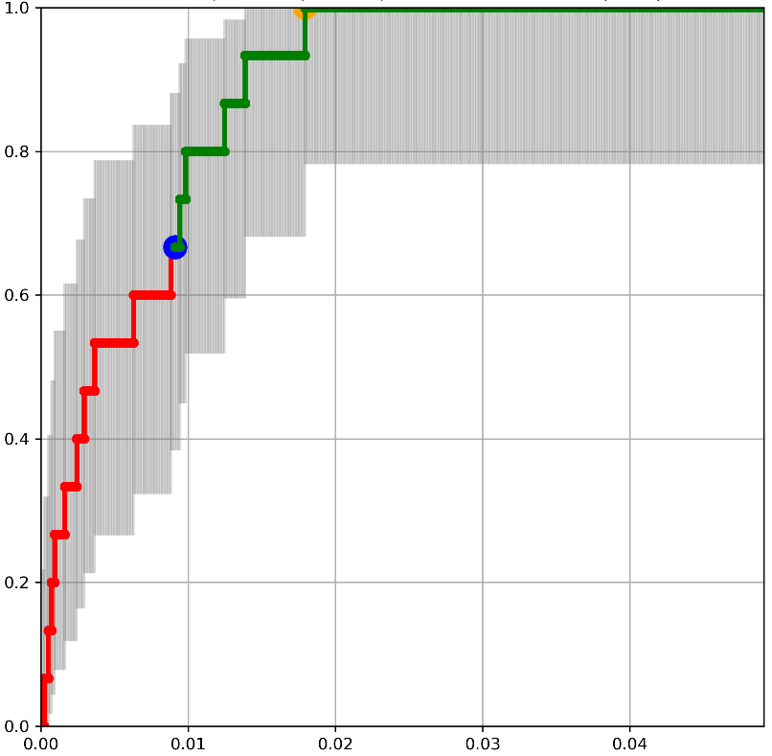
Assumptions Required for Underwater Demonstrations
Textbook definition
IDA definition
There are many valid definitions for the ROC curve x-axis metric
Y-Axis Metrics
$Pd,c=\frac{\# True Alarms}{\# True TOIs}≈\frac{\# True Alarms}{\# Emplaced TOIs}$
X-Axis Metrics
NOTIONAL
$Pfa1=\frac{\# False Alarms}{\# True Non−TOIs}≈\frac{\# False Alarms}{\# Emplaced Non−TOIs}$
$Pfa2=\frac{\# False Alarms}{\# True Non−TOIs}≈\frac{\# False Alarms}{\# Detections}$
$Pfa3=\frac{\# False Alarms}{\# True Non−TOIs}≈\frac{\# False Alarms}{\# Detections − \# Emplaced TOIs}$
$Pfa4=\frac{\# False Alarms}{\# True Non−TOIs}≈\frac{\# False Alarms}{\# Detections − \# Found TOIs}$
$FP=\# False Alarms$
$FAR=\frac{\# False Alarms}{Test Area}$
Pd,c
FAR (1/m²)
Note the
units and scale!
jbartel@ida.org
Notes:
Or, alternatively, the number of False Alarms normalized by the physical size of the test area. We will touch on these in the next few slides.

Slide 17
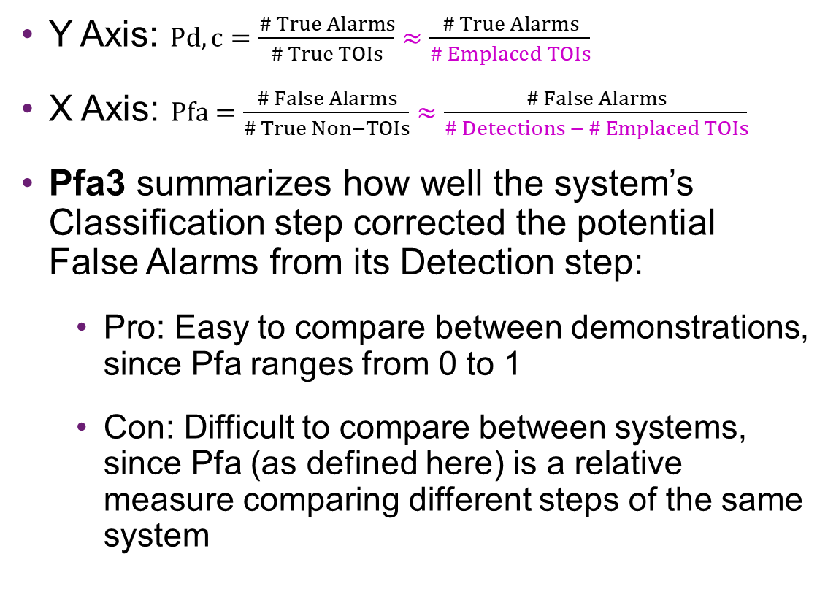
Example: Notional ROC Curve A
Y Axis: $Pd,c=\frac{\# True Alarms}{\# True TOIs}≈\frac{\# True Alarms}{\# Emplaced TOIs}$
X Axis: $Pfa=\frac{\# False Alarms}{\# True Non−TOIs}≈\frac{\# False Alarms}{\# Detections − \# Emplaced TOIs}$
Pfa3 summarizes how well the system’s Classification step corrected the potential False Alarms from its Detection step:
  Pro: Easy to compare between demonstrations, since Pfa ranges from 0 to 1
  Con: Difficult to compare between systems, since Pfa (as defined here) is a relative measure comparing different steps of the same system
Receiver-Operating Characteristic (ROC) Curve
NOTIONAL
System could:
Detect & correctly classify 67% of emplaced TOIs
and:
Reduce its own potential False Alarms by 81%
Pd,c
Pfa3
jbartel@ida.org
Notes:
Now we will look at a few examples of ROC curves using these different x-axes metrics to show how the story changes with each one. First, we’ll look at a Pfa-like metric (Pfa #3 from the last slide). This Pfa metric summarizes how well the system’s classification step corrected the potential false alarms from its own detection step. In the ROC curve, the blue dot points out the demonstrator’s prospective “TOI vs. Non-TOI” classification threshold. You can see that at the blue dot, the system was able to correctly detect and classify 67 percent of the emplaced TOIs (vertical axis), while reducing its own potential False Alarms by 81 percent (horizontal axis).
The benefits of this metric are that all x-axis values range from 0 to 1, allowing for easy comparisons between different demonstrations. However, this metric also makes it difficult to compare between different systems, since Pfa is a relative measure comparing different steps of the same system (detection vs. classification). Some systems prefer to start out with a lot of detections, that they then whittle down with their classification step, giving them the opportunity to have a very good Pfa metric. Other systems prefer to have a more rigorous detection step, so that their classification step has less work to do. That’s a fine approach, but it doesn’t allow the opportunity to show a good Pfa metric even if the final result is the same.

Slide 18

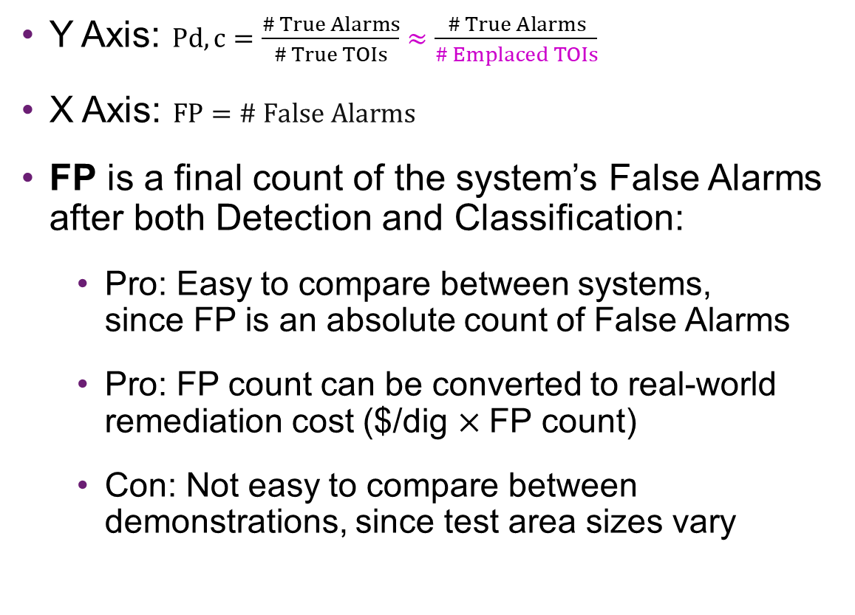
Example: Notional ROC Curve B
Y Axis: $Pd,c=\frac{\# True Alarms}{\# True TOIs}≈\frac{\# True Alarms}{\# Emplaced TOIs}$
X Axis: $FP=\# False Alarms$
FP is a final count of the system’s False Alarms after both Detection and Classification:
  Pro: Easy to compare between systems, since FP is an absolute count of False Alarms
  Pro: FP count can be converted to real-world remediation cost ($/dig $×$FP count)
  Con: Not easy to compare between demonstrations, since test area sizes vary
Receiver-Operating Characteristic (ROC) Curve
NOTIONAL
System could:
Detect & correctly classify 67% of emplaced TOIs
and:
Create 90 False Alarms
Pd,c
FP
Different
units and scale!
jbartel@ida.org
Notes:
One way to get around the comparability issue that the Pfa metric on the last slide has, is to simply plot the number of False Positives on the x-axis (the numerator, all by itself). Plotting this number results in an easy comparison between systems, since systems that prefer either a stringent detection or classification step wouldn’t be artificially ‘dinged’ for choosing one approach over the other. Additionally, in a real world remediation project, the number of False Positives is directly related to the remediation cost– i.e. each ‘dig’ when removing a suspected UXO costs money.
However, the False Positive metric does not make it easy to compare between different demonstrations, since the area of testbeds can differ significantly for different sites. For instance, a ROC curve from a demonstration in a large test area may look worse than a demonstration in a small test area, because the larger test area may provide more opportunity for False Alarms.

Slide 19

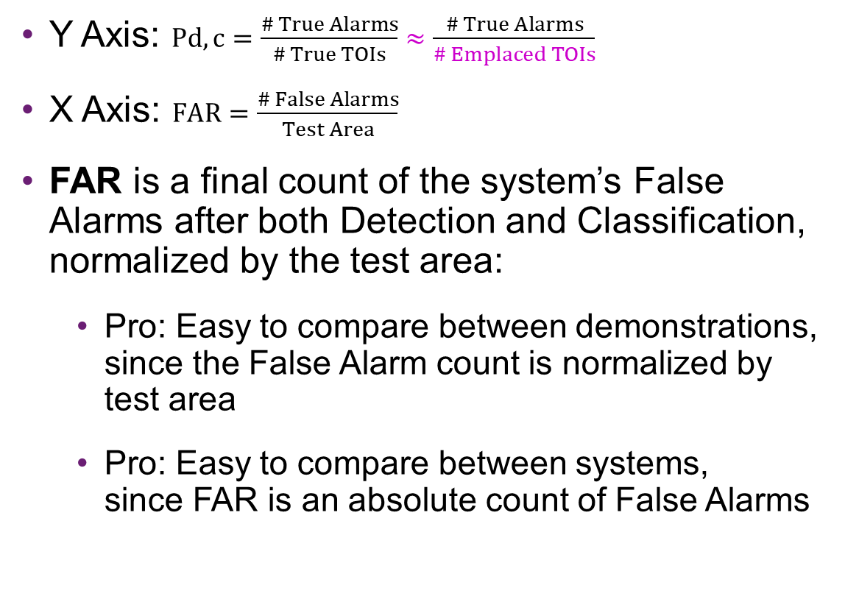
Example: Notional ROC Curve C
Y Axis: $Pd,c=\frac{\# True Alarms}{\# True TOIs}≈\frac{\# True Alarms}{\# Emplaced TOIs}$
X Axis: $FAR=\frac{\# False Alarms}{Test Area}$
FAR is a final count of the system’s False Alarms after both Detection and Classification, normalized by the test area:
  Pro: Easy to compare between demonstrations, since the False Alarm count is normalized by test area
  Pro: Easy to compare between systems, since FAR is an absolute count of False Alarms
Receiver-Operating Characteristic (ROC) Curve
NOTIONAL
System could:
Detect & correctly classify 67% of emplaced TOIs
and:
Create 0.009 False Alarms per square meter (9,000/km²)
Pd,c
FAR (1/m²)
Different
units and scale!
jbartel@ida.org
Notes:
The solution is to construct a metric that accounts for the area of the test site. This metric, called False Alarm Rate (FAR), having units of inverse area, is just the number of False Alarms (the same numerator as before), now divided by the Test Area. This metric is easy to compare between demonstrations since test area is accounted for, and easy to compare between systems, since FAR is an absolute count of False Alarms similar to the FP metric.

Slide 20


Conclusion
ROC Curve A
ROC Curve C
A relative measure of performance
Good for R&D: compares a system’s classification step to a standard detection method
NOTIONAL
An absolute measure of performance
Good for OT&E: evaluates a system’s classification and detection steps together
NOTIONAL
System could:
Detect & correctly classify 67% of emplaced TOIs
and:
Reduce its own potential False Alarms by 81%
System could:
Detect & correctly classify 67% of emplaced TOIs
and:
Create 0.009 False Alarms per square meter (9,000/km²)
Pd,c
Pd,c
Pfa3
FAR (1/m²)
Same system, same demo, same scoring → Same ROC curve shape
Different ROC curve axes → Different story to tell on system performance
jbartel@ida.org
Notes:
The major point we’d like to leave you with is that there are many different scores that can be calculated from a demonstration, and each of those scores describes the system’s performance from a slightly different perspective. The last several slides showed the same notional system from the same demonstration, scored with the same process, resulting in many ROC curves of the same shape– two of them are shown here. However, for each of those ROC curves, we plotted a slightly different metric on the X axis, which allowed us to interpret the system’s performance from different perspectives. That is, we were able to tell different stories about how well the system could find TOIs and avoid false alarms:
ROC Curve A on the left, with Pfa3 on the X-axis, described how well the system’s Classification step cleaned up the potential False Alarms it made during the Detection step– a relative measure of performance, comparing the system to itself. ROC Curve A is helpful when we’re focused solely on the system’s Classification step, compared to a standard detection method.
ROC Curve C on the right, with FAR on the X-axis, described how often the system as a whole created false alarms– an absolute measure of performance. ROC Curve C is helpful when we’re focused on the system’s Detection and Classification steps, together.
Both stories were legitimate, and both were fair assessments of the system. However, as the systems mature, we must move from R&D-like metrics on the left to operational metrics on the right.

Slide 21
Questions
Jacob Bartel: jbartel@ida.org; 703 845 2172
jbartel@ida.org
Notes:
Please contact Jacob Bartel (jbartel@ida.org) or Shelley Cazares (scazares@ida.org) with any comments or questions.

Slide 22
Backups
jbartel@ida.org
Notes:
The following slides may be useful in follow-on discussions.

Slide 23
Probability of Detection
Two types of missed TOIs:
  TOI Miss Detection Error:
  system fails to detect object when a TOI is actually there (example in figure)
  TOI Miss Classification Error:
  system detects TOI but mis-classifies it as Non-TOI
Both types should be counted as False Negatives and included in the Pd,c metric
Bird’s Eye View of Test Site
true
alarm
found TOI
false
alarm
detection
halos
false
alarm
true alarm
missed
TOI
true
alarm
found TOI
found TOI
jbartel@ida.org
Notes:
Since these tests are combined detection and classification tests, there are actually two ways to miss a TOI. First, a TOI Miss detection error, where the system fails to detect an object entirely. Secondly, a TOI miss classification error, where the system detects a TOI but mis-classifies it as a Non-TOI. Both of these types of errors are counted as False Negatives and included in the Pd,c metric.

Slide 24
False Alarm Rate
Two types of false alarms:
  False Alarm Detection Error:
  system detects object even when no object is actually there (two examples in figure)
  False Alarm Classification Error:
  system mis-classifies Non-TOI as TOI
Only one type (False Alarm Classification Error) should be counted as a False Positive and included in the Pfa metric
Bird’s Eye View of Test Site
true
alarm
found TOI
false
alarm
detection
halos
false
alarm
true alarm
missed
TOI
true
alarm
found TOI
found TOI
jbartel@ida.org
Notes:
There are also two ways to make a False Alarm: A False Alarm detection error, where a system detects objects even when no object is actually there, and a False Alarm classification error, where a system mis-classifies a non-TOI as a TOI. However– only the False Alarm classification error should be counted as a False Positive and included in the FAR metric, to avoid double-counting False Alarm detection errors that are then passed on to the classification step.

Slide 25
Detection Halo Radius
The detection halo is a circle centered around each true TOI
Its radius R depends on:
  Requirements of subsequent steps of remediation process (e.g., retrieval)
  Geolocation error
  Sensor resolution
Bird’s Eye View of Test Site
true
alarm
found TOI
false
alarm
detection
halos
radius
R
false
alarm
true alarm
Proper selection of R is the trickiest part of underwater demonstration scoring
missed
TOI
true
alarm
found TOI
found TOI
jbartel@ida.org
Notes:
We have frequently mentioned the ‘location’ of a TOI in the ground truth or the ‘location’ of a detection on a demonstrator’s call list. However, defining what this ‘location’ is has been one of the trickiest parts of scoring. The way that we define a ‘location’ of a TOI is by drawing an imaginary ‘halo’ around its ground truth coordinates with a certain radius (R). This radius R is based on various real world parameters effecting the geolocation of TOIs– including: the requirements of the remediation process (or retrieval of the TOI), the geolocation error of both the ground truth and the UXO system, and the sensor resolution of the UXO system.

